Slide 1
WHERE IS THE MONEY
WATER RESOURCE DEVELOPMENT ACT (WRDA)
&
WATER INFRSTRUCTURE FINANCE INOVATION ACT (WIFIA)
&
WATER INFRASTRUCTUR IMPROVEMENTS for the NATION Act (WIIN)

Slide 2
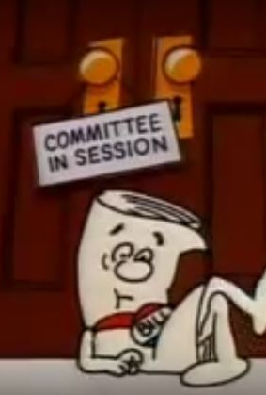
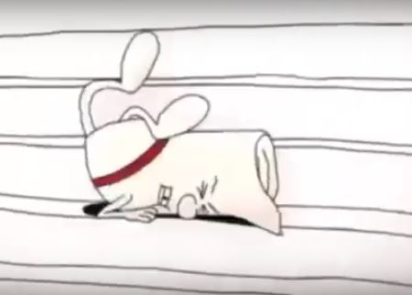
WATER RESOURCE
DEVELOPMENT ACT
Passed the Senate
Did not pass the House of Representatives
DOA
Schoolhouse Rock

Slide 3

WATER INFRASTRUCTURE FINANCE and
INNOVATION ACT
Passed the Senate
Pass the House of Representatives
President signed WIFIA into law
WIFIA is AUTHORIZED
Under 2017 continuing resolution Congress APPROPRIATED $17M

Slide 4
WIFIA
Loan Program
WIFIA can pay up to 49% of a project
Total of 80% from Federal source, waiver provision
$5M minimum project for small communities
Project must be credit worthy and have a dedicated source of revenue
Interest rate equal to or greater than the Treasury rate
States, Tribes or Tribal Consortia are eligible

Slide 5
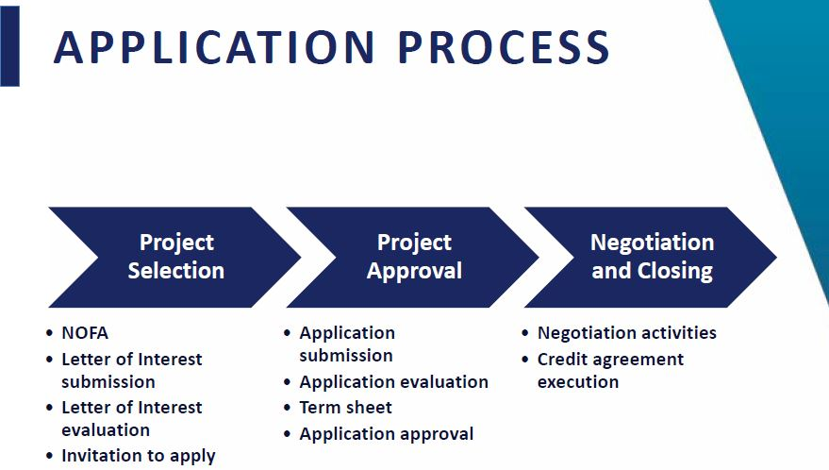

Slide 6
WATER INFRASTRUCTURE IMPROVEMENTS for the
NATION ACT
Passed the Senate
Pass the House of Representatives
President signed WIIN into law
WIFIA is AUTHORIZED
No funding has been APPROPRIATED by Congress

Slide 7
WIIN
National Grant Program
Small disadvantaged underserved communities
Under served communities
  Does not have drinking water or sewer service
  PWS that violates primary drinking water regulation
Total of 45% WIIN 55% non-federal, waiver
Authorization $60M FY17-21
  no appropriation at this time
PWS or a States on behalf of a underserved community are eligible

Slide 9
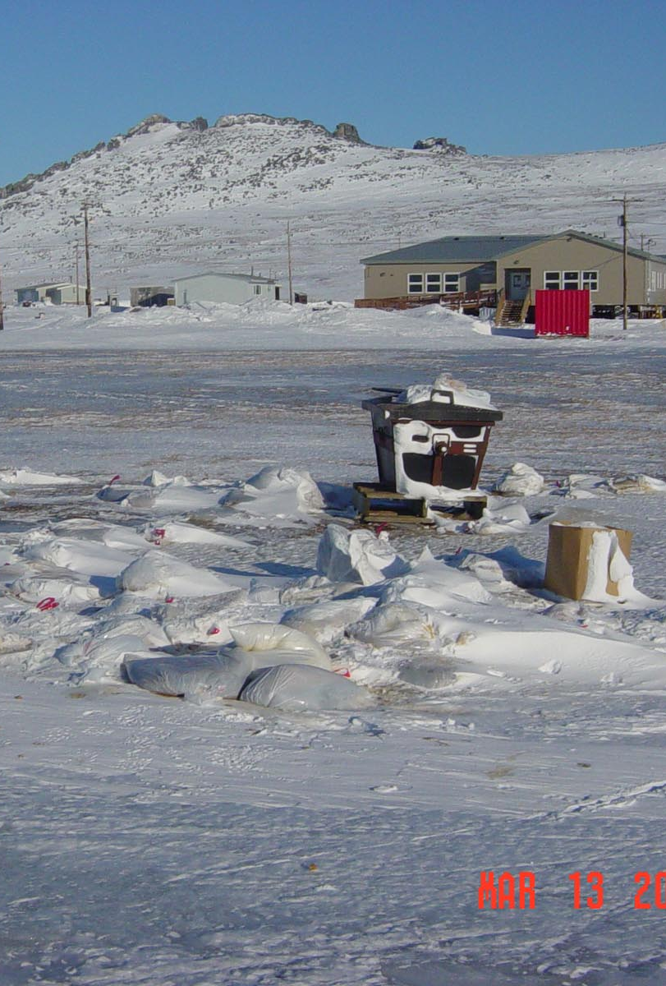
WHERE ARE WE?
WRDA
  No longer exists
WIFIA
  Authorized and appropriations approved
  Loans 49% WIFIA up to 80% Federal funds
  Pre-application process
  NOFA
WIIN
  Authorized but no appropriations
  National grants 45% WIIN 55% non federal funds
  Application process has not been determined

