Slide 1
Hazard Vulnerability Analysis
Screen for risk, and plan for strategic use of limited resources.
Focus on hazards that are likely to occur and have greatest impact (health and economic)
HVA provides an objective planning tool to assist with this process.

Slide 2
Hazard Analysis
Determine Vulnerability
Quantify Risk = Probability * Severity
Probability = likelihood event will occur
Severity = Magnitude – Mitigation, Preparedness and Response Efforts
Activity: Hazard Vulnerability Assessment, (Appendix 2)
Notes:
There are many tools available to assist with conducting a multi-hazard risk assessment. Some examples include HAZUS-MH, Environmental Planning and Historic Preservation Program, and Kaiser Permanente Hazard Vulnerability Analysis.
These tools will allow us to take the information used when profiling the hazard and quantify the over all risk. Something is said to be very risky when there is a high likelihood the event will occur, will have a large impact on business, property and/or health, and we are not prepared for the event through mitigation, preparedness or response efforts.
We will be using the Kaiser Permanente’s Hazard Vulnerability Tool to help assess our risk associated with each hazardous event identified in your hazard profiles earlier. The tool we are using for this activity may not have included an event you felt could occur in your area. Please insert the even you believe could occur in place of one that is on the list, but is not applicable in your area.

Slide 3
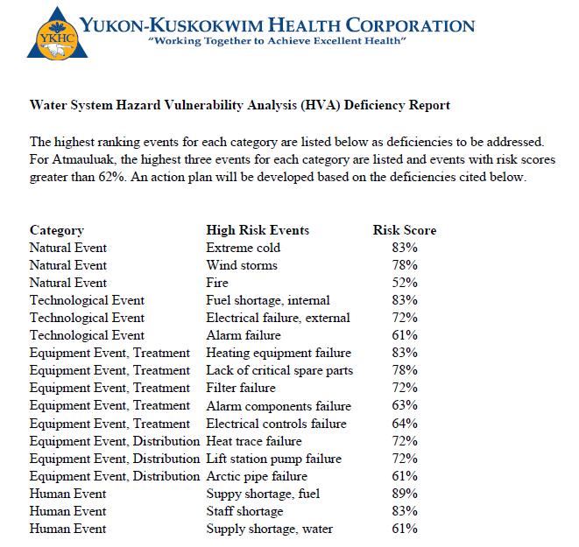
Case Study - ATT

Slide 4
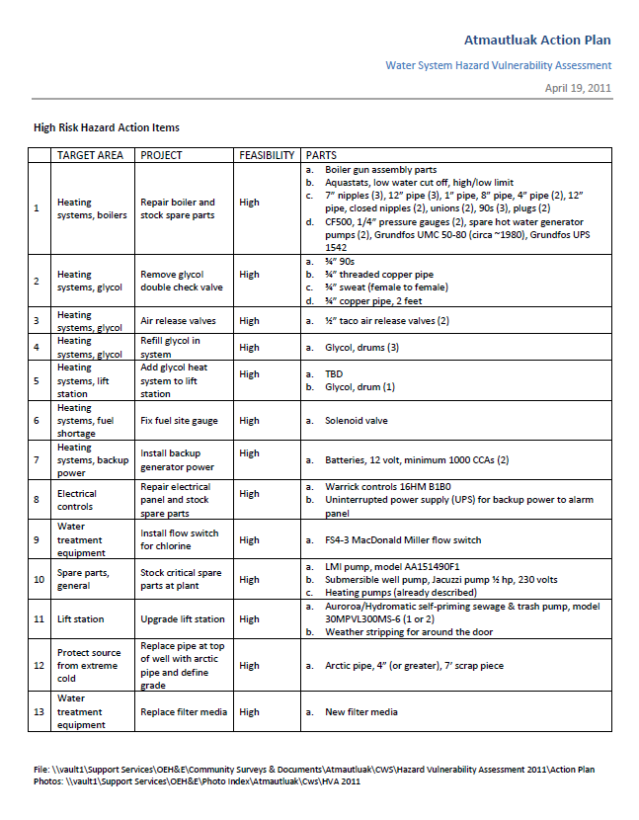
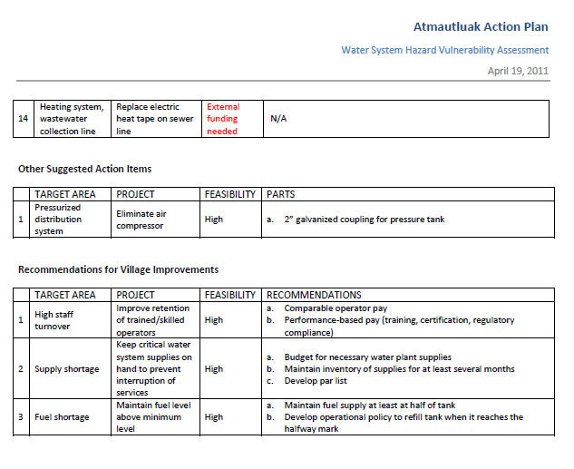
Case Study -ATT

Slide 5
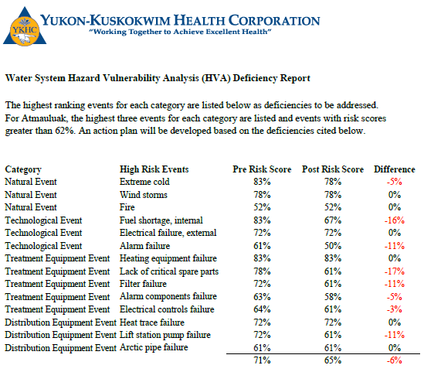
Case Study - ATT
Event Category | Pre Relative Threat | Post Relative Threat
Natural | 48% | 47%
Technological | 46% | 43%
Treatment Equipment | 61% | 55%
Distribution Equipment | 52% | 49%
 | 52% | 49%

Slide 6
Questions?

Slide 7
Hazard Analysis
Identify Hazard
List potential hazards that may occur
Cross check with several sources
Notes:
In the first column of the chart, list all emergencies that could affect your facility, including those identified by your local emergency management office. Consider both:
Emergencies that could occur within your facility
Emergencies that could occur in your community
Below are some other factors to consider:
Historical -- What types of emergencies have occurred in the community, at this facility and at other facilities in the area?
Fires
Severe weather
Hazardous material spills
Transportation accidents
Earthquakes
Hurricanes
Tornadoes
Terrorism
Utility outages
Later on we will be practicing using a model.
Geographic -- What can happen as a result of the facility's location? Keep in mind:
Proximity to flood plains, seismic faults, and dams. Also consider shifting and settling from permafrost.
Proximity to companies that produce, store, use or transport hazardous materials (ex: fuel farms)
Proximity to major transportation routes, rivers, ponds and airports
Proximity to nuclear power plants
Technological -- What could result from a process or system failure? Possibilities include:
Fire, explosion, hazardous materials incident (adding too much or too little chemicals to treatment process)
Safety system failure (check valves, twist-lock chemical injection point)
Telecommunications failure
Computer system failure
Power failure
Heating/cooling system failure
Emergency notification system failure
Human Error -- What emergencies can be caused by employee error? Are employees trained to work safely? Do they know what to do in an emergency? Human error is the single largest cause of workplace emergencies and can result from:
Poor training
Poor maintenance
Carelessness
Misconduct
Substance abuse
Fatigue
Physical -- What types of emergencies could result from the design or construction of the facility? Does the physical facility enhance safety? Consider:
The physical construction of the facility and distribution network
Hazardous processes or byproducts
Facilities for storing combustibles or other hazardous chemicals
Layout of equipment
Lighting
Evacuation routes and exits
Regulatory -- What emergencies or hazards are you regulated to deal with?
Analyze each potential emergency from beginning to end. Consider what could happen as a result of:
Prohibited access to the facility
Loss of electric power
Communication lines down
Ruptured gas mains or oil lines
Water damage
Smoke damage
Structural damage
Air or water contamination
Explosion
Building collapse
Trapped persons
Chemical release
http://www.fema.gov/business/guide/section1b.shtm

Slide 8
Hazard Analysis
Probability of Occurrence
Potential Impact – Magnitude
Preparedness & Response Efforts
Activity: Profiling a Hazard, (Appendix 1)
Notes:
We just developed a list of hazards that could occur in our area. For each hazard assess each of the following:
Estimate Probability
Probability is the likelihood of each emergency's occurrence. This is subjective, but should be based on some historical knowledge about the area. Use a simple scale of 1 to 3 with 1 as the lowest probability and 3 as the highest. Select 0 if the is very slim or no chance the event will occur in your area.
Assess the Potential Human Impact
The potential human impact of each emergency is the possibility of death or injury. You will assign a rating in the Human Impact column of the Hazard Vulnerability Analysis Chart. As before, use a 1 to 3 scale with 1 as the lowest impact and 3 as the highest. Use 0 if not applicable.
Assess the Potential Business Impact
This is the potential loss of market share from interruption of services. Assign a rating in the Business Impact column. Again, 1 is the lowest impact and 3 is the highest. Assess the impact of:
Interruption in service
Employees unable to report to work
System in violation of contractual agreements or regulations (boil water notice)
Imposition of fines and penalties or legal costs
Interruption of critical supplies
Interruption of deliver of water or sewer.
Assess the Potential Property Impact
Consider the potential property for losses and damages. Again, assign a rating in the Property Impact column, 1 being the lowest impact and 3 being the highest. Consider:
Cost to replace
Cost to set up temporary replacement
Cost to repair
Example: A bank's vulnerability analysis concluded that a "small" fire could be as catastrophic to the business as a computer system failure. The planning group discovered that bank employees did not know how to use fire extinguishers, and that the bank lacked any kind of evacuation or emergency response system.
Assess Internal and External Resources
Next assess your resources and ability to respond. Assign a score to your Internal Resources and External Resources using the same scale above: 1 for high level of response and 3 for low level of response. The lower the score the better. To help you do this, consider each potential emergency from beginning to end and each resource that would be needed to respond. For each emergency ask these questions:
Do we have the needed resources and capabilities to respond?
Will external resources be able to respond to us for this emergency as quickly as we may need them, or will they have other priority areas to serve?
If the answers are yes or 1, move on to the next assessment. If the answers are no, identify what can be done to correct the problem. For example, you may need to:
Develop additional emergency procedures
Conduct additional training
Acquire additional equipment
Establish mutual aid agreements
Establish agreements with specialized contractors
We will see how the combination of our the impact and response/preparedness will effect our risk later in the presentation.
The information above was taken from http://www.fema.gov/business/guide/section1b.shtm and modified to reflect the scale used by Kaiser Permanente’s HVA model which will be used for Activity 2 in this course.

Slide 9
Emergency Preparedness
Emergency Response Plan
Contains General Information About Your System
Flexible All-Hazard Response Tool
Notes:
Before developing your Emergency Plan you should gather basic information about your system.
1. Public Water System (PWS) ID, Owner, Administrative Contact Person, Alternate Administrative Contact Person;
2. Population Served and Service Connections;
3. Distribution Map;
4. Pressure Boundary Map;
5. Overall Process Flow Diagrams;
6. Site Plans and Facility “As-Built” Engineering Drawings
a) Pumping and Storage Facilities
b) Reservoirs and Retention Facilities
c) Water Treatment Facilities
d) Booster Pump Stations
e) Pressure-Regulating Valve (PRV) Sites
f) Distribution System Process and Instrumentation Diagrams (P&ID)
g) Equipment and Operations Specifications
h) Emergency Power and Light Generation
i) Maintenance Supplies
7. Operating Procedures and System Descriptions including back-up systems and interconnections with other systems;
8. Supervisory Control and Data Acquisition (SCADA) System/Process Control Systems Operations (rare in rural AK);
9. Communications System Operation;
10. Site Staffing Rosters and Employees’ Duties and Responsibilities; and
11. Chemical Handling and/or Storage Facilities and Release Impact Analyses (i.e., chemical releases into air or water).
It is important to note that not all of this technical information may be needed to document how you operate. The level of technical documentation should reflect the complexity of your CWS. Your Regional Health Organization or community engineer can assist you with gathering this information.
This information is then compiled into Emergency Operation Plan to serve as a overview of the approach your system should take when responding to all disasters. The plan is used to provide an overview of your system’s approach to emergency management such as broad policies, plans, and procedures. It has functional annexes that address specific activities critical to emergency response and short-term recovery efforts and hazard-specific appendices that support each functional annex and contain technical information, details and methods for us in emergency operations.
The Plan is divide into eight sections:
Statement of Purpose
Situation and Assumptions
Organization and Assignment of Responsibilities
Concept of Operations
Administration and Logistics
Plan Development and Maintenance
Authorities and References
Definitions and Terms
We will not be going into development of the plan in detail, but resources are available to you through the Alaska Native Tribal Health Consortium and the State of Alaska Division of Homeland Security to help you develop your Emergency Plan. Contact your Regional Health Corp. Office of Environmental & Engineering for assistance in locating other similar resources.
FEMA IS0001 – Emergency Program Manager http://training.fema.gov/IS/
http://www.epa.gov/safewater/watersecurity/pubs/small_medium_ERP_guidance040704.pdf

Slide 10
Emergency Preparedness
Event Specific Action Plans
High risk events
Walk through entire system
Special Steps
Notes:
Action Plans, are guidelines for how to respond for a specific event that may occur. They are Hazard—specific Appendixes to your Emergency Plan. These are usually developed for events that you believe are most likely to occur at your facility based on your hazard vulnerability assessment. When you are at a high risk for a particular event, it may be a good idea to develop an Action Plan to address this hazardous event.
The Action Plan should be a compliment activities already initiated through your Emergency Preparedness Plan (EPP). They should cover specific response information since you have already addressed basic emergency response steps in the core elements of your EPP. It should include the following:
Any special notification requirements;
Special response steps to be taken upon ERP activation; and
Recovery actions to bring the CWS back into operation.
Your Remote Maintenance Worker or Community Engineer should be able to help you develop action plans to address the high risk events you identified in this course.
http://www.epa.gov/safewater/watersecurity/pubs/small_medium_ERP_guidance040704.pdf
FEMA IS0001 – Emergency Program Manager http://training.fema.gov/IS/

Slide 11
Emergency Preparedness
Exercising
Orientation
Table-top
Functional
Field Dri,ll
Notes:
The best way to test your plans are to practice before you need it in a real emergency situation. There are four basic ways of practicing your plan.
Orientation
This is just an introduction to the plan and allows you to familiarize yourself with it’s contents.
Table-top Exercise
This goes a little more in depth than the orientation and familiarizes everyone involved with their roles, procedures and responsibilities in the plan. It usually occurs around a table and does not simulate actual emergency events.
Functional Exercise
The takes place in a location designed to look like your emergency operations center. You try to simulate a real event and practice procedures you would use when you put the plan into action. This is usually for key emergency management personnel.
Field Drill
This is where everyone practices a full-scale exercise that mimics disaster like situations.
FEMA IS0001 – Emergency Program Manager http://training.fema.gov/IS/

Slide 12
Hazard Mitigation
Preventative Maintenance
Critical Spare Parts
Notes:
Mitigation efforts are actions taken to prevent a negative impact from an hazardous event. This is done through
Preventing the hazard in the first place
Changing the nature or size of the hazard
Separating the hazard from that which it might affect
Modify the basic characteristics of a hazard
Research what others are doing
An example of the first items would be a the double walled fuel tanks at your water treatment building. If a leak occurs in the first wall, the second wall will prevent it from contaminating the area. Another example would be the back-up generator at your treatment plant. Should the power go out in your community this will keep the circulating pumps going to prevent freeze-up from occurring in the winter. T
Many mitigation efforts take place in the design phase by the engineer. These are often regulated requirements, but may be additional protection measures incorporated by the engineer from years of experience.
Critical to mitigation efforts are your preventative maintenance efforts and critical spare parts. By Contact your Remote Maintenance Worker for your preventative maintenance schedule.
FEMA IS0001 – Emergency Program Manager http://training.fema.gov/IS/

Slide 13
Response
Alert and Notification
Warning
Protect People and Property
Provide for the Public Welfare
Restore
Notes:
Alert & Notification
When disasters do impact your community it is important that you keep the public up to date. This may include announcements over the VHF or postings at the store or school. The notification plan should be in your Emergency Plan.
Warning
If necessary you will need to warn people about the dangers associated with the emergency. This may include boil water notice or possible hazardous material spills. Regardless of the event, be sure the message includes what the hazard is, who is affected, and what protective actions they should take. Keep it simple, but thorough. Your Regional Health Corp Office of Environmental Health & Engineering can help you develop this message.
Protect People & Property
This may include measures such as information on how to properly dispose of human waste with no sewer, and how to treat water with no potable water source available. You may want to help protect personal property by informing the public that the main will be frozen soon so that they can take precautionary measures in their own home.
Providing for Public Welfare
Steps can now be taken to help meet essential needs in the absence of a water and sewer operation. If possible set up distribution points to provide potable water or work with another local entity such as the school or store to provide this service until you can resume normal operations. Agreements such as these can be worked out in an advance and incorporated into the Emergency Plan.
Restoration
Finally, you can begin restoring essential services. You may need to thaw pipes, or replace pumps. For assistance with this, contact your Remote Maintenance Worker. He may be able to help you locate funding for some short-range recovery efforts, and can normally be on the ground to assist in less that 24 hours. Your community engineer should be contacted to help address long term recovery efforts.
FEMA IS0001 – Emergency Program Manager http://training.fema.gov/IS/

