Slide 1
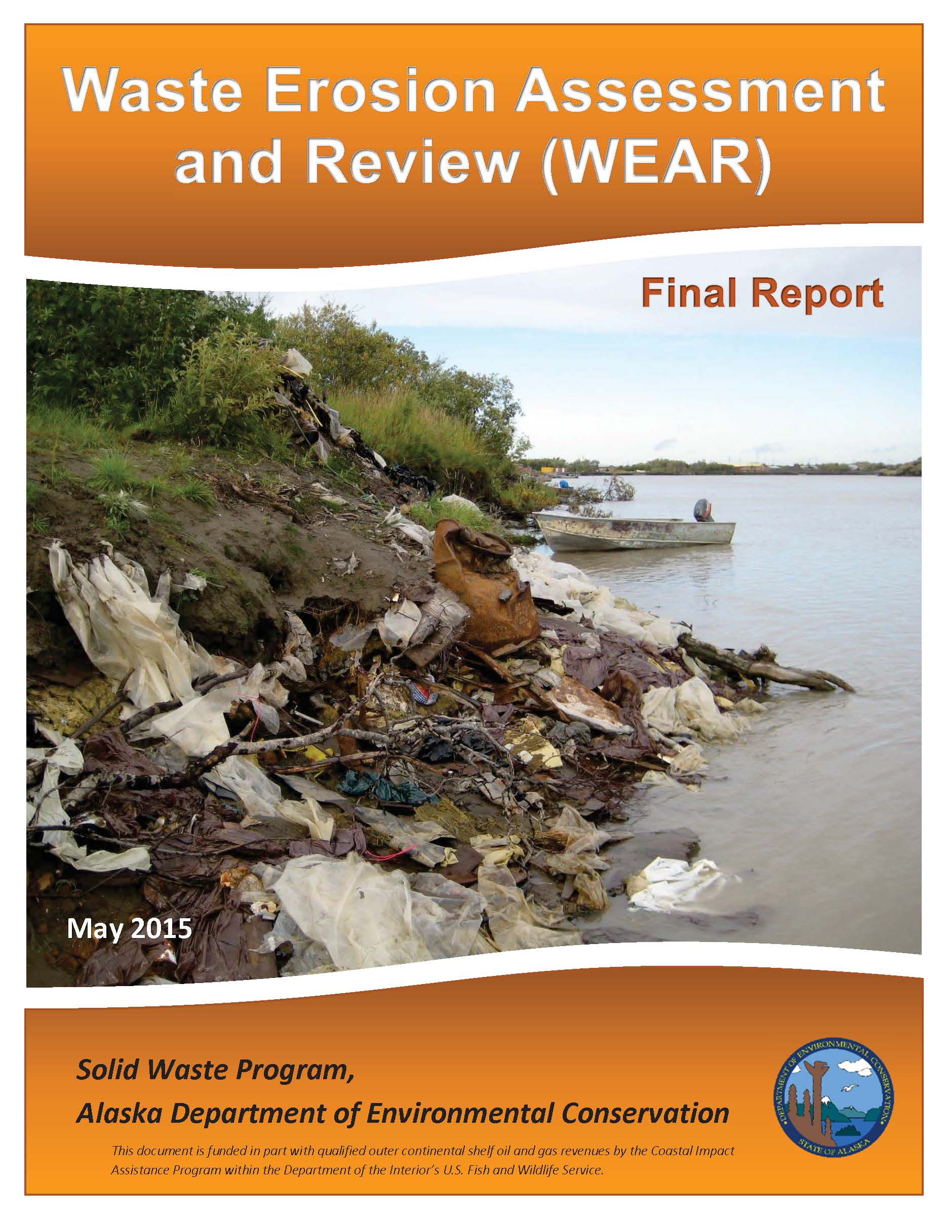
WEAR Methodology
Marlena (Marty) Brewer
ADEC Solid Waste Program
January 20, 2017
Notes:
The Alakanuk South Side Dump Site was an old dump from the 1970s mainly used during construction of the high school. This site experienced significant erosion between the 2012 and 2014 site visits & much of this waste was no longer present in 2014.

Slide 2
Project Overview
Funding through Coastal Impact Assistance (CIAP)
4-year project
Assess, inventory, prioritize landfills, contaminated sites & other environmental concern sites (tank farms, city shops, waste staging areas, etc.)
Alaska’s northern & western coastline, Aleutian Islands & river communities (300 miles from coast)
Sites ranked on potential erosion & contaminant risks
Notes:
This document was funded in part with qualified outer continental shelf oil and gas revenues by the Coastal Impact Assistance Program within the Department of the Interior’s U.S. Fish and Wildlife Service
Scope of project focused on those sites with potential environmental contaminants, not residences, community infrastructure, or sites of cultural significance.
Funding only to study; none for mitigation. Intent of report to provide documentation of risk to pursue mitigation funding.

Slide 3
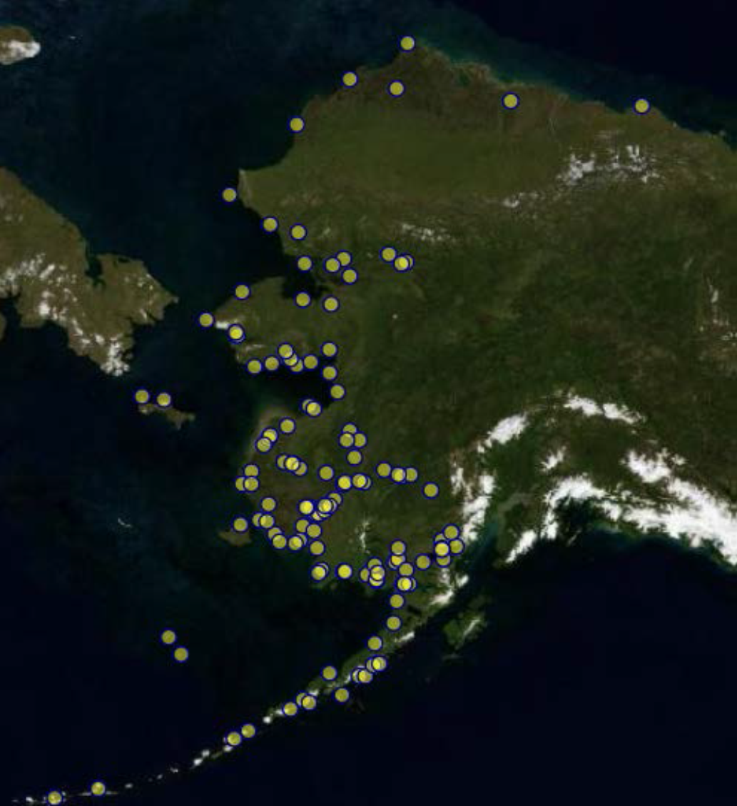
Inspected 716 sites
in 124 communities
Notes:
Desktop evaluation – focus on coastal & riverine communities
Analyzed existing data from USACE Baseline Erosion Assessment (BEA) report, CS database, Google Earth, Division of Community & Rural Development (DCRA), ADEC Drinking Water Protection Area Map, USFWS Critical Habitat Map
Communications with community members inquiring about other sites of concern within communities.

Slide 4
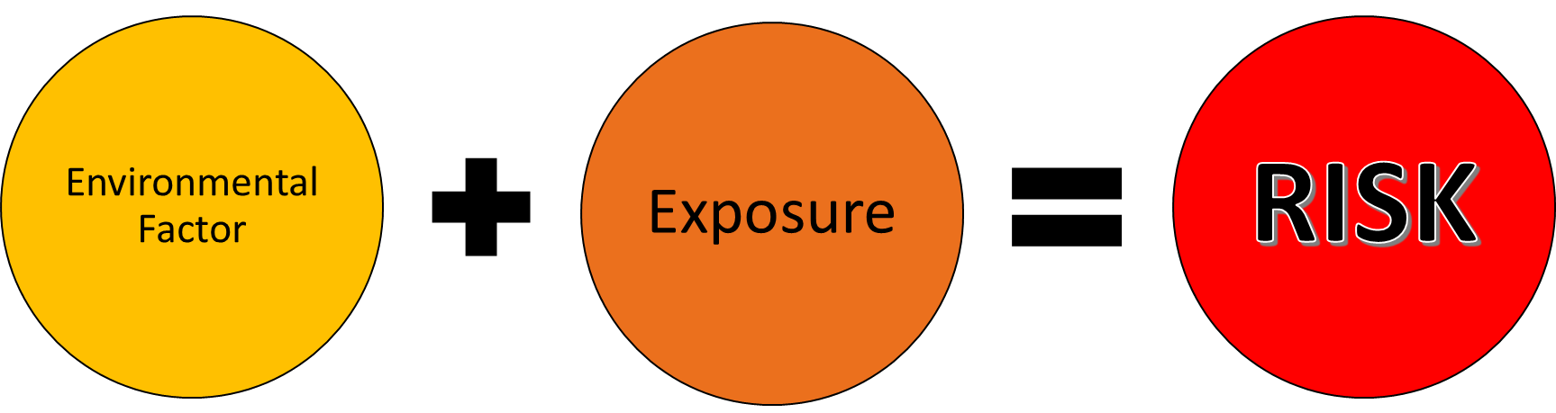
Risk Calculations
Erosion Risk
  2009 Alaska Baseline Erosion Assessment USACE, Alaska District
  Desktop assessment
  Field measurements & observations
Contaminant Risk
Site assessment
Toxicology
Exposure pathways
Human & ecological risk assessment
Notes:
Erosion risk methodology similar to that in the 2009 USACE Alaska Baseline Erosion Assessment.
Contaminant risk methodology similar to hazardous site characterization & human/eco risk assessment.

Slide 5
Data Collected
Site information
Size of site
Years of operation
Possible contaminants
Drinking water protection zone
Distance to critical habitat
Distance to residences
Distance to stressed habitat
Years until erosion
Erosion type
Erosion factors
Erosion symptoms
Soil Class
Mitigation efforts
Notes:
Collected data on environmental factors and potential exposure to assess risks.

Slide 6
WEAR Project
Site Information Form
Inspectors:_
Date:_
Community
Site name
Site Type |  |  |  | Landfill, Tank Farm, Drum Dump, Military, Mining
Status |  |  |  | Active/Open, Covered/Closed, Removed/Remediated
Location
Latitude: Longitude: GPS Point ID's:
Description:
Approx. Size (acres): |  | Years Operated:
Possible Contaminants: |  |  |  | Municipal Waste, Fuels, Mining Waste, C&D/Asbestos, Military Waste, Industrial Waste, Other
Distance to (ft):
Active Erosion: |  | Closest Water: Name: |  | Anadromous water body?
Subsistence Area: |  | Critical Habitat: |  | USFW
Residences: |  | Stressed Habitat:
Exposure Pathways: |  |  |  | Inhalation, Direct Contact, Wildlife, Other
Erosion:
Type: |  |  | Waves, Currents, Ice, Heat, Wind, Precipitation, Seepage
Factors: |  |  | Tides, Storm Surge, Flooding, Permafrost, Human Influenced, Other
Symptoms: |  |  | Slides, Undercutting, Scarps, Exposed Permafrost, Root Exposure/Fallen Trees, Waste Exposed, Ice Gouging, Other
NRCS Soil Classification:
Silt % | Clay % | Cobble % | Organics %
Sand % | Gravel % | Boulder % | Loam %
Erosion Rate: |  | Erosion Rate QA: |  | Reported, Calculated, BEA Calculated
Current Erosion Mitigation Efforts:
Drinking Water:
Is the site in a drinking water protection area? If Yes:
1° Source Name: |  | 2° Source Name:
Type: |  | Type: |  | Surface Water, Groundwater
Treatment: |  | Treatment: |  | Filtration, UV, Chlorination, Reverse Osmosis, Nanofiltration
Well Depth (ft.): |  | Protection Zone: |  | Zone A, Zone B, Zone C, Zone E, Zone F
If No:
Distance to Drinking Water Protection Area: |  |  |  | Upgradient or Downgradient
Notes:
Utilized a WEAR site inspection form to collect data. This ensured comprehensiveness of data collection & consistency in data evaluation.

Slide 7
Scoring
Weighting factors for relative importance
  1 - important
  2 – more important
  3 – most important
Multipliers corresponding to relative risk
  Higher # = higher potential risk
Weighting Factor x Multiplier = Score
Notes:
The scoring was similar to the approach taken in the 2009 USACE Alaska Baseline Erosion Assessment.

Slide 8
 | Weight | Multiplier | Characteristics Considerations & References
 | 1-important; 2-more; 3-most | Higher # corresponds to higher risk
 |  |  |  |  | Possible Score
WEAR Status | 3
Removed |  | 0 | Waste removed |  | 0
Closed/Covered |  | 2 | Closed and covered | No longer accumulating waste but all waste remains | 6
Inactive |  | 3 | left in place; all waste remains; potential responsible party |  | 9
Abandoned |  | 3 | Left in place; all waste remains; no responsible party | No longer accumulating waste, no cover, maintenance, etc. | 9
Active/open |  | 4 | Actively accumulating waste | Increasing waste | 12
Size | 3
Small |  | 1 | Approximately 0-1 acre | Small, limited waste | 3
Med |  | 2 | >1 acre, but <5 acres | Minimal waste | 6
Possible Contaminants | 3
Burning |  | 1 | Burning of waste at any point in time | Air quality issue & formation of hazardous ash | 3
Fuels |  | 1 | Fuels (gasoline, diesel, heating fuel) | Based upon relative toxicity of suspected contaminants | 3
C&D/Asbestos |  | 2 | Demolition debris presumably containing asbestos |  | 6
Municipal Waste |  | 3 | Household waste |  | 9
Sewage |  | 3 | Human waste |  | 9
Mining Waste |  | 4 | Metals, acid generating rock (AGR) |  | 12
Industrial Waste |  | 5 | Mixed wastes, haz waste, fuels |  | 15
Military Waste |  | 6 | Military waste, mixed wastes, haz waste, fuels |  | 18
Notes:
Site scoring showing weighting factor & multiplier to calculate score. These calculations were programmed into SWIMS.

Slide 9
Solid Waste Information System (SWIMS)
Notes:
Entered WEAR site inspection data into Solid Waste Information Management System (SWIMS) for data basing & calculations.

Slide 10
Site Rankings
716 total sites assessed
5 eroded during project timeframe
711 sites were scored
605 sites excluded likely to erode >50 years
106 sites left for final ranking
20 sites in upper 25% for both erosion & contaminant risk
Notes:
Erosion & contaminant scores were calculated for each site. Sites were eliminated if they had eroded during the project timeframe.
Many sites were eliminated because the erosion rate calculated indicated that they were not likely to erode for 50+ years. Several were 100+ years.
Sites were prioritized for each type of risk. Some sites that had a high erosion risk scored low for contaminant risk and vice versa.
Plotting the contaminant risk score against the erosion risk score allowed us to identify those sites with the most combined risk.
The upper 25% of sites were identified as highest risk for which Detailed Action Plans were developed.

Slide 11
Notes:
20 sites in upper 25%

Slide 12
High Priority Sites
Alakanuk Old BIA School
Alakanuk South Side Dump Site
Chevak Company Corporation Tank Farm
Chevak Former AVEC Tank Farm
Chevak Former City Tank Farm
Chevak Old River Landfill
Dillingham IHS Hospital Site
Emmonak Landfill
Golovin Fish Processing Plant
Kalskag Consolidated Tank Farm
Kotlik Landfill
Kotlik LYSD Former Tank Farm
Napakiak Corporation Tank Farm
Napakiak School Tank Farm
Nelson Lagoon Landfill
Newtok Backhaul Staging Area
Newtok UPC Generator Building
Nunapitchuk Old Elementary School Tank Farm
Oscarville School Tank Farm
Shageluk City Tank Farm
Notes:
Variety of types of sites in top 20

Slide 13
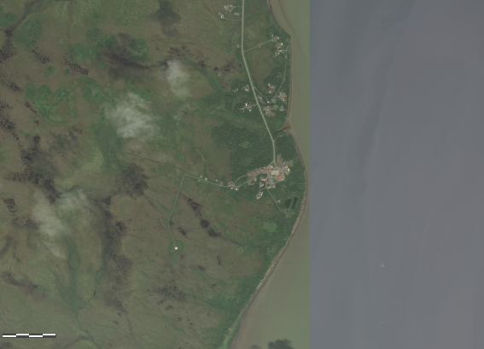
Dillingham IHS Hospital Site
IHS Kanaknak Hospital, old hospital landfill, and multiple fuel-contaminated sites
Multiple types of contaminants
>50 acre site along Nushagak River
Old landfill waste exposed by erosion
Seeps & stressed vegetation noted
Located within critical habitat area
Silt & clay soils
Erosion rate of 1ft/year
Active erosion noted
No erosion mitigation efforts
Notes:
The site includes the IHS Kanakanak Hospital as well as multiple fuel-contaminated sites and an old hospital landfill. These were combined into a single WEAR site as they are all associated with the hospital.
Large site with multiple possible contaminants, current erosion & conditions right for further erosion.

Slide 14
Oscarville School Tank Farm
Store 28,000 gallons heating fuel
120ft from school, 165ft from residences, 790ft from subsistence fishing area
Drinking water protection zone for school’s water supply
Xylenes in drinking water
Erosion rate of 3ft/year
Silt riverbank
Notes:
Tank farm owned by Lower Kuskokwim School District & land owned by Department of Education
Small site (0.09 acres)
Store 28,000 gallons heating fuel
No liner, old wooden foundation
Petroleum contamination
120ft from school, 165ft from residences, 790ft from subsistence fishing area
Site within drinking water protection zone for school’s water supply
Xylenes consistently detected in drinking water
Erosion rate of 3ft/year
Erosion factors include river current, ice jams, boating, ATV traffic along riverbank
Silt riverbank

Slide 15
Tuntutuliak - Riverbank Erosion 2012
Nunam Iqua - Shoreline Erosion 2014
Wainwright - Shoreline Erosion and Riprap Installation 2013
Alakanuk - Riverbank Erosion 2014
Notes:
Tuntutuliak riverbank photo shows mobile propane tanks. Residents reported they had already been moved to their current position due to the riverbank eroding. They were preparing to drag them further from the edge during our visit as one was overhanging the bank. The community’s tank farm is just outside the photo.

Slide 16
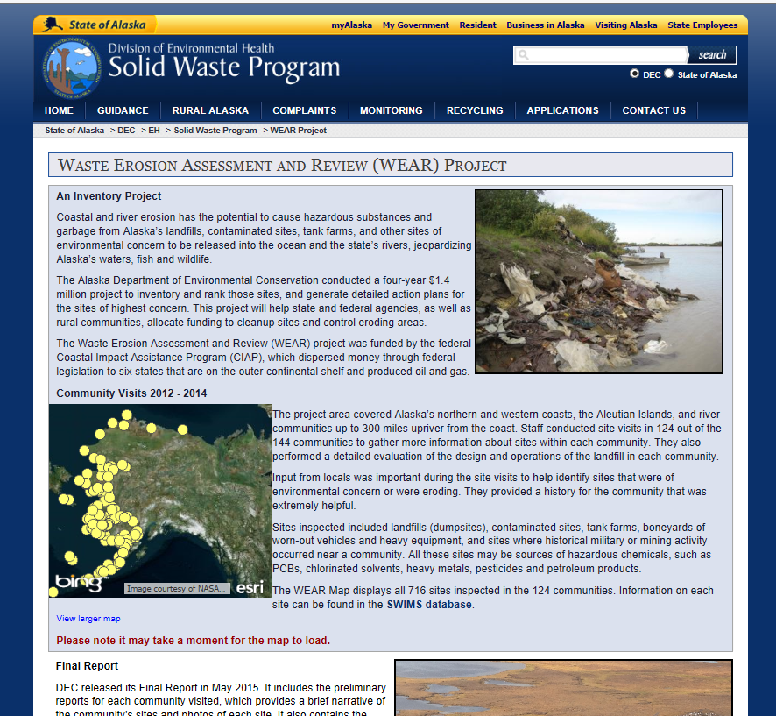
http://dec.alaska.gov/eh/sw/wear.html

