Slide 1
Threats of Climate Change on Water and Sanitation from an International Survey in the Arctic
Jonathan M. Bressler, MPH^{1,2}
¹ Section of Epidemiology, Division of Public Health, Alaska Department of Health and Social Services, Anchorage, AK, USA
²Applied Epidemiology Fellow, Council of State and Territorial Epidemiologists, Atlanta, GA, USA

Slide 2
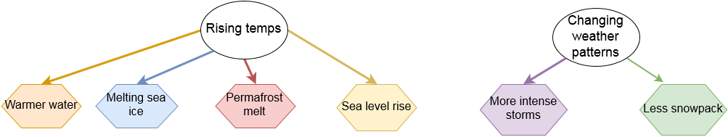
How does climate change affect water and health in the arctic?

Slide 3
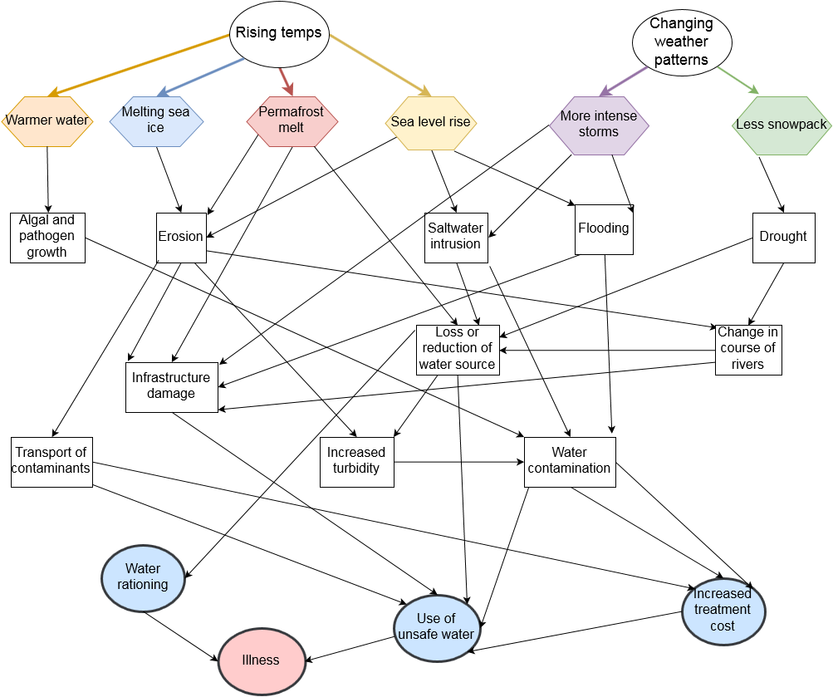

Slide 4
Mediating factors
Population growth
  Higher demand on outdated water & sanitation infrastructure.
Melting sea ice opens transportation routes
  Previously isolated communities may gain access to imports and new technologies.
Investment, innovation, and collaboration in coping with climate change-related threats

Slide 5
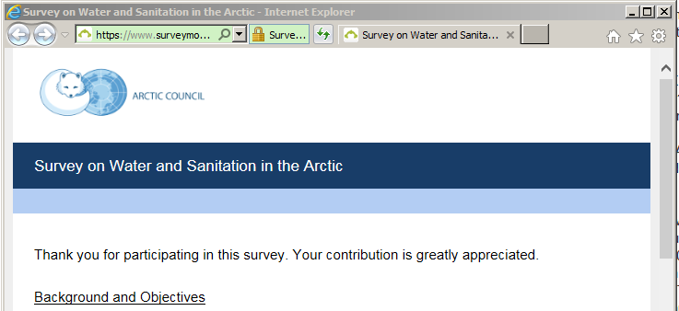
Arctic Council Water/Sanitation Project
https://www.surveymonkey.com/r/arctic_council_water_sanitation

Slide 6
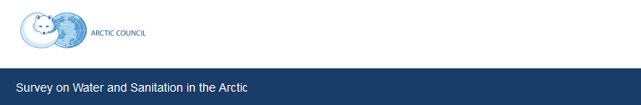
Survey Methods
Three-part survey:
  Access to water and sanitation services
  Water- and sanitation-related disease surveillance
  Effects of climate change on water and sanitation access
Distributed to professionals in health, water and sanitation; government authorities; and residents in the Arctic nations.
  Email lists, direct contacts, and a previously published article.¹
  Responses collected April through September 2016.
Details and additional information solicited from known and recommended experts and WIHAH presenters.
¹Hennessy TW, Bressler JM. Improving health in the Arctic region through safe and affordable access to household running water and sewer services: an Arctic Council initiative. Int J Circumpolar Health. 2016 Apr 29;75:31149.

Slide 7
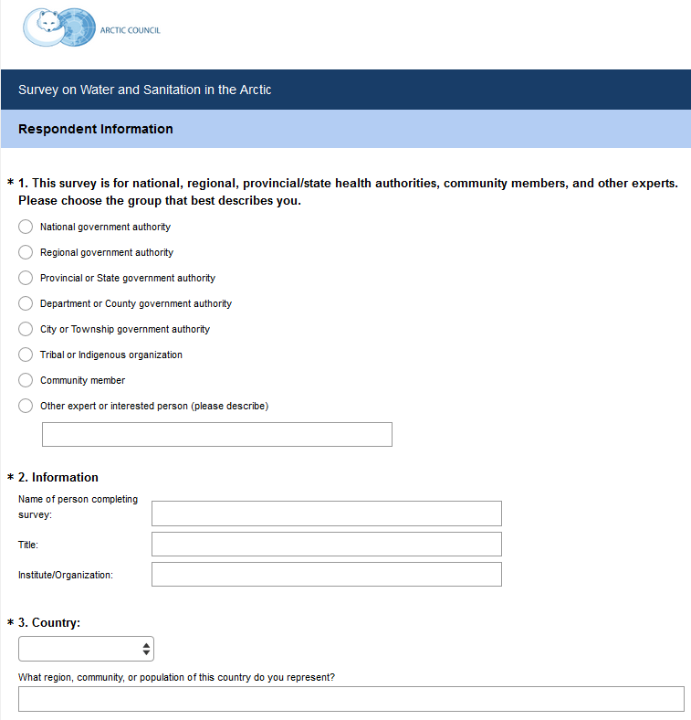
Survey Methods
Respondents provided:
  Organization
  Affiliation
  Location
Countries surveyed:
  Canada
  Greenland
  Finland
  Iceland
  Norway
  Russia
  Sweden
  US (Alaska)

Slide 8
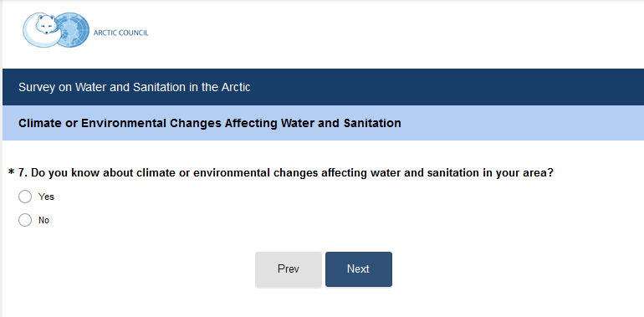
Survey Methods

Slide 9
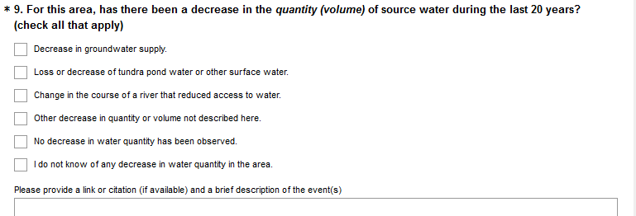
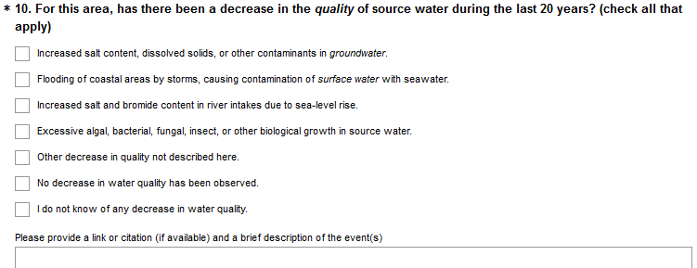
Survey Methods

Slide 10
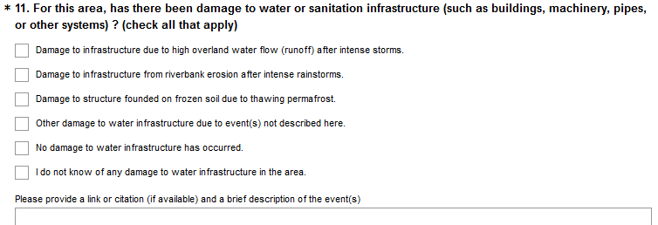
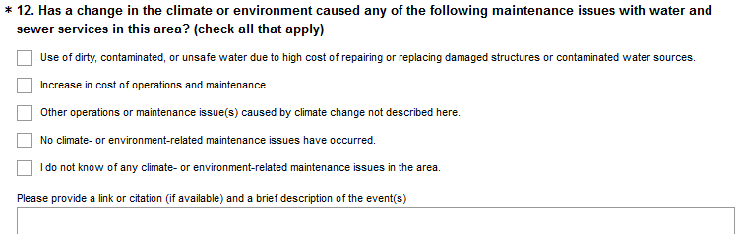
Survey Methods

Slide 11
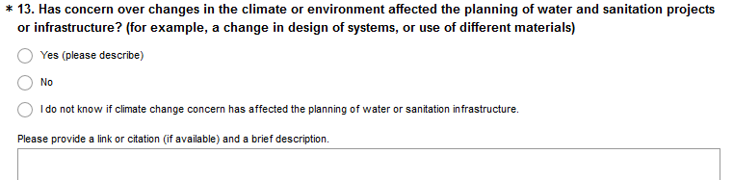
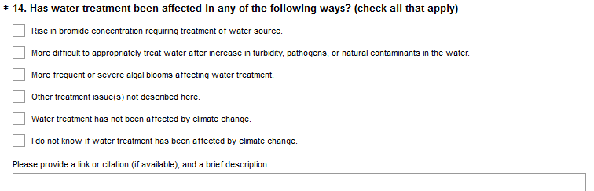
Survey Methods

Slide 12
Climate change-related threats to water and sanitation access in the Arctic, as reported by survey respondents, 2016
 |  | Number of responses
 |  | Canada: Nunavut | Finland | Greenland | Iceland | Norway | Sweden | U.S.: Alaska
TOTAL RESPONDENTS |  | 3 | 1 | 1 | 1 | 1 | 2 | 13
Decrease in source water quantity? | Decrease in groundwater supply. |  |  |  |  |  | 1 | 4
 | Loss or decrease of tundra pond water or other surface water. | 2 |  |  |  |  |  | 7
 | Change in the course of a river that reduced access to water. | 1 |  |  |  |  |  | 4
 | Other decrease in quantity or volume not described here. | 2 |  | 1 |  |  |  | 1
 | No decrease observed | 1 |  |  |  | 1 |  | 1
 | Do not know | 1 | 1 |  | 1 |  | 1 | 4
Decrease in source water quality? | Increased salt content, dissolved solids, or other contaminants in groundwater. |  |  |  |  |  | 1 | 3
 | Flooding of coastal areas by storms, causing contamination of surface water with seawater. |  |  |  |  |  |  | 4
 | Increased salt and bromide content in river intakes due to sea-level rise. | 1
 | Excessive algal, bacterial, fungal, insect, or other biological growth in source water. |  |  |  |  |  |  | 3
 | Other decrease in quality not described here. |  |  | 1 |  | 1 |  | 2
 | No decrease observed | 1 |  |  |  |  | 1 | 1
 | Do not know | 1 | 1 |  | 1 |  |  | 4
Notes:
Decreases in quantity and quality reported in Nunavut, Greenland, Norway, Sweden & Alaska.
Greenland & Iceland: Only “Do not know”

Slide 13
Climate change-related threats to water and sanitation access in the Arctic, as reported by survey respondents, 2016 (continued)
 |  | Number of responses
 |  | Canada: Nunavut | Finland | Greenland | Iceland | Norway | Sweden | U.S.: Alaska
TOTAL RESPONDENTS |  | 3 | 1 | 1 | 1 | 1 | 2 | 13
Damage to water and sanitation infrastructure? | Damage to infrastructure due to high overland water flow (runoff) after intense storms. |  |  |  |  | 1 | 1 | 3
 | Damage to infrastructure from riverbank erosion after intense rainstorms. | 1 |  | 1 |  | 1 |  | 3
 | Damage to structure founded on frozen soil due to thawing permafrost. | 3 |  | 1 |  |  |  | 4
 | Other damage to water infrastructure due to event(s) not described here. | 1 |  | 1 |  |  |  | 1
 | No damage occurred
 | Do not know |  | 1 |  | 1 |  |  | 6
Climate-caused maintenance? | Use of dirty, contaminated, or unsafe water due to high cost of repairing or replacing damaged structures or contaminated water sources. | 1 |  |  |  |  | 1 | 2
 | Increase in cost of operations and maintenance. | 2 |  | 1 |  | 1 |  | 6
 | Other operations or maintenance issue(s) caused by climate change not described here. | 1 |  | 1 |  |  |  | 3
 | No climate-related issues/Do not know
 | Do not know |  | 1 |  | 1 |  |  | 6
Notes:
Infrastructure damage and maintenance issues reported from Nunavut, Greenland, Norway, Sweden & Alaska.
Greenland & Iceland: Only “Do not know”

Slide 14
Climate change-related threats to water and sanitation access in the Arctic, as reported by survey respondents, 2016 (continued)
 |  | Number of responses
 |  | Canada: Nunavut | Finland | Greenland | Iceland | Norway | Sweden | U.S.: Alaska
TOTAL RESPONDENTS |  | 3 | 1 | 1 | 1 | 1 | 2 | 13
Water treatment affected? | Rise in bromide concentration requiring treatment of water source. |  |  |  |  |  | 1
 | More difficult to appropriately treat water after increase in turbidity, pathogens, or natural contaminants in the water. | 2 |  |  |  |  |  | 4
 | More frequent or severe algal blooms affecting water treatment.
 | Other treatment issue(s) not described here. |  |  | 1 |  | 1 |  | 3
 | Treatment not affected |  |  |  |  |  |  | 2
 | Do not know | 1 | 1 |  | 1 |  |  | 7
Climate change affected planning? | Yes | 2 |  | 1 |  | 1 | 2 | 6
 | No |  |  |  |  |  |  | 2
 | Do not know | 1 | 1 |  | 1 |  |  | 5
Notes:
Treatment and planning issues reported from Nunavut, Greenland, Norway, Sweden & Alaska.
Greenland & Iceland: Only “Do not know”

Slide 15
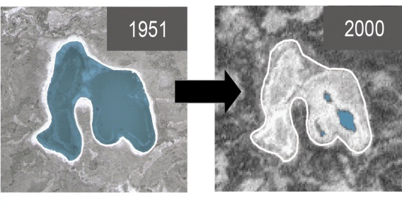
Survey responses:
Decreases in source water quantity
CANADA - Nunavut
“Some communities' principal water source is fed by receding glaciers and/or snow packs. Less melt has been witnessed in several communities over the last decade.”
ALASKA – North Slope Borough
“Decrease in groundwater aquifers and main tundra pond water source.”
ALASKA – Gakona
“Dry summers and warm winters have caused a loss of ground moisture and water in bog and pond areas.”
ALASKA – Kotzebue
“The lack of snow and rain, and the increased heat have been diminishing our water supply.”

Slide 16
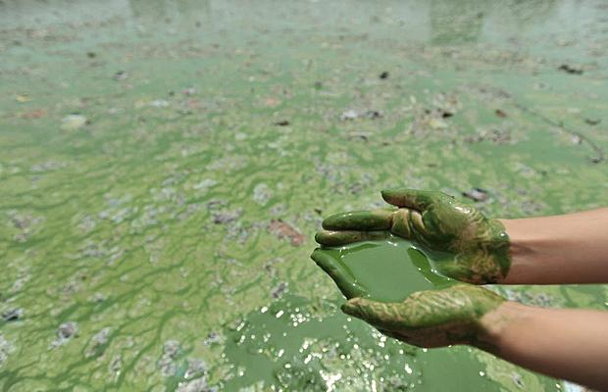
Survey responses:
Decreases in source water quality
CANADA – Nunavut
“Storm surges are causing salt water intrusions near river intakes. Intake pipes need to be moved upstream to avoid drawing brackish waters into the pumping stations.”
NORWAY
“The color of water in river and lakes have gradually changed over time.”
ALASKA - Northwest Arctic Borough
“Stream bank erosion and permafrost thawing (i.e. sloughing) decreases water quality via turbidity.”

Slide 17
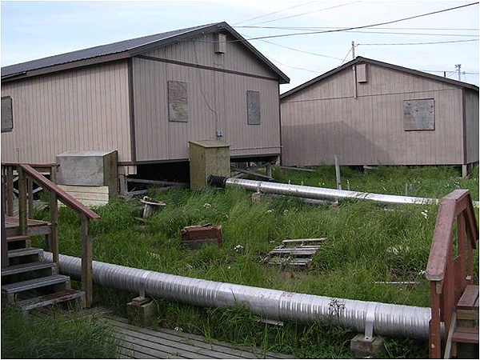
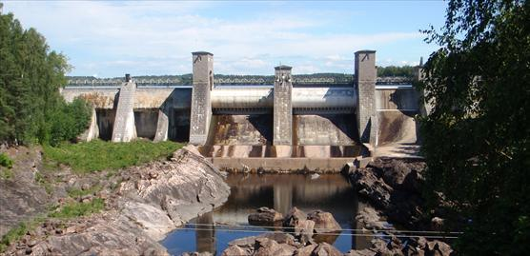
Survey responses:
Damage to infrastructure
CANADA – Nunavut
“Leaks in reservoirs due to berm instability (thawing).”
ICELAND
“Damage to water infrastructure has occurred caused by volcanic eruptions or earthquakes.”
FINLAND
“Dam safety incidents due to power cuts during
intense storms, land collapse, rising water level.”
ALASKA – Kotzebue
“More frequent and intense storms along with warm weather.”
ALASKA – Shishmaref
“The community has been suffering from erosion and flooding of the coastline which puts the facilities (like the sewage lagoon) in a vulnerable position.”

Slide 18
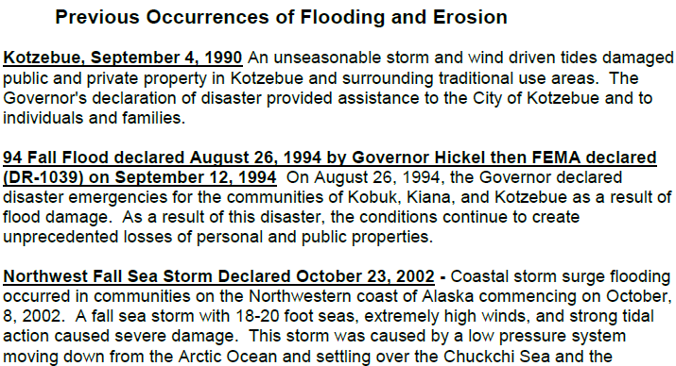
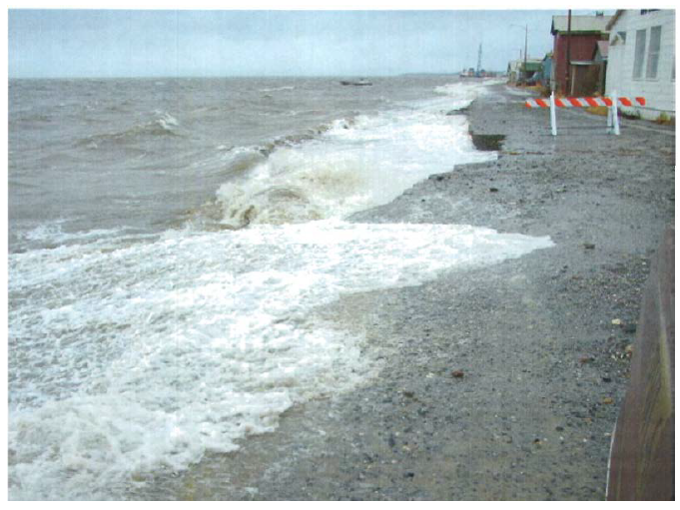
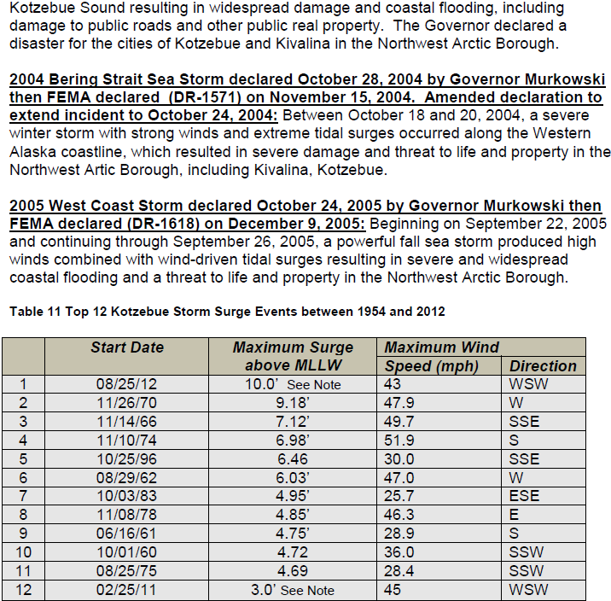
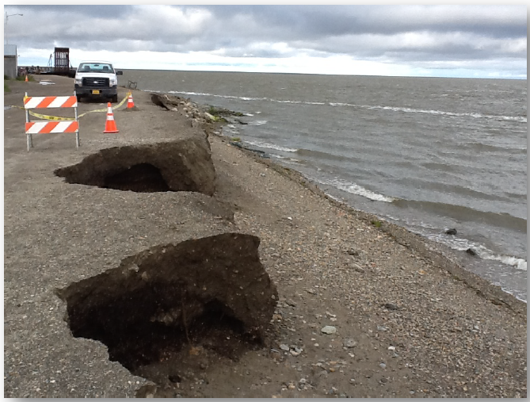
Storm erosion in Kotzebue, Alaska

Slide 19
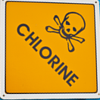
Survey responses:
Water treatment effects
NORWAY
“Storm water infiltration of the sewage plant reduces the effectiveness of treatment.”
SWEDEN
“More frequent flooding in the past ten years though it has not yet affected the water wells. “
ALASKA – Kotzebue
“My 13 stage water filter now clogs with debris in 1/4 of the time it ordinarily would have.”
ALASKA – Northwest Arctic Borough
“Increased organic loads into source water, which when combined with chlorine as a disinfectant, causes disinfection by-products. Many of our water systems lack sufficient treatment to remove these by-products.”

Slide 20

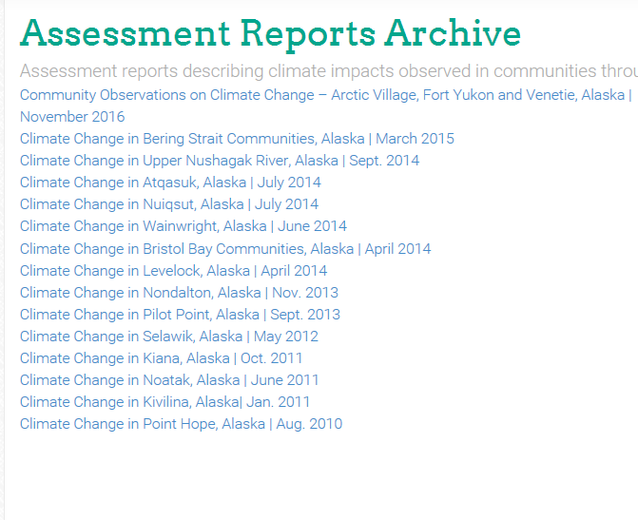
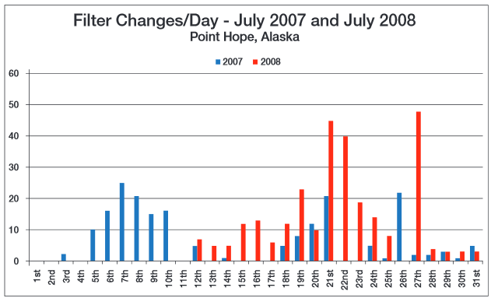
Survey responses:
Infrastructure damage, maintenance, and treatment (continued)
ALASKA – ANTHC assessment reports
  Selawik:
  Uneven ground settling following permafrost melt causing damage to piping.
  Point Hope:
  Increase in amount of biologic slime requiring drastic increase in frequency of filter changes.

Slide 21
Survey responses:
Planning of infrastructure
CANADA – Nunavut
“Reservoirs are now being lined since relying solely on impermeability from permafrost is no longer an option.”
GREENLAND
“In cooperation with Nukissiorfiit (the national electricity and water supply company) we plan a larger research project in summer 2017 to develop solutions for Qaanaaq.”
NORWAY
“Change in design of systems to deal with storm water and sewage will be topics in the coming years.”
SWEDEN – Älvsbyn
“Due to repeated flooding and expected increasing rain/snow, the risk for contamination of water is expected to increase. The municipality has installed chemical and ultraviolet treatment in the water treatment plant and built protecting walls to prevent contamination of the ground water wells from flooding river water.”

Slide 22
Survey responses:
Planning of infrastructure (cont.)
ALASKA – Point Lay
“Thawing permafrost has caused our direct bury distribution & collection system to fail. Homes are being put on tanks to continue service until an above ground system can be built.”
ALASKA – Northwest Arctic Borough
“Federal and State funding agencies are hesitant to fund new water and sanitation projects in communities that are "highly threatened" and at risk of relocation.”
“Shift of engineering efforts to serve homes with decentralized in-home systems rather than standard community/centralized systems so homes and systems may be portable with relocation.”
“Flexible arctic service connection designs are being used to minimize service line damage when houses shift due to freeze/thaw cycles and permafrost melting.”
“At least one water treatment plant project has been completely stalled because the project funded amount was insufficient. This community continues to sit with inadequately treated drinking water.”

Slide 23
Recommendations & Workshop Objectives
Under the AC Sustainable Development Working Group, create a regular forum for Arctic nations and communities to share innovations in water and sanitation technology, cost management methods, and climate change adaptation strategies.
Workshop objectives:
  Design a plan for an “asset inventory” of at-risk water and sanitation infrastructure.
  Assess community-based monitoring and response strategies involving health and water-related resources/infrastructure failure.
  Provide an update on the knowledge shared at the Water Innovations for Healthy Arctic Homes (WIHAH) Conference.

