Slide 1
Damage and Disruption to Water Infrastructure
Carrie Bohan, DEC

Slide 2
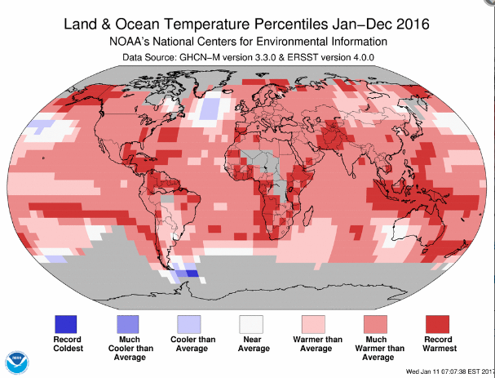
Notes:
Daily headlines regarding impacts and indications of climate change
Last week, NOAA issued the annual Global Analysis report which states that global temperatures have hit an a record high for the past three years.

Slide 3
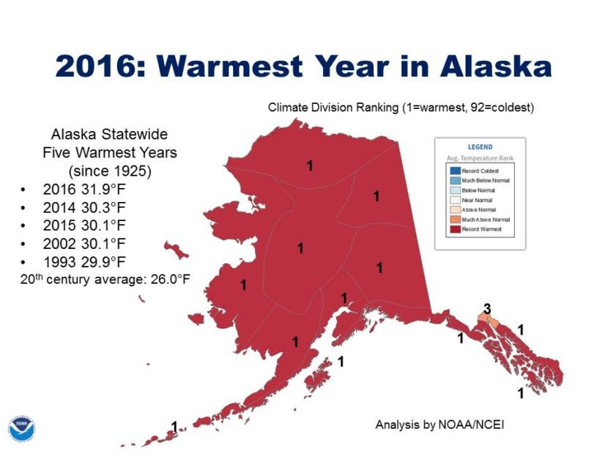
Notes:
Here in Alaska, temperatures in 2016 were the warmest on record.

Slide 4
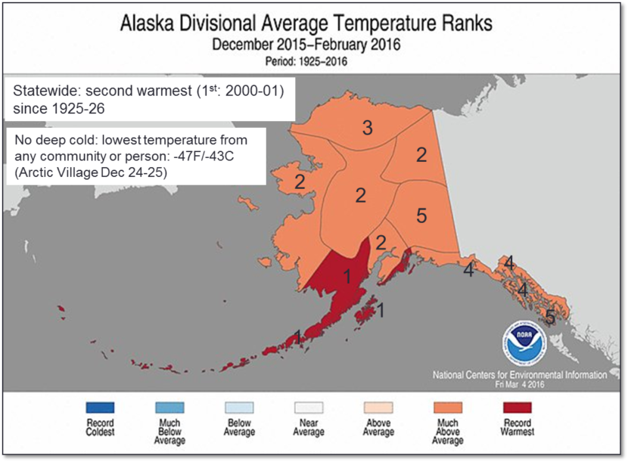
Notes:
Similarly, 2015 had been the warmest, or nearly the warmest, on record

Slide 5
Impacts of climate change
Warming
  Permafrost melting or heaving
  Reduced source water availability
Changing weather conditions
  Increased storm frequencies and intensities
  Erosion
Notes:
Today, I am going to share some examples of impacts of climate change, specifically impacts to rural sanitation systems.
I have categorized my examples into two groups: those caused by warming and those caused by changing weather conditions.

Slide 6
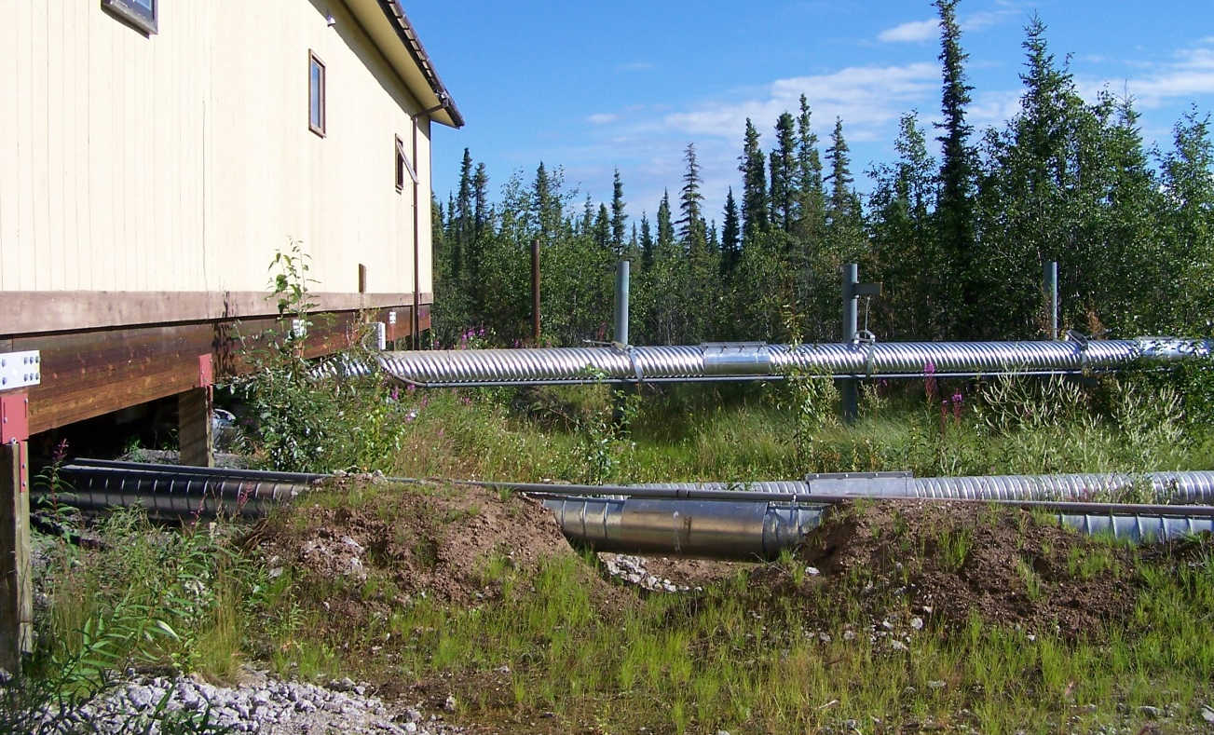
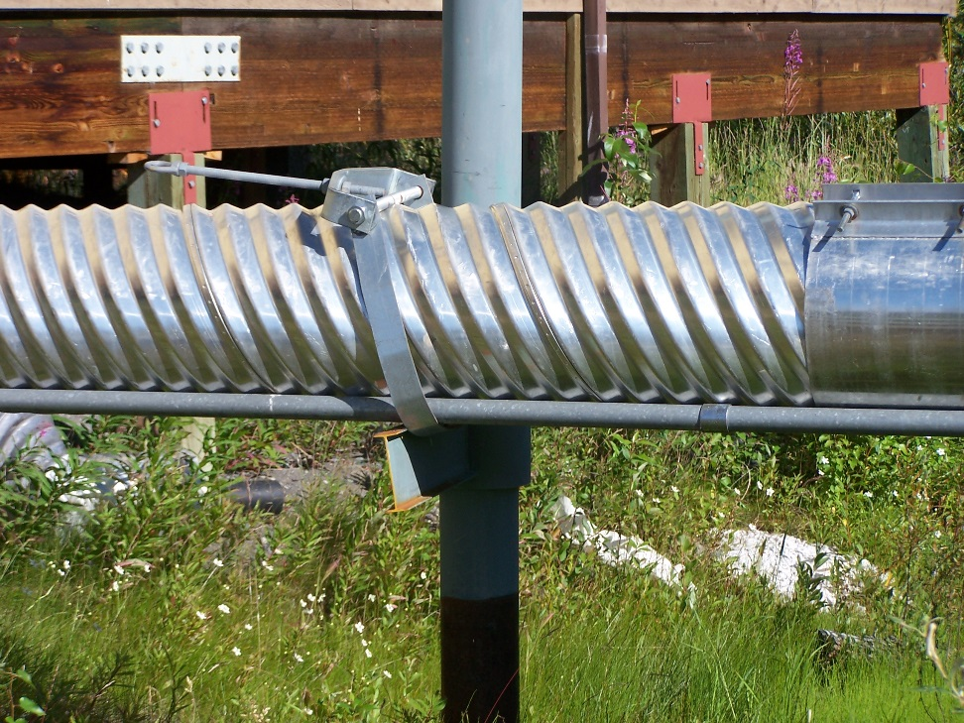
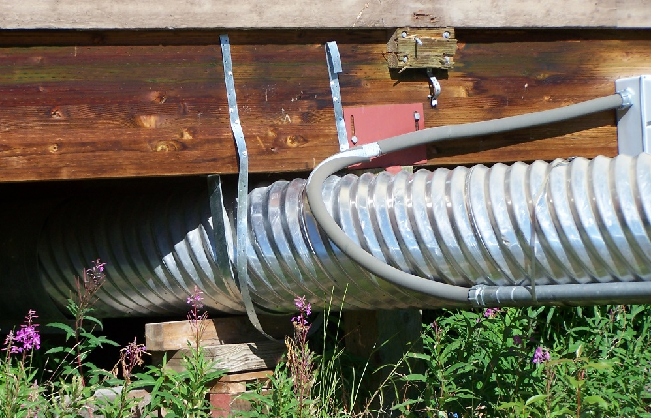
Notes:
Examples of warming/changes to permafrost: Northway building piles sinking. Had to release sewer discharge line from the hangers to reduce a belly in the line just below the washeteria. (Bohan photos 2011)

Slide 7

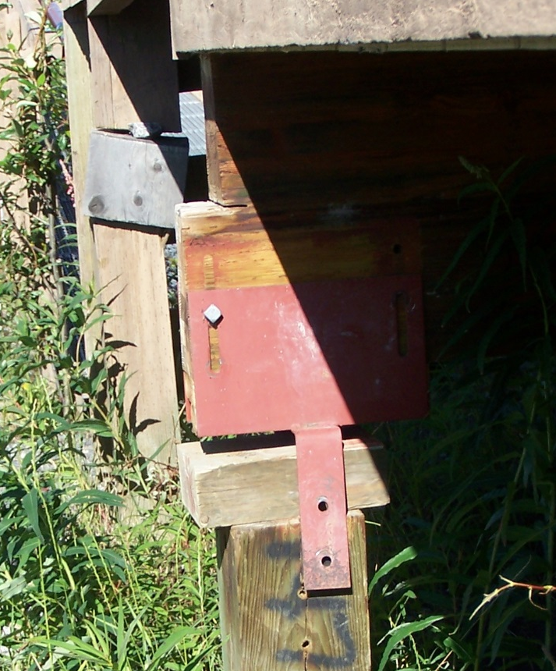
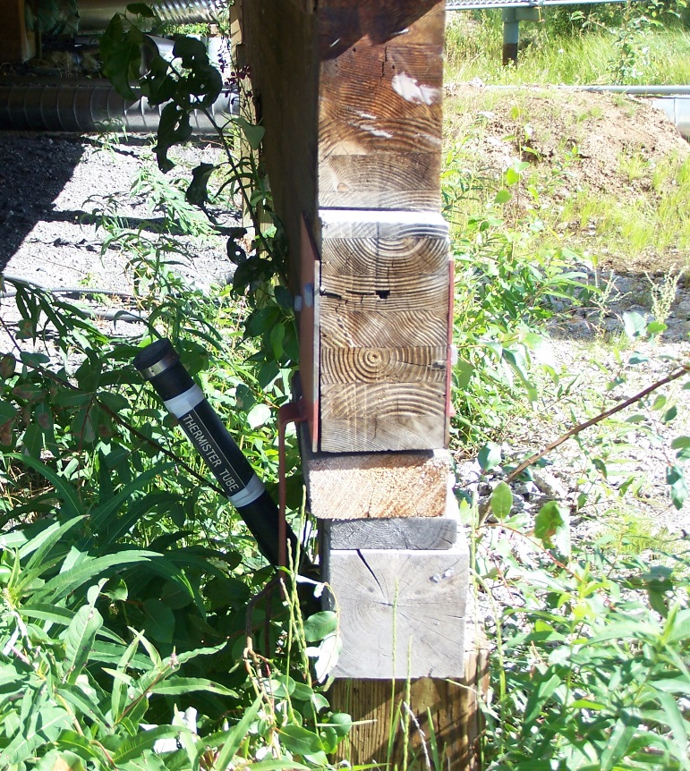
Notes:
Northway

Slide 8
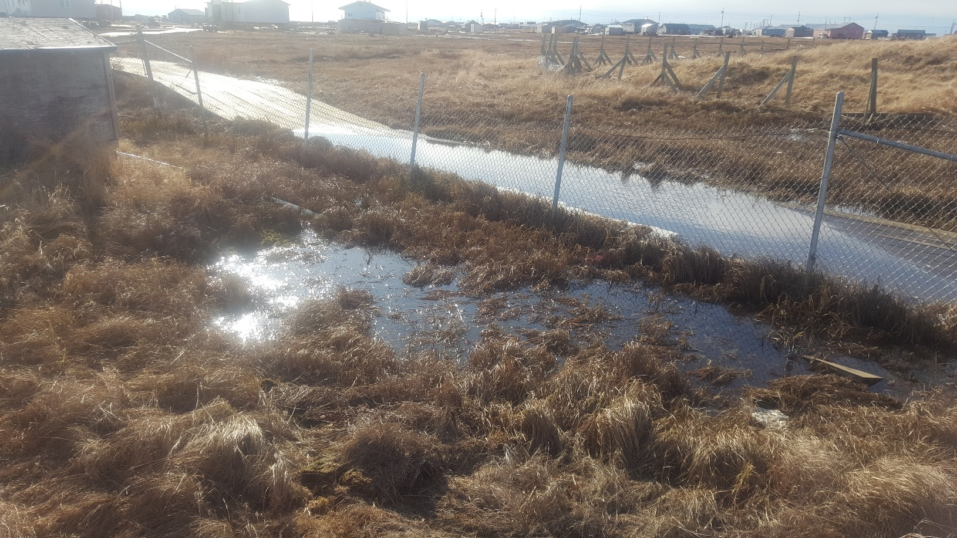
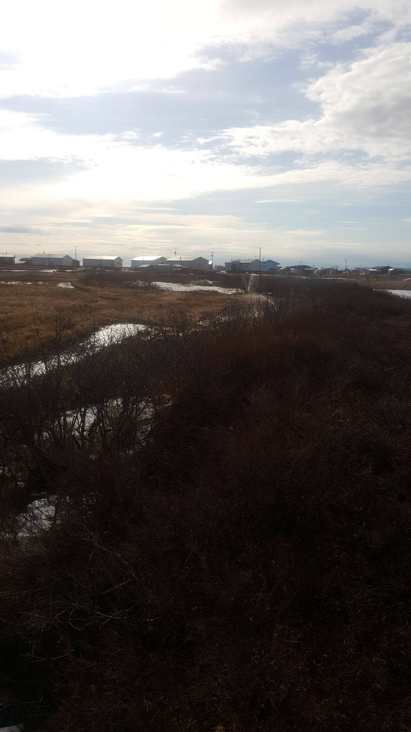
Notes:
Nunapitchuk lagoon berms are settling (YKHC photos 2016)

Slide 9
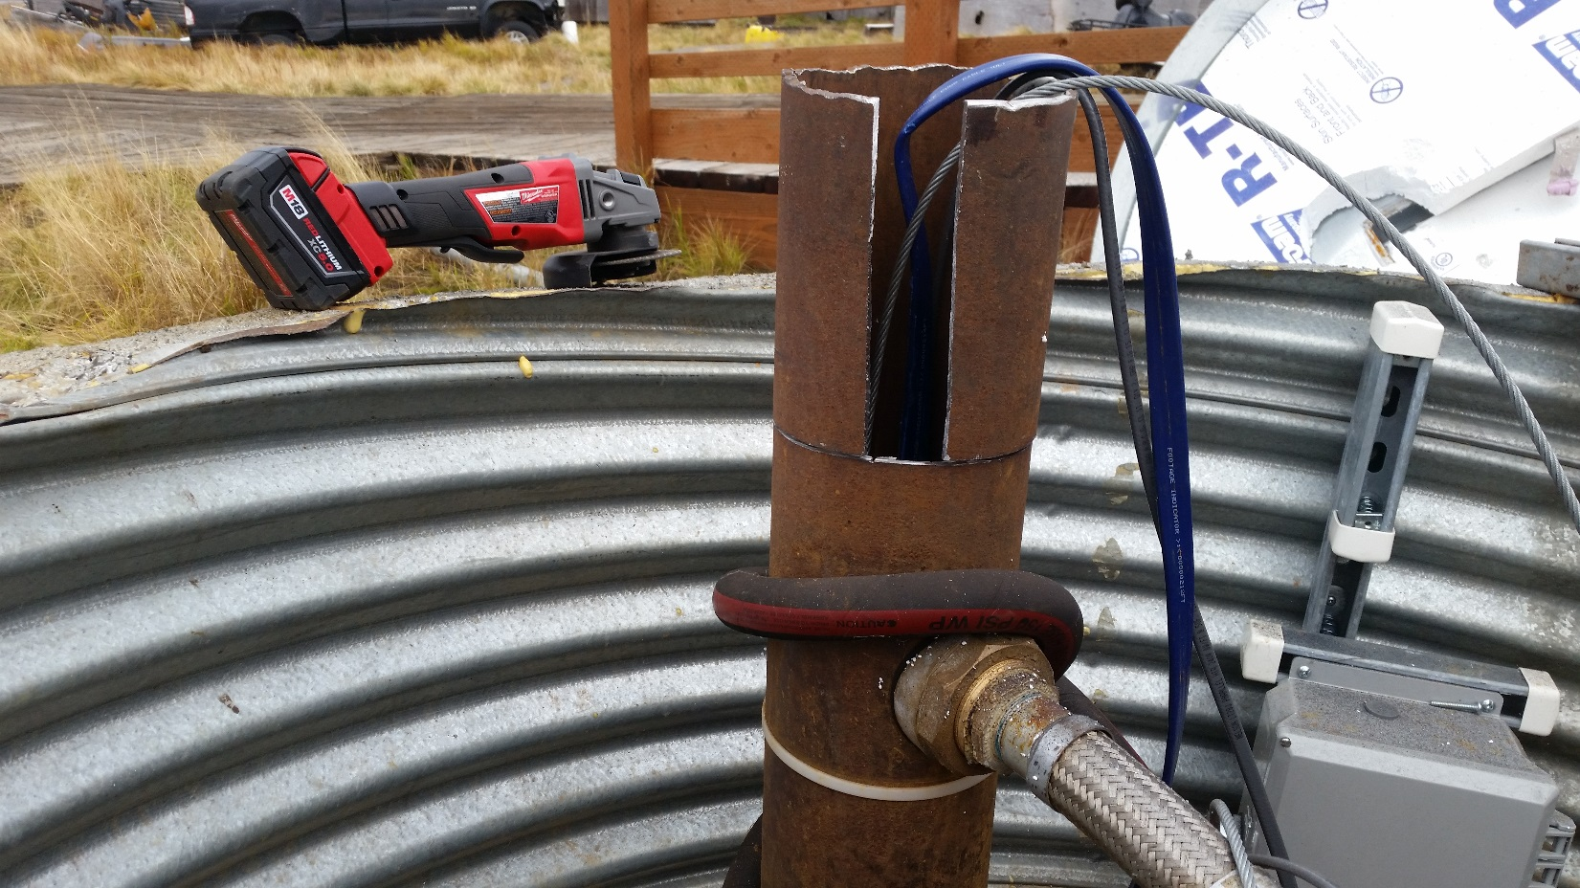
Notes:
Kasigluk October 2016, Bob White trip. Had to cut 1 foot off the well casing because the box had sunk. Washeteria and lift station are also settling.

Slide 10
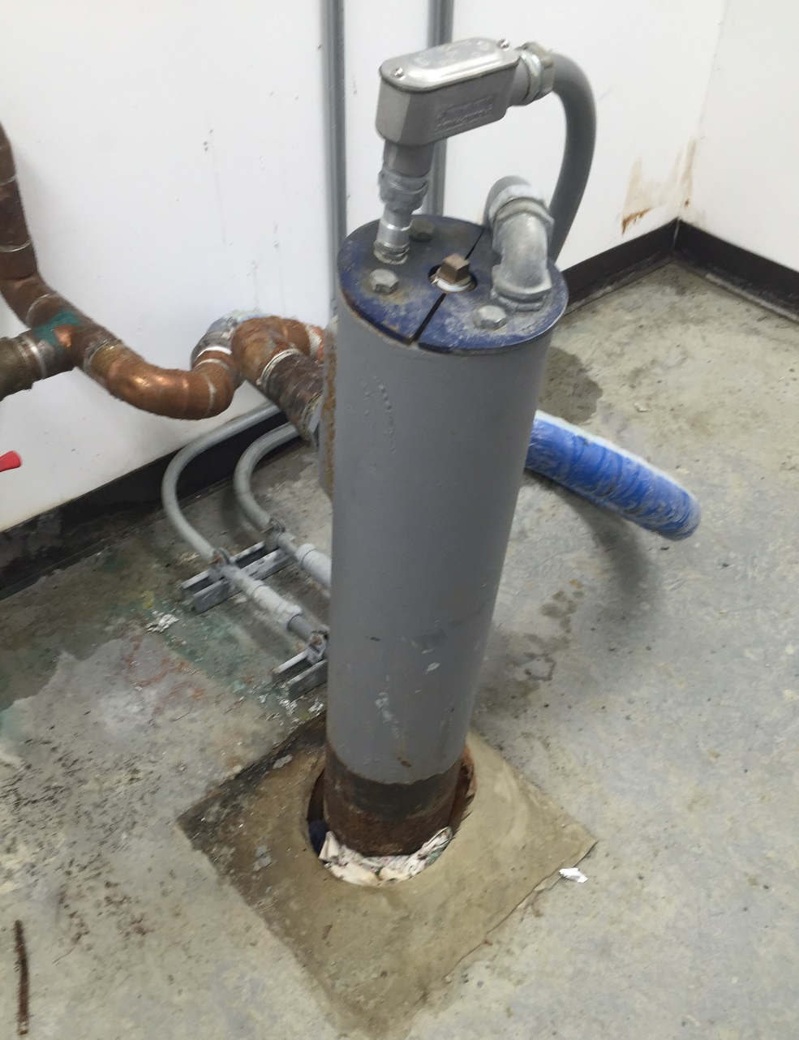
Notes:
Similar issue with the well jacking in Marshall

Slide 11
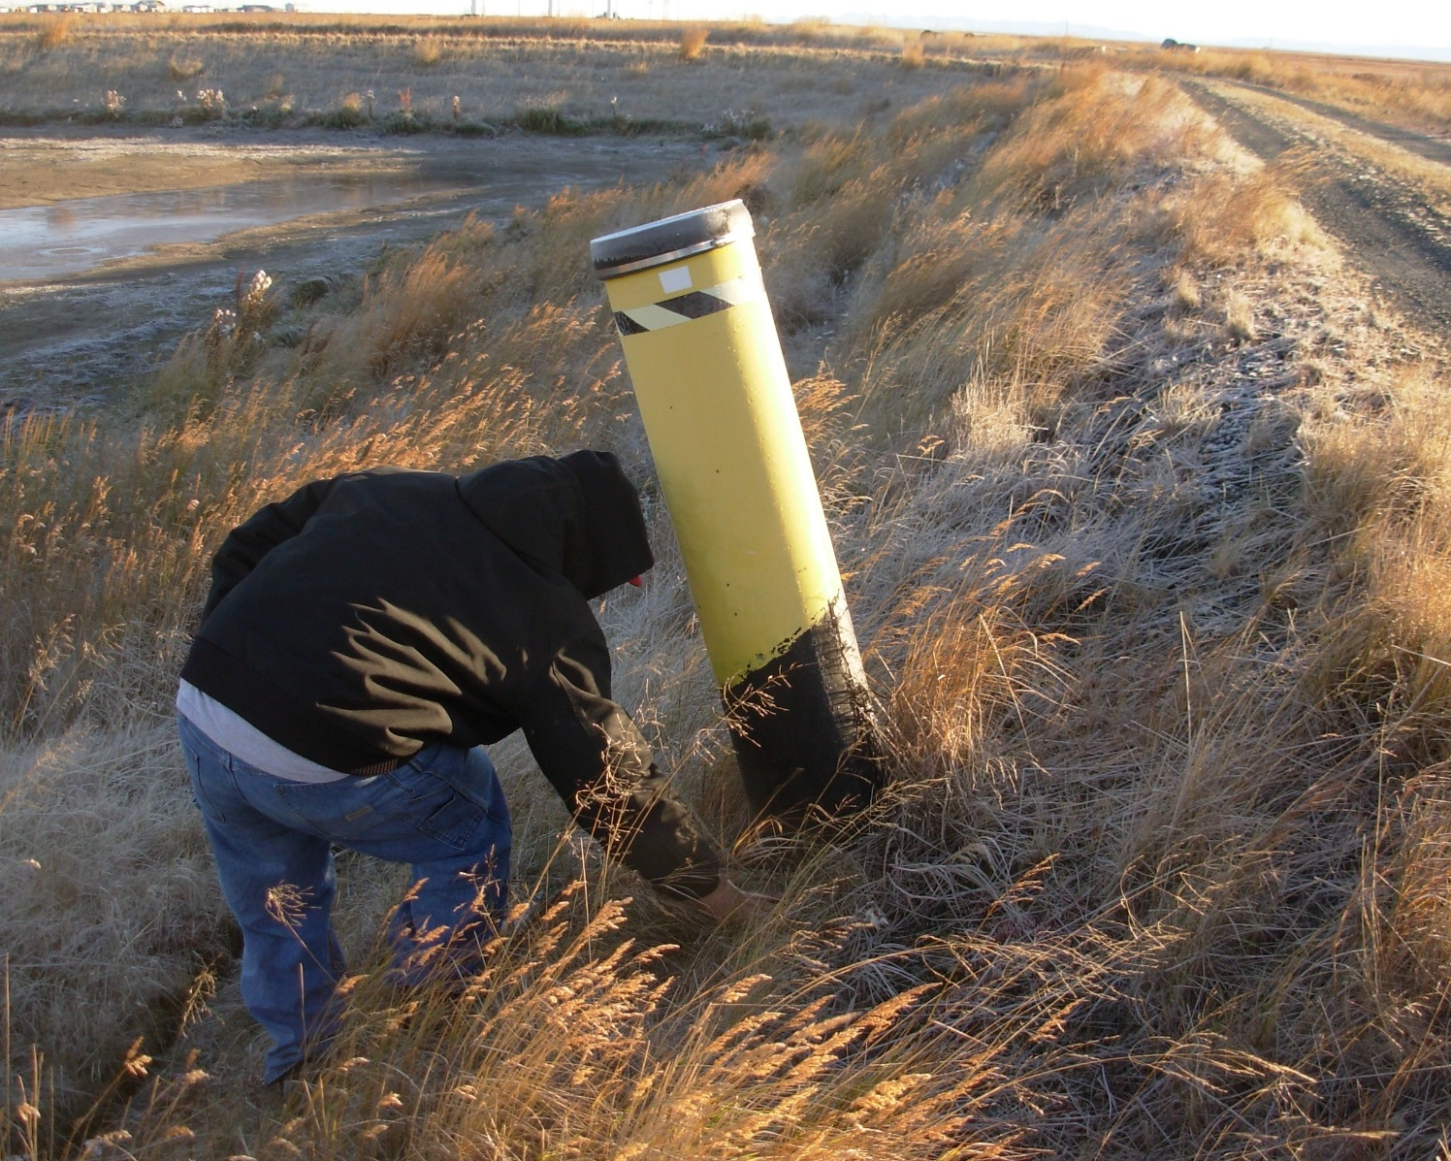
Notes:
Quinhagak – Sewer clean out jacking. Most helicals are also jacking and it seems to have gotten worse in the last year.
Per YKHC at recent meeting, this is a common issue across YK region.

Slide 12
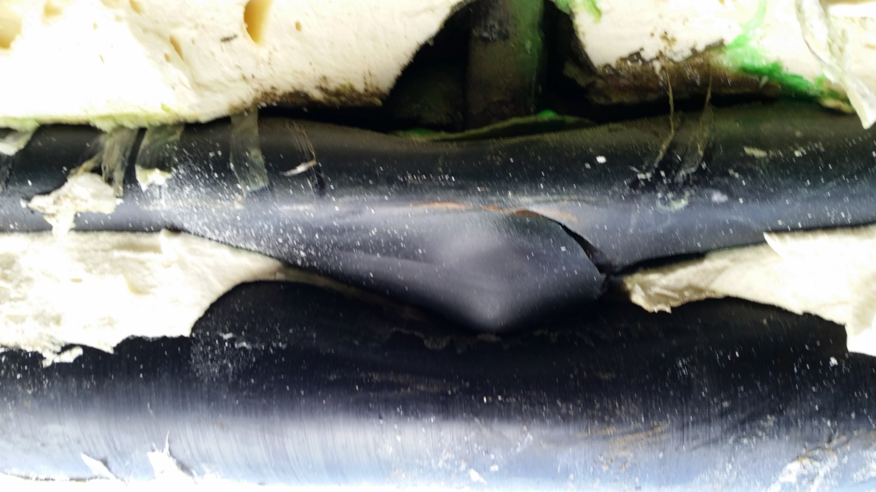
Notes:
Quinhagak
A helical that was jacking was cut but left in place. It continued to move upwards, puncturing the arctic pipe and eventually the pipe inside.

Slide 13
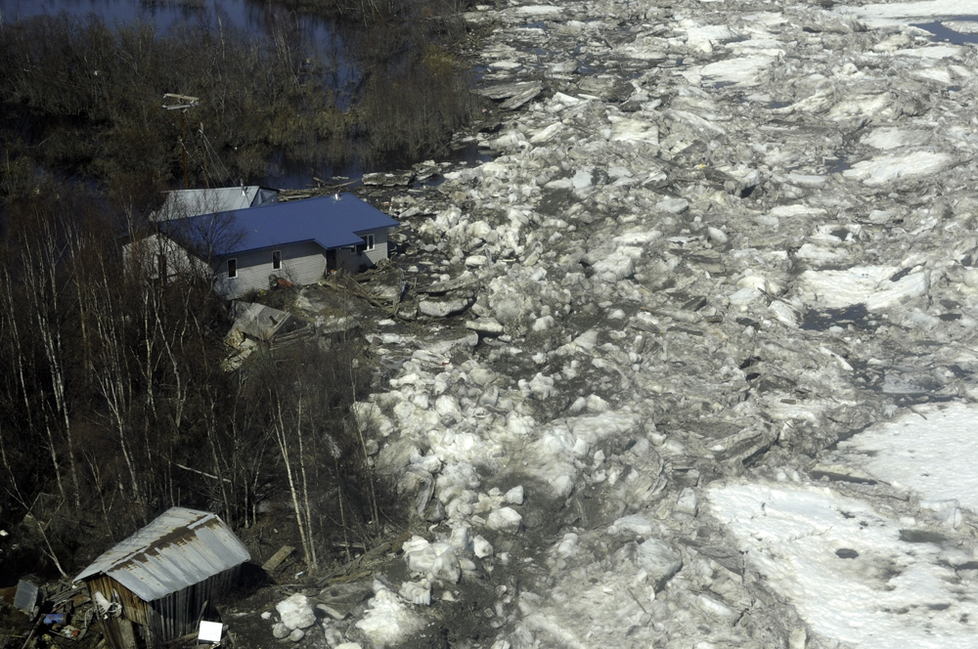
Notes:
Now let’s look at some examples of changing weather patterns.
Crooked Creek Flood May 2011.
In recent years, warmer spring temperatures cause rapid ice melt and increased chance of flooding during breakup. Similar instances in Eagle 2009 (record high temps), Galena 2013.
Flood wells and septics, push buildings off foundations.
Recent summers, SE communities who use surface water systems struggled to maintain adequate supplies due to long stretches of hot, dry weather.
In some areas, persistent warming causes source water lakes to dry up altogether.
In the past couple years, low snow fall has resulted in reduced insulation for pipes and septic tanks, making them more susceptible to freezing.

Slide 14
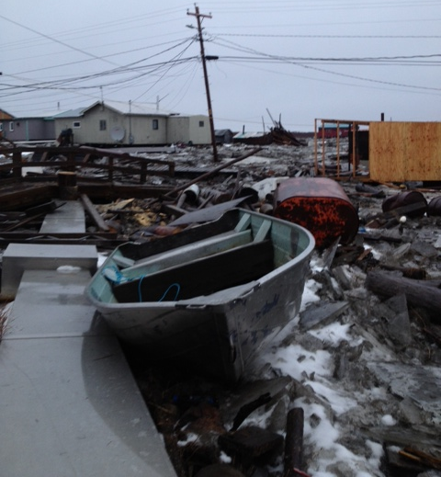
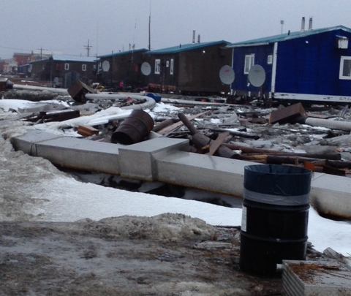
Notes:
Examples of increased storm frequency and intensity.
November 2013 Western Alaska storm event and declared disaster.
Kotlik’s force main was disconnected, river pump was carried away with the ice, some homes floated and their service connections were twisted and disconnected from their arctic boxes, one service loop (loop 3) out of service.
Trouble maintaining the vacuum sewer system

Slide 15
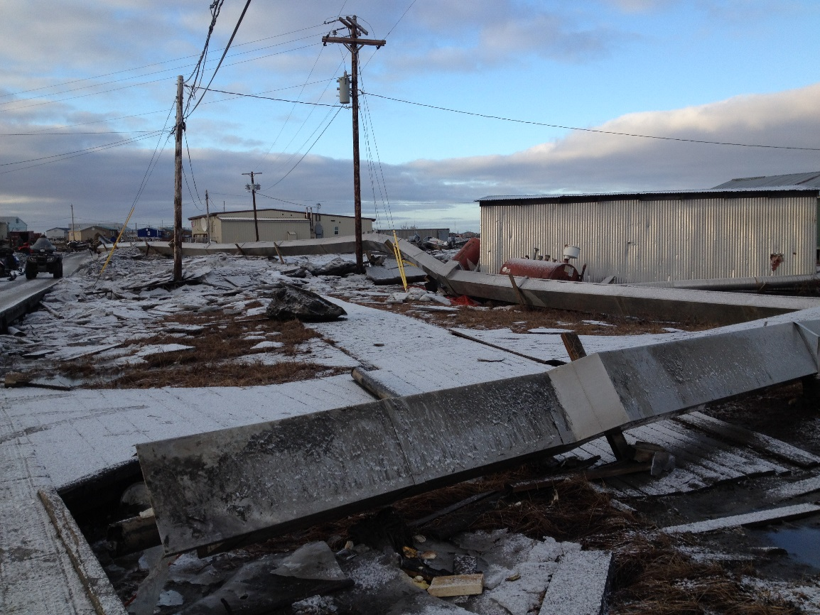
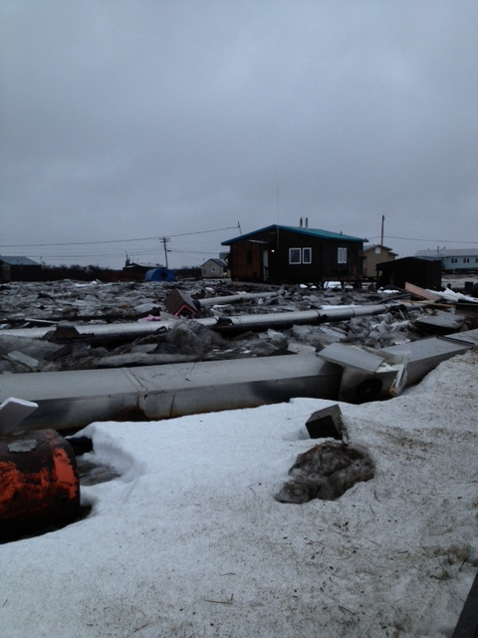
Notes:
Kotlik 2013

Slide 16
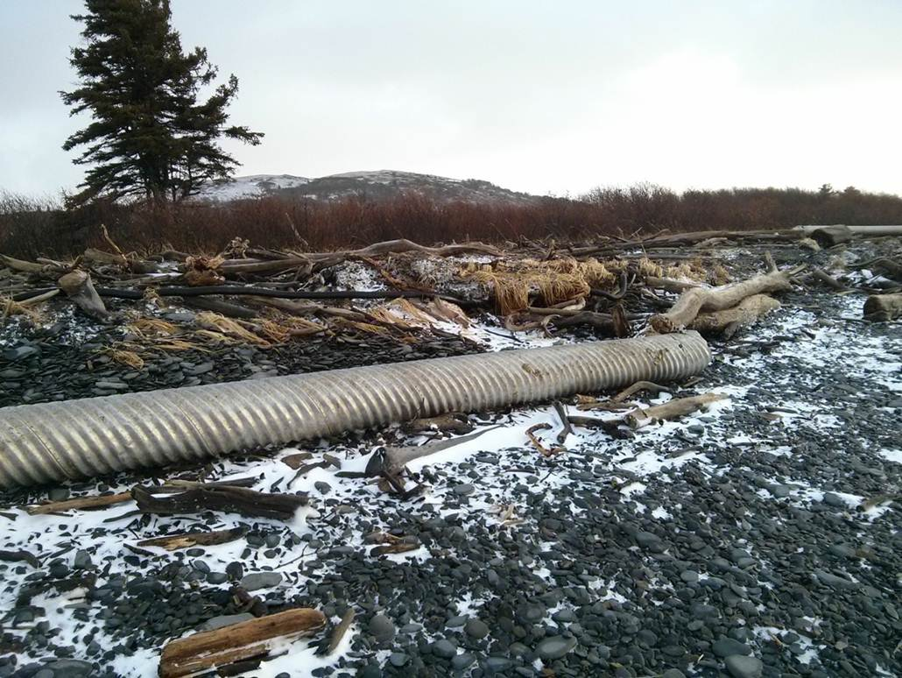
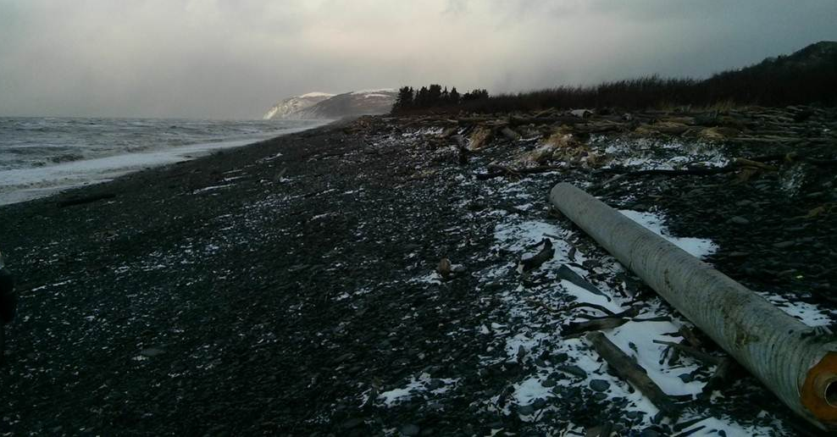
Notes:
Unalakleet 2013 – Approx 600 feet of water transmission line was damaged

Slide 17
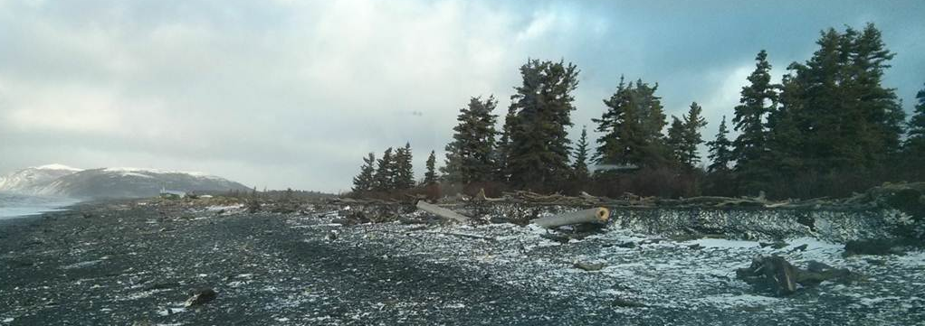
Notes:
October 2016, Unalakleet. In some instances, lack of sea ice increases damage during storms. For example salt water is pushed into Kwigilinghok’s raw water reservoir during storm surges. The ocean side of Goodnews Bay’s lagoon floods during storm surges.

Slide 18
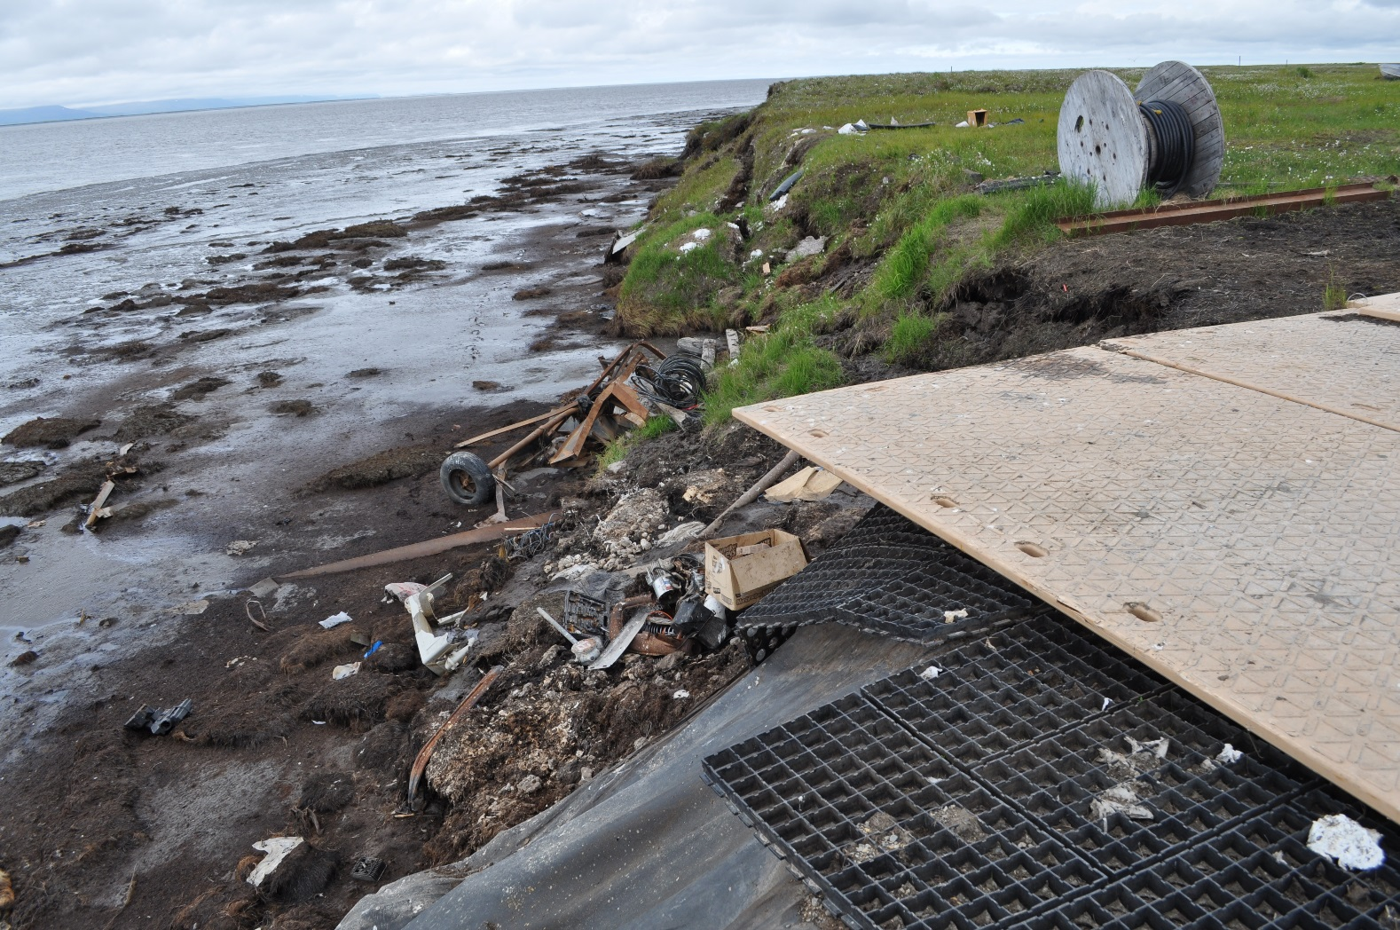
Notes:
While erosion increases with severe storms, storms are not always the cause of significant erosion.
This photo is of permafrost erosion in Newtok
In some communities, beach erosion exposes outfall lines or buried transmission lines.

Slide 19
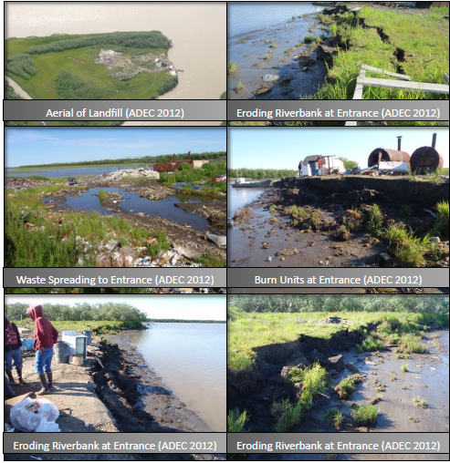
Notes:
Kotlik landfill - A US Army Corps of Engineers 2009 study estimated an erosion rate of 3 feet per year along the banks of the landfill. During the 2012 DEC inspection, the landfill was only 15 feet from the eroding riverbank and impact to the landfill was expected by 2016.

Slide 20
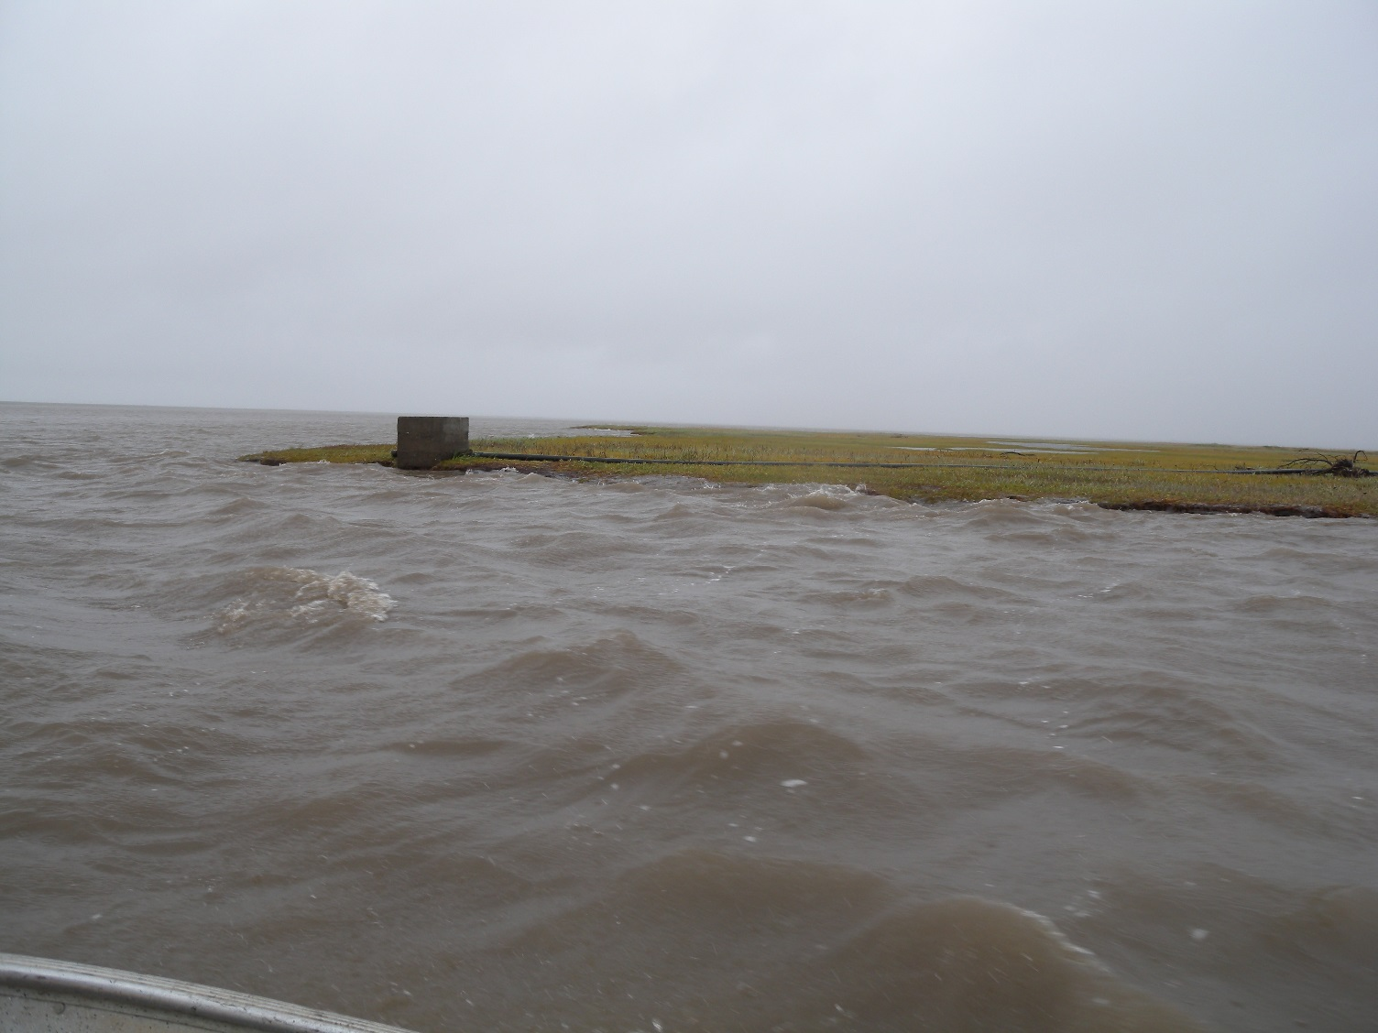
Notes:
Kivalina – Flooding of the Wulik River in 2013. The anchor block that is used to stretch the flexible line across the lagoon during summer filling the raw water storage tank fell into the river the day after this photo was taken.

