Slide 1

Food Security
Presented by: Carolina Behe
7th Annual Water and Sanitation Innovations for the Arctic
January 20th, 2017
Notes:
Good Morning!
Thank you Cheryl and USARC for inviting me to join this interesting conversation and to share information about water and food security.
What I share today is the product of Inuit across Alaska. For those of you that are not familiar with ICC, ICC advocates on behalf of 160,000 Inuit across Chukotka, Alaska, Canada and Greenland. Here in Alaska…

Slide 2
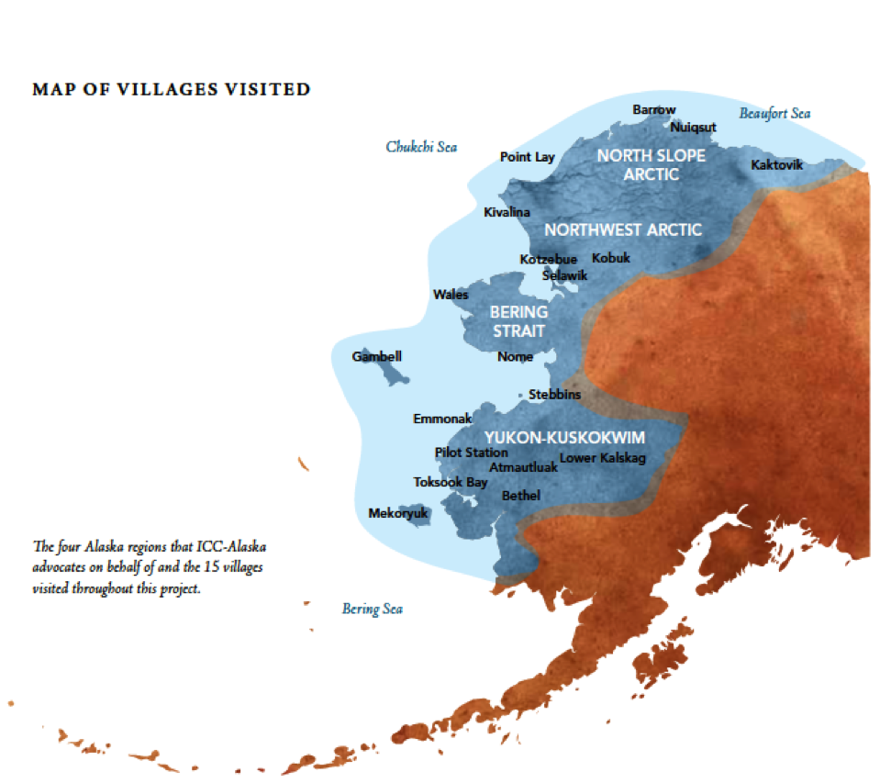
Notes:
we advocate on behalf of Inupiat, St. Lawrence Island Yupik, Centeral Yupik and Cupik. We collectively refer to everyone as Inuit internationally and for the sake of this presentation. These are the people that developed what I will share today.
To begin a conversation about food and water security, we first need to share what Alaskan Inuit food security is…

Slide 3
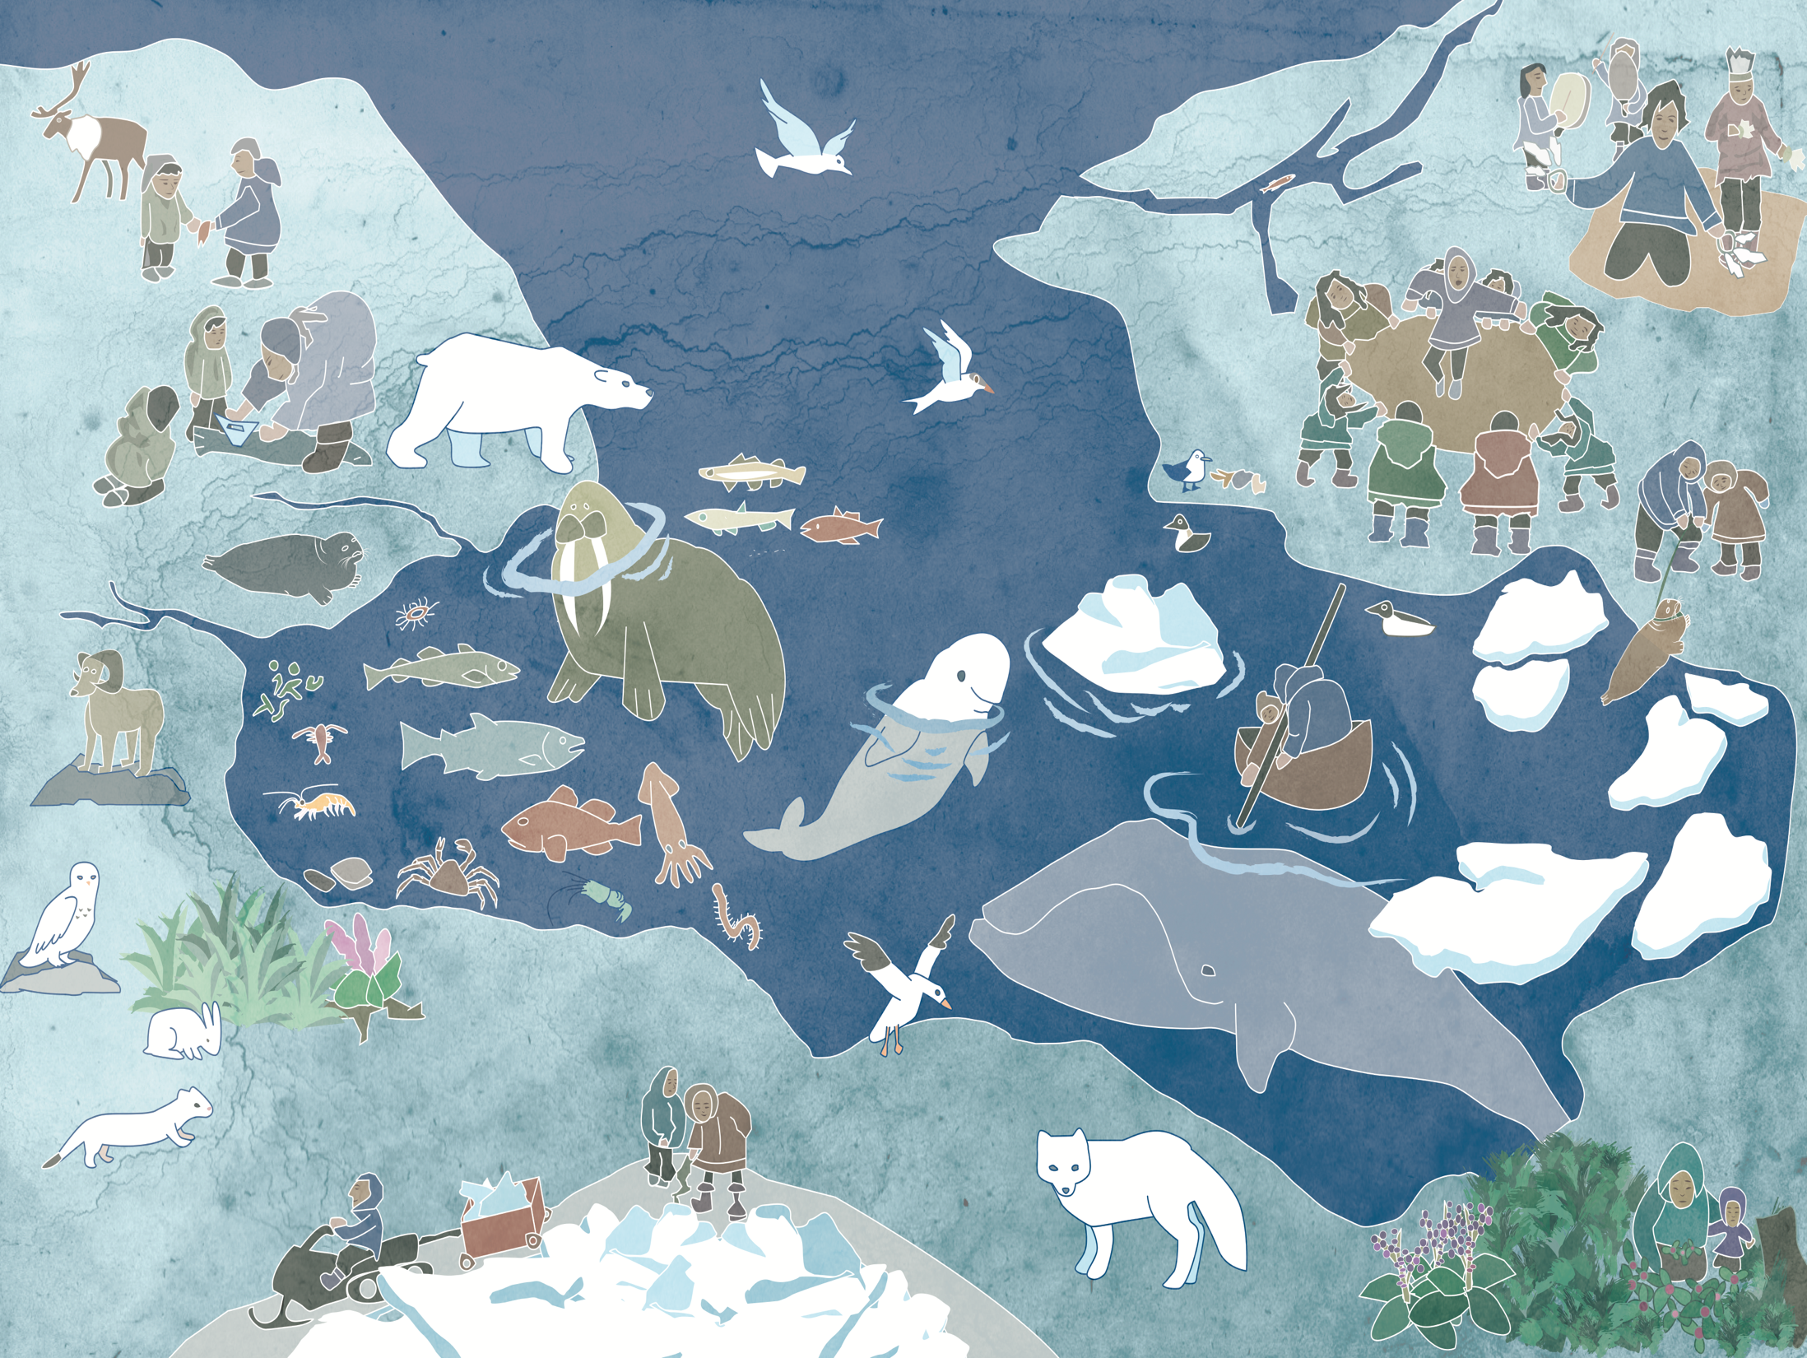
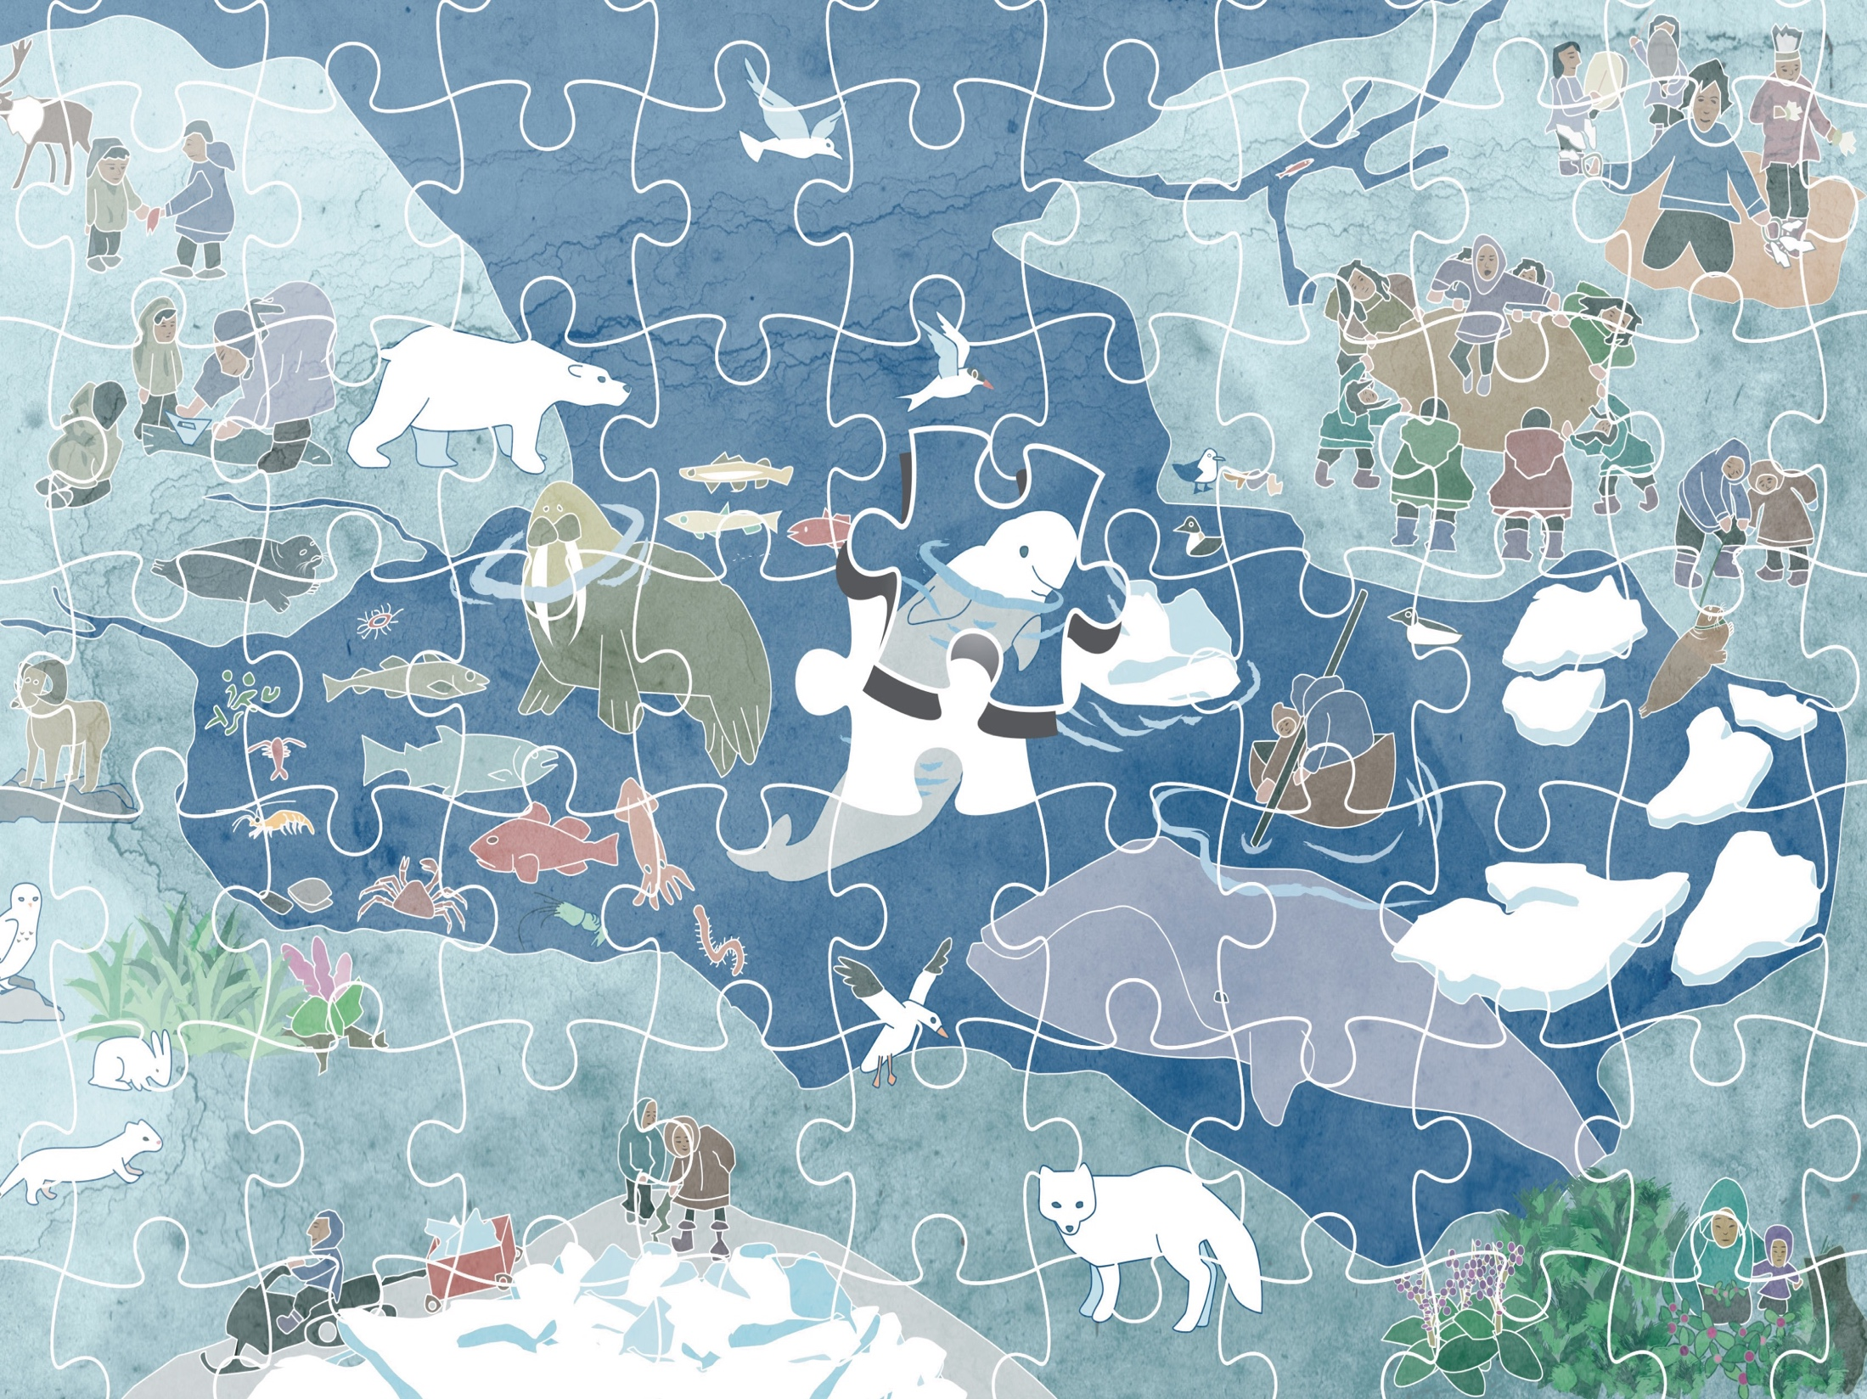

Notes:
As one elder explained, the Arctic is a puzzle made up of many pieces.
PUSH

Slide 4
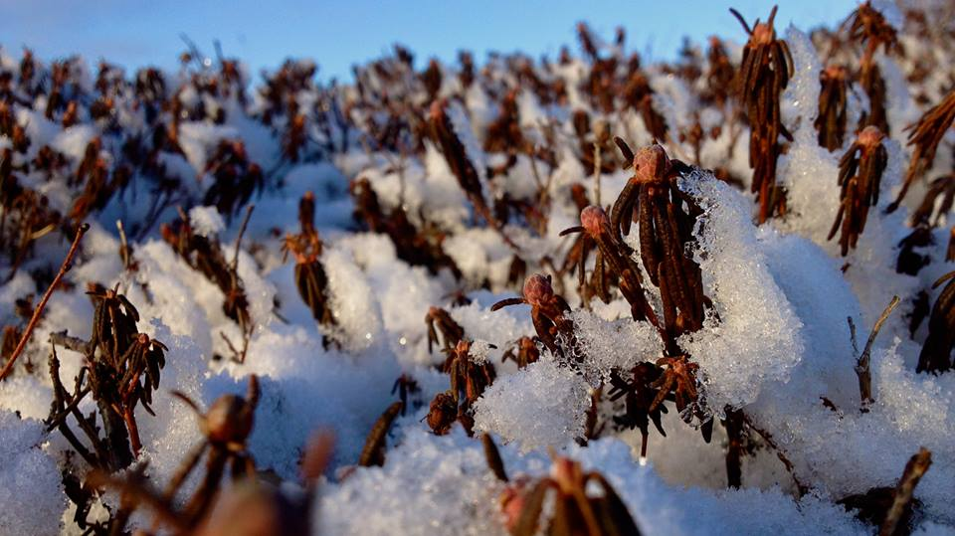
Alaska Inuit Food Security is the natural right of all Inuit to be part of the ecosystem, to access food, to care-take, protect, and respect all of life, land, water, and air.
Photo: Jacki Clevland
Notes:
This definition is long – because food is the foundation of Inuit culture; it is a description of an Ecosystem. I will read the first line. But please read the entire definition.

Slide 5
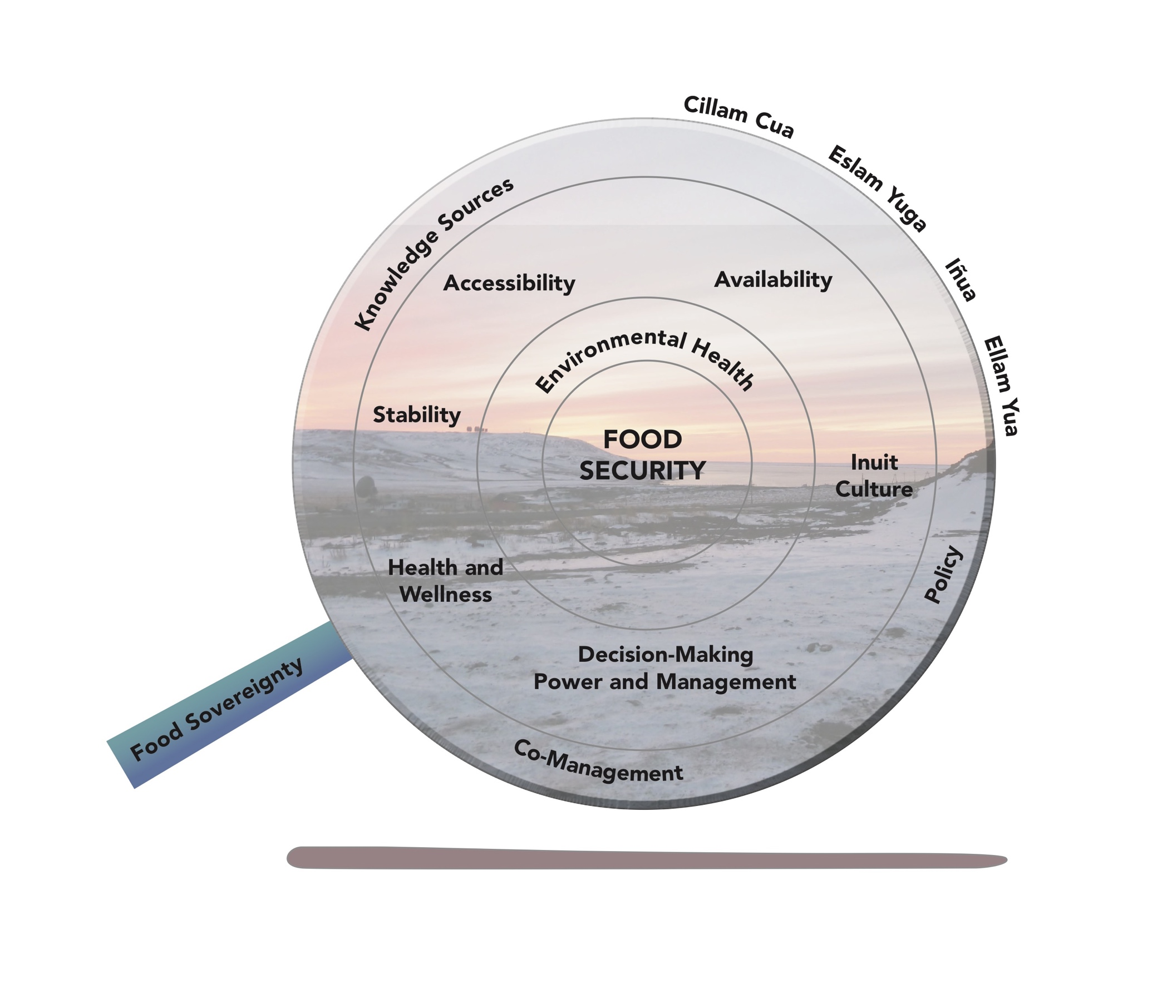
Notes:
This is food security…these are all of the pieces – all of the dimensions that make up Alaskan Inuit food security. This is a conceptual framework that comes out of the work done in Alaska.
Explain the conceptual framework....
Within these dimensions lie water security, lies discussions about sanitation, about water accessibility, about decision making power...

Slide 6
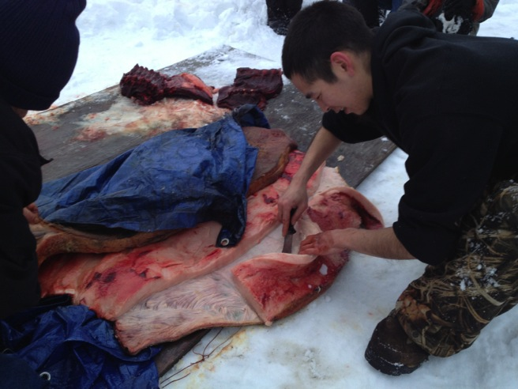
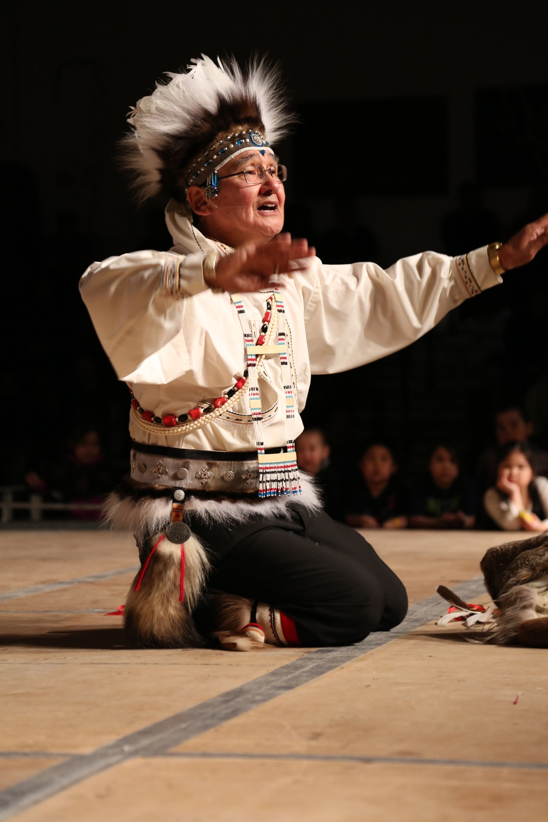
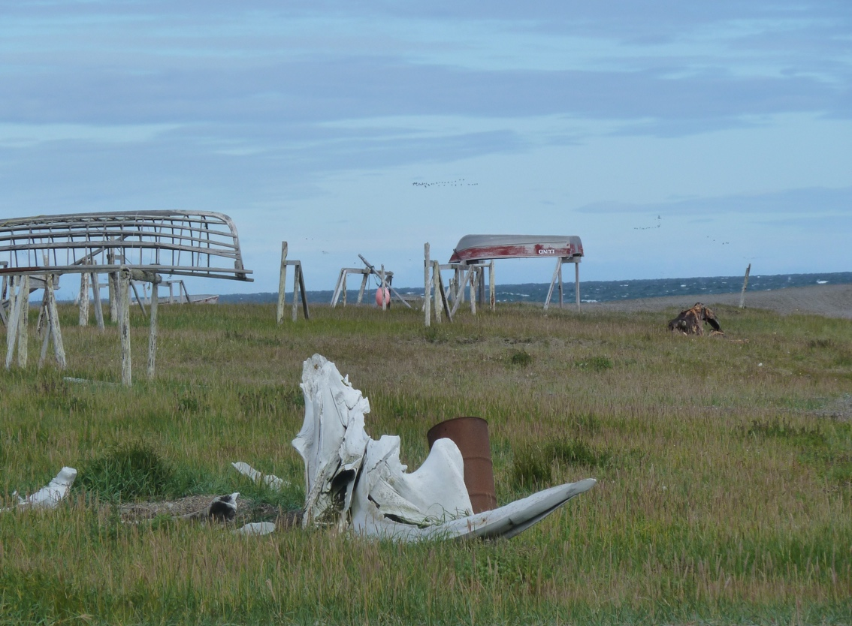
Photo: Carolina Behe
Photo: Carolina Behe
Photo: Jacki Cleveland
Notes:
A key point here is that one piece of the puzzle cannot be looked to understand the Arctic. You must consider all the pieces and how they interlink with each other and the importance of understanding cumulative impacts.
Consider the health and wellness dimension – this includes health of everything, inlcuding water - environmental integrity and productivity to withstand pollution, habitat destruction and
other disturbances.
Accessibility includes, access to water. Sources of water have been changing. There is a loss of multi year sea ice for fresh water, some areas that once accessed water from near by lakes are unable to do to an increase in pollution. And freshwater lakes are drying up.

Slide 7
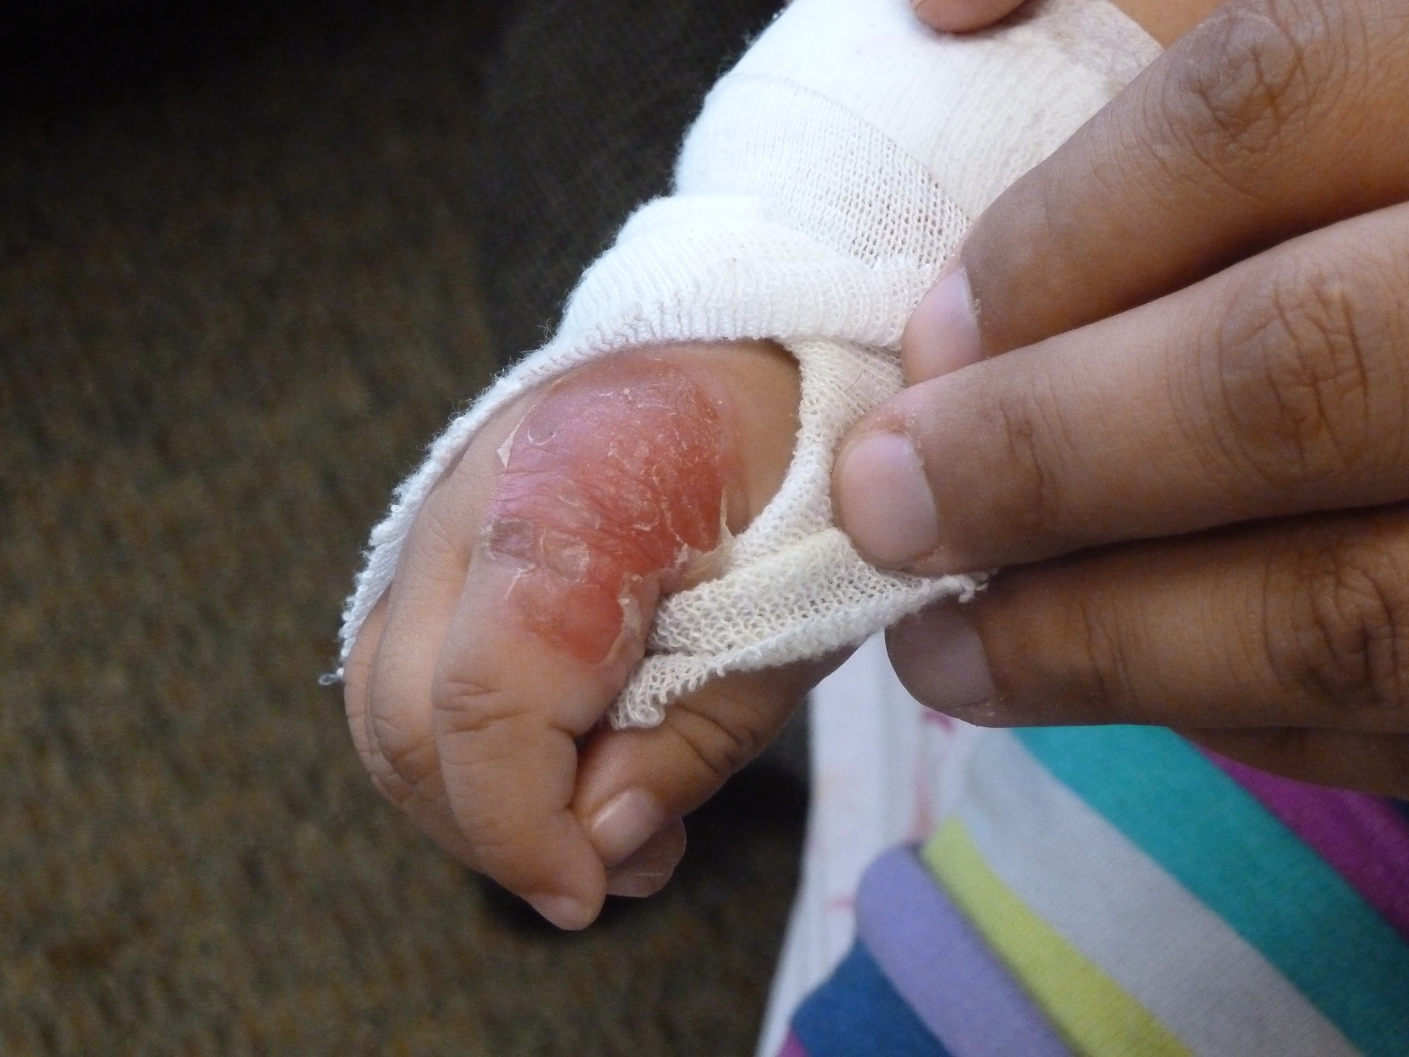
Notes:
All of this is linked to decision making power....many people discussed the impact of not having input, or their Indigenous Knowledge considered, when deciding were to place sanitation facilities. The result has been facilities placed in areas were they pollute fresh water. In making this conceptual model, many people shared concerns of particles from these systems are blown throughout a village…people also shared that incidents of sanitation systems discharging waste and chemicals through processing water systems have resulted in a decrease in life (fish and vegetation) within the direct area.
These concerns stress the need to use both Indigenous Knowledge and science when determining the best solutions.
Accessibility includes, access to water. Sources of water have been changing. There is a loss of multi year sea ice for fresh water, some areas that once accessed water from near by lakes are unable to do to an increase in pollution. And freshwater lakes are drying up.

Slide 8
Notes:
Remember here, we need knowledge sources to support the dimensions.
This work resulted in numerous recommendations:
Determine the location of sanitation systems and landfills in collaboration with IK
holders.
Continue to monitor contaminants associated with sanitation and landfill systems.
Implement an active communication of pollutants system…it is understood that pollutants are
playing a role in how life is changing within the Arctic.

Slide 9
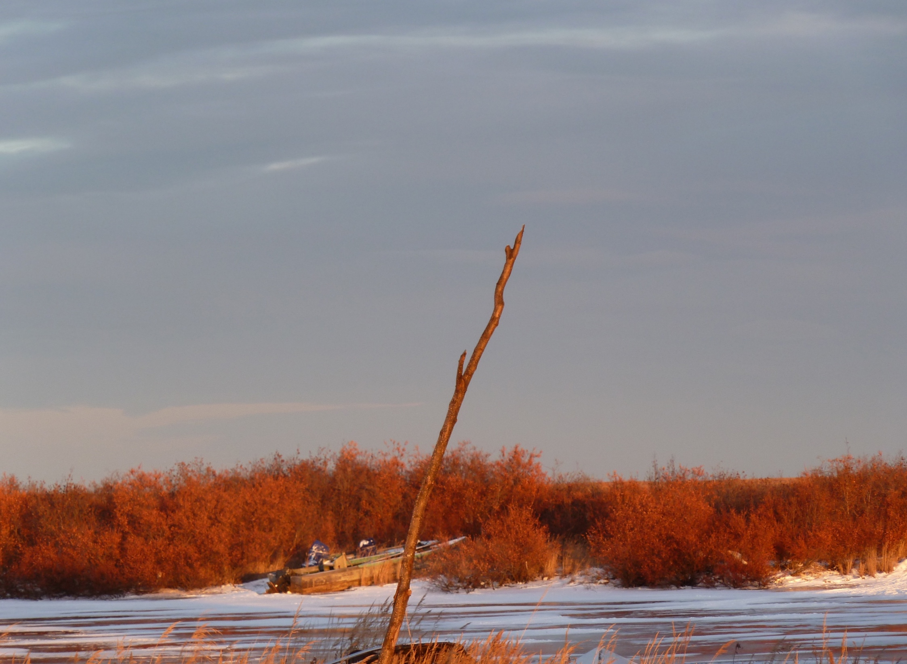
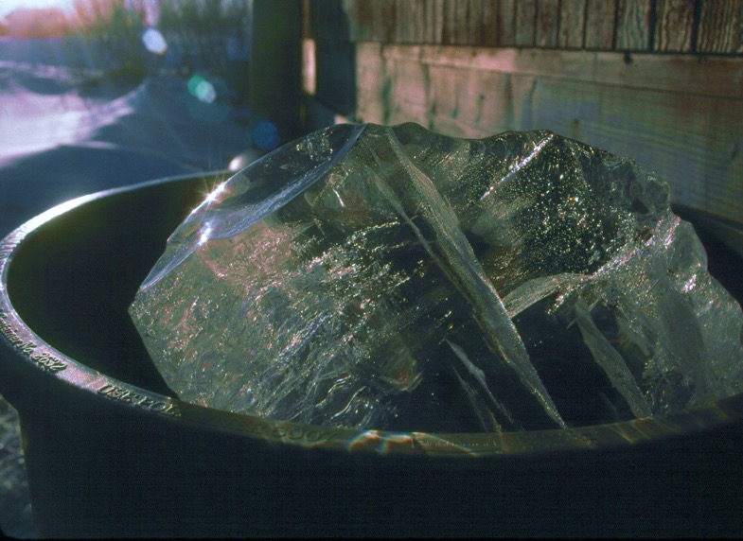
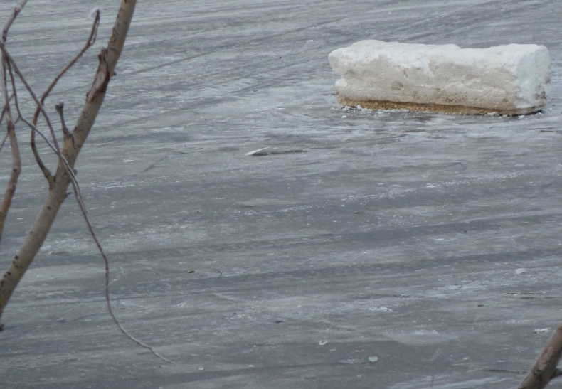

Quyanaq, Quyana, Taikuu
www.iccalaska.org
Notes:
Quyanaq puk for listening and considering this point of view

