Slide 1
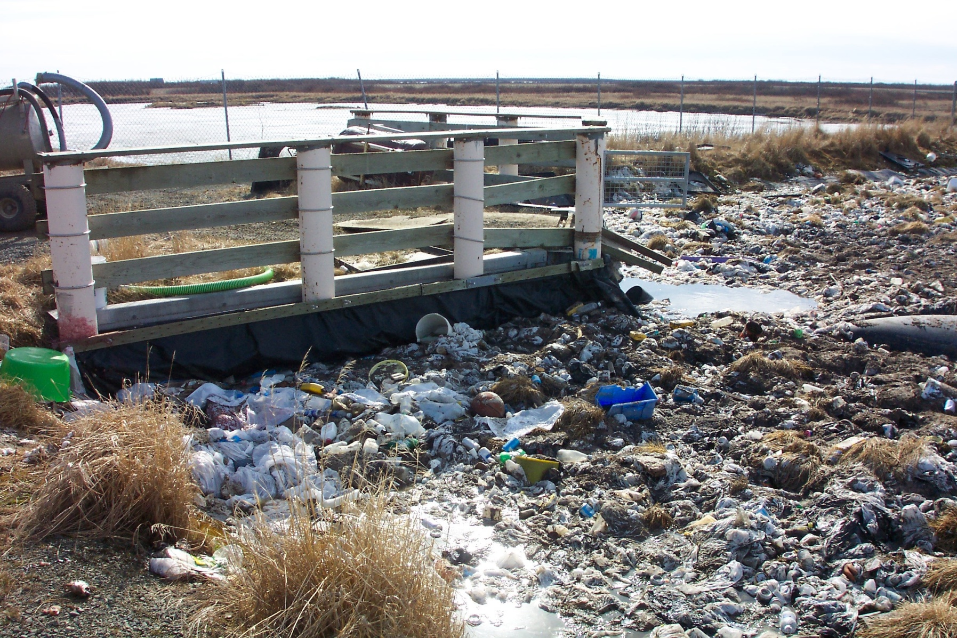
Challenges To Sewage Lagoons

Slide 2
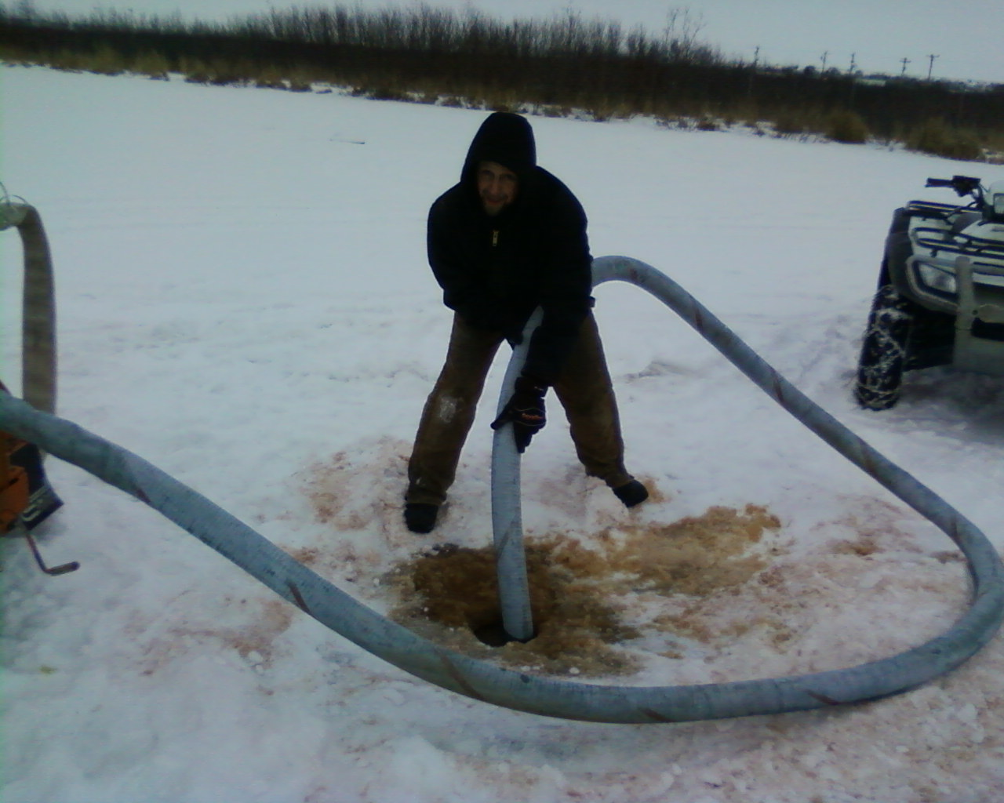
Operations
Access
Air Flow
Discharge
Sludge Removal

Slide 3
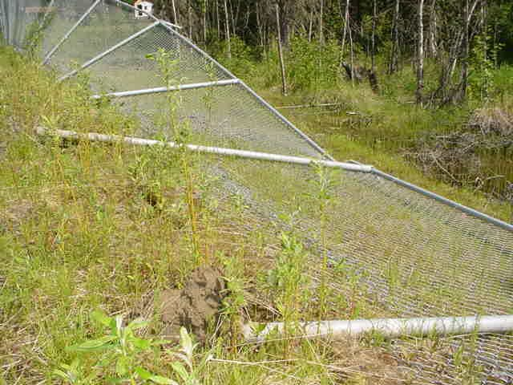
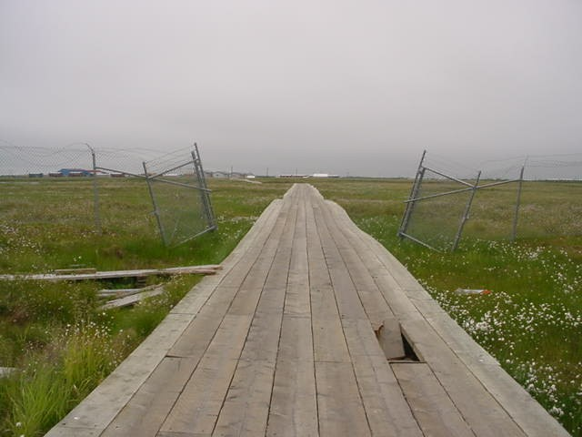
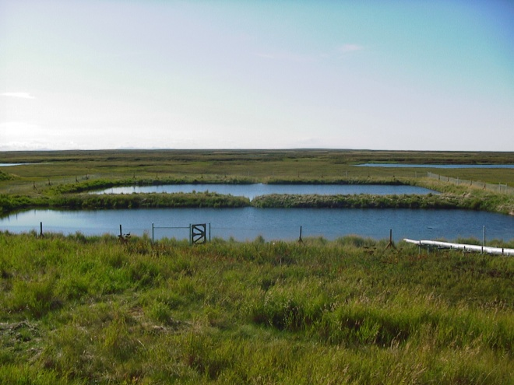
Access
Access to lagoon should be limited.
Operators need easy access to lagoon.
Public needs limited access for dumping honey buckets.
Fencing must be designed appropriately for soil conditions.

Slide 4
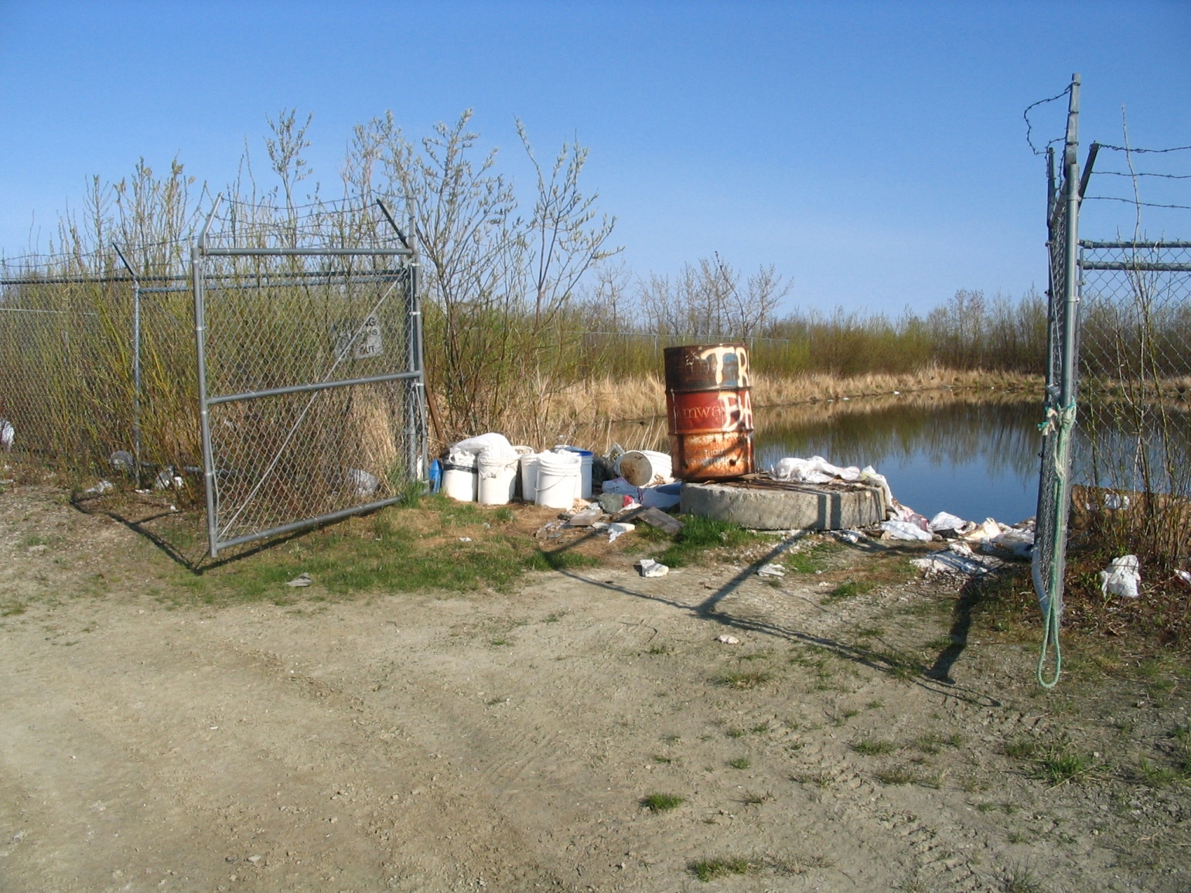
Air Flow
Keeping brush clear to allow air flow is important to healthy lagoon and smell reduction

Slide 5
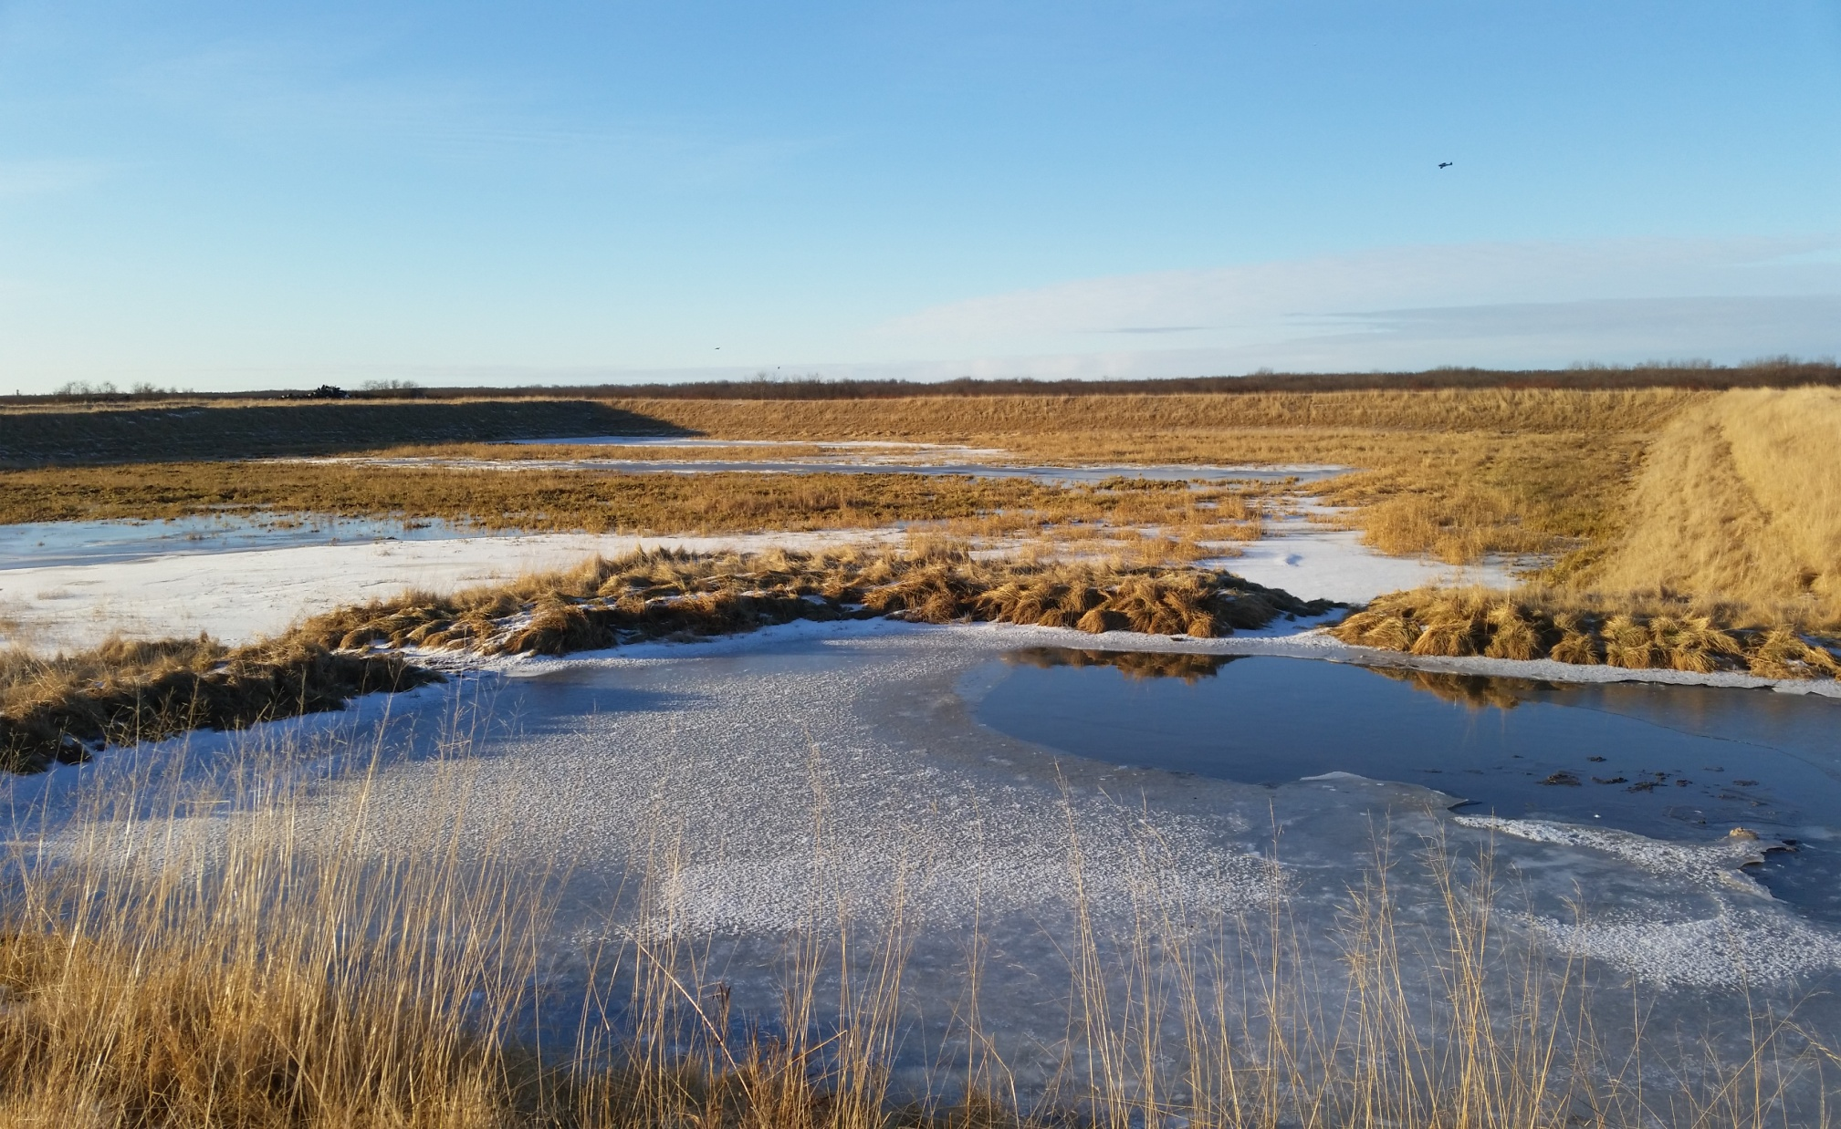
Size of Lagoon
Lagoons can be made too large.
They don’t ever fill up and can’t provide treatment
Lagoons can be made too small.
These quickly reach capacity and require frequent discharge.

Slide 6
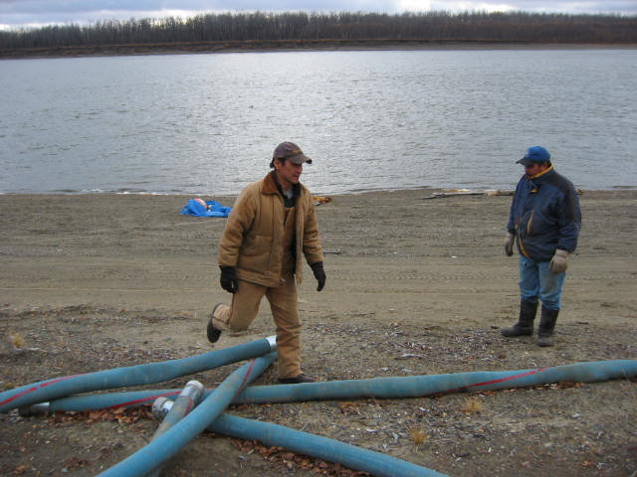
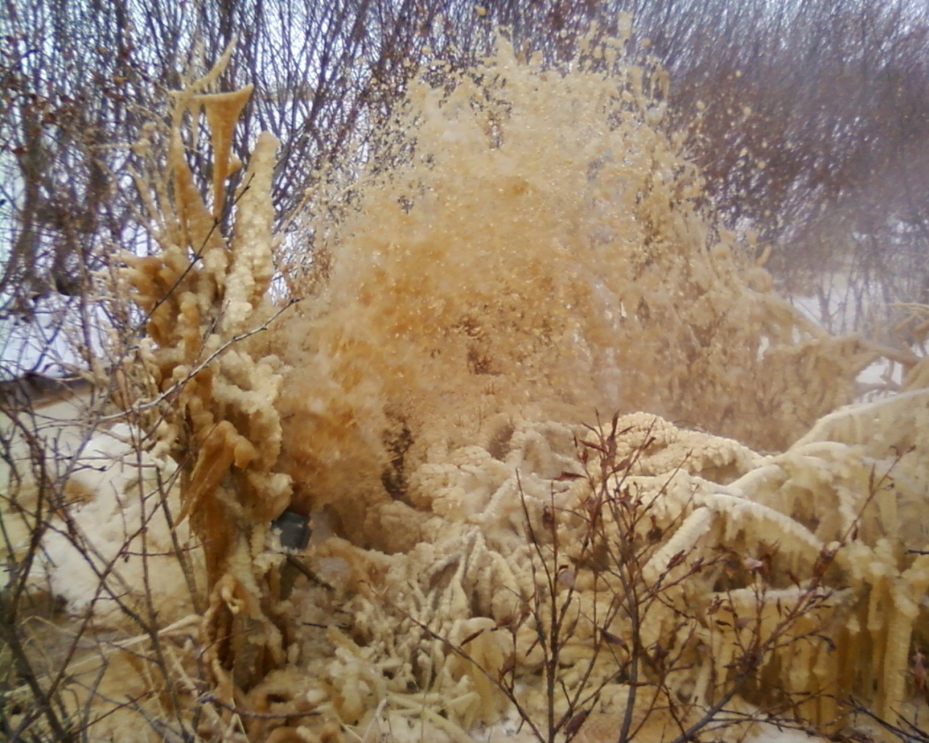
Discharge
River
Wetland
Dry land

Slide 7
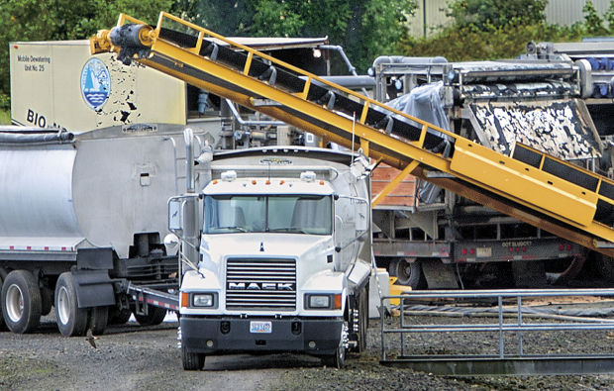
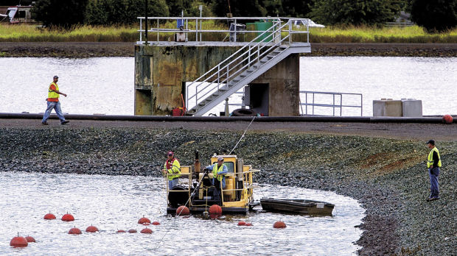
Sludge Removal
Lack of equipment
Dredge
Dewatering
Disposal

Slide 8
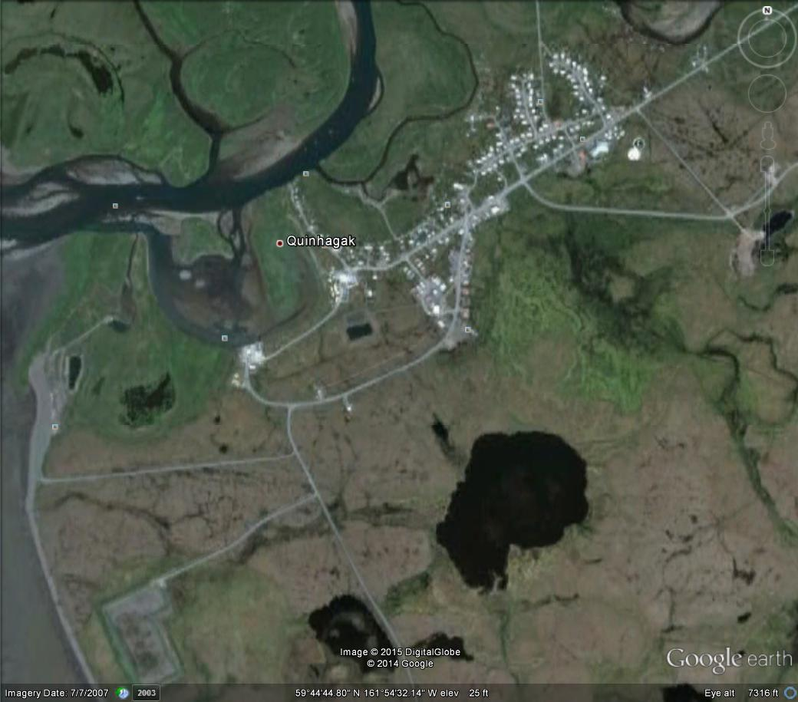
Location
In town
Smell and disease vector
Close to town
Best for access
Town may grow around lagoon
Far from town
Too far to transport, leads to public dumping.
Increased pumping and collection cost.

Slide 9
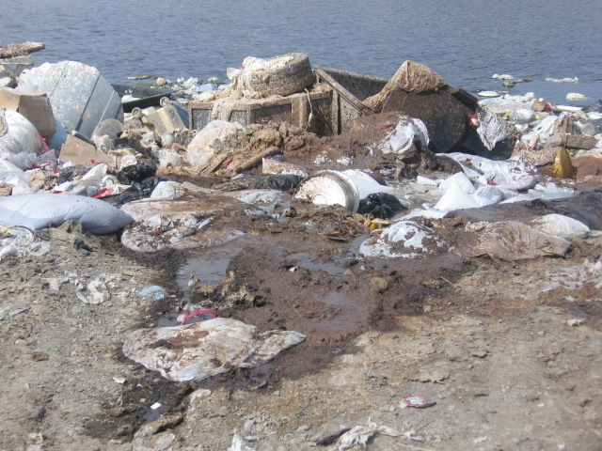
Foreign Materials
Honey bucket liners
Trash
Broken Hoppers

Slide 10
Collection
Lagoons are part of a system and collection will determine the success of the Lagoon.

Slide 11
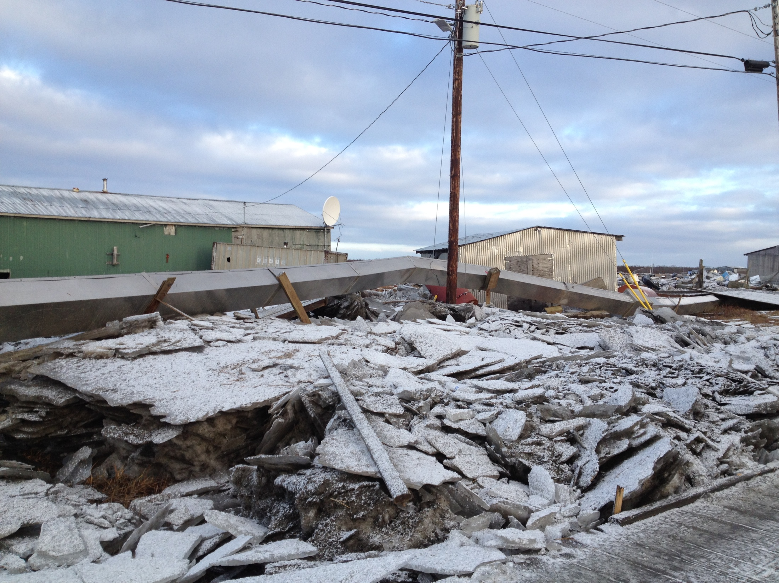
System Interruptions
Natural Disaster
Kotlik
Crooked Creek
System Breakdowns
Freeze ups
Equipment failure

Slide 12
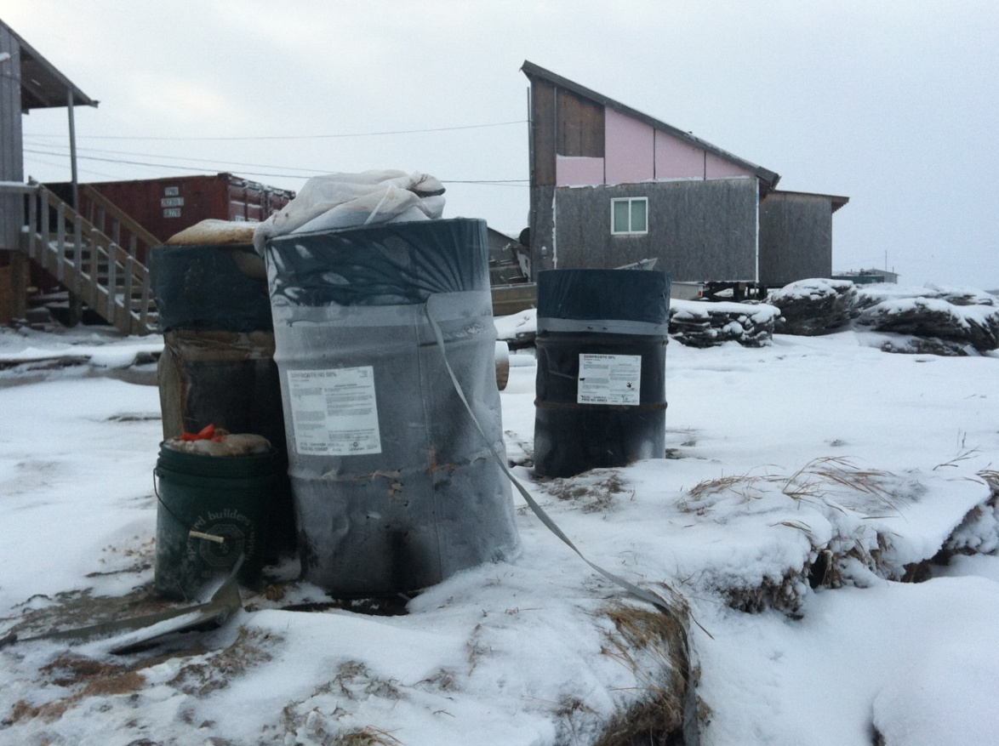
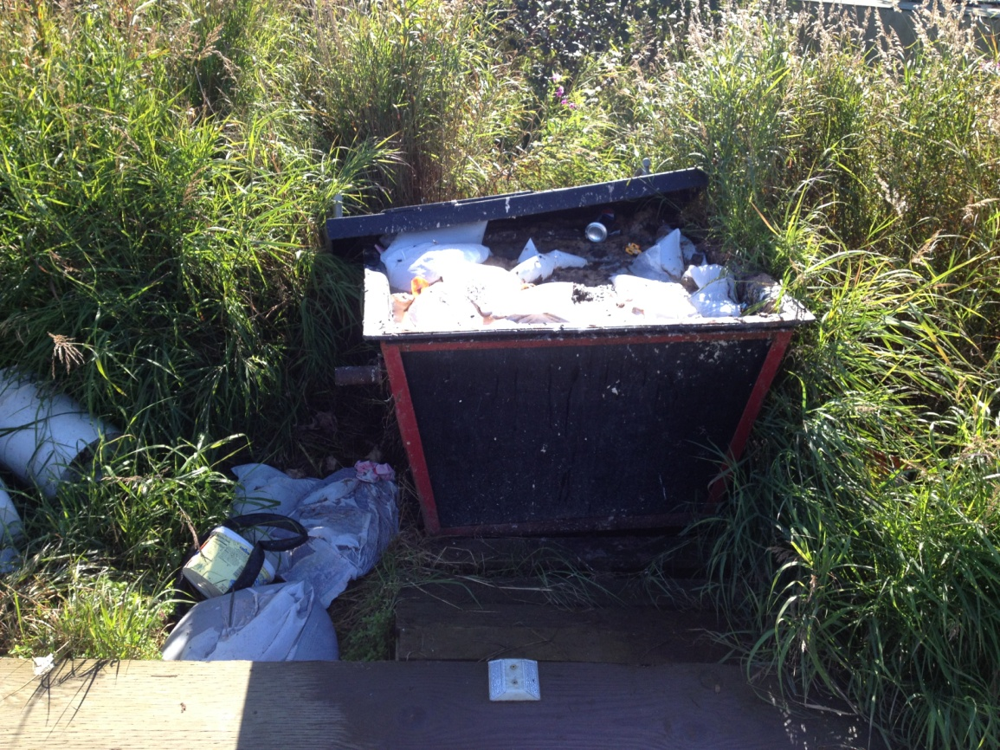
Honey Buckets
They are here to stay in some capacity.
We need to have a plan for when they are needed.

