Slide 1
5th Annual Water and Sanitation Workshop: Arctic Wastewater Treatment and Disposal: current status and research needs
GIFT BAGS ☺ (Door Prize)

Slide 2
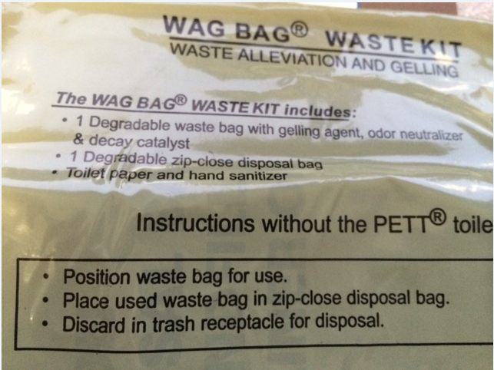
WAG BAG

Slide 3
HONEY BUCKETS
They are reality and will be for awhile

Slide 4
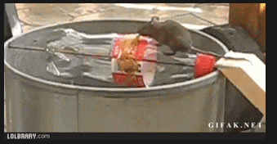
Is There A Better Mouse Trap?

Slide 5
Honey Buckets
They are reality and will be for a while
Is There A Better Mouse Trap?
=

Slide 6

What Are The Cost To Eliminate The
Honey Bucket Using The WAG BAG?

Slide 7
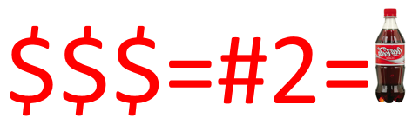
What Are The Cost To Eliminate The
Honey Bucket Using The WAG BAG?

Slide 8


Slide 9
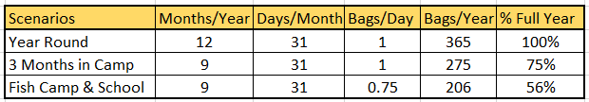
How Many Times Does That Equal?

Slide 10
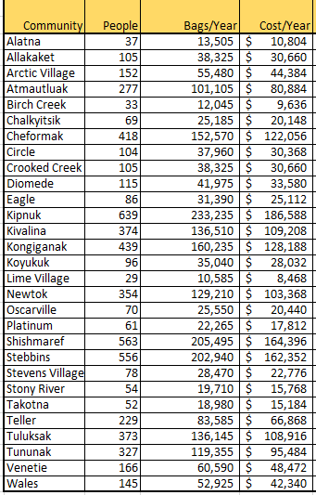
Annual WAG BAG Cost By Community

Slide 11
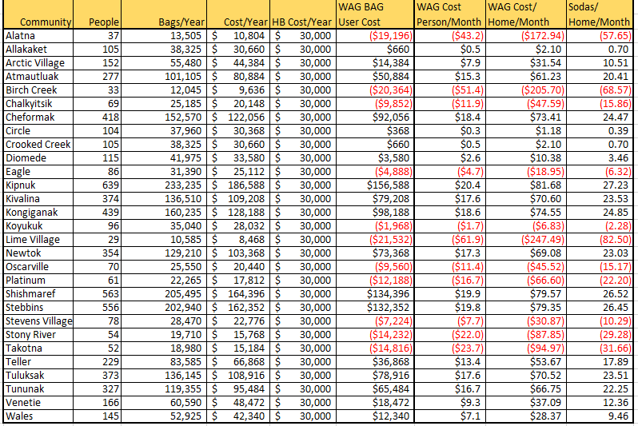
What About The Cost Of Running A
Honey Bucket System

Slide 12
What Are The Cost To Eliminate The
Honey Bucket Using The WAG BAG?

Slide 13
Cost Per Person Per Day
¼ 20 oz. Soda

Slide 14
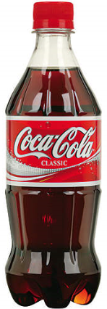
Cost Per House Per Day
Is That Reasonable To Eliminate The Honey Bucket For The Home Owner?

Slide 15

Economy Of Scale?
TCC – 470,000
YKHC – 1,117,000

Slide 16
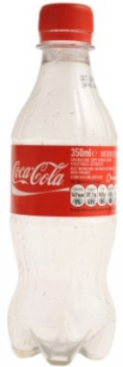
Cost of WAG BAGS For An Order Of
2,228,690?

Slide 17
Honey Buckets
They are here and will be for a while
Is There A Better Mouse Trap?
=

