Slide 1

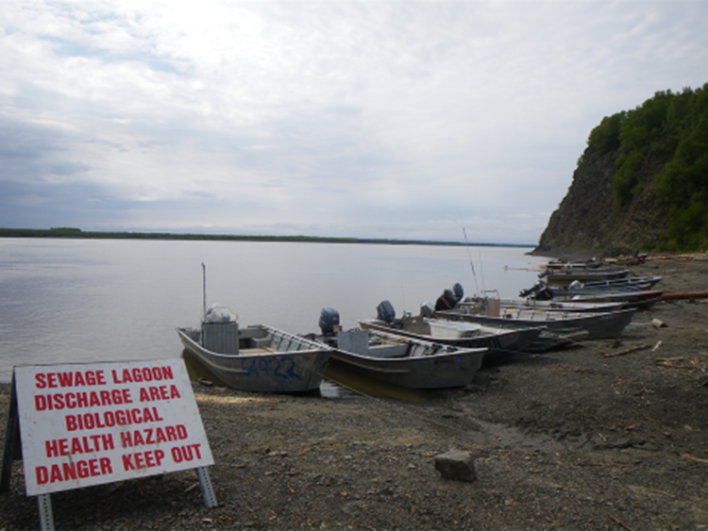
Microbial Contamination Studies Around Sewage Lagoons
Edda Mutter
Yukon River Inter-Tribal Watershed Council
emutter@yritwc.org

Slide 2
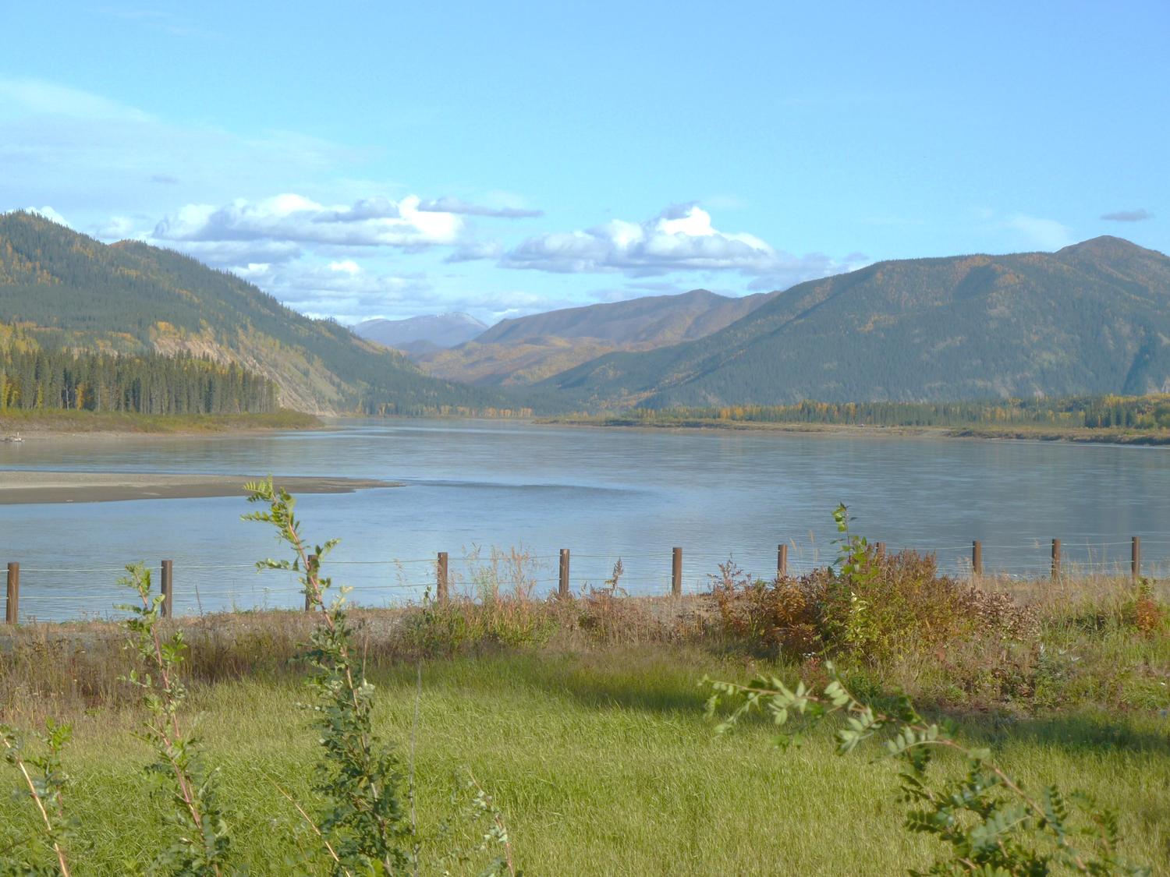
Assessment of Contaminant Concentrations and Transport Pathways in Rural Alaskan Wastewater Sites
Environmental Regulatory Enhancement:
Building capacity to regulate and monitor sewage discharge in the Yukon River Watershed

Slide 3
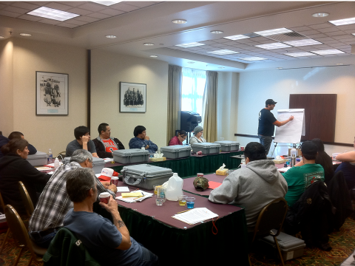

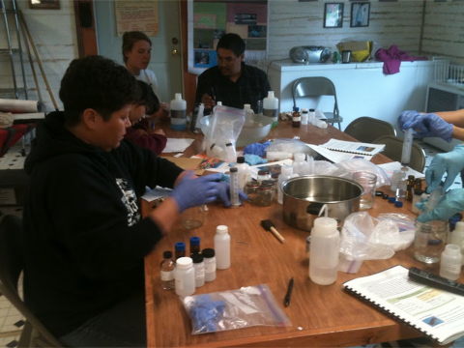
Yukon River Inter-Tribal Watershed Council
70 First Nations and Alaskan Tribes are members, with offices and technical staff in Anchorage, Fairbanks and Whitehorse.
The Council’s Mission is to protect and improve water quality in the Yukon River, to achieve a 50-year vision of a Yukon River clean enough from which to drink.

Slide 4
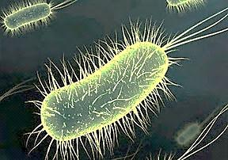
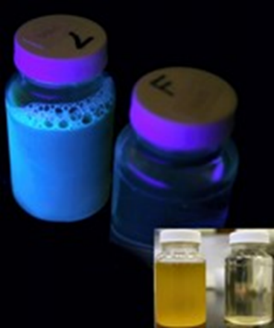
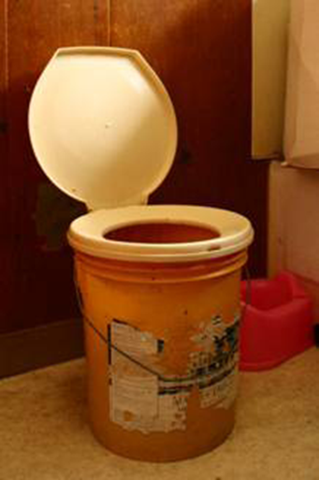
  Microbial Indicator Organisms
Used because it’s difficult, time-consuming, and expensive to test directly.
“Indicators” of other disease-causing (i.e., pathogenic) microbial organisms.
Detect possible sewage contamination
E. coli and Enterococci are the EPA recommended indicators for recreational waters

Slide 5
MIO survivability in manure before and after stored in -40 degree Celsius for six months.

Slide 6
Constructed Lysimeters ,2008

Slide 7
Pearson Correlation for Waters
MPN ENT pH Temperature Conductivity TSS
MPN EC 0.844 0.0548 0.007 0.004 0.505
3.5E-055 0.442 0.917 0.956 2.9E-014
199 199 199 199 199
MPN ENT 0.0564 0.0830 0.004 0.508
0.429 0.244 0.961 1.9E-014
199 199 199 199
pH 0.282 0.356 0.085
5.1E-06 2.5E-08 0.232
199 199 199
Temperature 0.260 0.214
2.1E-05 0.003
199 199
Conductivity 0.370
7.5E-09
199
*For pairs with P values greater than 0.050, there is no significant relationship between the two variables.

Slide 9
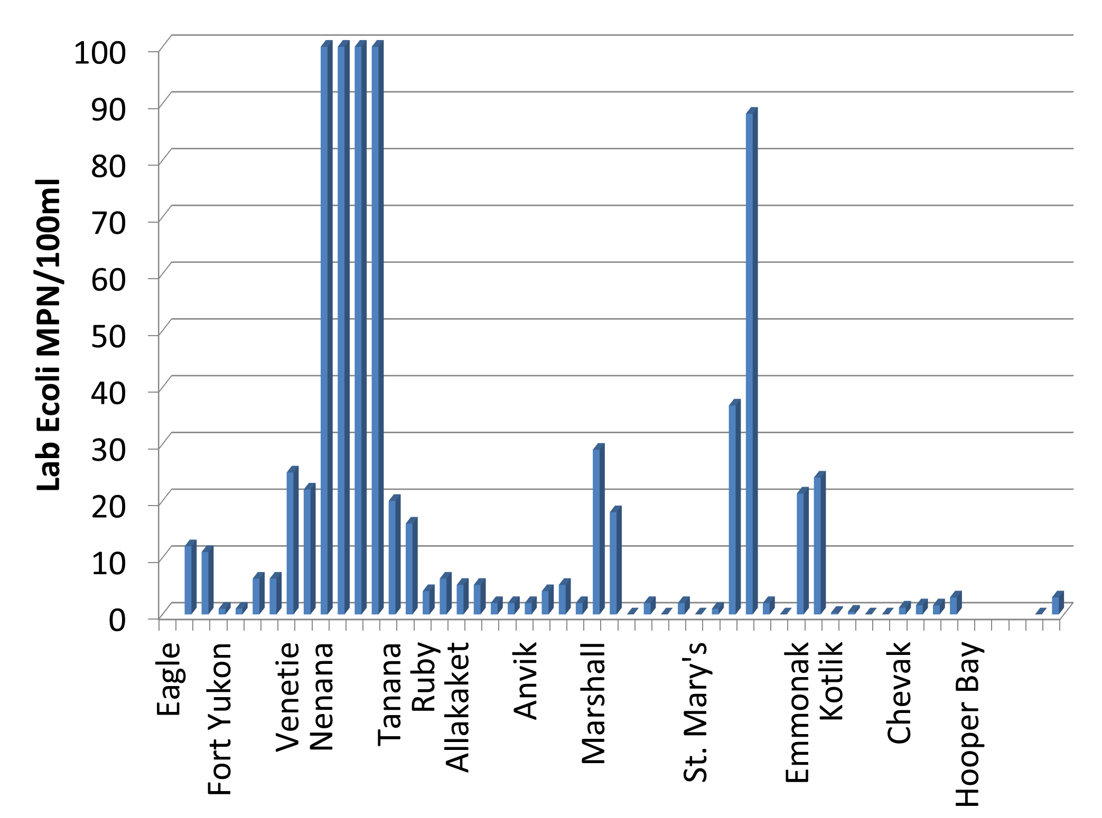
N= 120

Slide 11
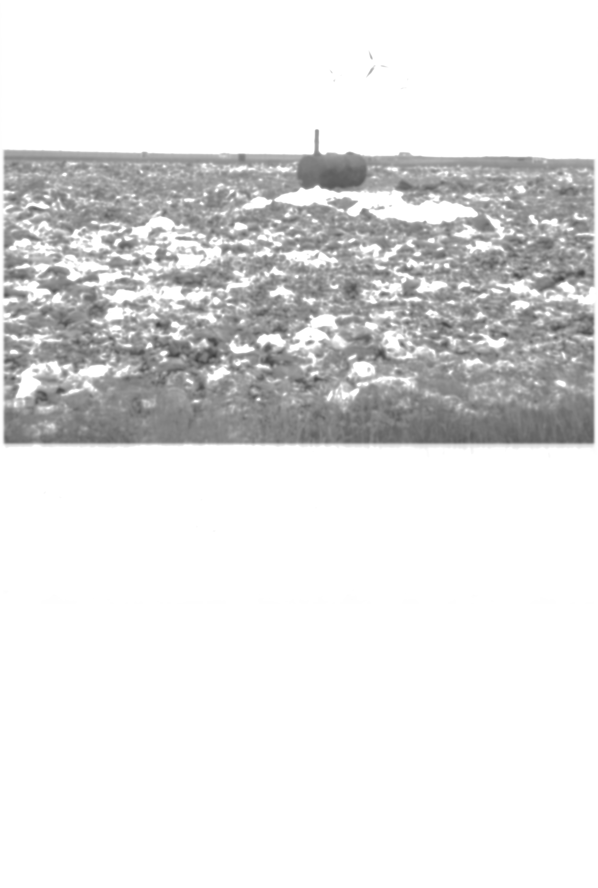
Conclusions
The microbial indicator organisms’ density were detected in the range of 1.1->3.4 Mean Log MPN/100mL.
  Although the 2011 Alaska Water Quality Standards sets limits upon Fecal Coliform bacteria rather than the indicator organisms tested, it is unlikely that these waters would meet the microbial water quality standard for any designated use.
The lysimeter partitioning behavior study results demonstrating that MIO in snowmelt tend to preferentially associate with particulates in surface flows
  The lysimeter study also showed that ENT survived cold storage in the field and laboratory in greater numbers than did EC bacteria, thus indicating that ENT may serve as a more robust indicator organism in Alaskan environmental conditions.
No significant microbial indicator organisms’ density were detected in Yukon River samples.
In rural Alaska leachate and raw sewage pharmaceuticals (sulfamethoxazole and trimethoprim (antibiotics), non-prescription drugs ibuprofen and Tylenol (acetaminophen), bupropion (antidepressant), caffeine and 1,7-dimethylxanthine.

Slide 12
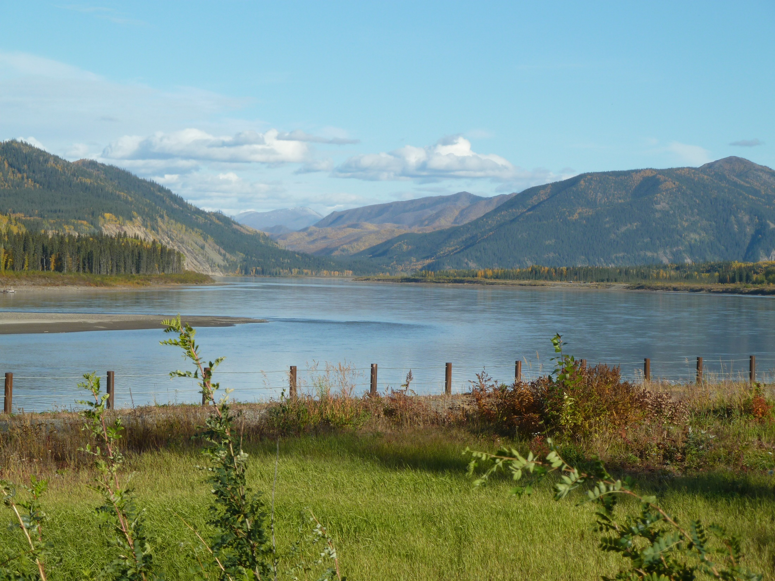



Thank You!
Acknowledgement
Funding Agencies: EPA RARE, NIWR USGS, Alaska EPSCoR, USDA, and ANA
Ryan Toohey and Leah Mackey, Carol Thomas (YRITWC), Drs. William Schnabel, Dave Barnes, Larry Duffy (UAF), Birgit Hagedorn, and Khrys Duddleston (UAA)

