Slide 1
Health Update
Alaska Rural Water and Sanitation Working Group, Jan 30, 2015
Tom Hennessy, MD, MPH
CDC Arctic Investigations Program
tbh0@cdc.gov

Slide 2
Progress with In-home
Water & Sanitation Services in Rural Alaska
Healthy Alaskans 2020 Indicator #19

Slide 3
What’s Ahead?
Update on related activities
Health improvements after new in-home service delivery
  4 village study
Outbreaks due to water in Alaska

Slide 4
Healthy Alaskans 2020
25 leading health indicators
  Critical health priorities for Alaska
Indicator #19
  “Increase the proportion of Alaskans with access to in-home water and wastewater services”
    % of rural community housing units with water and sewer services
    2010: 78%
    Target: 87%

Slide 5
HA 2020 Strategies
Establish sustainable water and sanitation services in communities where homes are unserved.
Promote research and development that will address the technologic challenges of providing adequate and affordable water and sanitation services.
Ensure homes with existing water and sanitation services continue to function.

Slide 6
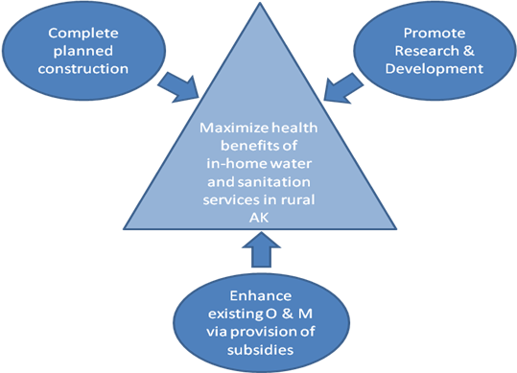

Slide 7
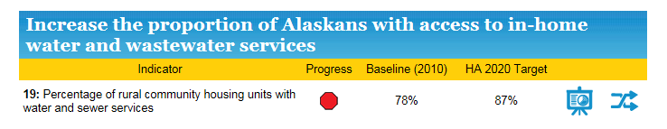
HA2020 Dashboard
http://hss.state.ak.us/ha2020/25LHI.htm

Slide 8
Arctic Council:
US Chairmanship, 2015 - 17
Water, Sanitation, and Human Health
  Current status in Arctic
    Water/sewer service
    Related health indicators
  Sustainable, innovative approaches to expand service
  Share best practices across Arctic
    Circumpolar Sanitation Conference, Aug 2016

Slide 9
Water-related Infections
Water-borne
  Pathogen ingested with water
    Cholera, other enteric infections
Water-washed
  Person-to-person transmission
  Lack of water for hygiene
    Skin infections, trachoma
Water-based
  Aquatic intermediate host
    Schistosomiasis, guinea worm
Water-related insect vector
  Insects breed or bite near water
    Malaria, dengue
* “Drawers of Water”; White, Bradley, White; U of Chicago Press, 1972
Notes:
When thinking about water and infectious diseases, we can divide the problem into several categories, as Bradley and White did in their 1972 publication. Most of use think first of water-borne infectious, where the pathogen is ingested in contaminated water. Cholera and many enteric bacterial infectious are acquired this way, although these diseases can be acquired also by ingesting the pathogen via hand contamination.
Water-washed diseases are those spread person to person, where lack of water leads to inadequate hand or body hygiene. In the original classification, Bradley listed skin infections and trachoma as water washed.
Water-based infections arise where water is the home for an intermediate parasitic host such as for schistosomiasis and guinea worm.
Bradley called water-related infections those where the insect vector breed or bite near water as is the case for mosquitos transmitting malaria or dengue.

Slide 10
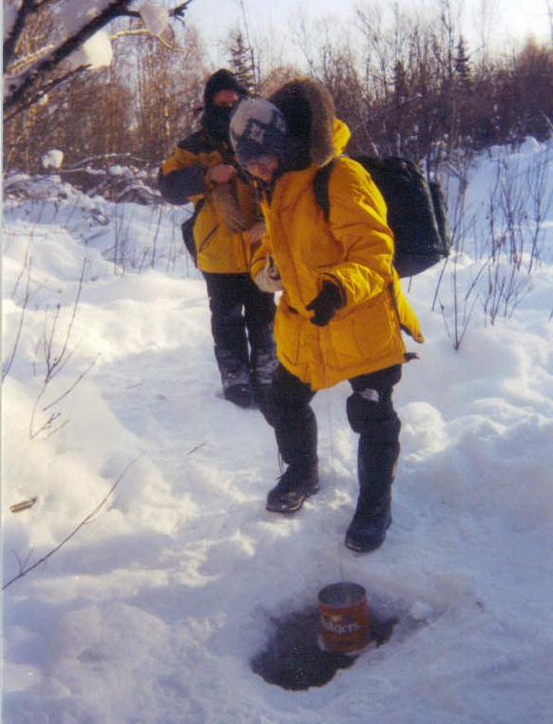
Hierarchy of Water Requirements
Drinking
Cooking
Personal washing
Washing clothing
Cleaning home

Slide 11
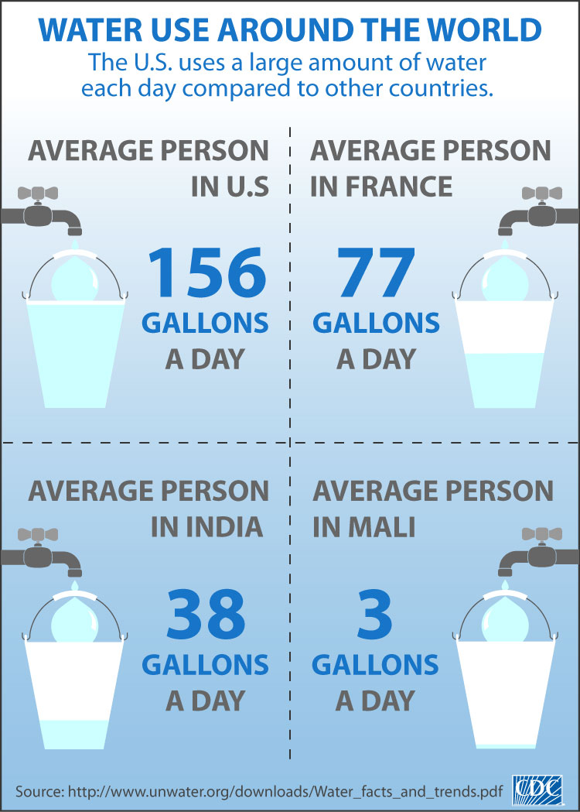
and Rural Alaska, USA

Slide 12
Hospitalization Rates for “High” and “Low” Water Service Regions, Alaska, 2000-2004
*
*
Rate per 10,000
*
*
Hennessy, AJPH, 2008
Notes:
When we matched hospitalization rate to water service this is what we found. Higher rates of hospitalzation for pneumonia and influenza, RSV in children, skin infections and MRSA. Interestingly, diarrhea hospitalizations were uncommon in all regions and did not differ according to water service.

Slide 13
Hospitalization Rates for “High” and “Low” Water Service Regions, Alaska, 2000-2004
*
*
Rate per 10,000
*
*
Water-wash infections
Water quantity
Water-borne infections
Water quality
* P < 0.05
CDC and ANTHC
Hennessy et al; AJPH Nov 2008
Notes:
When we matched hospitalization rate to water service this is what we found. Higher rates of hospitalization for pneumonia and influenza, RSV in children, skin infections and MRSA. Interestingly, diarrhea hospitalizations were uncommon in all regions and did not differ according to water service.

Slide 14
Serious infections with Streptococcus pneumoniae in children < 5 years old,
Southwest Alaska, 2001-2007
Water Service
Rate per 100,000
* J Wenger, 2010, Pediatric Infectious Diseases
Notes:
We conduct laboratory based surveillance for invasive Streptococcus pneumoniae infections throughout Alaska. The pneumococcus is a respiratory pathogen spread by coughing or sneezing and via contaminated hands. This slide, set up the same way as the previous ones, shows the greatly increased rates of invasive infections, such as blood stream and meningitis, among childre from villages that lack inhome running water.
Each of these health outcomes, lower respiratory infections, skin infections and invasive pneumooccal disease share a person to person mode of transmission that can be broken by having adequate amounts of water available for hand washing and body hygiene. We think lack of water availability explains these health disparities.

Slide 15
Infectious Diseases in Rural Alaska Communities:
Without In-home Water Service vs.
With Service
Water-washed diseases
  85% more pneumonia hospitalizations in infants^{1, 3}
  Skin infection hospitalizations 2X higher¹
  Serious bacterial infections in children 2X higher²
Water-borne diseases
  Diarrhea hospitalizations are similar and uncommon¹

Slide 16
Hospitalization rates for Alaska Native infants, according to percent of homes with water service
1999 - 2004*
Rate per 1,000 births
* Hennessy, AJPH, 2008
Notes:
So, this slide shows hospitalization rates for Alaska Native infants according to the % of homes with water service in their village. The height of the bars shows rates of hospitalization, per thousand infants, for three diagonoses: Lower respiratory tract infection (the first set of bars), xray confirmed pneumonia and lab confirmed Respiratory Syncytial Virus (RSV). The light blue bars represent rates for infants living in villages where less than 10% of homes have running water, the dark blue show rates for villages with 10 -79%, the purple for those villages> 80% served, the red shows rates for the region’s main town, where 100% of homes have running water. The brown and yellow bars show rates for all Alaska Native infants and for the overall US infant rate.
For each of these respiratory illnesses, rates of hospitalizations are highest in children coming from villages with the lowest level of water service and rates decrease with increasinng levels of water service.

Slide 17
Skin infection rates, all ages, by village water service,
Southwest Alaska, 1999 - 2000
Water Service
Rate per 1,000 persons
Notes:
This slide is set up the same way and shows data for skin infections due to lab confirmed Staph aureus, Methicillin Resistant Staph aureus and hospitalization for skin infections among persons of all ages from southwest Alaska. As we saw with respiratory infections, rates are highest in villagers lacking running water and decrease with increasing levels of water availability.

Slide 18
Number of Cavities in Primary Teeth by
Village Fluoridation Status
3x
*
*
1.5x
1.6
1.8
* p < 0.01
MMWR, Sept 2011
Notes:
Dental caries severity differs in region A by village water fluoridation status.
This graph displays the mean number of dental caries in primary teeth by age group and village fluoridation status.
The x-axis is the age group and the y-axis is the mean number of dental caries.
Non-fluoridated villages are in orange and fluoridated villages in blue.
Children 4 -5 and 6 -11 from non-fluoridated villages had 3 times and 1.5 times the number of dental caries in primary teeth than children from fluoridated villages, respectively.

Slide 19
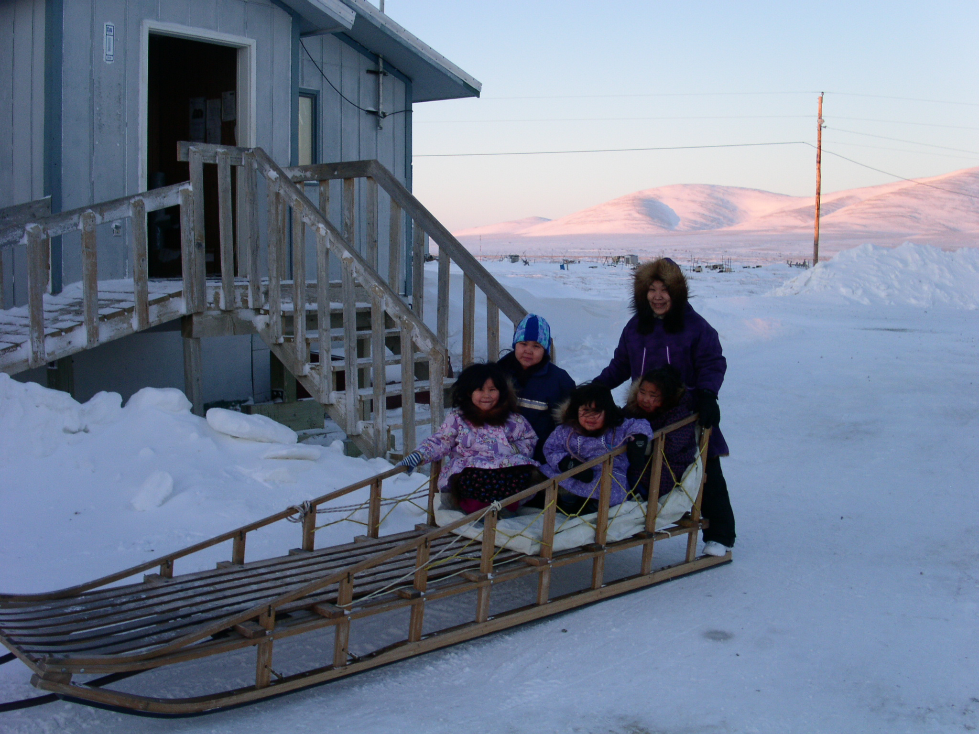

Slide 20

Impact of In-home Piped Water on Rates of Infectious Disease
- The Four Village Study
Timothy Thomas: ANTHC
Troy Ritter: ANTHC
Dana Bruden: CDC/AIP
Mike Bruce: CDC/AIP
Korie Hickel: ANTHC
Tom Hennessy: CDC/AIP
Alaska Native Tribal Health Consortium
Centers for Disease Control and Prevention/Arctic Investigations Program

Slide 21
Objectives
Health status before and after piped water installation
Water-borne
  Diarrhea
Water-washed
  Respiratory, skin infections

Slide 22
Methods
4 western Alaska villages
Piped water installation: 2007 - 2008
Prospective cohort study
  Household enrollment
Study approved by
  IRB: CDC, Alaska Area
  Alaska Native Tribal authorities and villages

Slide 23
Intervention and Timeline
Intervention
  Installation of pipes to homes
  Plumbing inside home
  Education/Promotion of water use
Study started in 2008
Last village received water in April 2010
No intentional control group
  Not all homes received piped water

Slide 24
Outcomes
Review of electronic medical record
  Village clinic and hospital visits
  ICD-9 codes for acute respiratory, skin and gastrointestinal infections
  3 years before any water installed
  3 years after completion of installation
Water use
  Pre-pipe survey of water use
  64% of homes had water meters

Slide 25
Analysis
Annual illness rates for each community
  3 years before and after pipes installed
  Rates presented by village and age class
Excluded visits with same ICD-9 code within 14 days
Age-adjusted rates for post-installation period
GEE used to account for repeated observations on same individual

Slide 26
Results

Slide 27
Study participants, by village
 | Villages
Population | A* | B | C | D | All Homes With Water | Total
2010 Census | 627 | 346 | 243 | 187 | 1087 | 1403
Participants Enrolled (%) | 405 (65%) | 296 (86%) | 152 (63%) | 179 (96%) | 835 (77%) | 1010 (72%)
Households Enrolled (%) | 102 (68%) | 71 (79%) | 53 (70%) | 39 (91%) | 217* (70%) | 265 (74%)
* 48 homes in Village A never received water

Slide 28
Community Demographics
Community | A | B | C | D | USA
Population | 627 | 346 | 243 | 187 | 308M
% Alaska Native/ American Indian | 96 | 95 | 95 | 93 | 1.2
% < 5 years old | 10 | 10 | 14 | 12 | 6.3
No. of Households | 150 | 90 | 76 | 43
Mean persons per Household | 4.2 | 3.8 | 3.2 | 4.4 | 2.6
% below federal poverty level | 24 | 28 | 44 | 15 | 14.9
US 2010 census

Slide 29

Mean household water use pre- and post-installation
1 gallon = 3.8 litres
10 gallons = 38 litres
20 gallons = 76 litres
Mean water
use
27.5 g
n=54
n=71
n=53
n=39
n=217
1.5 g

Slide 30
W.H.O.
Water availability and health
Health concern | Quantity available Litres / Person / Day (US gallons)
Very high | <5 (1)
High | 20 (5)
Low | 50 (13)
Very low | 100 or more (26)

Slide 31
Illness Episodes (ppy) in Homes That Received Water
 |  | Villages (Enrolled Population)
Infection type | Period |  |  | B (296) | C (152) | D (179)
Respiratory | Pre |  |  | 1.81 | 0.93 | 1.49
 | Post |  |  | 1.73 | 0.82 | 0.92
 | p-value |  |  | 0.03 | 0.03 | <0.0001
Skin | Pre |  |  | 0.27 | 0.31 | 0.22
 | Post |  |  | 0.17 | 0.12 | 0.16
 | p-value |  |  | 0.0001 | <0.0001 | 0.049
Gastro-intestinal | Pre |  |  | 0.06 | 0.03 | 0.03
 | Post |  |  | 0.02 | 0.02 | 0.04
 | P-value |  |  | 0.0003 | 0.57 | 0.30

Slide 32
Annual Clinic and Hospital Visit Rates, All Homes Installed with Piped Water
16%
*
Rate per 1,000
20%
38%
*
*
* P < 0.05
Notes:
When we matched hospitalization rate to water service this is what we found. Higher rates of hospitalization for pneumonia and influenza, RSV in children, skin infections and MRSA. Interestingly, diarrhea hospitalizations were uncommon in all regions and did not differ according to water service.

Slide 33
Illness episodes (ppy),Village A
 |  | Villages
Infection type | Period | A (water) | A (no water) | B | C | D
N (Pre) |  | 219 | 161
Respiratory | Pre | 1.68 | 1.88
 | Post | 1.46 | 1.76
 | P-value | 0.06 | 0.08
Skin | Pre | 0.44 | 0.44
 | Post | 0.51 | 0.36
 | P-value | 0.18 | 0.06
Gastro-intestinal | Pre | 0.06 | 0.06
 | Post | 0.04 | 0.06
 | P-value | 0.2 | 0.8

Slide 34
Summary
After Piped Sanitation Service Installed:
Water use in homes increased
  Moved from very high to low level concern
Illness rates significantly decreased
  Respiratory, skin and gastrointestinal visits
No difference in Village A
  Suggests a threshold of proportion of homes served to achieve health benefit

Slide 35
Limitations
Did not observe changes in behavior
  Post-installation surveys indicated increased bathing and handwashing
Declines in rates may be due to other factors:
  Increased immunization
  Seasonal variation
  Other factors
However, Village A serves as a comparison

Slide 36
Conclusions
Findings reinforce earlier Alaska studies
Adequate quantity of water for bathing and handwashing results in a decrease in respiratory, skin and gastrointestinal infections
Having running water is good for health

Slide 37
Recommendations: Total Water Use
Organization | Recommendation Litres / Person / Day (US gallons) | Storage Volume Litres / household of 5 (US gallons)
*Sphere: disaster response minimum | 15 (4) | 75 (20)
**CRUM: minimum piped | 60 (16) | 300 (79)
CRUM: standard for truck-haul system | 90 (24) | 450 (119)
WHO: very high health concern | <5 (1) | 25 (7)
WHO: high health concern | 20 (5) | 100 (26)
WHO: low level of health concern | 50 (13) | 250 (66)
WHO: very low level of health concern | 100 or more (26) | 500 (132)
*Sphere: NGO handbook for disaster response
**Cold Regions Utility Monograph, 1996

Slide 38
Illness episodes per person per year for each village by age class
Age class | Period | A (no water) |  |  | All homes served Villages B, C, D only
 |  | Resp | Skin | GI | Resp | Skin | GI
< 10 years | Pre | 3.42 | 0.63 | 0.14 | 2.85 | 0.43 | 0.14
 | Post | 2.88 | 0.35 | 0.07 | 2.13 | 0.37 | 0.013
 | P | 0.06 | 0.02 | 0.14 | 0.007 | 0.04 | 0.006
10-19 years | Pre | 1.70 | 0.46 | 0.00 | 1.34 | 0.24 | 0.01
 | Post | 1.55 | 0.22 | 0.05 | 1.16 | 0.12 | 0.003
 | P | 0.86 | 0.01 | 0.66 | 0.002 | 0.005 | 0.16
20-35 years | Pre | 1.22 | 0.30 | 0.03 | 0.89 | 0.20 | 0.02
 | Post | 1.13 | 0.27 | 0.06 | 0.77 | 0.10 | 0.02
 | P | 0.78 | 0.79 | 0.47 | 0.07 | 0.002 | 0.99
35-50 years | Pre | 0.97 | 0.38 | 0.02 | 0.99 | 0.26 | 0.01
 | Post | 1.03 | 0.40 | 0.02 | 0.76 | 0.13 | 0.02
 | P | 0.95 | 0.87 | 0.84 | 0.35 | 0.0007 | 0.58

Slide 39
Illness episodes ppy
All homes with Water, Villages A-D
 |  | Villages A-D
Infection type | Period | All Homes With Water
N (Pre) |  | 821
Respiratory | Pre | 1.55
 | Post | 1.35
 | P | P <0.0001
Skin | Pre | 0.31
 | Post | 0.25
 | P | P= 0.003
Gastro-intestinal | Pre | 0.05
 | Post | 0.03
 | P | P = 0.005

Slide 40
Examples of Waterborne Infectious Pathogens
Bacteria
  Salmonella*, Shigella*, Cholera*
Virus
  Enteroviruses (polio)*
  Hepatitis A*
Protozoans
  Giardia*, Cryptosporidia*
Parasites
  Guinea worm, schistosomes
* also transmitted by other routes

Slide 41
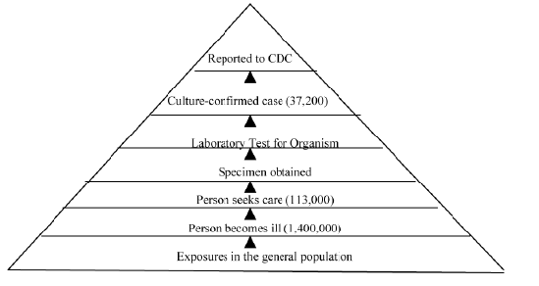
“Pyramid” of Diarrheal Disease
Each reported case may represent hundreds of persons ill in the community
Notes:
8% with diarrhea sought medical care. 19% provided a stool specimen. Salmonella 200:1

Slide 42
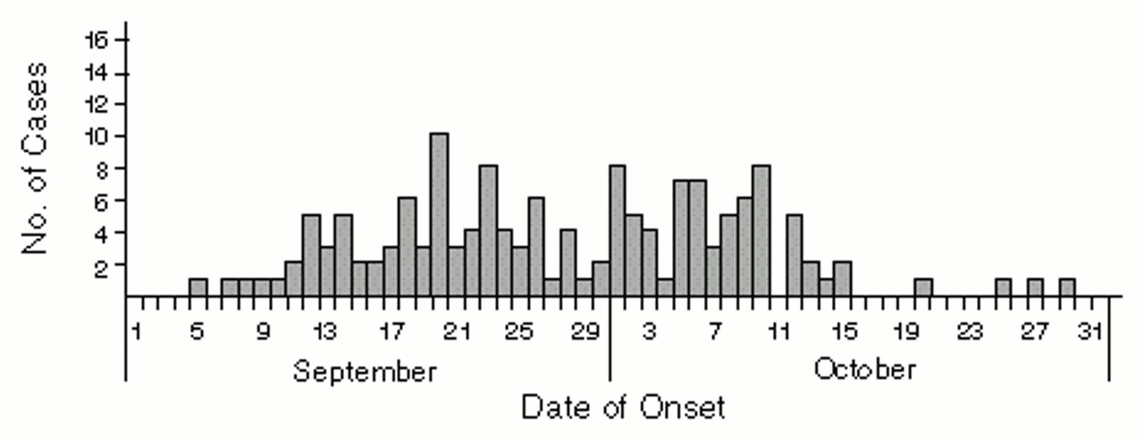
Salmonella due to Contaminated Schwan’s Ice Cream, 1994
593 culture-confirmed cases
Attack rate of 6.6%
Estimated 224,000 cases in US

Slide 43
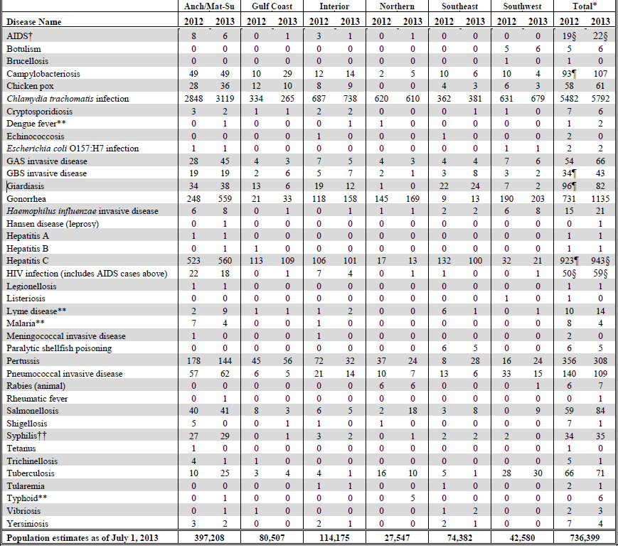
Notes:
290 reported case of gastroenteritis in 2013

Slide 44
Reported gastro-intestinal diseases
Under reported to public health
Outbreaks difficult to detect
  Low attack rates, small populations
  Patient care-seeking behavior
  Difficulty in getting diagnosis
“Sporadic” illness
  Not in an obvious cluster or event
  Very difficult to assign a cause

Slide 45
Waterborne Disease Outbreaks in Alaska
Are there documented infectious disease illnesses that are a result of untreated sewage contaminating drinking water?

Slide 46
Methods, 1
PubMed Search (National Library Medicine)
  1940 - today
  Search Criteria: Inclusive set
      Outbreak, Alaska
      Outbreak, Arctic Region
      Gastroenteritis, diarrhea
      Water/adverse effects
      Sewage
  Reviewed articles for relevance
    Confirmed waterborne outbreaks

Slide 47
Methods, 2
Morbidity Mortality Weekly Reports
  Waterborne disease outbreaks, 1990 – present
CDC waterborne disease section
  Reported waterborne outbreaks
    1970 – 2009
Google scholar
  Outbreak, Alaska, infection: 15,900 hits!
State of Alaska Epidemiology Bulletins
  Topical search “gastrointestinal illness”

Slide 48
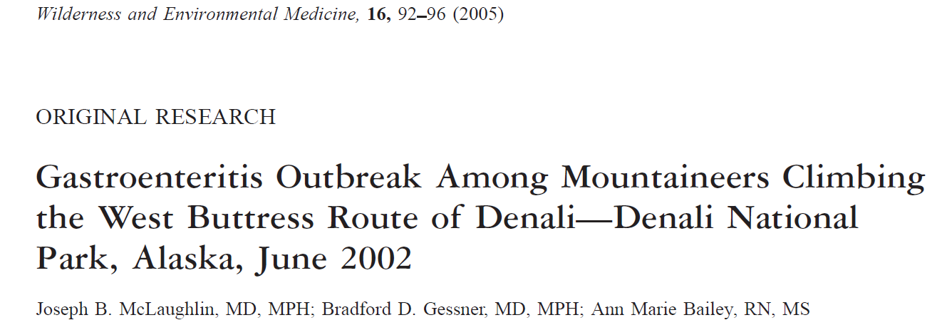

Slide 49
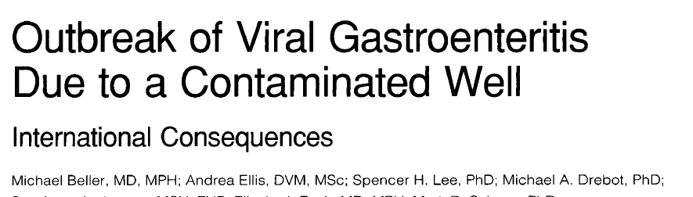

Slide 50
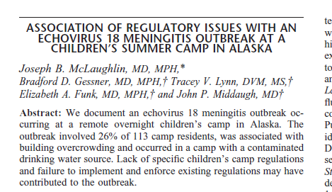

Slide 51
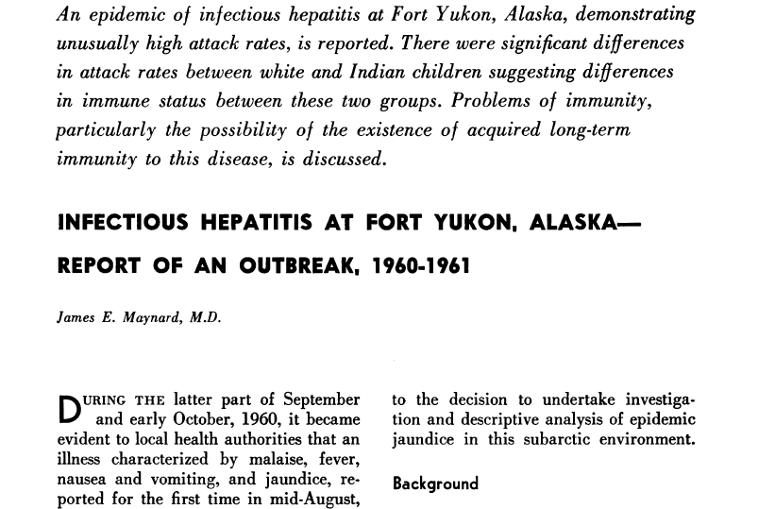

Slide 52
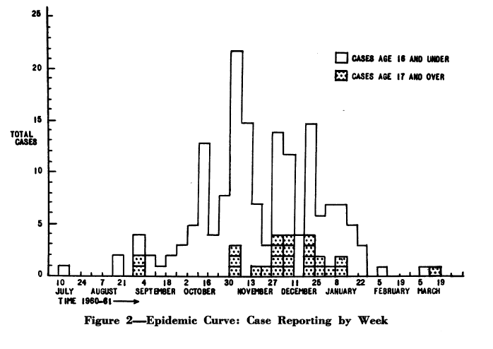
Hep A, Ft Yukon, 1960 -61
July 1960 – March 1961
  608 cases of hepatitis A, 28% of village
  Person-to-person spread
    Pattern of epidemic

Slide 53
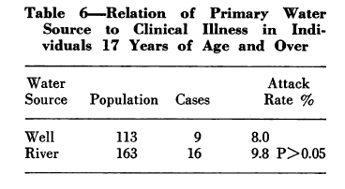
Hep A, Ft Yukon, 1960 -61
July 1960 – March 1961
  Water testing negative for coliforms, Fluorescein test
  Rates similar among river water and well water users

Slide 54
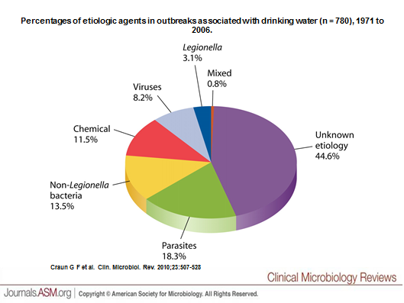
Waterborne Illness Outbreaks, Reported to CDC, 1971 - 2006

Slide 56
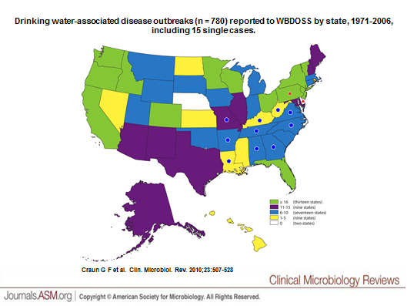

Slide 57
Waterborne Illness Outbreaks in Alaska, Reported to CDC
1971 - 2009, drinking water sources
15 events
  6 bacteria
  2 chemical: copper, fluoride
  5 Giardia
  2 unidentified cause
6 community sources
  3 mobile home parks, 1 boat, 3 municipal

Slide 58
Waterborne Illness Outbreaks in Alaska, Reported to CDC, 2
Infectious, community sources (6)
    Anchorage, 1971, Shigella, 89 cases
      Untreated ground water
    Old Harbor, 1973, Shigella, 50 cases
      Treatment deficiency
    Juneau, 1974, Salmonella, 34 cases
      Treatment deficiency
    ?Community, 1976, Shigella, 25 cases
      Untreated surface water
    Barge Unisea, 1980, Giardia, 189 cases
      Plumbing system deficiency
    Ketchikan, 1984, Giardia, 177 cases
      Treatment deficiency

Slide 59
Ketchikan 1984
Aug through Nov
  Giardiasis
  177 cases
      Most from Carlanna Lake area
  City water was common source
      Carlanna Lake pretreatment water
        giardia +
      Construction was ongoing during this time

Slide 60
Summary
Waterborne infectious diseases in Alaska
  Reportable, but uncommon
Waterborne Outbreaks
  Uncommon, 1 every other year
  No recent municipal outbreaks
    Last in 1984
  None attributed to sewage lagoons
Risk appears low

Slide 61
Limitations
Untapped sources
  14000 google hits still to review
  DEC files?
Infectious diarrhea is under-reported
  Outbreaks are under-recognized
“Sporadic” cases nearly impossible to explain

