Slide 1
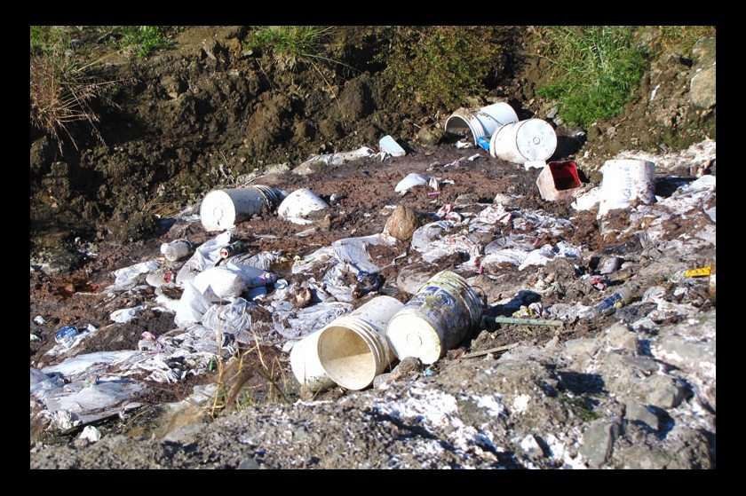
Honeybuckets: A Long Way From the Museum
Brian Berube
YKHC Office of Environmental Health

Slide 2
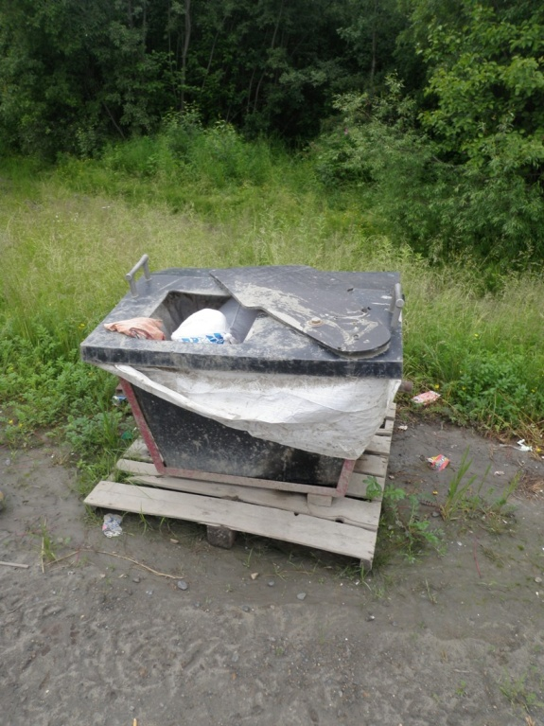
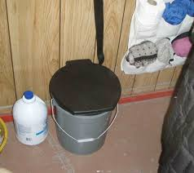
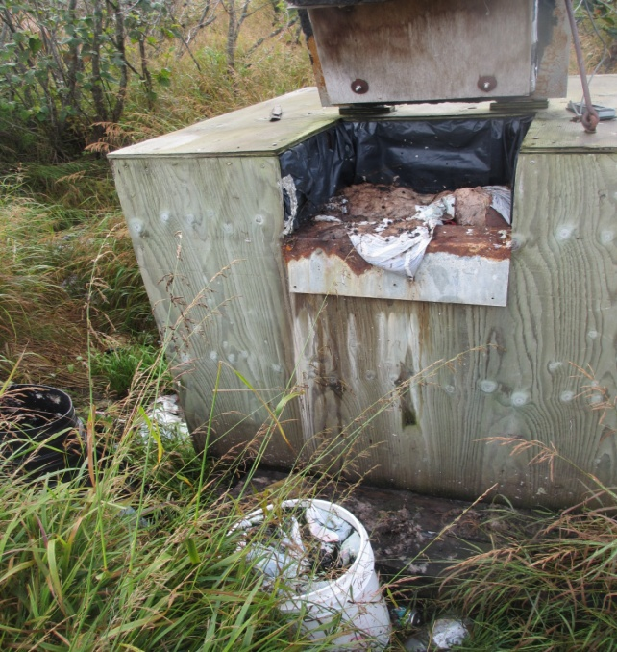
In 1995 we promised to “put the honey bucket in the museum.”
State of Alaska - 22% of occupied homes in rural Alaska lack indoor plumbing.
Different reality in the YK Delta.
Notes:
By we I don’t just mean Tony Knowles or the State, but the entire public health profession in AK.
Alaska ranks last amongst the States for complete plumbing. IN 2012, 99.6 percent of homes in the USA had indoor plumbing. 78% in rural Ak.

Slide 3
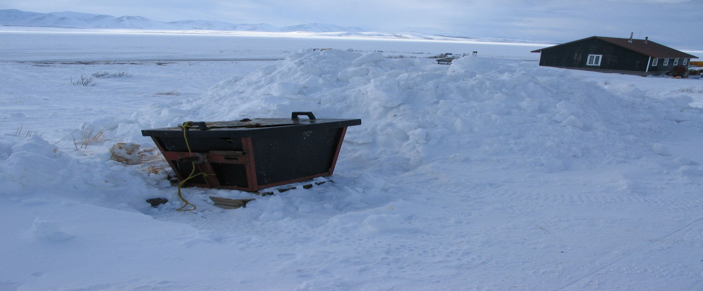
2014 YKHC OEHE Service Count
4,910 total homes, 48 villages
In March of 2014, 2,249 were not receiving water/sewer service – 45%
Notes:
Every year, in March, the EHOs contact all of the water/sewer utilities in the YK Delta to get a snapshot count of how many people are receiving service.
45% in 2013, 45 % in 2012, 46% in 2011 – These are the normal conditions.

Slide 4
Homes Without Service
March 2014
Notes:
29% of homes in the YK Delta that don’t have water/sewer service have system installed.

Slide 5
Homes With Service
Notes:
Reasons for failure – Maintenance, Freezing problems are common during winter, in home freeze-ups, non-payment (obviously there is nothing we can do about non-payment but this is a continual undeniable issue)
Napaskiak – Co-Water systems were installed in 2007. No maintenance plan was ever established. In 2014, most of the systems have problems, a large portion of the community are not using them at all. We went in a surveyed all the homes. Issues range from breakages due to freezing, pump issues, instillation and toilet problems. There are no supplies in the village and nobody trained to work on the systems. The toilets are obsolete and parts cannot be ordered. There is no working HB equipment in the village. Most people that didn’t have plumbing were dumping around the village. Health Aides have shared that homes without sewage disposal are seen more frequently for skin infections and Gastrointestinal illness.
Mountain Village- Every year in the winter months the aquifer that supplies the MV wells dries up. With no water pumps consistently burn out leading to freeze ups and breaks throughout the system. These occur in mainlines and on home service lines. MV does not have the resources to fix the piped system plagued with problems. WPOs spend most of their time trying to locate and fix leaks and freeze ups. When the aquifer runs dry they pump directly out of the silt heavy yukon river, creating clogs and additional freeze-ups/breaks. This has created a situation where they don’t have time for daily plant operations, compounding the problem.
Still a small portion of the total # of homes. The 1,600 that never had service are in need of new honey buckets as well.

Slide 6
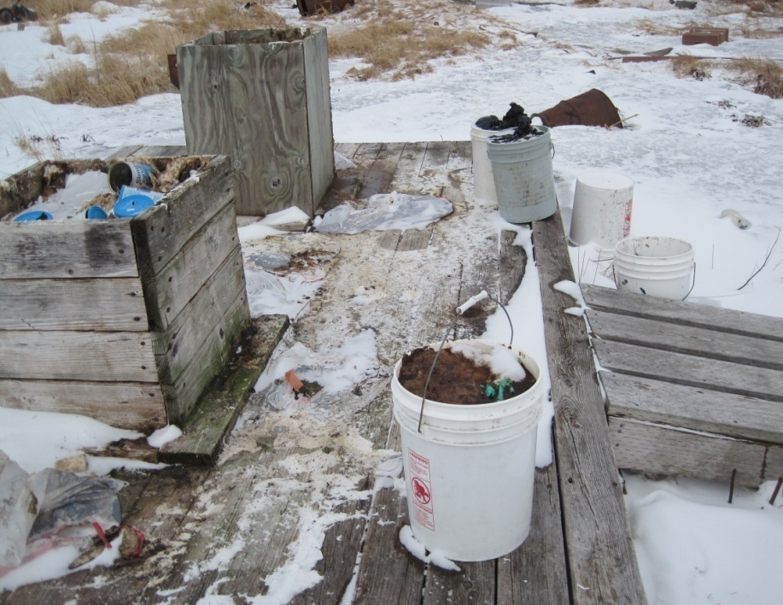
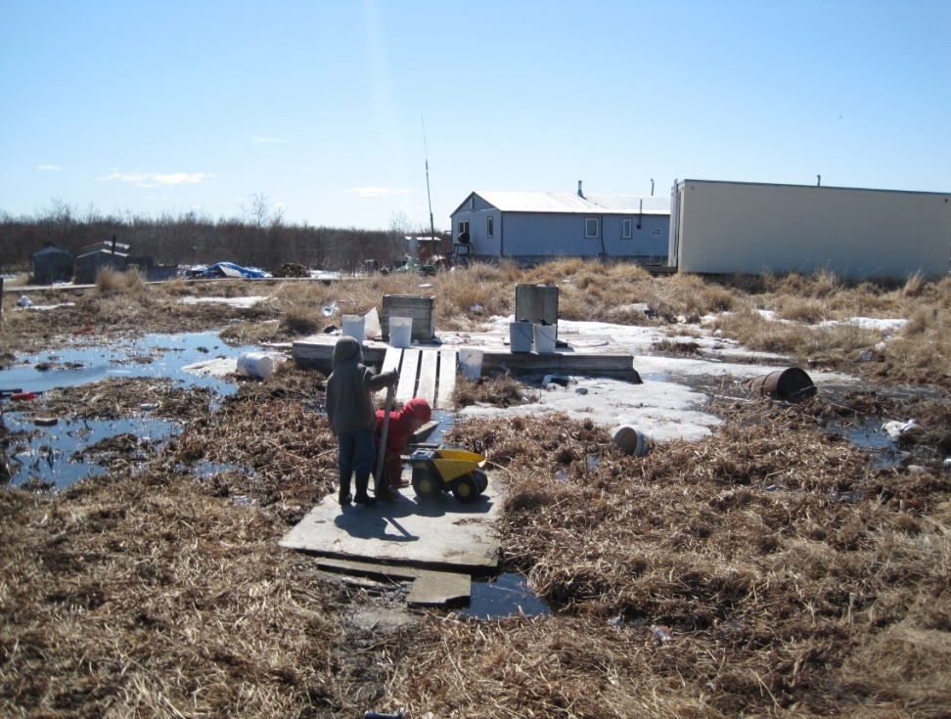
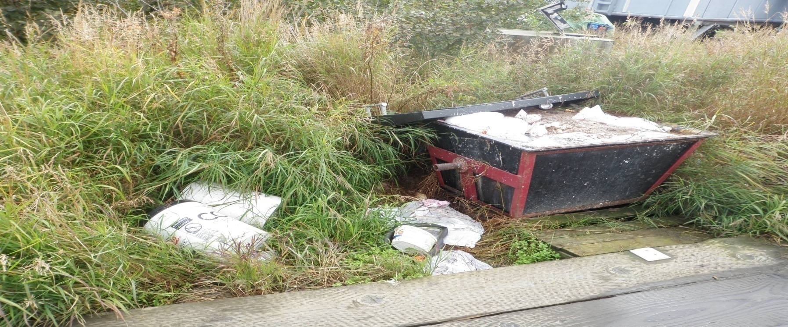
Notes:
Public dumping has become and inevitable outcome of this lack of available honeybucket deposit points. In many cases, these people are elderly or do not have a means of transportation to haul their sewage to lagoons situated outside most communities. We all know this lends itself to an increase of infectious disease transmission and can lower the collective emotional wellbeing of a community. It is important to remember that in these small communities most of the dumping is happening on public so these sights are constantly in view.
Top pictures, old bunker site that should be closed off. Right in the middle of town, with no options people continue to use them and dump around the area. In spring thaw this area fills with water. Notice all the bagged waste. This is an issue in Lagoons. Most of the lagoons in our area littered with bagged waste. It is the suggested means of using a honeybucket, think, it happened one summer dvd. Design of lagoons need to account for this.
Bottom – I assure you this hopper is sitting in the same place full today. The site around this hopper became a dumpsite for 4 homes around it.

Slide 8
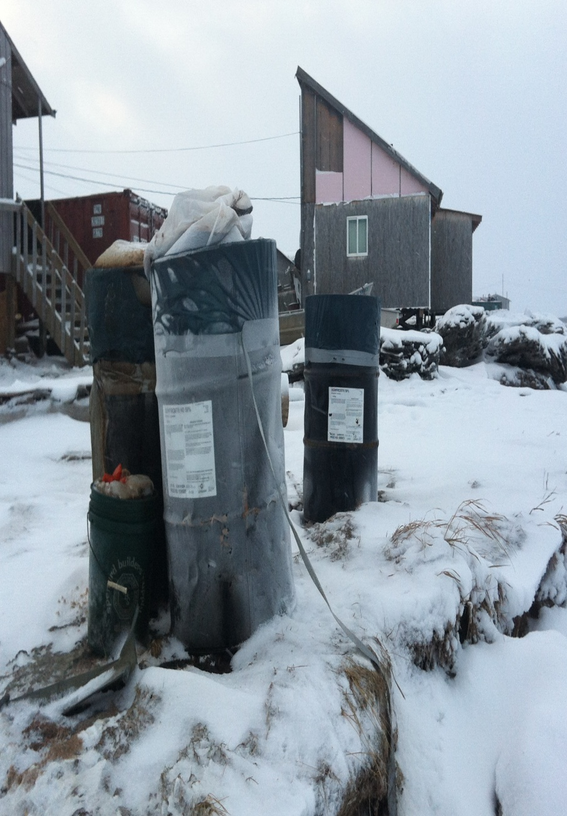
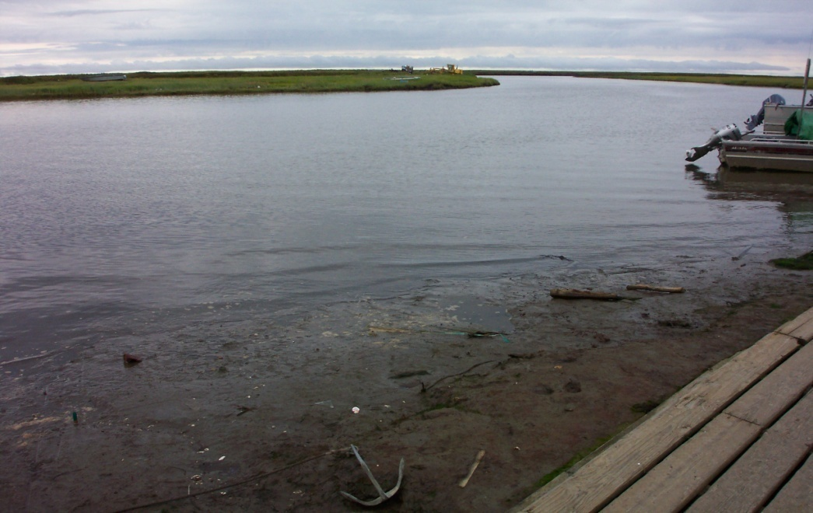
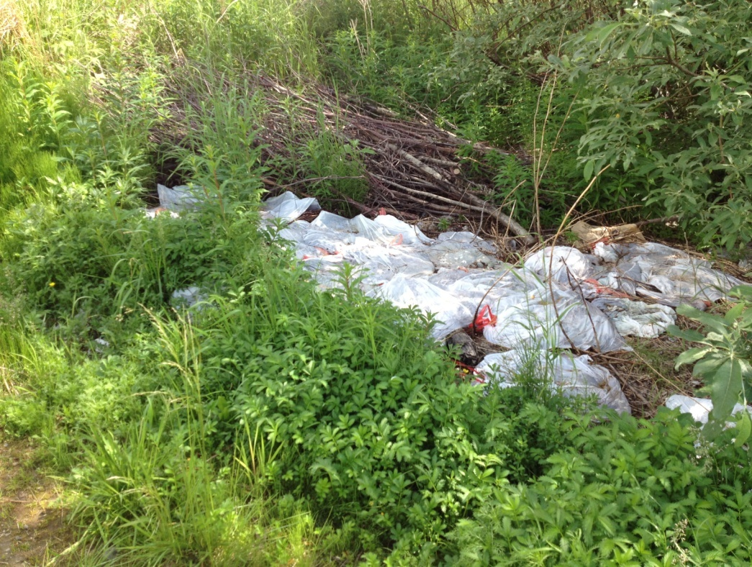
Notes:
Slough in a coastal community. People dump in and sewage goes out into the river @ high tide. Full of waste/debris at low tide.
Someone's dump area immediately outside of a village center.
People using old oil drums. In this community full ones are hauled to the lagoon and dumped the next spring. Many homes have several full ones. They are also hauled on a sled. There is a lot of spilling in this process.

Slide 9
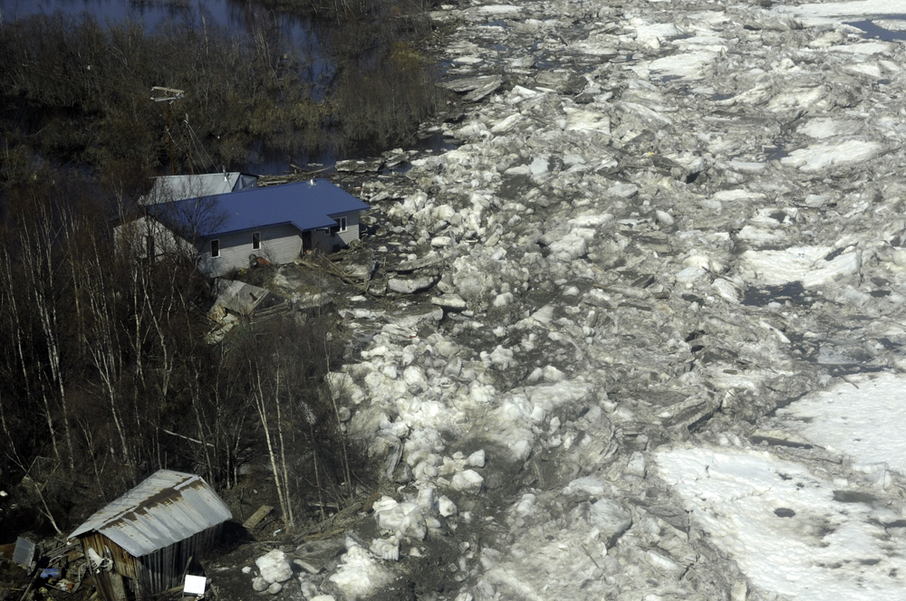
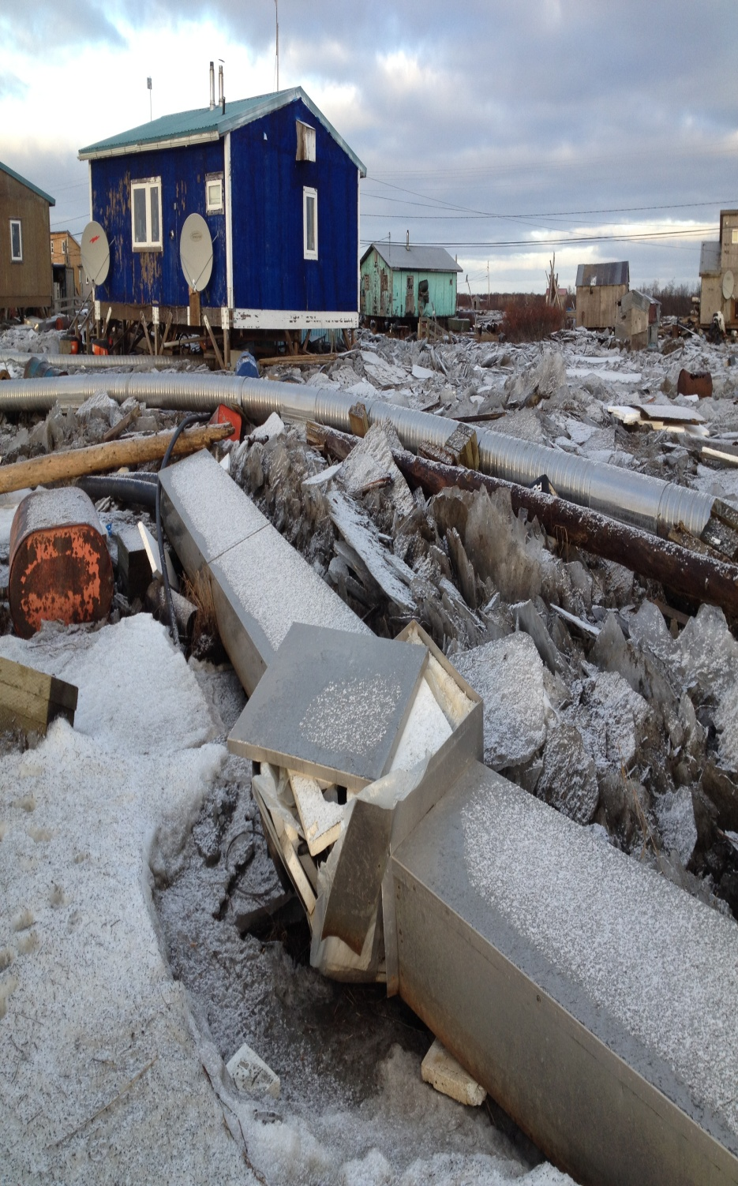
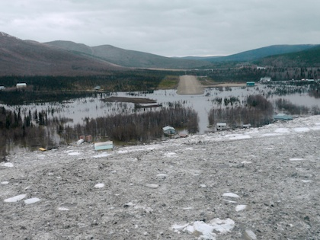
Notes:
Nearly every spring thaw and fall during costal storms that require short term sewage disposal solutions. With more water in the ocean and warmer fall and winter temps we are seeing frequent storm surges along the coast and flooding on the river systems.
- 2009 Crooked Creek – All of the outhouses on the shore were wiped out by the flood. After the waters receded people were sharing the few remaining outhouses, using honeybuckets and dumping in the river, in other outhouses or self-hauling to the lagoon. After the river cleared OEHE went to Chuathbaluk by boat and brought several old hoppers to Crooked.
The community asked for emergency hoppers from ANTHC. They arrived onsite 2 years later and remain on the runway. An illistration of how long it takes to get these out to the village.
- 2013 Kotlik, Emmo, Alakanuk, Tununak, Newtok – A fall storm surge wiped out loop three in Kotlik. This loop served the majority of homes in the village. Despite work on the system in the summer of 2014, much of the loop is still not fixed. There are only a handful of hoppers available. Most people are using metal 55 gallon drums. Obviously, these are very difficult to dump. They are moved by a snowmachine sled and don’t have lids. Very prone to spilling. Many people have several full ones outside of their home which they dump when the weather warms up.

Slide 10
A Long Ways From the Museum
Honeybuckets are not “going to the museum” any time soon.
Disparity between available funding and estimated need to address critical health need is $667.2 million dollars and growing.
Far less money coming into the system.
Projects are exceedingly expensive.
Notes:
In 2004 there was $97 million available for water sewer development, only $34 million in 2013.
The projects that have been completed were easier ones, engineering wise. The village that currently have no infrastructure are those that will be the most difficult to serve.
Project costs are increasing as funding sharply decreases. For example, there is already $45 million invested in piping Kwethluk; the project should finish this summer. $65 million dollars just to start the Hooper Bay project (build plant, piped very small portion of homes”
On this path no one in this room can tell me or the people that we are meant to serve that we are on the path to “kicking the honeybucket”. They will continue to be a reality of daily lives in rural Alaska for any foreseeable future.

Slide 11
Equipment Costs
Arctic Insulation
Bob’s Services
Haul trailer
        $7,100
Honeybucket hopper
$1,925
Hopper cover
$750
Hopper frame
$1,250
TOTAL $3,925
Haul trailer
        $6,886
Honeybucket hopper
$2,145
Hopper cover
$791
Hopper frame
$362
TOTAL $3,298
Notes:
No fabrication shop has molds for the containers. Because of this they all have to be pieced/welded together.
Just for the hopper, before shipping you are looking at least $3,250.
Not a single community, housing two of the poorest census areas in the USA, in the Delta can afford this.

Slide 12
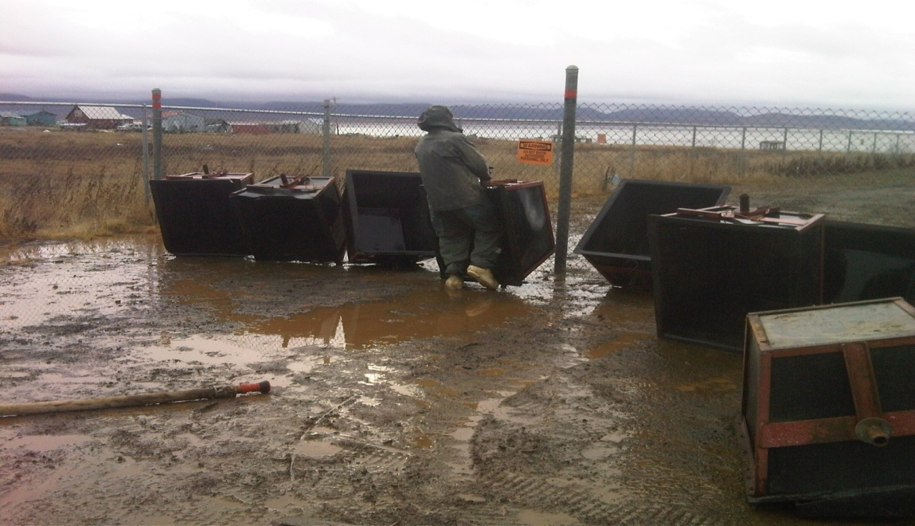
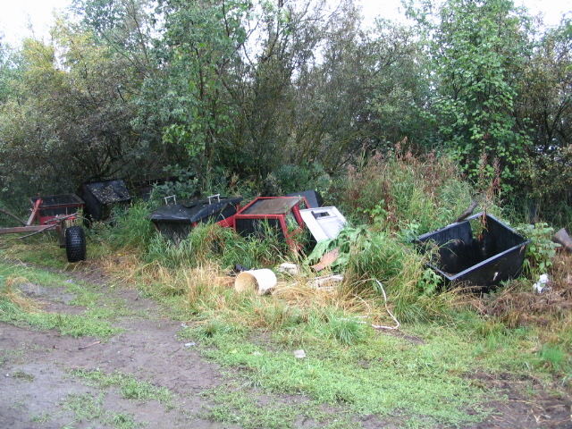
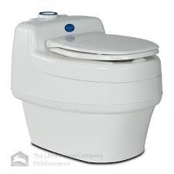
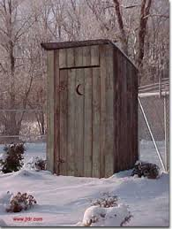
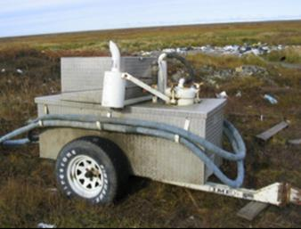
Solutions
Notes:
We used to help relocate old hoppers not in use to villages in need. There really aren't any left. Village’s like KWT have seen issues in other villages and plan on keeping their hoppers as a back up for the piped system.
In Crooked Creek Separette toilets were installed in homes built for people whose homes were destroyed in the flood. We surveyed the homes several months after instillation. Of the 11 homes who received the toilets only 2 were actually using them. Most preferred the honeybucket as the Separette was difficult to use (especially for woman), used more energy, and the vents allowed cold air into the house. Key point here is the acceptance of a new technology.
-Newtok Project 2011, attached a lid to their FTH trailer and clean out bins at the home. Ran into problems with bags. Doable, but has a more complex collection schedule.
In places where is it feasible, people can go back to using outhouses.
For broken hoppers inserts can be purchased. Nomar Alaska sells inserts for $175 without shipping – 10 liners shipped to Akiachak cost $1,800.
The quick and easy solution we propose is that resources be allocated to build hopper equipment en mass. Building 200 units instead of 5 will drastically lower the cost. These can be stored in hub villages and with Homeland Security so they are available when there is a need.
They can be used at individual homes or placed in a central location around homes lacking service.
On the village level, ordinances about public dumping need to be created and enforced.
- Reiterate that we need more honeybucket collection infastructure.

Slide 13
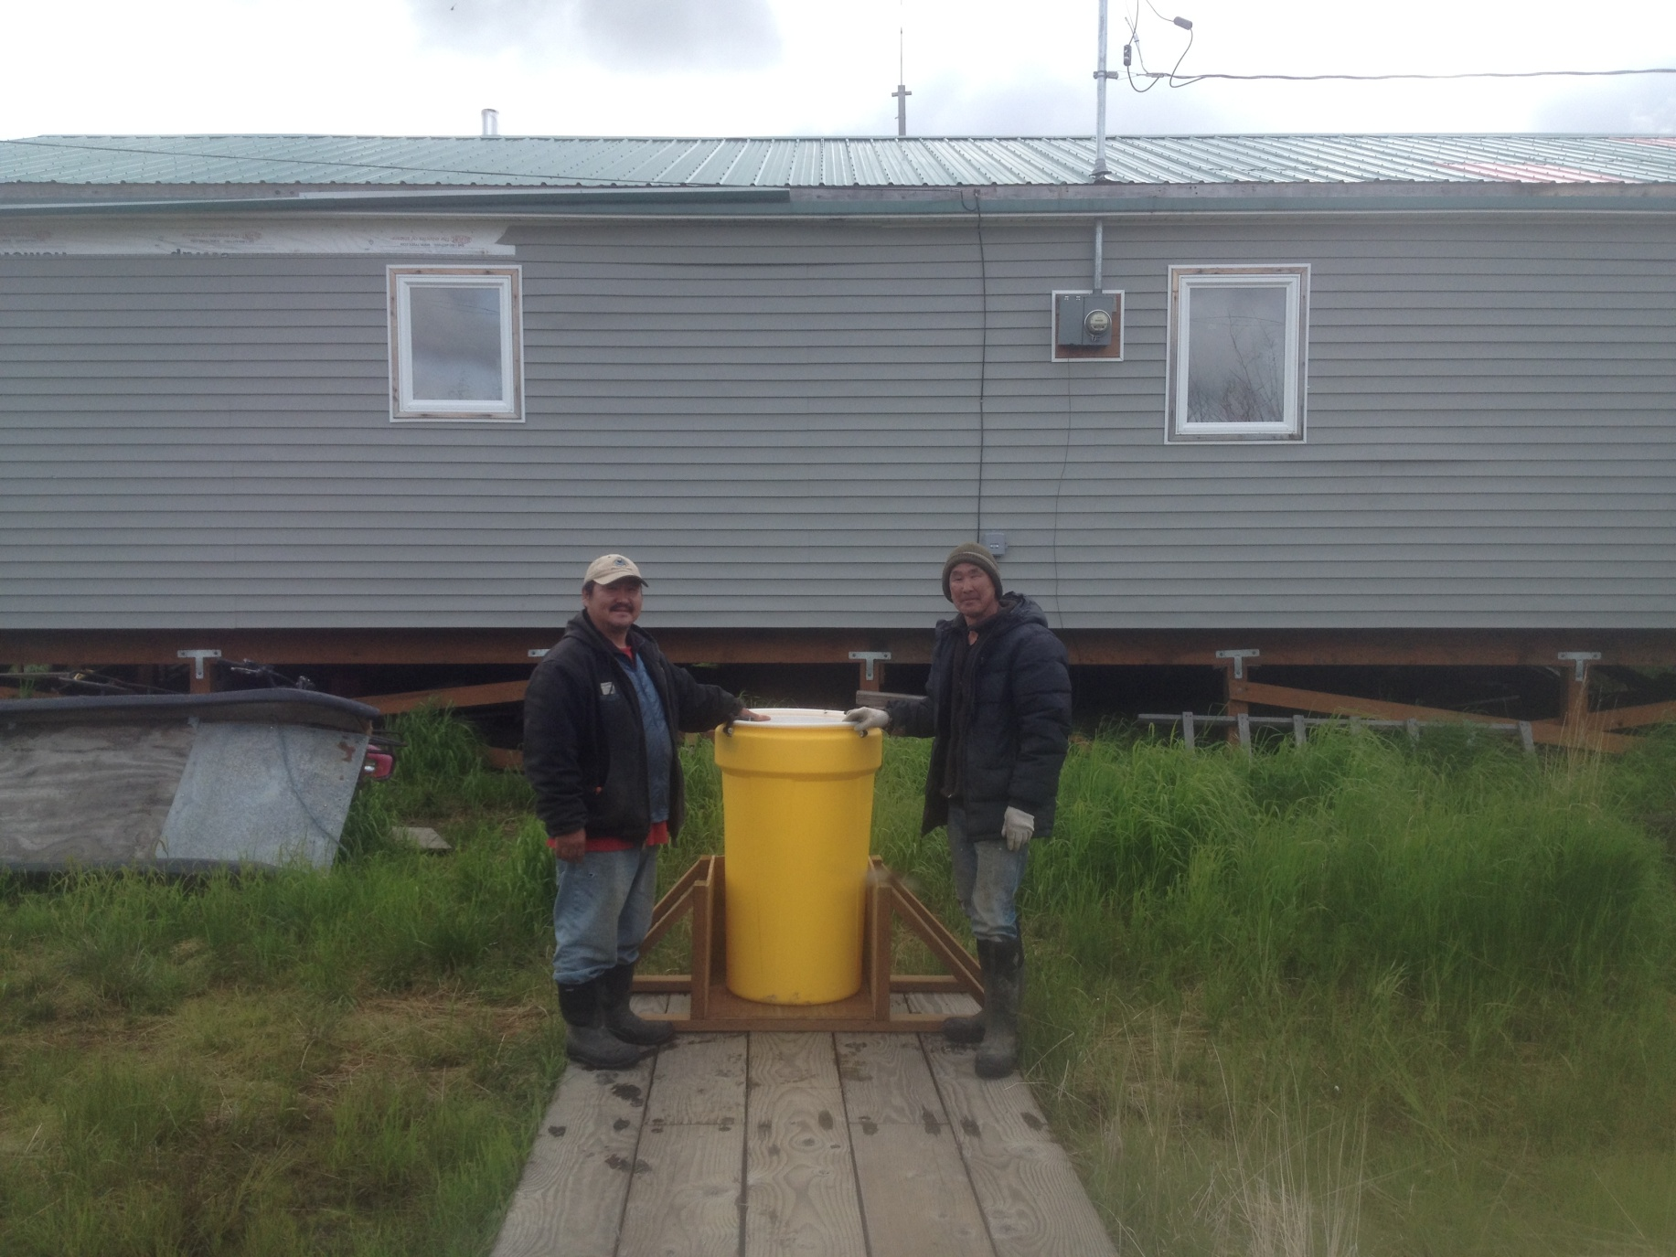
Reinventing the Honeybucket
Notes:
OEHE has been working with Napaskiak to rectify their water/sewer issue. Due to a lack of maintenance since their initial instillation a good amount of there FTH systems are inoperable. Problems range from broken handles, pumps frozen and broken hard wear resulting from freezing.
YKHC Remote Maintenance Worker (RMW), Bob White and I worked with Shorty’s Welding Shop in Bethel throughout the winter of 2013-2014 to create a prototype haul unit that could mount on to existing haul carts scattered throughout the delta. During the same period we ordered and tested numerous affordable plastic barrels by filling them with dog team waste and water at different rates, freezing them solid then emptying the frozen contents.
In early June, we identified homes in need and transported the equipment to the village of Napaskiak. Upon instillation, both the sewage haulers and homeowners were educated about the system and given my contact information. I have kept contact with all parties involved for feedback. As of December, no homeowners have reported spills or any other major issues.

Slide 14
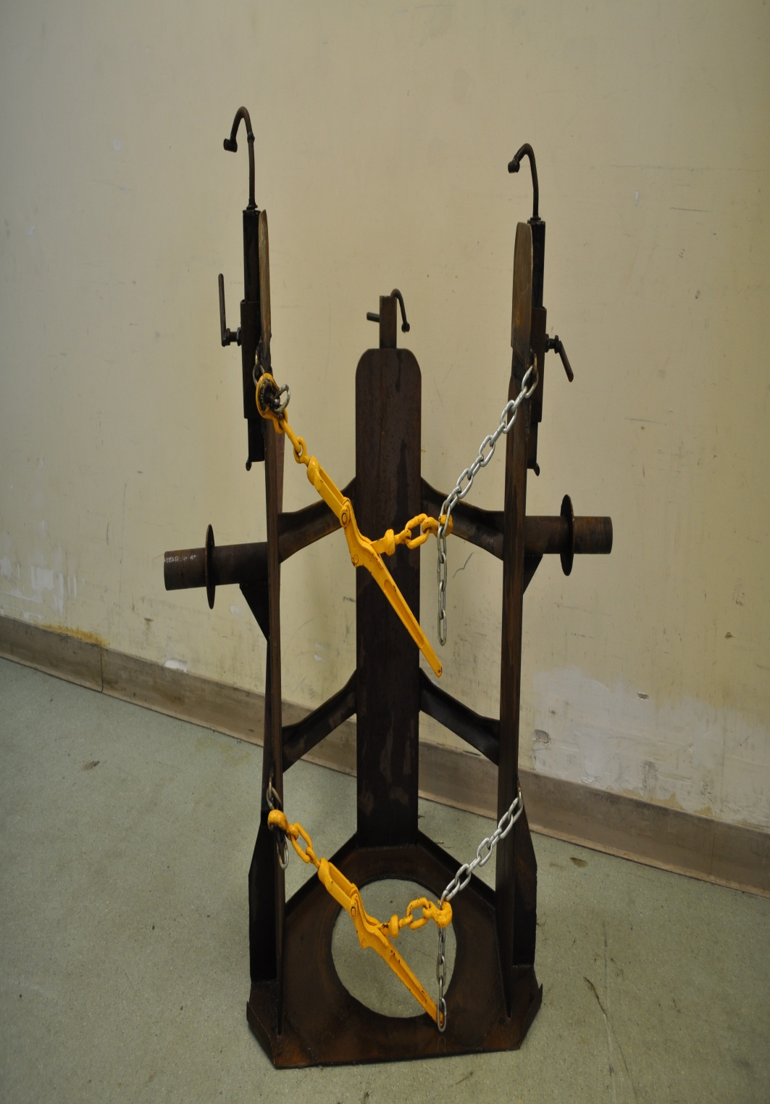
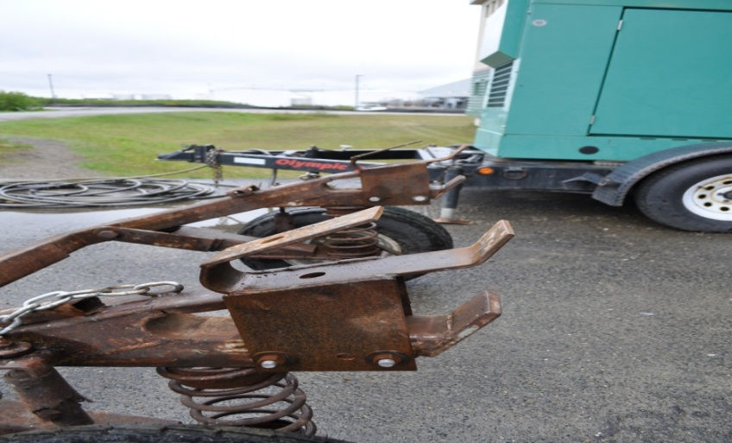
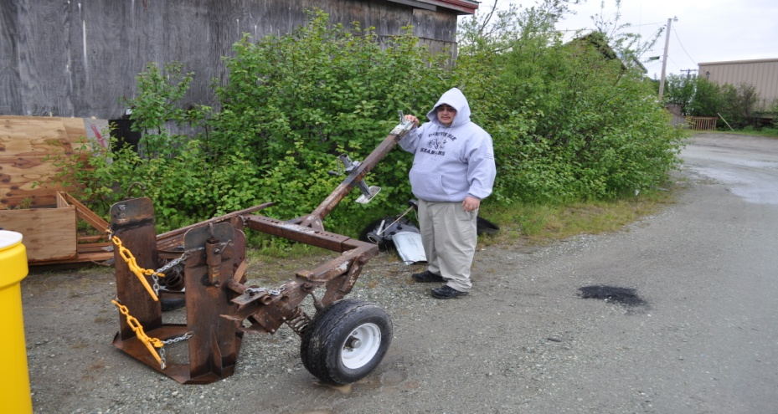
Notes:
Lift point consideration to prevent spillage.
Can fit 55 gallon drums too
-Made in Bethel for $1500-$2000
- We are having two more built that will be modified versions.

Slide 15
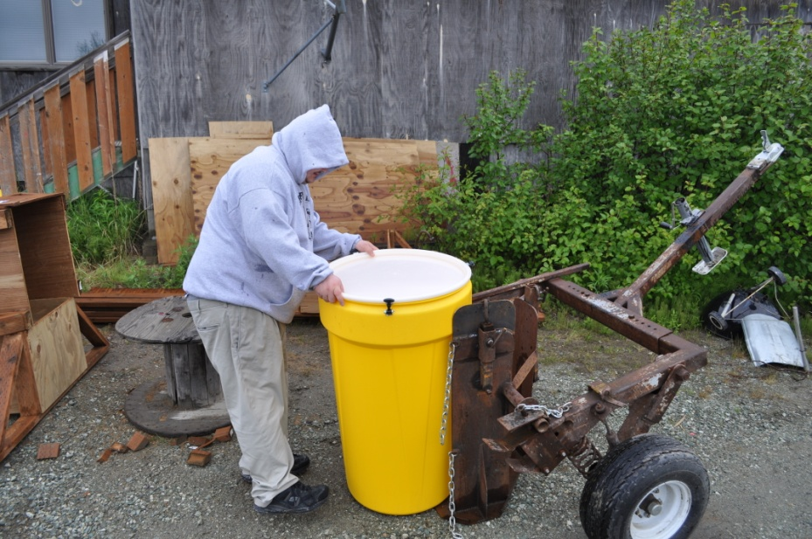
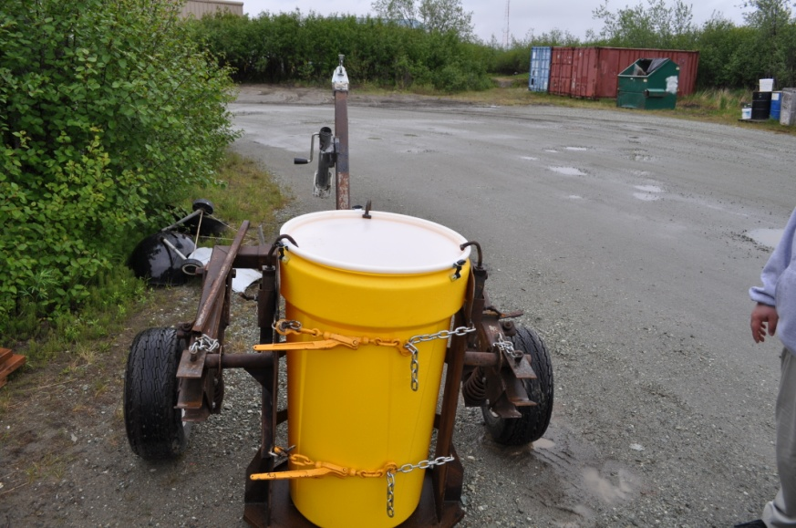
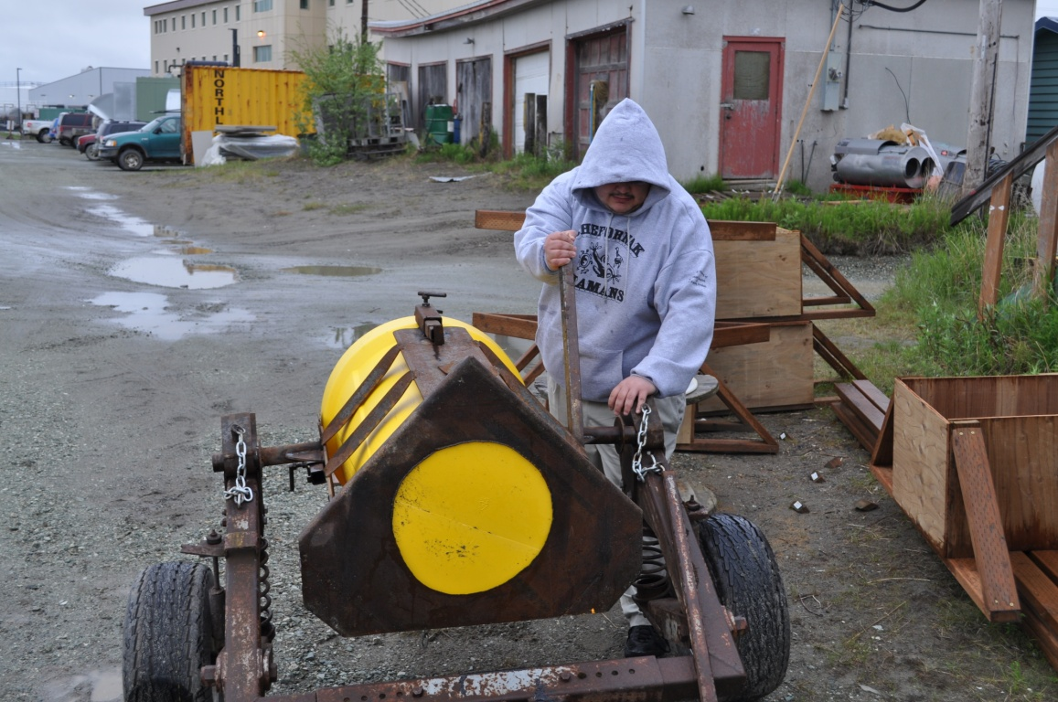
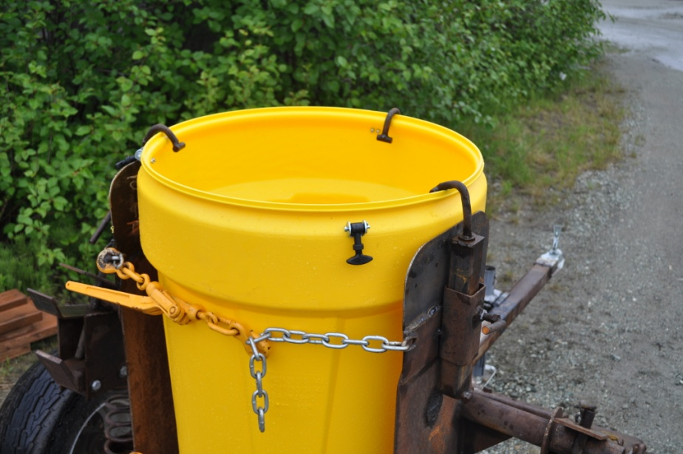
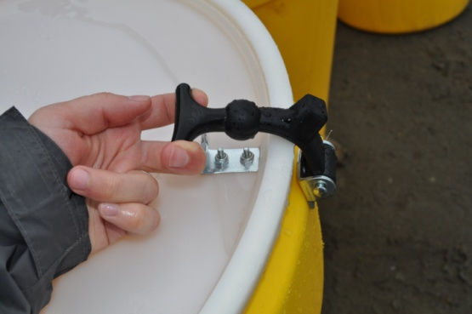

Slide 16
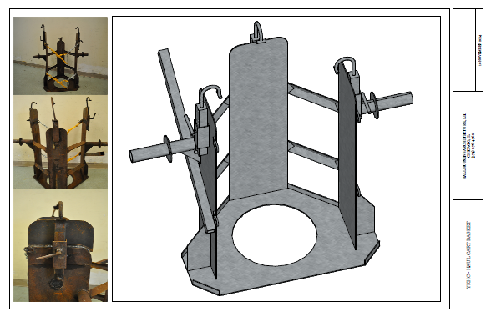
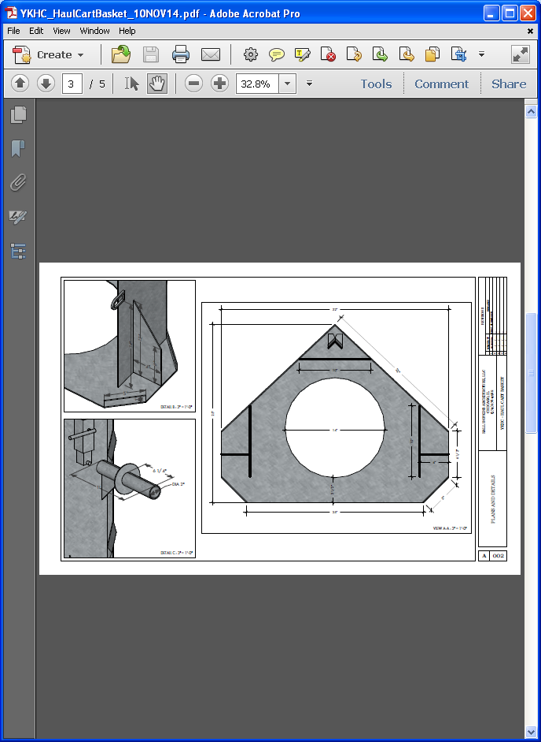
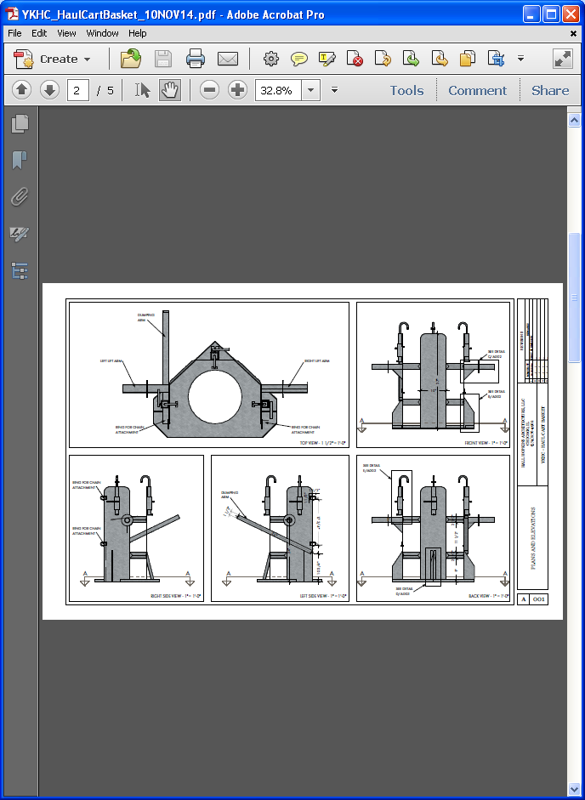
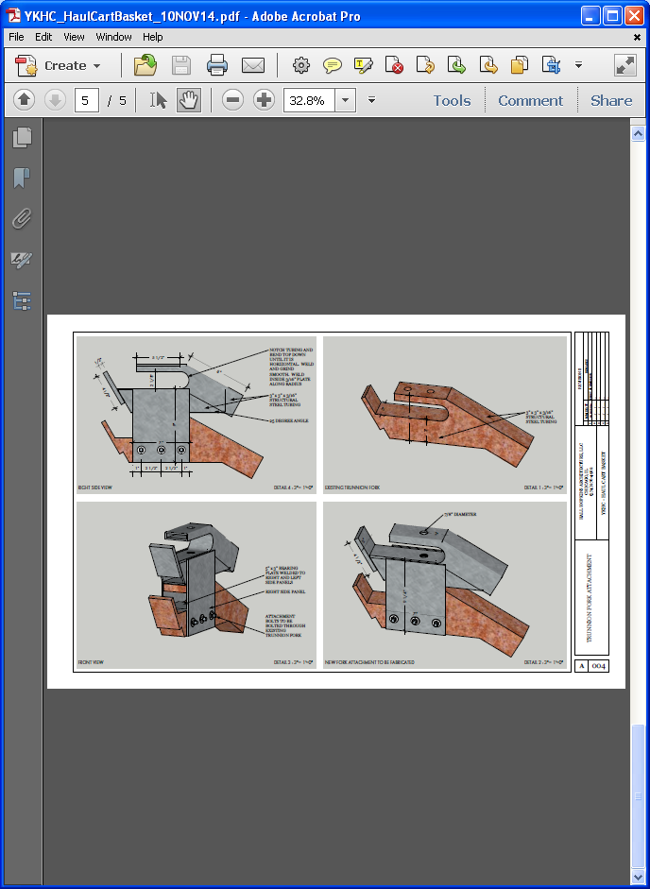
Notes:
We immediately noted that the bins are being filled too high. Just like traditional hoppers, when filled much over half way they become increasingly difficult to empty under freezing conditions. Obviously this doesn’t matter in warmer months. This results in frequent cracking. People’s natural tendency is to try and fill them up as much as possible to get more for their money.. Emptying hoppers at the proper level is the single most important operations consideration. Cost structures should reflect this.
While we have no absolute conclusion about the effectiveness of our system we were successful in adapting an alternative and more importantly affordable sewage collection system in a reasonable timeframe. We were successful in having a direct, positive impact on public health. Because they are not manufactured in large numbers a single new honeybucket hopper costs upwards of $4,000 dollars before shipping. If a community already has a haul cart or can acquire one, they can equip 10-15 homes for roughly the same price as one traditional hopper.

Slide 17
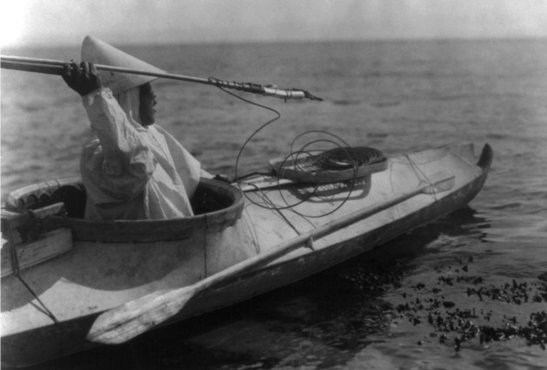
Simple Solutions
Notes:
Another success of this project is demonstrating the effectiveness of simple solutions. The thing that really attracted me to the public health profession is that for the most part, solutions to basic sanitation are simple. In this case, people in Napaskiak didn’t have a sanitary means to dump their honeybuckets. The solution was to give them a bucket to dump into; cheap, effective and timely.
Success for the people that live in our harsh climate has always demanded simple and efficient solutions; the present sanitation issues are no different. A prevailing thought process that stresses simple, effective and real time solutions needs to be the mantra of sanitation infrastructure in the future of bush Alaska. Our remote maintenance workers can attest that the newest technology do not always work best! Something that cannot be fixed with a wrench and some gumption is something we don’t need in the YK Delta.
In the face of dwindling resources, we need to acknowledge the failures of our prevailing system and develop solutions that fit the original residents of this land. I am by no means recommending that we revert to honeybuckets and erase the progress made in the last decades; I only advocate an open and honest discussion about the realities of life in rural Alaska and what we as professionals can do to improve them.

Slide 18
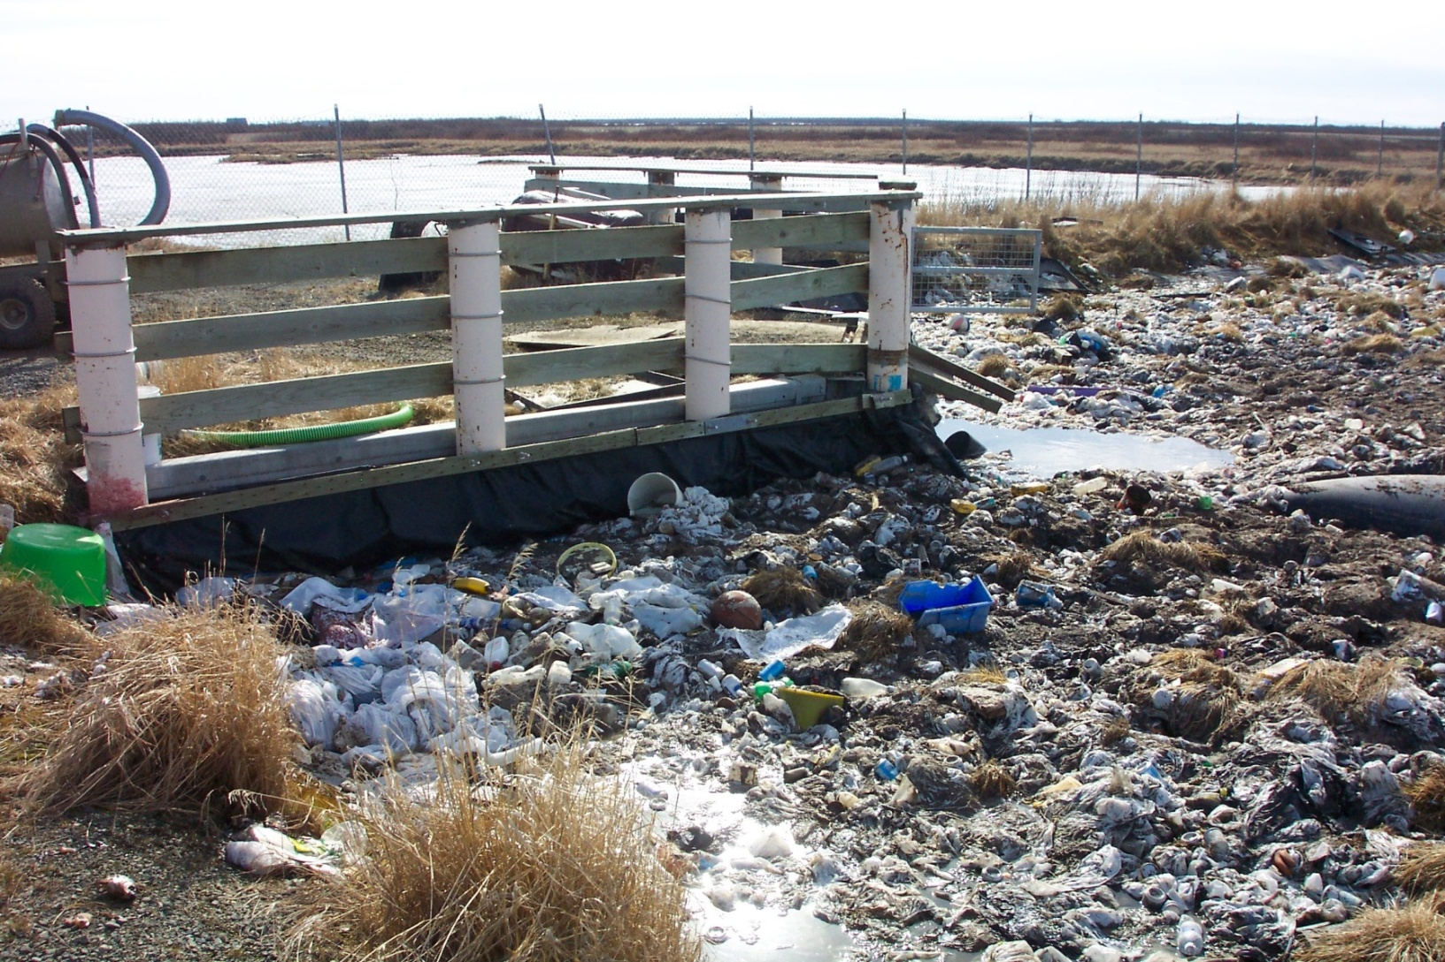
Honeybuckets and Lagoons
Notes:
We design lagoons to only take influent from a piped or FTH system. A lot of the issues that bob discussed in his presentation are happening when honeybuckets are dumped into a lagoon not meant to take bags.
The reality is that even in situations where communities are piped or have haul units honeybuckets are still being used. Just like we can no longer deny the need for honeybuckets, we must take into account the fact that honeybuckets are being dumped into lagoons and develop solutions.
- We talk about a separate cell for honeybucket waste. Some communities have had success cleaning out the bags. In the picture above, Napakiak raked the material to the shore, stood back and shot the contents with shotguns (steel shot of course) and removed all the bags.
The design of lagoons need to account for this reality.

