Slide 1

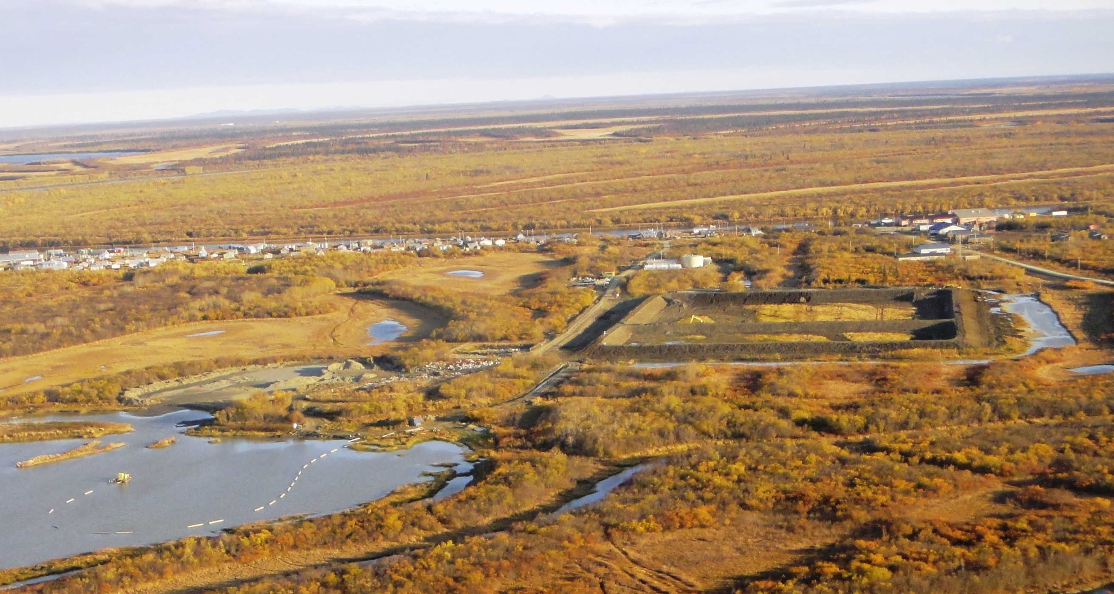

ANTHC
DIVISION OF ENVIRONMENTAL
HEALTH & ENGINEERING
Current State of Wastewater Treatment and Disposal in Alaska
5th Annual Water and Sanitation Workshop
January 2015
Notes:
Rural Alaska, Energy and Health
They are all interconnected which has been seen clearly, especially lately.

Slide 2
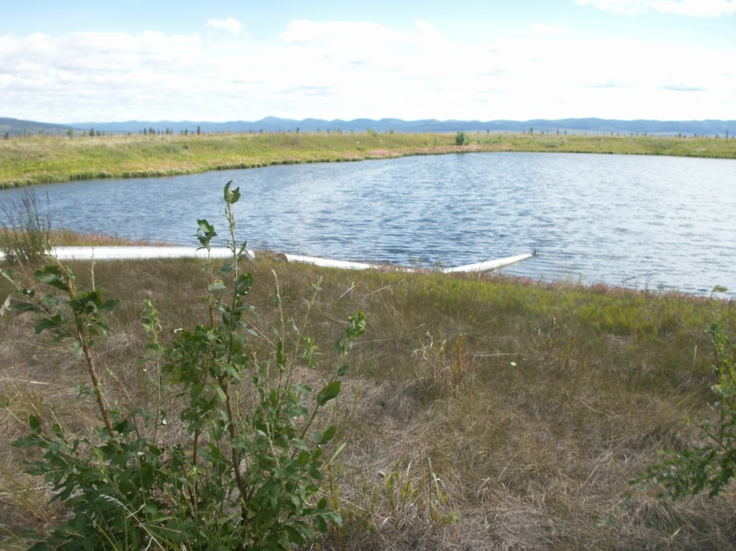
Sources of Wastewater
Domestic (Sanitary)
  Piped
  Hauled or Honey-bucket
Industrial
Infiltration and Inflow
Combined Sewers
Kiana Lagoon Cell
Notes:
Rural Alaska households spend their meager income on energy. In part due to low incomes and in part due to high energy prices.

Slide 3
Treatment Objectives
  Identify contaminants of concern.
  Effectively remove identified contaminants.
  Return effluent to the natural water bodies or the land.
  Dispose of Contaminants.
  Do so in a manner that protects the environment and human health.
  Do so in a sustainable manner.
Notes:
Rural Alaska households spend their meager income on energy. In part due to low incomes and in part due to high energy prices.

Slide 4
Contaminants of Concern
  Suspended Solids: When unremoved, lead to sludge deposits and anaerobic conditions in the aquatic environment.
  Biodegradable Organics: If discharged untreated, leads to depletion of natural oxygen in the receiving waters.
  Pathogens: Diseases can be transmitted via pathogens in wastewater.
  Nutrients: Nitrogen and phosphorus can lead to growth of undesirable aquatic life.
  Heavy Metals: Usually added in industrial or commercial processes.
  Priority Pollutants: Other contaminants selected for removal based on known carcinogenicity or toxicity.
Notes:
Rural Alaska households spend their meager income on energy. In part due to low incomes and in part due to high energy prices.

Slide 5
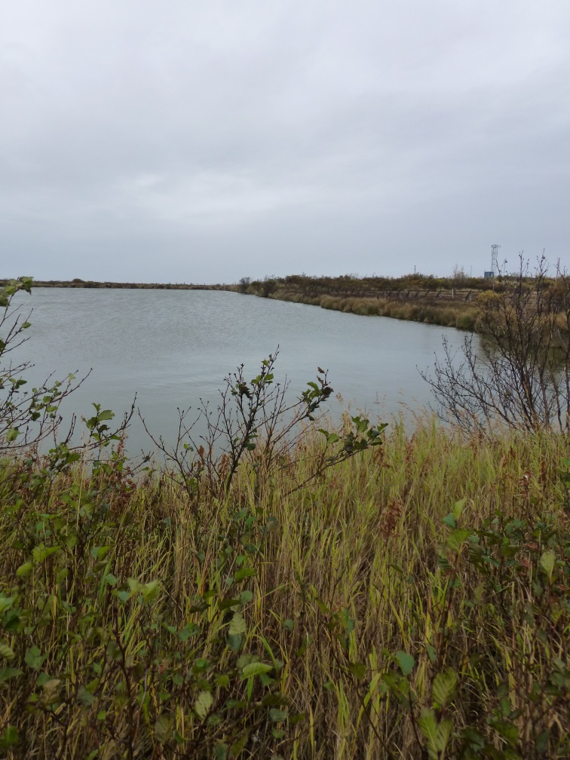
Wastewater Treatment Stages
  Primary Treatment: Physical Treatment (screening, settling, floating)
  Secondary Treatment: Biological and/or chemical processes to remove organic matter, suspended solids, and pathogens.
  Tertiary Treatment: Chemical and biological treatment for targeted contaminants.
  Effluent Disposal: Consistent with receiving body water quality standards.
  Sludge Disposal: Often misjudged level of effort – significant challenge.
Naknek Lagoon Cell
Notes:
Rural Alaska households spend their meager income on energy. In part due to low incomes and in part due to high energy prices.

Slide 6
Governing Regulations
  Clean Water Act of 1972
    Defines Minimum Requirements (Secondary Treatment)
      Maximum Effluent Contaminant Levels
      Total Suspended Solids (TSS): 30 mg/l
      Bio-chemical Oxygen Demand (BOD): 30 mg/l
      Chloroform Bacteria (# colonies / 100 ml)
    Minimum Removal Requirements (%).
  Establishes National Pollution Discharge Elimination System (NPDES) Program
  Secondary Treatment Exceptions
Notes:
Rural Alaska households spend their meager income on energy. In part due to low incomes and in part due to high energy prices.

Slide 7
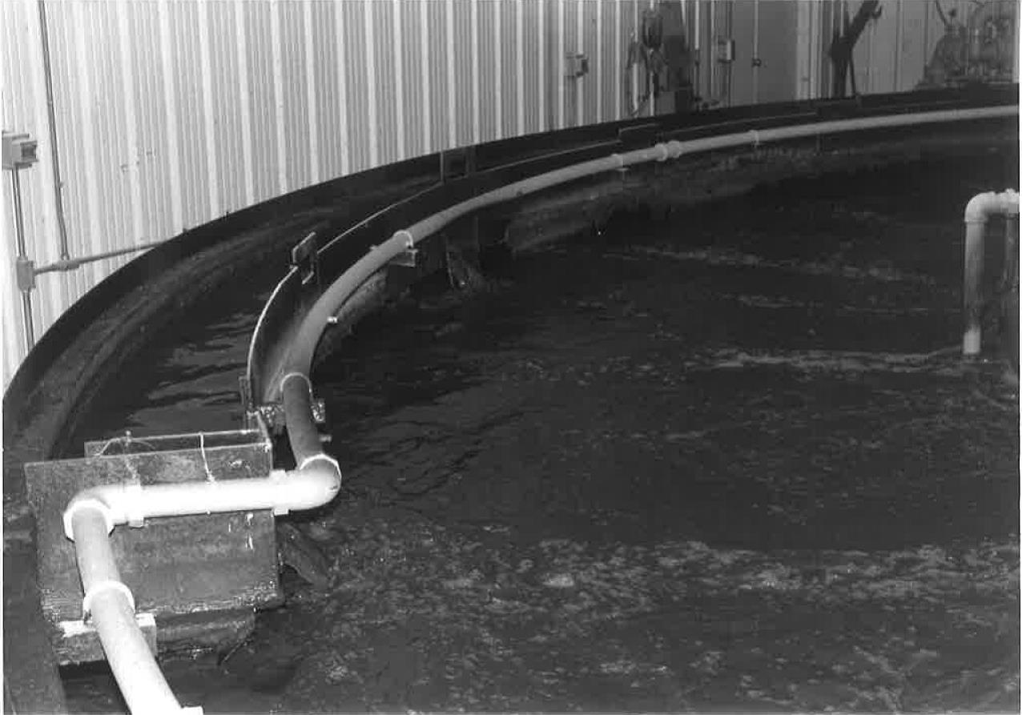
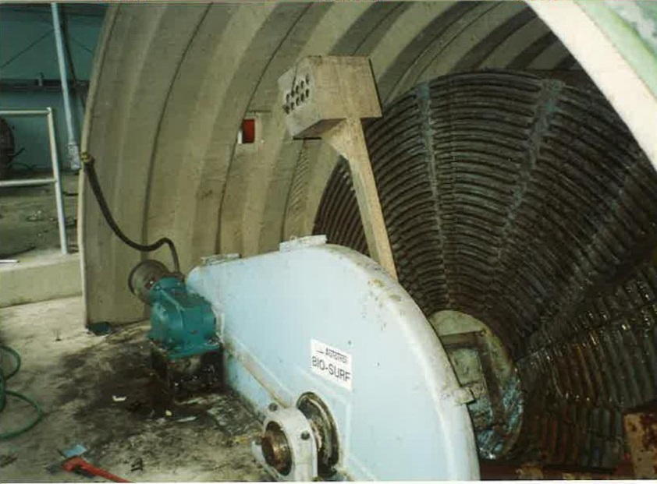
Common Treatment Systems in Alaska
Mechanical Plants
Settling Tanks / Ocean Outfalls.
Facultative Ponds (Lagoons)
Hoonah Bio-reactor
Angoon abandoned RBC

Slide 8
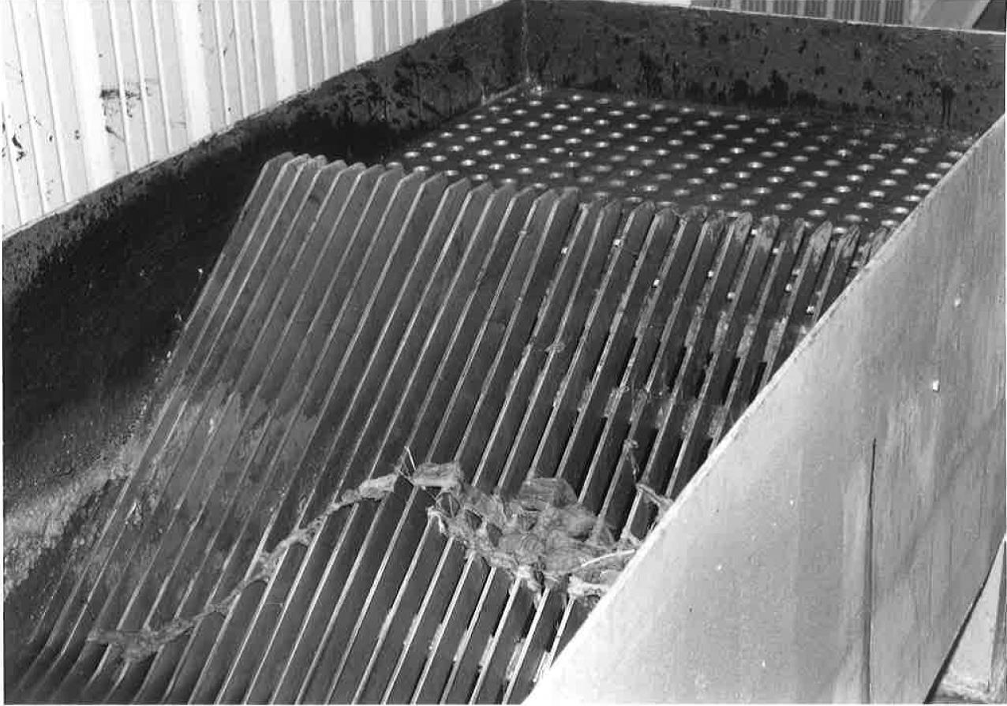
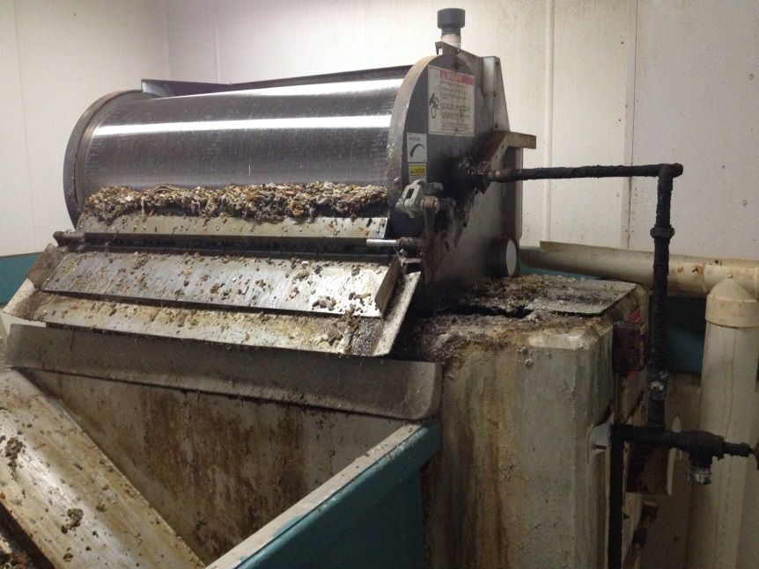
Mechanical Treatment Systems
Description: Natural treatment mechanisms optimized in a controlled environment. Tight control the parameters necessary for optimum micro-organism growth.
Treatment Level: Up to Tertiary
Hoonah Bar Screen
Klawock Rotating Drum Screen

Slide 9
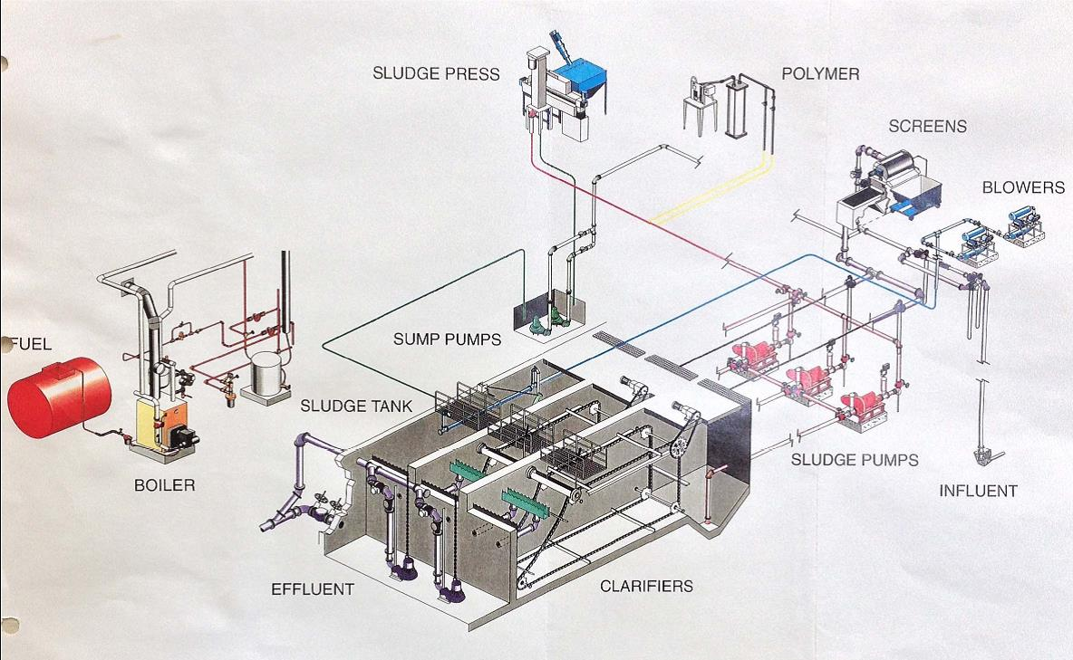
Mechanical Treatment Systems

Slide 10
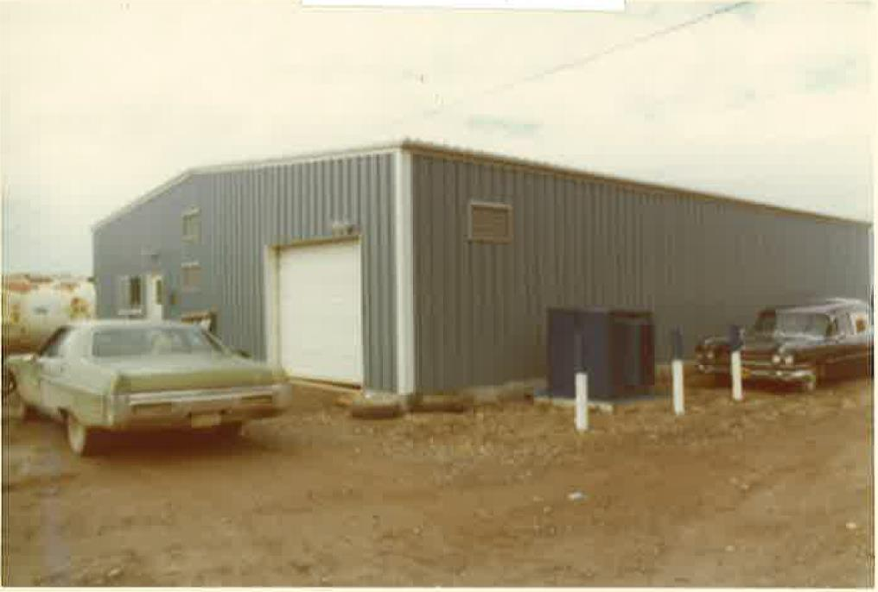
Mechanical Treatment Systems
Advantages:
  Lower Capital Cost
  High Loading Rate/Smaller Footprint
  Consistent Effluent (with good O&M control)
Disadvantages:
  Highest O&M Costs
  Highest operator cert. requirements
  Daily O&M required
  Continuous removal of sludge.
Hoonah WWTP

Slide 11
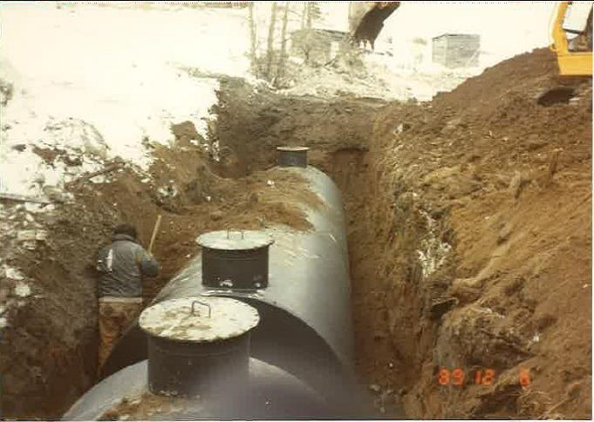
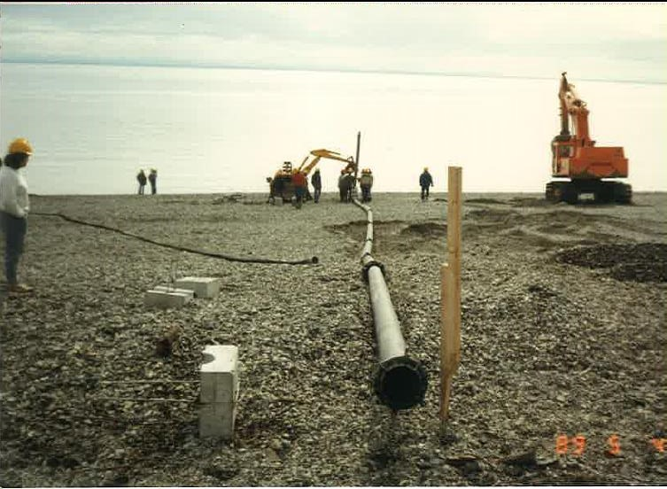
Settling Tank/Outfall Systems
Description: Large tanks in series provide primary treatment prior to effluent disposal via an ocean outfall.
Treatment Level: Primary
Tyonek Settling Tanks
Tyonek Ocean Outfall

Slide 12
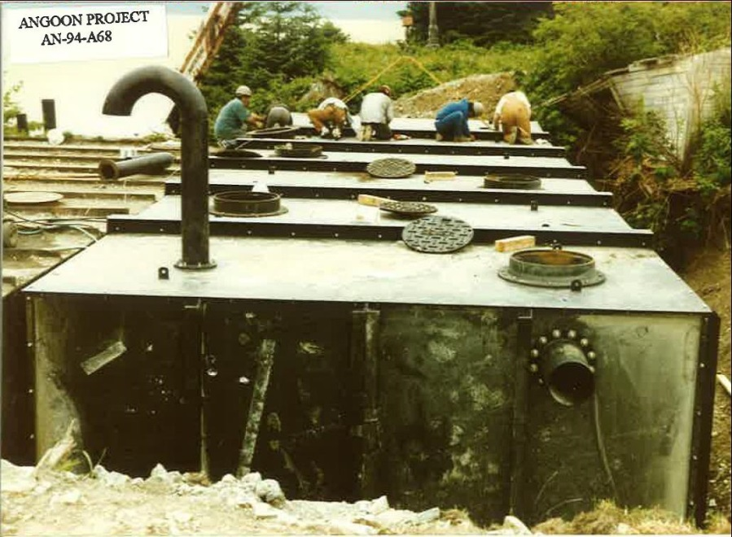
Settling Tank/Outfall Systems
Advantages:
  Low capital cost
  Lower operator cert. requirements
  Periodic sludge removal and handling
Disadvantages:
  Primary treatment only
  Suitable only for small communities
  Requires sludge pumping equipment
  Requires long outfall construction
Angoon Settling Tanks

Slide 13
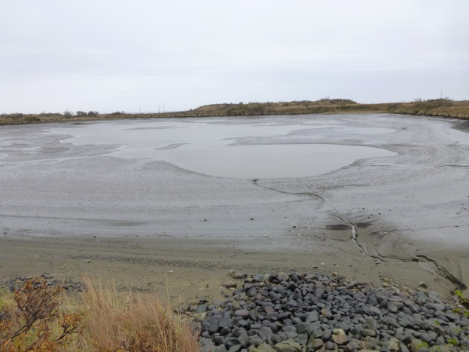
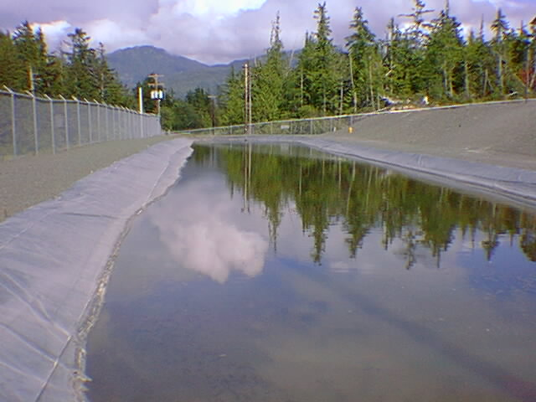
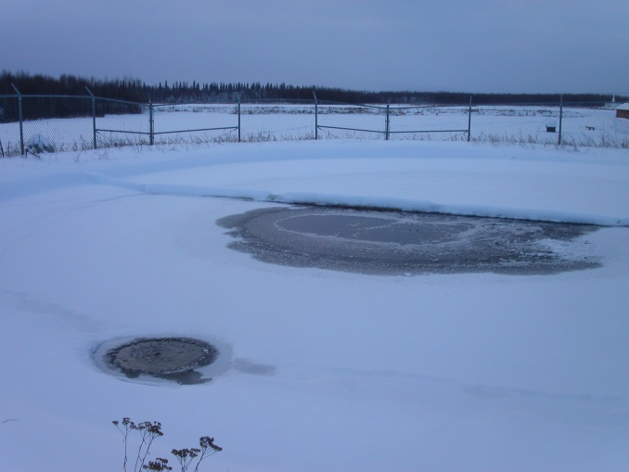
Wastewater Treatment Ponds
Description: Shallow ponds used to treat wastewater through natural processes.
  Tundra ponds
  Constructed single and multi-cell facultative lagoons
  Aerated Lagoons
Treatment Level: Typically Secondary
Cold Climate Considerations: Biological treatment achieved only in the summer.

Slide 14
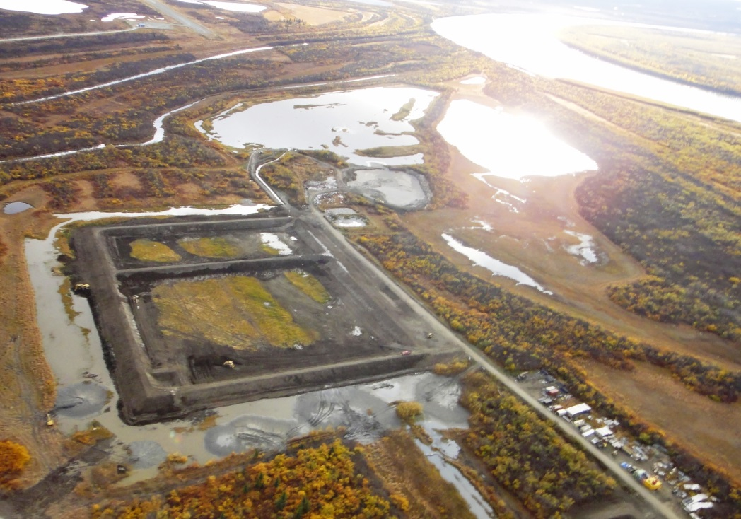
Wastewater Treatment Ponds
Advantages:
  Lowest O&M cost
  Lower operator cert. requirements
  Infrequent discharge
  Sludge storage in the cells
  Secondary treatment
Disadvantages:
  Potentially highest capital cost
  Very large foot print
  Large volume annual/bi-annual discharges
  Separation requirements
  Inconsistent treatment
Kwethluk Lagoon

Slide 15
Wastewater Systems in All Rural Alaska Communities
(238 Communities with a combined population of 109,652)

Slide 16
Wastewater Systems in Rural Communities with a Pop > 1,000
(20 Communities with a combined population of 49,393)

Slide 17
*A community is considered “unserved” if 55% or less of the homes in the community have a piped, septic tank & well, or covered haul system.

Slide 18
For More Information:
Don Antrobus, PE
Director of Design
ANTHC, DEHE
907-729-3544
dantrobus@anthc.org

Slide 19
