Slide 1

SEWAGE SLUDGE:
NOW WHAT DO
WE DO WITH IT ?
ADEC Solid Waste Program
Lori Aldrich
Regional Program Manager
State Biosolids Coordinator

Slide 2
Sewage Sludge Options
Closure in Place
Disposal in the MSWLF
Sewage Sludge Monofill
Treatment
Land Application

Slide 3
General Requirements
Solid Waste Program approval or permit
Dewatered to ≥ 10% solids
Sampled for metals [Arsenic, Chromium, & Nickel]
Location requirements for landfills
Vector attraction reduction requirements [40 CFR 503.32]
Pathogen reduction requirements [40 CFR 503.33]

Slide 4
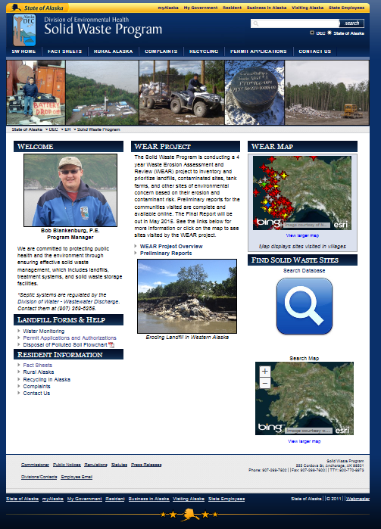
Closing a Sewage Lagoon in Place
  For less than 1000 cy
    One-Time Authorization
  Any volume
    Plan Approval
    dec.alaska.gov/EH/SW

Slide 5
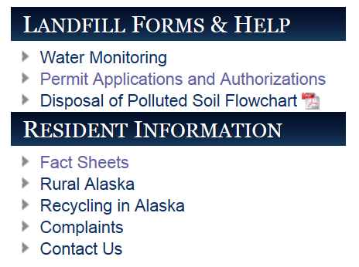
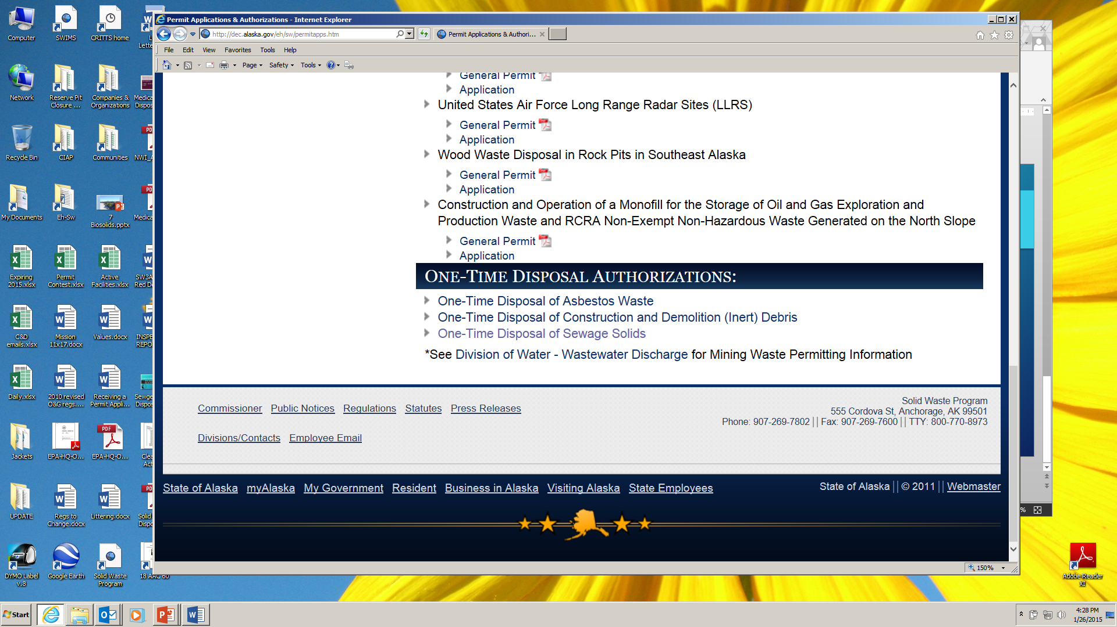
Closing a Sewage Lagoon in Place
One-Time Authorization
Remote locations only
Less than 1000 cubic yards
Sampling of sludge for metals
I year to complete closure
$1000 one time fee
Closure report
Application Online

Slide 6
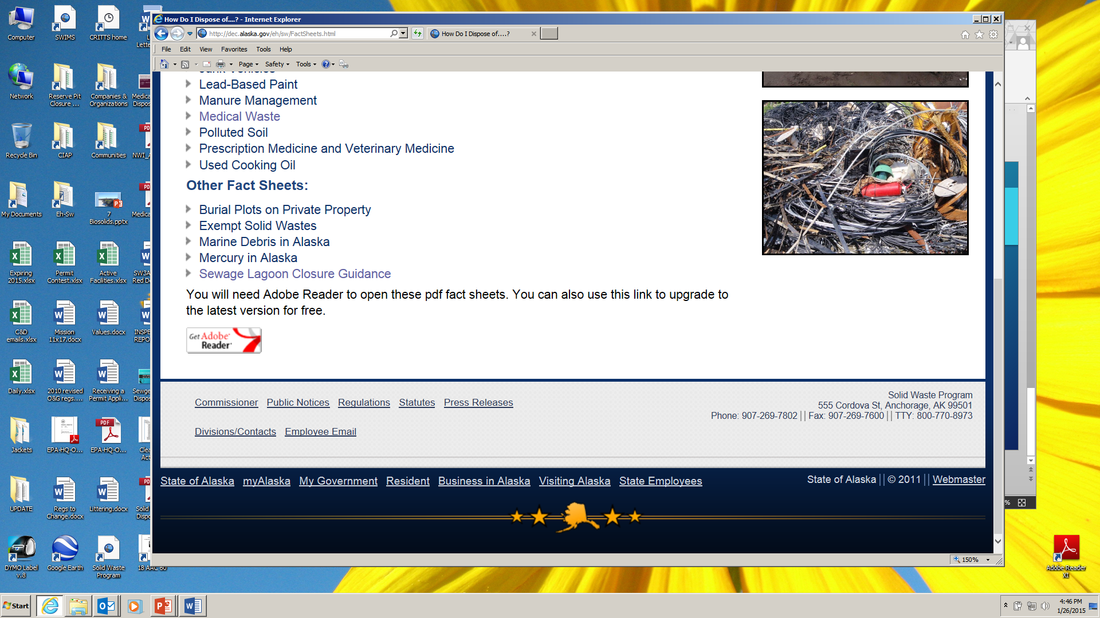
Closing a Sewage Lagoon in Place
Plan Approval
Submit Plan to ADEC 6 months out
Lagoon Design
Operations
Closure
5 years post-closure monitoring
$490 Fee
Closure report
Fact Sheet Online

Slide 7
MSW Landfill Co-Disposal
Must be a PERMITTED landfill
  This can be an opportunity to get
    the local landfill permitted
  If not included as a permit condition,
    requires separate approval
Must be managed to minimize
  human exposure
  Separate section of the landfill
  During landfill closed days
Must be covered daily with 6” of soil
(or other method to reduce pathogens and vector attraction)

Slide 8
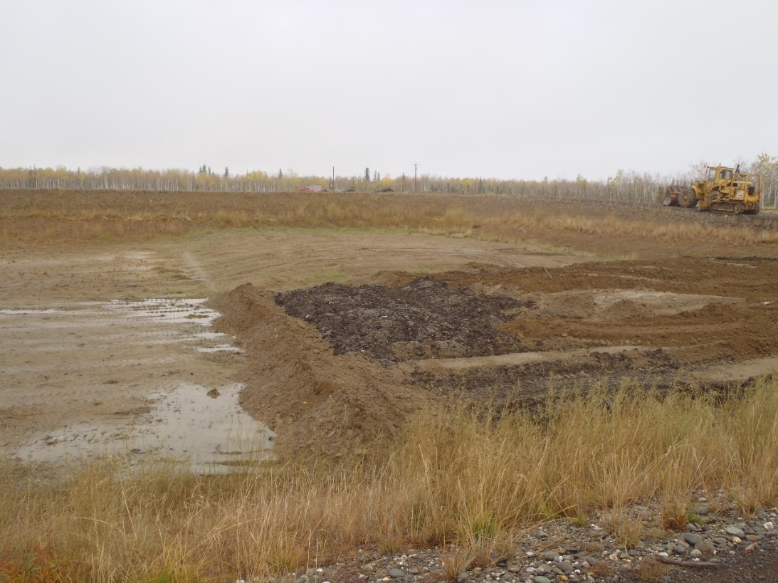
Sewage Sludge Monofill
>1000 cy or regular sludge disposal
Renewable Permit
More complex application
Annual fee – currently $842
Monitoring
  Sludge sampling
  Monthly visual inspection
  Possible groundwater monitoring
  Possible gas monitoring
Minimum of 5 years of post closure monitoring

Slide 9
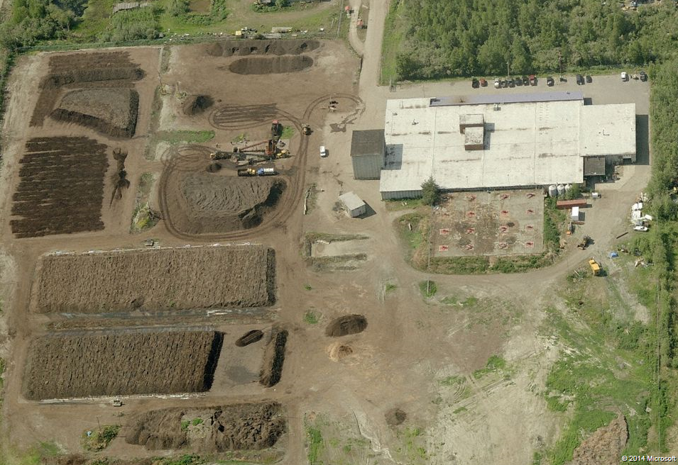
Treatment
Goals:
  Pathogen Reduction
  Vector Attraction Reduction
40 CFR 503
Consider use options
  Class A vs. Class B Biosolids
Treatment options:
    Composting
    Lime Stabilization
    Digestion
    Incineration

Slide 10
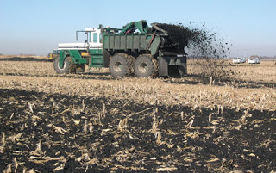
Land Application
Class A permit exemption
Fertilization
Requires testing and
  application rate calculation
  Access limitations
  Grazing/use limitations

Slide 11
Considerations
Options for closure/cleaning lagoon should be included in O&M manuals and considered in the design of the facility.
Planning and ADEC contact should begin well in advance
Community involvement in the choice of options is important.
Consider cost and ability of community to perform post-closure requirements.

Slide 12
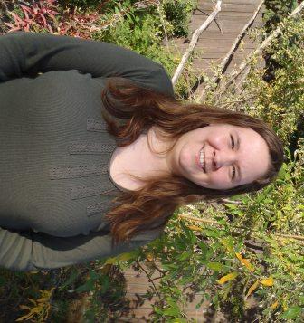
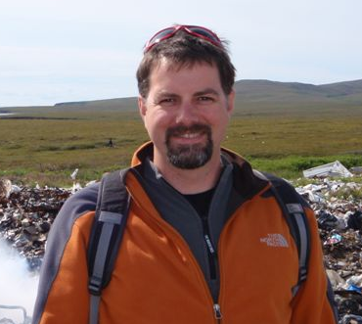
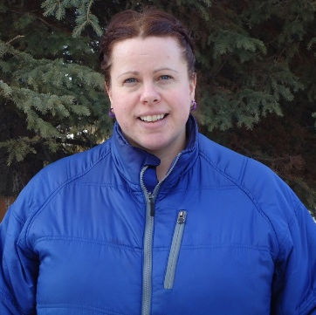
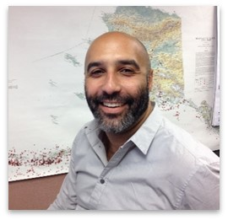
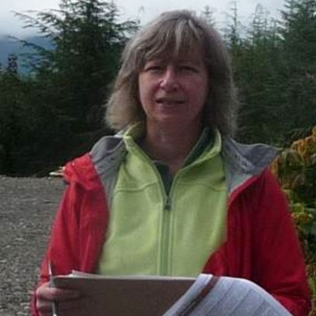
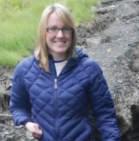
Solid Waste Village Contacts
Trisha Bower
Northern Interior
451-2174
Doug Huntman
Kuskokwim Aleutians East
269-7642
Sarah Durand
Interior
Upper Yukon
451-2761
Stephen Price
Bristol, Lake/Penn
Kodiak, L. Yukon
269-7467
Sandi Woods
Southeast
NW Arctic
465-5318
Kym Bronson
Aleutians West
Kenai
269-7626

Slide 13
SEWAGE SLUDGE DISPOSAL
QUESTIONS ?
Lori Aldrich
Solid Waste Regional Program Manager
ADEC
555 Cordova St., Anchorage 99501
lori.aldrich@alaska.gov
269-7622 / 269-7802

