Slide 1
Nunapitchuk Washeteria
By Juliana Wassillie

Slide 2
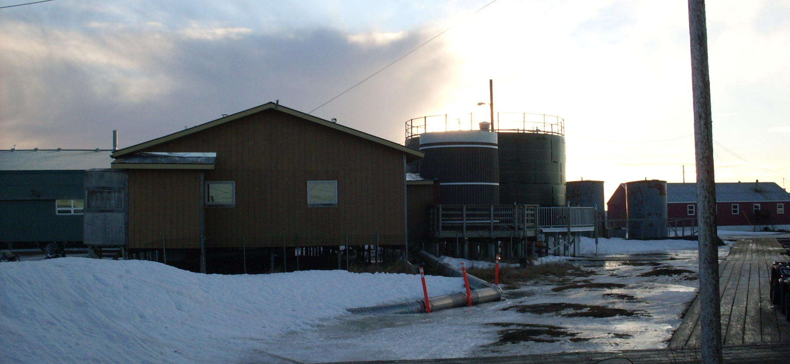
North Side of Washeteria
Notes:
This is our Washeteria facing North. On the right of the building is the old water in the brown and the newer black water tank. To the right of the black tank are the two single walled bulk fuel tanks. These fuel tanks support the laundromat as well as the City bulidings.

Slide 3
Washeteria Services
Water for the whole community
Washers and dryers
Watering point for self service
Sauna
Showers
Notes:
Currently our washeteria is where our water operator makes water for all entities, the school, Kindergarten and head start building, teacher housing, clinic, local store, Tribal building, police station, restaurant, and all homes. We have 5 washers and two dryers, a watering point for anyone who would like to get their own water, a sauna, and two shower stalls. Most of everyone makes the best of what is available at the washeteria since it is the only laundromat Nunapitchuk has.

Slide 4
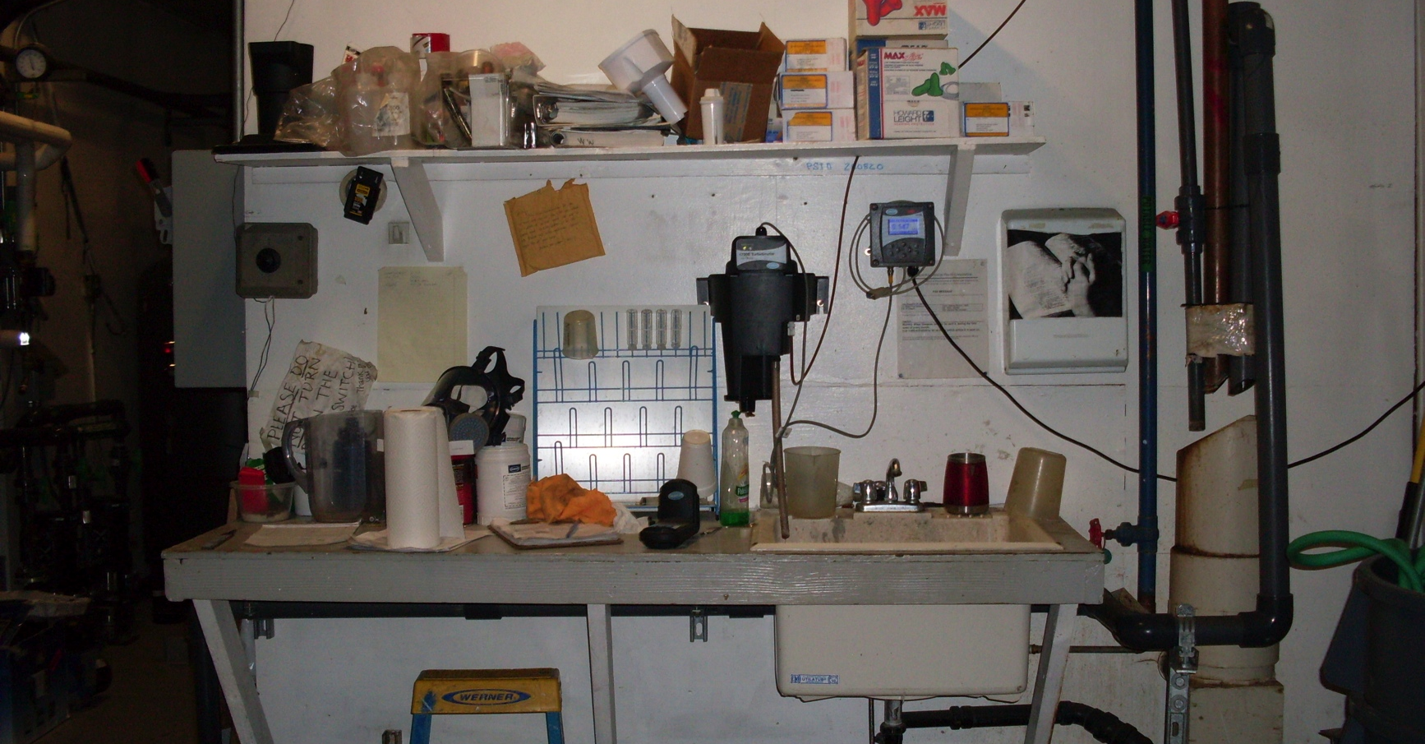
Chemical Mixing Area
Notes:
This is where our water operator mixes chemicals to make water. The pipe on the right of this photo is where water backwashes, goes through the drain that is connected to the 4” plastic pipe that is located in the center of the building leading to the sewer tank outside the washeteria. As you can see, there is one sink and equipment on the table. Used water from the Sauna, washers, showers, and toilets also go into the central 4” pipe.

Slide 5
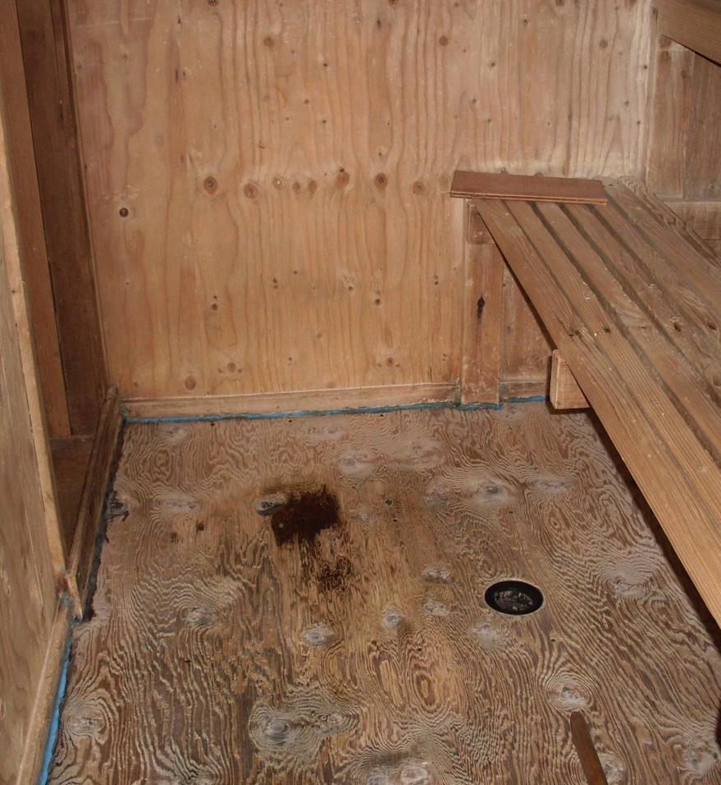
Sauna Room
Made of lumber
Backwashed water enters through the pipe
Has two entrances
Notes:
This photo is part of the sauna room which is made out of lumber. Since the sauna room is right next to the chemical mixing area, water from backwashing enters the sauna room floor through that pipe showing on the bottom. This water is brown and as you can see is staining the lumber floor. Last year this when the pipes clogged, this sauna room was flooded with brown murky backwashed water.

Slide 6
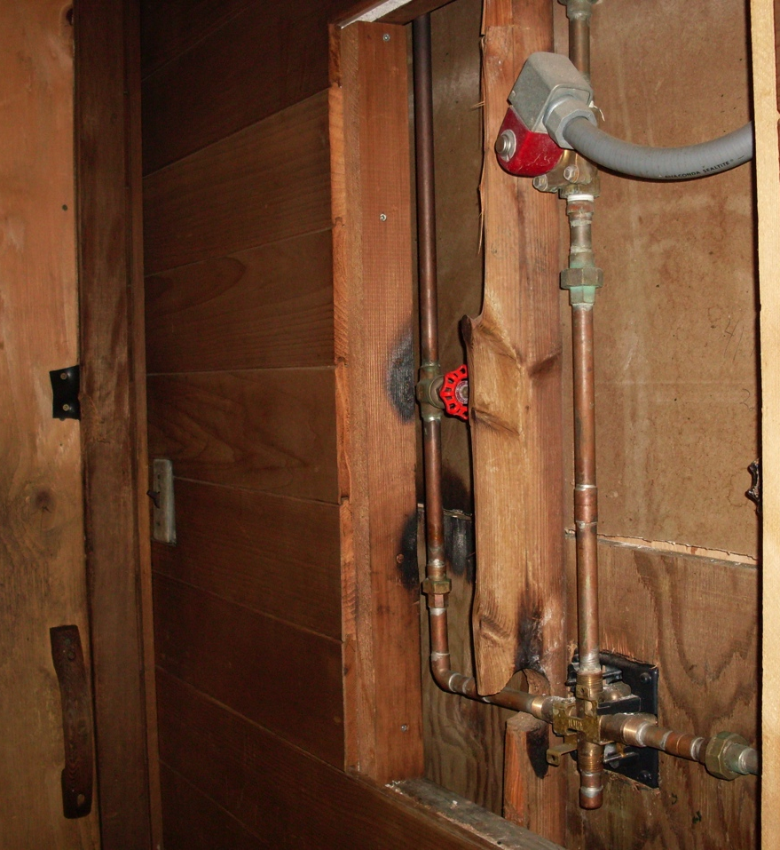
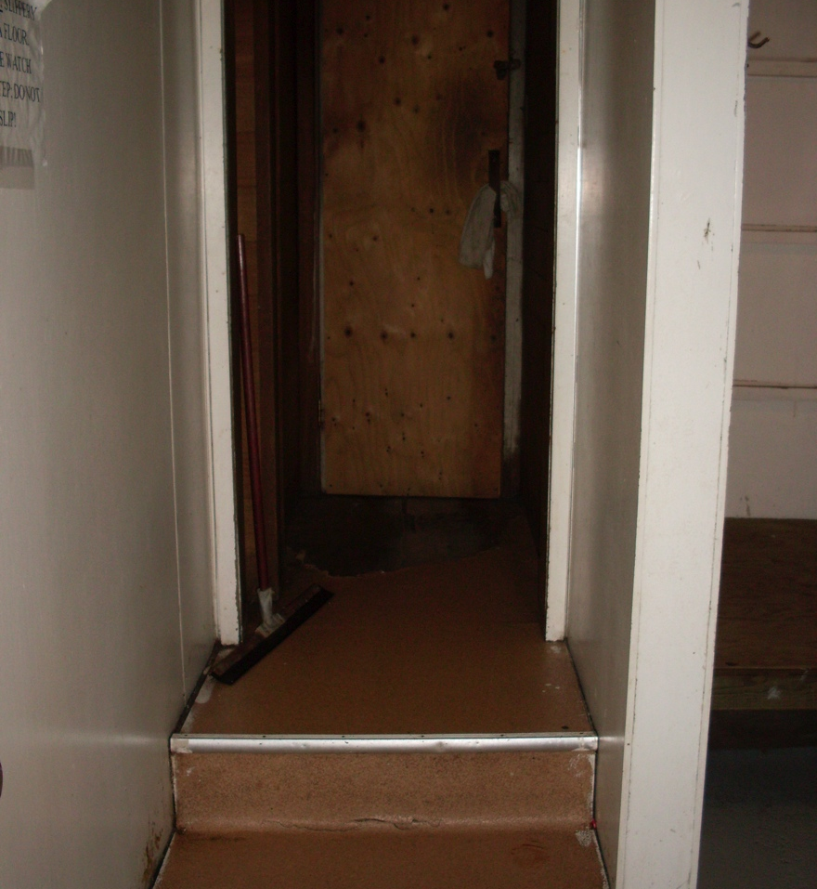
Sauna Entryway
Notes:
There are two doorway entrances to the sauna room. The linoleum flooring is chipping off and pipes are exposed. All the corners of the steps leading to the sauna doors have gaps and are rotting.

Slide 7
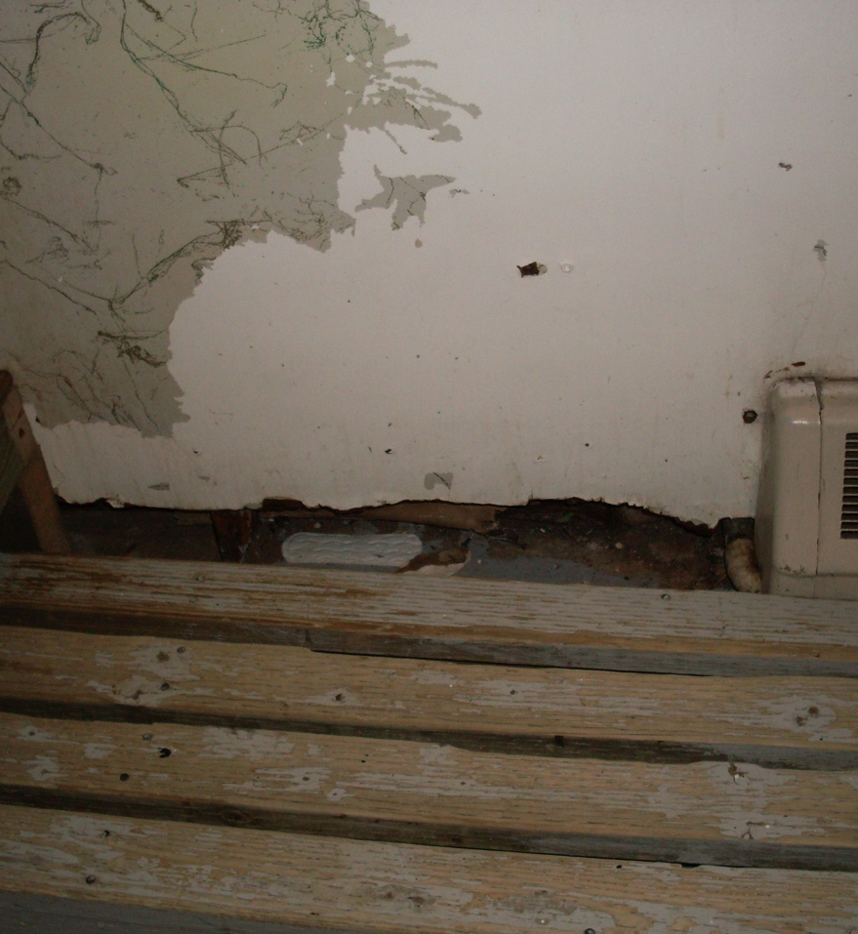
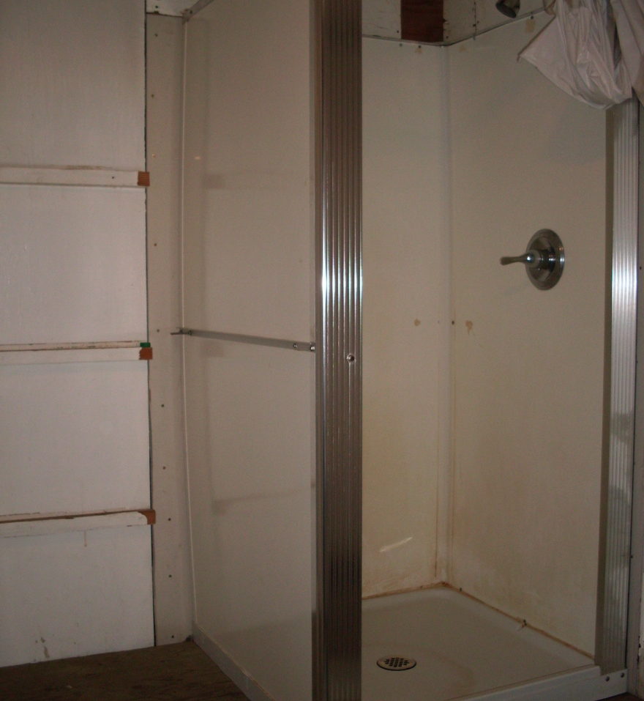
Restrooms/Shower Room
Notes:
Our maintenance man says some of the bathroom walls are made of fire resistant chalk. He thinks these rooms will eventually get moldy from the pipe leakages and heat creating damp floors/walls.

Slide 8
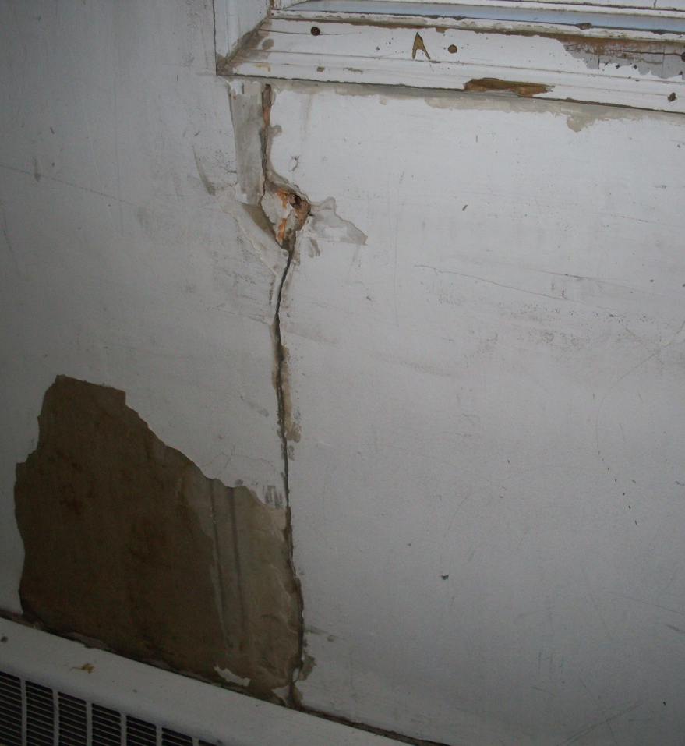
Wall Cracks
Cracks all around the building
Cold wind seeps through
Covered in goop
Notes:
All around the inner building there are cracks where cold wind seeps through. They are covered up with goop to prevent wind from coming in. The two windows on the west side of the building are the most draftiest during windy and extreme cold days.

Slide 9
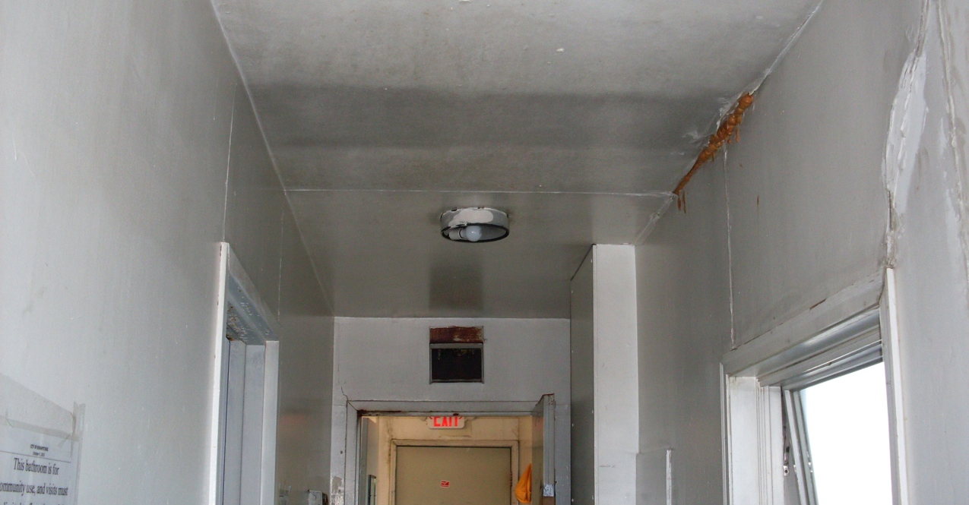
Exit signs
Notes:
Currently, there are only two working exit signs in the building one in the washer/dryer area and the other near the back office. Here you can see the top right wall with silicone to cover up a gap.

Slide 10
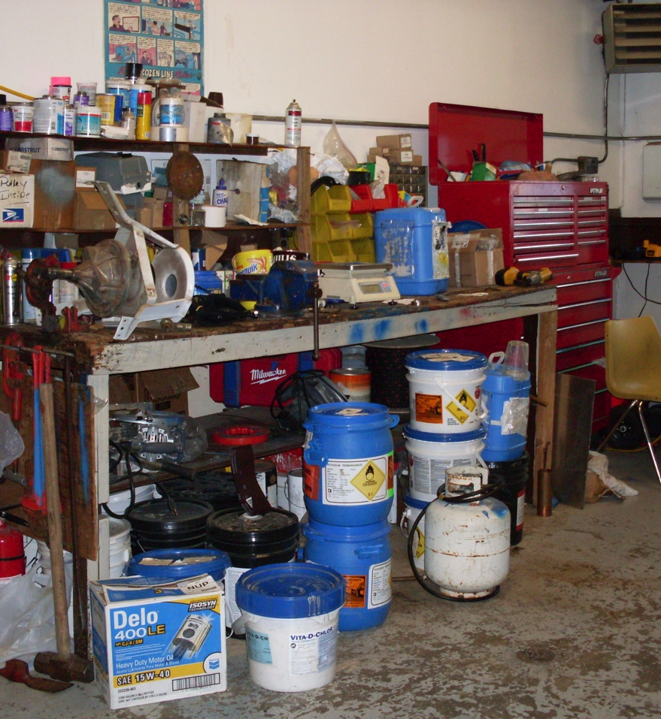
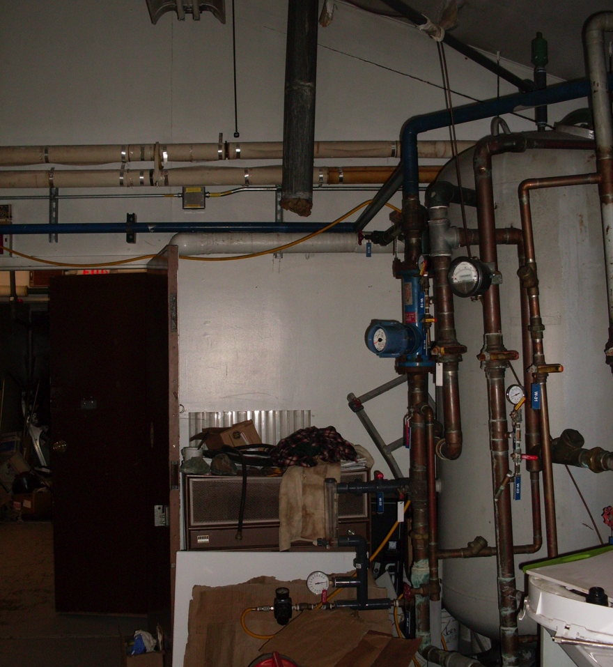
Maintenance Area
Notes:
There are no shelves for the water operator to place chemicals in. They lie around in the maintenance area near the back office. The photo on the right is the other side of the chemical mixing room showing an old heater with the pipe closed off just sitting there.

Slide 11
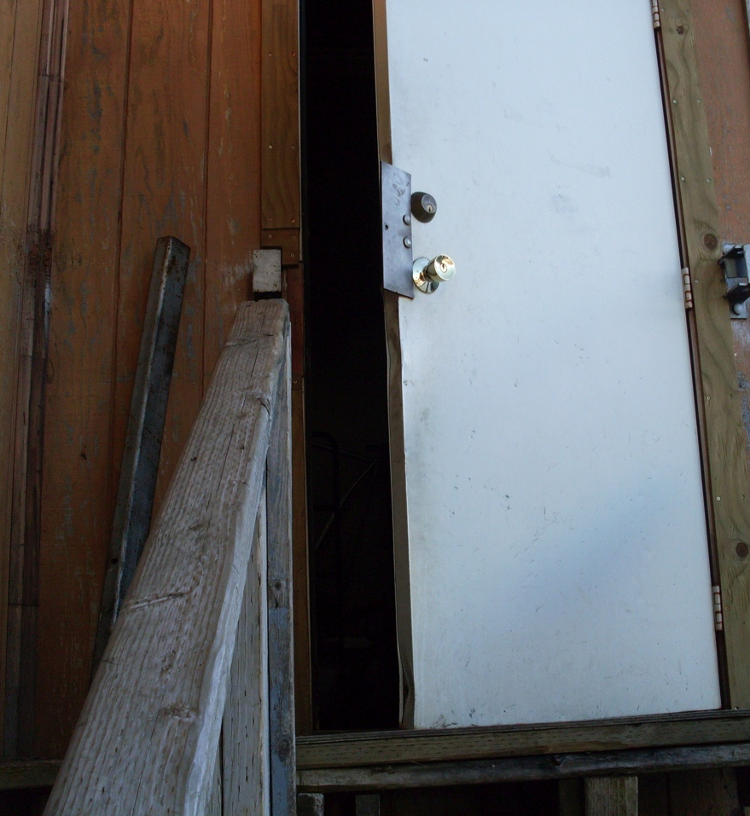
Back Door
Cannot open completely
Stairway is unleved
Notes:
The back door of the washeteria is unable to open all the way. That’s how far it will go to open. The unleveled stairway prevents it from opening completely. Since we are on top of marsh land, the building is ever shifting.

Slide 12
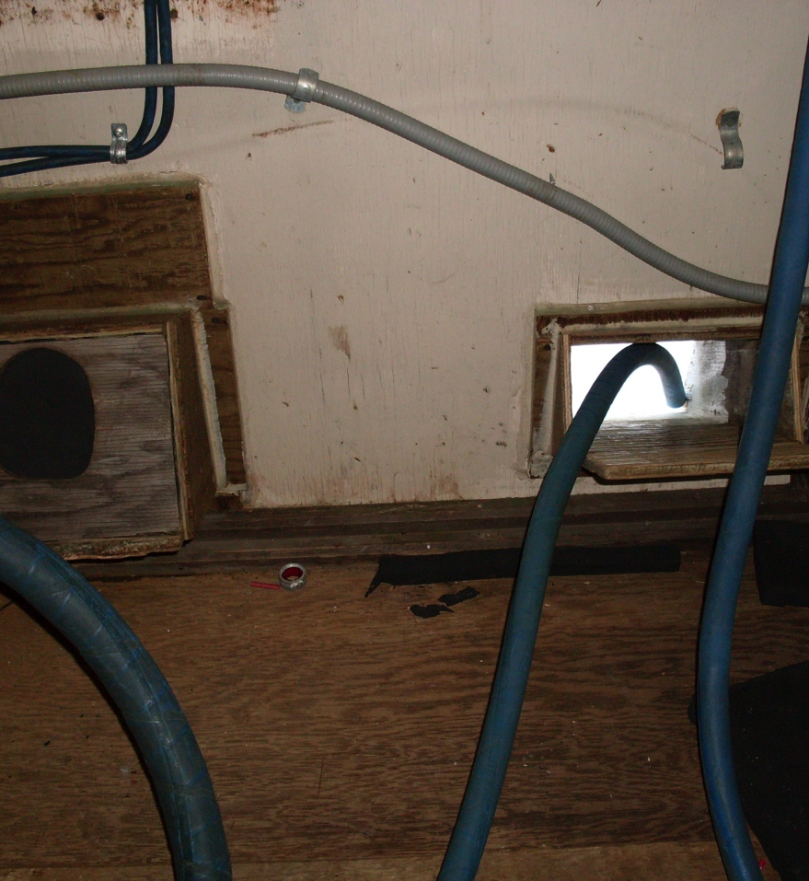
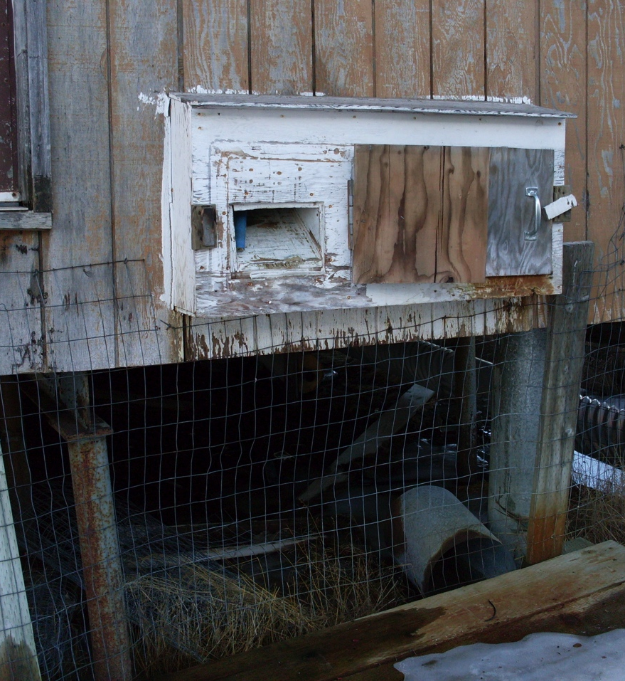
Water Hose
Notes:
This is the water hose that the water and sewer boys use to fill a 100 gallon water tank to make water deliveries to homes and businesses. Nunapitchuk does not have pipes for water or sewer and instead has 50 or 100 gallon water tanks and dog houses connected outside of each home for sewer. On the right you can see a cut out box shaped hole made of lumber for the water hose access from the outside.

Slide 13
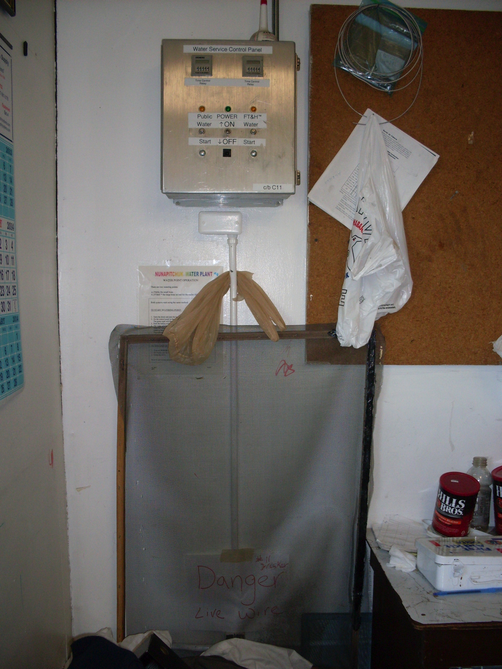
Water Service Control Panel
Set up inside water operator’s office
Hassle for water/sewer boys
Has a live wire below the panel
Notes:
Thiswater service control panel is set up inside the water operators office. Everytime the water and sewer boys come to get water, they have to come to this panel box turn it on to fill the 100 gallon water tank and then off once the tank is full. Below the panel there’s a live wire that’s blocked with this window screen for safety.

Slide 14
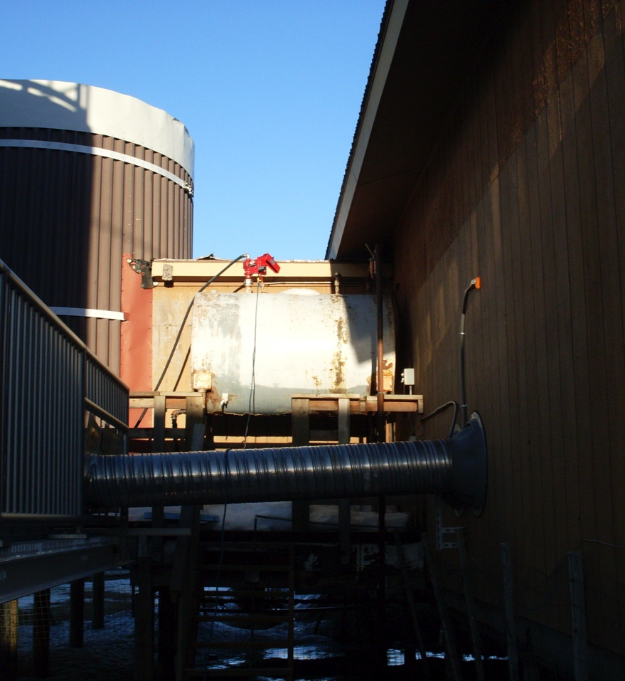
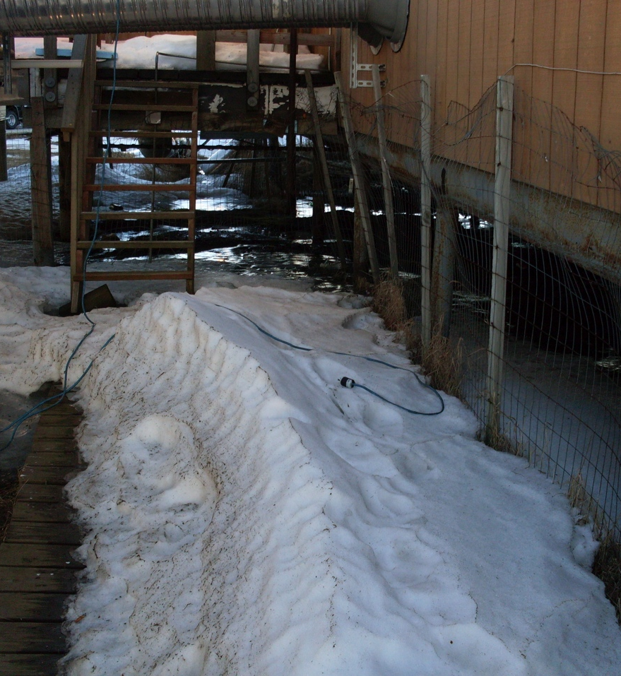
Day Tank and No Outlet
Notes:
The picture on the left shows what they call a day tank. This day tank gets filled with stove oil from the bulk fuel tanks and then gets transferred onto a portable 300 gallon fuel tank to heat the rest of the three City buildings. In order to make a transfer from the day tank to the portable tank, the boys have to plug the extension cord (shown on the right) inside the washeteria through the water operators office window since there is no outlet outside the building. During the start of spring and winter, rain dripping from the over hang freezes and ice builds up on top of the day tank. Our maintenance man fears water might enter the tank.

Slide 15
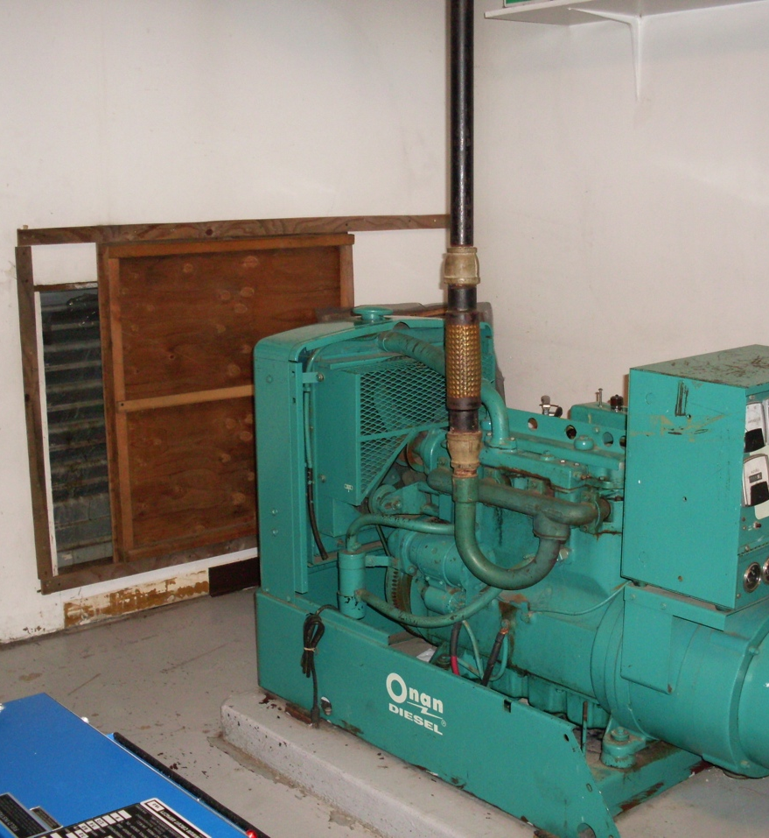
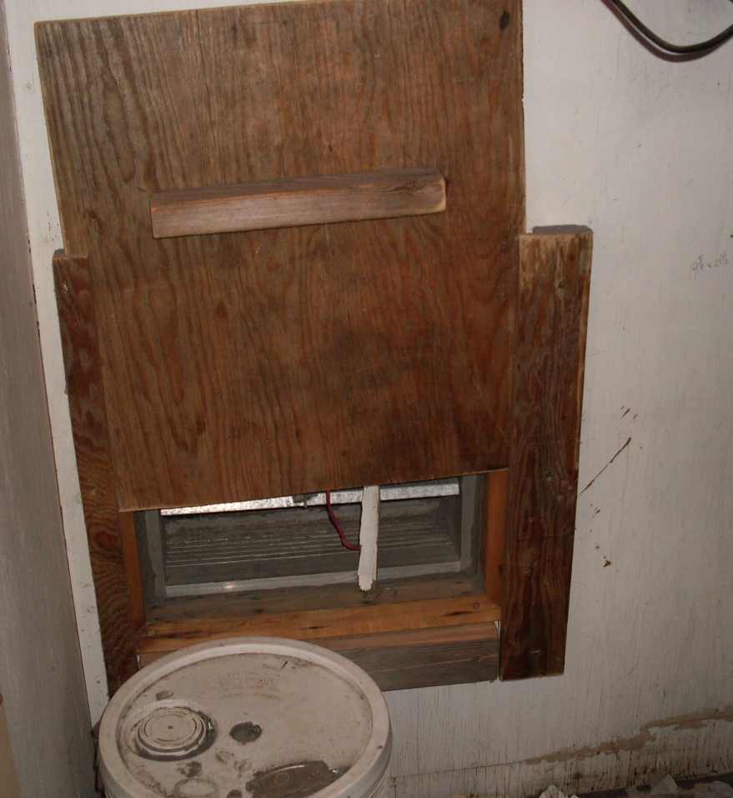
Ventilation
Notes:
Our washeteria has two ventilators. One by this green generator and one behind the two dryers. At closing and opening times staff have to open these vents for air circulation. If they aren’t opened dryers will not work as good as they should.

Slide 16
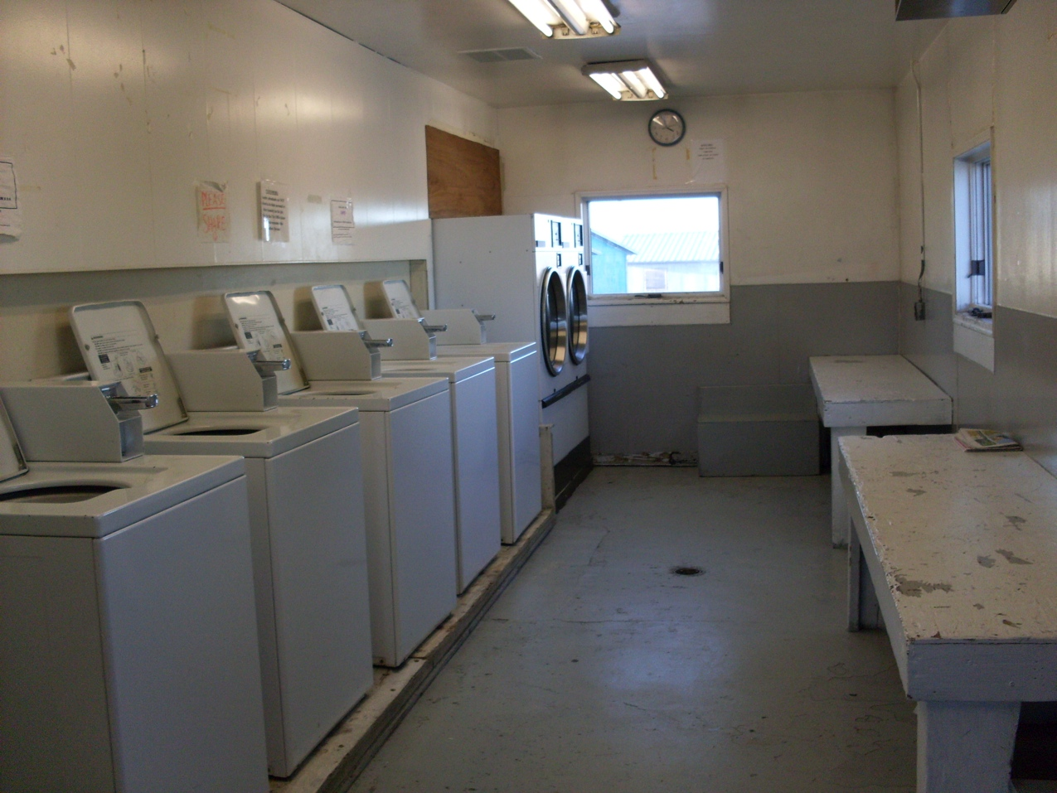
Washer/Dryer Area
Five Washers
Two Dryers
Three Benches
Two Tables
Notes:
At this time we have five washers and 2 dryers to provide for a community of 597 people. Some customers come wash as many as 10 loads or more and use the dryers all day or almost all day. It gets so busy sometimes that some folks don’t get to use the dryers at all until the next day. They always request that the City add more dryers but aren’t able to.

Slide 17
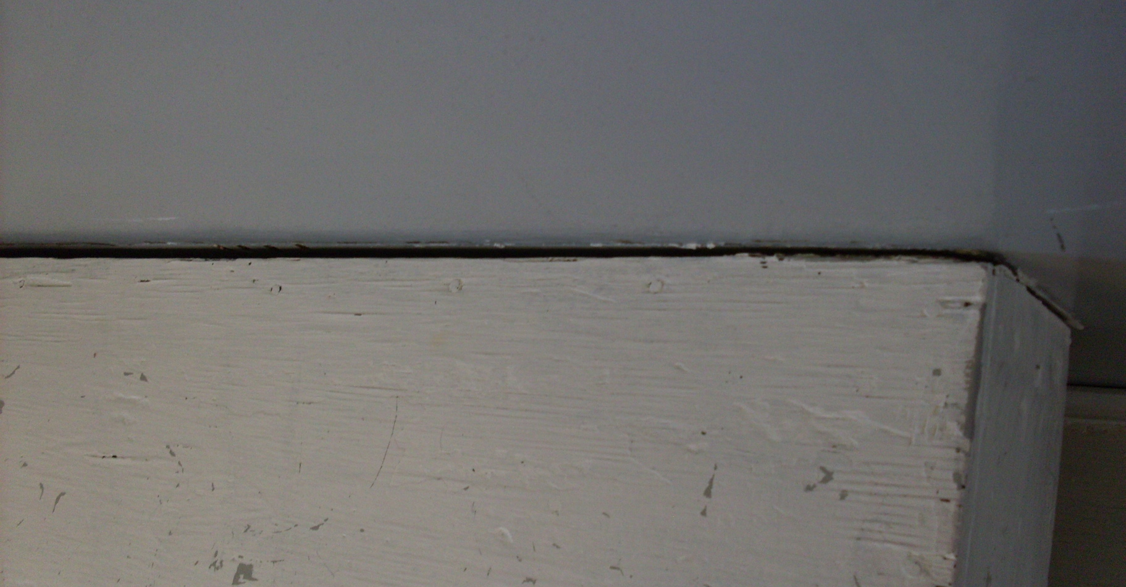
Benches and Tables Gaps
Notes:
The tables and benches against the wall in the washer room have gaps. Recently in December 2013, a customer killed a bed bug from this very bench and we’ve had less customers since. The staff cleaned the entire washer/dryer area ever since then and our customers are slowly returning. These gaps need to be fixed or covered up.

Slide 18
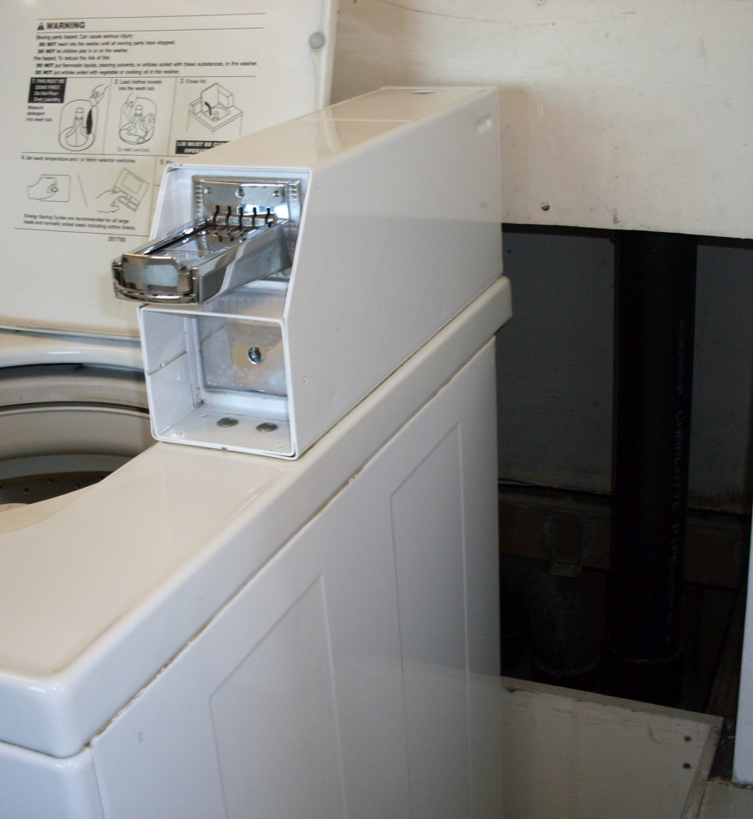
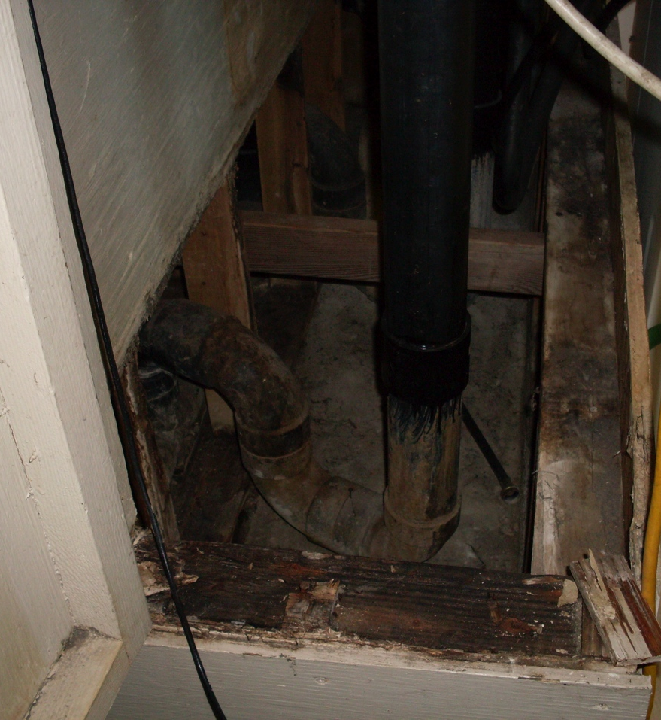
Drain Pipes Rotting
Notes:
There is a gap behind every washer showing their drain pipes. About a year and a half ago, these pipes were extended so that they wouldn’t overflow with washer water anymore. The overflow caused the wood to rot so bad that the building has an odor. Wood continues to deteriorate due to damp air.

Slide 19
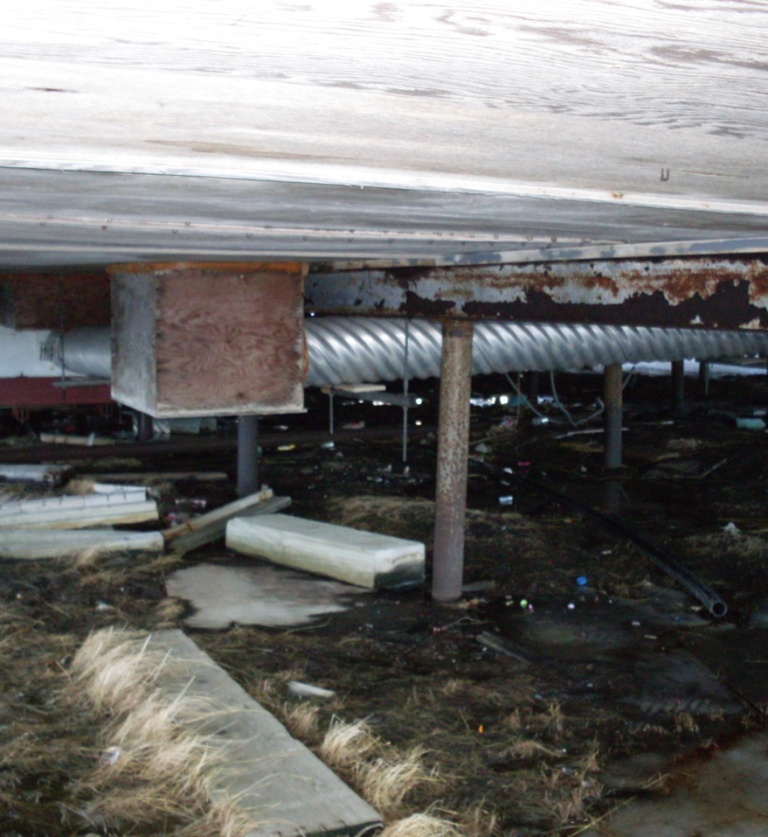
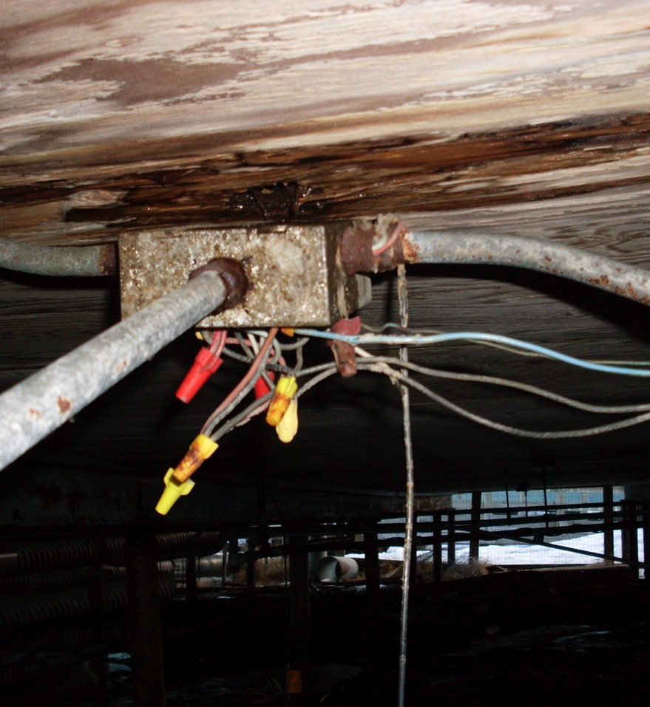
Rotting Foundation
Notes:
Our washeteria building is so old that the steel foundation are rotting in place. Wires that are hanging from underneath the flooring outside look dangerous and are leaking with water that is probably coming from the 4” plastic pipe shown here.

Slide 20
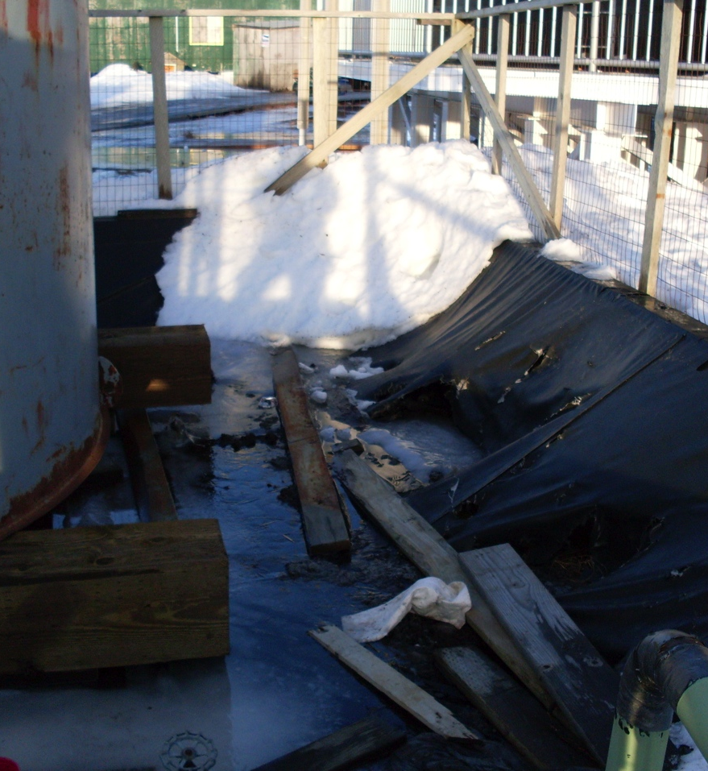
Bulk Fuel Tanks
Single Walled
Have to level the dykes every couple years
The tank liner has many holes
Notes:
Lastly, the bulk fuel tanks we have now are single walled and are very outdated compared to the newer bulk fuel tanks today. We have to be very cautious for these because the tank liner has many holes and will not contain much fuel if there ever was a spill. The dykes supporting these tanks were adjusted this past fall to keep the tanks leveled.

Slide 21
Improvements
Larger washers and more dryers
Sauna room away from backwashing pipe
Water service panel moved outside the office
Shelves for chemicals
Double walled bulk fuel tanks
Ramp for handicap access
Outlet outside the building and better water access
Notes:
Everything about this laundromat needs improvements. It would be cool if there were larger washers that can fit bulky clothing like blankets and sleeping bags. We definitely need more dryers and a sauna room not too close to the backwash drain pipe. Shower rooms need fixing. The water service panel needs to be moved outside the water operator office. We also are in need of shelves for chemicals and it would be safer to have double walled bulk fuel tanks.

Slide 22
In Conclusion
Many people rely on the Washeteria for washers/dryers, sauna, and water
Residents are not able to afford their own washers/dryers
Some residents do not own a steam bath (sauna)
Notes:
Many of the residents of Nunapitchuk rely on the Washeteria. They use the washer and dryers a lot, the sauna and depend on the water we make. Sometimes they substitute laundry water with river or rain water when they can. Some folks own a danby washer but most folks are not able to afford a washer or a dryer. I think it would be hard to own a washer at home since we have limited water supply and washers use a large amount of water. Steam baths are famous in this region and most people would rather take a steam bath then a shower. If there was no washeteria, it would definitely be hard on the whole community including the school and teacher housings because we rely heavily on water the washeteria makes. The City runs our local washeteria and it costs too much to try to keep it running. Right now the obama sequestration is affecting operations and maintenance costs for the washeteria. Basically, it will be hard to keep the City operations afloat since the laundromat is the third most money maker for the City of Nunapitchuk.

Slide 23
Nunapitchuk Washeteria
By Juliana Wassillie

