Slide 1

The Ideal Washeteria:
How consumers, operators and utility managers work together to maximize healthy communities
Presentation by the National Tribal Water Center
Troy Ritter, Director
Chris Dankmeyer, Program Specialist
4th Annual Water and Sanitation Innovations for the Arctic
Thursday, January 30th, 2014

Slide 2
2 Characteristics of the Ideal Washeteria
Facilitates and encourages consumers to practice the six model healthy water-use behaviors
Limits opportunity for washeteria-acquired infections (nosocomial)

Slide 3
#1
The Six Model Healthy Water-Use Behaviors

Slide 4
The Six Model Water-Use Behaviors*
Model Behavior | Respiratory | Skin | Diarrhea
Handwashing | x | x | x
Bathing | x | x | x
Household Cleaning | x | x | x
Laundry | x | x | x
Drinking Treated Water |  |  | x
Sewage Disposal |  |  | x
*Supporting literature for this table is available upon request

Slide 5
#2
Limit opportunity for washeteria-acquired infections

Slide 6
Thomas, T. K., et al. (2013). "Washeteria closures, infectious disease and community health in rural Alaska: a review of clinical data in Kivalina, Alaska." Int J Circumpolar Health 72.
Notes:
* One Conclusion: The significant decline in respiratory infections is of interest. This may be partially explained by the increased uptake of paediatric pneumococcal vaccine and possibly less opportunity for people to get infection because they are no longer congregating in the laundry facility.

Slide 7
Data Sources
Anecdotal evidence gathered from ANTHC/DEHE field work
Lit search supported by CDC Public Health Library and Information Center
  Database(s):MEDLINE, EMBASE, and Global Health:1946 to 2012
  58 lines of criteria included in the search strategy
  4219 “hits” being reviewed and categorized (ongoing)
Personal communications with subject matter experts
Notes:
identify the potential health concerns
where pathogens might exist within a washeteria
Knowledge gaps

Slide 8
The Suspects
Skin Infections | Respiratory | Diarrhea
Staphylococcus spp. | Influenza | Norovirus
Group A Streptococcal | Streptococcus pneumoniae | Clostridium difficile
Scabies, Lice, Bedbugs | Enterovirus
Pseudomonas aeruginosa | RSV
Biofilms | Coronavirus
Fungal Infections (Tinea)
Notes:
Don’t worry Troy, I’m not going to spend much time here.
Tinea is the name of a group of diseases caused by a fungus. Types of tinea include ringworm, athlete's foot and jock itch. These infections are usually not serious, but they can be uncomfortable. You can get them by touching an infected person, from damp surfaces such as shower floors, or even from a pet.
Pneumococcal (S pneumoniae) is the most common cause of community-acquired pneumonia (CAP), bacterial meningitis, bacteremia, and otitis media, as well as an important cause of sinusitis, septic arthritis, osteomyelitis, peritonitis, and endocarditis and an infrequent cause of other less common diseases.
The human enteroviruses are ubiquitous viruses that are transmitted from person to person via direct contact with virus shed from the gastrointestinal or upper respiratory tract. The enteroviruses belong to the Picornaviridae family of viruses and are traditionally divided into 5 subgenera based on differences in host range and pathogenic potential.
Coronaviruses are common viruses that most people get some time in their life. Human coronaviruses usually cause mild to moderate upper-respiratory tract illnesses.
C. diff, is a bacterium that can cause symptoms ranging from diarrhea to life-threatening inflammation of the colon.

Slide 9
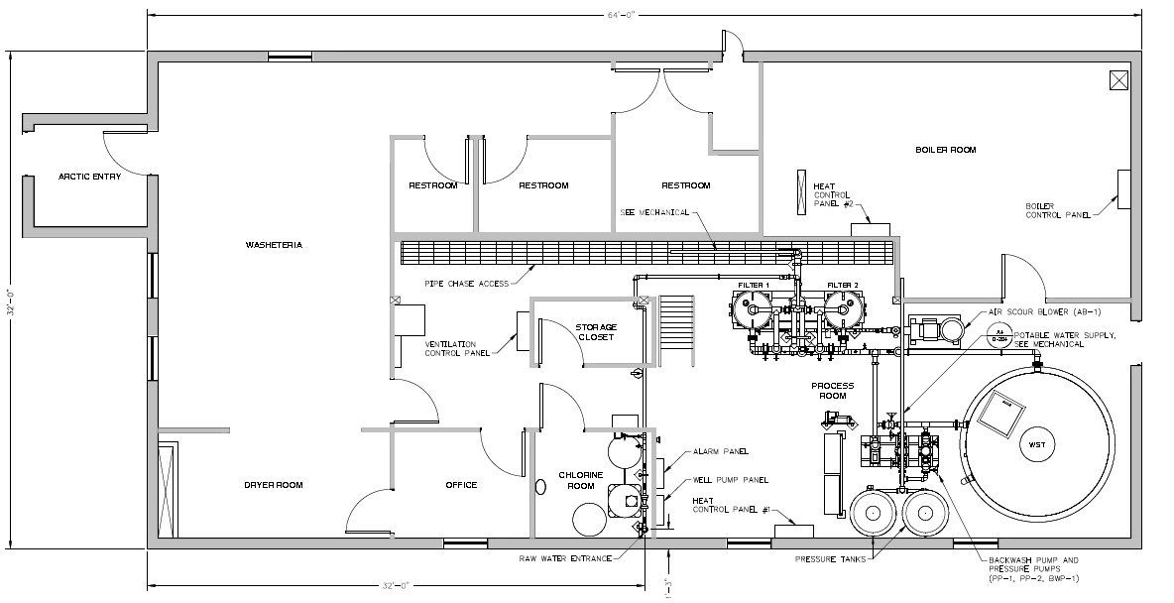
Where are they?
High traffic areas
Commonly touched surfaces
Equipment contamination
General cleanability
Fomites, fomites, fomites

Slide 10
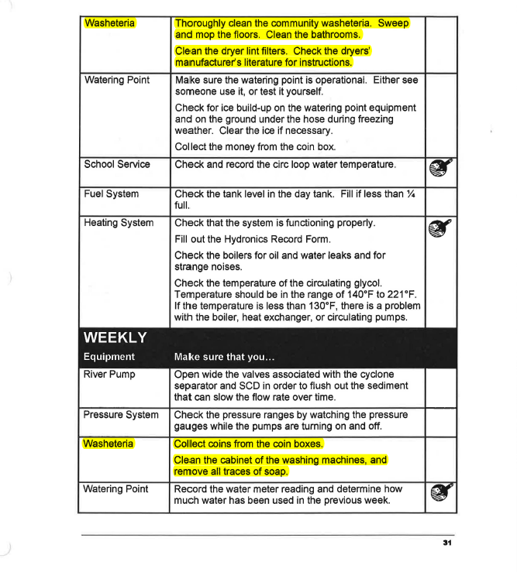
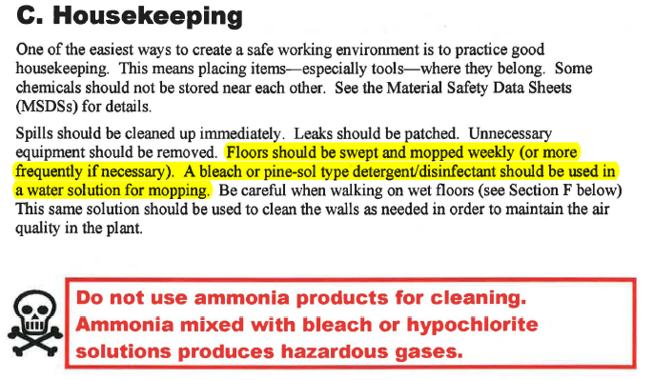
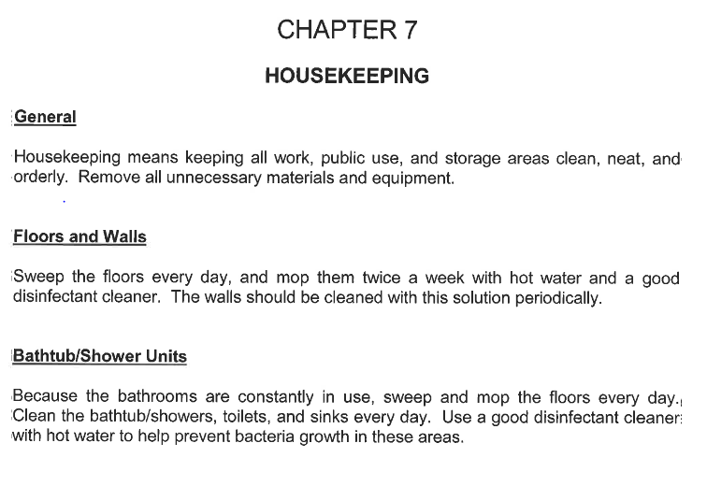
O&M Housekeeping Guidance
Notes:
The point here is that the guidelines are sparse and non-specific (historically and current).
What are utilities actually doing?

Slide 11
Some Knowledge Gaps
What we know | What we don’t know | Gap
Washeterias present an environment suitable for pathogen transmission | What pathogens are in Alaska’s washeterias? In what quantities? | Environmental Sampling
There are a myriad of cleaning/ disinfecting protocols and research articles (4000+) | What’s most appropriate for washeterias in Alaska? | Washeteria housekeeping best practices
Washeteria O&M Manuals provide general housekeeping recommendations | What’s actually being done? What frequency? Is it effective? | Behavior

Slide 12
Maximizing Health Through Behaviors
Consumers
Operators
Utility Management

Slide 13
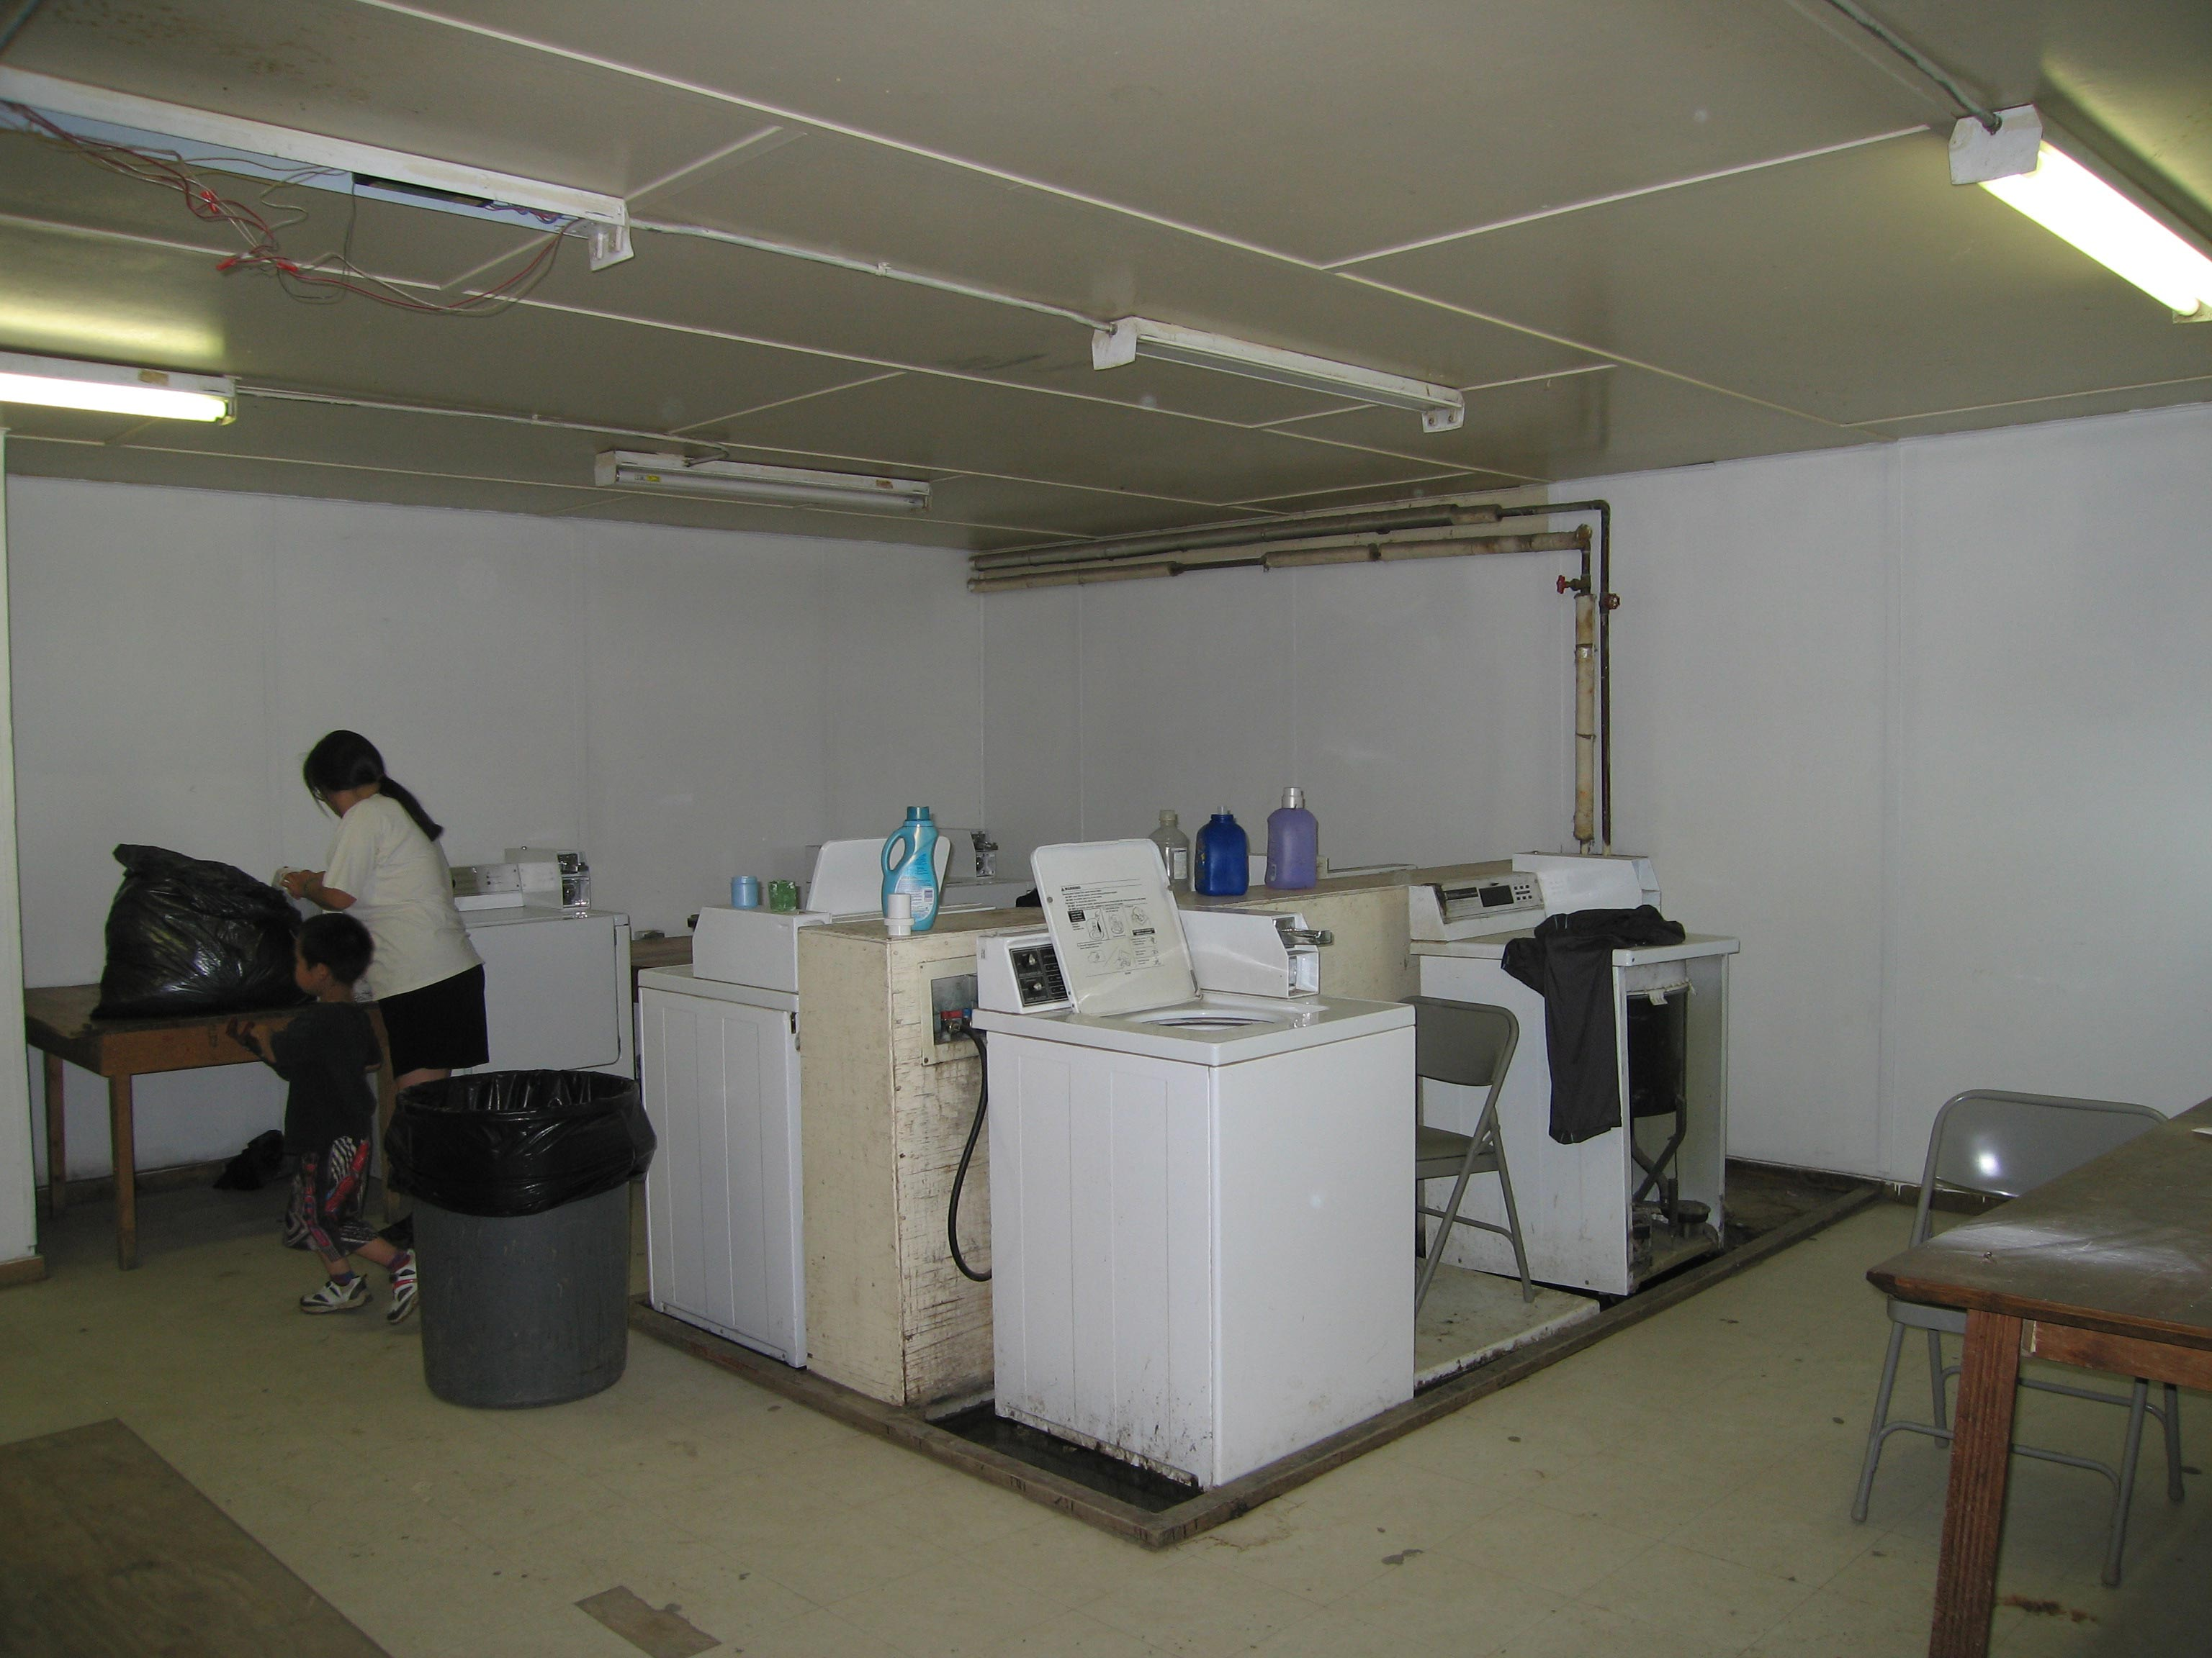

Slide 14


Slide 15

Thank you

