Slide 1

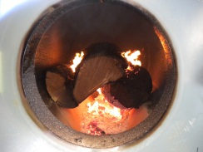
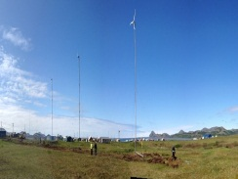
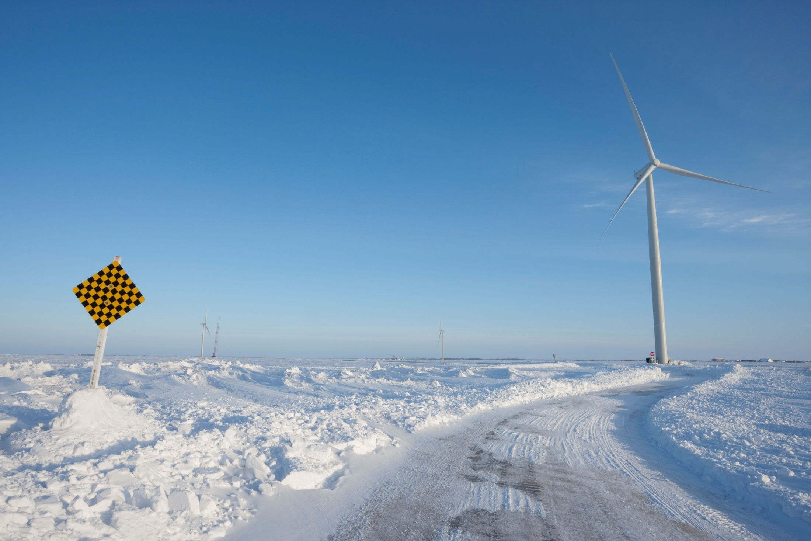

Wagner
ANTHC
DIVISION OF ENVIRONMENTAL
HEALTH & ENGINEERING
ANTHC Rural Energy – Washeterias
Briefing
for the Arctic Research Commission
January 2014
Daniel Reitz, P.E.
Rural Energy Program Manager
Notes:
Rural Alaska, Energy and Health
They are all interconnected which has been seen clearly, especially lately.

Slide 2
The Rural Conundrum
“ The poorest Alaskan households spend up to 47% of their income on energy, more than five times their urban neighbors.” - Commonwealth North 2012
Notes:
Rural Alaska households spend their meager income on energy. In part due to low incomes and in part due to high energy prices.

Slide 3
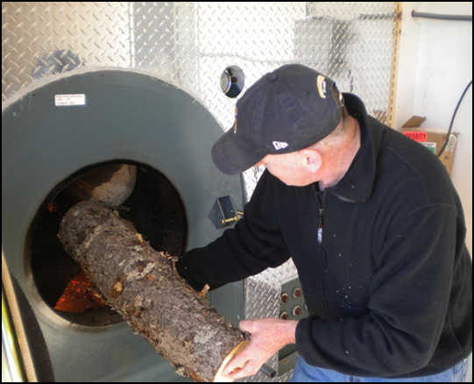
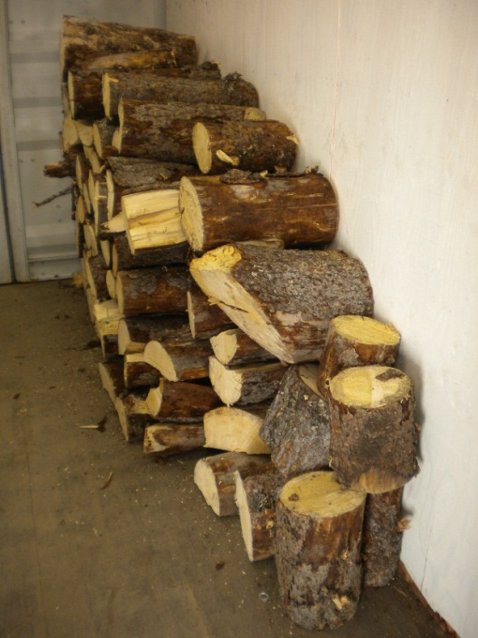
ANTHC Energy Program Overview
Initial Survey 2011
Energy Audits
Energy Efficiency Upgrades
Heat Recovery Projects
In home TED meters
Biomass heating
Wind Energy
Education
Notes:
ANTHC recognized this and took action.
We studied the problem and, at the same time, responded to it.
We have started to quantify the problem and understand it in much more detail.
Responses have included: efforts in central facilities, in-home monitoring, and education.

Slide 4
Energy Survey of 2011
• Circulating arctic water and vacuum sewer
• Circulating arctic water and conventional gravity sewer
• Conventional water distribution and gravity sewer
• Washeteria/watering point with honeybucket sewage disposal
Energy needs comprise 30 to 60 percent of a community’s water system operating costs and up to 30 percent of a community’s total energy.
Notes:
ARUC Records were used
We contacted villages in several manners to assess energy use in water systems
Records of actual use of fuel oil were very sketchy in most locations
Power company records were analyzed
A predictive model could not reliably be generated. Data as all over the place and much of it was questionable. However, it was the best in existence for now.

Slide 5
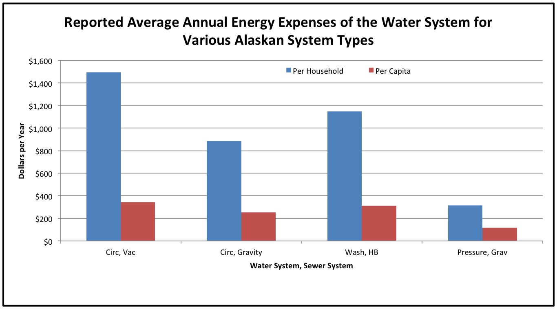
Notes:
The survey did reveal some broad patterns.
Clearly arctic systems with vacuum sewers were the most energy intensive – no surprise.
Energy use by washeterias was a little surprising

Slide 6
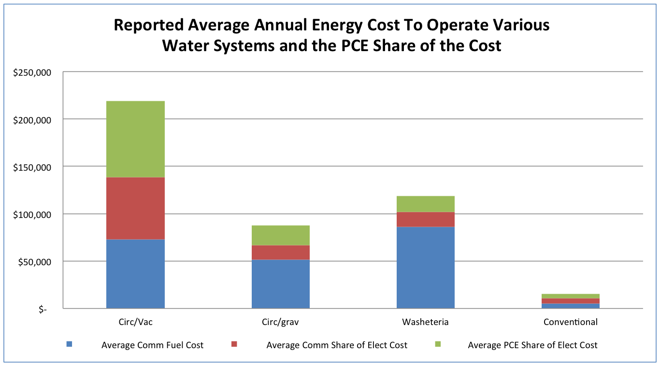
Notes:
This is the same data broken down in a different manner, by type of energy use.

Slide 7
Notes:
This is an ARUC analysis. As can clearly be seen, energy is a large component of water system expenses.

Slide 8
Energy Audit Overview
What is a water plant and are they all the same?
How important are energy costs in keeping rates down?
How much energy do water plants use?
How much can be saved?
What can be done short term to reduce energy costs?
What can be done long term to reduce energy costs?
Is renewable energy a good idea in water plants?
Notes:
Our learning and study came from our initial survey of 80 villages in 2008 and our extensive energy audit program of public buildings and facilities over the past 4 years.
We found that the sanitation systems in Arctic areas are one of the largest energy users and are very ripe for solutions.

Slide 9
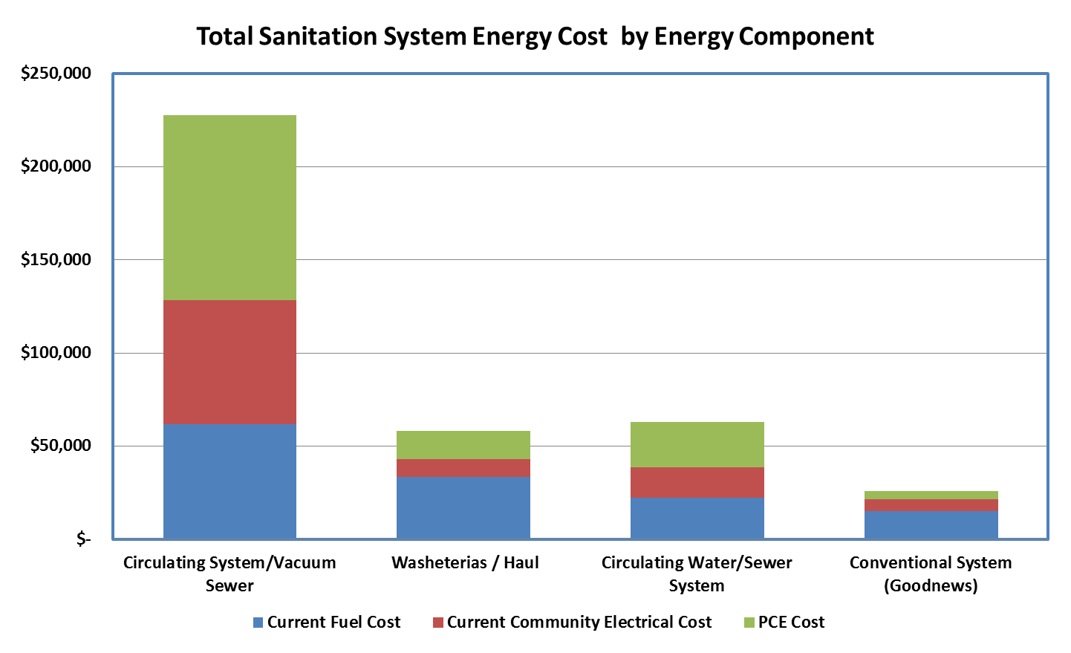
Notes:
Audit findings presented similar to the 2008 survey. The findings were fairly consistent with the original survey.

Slide 10
Audit Finding - Averages
(40 Villages)
Average by Facility Type | Potential Fuel Savings (gals) | Potential Electrical Savings (kwh) | Potential Cost Savings | Retrofit Costs | CO2 SAVINGS (lbs/yr) | SIMPLE PAYBACK (Years)
Water and Sewer Facilities | 1,890 | 24,400 | $ 14,575 | $ 65,447 | 61,098 | 4.5
Health Clinics | 417 | 4,974 | $ 3,544 | $ 11,582 | 18,015 | 3.2
Tribal Buildings | 387 | 2,047 | $ 2,999 | $ 12,032 | 11,826 | 4.0
Average Per Village | 2,694 | 31,421 | $ 21,118 | $ 89,061 | 90,039 | 4.2
Notes:
Audit findings by average per villages.

Slide 11
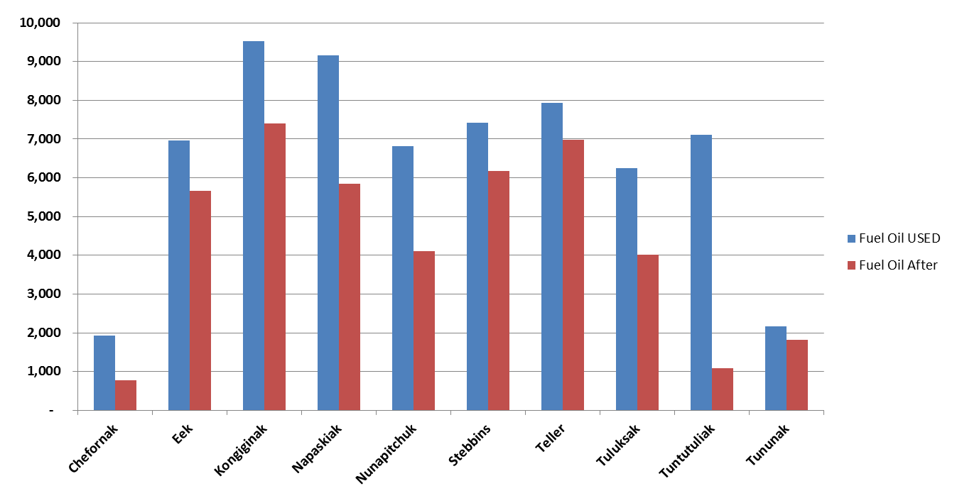
Washeteria Fuel Oil Usage Profile (Gallons)

Slide 12
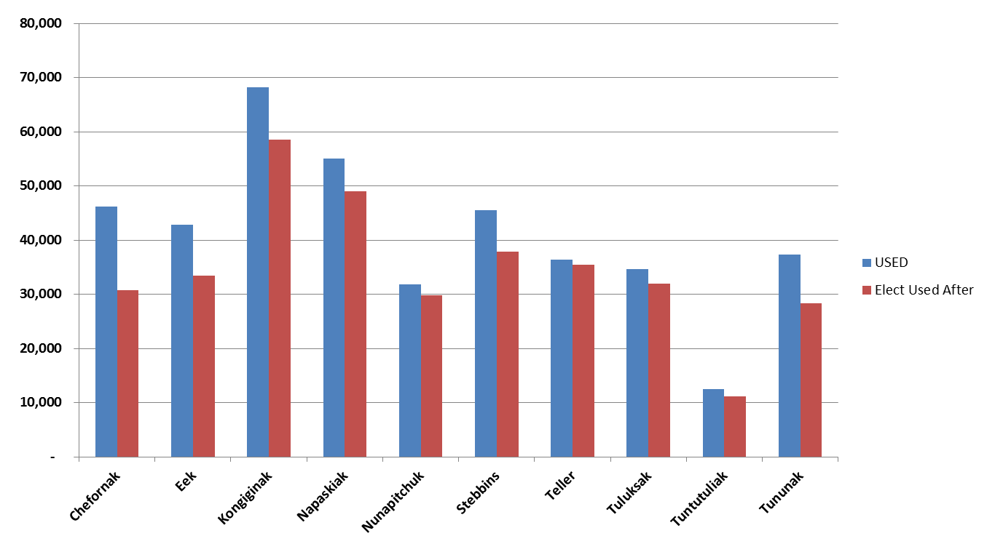
Washeteria Electrical Usage Profile (Kwh)

Slide 13
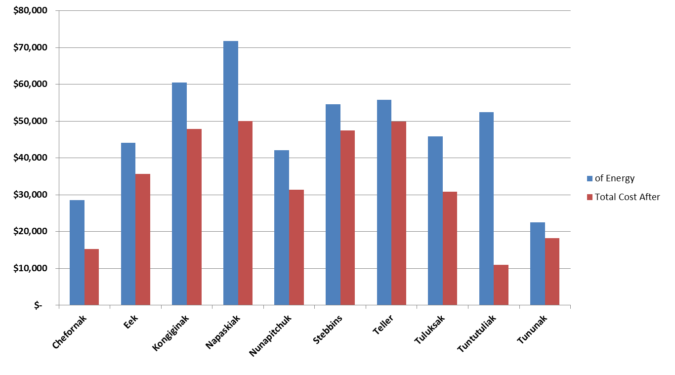
Washeteria Energy Cost Profile (Annual Dollars)

Slide 14
Retrofit Type Description and Examples
Retrofit Types | Description | Example
Operations and Maintenance | Simple projects that require little time or money to acomplish. Local village fully capable of doing. | Shut off heat tape, setback thermostat, shut off pumps, Reduce temperature in loop
 | Projects that may require a specialized person from the village, but the village has most necessary supplies. May need some funding. | Clean Boilers, Reduce air transfer, Clean and adjust floats in lift station
Local Retrofit | Projects that may require significant funding, but local village has all necessary skills and capabilities. Village may or may not have supplies for the job. | New Thermostats, New lights, Replace aquastats, insulation additions
Minor Project | Larger scale projects that require outside assistant. Project may require technicians to assist and/or very significant funding. | Controls retrofitting, new boiler installation, resizing and replacing pumps
Major Project | Largest scale projects that will require significant outside assistance. Projects may potentially need an Engineer, Superintendant, or other Professionals. Technical experts and very significant funding required. | Waste Heat projects, Outfall Replacement, Excess Wind to Heat
Notes:
The findings were “categorized into these broad categories” and analyzed.

Slide 15
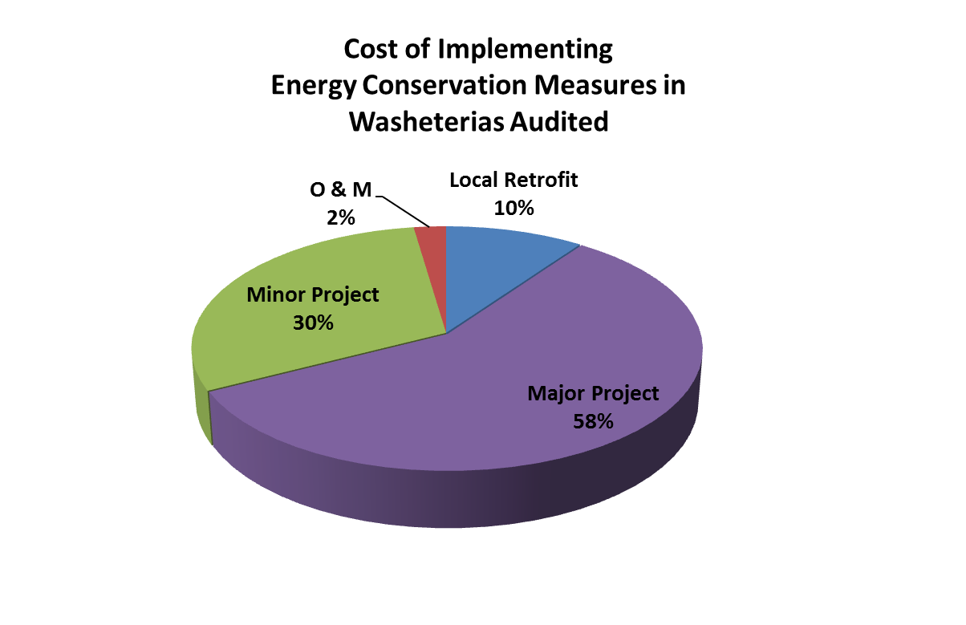
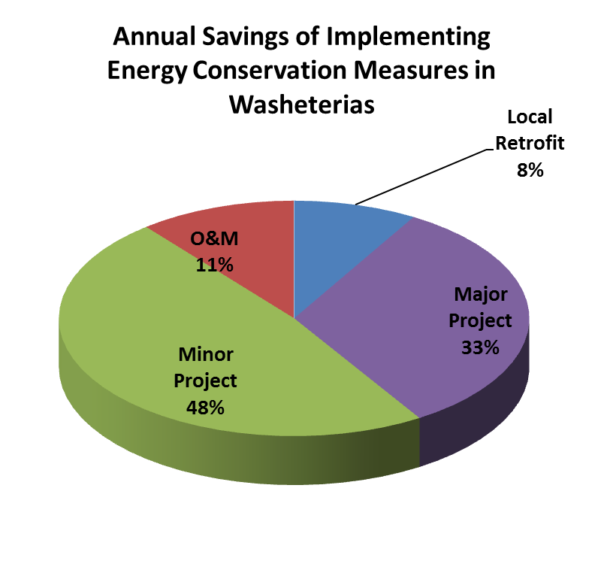
Operation and Maintenance Pays !
Notes:
So where were the savings found?
As can be seen, minor projects and retrofits ( green area on the left) is the largest followed by major projects. As can be seen on the right chart, the cost for implementing minor projects is disproportionately low to the savings. Minor projects have the “biggest bang for the buck.” Large projects cost more, so they have a longer pay back.
For the most part, only the major projects are being implemented due to available funding of the SOA renewable energy fund.
However, look at the red sliver on the right. Just basic operations changes, which cost very little, have fairly large return on the left.
Examples of different Project types:
Minor Major Operations
Heat / Boiler controls Heat recovery Heat tape shut off
Lighting Biomass Heating Temperature Optimization

Slide 16
Typical Minor Projects and Operational Issues Identified in the Audits of Washeterias
Boilers need to be cleaned and tuned
Boilers settings are too high and not properly staged
Boilers are operated all summer when they are not needed
Boiler optimization controls are bypassed
Building temperature is not set back during unoccupied hours
Water storage tank temperature set higher than needed
Water storage tank heat add controls not operational
Electric heat trace used all winter (or all year) when designed for emergency thaw only
Notes:
The theme here is operations and maintenance.

Slide 17
Longer Term Energy Upgrades
Improve the building shell by adding insulation and replacing windows
Replace old and tired boilers with new appropriately sized high efficiency cold start boilers
Replace pumps with new high efficiency pumps and variable speed drives
Repair and or replace process pipe insulation
Add remote monitoring to identify energy waste
Re-commission the building and all associated processes
Upgrade both interior and exterior lighting
Improved operator training
Evaluate the cost effectiveness of all types of renewable energy including:
  Heat Recovery
  Biomass
  Wind to Heat
  Wind
  Solar

Slide 18
Barriers to Energy Efficiency
Lack of Awareness - Communication between operations and management
Aversion to Risk – (sometimes real)
Change May Imply Problem with the Status Quo – threatening
Subsidies – Unintended consequences
Poorly Financed Operations
Age – Inherent to the time period of development

Slide 19
For More Information:
Daniel Reitz, PE
Rural Energy Program Manager
ANTHC, DEHE
907-729-3509
dreitz@anthc.org

