Slide 1
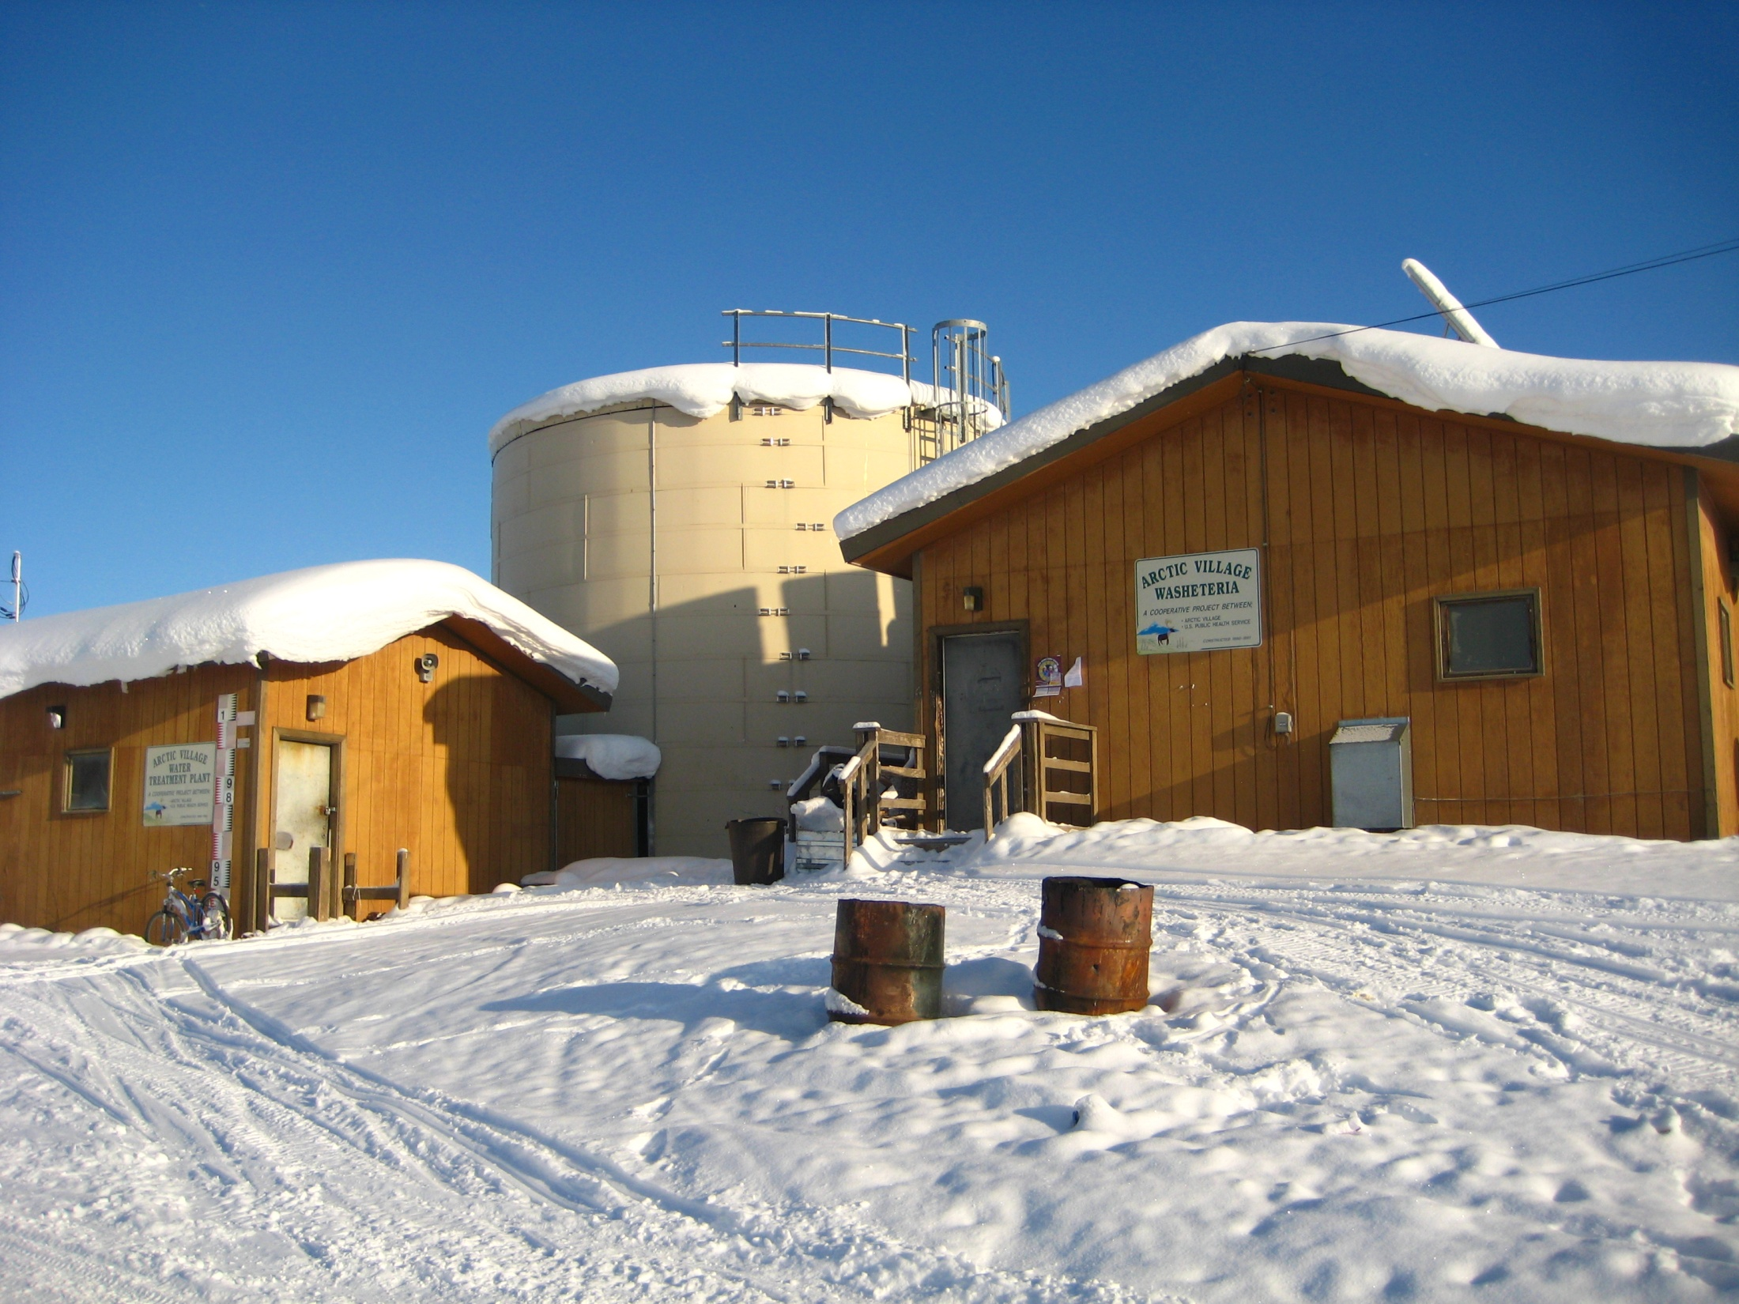
Alaska Village Washeterias in 2014 and Beyond
Bill Griffith
Alaska Department of Environmental Conservation

Slide 5
Total population of villages with no service or haul system service to homes: 8,934 people
(about 2,500 homes)

Slide 7
Funding need for washeterias
over the next ten years
20 washeterias
in fair or poor condition
X
$6 million replacement cost per facility (assume combined water treatment plant & washeteria)
=
$120 million
Serving 1,400 homes,
unit cost is around
$85,700 per home

