Slide 1
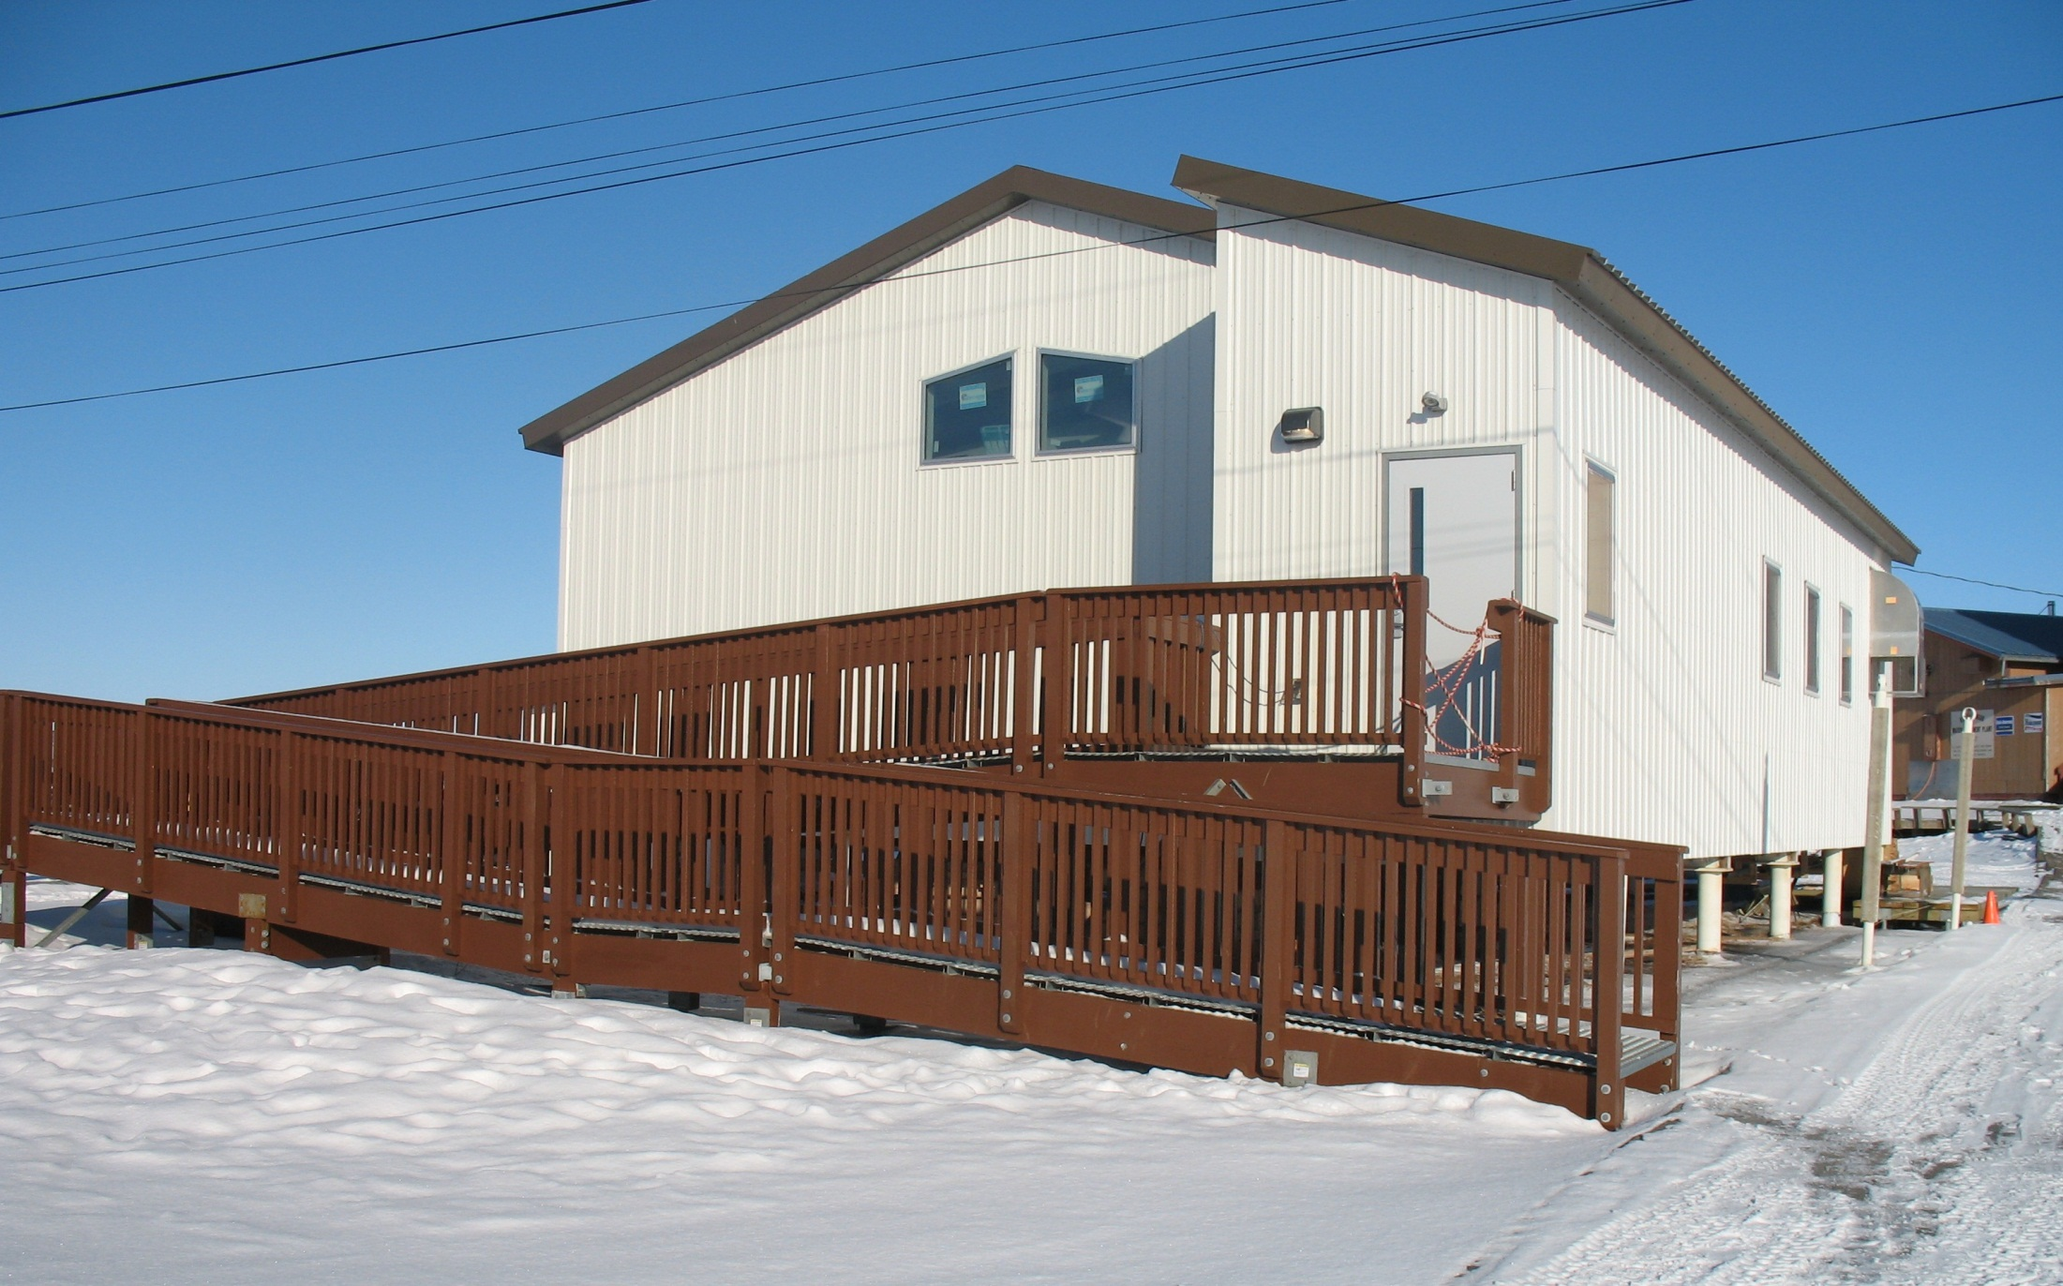
ANTHC
DIVISION OF ENVIRONMENTAL
HEALTH & ENGINEERING
Evolution of Central Facilities
The Washeteria
Don Antrobus, P.E. Design Director
Annual Water and Sanitation Renovations for the Arctic
January 2014

Slide 2
Birth of the Washeteria
Where was first washeteria constructed?
Who built it?

Slide 3
Birth of the Washeteria
EPA: Alaska Village Demonstration Project 1970
Wainwright 1972
Emmonak 1976
Alaska Village Safe Water Act of 1970
Central Facilities for 11 Communities
Northway and Chevak in 1972
Other 9 by 1979

Slide 4
Wainwright Floor Plan II

Slide 5
Emmonak Floor Plan

Slide 6
Beaver Floor Plan

Slide 7
AVDP Project Reporting
Washeteria concept acceptable.
O&M will be a challenge.
Cost: Too expensive with only user fees.
“With rare exception, Alaska native villages cannot pay, through service charges, the full cost of routine operation and maintenance of water –related utilities, especially where complex treatment is required to meet technology-based or receiving water quality standards.” (Alaska Village Demonstration Project: Final Report)
Standards: No Single best method. Too many variations to establish workable number of standards.

Slide 8
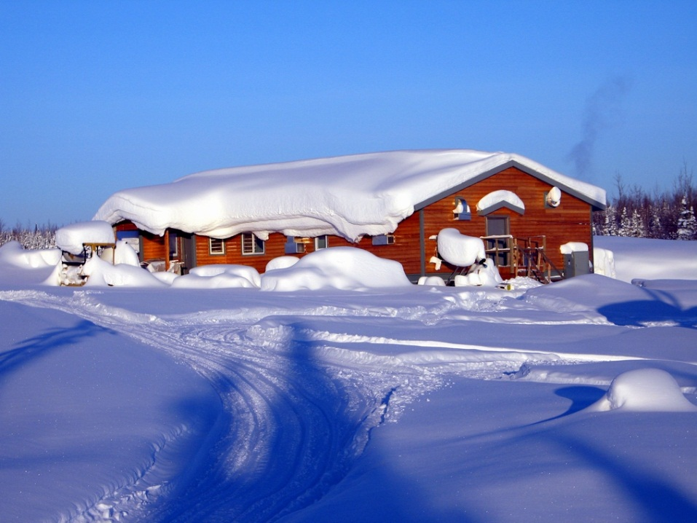
Standardization in 2013
From Statewide Perspective: Little or none.
Some Regional Standardization.
Commonalities:
Toilets, Sinks, Showers
Washing Machines, Dryers

Slide 9
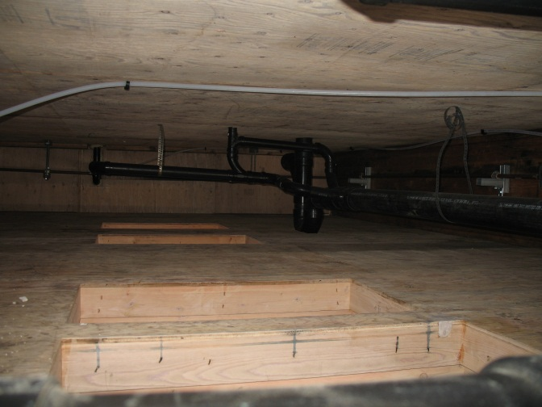
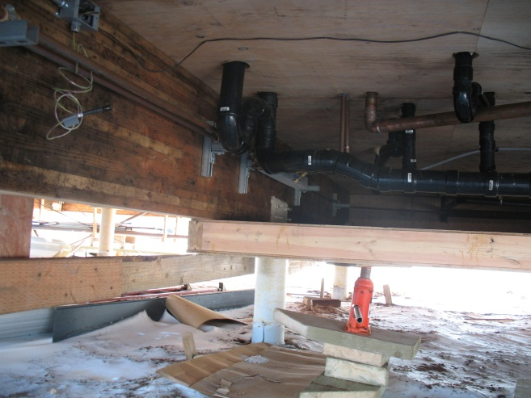
Plumbing Philosophy and Floor Plan
All Plumbing within Envelope
Easy to access and maintain
Better Protected from Freezing
More restrictive floor plan
Challenging configurations
Plumbing within Subfloor
Less Restrictive Layout
Difficult Access for maintenance/repair
Additional heating systems.

Slide 10
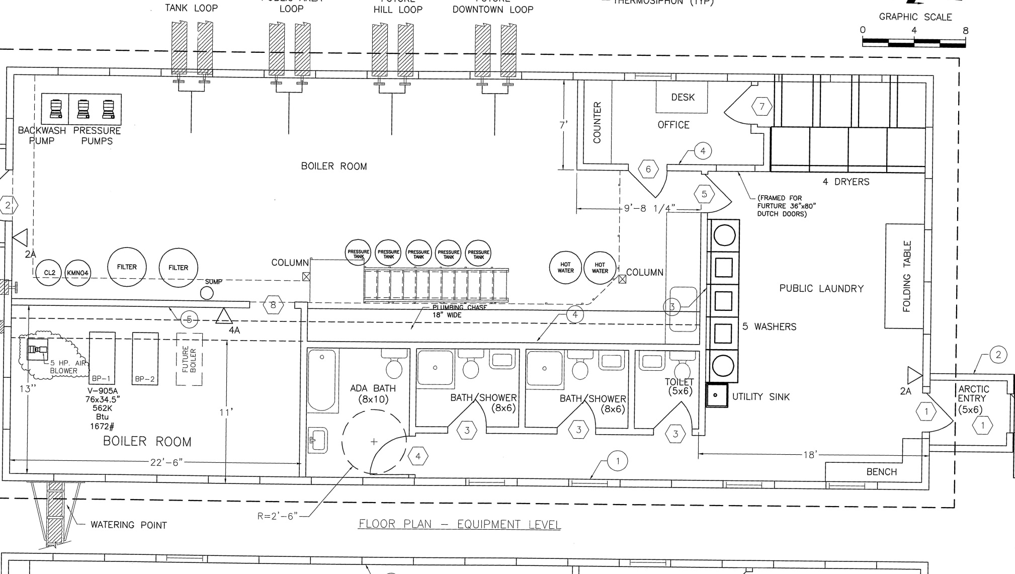
Plumbing Philosophy and Floor Plan

Slide 11
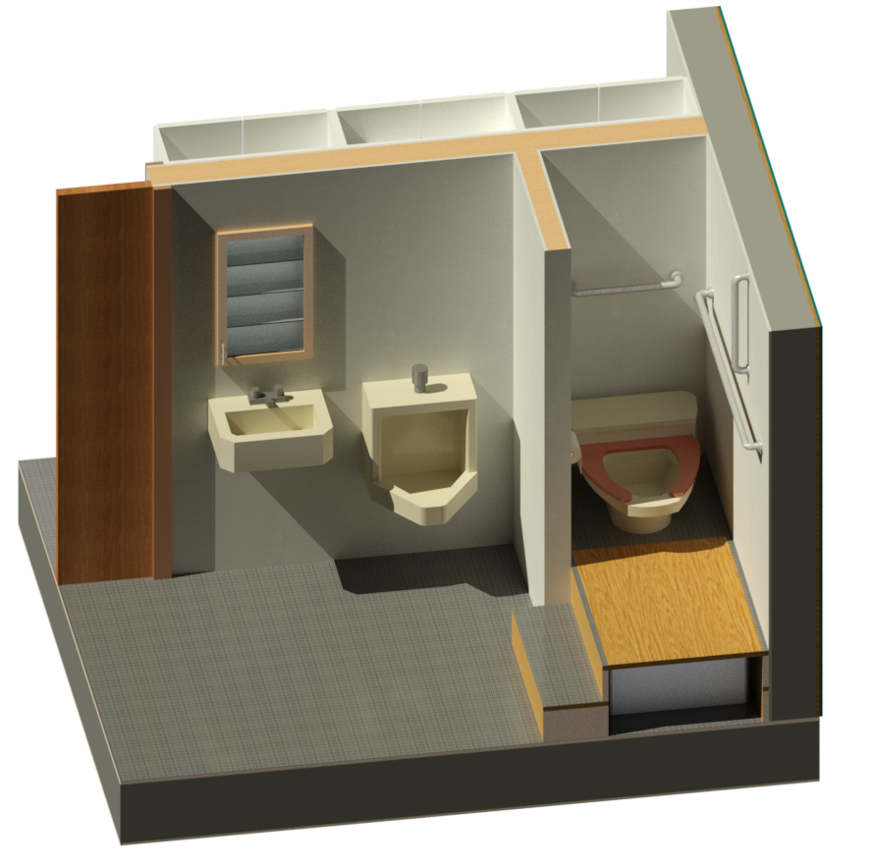
Plumbing Philosophy and Floor Plan

Slide 12
Plumbing Philosophy and Floor Plan

Slide 13
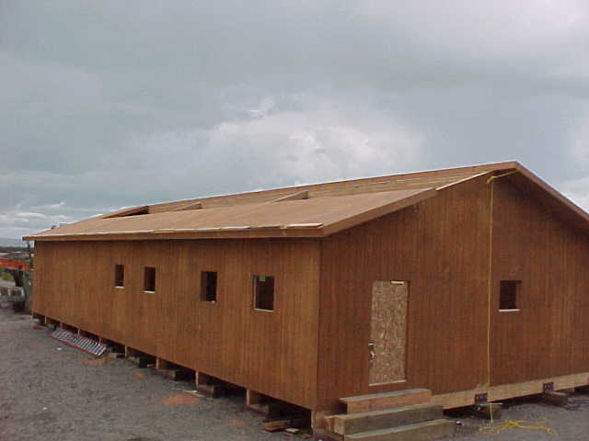
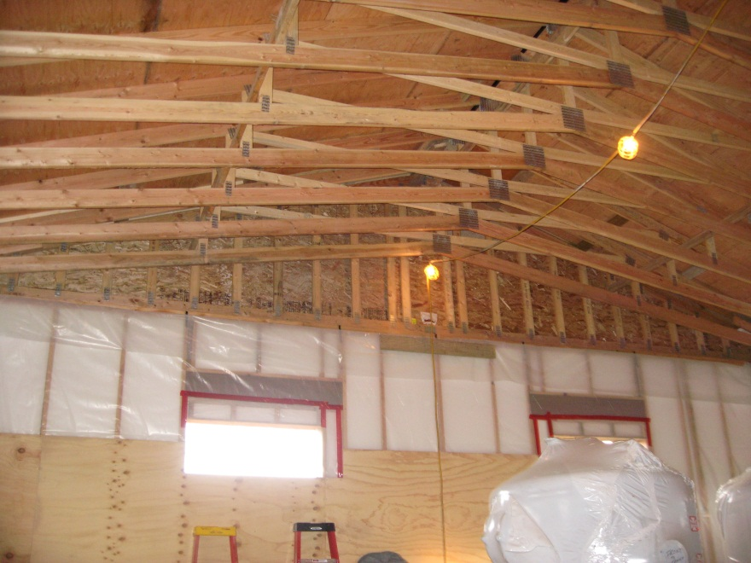
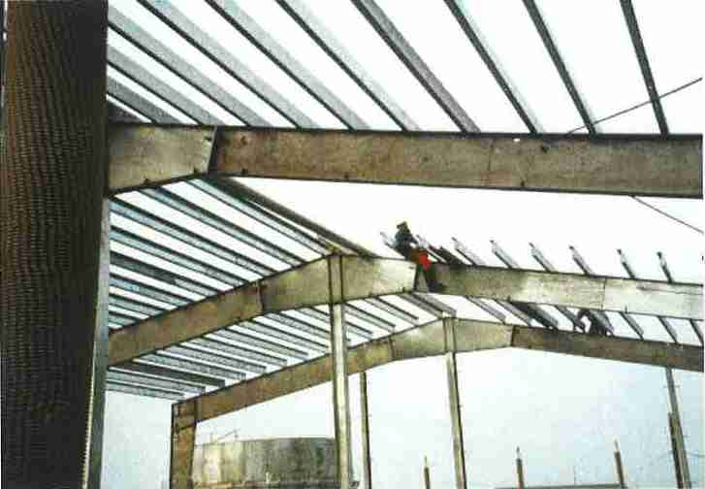
Structure
Wood Construction
Panelized Construction
Stick Framed Construction
Pre-fab Metal Buildings

Slide 14
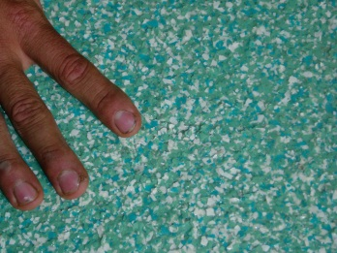
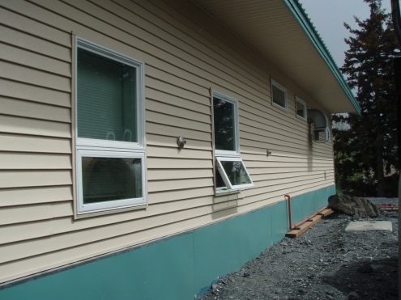
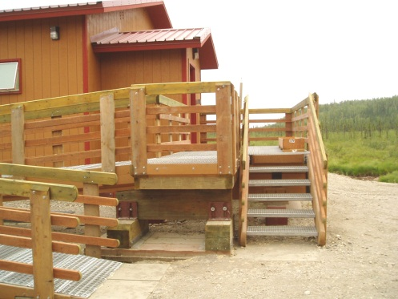
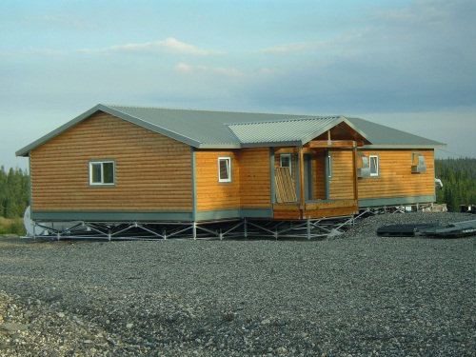
Finishes and Aesthetics
Floors
Durability, Ease of Repair, Application Safety, Community Preference.
Options: Concrete, Epoxy, Rubber, Polyurea, Flexible Epoxies.
Interior Walls:
Painted Plywood, Sheetrock, Wainscot, Fiber Reinforced Plastic (FRP)
Exterior Walls
T1-11
Metal Siding
Log Siding

Slide 15
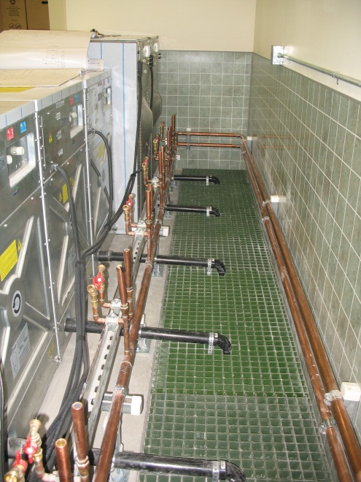
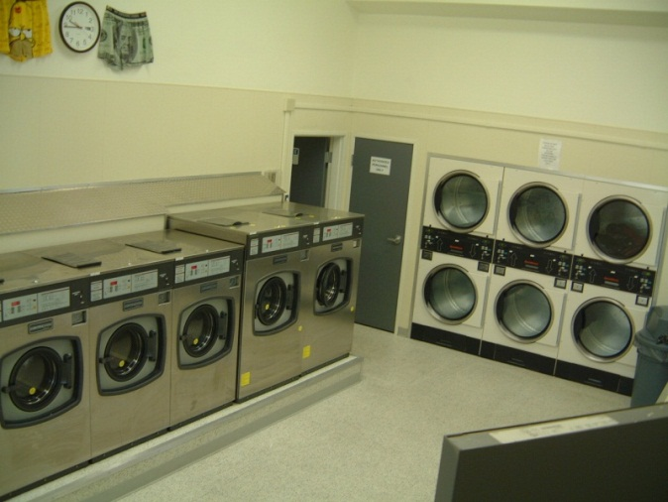
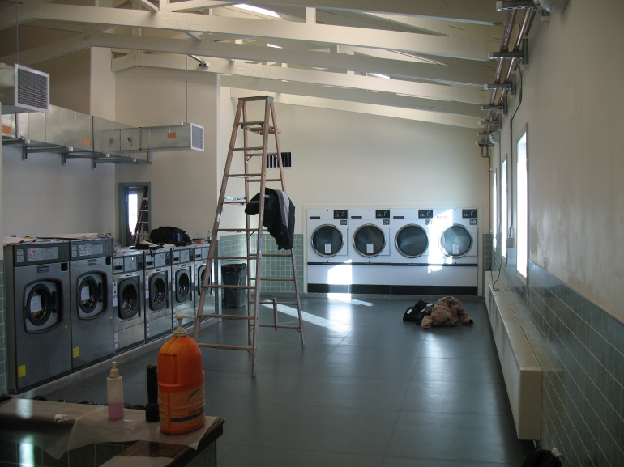
Appliances
Laundry Equipment:
Industrial
Tokens, Coins, or Attendant
Solid State Controls
Washing Machines
Size Matters
Discharge
Ozonation
Dryers
Temperature and Drying Time
Energy Source
Gas, Oil Fired, Electric
Hydronic
Waste-heat

Slide 16
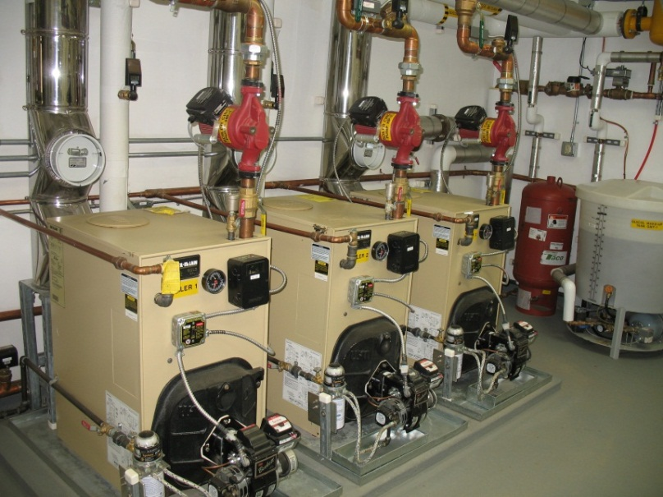
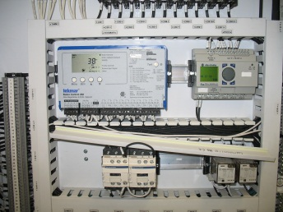
HVAC
Boiler Sizing Philosophy
Peak Load, Full Redundancy vs.
Critical Loads, Double Redundancy
Primary – Secondary Configuration
Controls:
Electro Mechanical
Solid State
WH
UH
HX
B-1
B-2
B-3

Slide 17
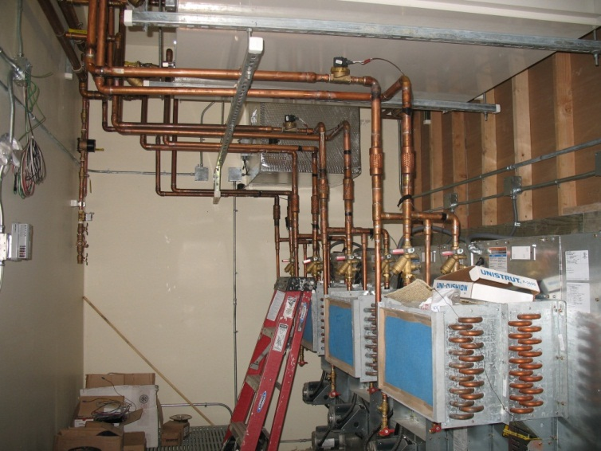
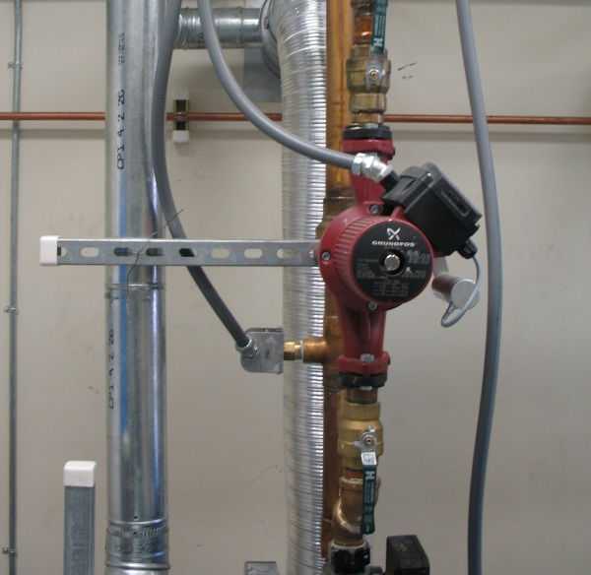
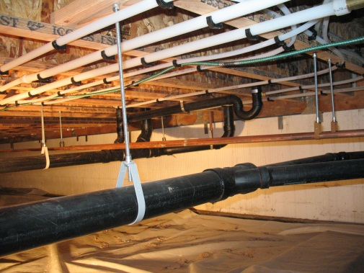
HVAC
Hydronic Dryer Heating
Multistage heating
Make-up air
Variable Speed Pumps
Plastic Pipe vs. Copper
Renewable Energy
Condensing vs. Non-Condensing Boilers

Slide 18
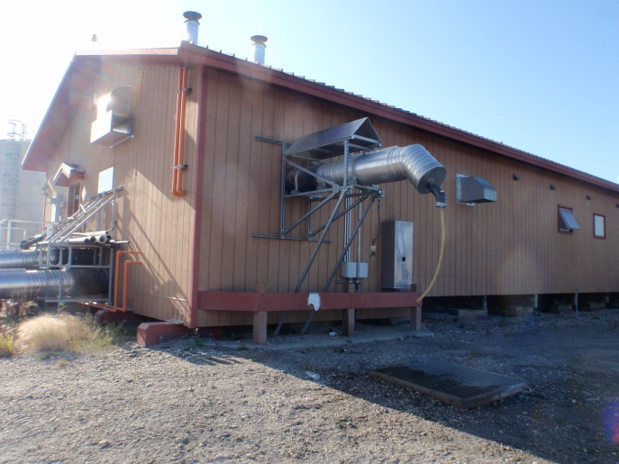
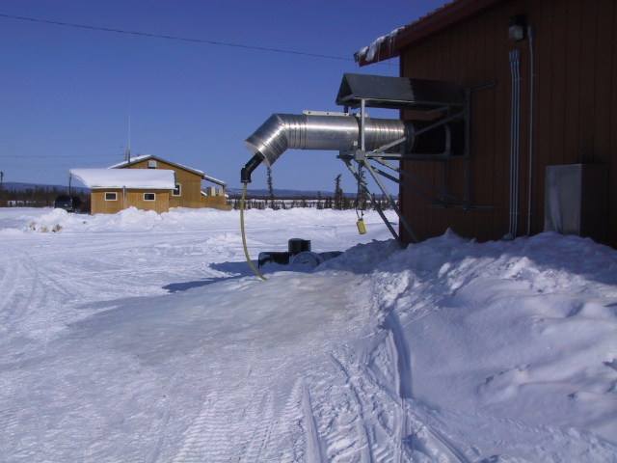
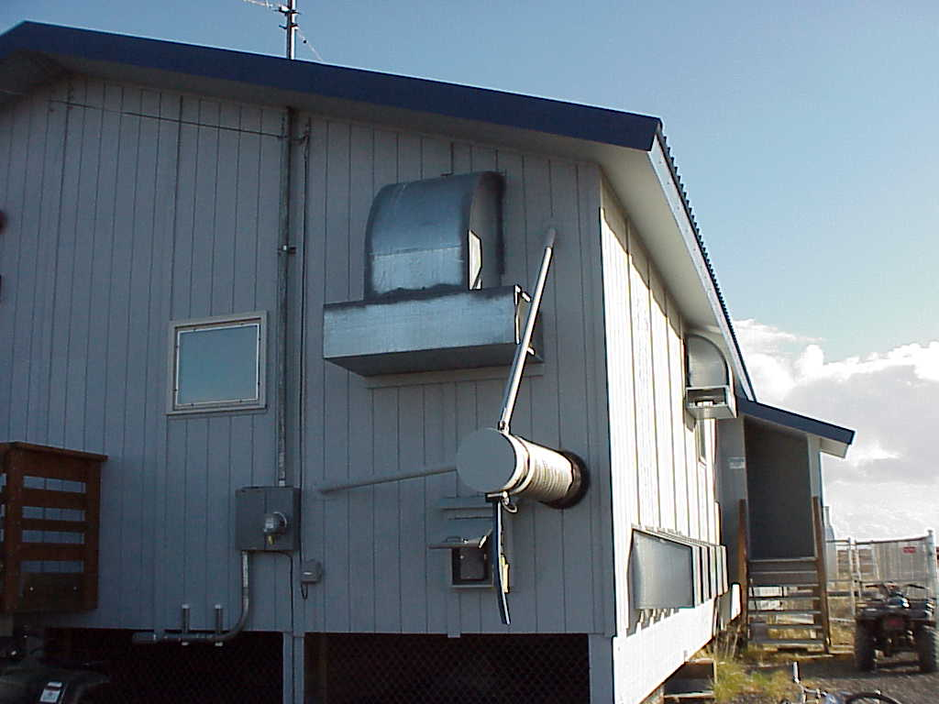
Appurtenances
Watering Point
Saunas
Service Sink
Offices/Attendant Space
Maintenance Closet
Drinking Fountain
Other Sales
Hot Water Sales
Snacks
Detergent

Slide 19
Soft Sciences
Sustainability: How do we achieve it?
Project Delivery
or
Community Development.
Who is responsible?
“System design is not in common practice among engineers, not because it is too clever or too difficult, but because it does not fit the political mold. That is, full scale system application requires integration of bureaucratic responsibilities and profession disciplines. Governmental agencies with individual responsibilities for schools, sanitation, housing, communication, environment and the many of the subsystems must meet at a solution which is mutually attractive. Identification of subsystems should not and cannot be accomplished by engineers alone, but needs the participation of administrators, village people, physicians, teachers, sociologists and economists.” (Alaska Village Demonstration Project: First Generation of Integrated Utilities for Remote Communities)

Slide 21
For More Information:
Don Antrobus, PE
Director of Design
ANTHC, DEHE
907-729-3544
dantrobus@anthc.org

