Slide 1
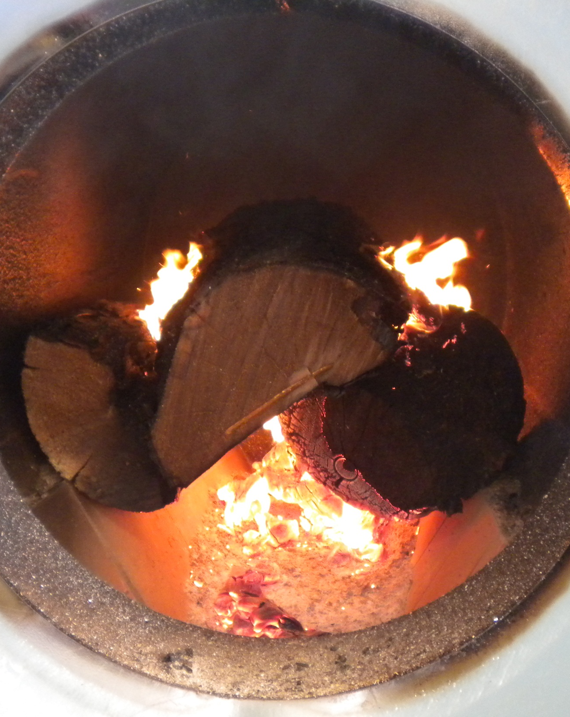


Rural Alaska Energy
Dan Reitz, P.E.
Rural Energy Program Manager

Slide 2

What is the Relationship of Energy to Sanitation?
Living in Utility Scarcity: Energy and Water Insecurity in Northwest Alaska published in the American Journal of Public Health found that water and sewer are the single largest energy consumer in NW villages. As energy costs rise public health suffers.
Notes:
Article in the Handbooks

Slide 3
The Rural Conundrum
“ The poorest Alaskan households spend up to 47% of their income on energy, more than five times their urban neighbors.” - Commonwealth North 2012

Slide 4
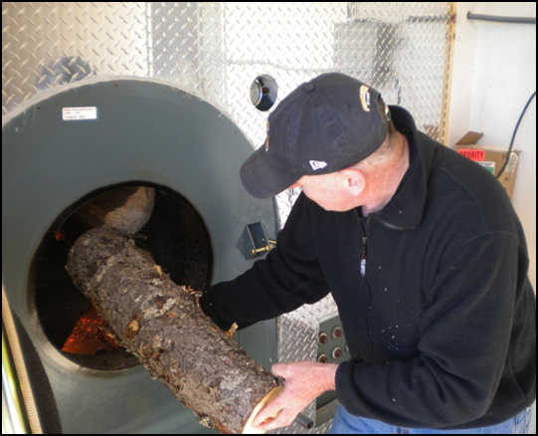
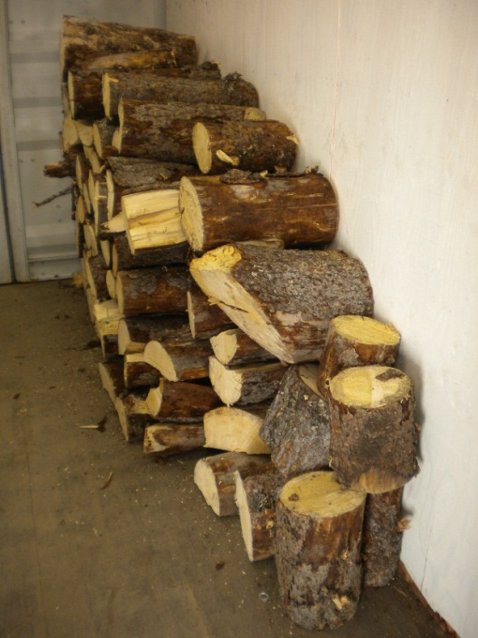
Energy Program overview
Initial Survey 2011
Energy Audits
Energy Efficiency Upgrades
Heat Recovery Projects
In home TED meters
Biomass heating
Wind Energy
Education

Slide 5
Energy Survey of 2011
• Circulating arctic water and vacuum sewer
• Circulating arctic water and conventional gravity sewer
• Conventional water distribution and gravity sewer
• Washeteria/watering point with honeybucket sewage disposal
Energy needs comprise 30 to 60 percent of a community’s water system operating costs and up to 30 percent of a community’s total energy.

Slide 6
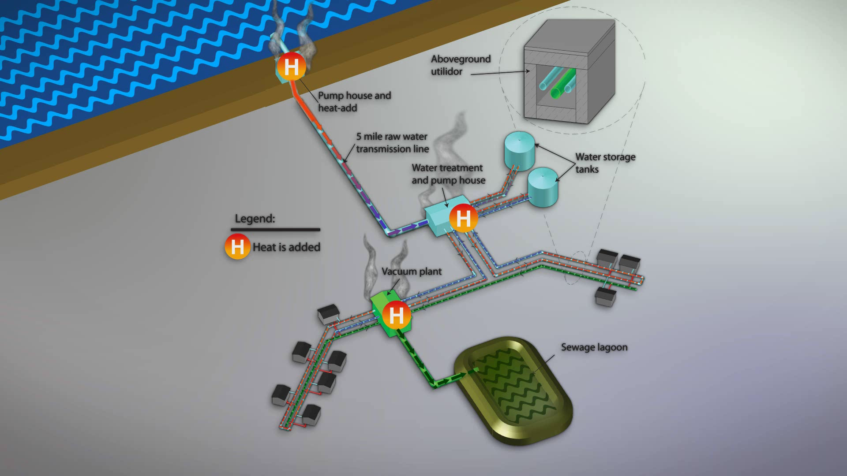

Slide 9
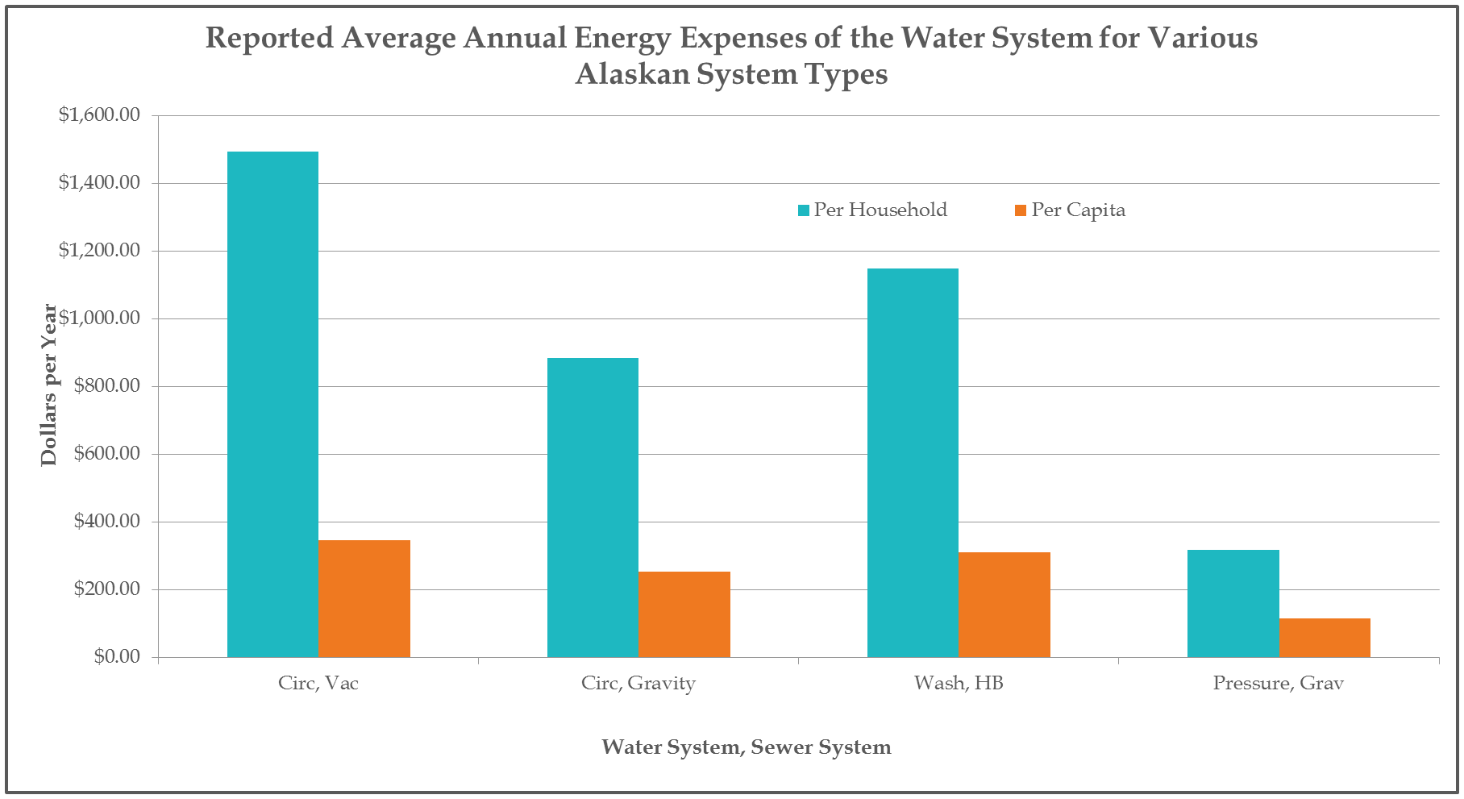

Slide 10
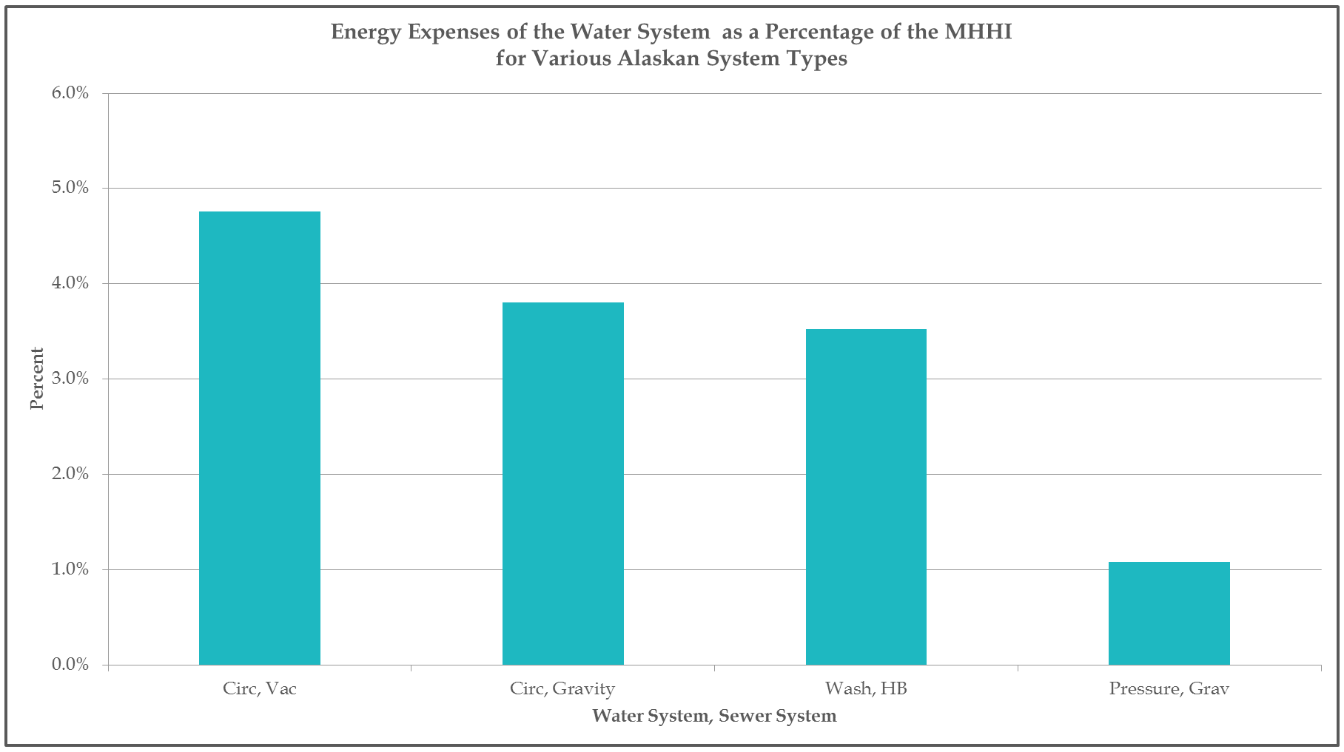

Slide 11
Energy Audits
44 villages, all tribal buildings, water systems
Audits can be complex, interrelationships between components
Findings grouped into 4 broad categories
25 were summarized into paper, all 44 will be included upon project completion in March.

Slide 12
Preliminary Audit Findings
Potential Energy Savings Identified in Audits of 25 Communities
 | Community Savings | State Savings | Total Annual Savings | Project Cost | Simple Payback
Heat Recovery* | $ 225,882 | TBD | $ 225,882 | $ 1,828,200 | 8.1
Energy Efficiency in 40 Communities** | $ 393,896 | $ 322,698 | $ 716,594 | $ 1,275,835 | 1.8
Total for 25 Communities | $ 619,778 | $ 322,698 | $ 942,476 | $ 3,104,035 | 3.3

Slide 13
Audit Finding Totals
(First 25 Villages)
Building Type | Potential Fuel Savings (gals) | Potential Electrical Savings (kwh) | Potential Savings | Retrofit Cost | Simple Payback
Water System totals | 52,837 | 640,303 | $ 402,658 | $1,913,379 | 4.75
Clinic Totals | 8,235 | 91,145 | $71,586 | $222,256 | 3.10
Tribal Building Totals | 11,209 | 58,279 | $ 87,338 | $350,557 | 4.01
All Facilities (25 villages) | 72,281 | 789,727 | $561,582 | $2,486,192 | 4.43

Slide 14
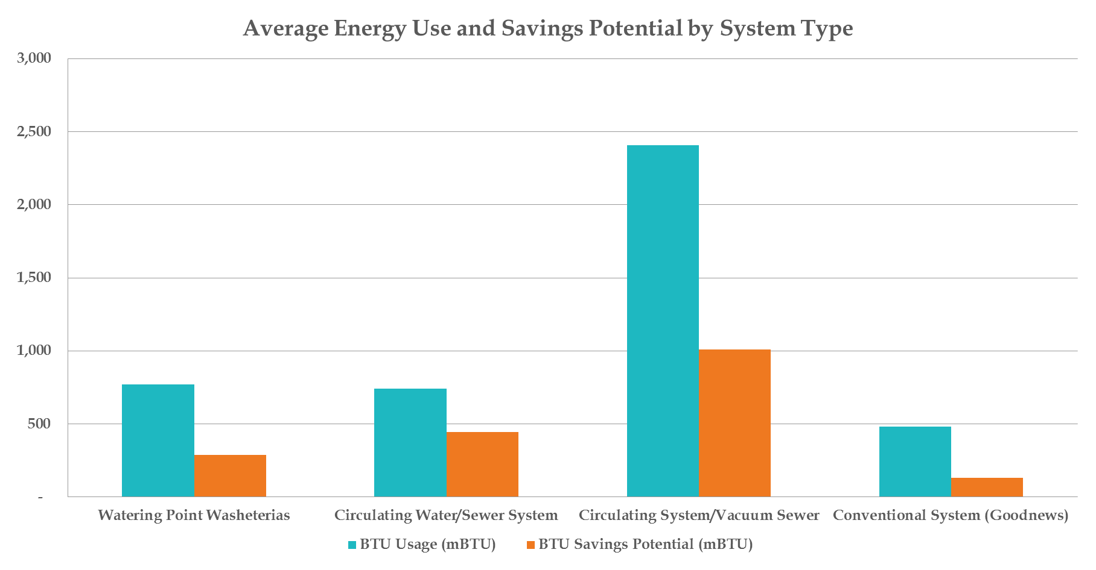
Average Energy Use and Savings Potential by System Type

Slide 15
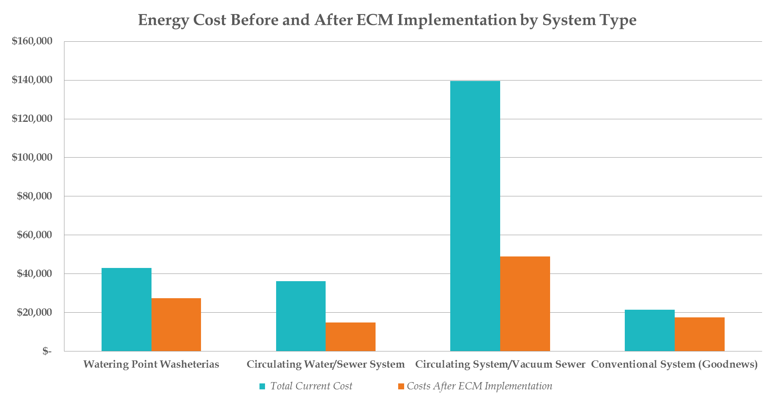
Energy Cost Before and After ECM Implementation by System Type

Slide 16
How are Savings Achieved ?
Retrofit Type | Tribal Facilities | Health Clinics | Water Systems | Total by Retrofit Type
Operations and Maintenance | $ 22,180 | $ 17,240 | $ 13,198 | $ 52,618
Local Project | $ 71,466 | $ 30,970 | $ 47,455 | $ 149,891
Substantial Project | $ 28,755 | $ 21,152 | $ 135,130 | $ 185,037
Major Project | $ 39,298 | $ 6,242 | $ 92,284 | $ 137,824
Total by Facility Type | $ 161,699 | $ 75,604 | $ 288,067 | $ 525,370

Slide 17
What is the Payoff for Implementation ?
AVERAGE PAYBACK (years) | Tribal Facilities | Health Clinics | Water Systems | Average by Retrofit Type
Operations and Maintenance | 2.2 | 0.7 | 1.9 | 1.6
Local Project | 3.7 | 3.0 | 2.0 | 3.0
Minor Project | 4.4 | 1.7 | 4.6 | 4.4
Major Project | 3.8 | 0.0 | 10.3 | 8.0
Average by Facility Type | 3.8 | 1.9 | 5.9 | 4.7

Slide 18
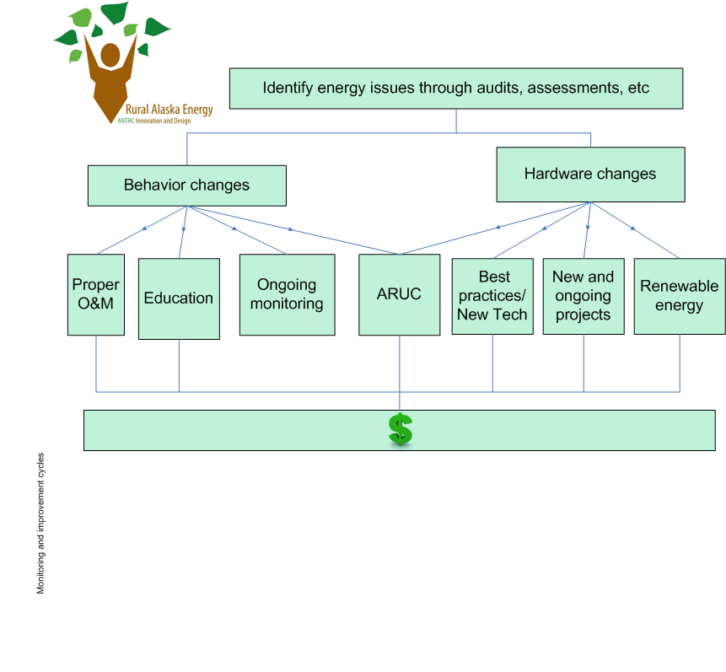

Slide 20
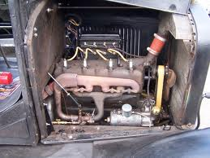
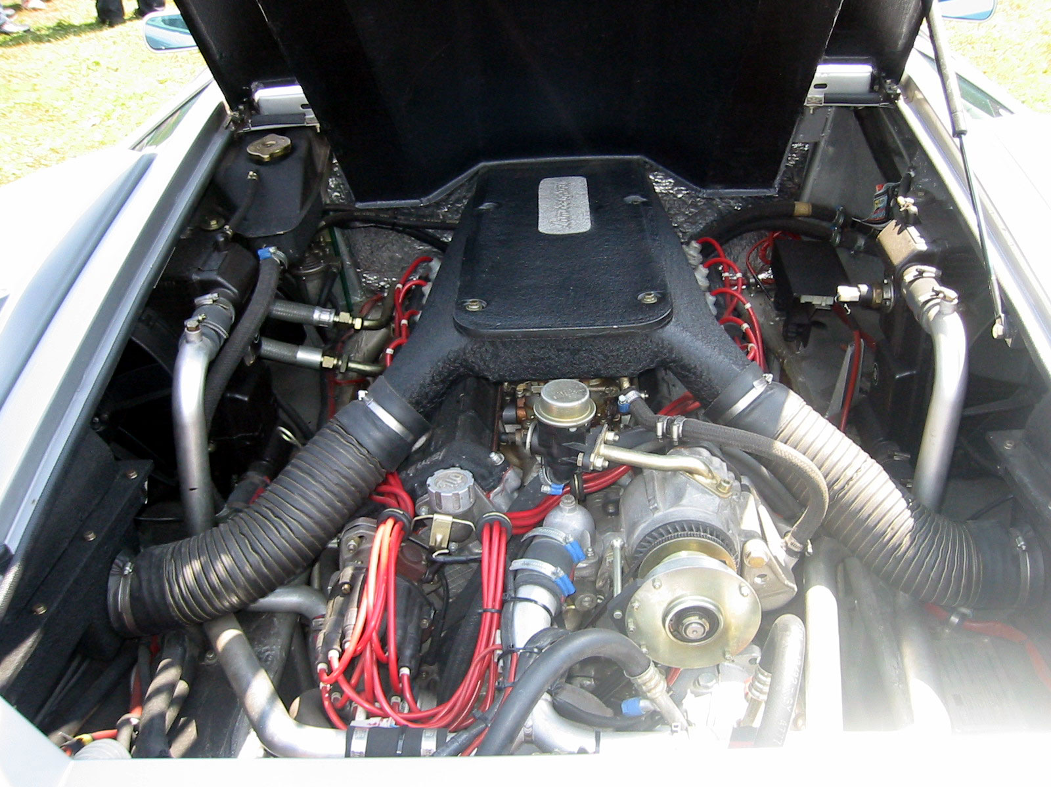
Old versus New Technology

Slide 21
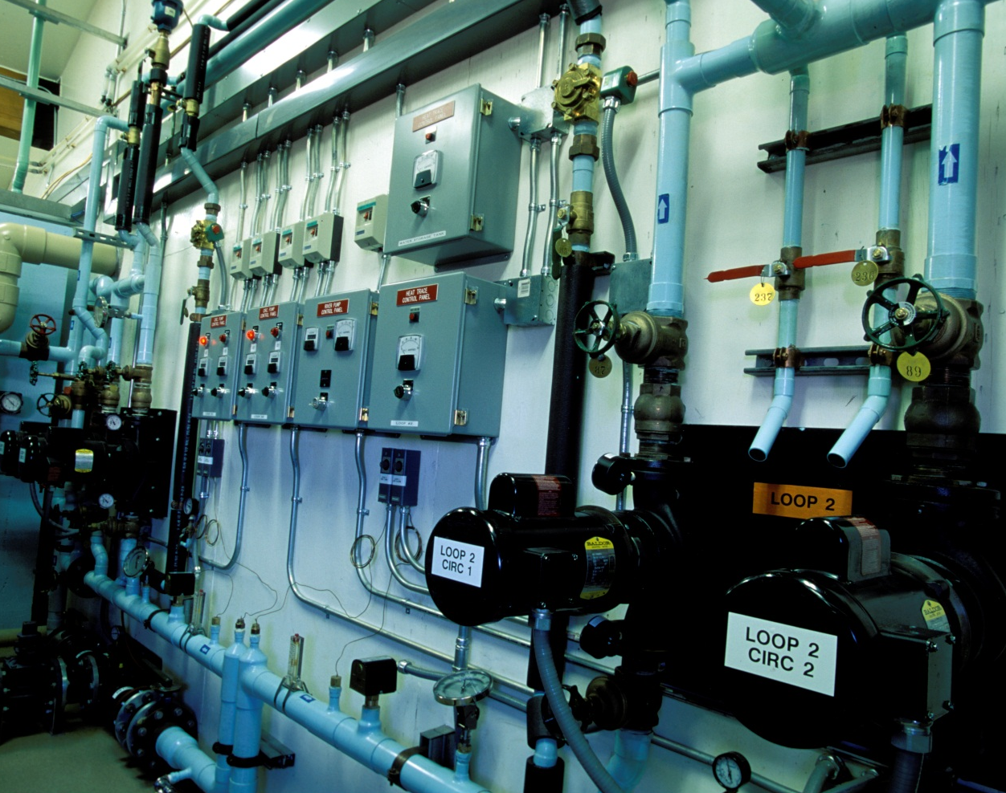
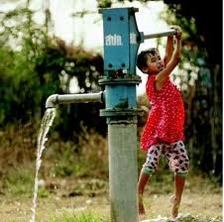
New verses Old Technology – Alaskan Arctic Water Systems

Slide 22
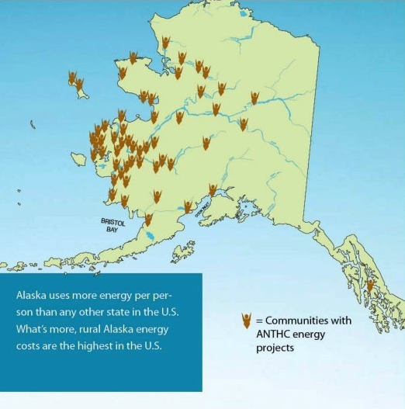
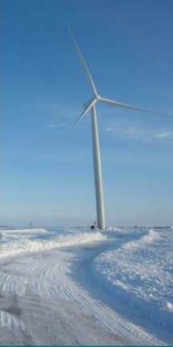
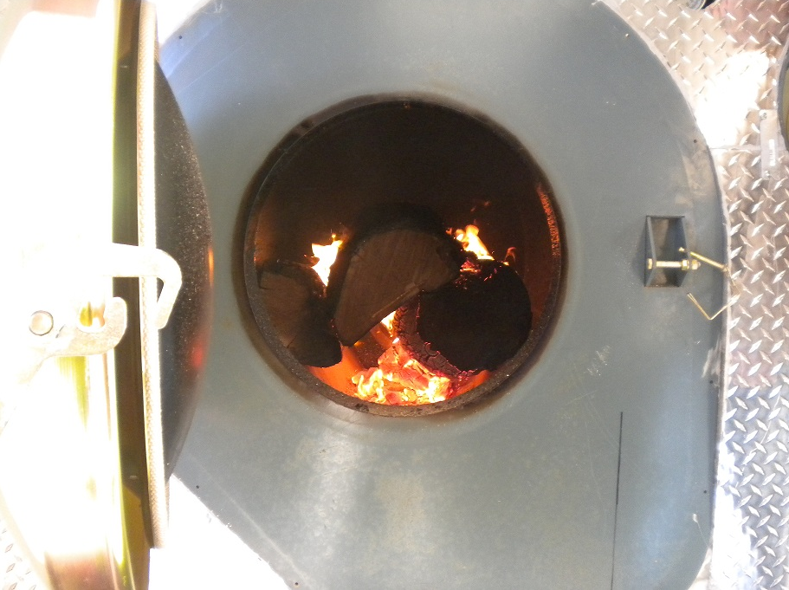
Renewable Energy Projects

Slide 23
Heat Recovery
Community | Energy Savings (annual gallons of fuel) | Annual Cost Savings (DCCED fuel price report January 2012) | Present Value of Lifetime Savings (20 years, 3.5% real cost increse of fuel)
Minto | 11,000 | $ 55,550 | $ 1,698,000
Allakaket | 7,300 | $ 45,041 | $ 1,370,000
Kwigillingok | 4,500 | $ 29,025 | $ 858,200
Goodnews Bay | 5,000 | $ 26,500 | $ 1,732,900
McGrath | 6,000 | $ 44,820 | $ 1,319,200
Savoonga | 9,000 | $ 50,490 | $ 1,477,200
Selawik | 11,875 | $ 73,268 | $ 2,157,000
Shungnak | 10,400 | $ 64,168 | $ 1,889,400
Ambler | 10,300 | $ 63,551 | $ 1,871,200
Sleetmute | 2,068 | $ 15,199 | $ 450,000
Russian Mission | 2,200 | $ 12,650 | $ 375,500
Totals | 81,843 gal | $ 491,058 | $ 15,198,700

Slide 24
Wind Harvesting Present and Planned
Goodnews Bay Micro Wind Turbines
Gambell- AVEC Surplus $54,979/Yr
Mekoryuk- AVEC Surplus $39,680/Yr
Chevak – AVEC Surplus $51,618/Yr
Shaktoolik – AVEC Surplus $ 33,343/Yr

Slide 25

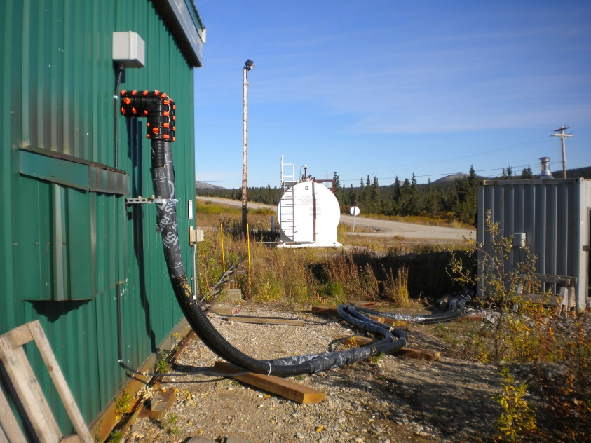
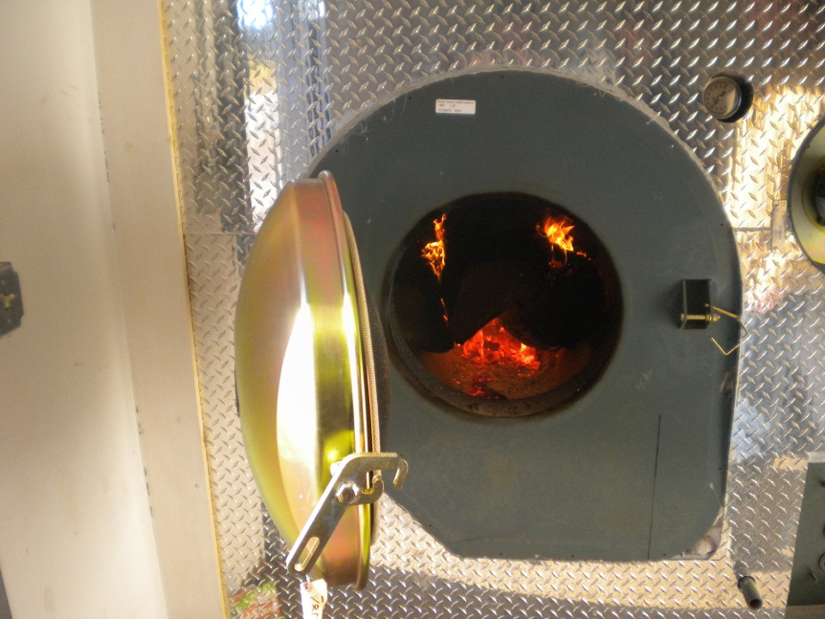
Elim Biomass Project
Operation
Procure fuel
Produce heat
Transfer heat

Slide 26
Elim Biomass Project
Economics (estimated per year)
1 cord of wood = 100 gallons of fuel oil
Average fuel consumption = 7,500 gal.
Cost of fuel at $5.00/gal. = $37,500
Number cords needed = 75
Cost of wood at $300/cord = $22,500
Potential savings = $15,000

Slide 27

Questions?

