Slide 1
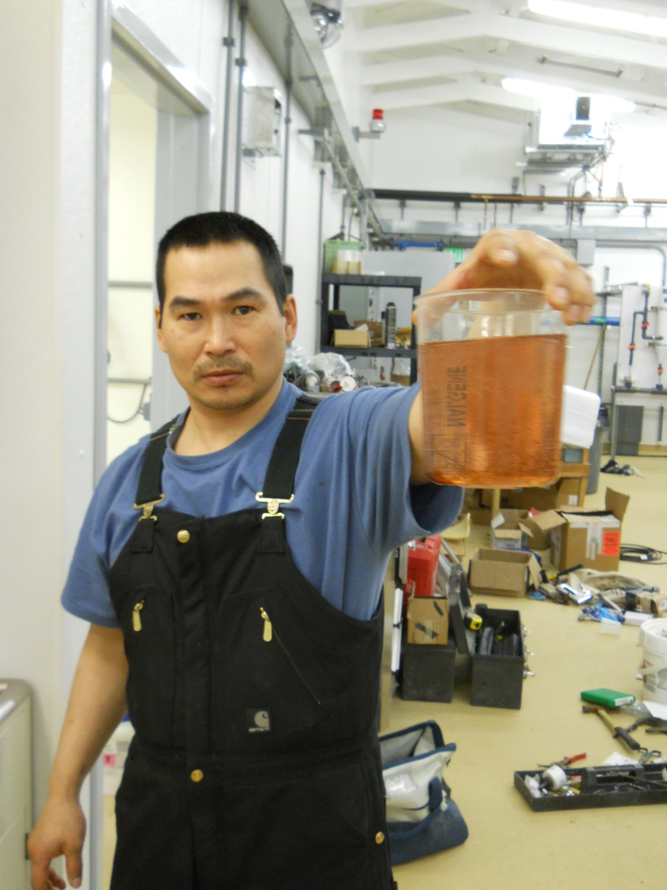
Project
Training and
Support

Slide 2
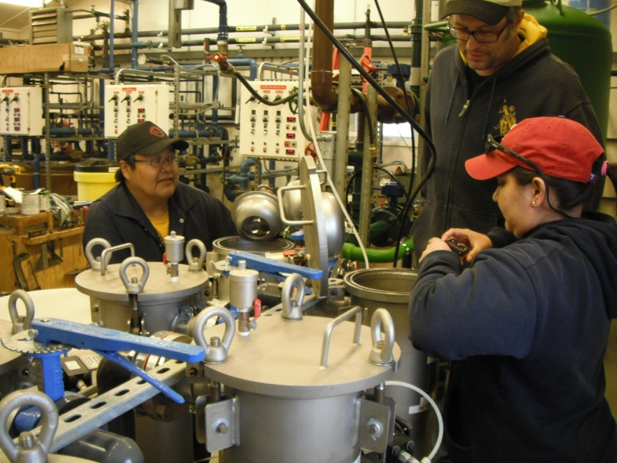
ANTHC DEHE
(Tribal Utility Support)
Project related training/support
Technical assistance to communities
Formal operator training
Plan review
Engineers
  Three Each
Operation Specialists
  Three Each
Technical Writer

Slide 3
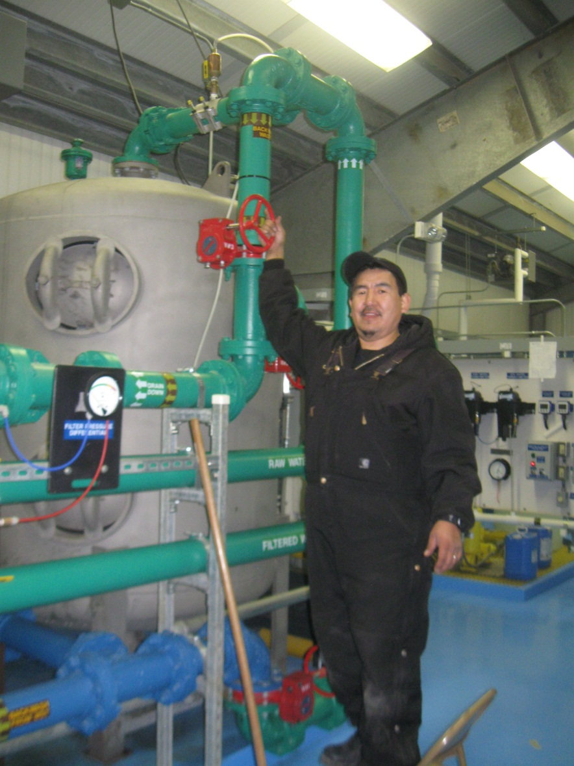
Smooth Transition to Community Ownership
Project plan for operator training
Comprehensive operator training
Community specific manuals and operation aids
Coordination with State RMW Program
Follow up training and support

Slide 4
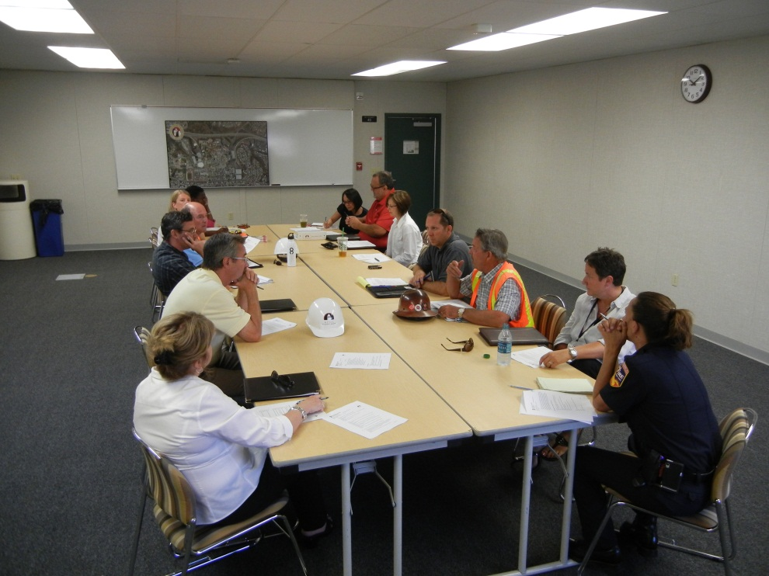
Notice to Proceed
Operator training needs and operator training plan
Project/Superintendent training role
Certification requirements
Project budget

Slide 5
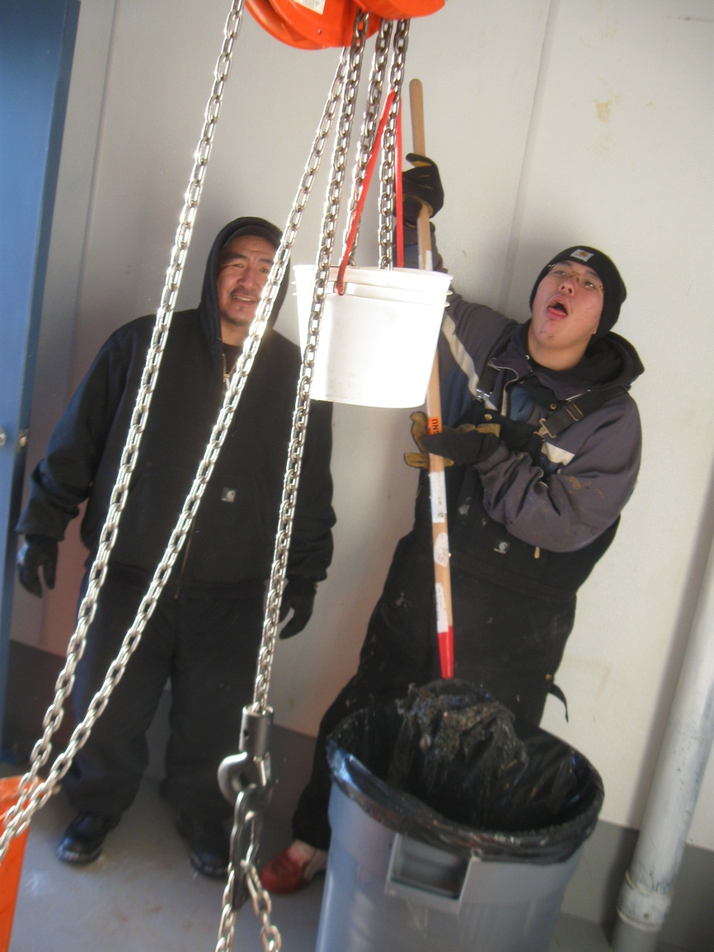
Operator Training
On the job training
Start-up/commission
Transition period
Performance period
Manual and Operation Aid Focused
RMW coordination

Slide 6
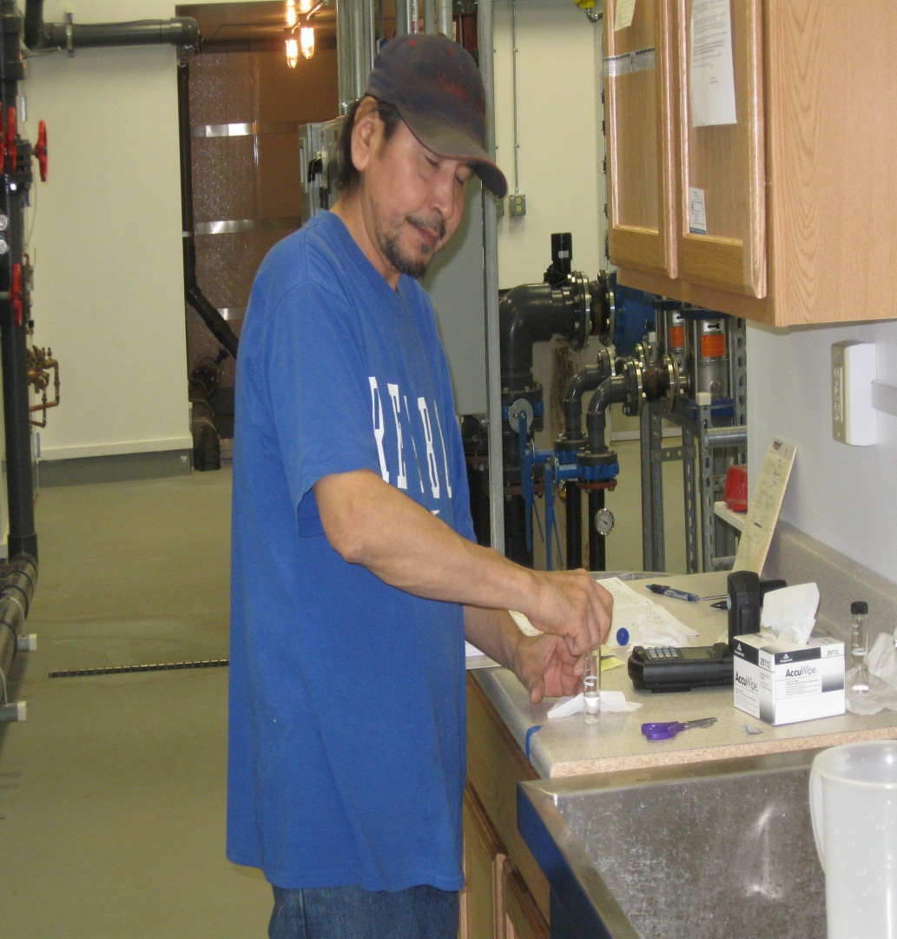
Operator Training
Water treatment and water systems
Wastewater collection and disposal systems
Boilers and hydronic systems
Heating Systems
Regulations
Electrical and controls
Generators
Community meetings

Slide 7
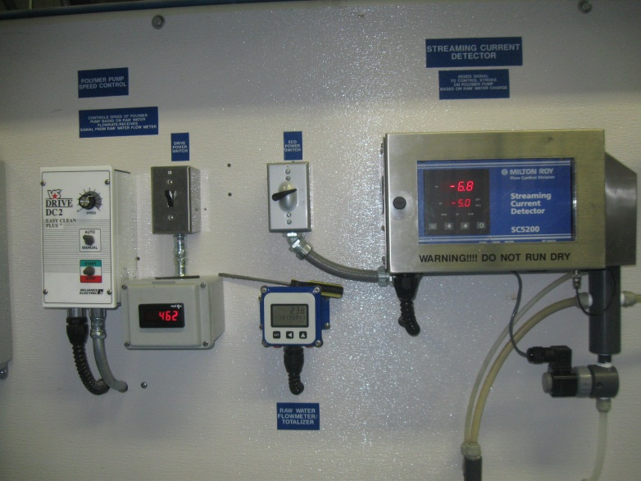
Operator Training
Performance based training
Community verification
Trainer check

Slide 8
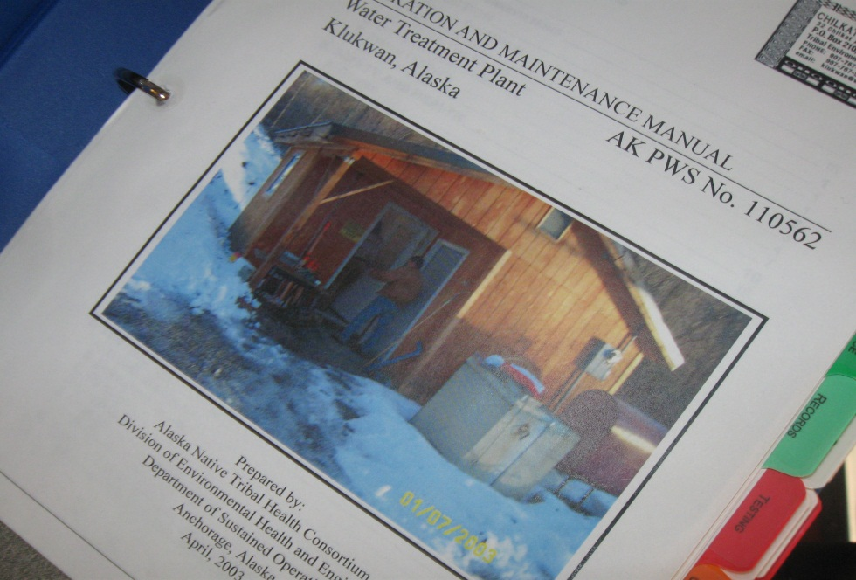
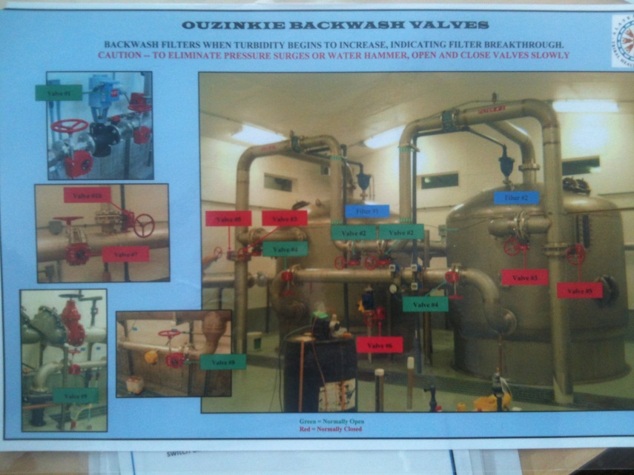
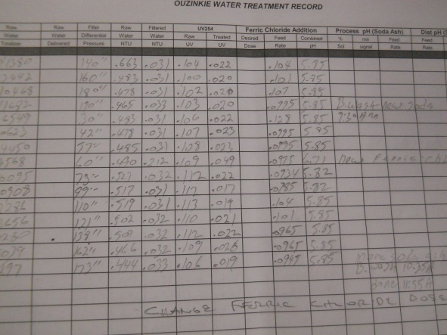
Manuals/Operation Aids
Manuals tailored to individual systems
Daily, weekly, monthly and annual checklists.
P.M. Plan
Equipment literature

Slide 9
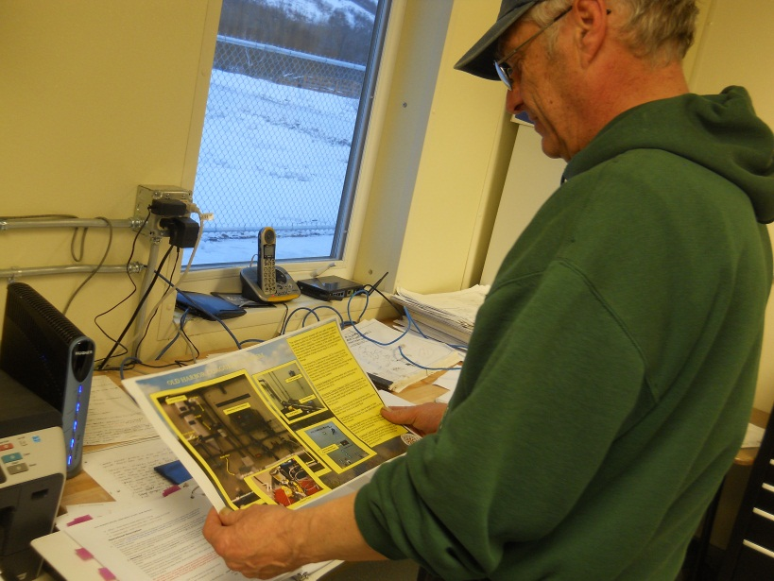
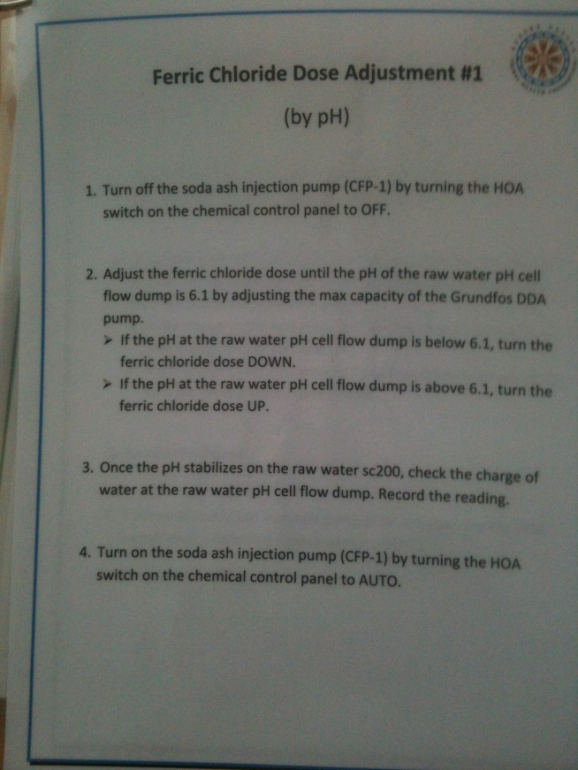
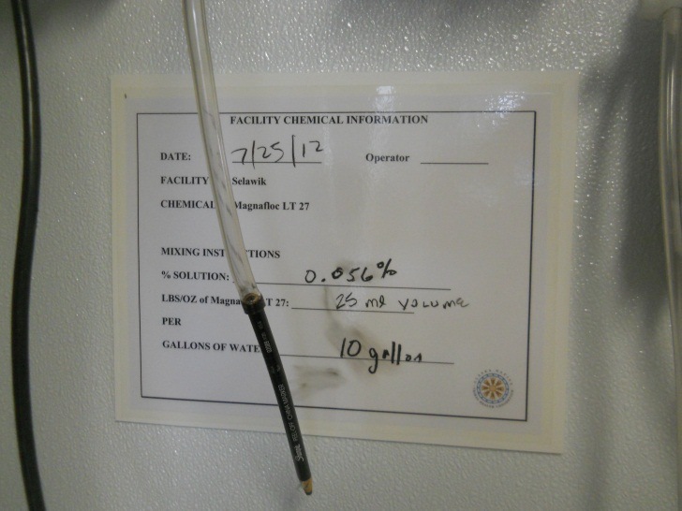

Manual/Operation Aids
Wall charts
Extensive labeling

Slide 10
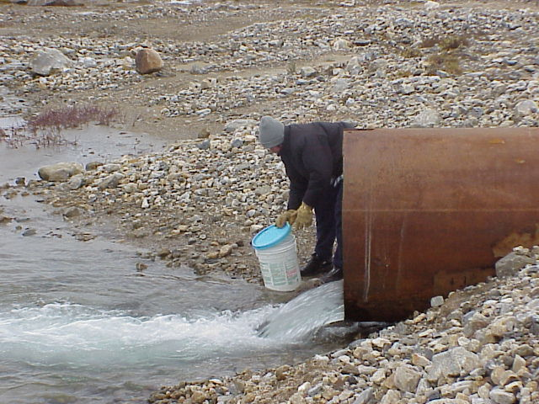
Training Challenges

Slide 11
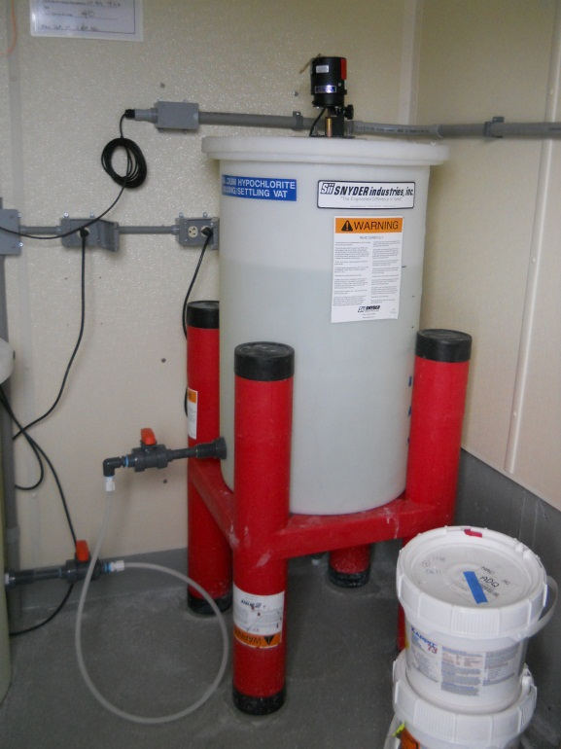
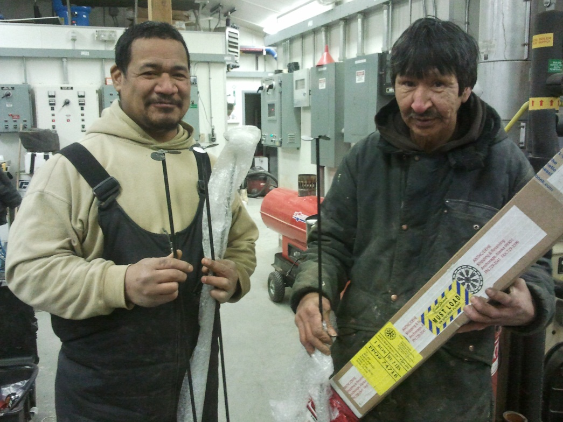
Operator Turnover
Low pay and high expectations
Talented move on to better paying jobs
Retraining is required/Resources strained

Slide 12
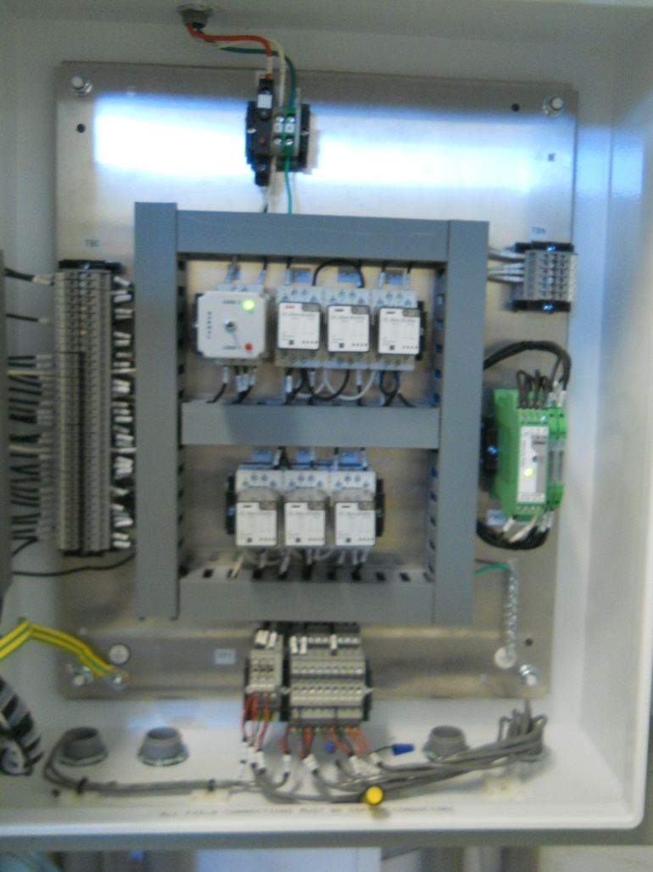
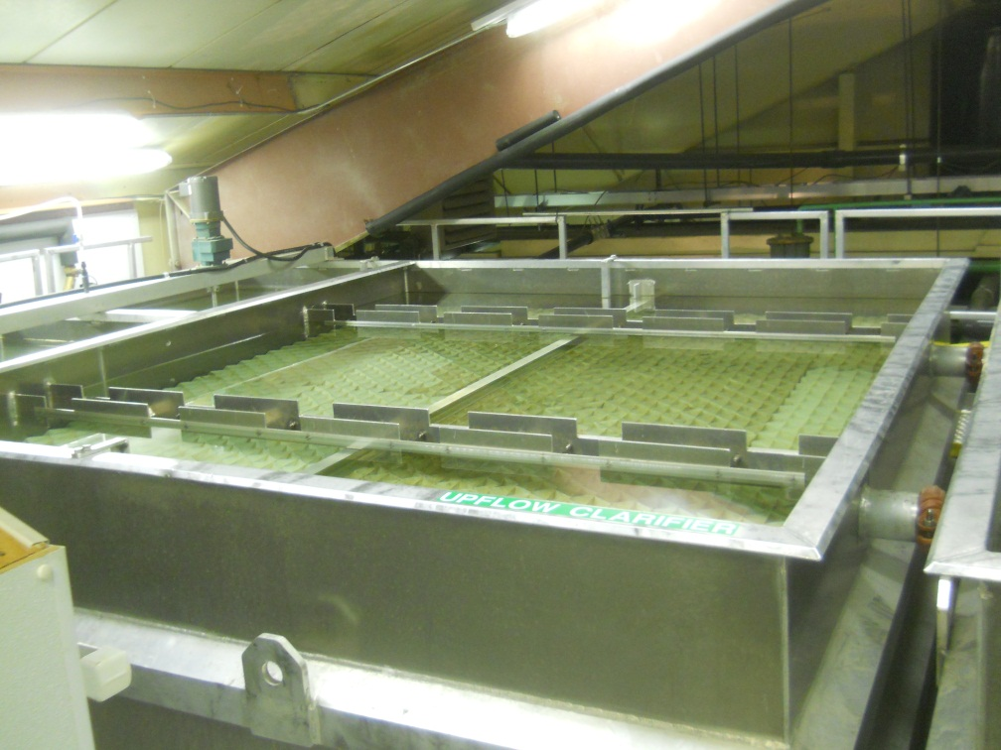
Increased Complexity
Basic level of training
Advanced water treatment
Automation and controls
Regulations

Slide 13
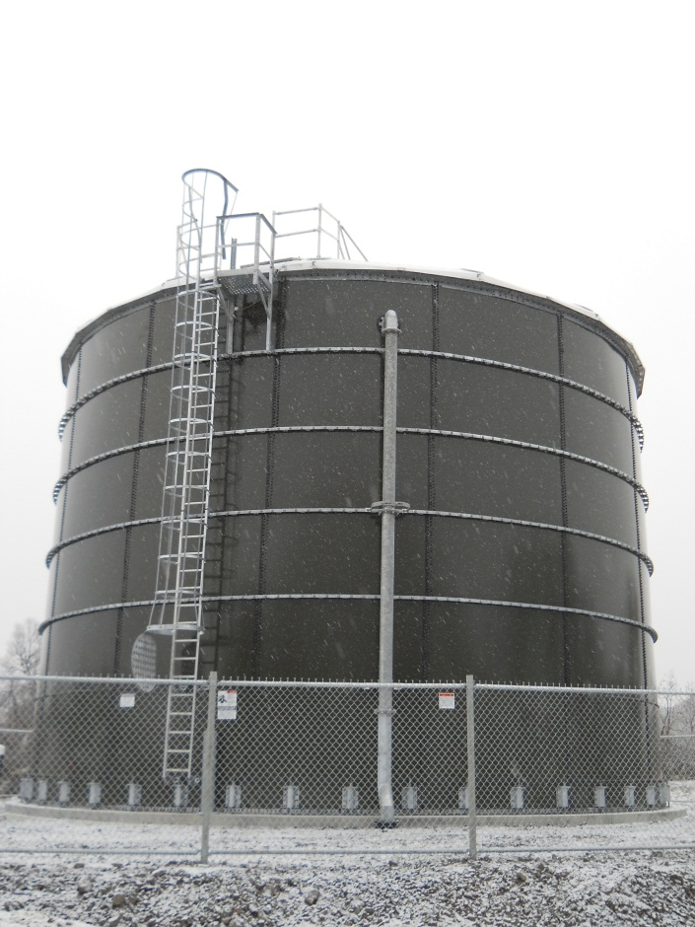
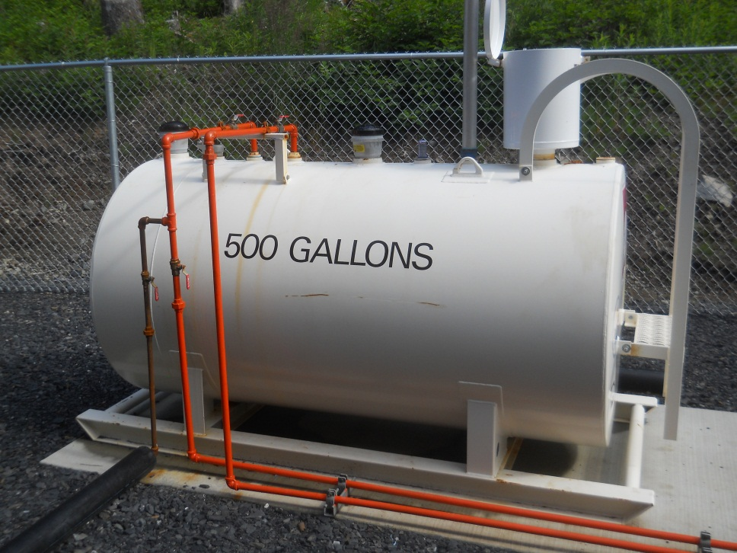
Refine Operation
Improve basic operation past a basic level
Operating temperatures
Data and experience driven

Slide 14
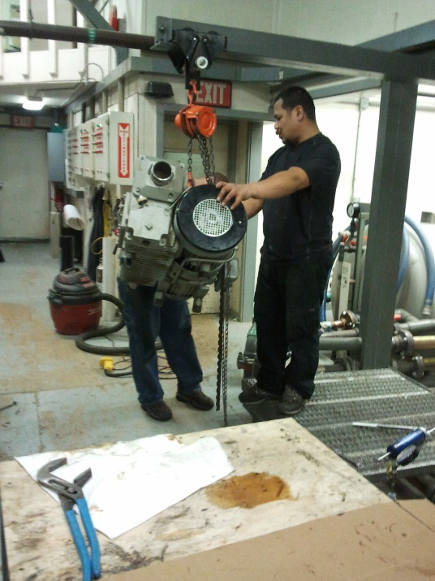
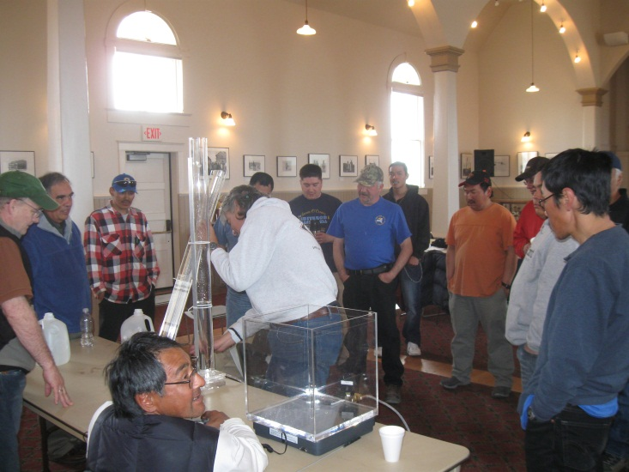
Certification vs Operation ?
ADEC Certifications
Book Based knowledge vs ability to perform task.
Test to measure out come vs competence running system.

