Slide 1
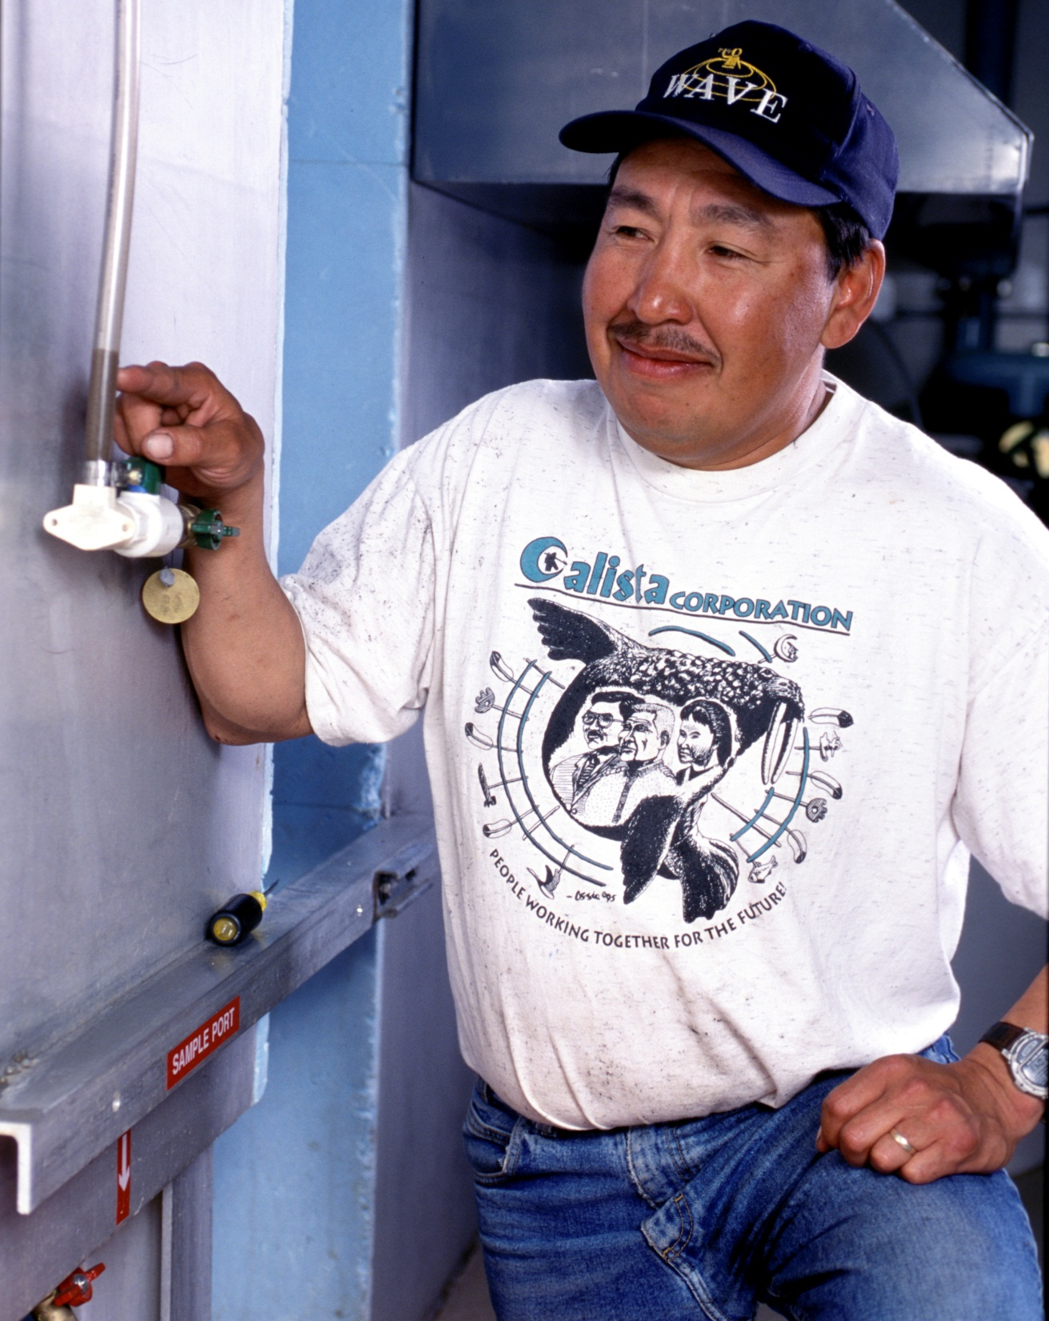

Local Utility Matching Program
Alaska’s experience with
water and sewer
local subsidy

Slide 2
LUMP
Pilot project that ran from November of 1992-October 1994, and was a performance based subsidy offered to 11 communities in the Northwest Arctic Borough through Alaska DEC.
$480,000 program funding through State capital appropriation.
Max of $10k/village/quarter
Dollar for dollar match against local collected residential user fees.

Slide 3
Purpose of LUMP
Encourage collection of user fees
Promote hiring of qualified operators and reduce turnover
Facilitate preventative maintenance
Reduce regulatory violations
Reduce costs for emergency repairs/replacements of existing W/S systems

Slide 4
Results of Lump
Over half of the participating communities showed substantial improvement in collection of fees.
Turnover in trained operators went from 115% to less than 30%.
There was 100% regulatory compliance
All communities produced a critical parts list and maintained critical parts

Slide 5
However, LUMP had shortcomings
Too short of time of performance to see how well it would work at sustaining benefits
Administrative costs were high in part because it took a considerable time to get communities to join into the program
No plan for keeping the benefits in place once incentives went away

Slide 6
LUMP-Lessons Learned
Subsidies that are performance based dramatically improve performance.
LUMP required and resulted in improved recordkeeping and performance measurements.
Performance based subsidies can extend the life of systems and reduce costly emergencies.
LUMP brought O&M to the attention of the agencies and organizations that formerly were most interested in construction funding.

Slide 7
Principles Needed in Any Future LUMP
LUMP is a privilege not a guarantee.
Performance must be measureable.
Subsidies must include improved training of operator and system management.
Operator advancement and system performance that extends the life of the investment must be rewarded (bonuses?).

Slide 8

Questions?

