Slide 1
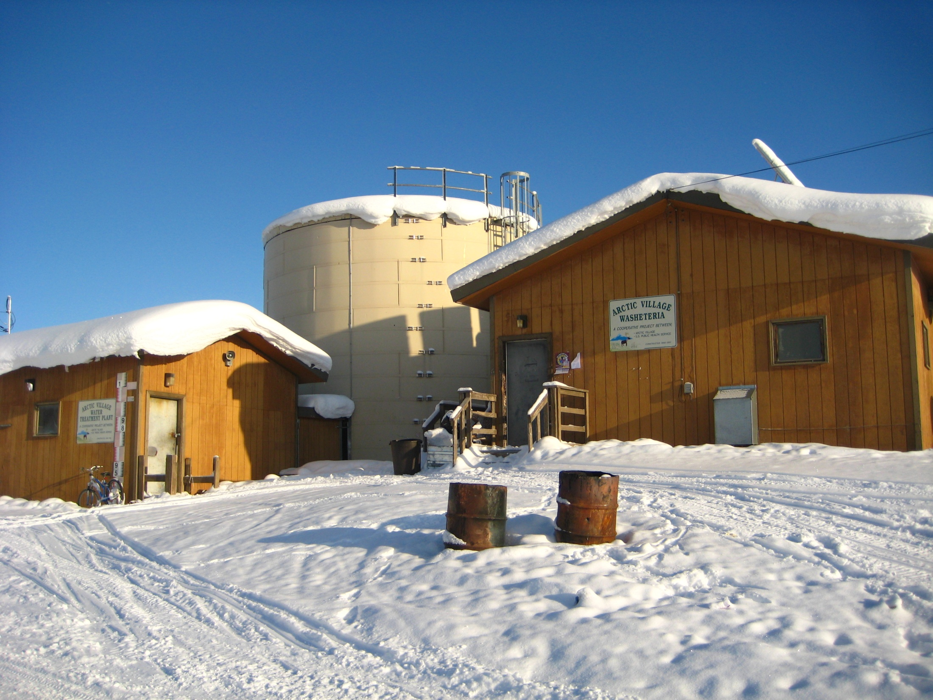
New Approaches to
Basic Water and Sewer Service
Bill Griffith
Alaska Department of Environmental Conservation

Slide 2
Progress in Alaska Village Sanitation
For half a century, we’ve focused on “putting the honey bucket in the museum” (and keeping it there!)
Much progress has been made:
  30 years ago, fewer than 25% of rural Alaska households had running water and flush toilets.
  In 1996, 55% of rural homes had piped or covered haul service.
  Today, approximately 75% of rural homes have indoor plumbing (over 90% if regional hubs are included in the calculation).

Slide 3
“Centralized” Approach Since 1970:
100% water treatment to full regulatory compliance (regardless of ultimate use)
Storage of large quantities of water, usually requiring heat addition
Distribution of treated water to individual homes via pipes or haul vehicle, usually requiring heat addition
Collection of all household sewage for lagoon disposal, usually requiring heat addition

Slide 4
Categories of Project Needs
January 2013
Upgrades or replacements to address substantial health threats: $410,015,442

Slide 5
Project Funding from All Sources
2004 - 2013

Slide 6
The Growing Gap Between Critical Needs and Available Funding

Slide 7
EPA Recommended Sustainability Threshold
- - - - - - - - Lower 48 Average

Slide 8
Bottom Line:
Conventional, community-wide piped systems and truck haul systems are expensive to construct, maintain and replace.
Many communities cannot afford the high operation and maintenance costs associated with piped or haul systems.
Available funding is not adequate to serve remaining homes and make needed improvements.
Innovative approaches are needed in order to address health problems associated with water and sewer system deficiencies.

Slide 9
“New Approaches to
Basic Water and Sewer Service”
A state-funded research and development project
Projected to last 5 – 7 years
Current year funding is $1 million
Funding requested for next year is $3 million
Focus is on “decentralized” approaches – household based systems that utilize water re-use technologies
Goal is to significantly reduce the capital and operating costs of in-home running water and sewer in rural Alaska homes.

Slide 10
Project Plan: Phase I, Spring 2013
Formation of Joint Venture Teams
DEC will advertise and request the formation of joint ventures, comprised of members with specific expertise.
A three-month long international solicitation for Statements of Qualifications will occur in early 2013.
Engineering companies, research institutions, manufacturers, and others will be encouraged to form partnerships in responding to the solicitation.
The top five to eight teams will be funded for development of proposals that will meet specific performance criteria.

Slide 11
Project Plan: Phase II, late 2013
Proposal Development
Project teams will spend six months to develop proposals that will meet performance criteria
Project teams will present their detailed proposals to the project Steering Committee.
The most promising proposals (up to three) will be selected to receive additional funding for further development and pilot testing in a laboratory setting.

Slide 12
Project Plan: Phase III, 2014
Prototype Development & Pilot Testing
Up to three proposals will be funded for prototype development and pilot testing in a laboratory setting.
Engineering plans of each prototype will be reviewed and approved and testing requirements will be provided.
In late 2014 the results of the pilot testing phase will be presented to the Steering Committee.
Systems that demonstrate promising results will be selected for the next phase of development.

Slide 13
Project Plan: Phase IV, 2015
Field System Development and Testing
Additional funding will be provided for to develop a field testing package that can be installed in rural Alaska homes.
Engineering plans will be reviewed and approved and testing requirements will be provided.
Field testing will include a full year of operation.
During this phase, systems will be closely monitored and users will provide feedback on operation and use.
Systems that can demonstrate sustainable, durable improvements will be refined and further deployed using available funding sources.

Slide 14
Project Plan: Phase V, 2016 - ?
Refinement and Improvement
Additional funding may be used to address inadequacies or failures identified during Phase IV field testing and to improve durability of the systems.
Field testing may be expanded to additional homes or locations.

Slide 15

“Discovery consists of seeing what everybody has seen and thinking what nobody has thought.”
Albert Szent-Gyorgyi
Hungarian physiologist who won the Nobel Prize in Medicine in 1937,credited with discovering vitamin C.

