Slide 1
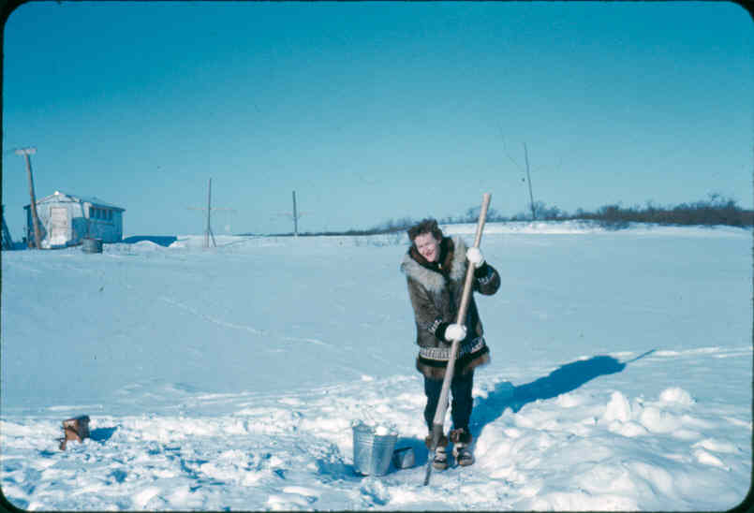
Bill Griffith
Facility Programs Manager
Alaska Department of Environmental Conservation
A “Best Practices” Approach to Improved Operations & Maintenance
of Water & Sewer Systems in Alaska Villages
February 5, 2013

Slide 2
Historical Approach
to Rural Water and Sewer O&M:
Provide training, technical and emergency
assistance
Define success loosely and separately by
various programs
Irregular, incomplete and inconsistent
monitoring of success
Infrequent and irregular feedback to system
owners
Reward good performance… sometimes
Cross our fingers!

Slide 3
A new approach:
Best Practices
Reward “best practices” with rewards from top to almost bottom – would provide incentives throughout
Continue to provide training and technical assistance without regard to performance
Define success clearly, widely and consistently across all programs (TA providers, funders, project administrators, etc.)
Measure and report performance of all systems annually
Target specific resources for consistent low performance

Slide 4
Defining O&M Best Practices:
Create a scale from 0 – 100 points
No make or break criteria: total score can achieved in different ways
Each best practice is worth a specific number of points, most important practices are more heavily weighted
Include elements associated with all aspects of successful O&M: governing body, manager, operator, etc.

Slide 5
Key to Making Best Practices System Work:
Annual Assessments
Performed jointly by TA providers and through data collection
Include all rural communities so progress can be tracked
Provide performance report to system owner and explain benefits of higher performance

Slide 6
Simplified example of Best Practices approach:
O&M Best Practice Score |  | Benefits
80 - 100 |  | Priority points for large capital projects
60 - 80 |  | Receive additional subsidy funding (not presently available)
40 - 60 |  | Eligible for large capital projects
30 - 40 |  | Receive “gap” subsidy funding (not presently available)
20 - 30 |  | Eligible for energy efficiency projects
10 - 20 |  | Eligible for small capital projects (Band-Aids)
0 - 10 |  | Training and technical assistance

Slide 7
Process for developing a Best Practices approach:
TA providers develop initial scoring criteria for best practices
All programs work together to establish initial ties to benefits
Notify communities and provide schedule for implementation
Begin implementing for SFY2015 (summer 2014)

Slide 8

Questions and Discussion about Proposed
Best Practice Approach

