Slide 1
Rural Utility Business Advisor &
Remote Maintenance Worker
State of Alaska Technical Assistance Programs
Carrie Bohan, ADEC

Slide 2
Program Resources
IHS
USDA
EPA
SOA
ANTHC
SOA
ARUC
TUS
RUBA
RMW
Shared goals of protecting public health and infrastructure investments by building technical and managerial capacity.

Slide 3
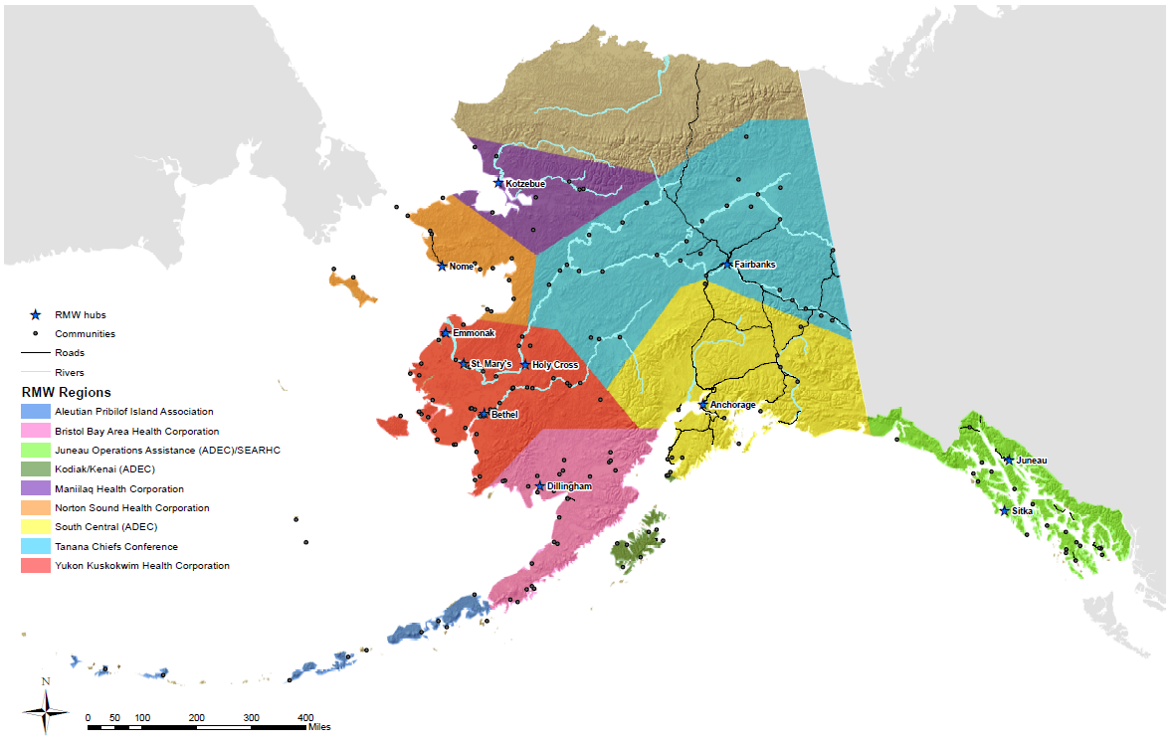
State Programs – RUBA & RMW
Staff based regionally
Approx. 10 active
communities each
Notes:
RUBA hubs a bit different

Slide 4
RUBA Program
Dual roles as Local Government Specialists and RUBAs
  LGS - Assist with all aspects of local government management and administration
    Elections, boards and councils trainings, municipal authority and procedures, ordinance writing and codification
  RUBA - Specialized attention regarding financial and managerial responsibilities related to water and wastewater utilities
    8 Utility Management Training courses, QuickBooks training, RUBA Assessments
  Require an invitation as a demonstration of the community’s investment in the process

Slide 5
RUBA Program
How RUBA Works
  “RUBA assesses a community’s ability to provide management and administration of sanitation utilities. Based on the assessment, a work plan and budget are developed to deal with the problems. The work plan is revised periodically to reflect changing conditions. Efforts to bring communities up to an acceptable management performance standard are tracked. Continued RUBA assistance to these communities depends on the community meeting a baseline level of progress towards improvements.”
Unintended negative connotation to RUBA and RUBA assessments as they became a tool for determining funding eligibility.
RUBA staff aim for two community visits per month.
Frequent changes in administration and governing bodies require repeated training within communities.
Notes:
Communities suffer as a result of the negative connotation because they don’t take advantage of the valuable assistance

Slide 6
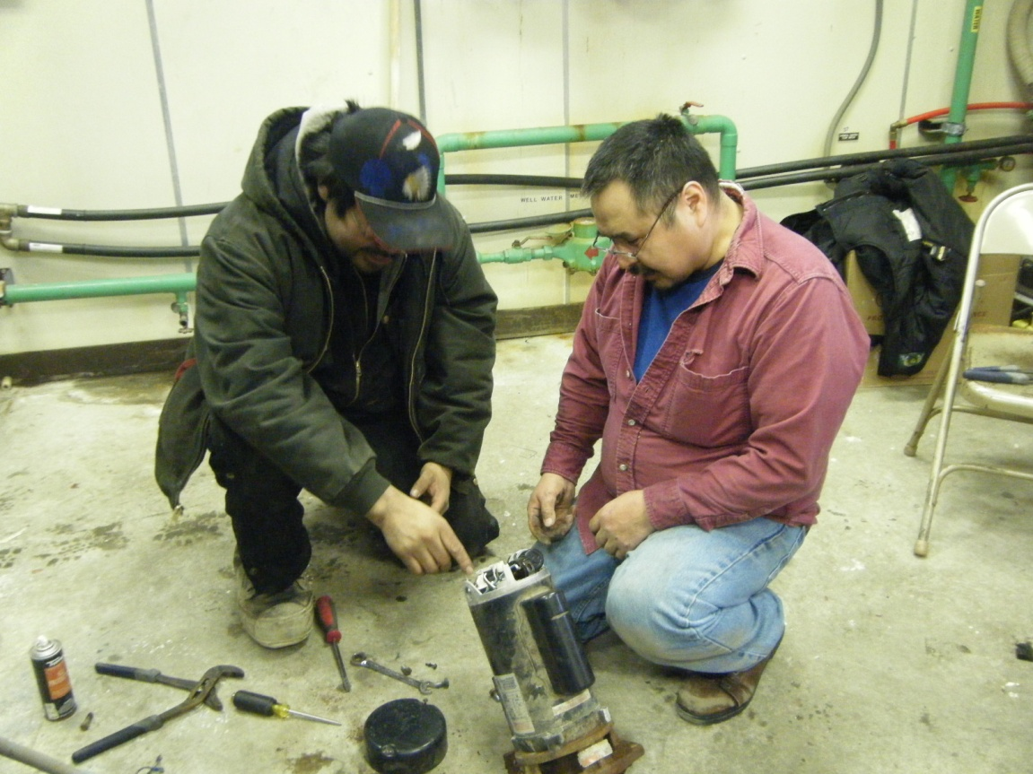
RMW Program
13 of 16 RMWs are employed regional health corporations and funded by State grants, 3 DEC RMWs
Meant to provide on-the-job, over-the-shoulder training locally and encourage and assist operators with attaining proper certification
Response becomes driving force, rather than prevention and O&M
  Lack of O&M at community
  level requires RMW assistance
  Frequent operator turnover
  requires repeated training
  within communities
  RMW longevity has a noticeable
  positive impact

Slide 7
RMW Program
Grants require twice as many trips per year as communities; not necessarily 2 trips per community
  Originally meant to be a trip in the fall to prepare for winter, another in spring to prepare for summer
  Does not inherently focus attention where it is most needed or effective for long-term improvement in capacity
Notes:
Sum of 5+ trips = ½ total trips (188 of 375) to 14% (26 of 188) of the communities
51 trips in FY12 were considered emergency trips

Slide 8
RMW Program
Grants require twice as many trips per year as communities; not necessarily 2 trips per community
  Originally meant to be a trip in the fall to prepare for winter, another in spring to prepare for summer
  Does not inherently focus attention where it is most needed or effective for long-term improvement in capacity
Notes:
Sum of 5+ trips = ½ total trips (188 of 375) to 14% (26 of 188) of the communities
51 trips in FY12 were considered emergency trips

Slide 9
RMW Program
Grants require twice as many trips per year as communities; not necessarily 2 trips per community
  Originally meant to be a trip in the fall to prepare for winter, another in spring to prepare for summer
  Does not inherently focus attention where it is most needed or effective for long-term improvement in capacity
Notes:
Sum of 5+ trips = ½ total trips (188 of 375) to 14% (26 of 188) of the communities
51 trips in FY12 were considered emergency trips

Slide 10
Technical Assistance Programs
Addressing operational capacity without corresponding managerial capacity or vice versa reduces effectiveness and is not likely to result in long term improvements.
Need to work collaboratively to direct our efforts and resources where they are needed most and will make the greatest impact.
Opportunities exist to improve coordination and efficiency, and reduce duplicative efforts.

