Slide 1
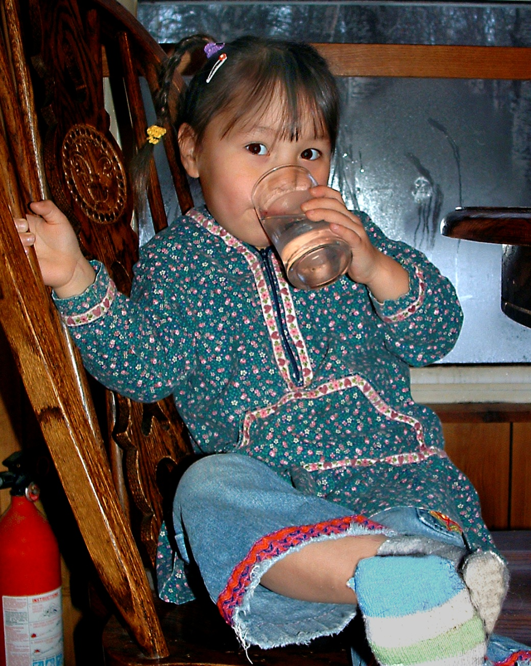
ARUC: Water/sewer management
Mike Black,Director
Department of Rural Utility Management Services (DRUMS)
ANTHC

Slide 2
ARUC Philosophy
Building infrastructure is the first step
Management of infrastructure is next
  Protect investment (life of system)
    Minimize ‘repair by replacement’
  Maximize health impact of system
  Reduce cost to operate
Strength in numbers: 26 communities working together, instead of each struggling alone

Slide 3
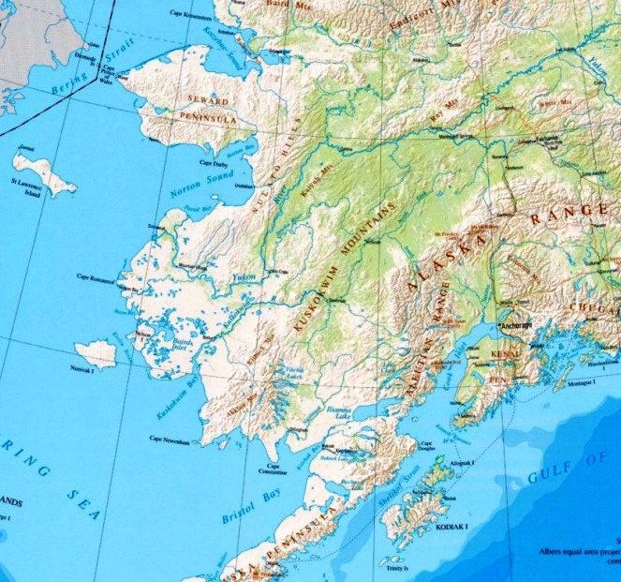
Ambler
Kobuk
Noorvik
Kiana
Selawik
Deering
Golovin
Savoonga
St. Michael
Kotlik
Russian Mission
Pitkas Point
Holy Cross
Chevak
Upper Kalskag,
Lower Kalskag
Sleetmute
Tyonek
Toksook Bay
Quinhagak
Newhalen
Goodnews Bay
New Stuyahak
South Naknek
Chignik Lake,
Chignik Lagoon

Slide 4
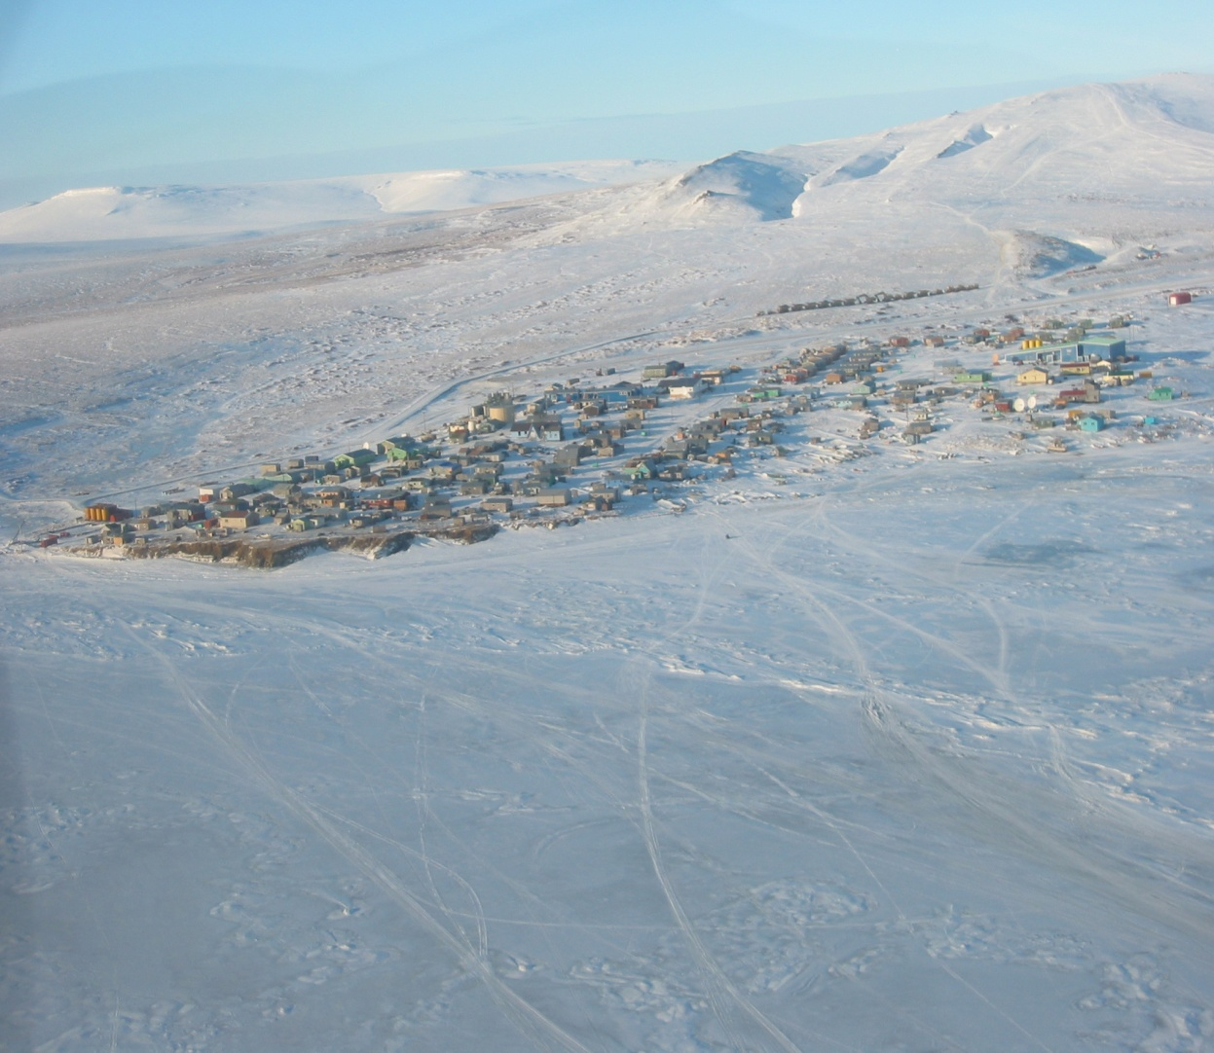
YK Delta: Circulating systems, shifting soils
Chevak
Goodnews Bay
Kotlik
Holy Cross
Lower Kalskag
Pitkas Point
Quinhagak
Russian Mission
Sleetmute
Toksook Bay
Upper Kalskag

Slide 5
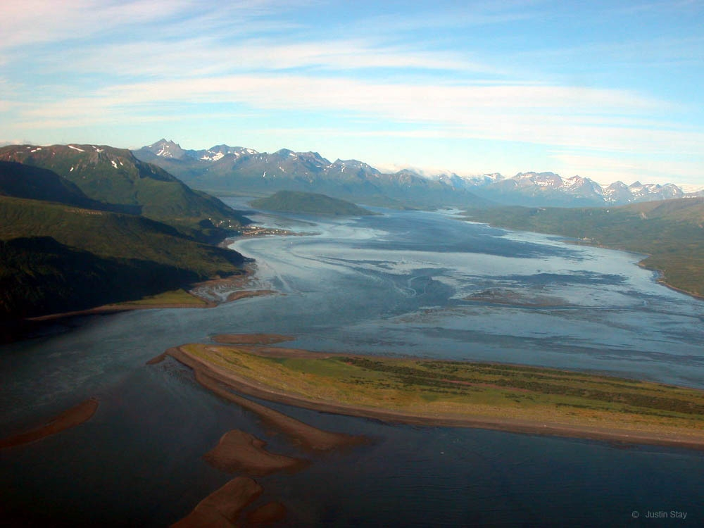
Bristol Bay: Buried systems more traditional
Chignik Lagoon
Chignik Lake
New Stuyahok
Newhalen
South Naknek
Tyonek

Slide 6
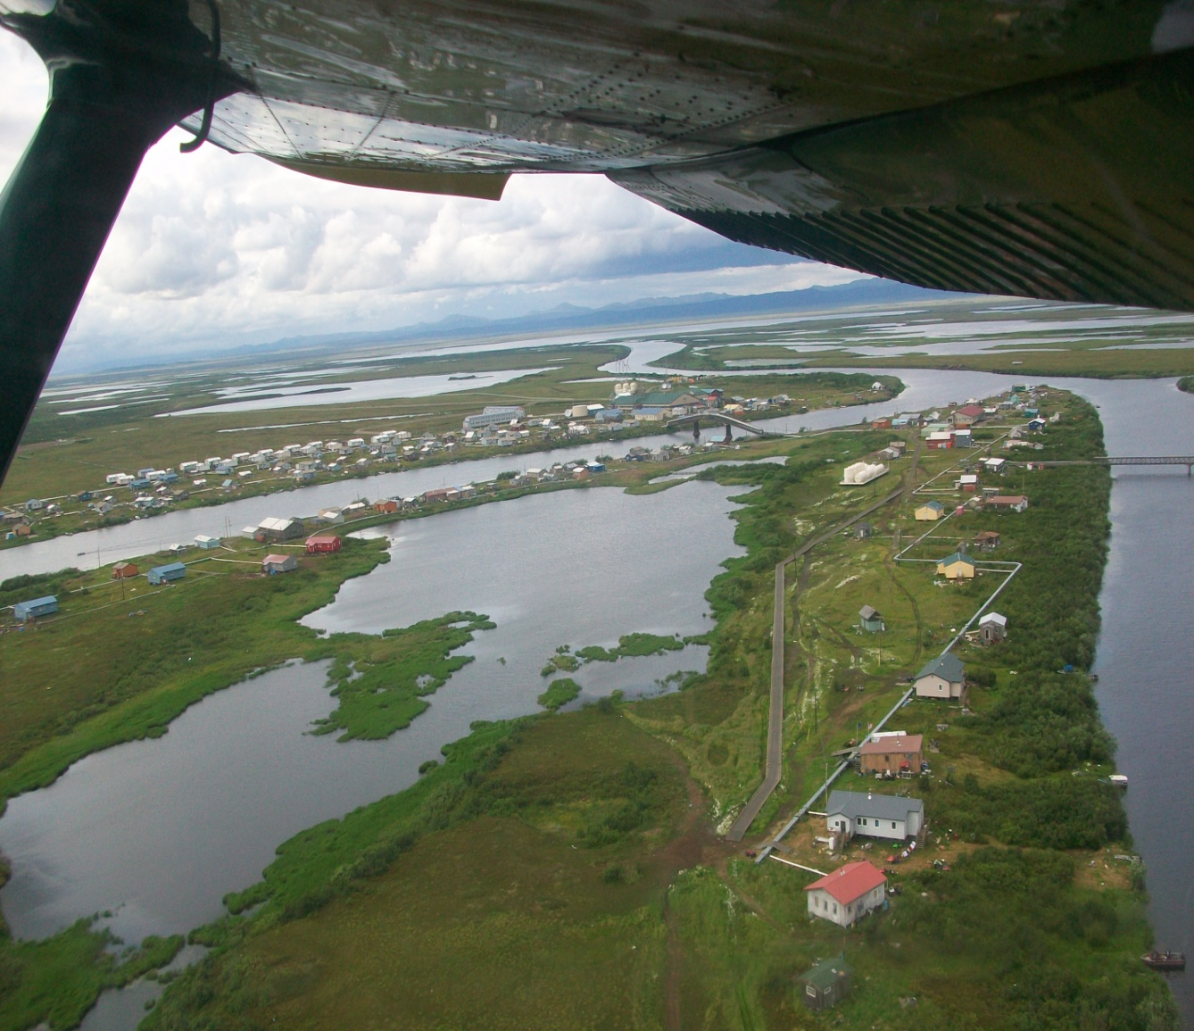
Maniilaq: Circulating systems, shifting soils, extreme cold
Ambler
Deering
Kiana
Kobuk
Noorvik
Selawik

Slide 7
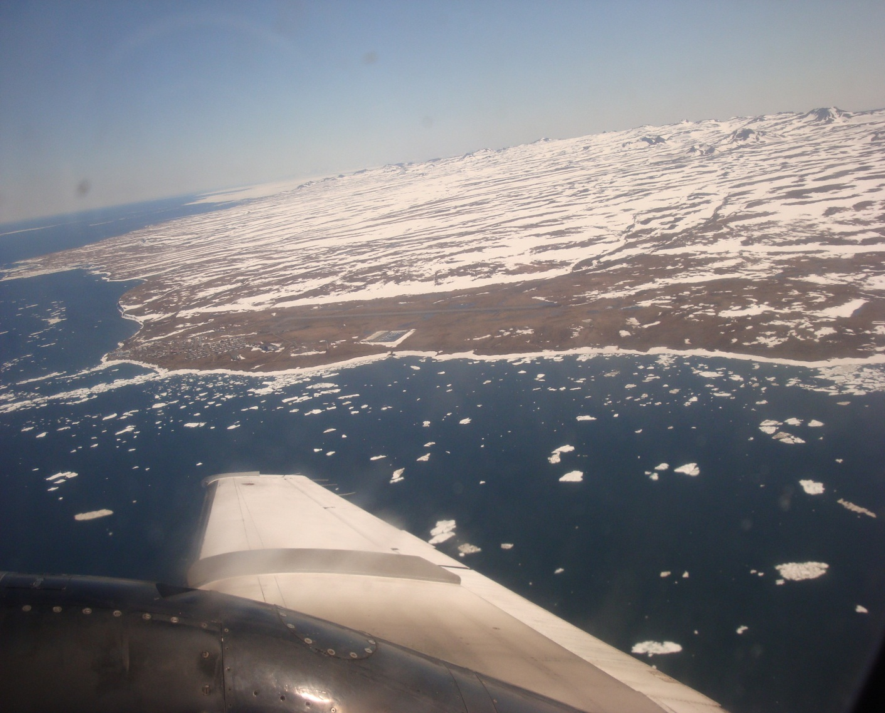
Nome: circulating, vacuum sewers
Golovin
Saint Michael
Savoonga

Slide 8
Lessons learned
Complicated systems require engineering to sustainably operate
  Energy efficiency!
  Data is critical
Proper maintenance is costly
Emergencies destroy budgets.

Slide 9
A tale of 5 cities.
Vacuum sewer system labor, 2012
  Chevak $166,000
  Savoonga $142,000
  St Michael $89,000
  Selawik $212,000
  Kotlik $ 94,000
  Noorvik $114,000
  AVERAGE $136,000

Slide 10
ARUC initiatives
Energy Savings
  1. O&M focus, small budget energy projects
    Chevak, Saint Michael, South Naknek, etc
  2. Recovered heat
  - all ARUC communities possible
  - Savoonga, Quinhagak, Noorvik apps pending
  Alternative energy
    Goodnews Bay windmills
    Chevak wind boilers
    Solar: Ambler now, all Maniilaq to follow
    Kobuk Biomass: wood supply = JOBS
Decrease dependence on grants
Remote monitoring

Slide 11
ARUC Summary
ARUC’s job is sustainability of member rural water systems & DEHE.

Slide 12
Tribal Utility Services (TUS)
Community Assistance
Review of Project Summary/Scope Documents
Plan Review
New system start-up
Operator training new systems
Transition to ownership
O&M Manuals and operational aids

Slide 13
TUS
Local response to emergencies
Construction Skills Training
  Apprenticeship Program
  Skills Training
  Internship Program
  Certifications
  Database Tracking
Significant Non Compliance (SNC) assistance

Slide 14
TUS
Operator Training on-site for new operators
Water Plant Operator class instructors
System Management Training
Technical Assistance

Slide 15
What does ARUC and TUS Really Do?
Excerpts from ARUC Energy Retrofitting reports:
Deering Waste heat
System was installed years ago, but was not properly controlled resulting in back fed heat to the power plant radiators. There was probably a net gain in value, but the system was poorly understood and was shut down. We have installed a new pump and controls, and thus far the boilers only fire when dryers are active. We currently have meters in route that will allow us to begin to quantify the fuel use and interface with remote monitoring. Additionally we have provided much of the neglected operational maintenance and should start to see the resultant savings. More to come.
Kotlik Waste heat retro-commission
This was a hot project… as the system was installed without appropriate controls. This project demonstrated our ability to roll all aspects of a complex small-scale project into a small team. Design, take-offs, electrical, plumbing, commissioning, etc. This is a great way to show the potential value-added of ARUC operations. Ironically this is also a great example of the disconnect from the operators and the bills. Although the boilers have virtually stopped firing, the operators are much more engaged with the other work, (stuff that makes their lives easier) pump controls, new vacuum valves, new impellers, etc… (these too have value, as operators either log less hours, or get more optimization while on shift).

Slide 16
continued
Kobuk Maintenance
Eric went out and began evaluating the system, and trying to attack some of the most critical failure potentials. While there he worked with the operator to conduct some very basic system maintenance. The highlight is that by cleaning the boiler, and adjusting a circuit setter we estimate the fuel savings to be 200 to 250 gal/mo. There is much more to be done there, and we are currently working to install more permanent fixes, and get the needed parts on-site. This is a prime example of why we need to develop the capacity to ensure this type of work isn’t neglected.
St. Michael, Boiler/HX rehab, retro-commission of HX add system
This report is ironic, mostly because they froze-up shortly after our work out there. I have no doubts that the project was saving fuel, but the freeze negated that savings. One point to make is that while there we identified a potential problem with the automated controls at the lake house… I have the fix, but being tied to project funding hasn’t allowed this to be implemented. This likely had an impact on the freeze up. We would need to discuss all this. Louis is currently implementing phase I of the Vacuum boiler project. I anticipate phase II in about a month.

