Slide 1
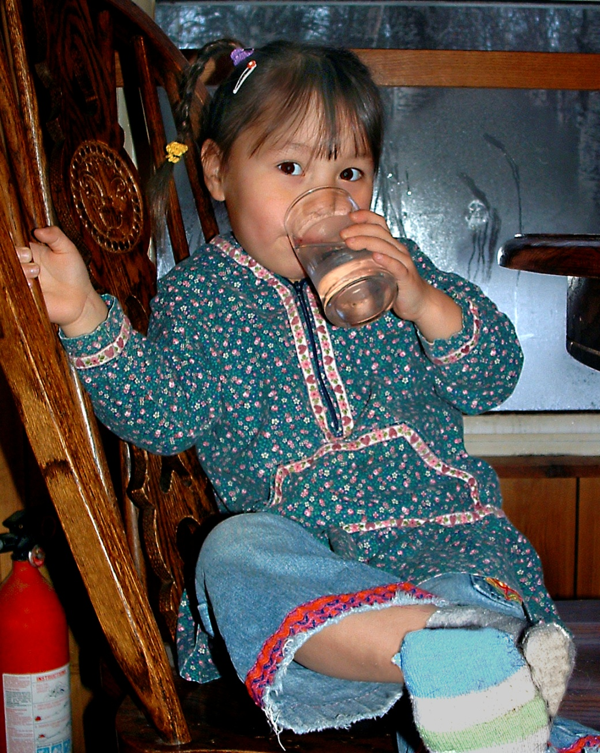
Alaska O&M Challenges
John Nichols, MS, PE
ARUC Manager,
ANTHC

Slide 2
My perspective
Engineer
Public Works Director, Dillingham AK
Western Alaska design/build, ANTHC
Idaho tribal water/sewer
Focus on O&M
  Maximize benefit per dollar spent
    Health benefits
    Infrastructure investment

Slide 3
Current ARUC Focus
24 villages in ARUC
  Full management & Operations
11 villages in Billing Assistance
  Billing services only
  Possible ARUC precursor
ARUC is a priority of ANTHC
  Preventative healthcare to hospital
  ANTHC long term vision

Slide 4
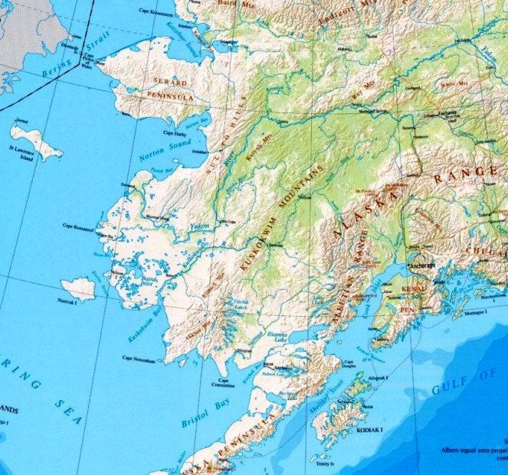
Ambler
Kobuk
Noorvik
Kiana
Selawik
Golovin
Savoonga
St. Michael
Kotlik
Russian Mission
Pitkas Point
Holy Cross
Chevak
Upper Kalskag,
Lower Kalskag
Sleetmute
Tyonek
Toksook Bay
Goodnews Bay
Newhalen
New Stuyahak
South Naknek
Chignik Lake,
Chignik Lagoon

Slide 5
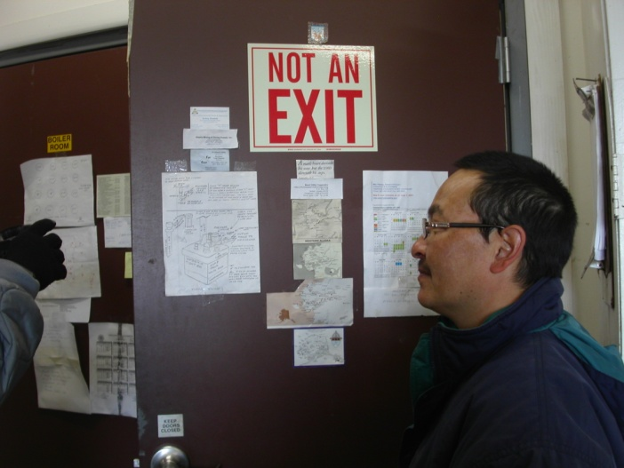
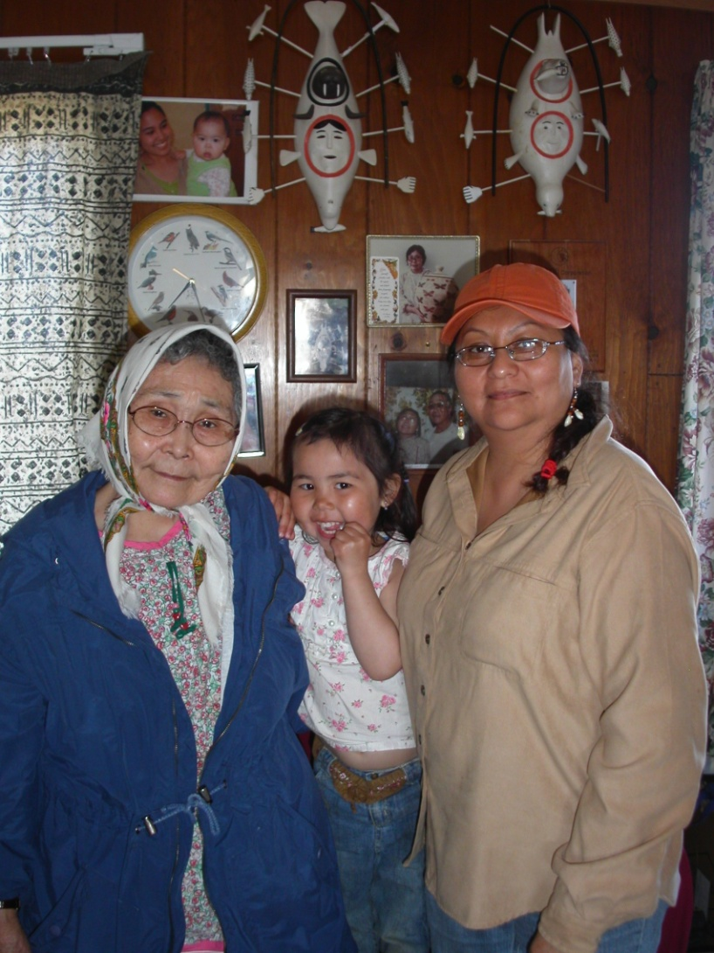
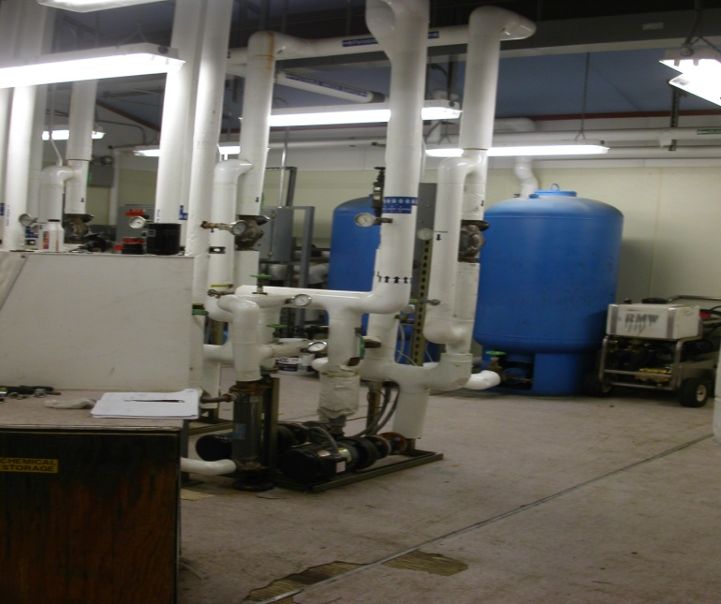
Foundations of O&M

Slide 6
#1: Enough Revenue
Most fundamental need
  Cannot operate without it!
  Lack of revenue causes:
    Deferred maintenance (short system life)
    Operator turnover
    Emergencies
  Must disconnect politics from management!

Slide 7
#2: Long-term Employees
Complicated systems are reality
Years to develop operators & managers
  Experience prevents emergencies and decreases costs
  Continual basic training = no progress
Required to progress beyond emergency avoidance

Slide 8
#3: Management & Operating Coordination
True costs need to be known
Operators influence costs & rates
Managers – know operations
Operators – know budgets
Cannot progress to improved efficiency without this!

Slide 9
Current Practice
Technical resources focus on emergency prevention/repair
Cannot focus on high efficiency until:
  Adequate revenue
    Disconnect management from politics!
  Stable staffing
    Managers and operators
  Coordinated management & operations

Slide 10
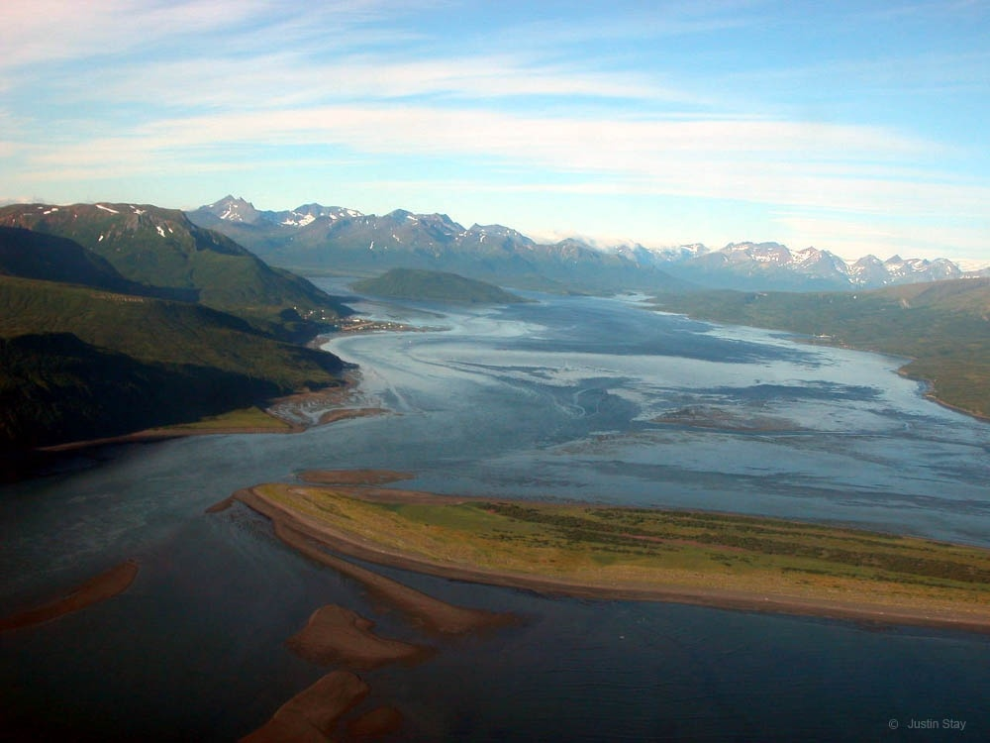
Climates are different,

Slide 11
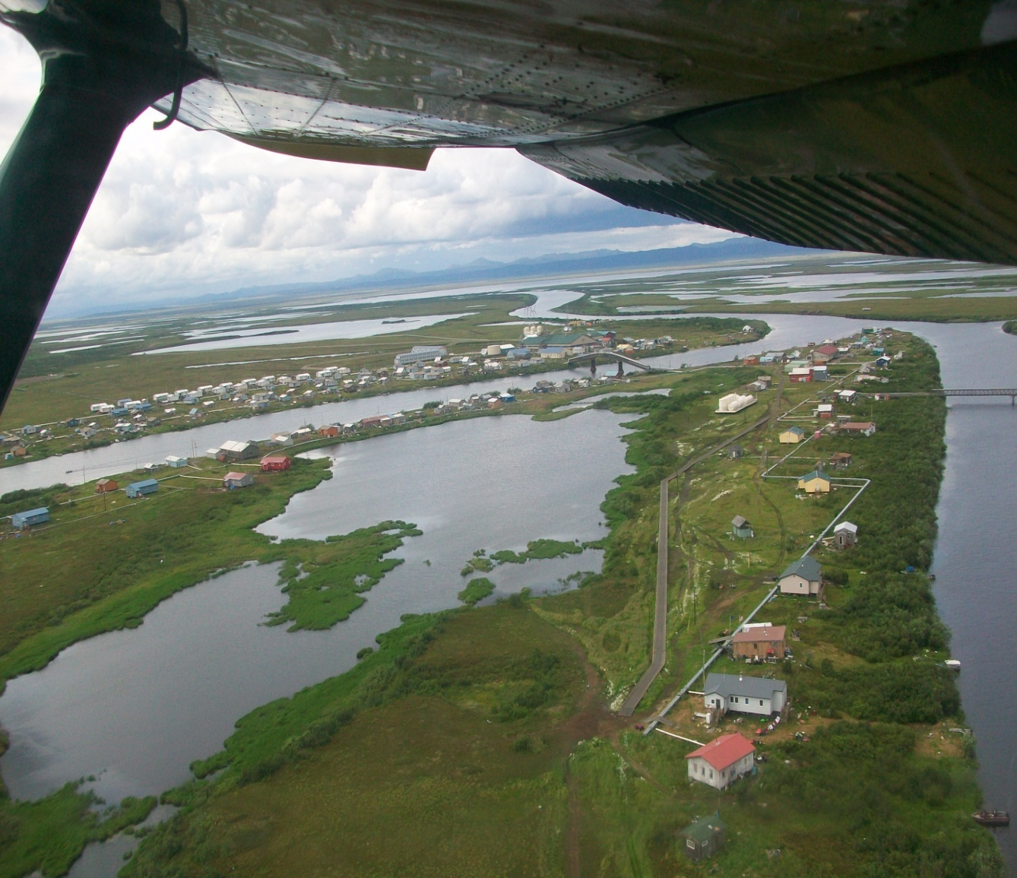
systems are different,

Slide 12
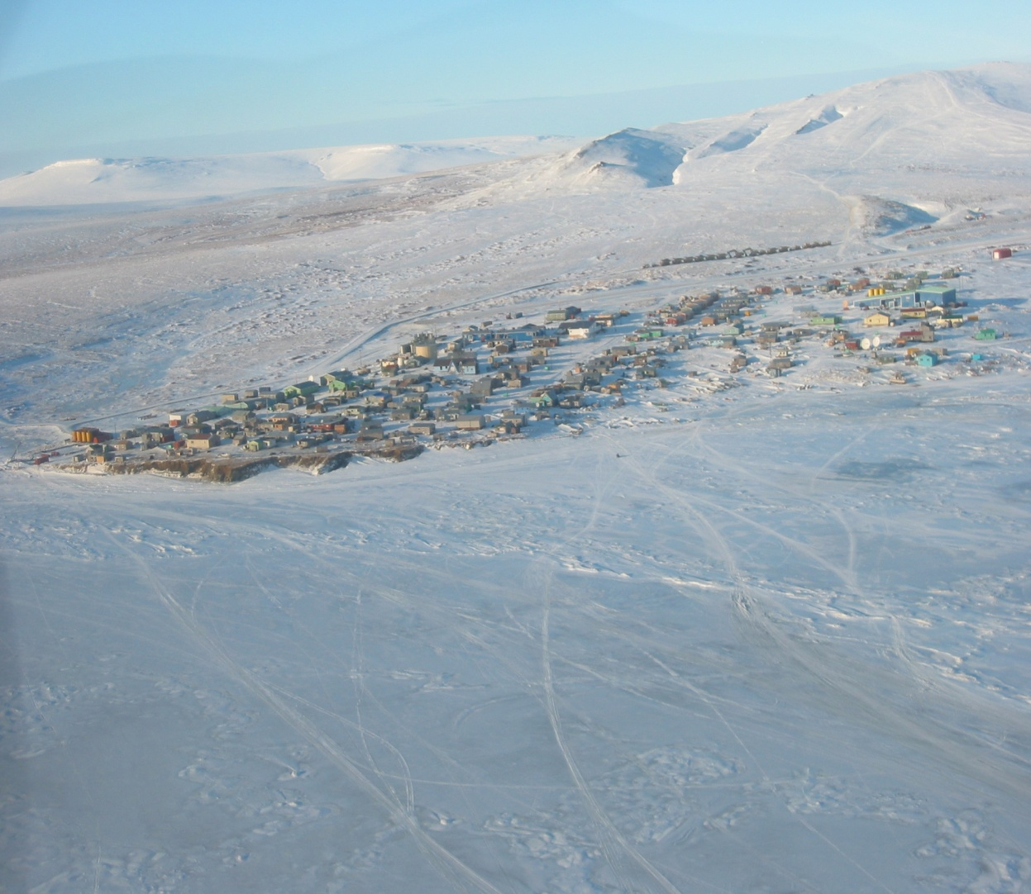
but issues are the same.

Slide 13
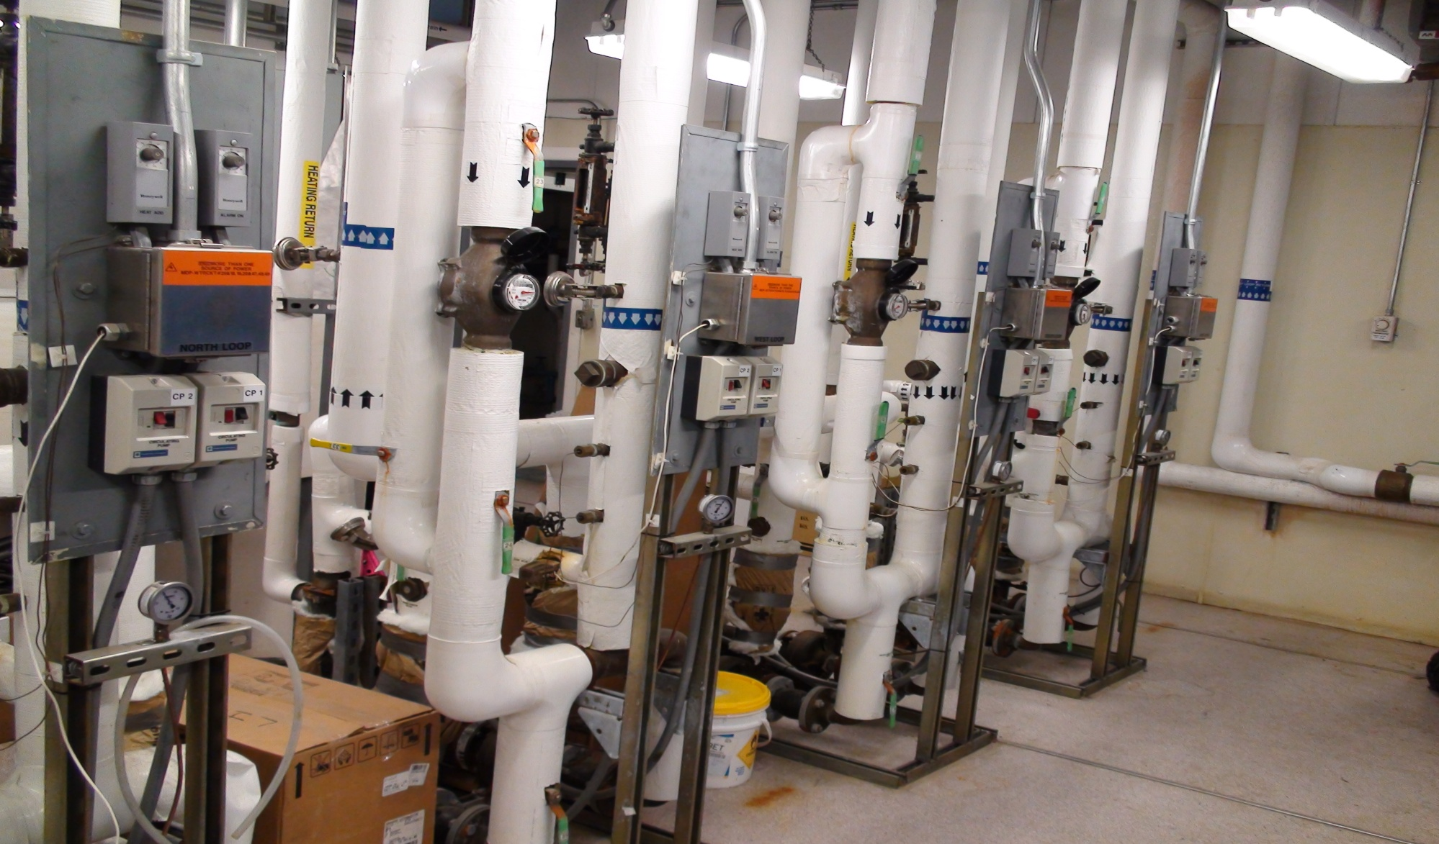
Discussion

