Slide 1
Sanitation Engineering in the North
Past Solutions and Considerations
John A. Warren, P.E.
Co-sponsored workshop by:
US Arctic Research Commission and Centers for Disease Control and Prevention

Slide 2
Sanitation Engineering in the North
Presentation Overview
Water Source
  Groundwater
  Surface Water
  Groundwater Under the Direct Influence of Surface Water (GUDISW)
Water Treatment
  Organics
  Inorganics
  Microorganisms
Water Distribution
  Piped Systems
  Haul Systems

Slide 3
Sanitation Engineering in the North
Presentation Overview
Wastewater Collection
  Gravity Systems
  Vacuum Systems
  Low Pressure Systems
  Haul Systems
Wastewater Treatment
  Lagoons
  Septic Tanks
  Advanced Treatment
Wastewater Disposal
  Liquids
  Solids

Slide 4
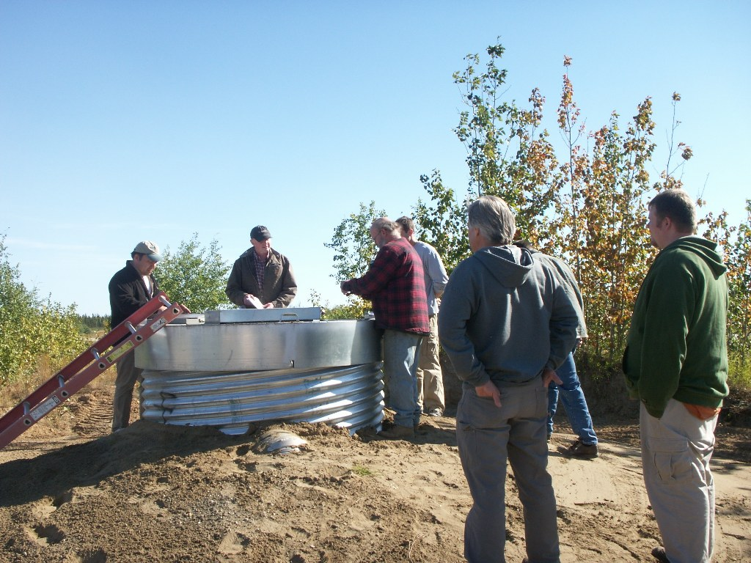
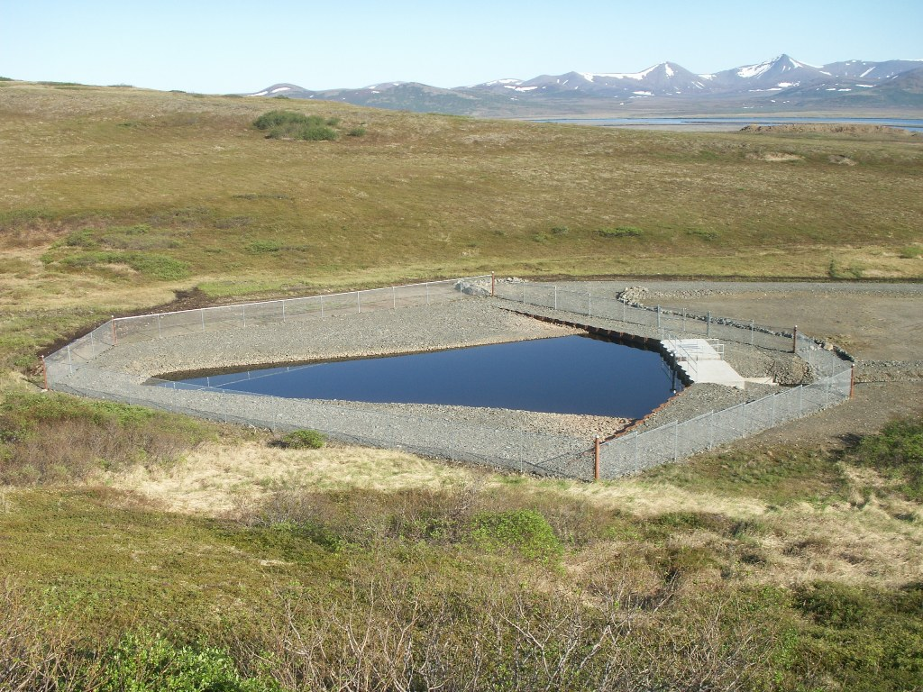
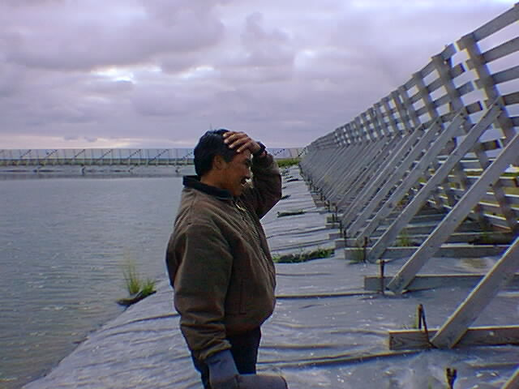
Water Source
Groundwater
  Wells
GUDISW
  Wells
  Infiltration Galleries
Surface Water
  Impoundments
  Diversion Structures

Slide 5
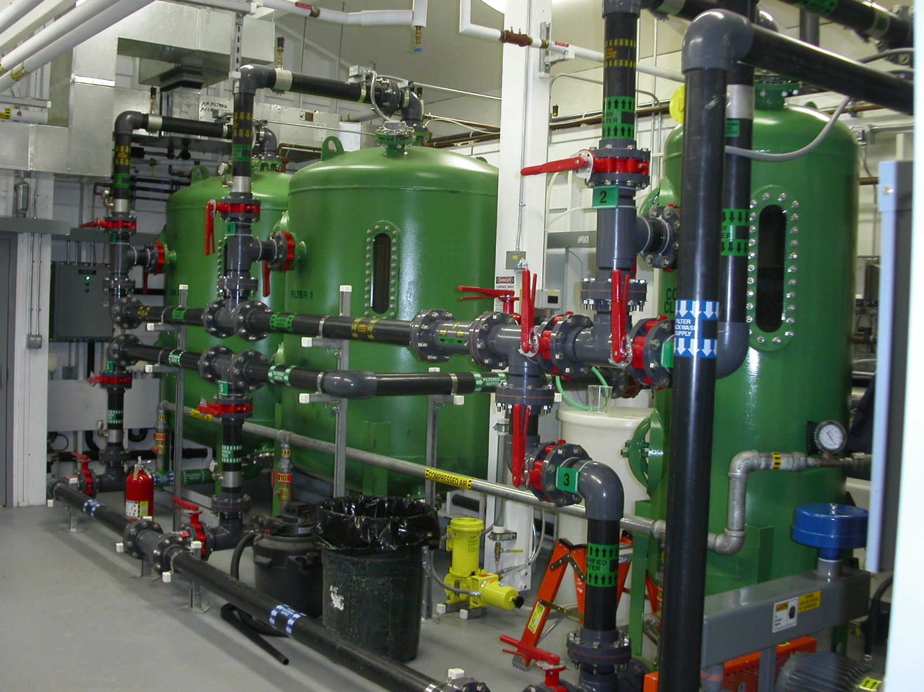
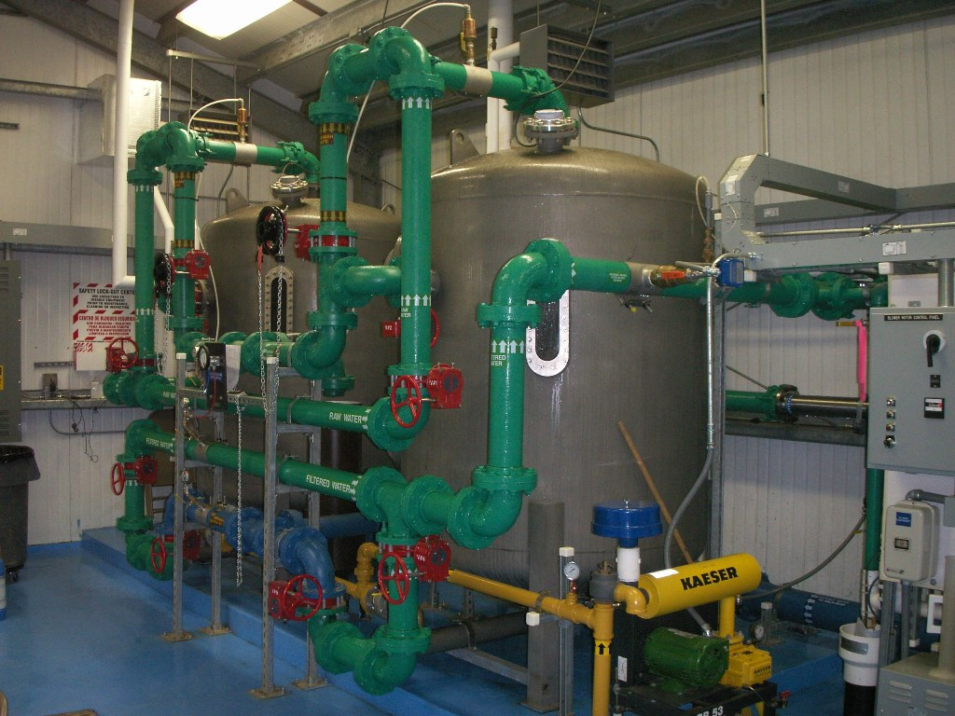
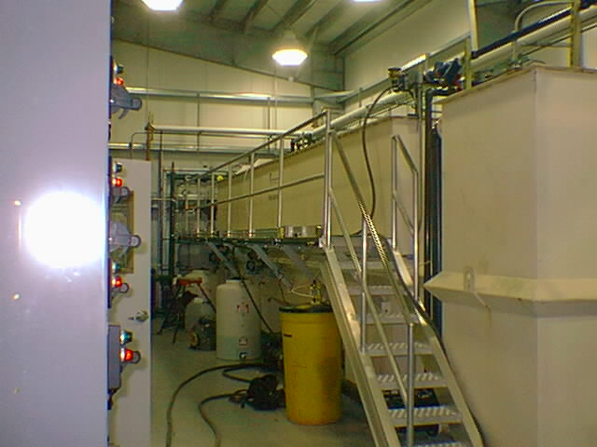
Water Treatment
Groundwater
  Inorganics & Complexed Organics
GUDISW
  Inorganics & Complexed Organics
  Microorganisms
Surface Water
  Inorganics
  Organics & Complexed Organics
  Microorganisms
Regulatory Requirements

Slide 6
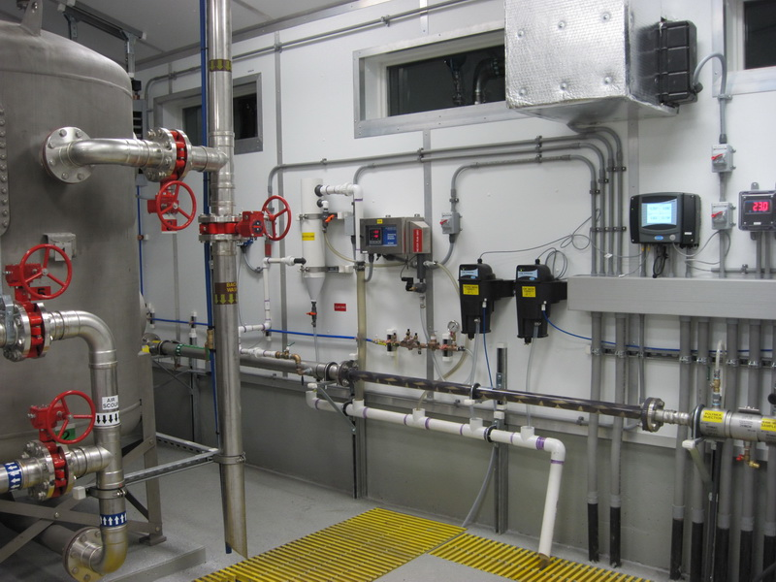
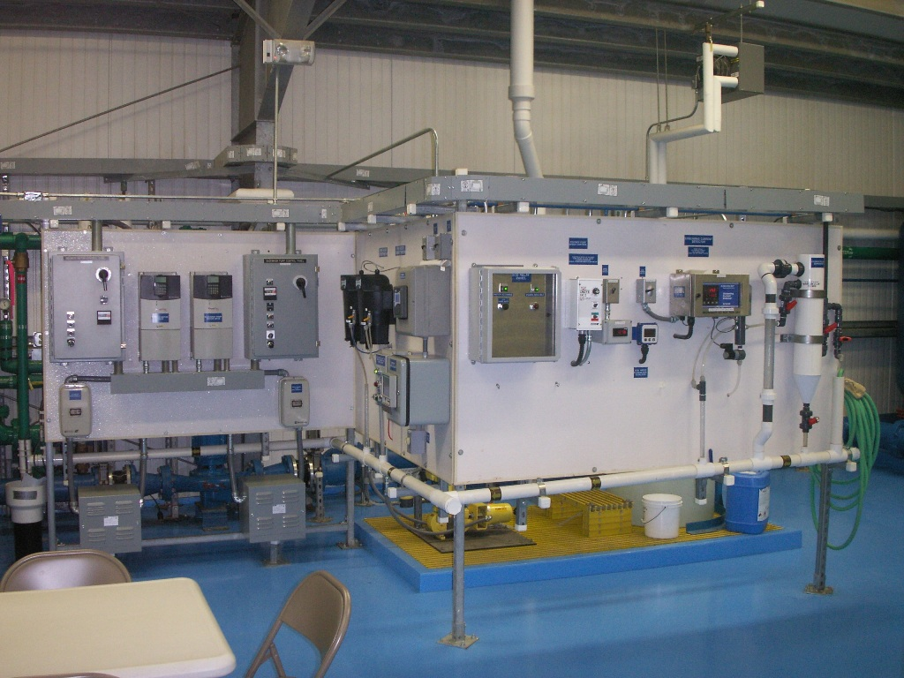
Water Treatment
Streaming Current Detectors
Online Monitoring
Drives

Slide 7
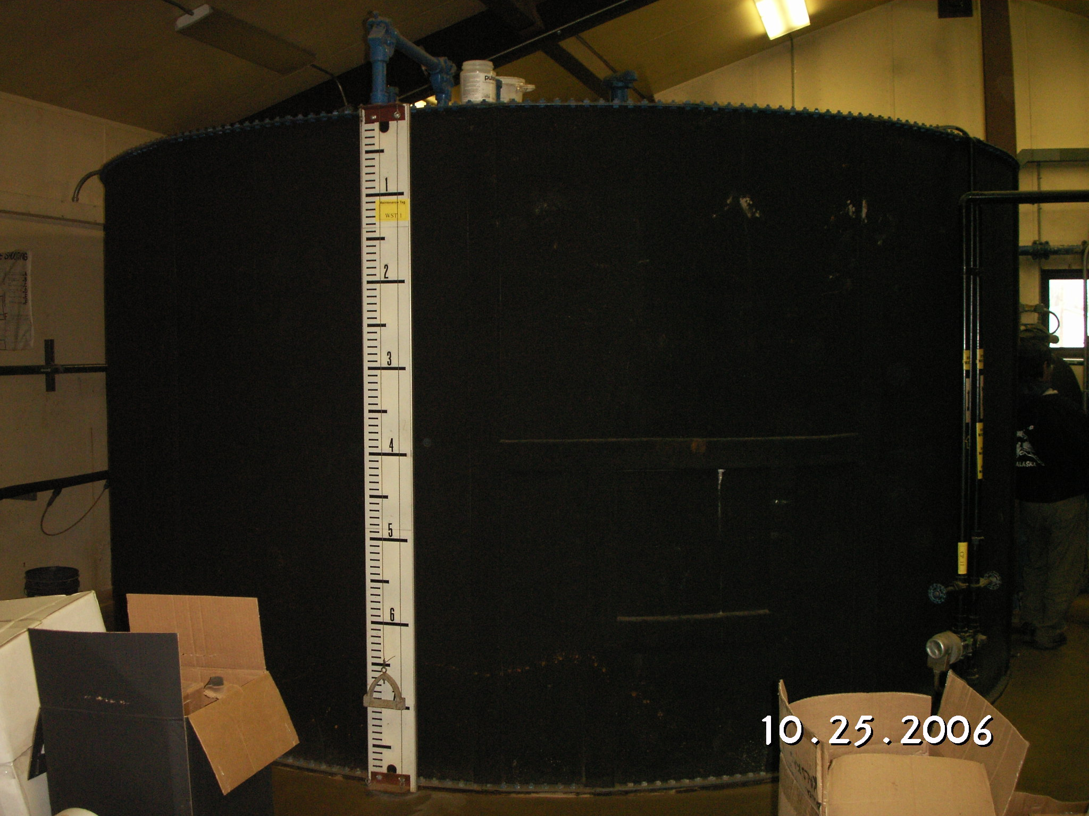
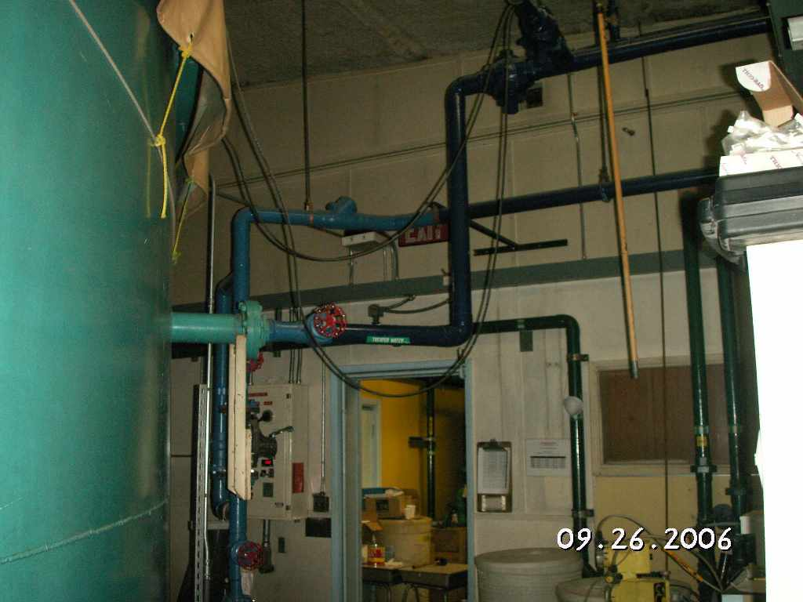
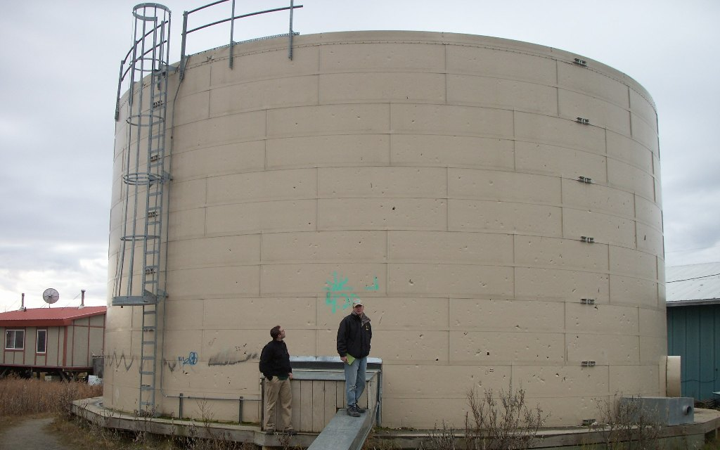
Water Storage
Exterior Insulated Tanks
Interior Tanks in Buildings

Slide 8
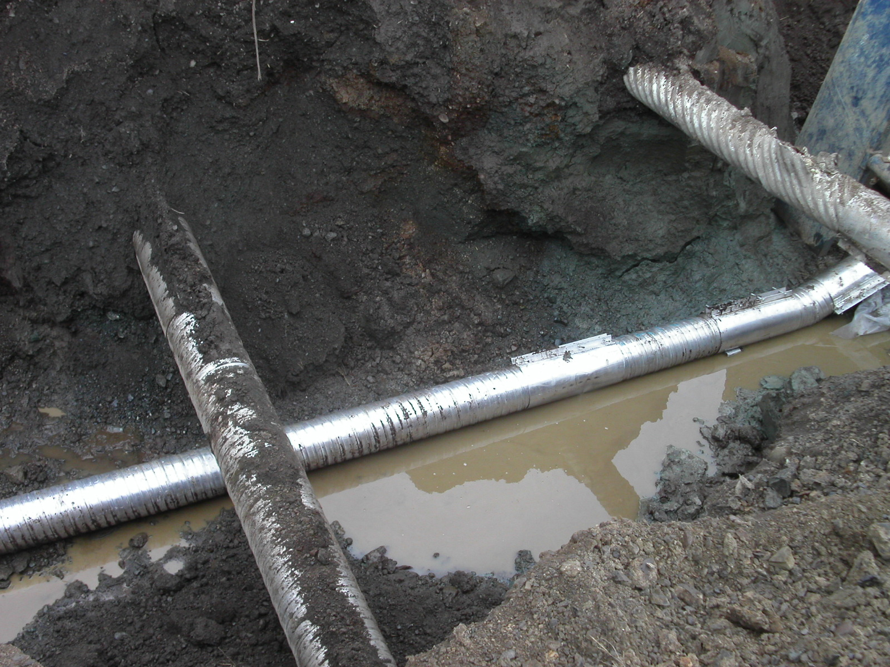
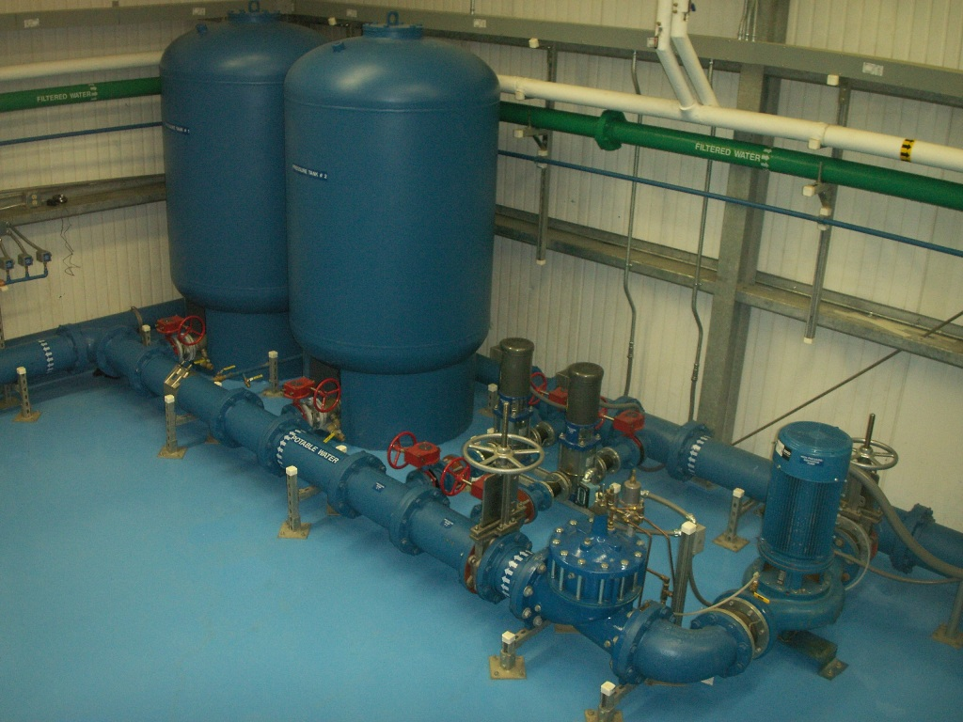
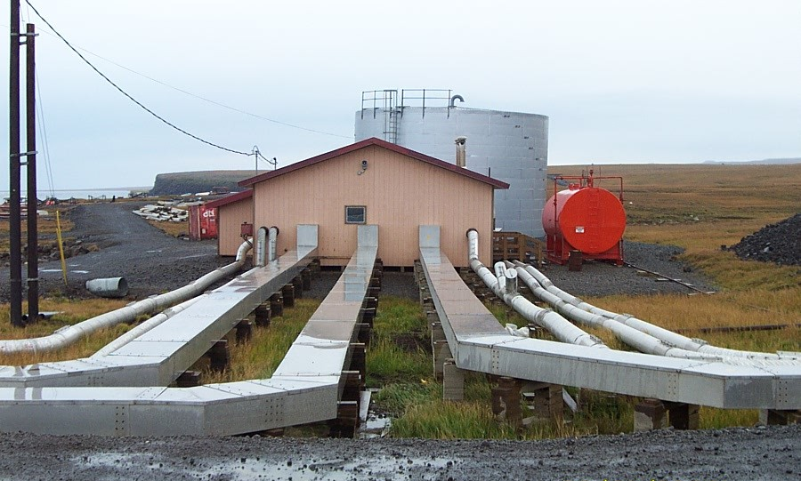
Water Distribution
Piped Distribution
  Buried
  Above Ground
  Utilidor

Slide 9
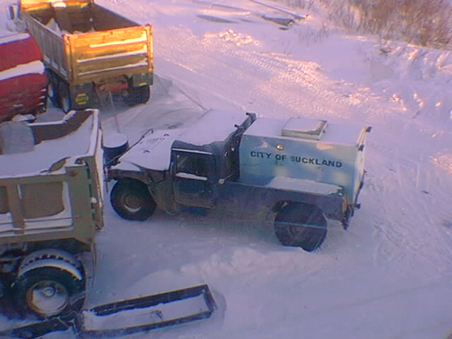
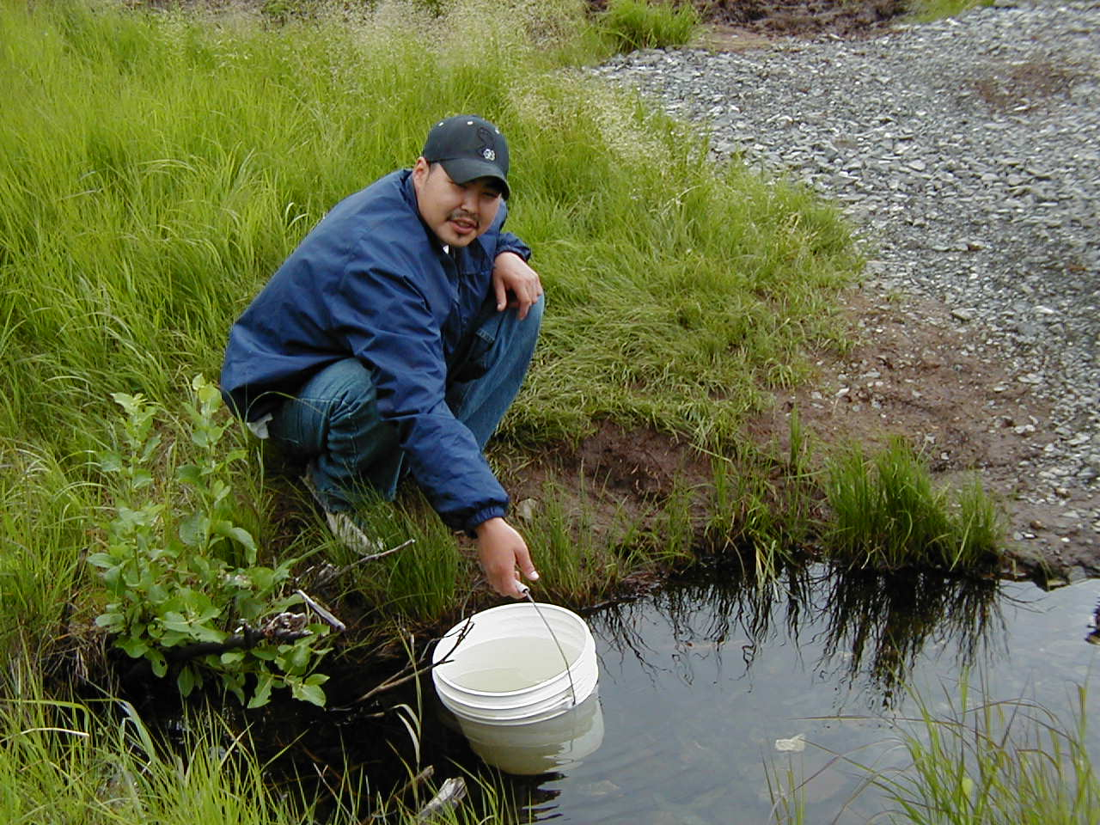
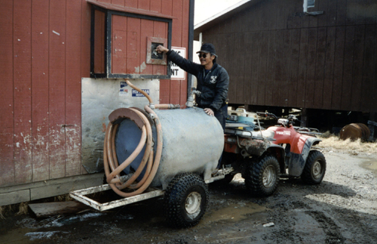
Water Distribution
Haul
  Community
  Individual

Slide 10
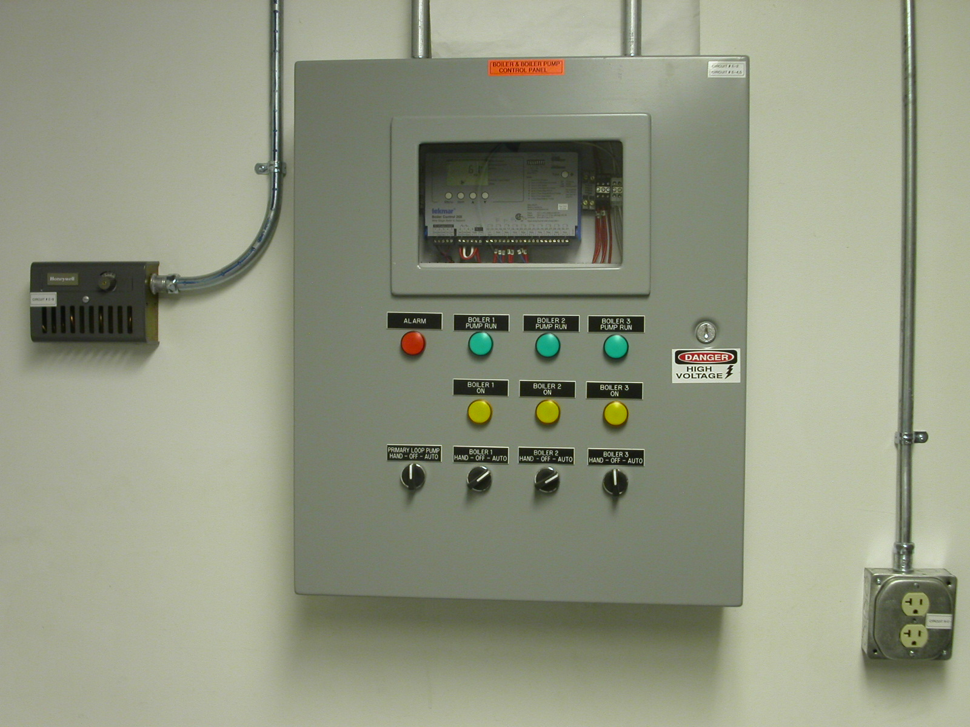
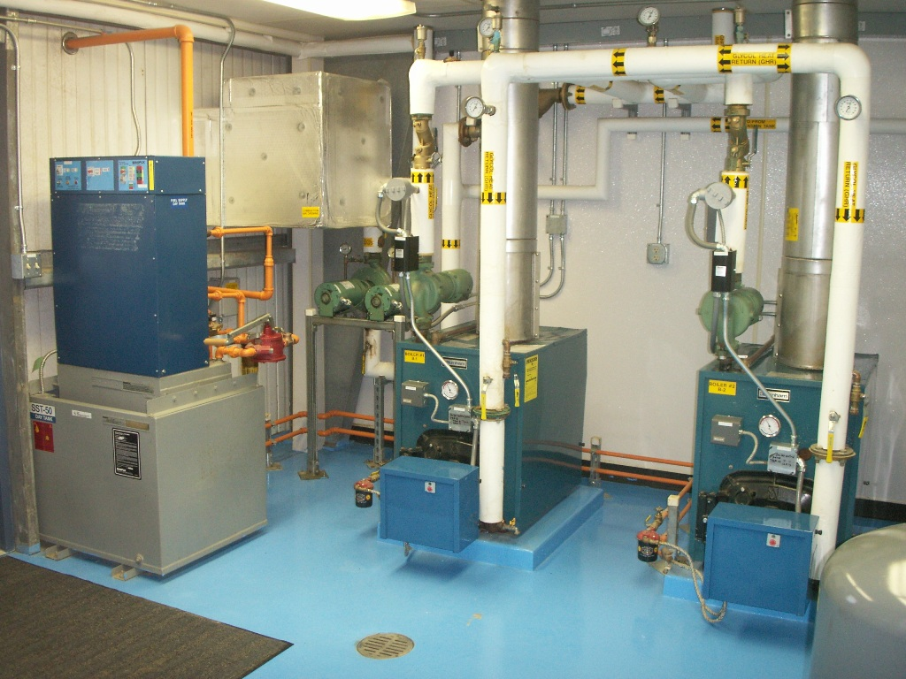
Water Distribution
High Efficiency Heating Systems
Boiler Controls
Drives (motor controls)
Integrating Online Monitoring

Slide 11
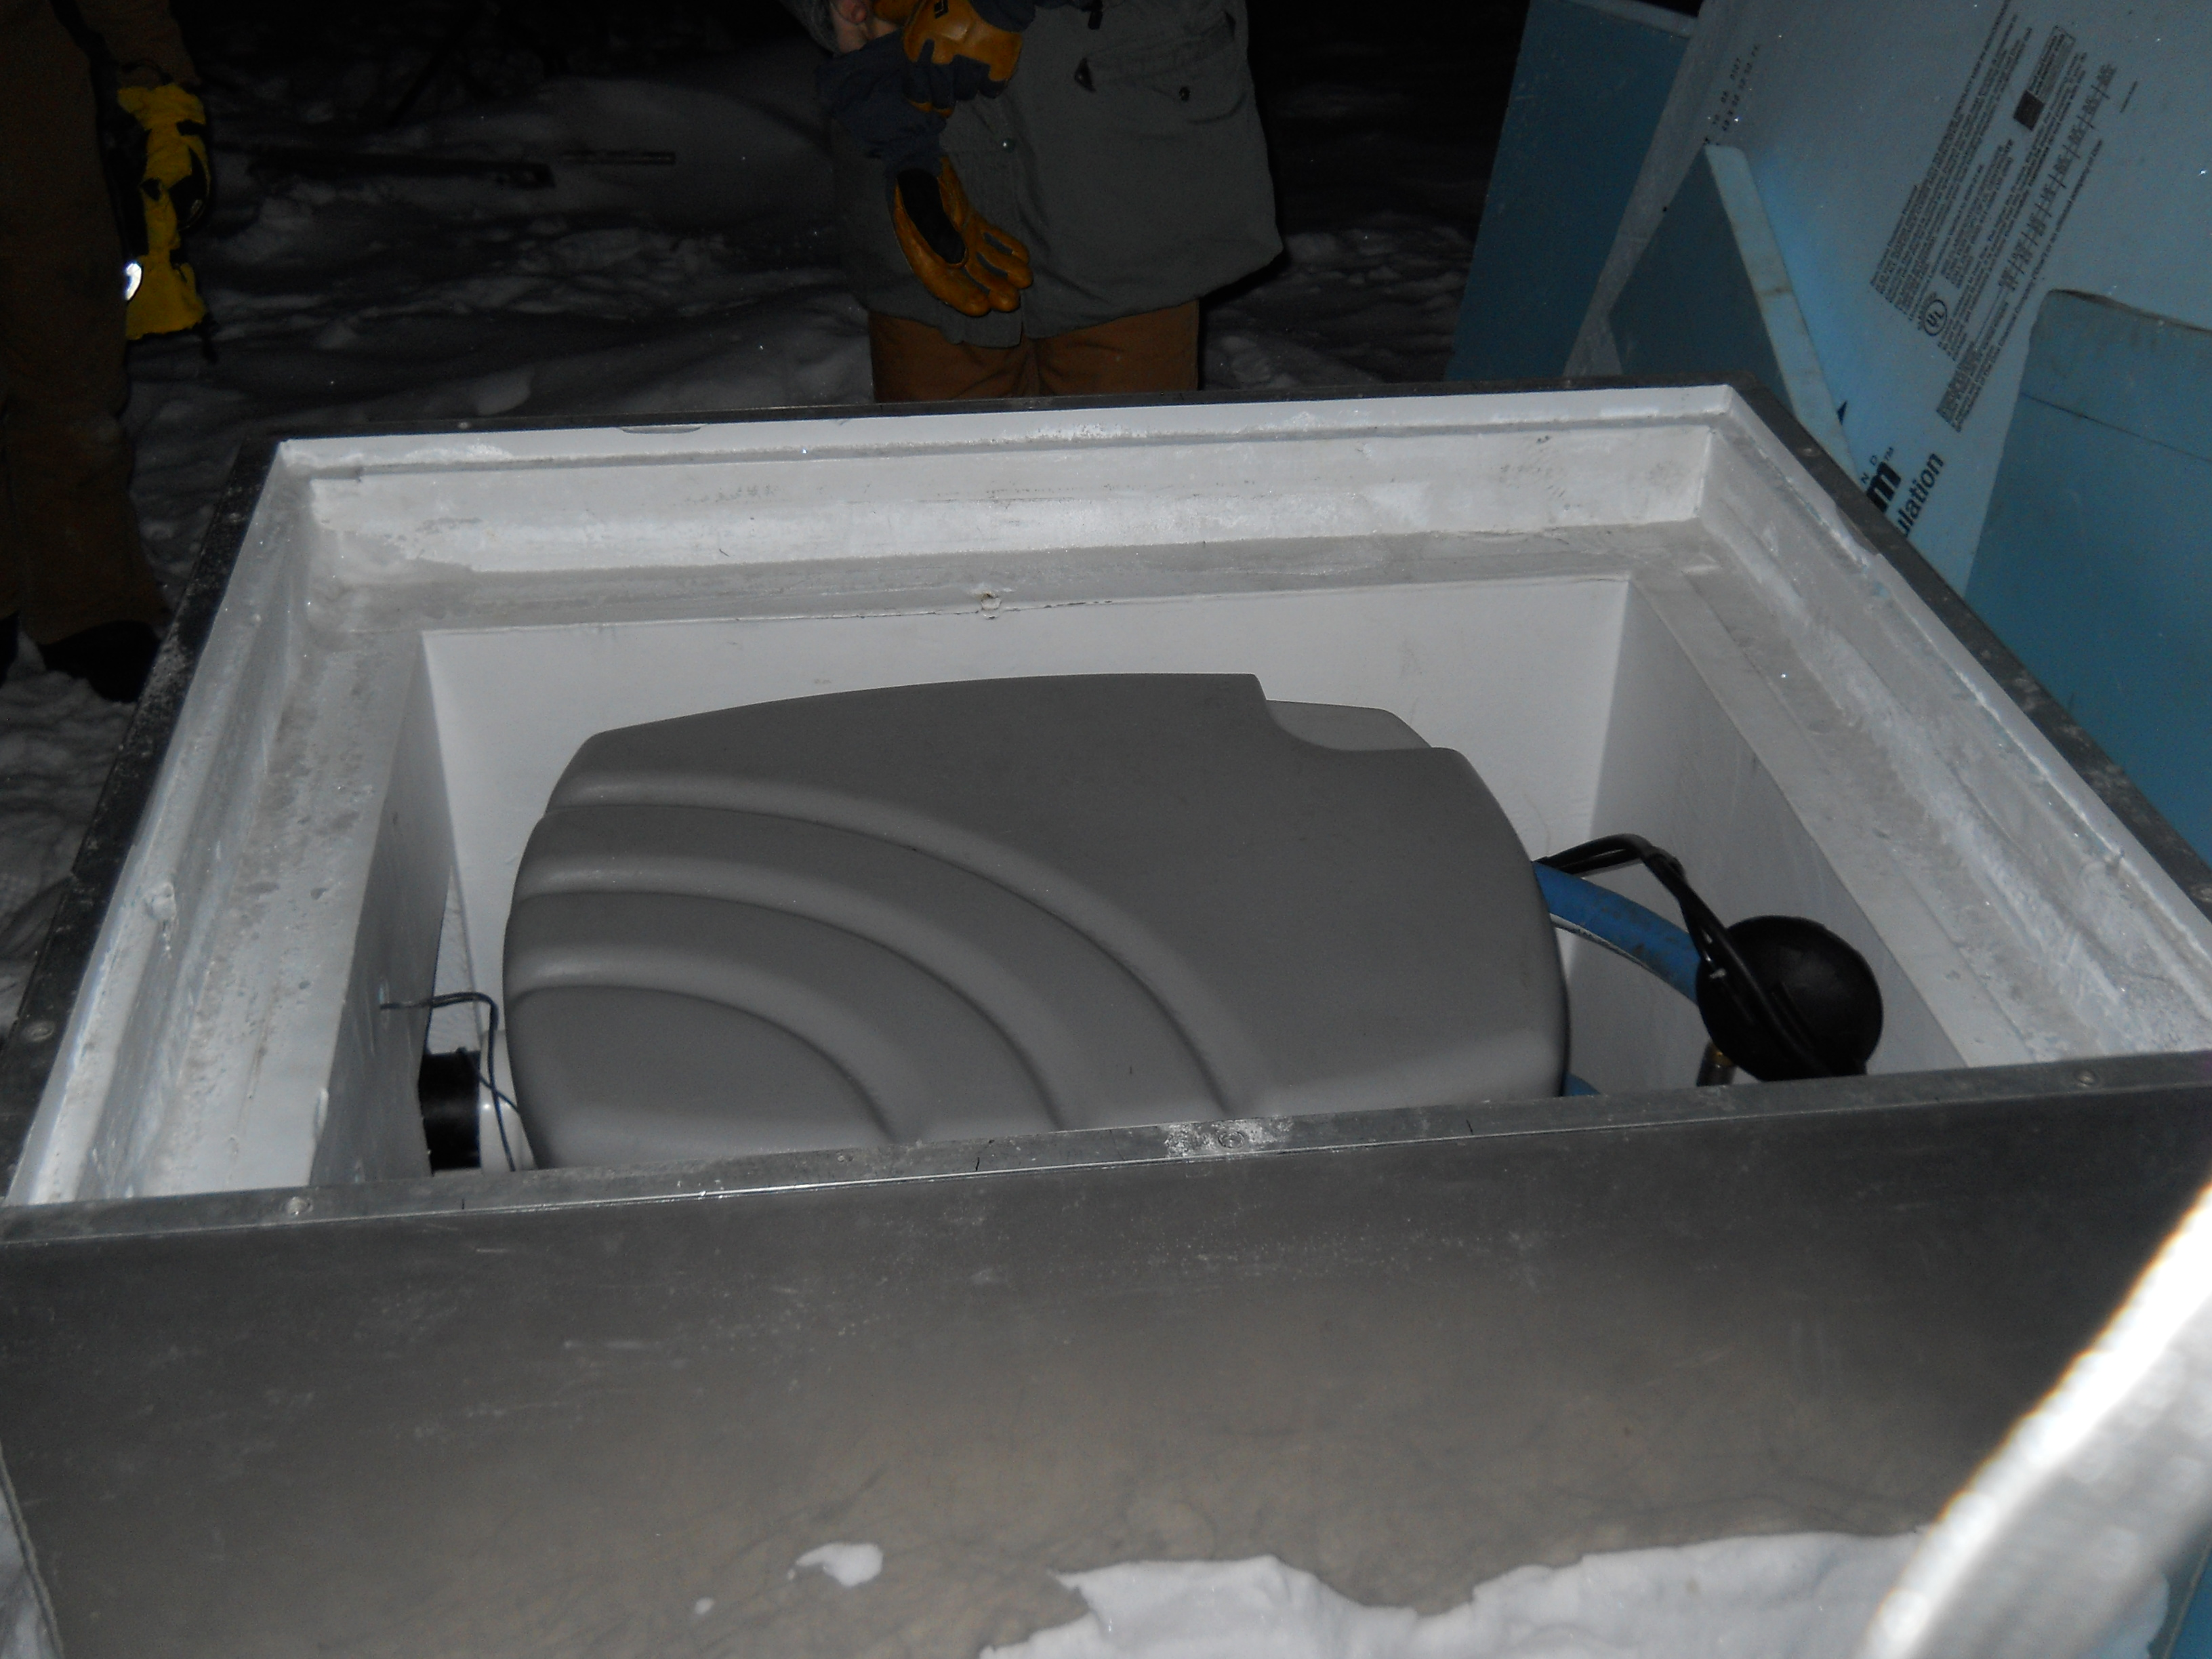
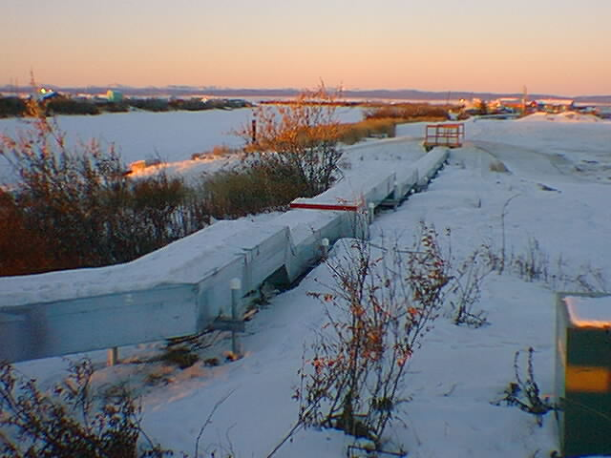
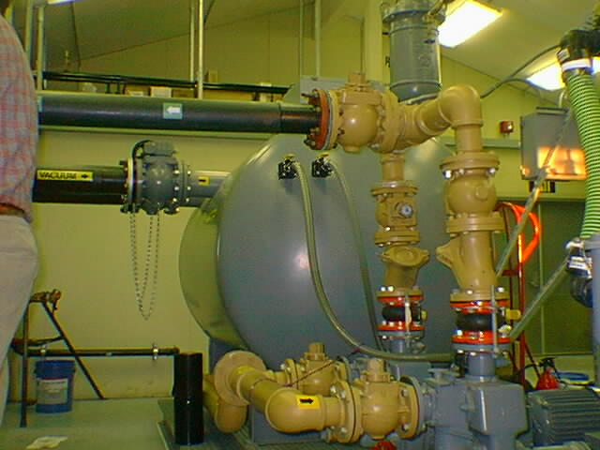
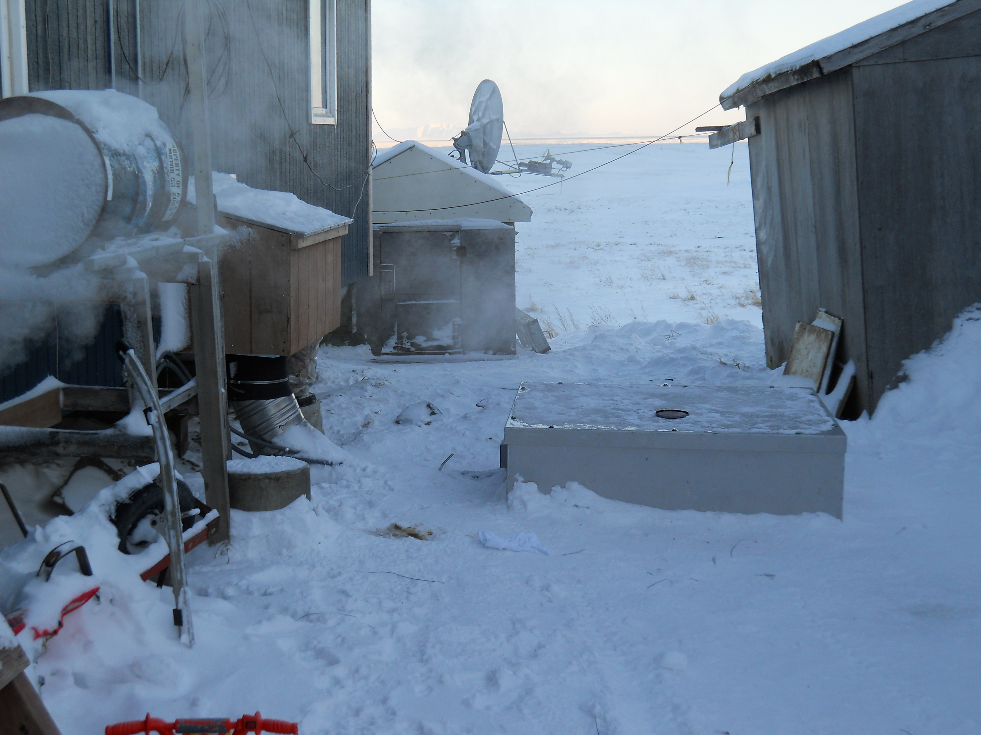
Wastewater Collection
Piped Collection
  Gravity
  Vacuum
  Low Pressure

Slide 12
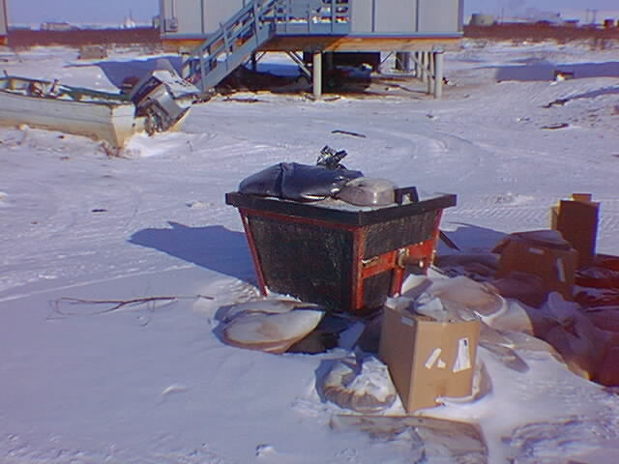
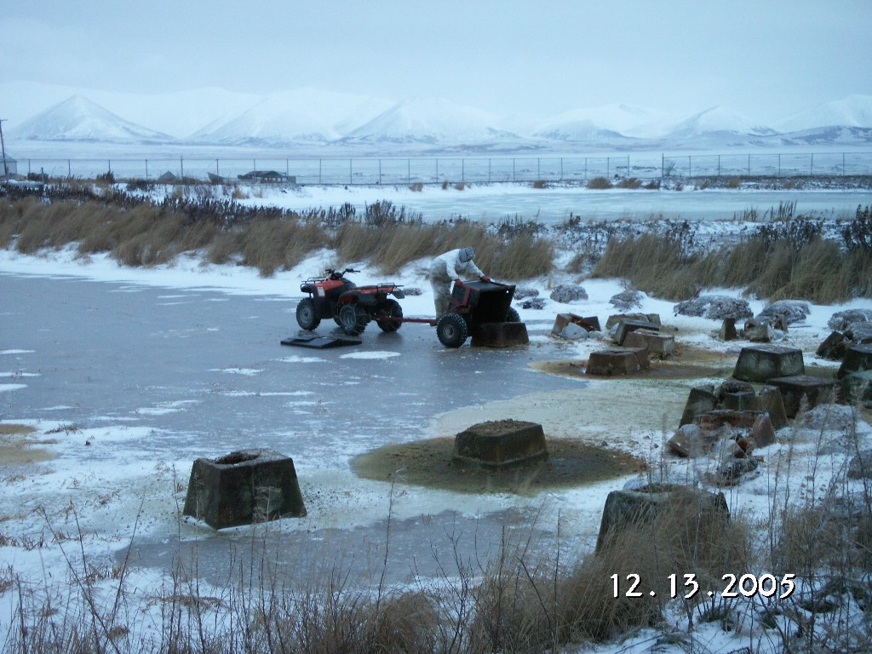
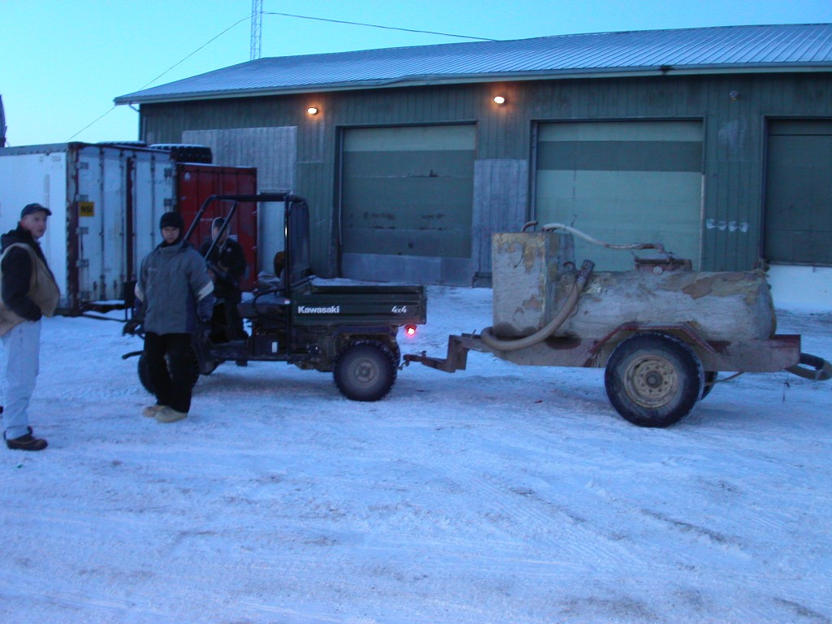
Wastewater Collection
Haul
  Individual
  Community

Slide 13
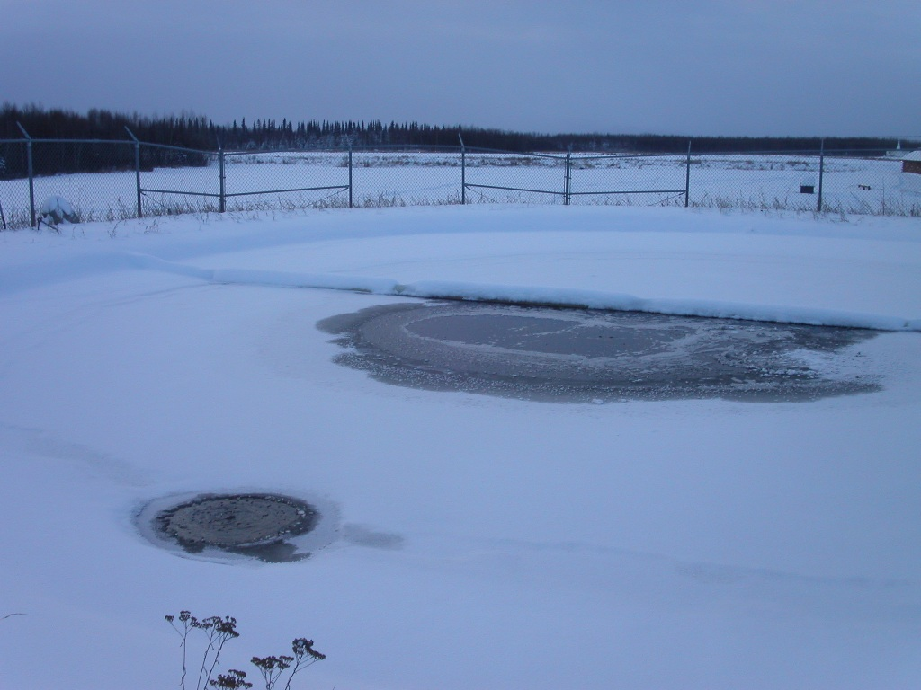
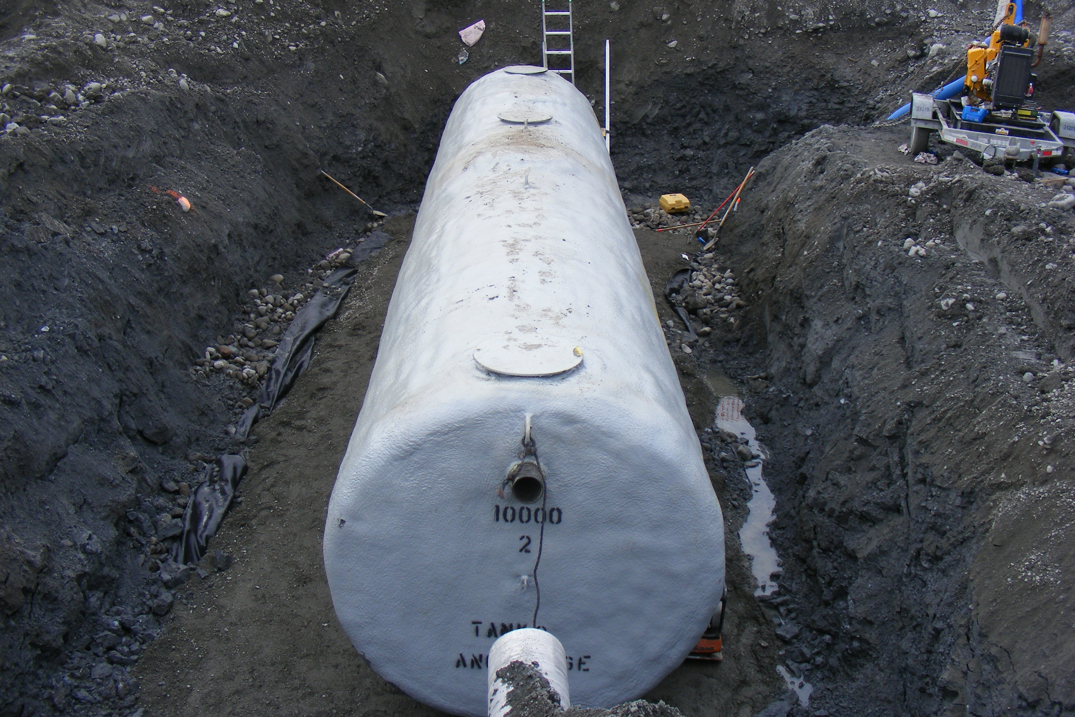
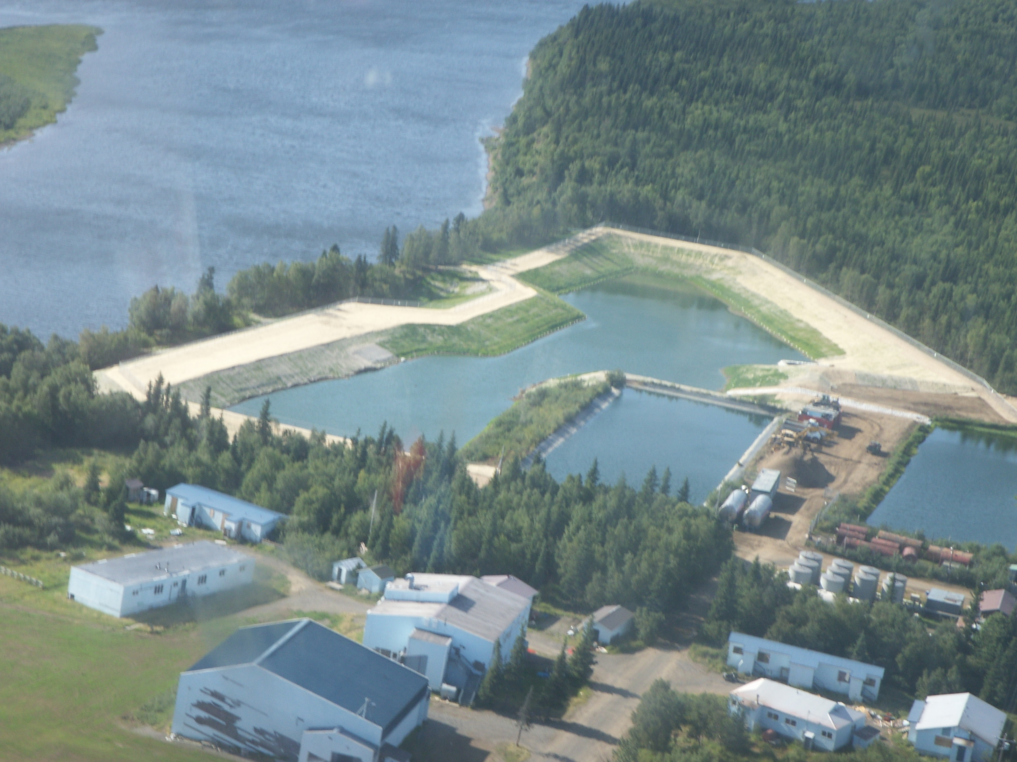
Wastewater Treatment
Natural Systems
  Facultative Lagoons
  Septic Tanks
Advanced Treatment
  Aerated Ponds
  Suspended or Attached Growth
Regulatory Requirements

Slide 14
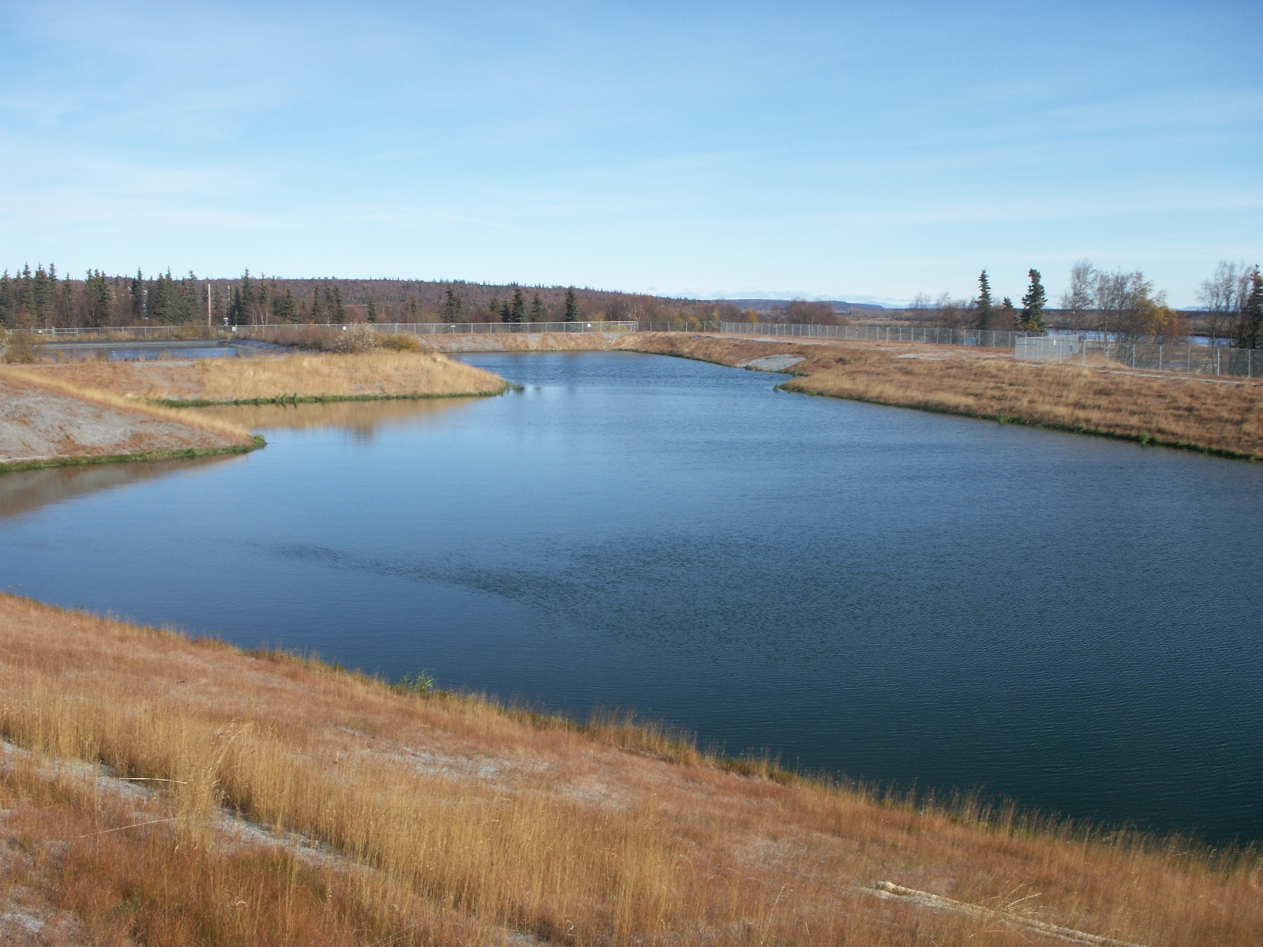
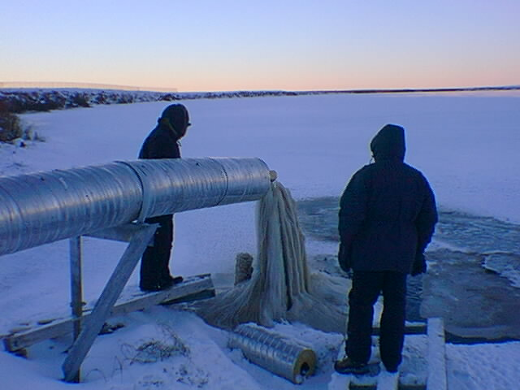
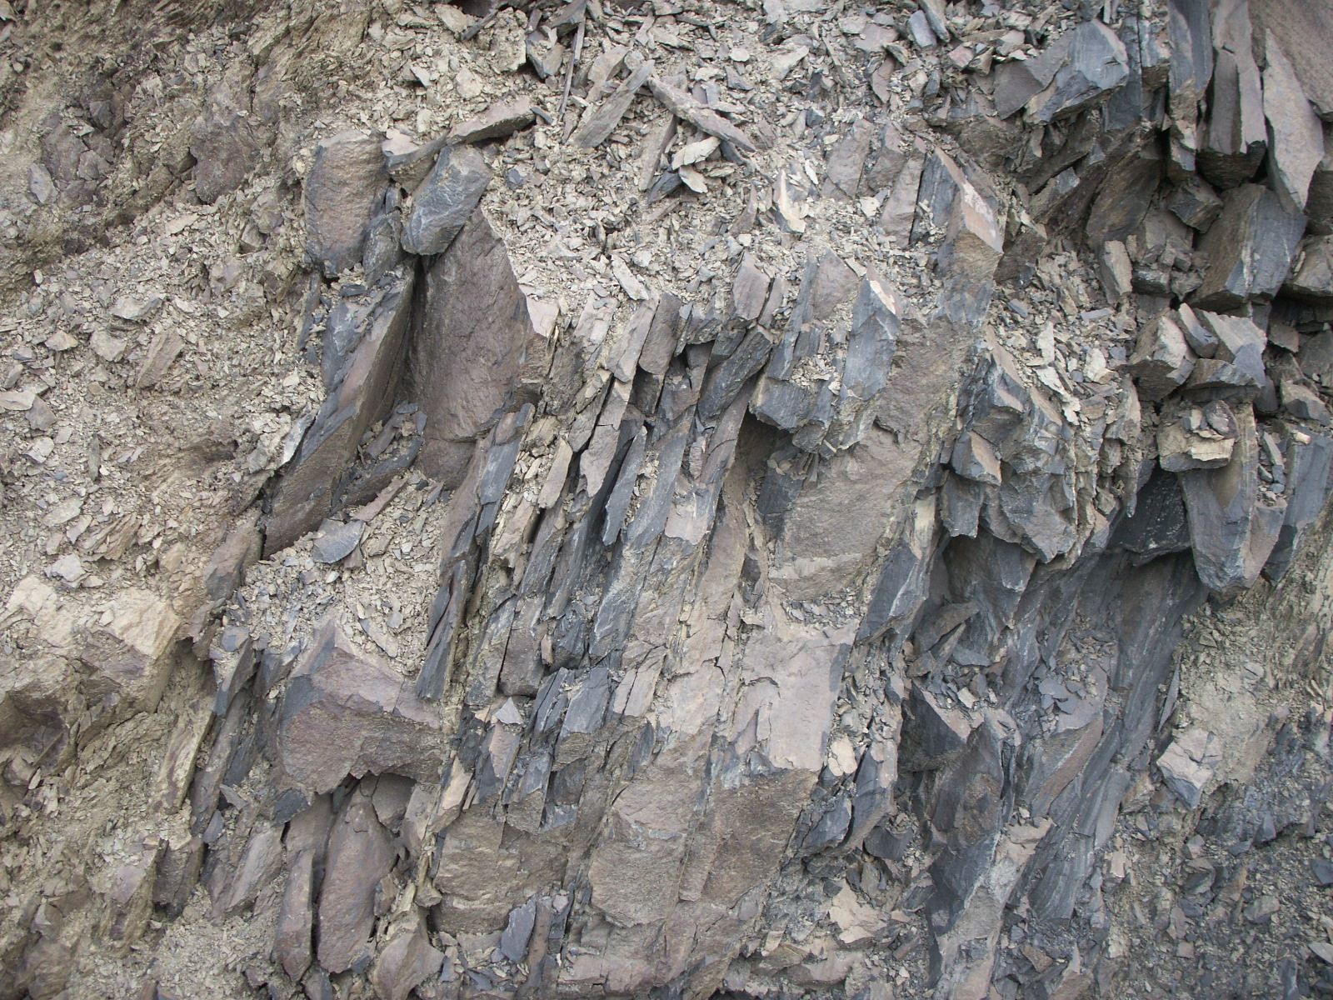
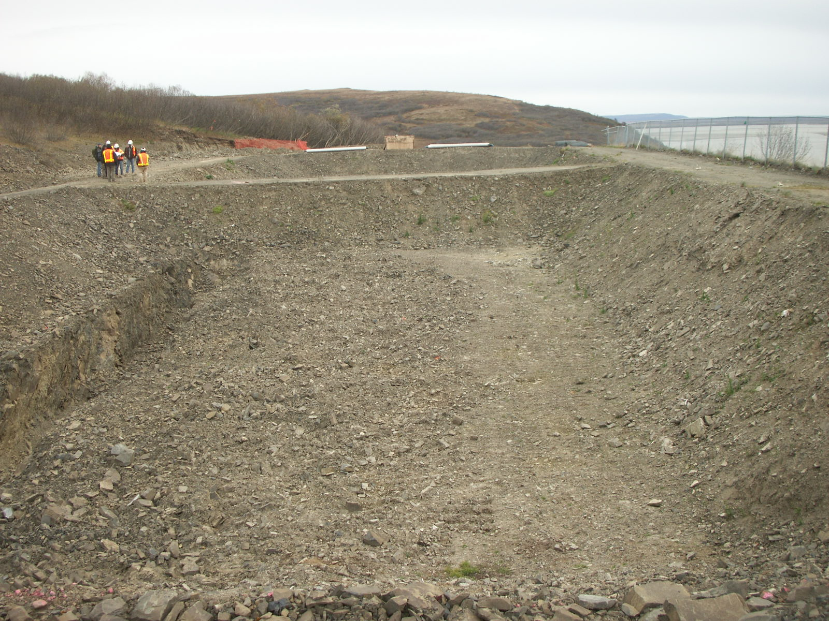
Wastewater Disposal
Liquids
  Percolation
  Surface Discharge
Solids
  Landfill

Slide 15
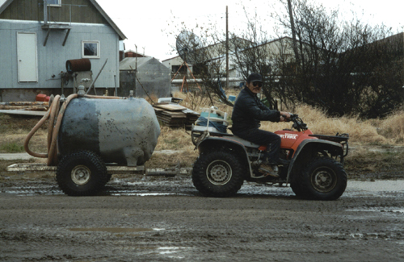
Opportunities
Piped Systems
  Well Refined
  Expensive to Construct
  Lower Operational Cost
  Benefit from Economy of Scale
Haul Systems
  Not Well Refined
  Inexpensive to Construct
  Higher Operational Cost

Slide 16
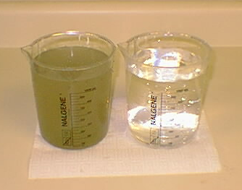
QUESTIONS?

