Slide 1
Water and Honey Buckets in Rural Alaska
By Mary C. Pete
U.S. Arctic Research Commission
January 13, 2011

Slide 2
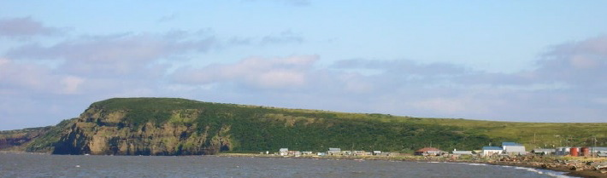
Stebbins, Alaska
Notes:
I was born and raised in Stebbins, where I spent 2 weeks over the holidays. It is along the Bering Sea coast, about 60 miles north of the Yukon delta. My experience and perspectives about the lack of safe water and sanitation is from living in Stebbins until my board school years.
Stebbins has nearly 600 people now. It currently has a million gallon water tank with wonderful water piped and pumped from Clear Lake, and households use honey buckets that they dump in bunkers, and contents are hauled away by 4-wheeler. When I was a child, water was melted ice or snow in the winter and rain water or homemade well water in the summer. Honey buckets were dumped in many ponds , ditches in summer or one the sea ice in winter. Outhouses were in extensive use, but with community growth, melting permafrost, and introduction of sewage collection programs, outhouses are relegated to fishcamps.

Slide 3
Water and Sanitation in Rural Alaska
23% of the approximately 280 rural communities lack adequate water and sewerage systems
Respiratory and other disease rates in these communities are much higher than in those with adequate sanitation
Many systems require high maintenance and are very costly
Notes:
Quinhagak fish plant took all water from the system – no water in the school

Slide 4
Continued…
The FY2011 CIP list on the DEC Safe Water Program about 60 communities with various scopes of work related to water and sanitation
The average community request is approximately between 11% to 12.5% of the total estimated project cost
In all rural communities, state-built schools have adequate water and sewer
Why can’t homes enjoy the same?
Notes:
Where are funds going to come from for these projects?

Slide 5
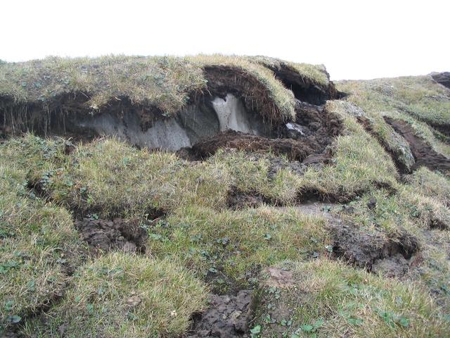
Impacts of Permafrost
Notes:
Permafrost and changes in its presence, thickness affects everything related to infrastructure, including outhouses, buildings and water and sewer systems.

Slide 6
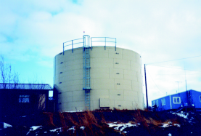
Notes:
Water tank similar to the 2 half a million gallon tanks in stebbins

Slide 7
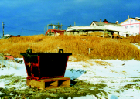
Honey Bucket Bunker
Notes:
This is the most common collection unit in villages without piped water and sewer. In some places, they are affectionately or jokingly called treasure chests. 4-wheelers with trailers haul full bunkers to community sewage lagoons or evacuate their contents. You can imagine how challenging all this can be in blizzards and other inclement weather. Spills, overflows, leaks, and mishaps while hauling commonly occur. Brownish yellow spots on roads quickly covered over with shoveled snow are telltale signs of these mishaps.

Slide 8
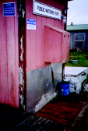
A Public Watering Station

Slide 9
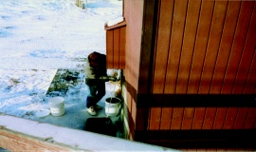

Slide 10
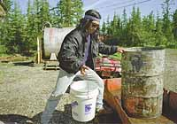
Water delivery in Venetie

Slide 11
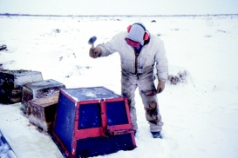

Slide 12
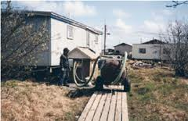
Evacuation System

Slide 13
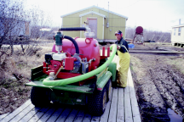

Slide 14
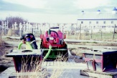

Slide 15
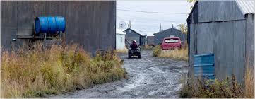

Slide 16
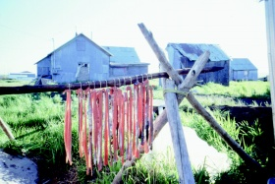
Notes:
Subsistence facilities and products are exposed to everything, including dust from roads and what gets on those roads.

Slide 17
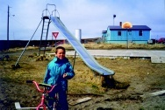
Notes:
As are children.

