Slide 1

28th Alaska Health Summit, January 10-13, 2011
Wastewater treatment in cold/arctic climate with a focus on small scale and onsite systems
Department of Plant and Environmental Sciences
NORWEGIAN UNIVERSITY OF LIFE SCIENCES
Professor, Petter D. Jenssen
Department of Plant- and Environmental Sciences
Norwegian University of Life Sciences (UMB)
1
1
www.umb.no

Slide 2
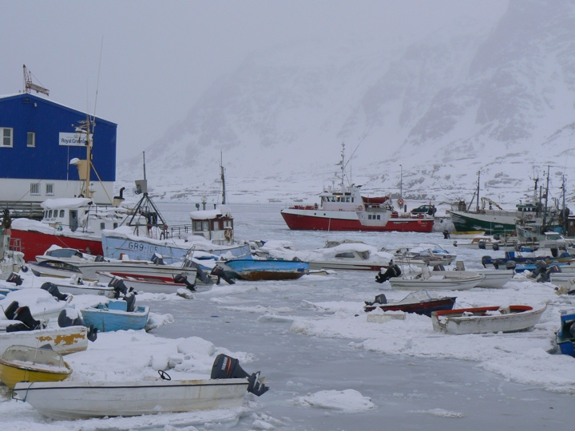
Extremely cold climate
2
January 11, 11

Slide 3
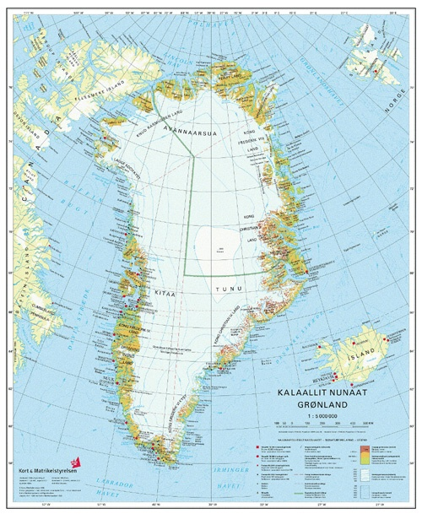
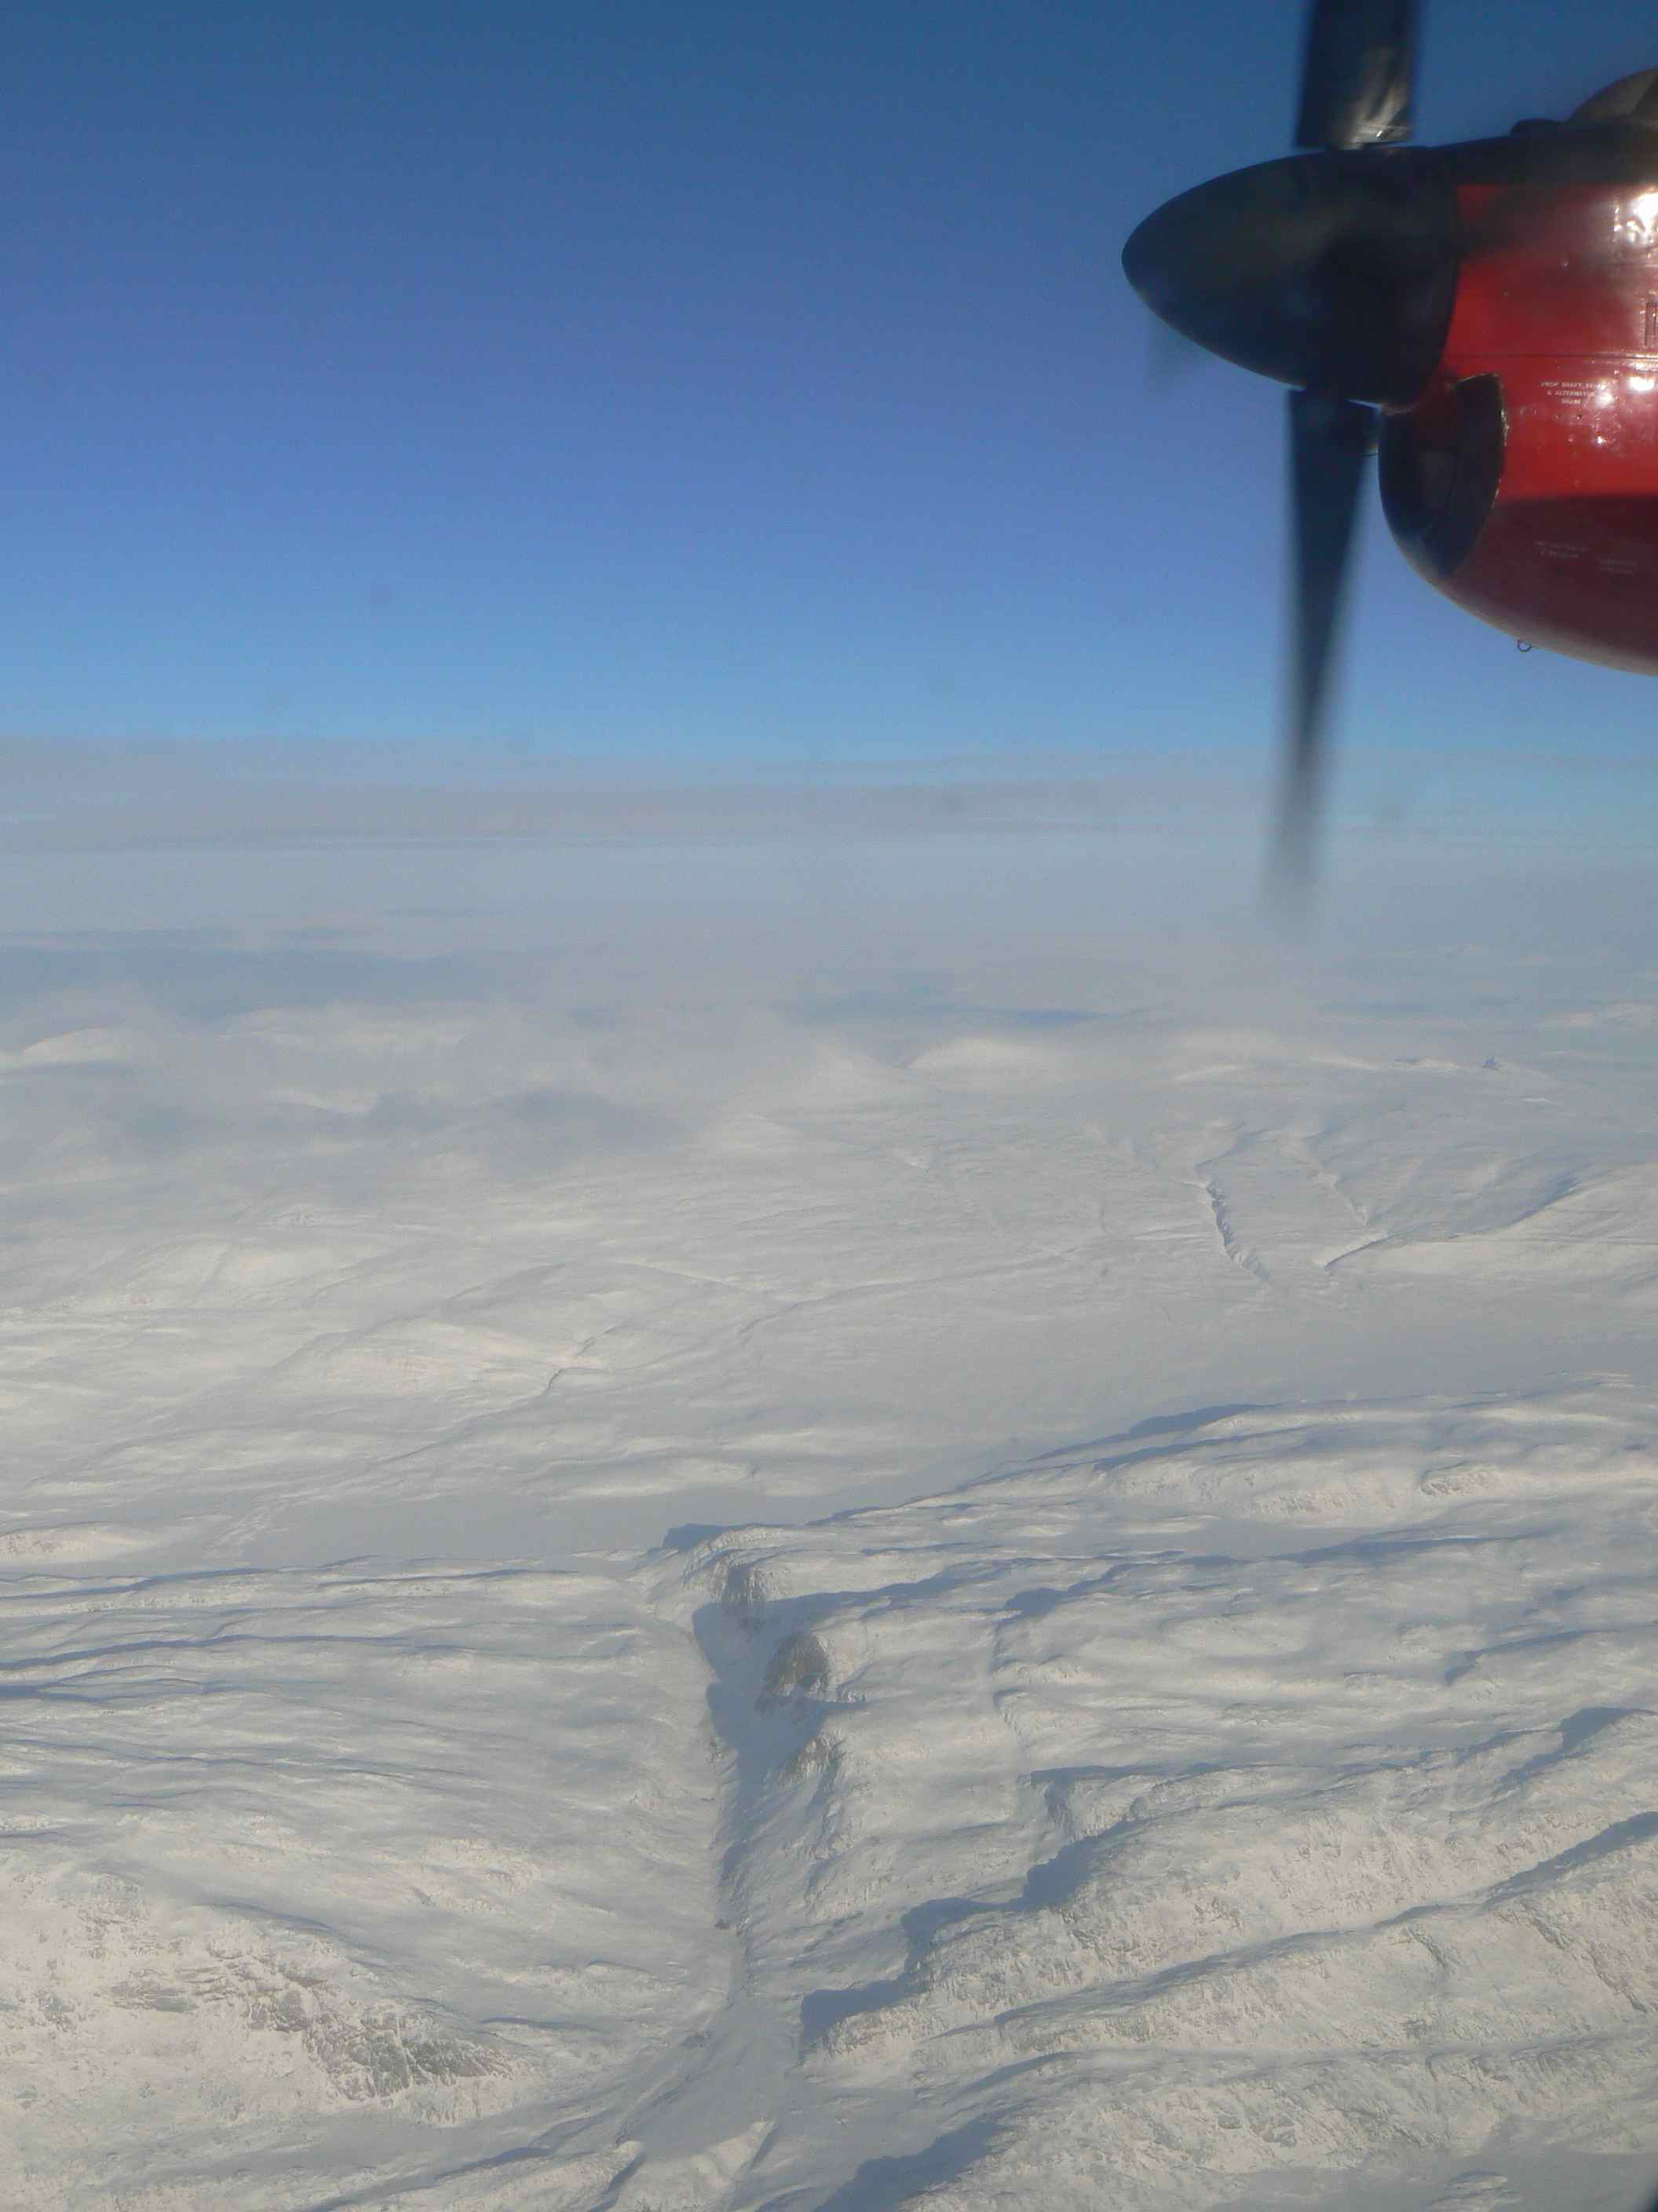
Large areas - extremely low population density
The world’s biggest island
The ice free area 19%
Inhabitants 50.000
Climate differs from one locality to the other
January 11, 11

Slide 4
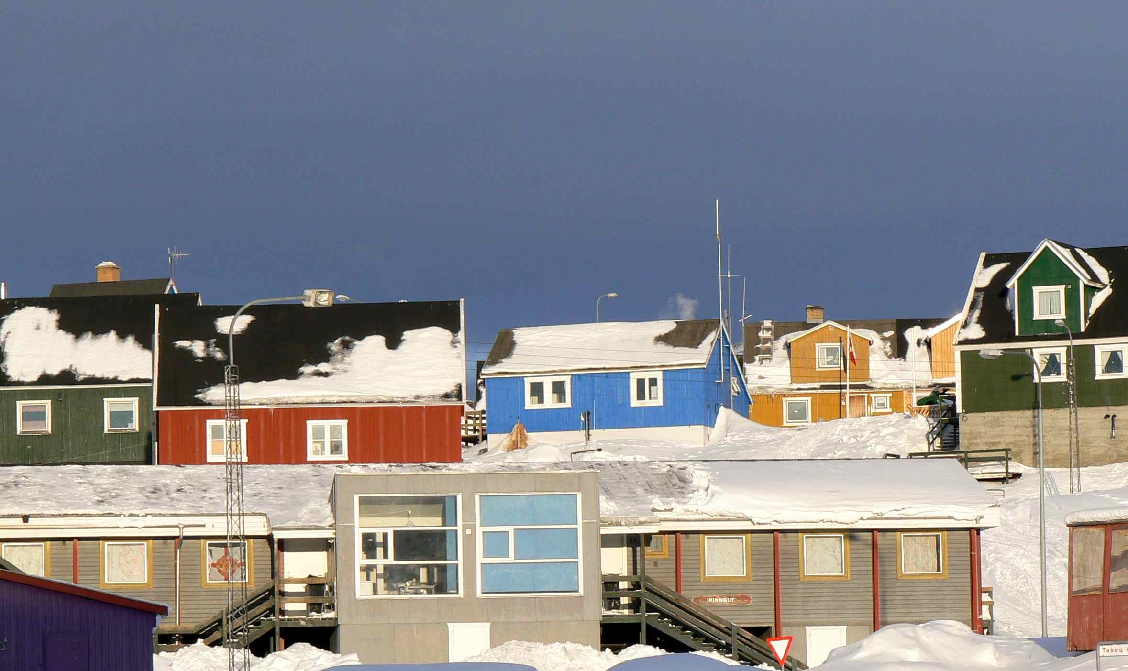
Sisimiut Greenland, 5000 people (2500 dogs)
January 11, 11

Slide 5
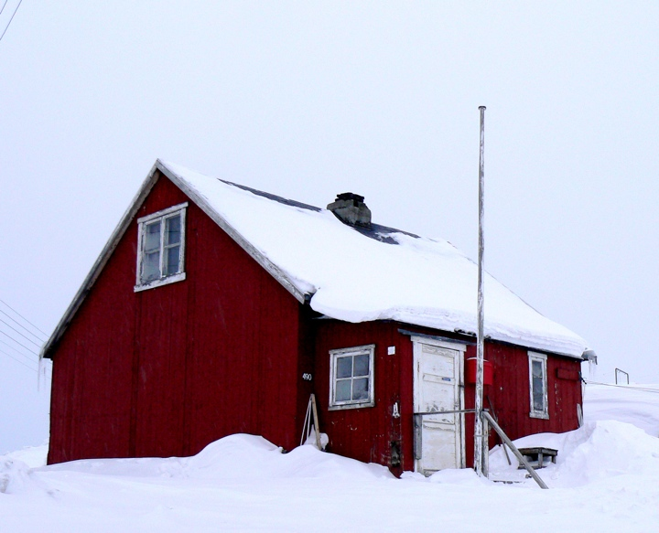
Low income - poor communities
5
January 11, 11

Slide 6
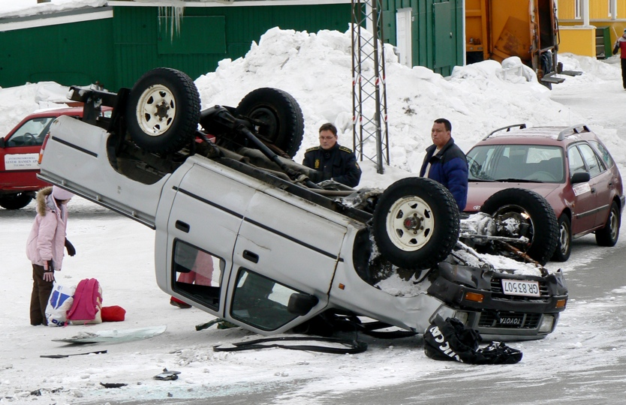
Social stress
6
January 11, 11

Slide 7
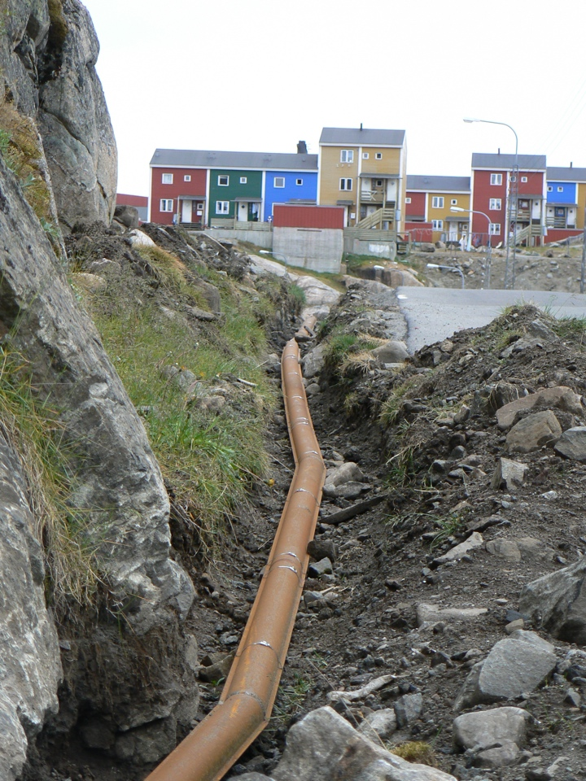
Water pipe
7
January 11, 11

Slide 8
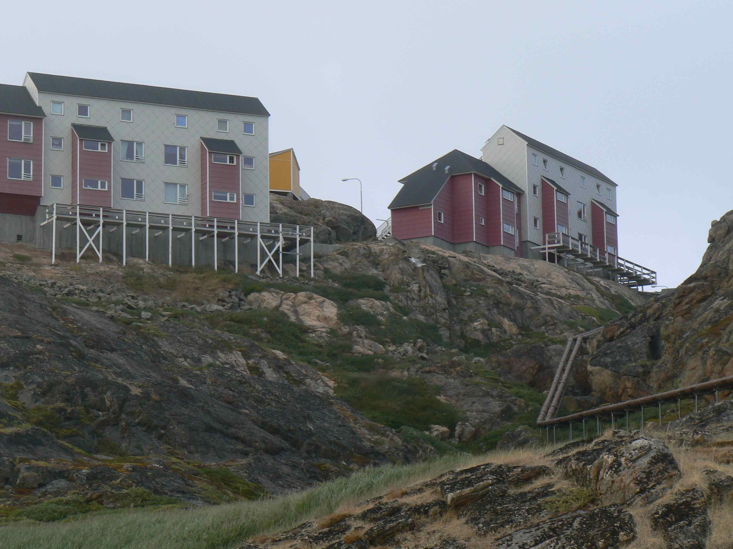
Wastewater handling in Greenland
Wastewater handling in Greenland - Towns
Wastewater is led untreated to the recipients everywhere in Greenland
  This goes for both black wastewater (toilet waste) and gray wastewater (wastewater from kitchen, bathroom and washing facilities)
30% of the Greenlandic residences were not connected to sewerage in 2001
Wastewater pipes
January 11, 11

Slide 9
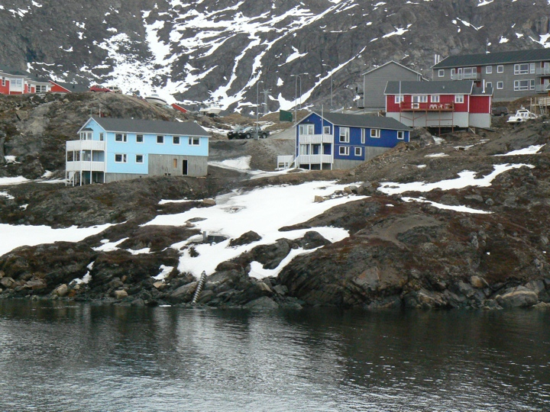
Sewer outlet
9
January 11, 11

Slide 10
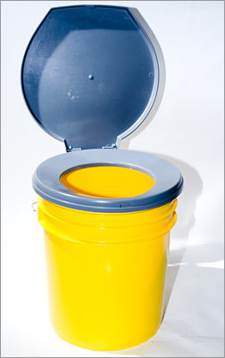
Wastewater handling in Greenland - towns and smaller settlements
”Honey
buckets”
January 11, 11

Slide 11
Wastewater handling in Greenland - towns and smaller settlements
Smell !
Dignity !
Health risk !
”Honey
buckets”
January 11, 11

Slide 12
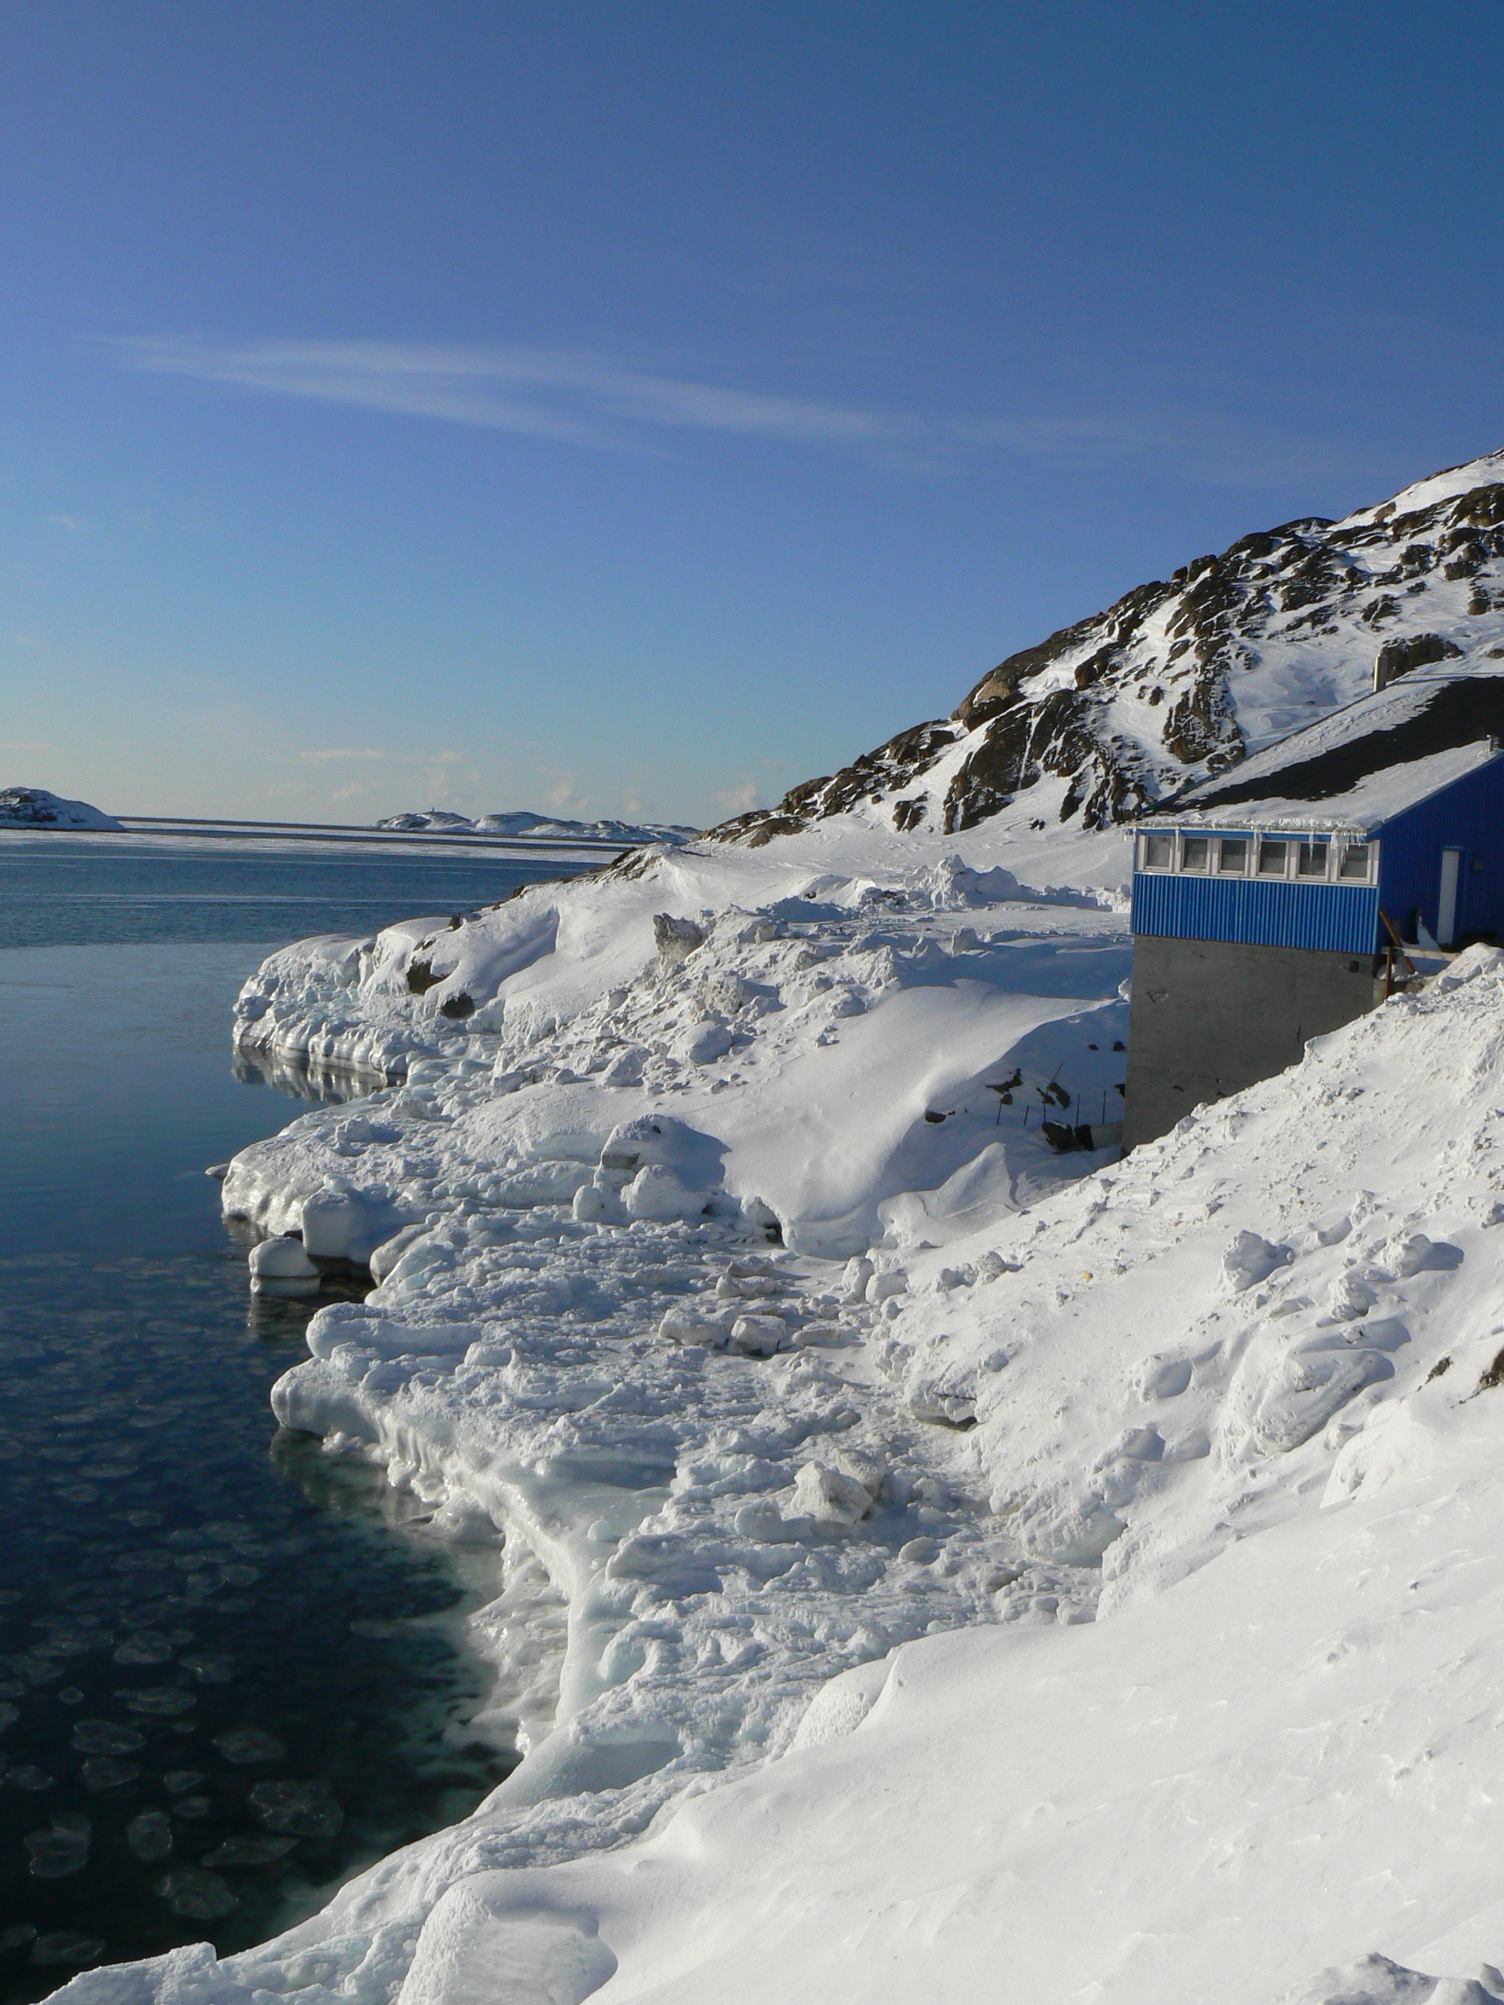
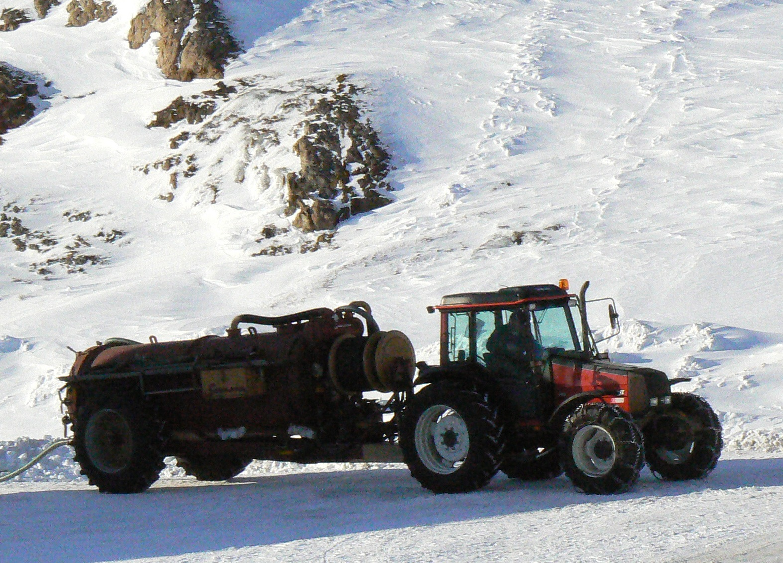
Sewage outlet

Slide 13
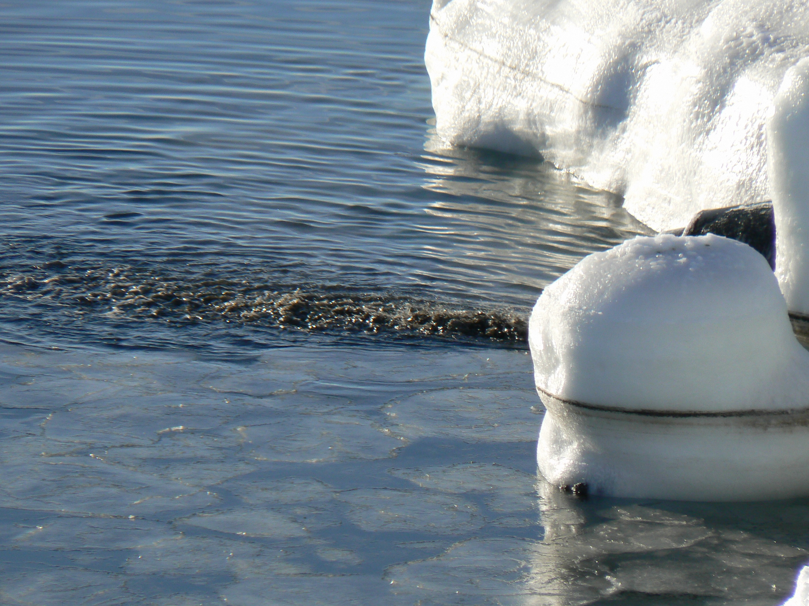
10
January 11, 11

Slide 14
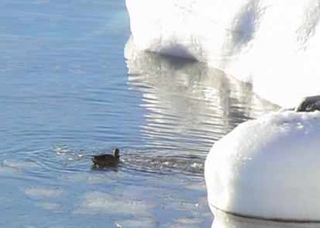

Slide 15
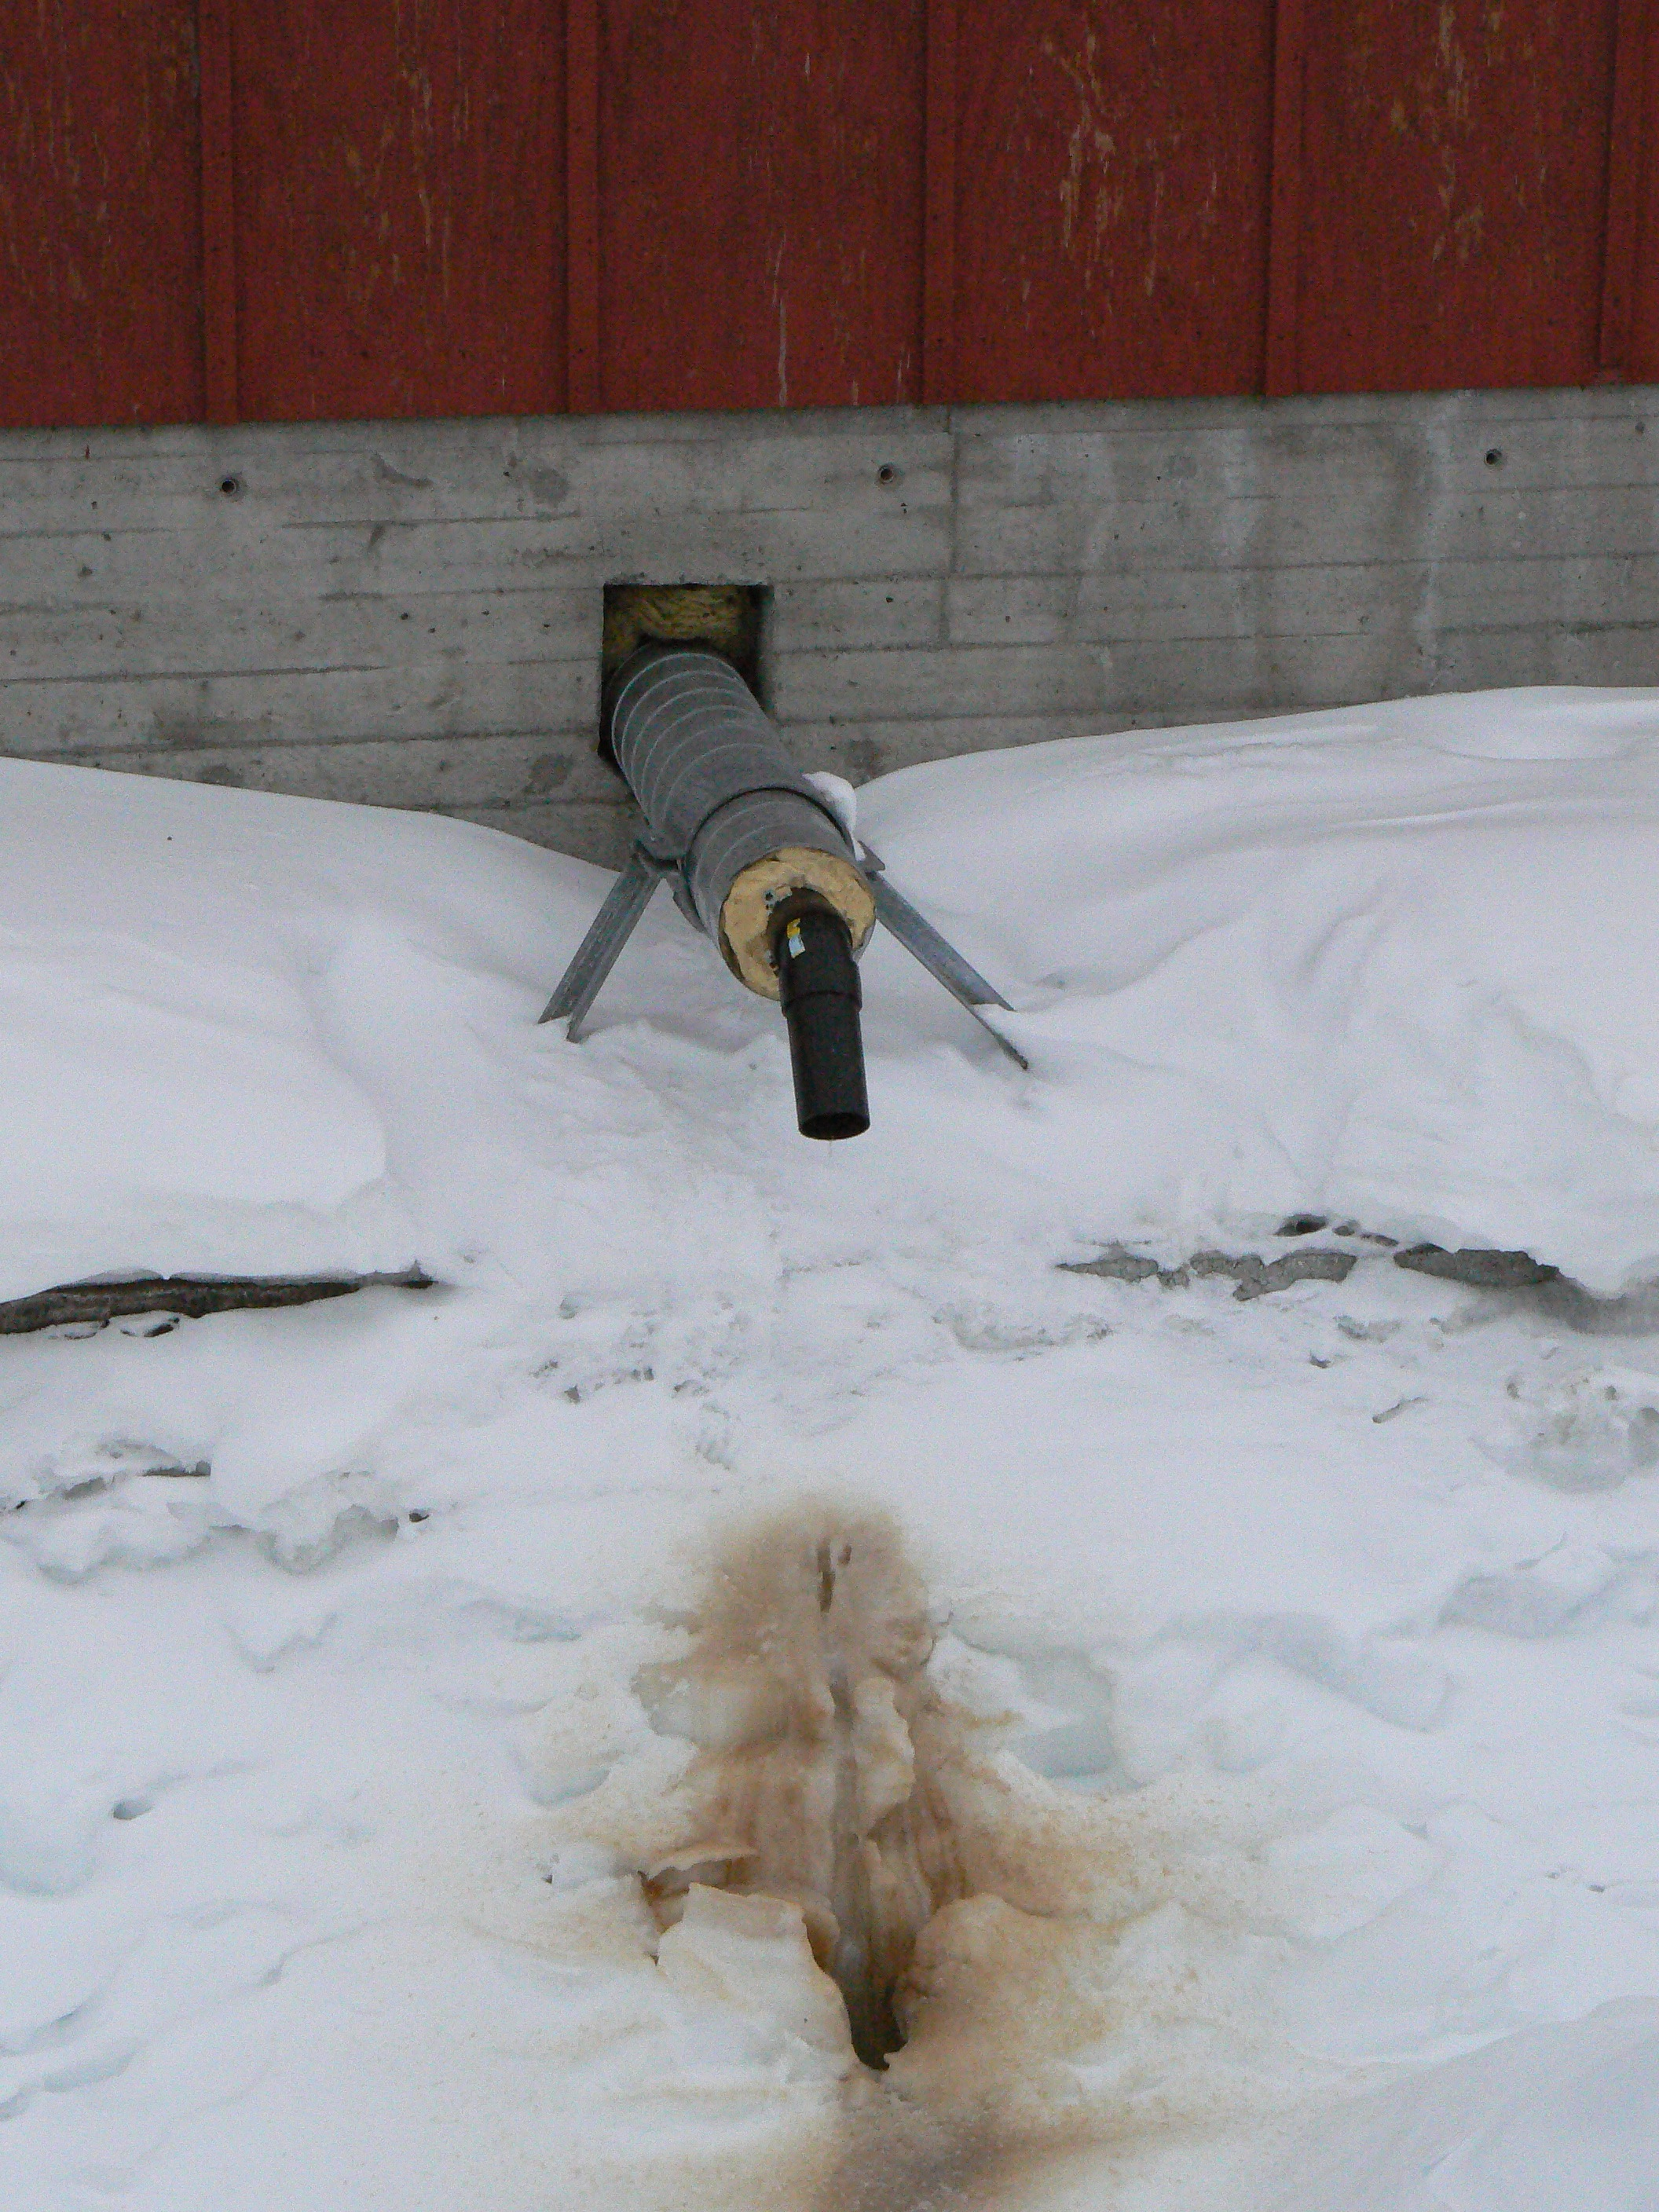
Greywater outlet
13
January 11, 11

Slide 16
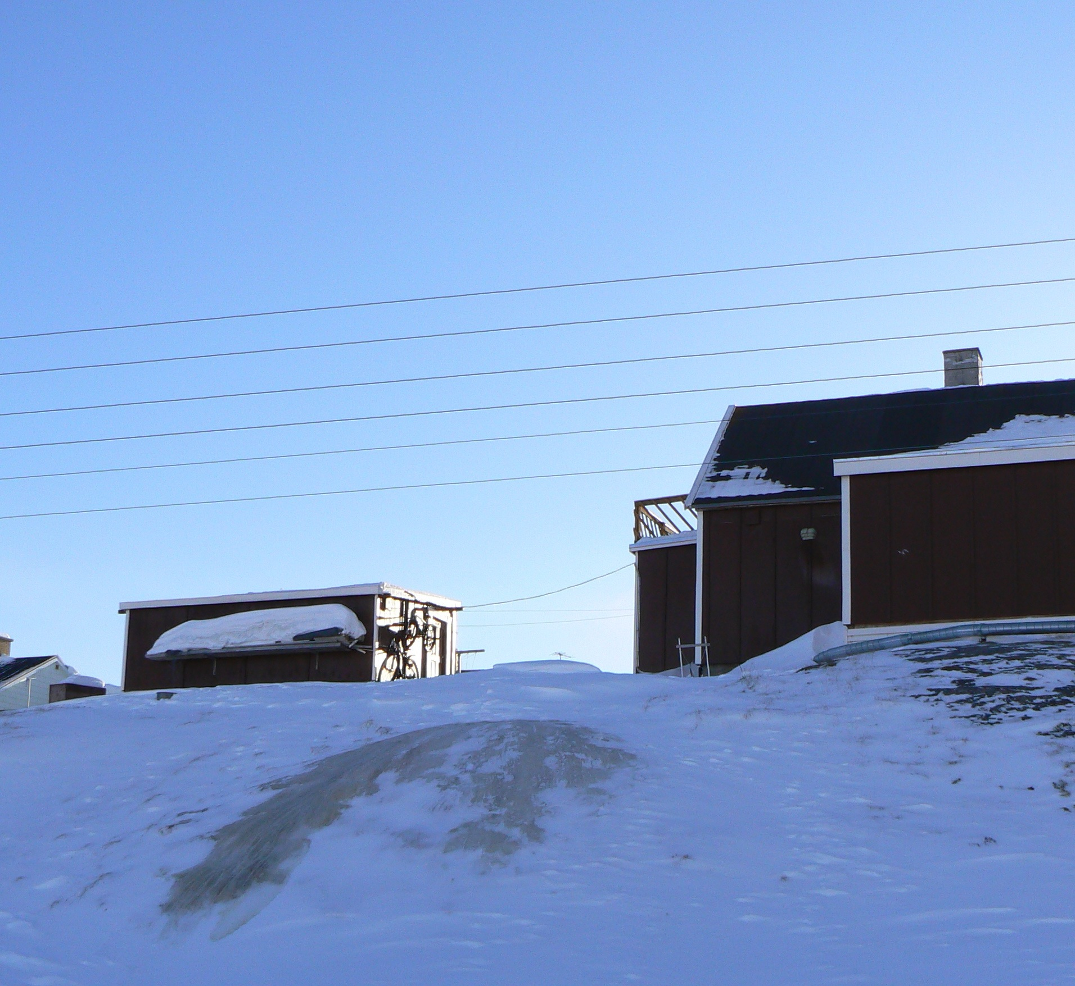
Frozen greywater
12
January 11, 11

Slide 17
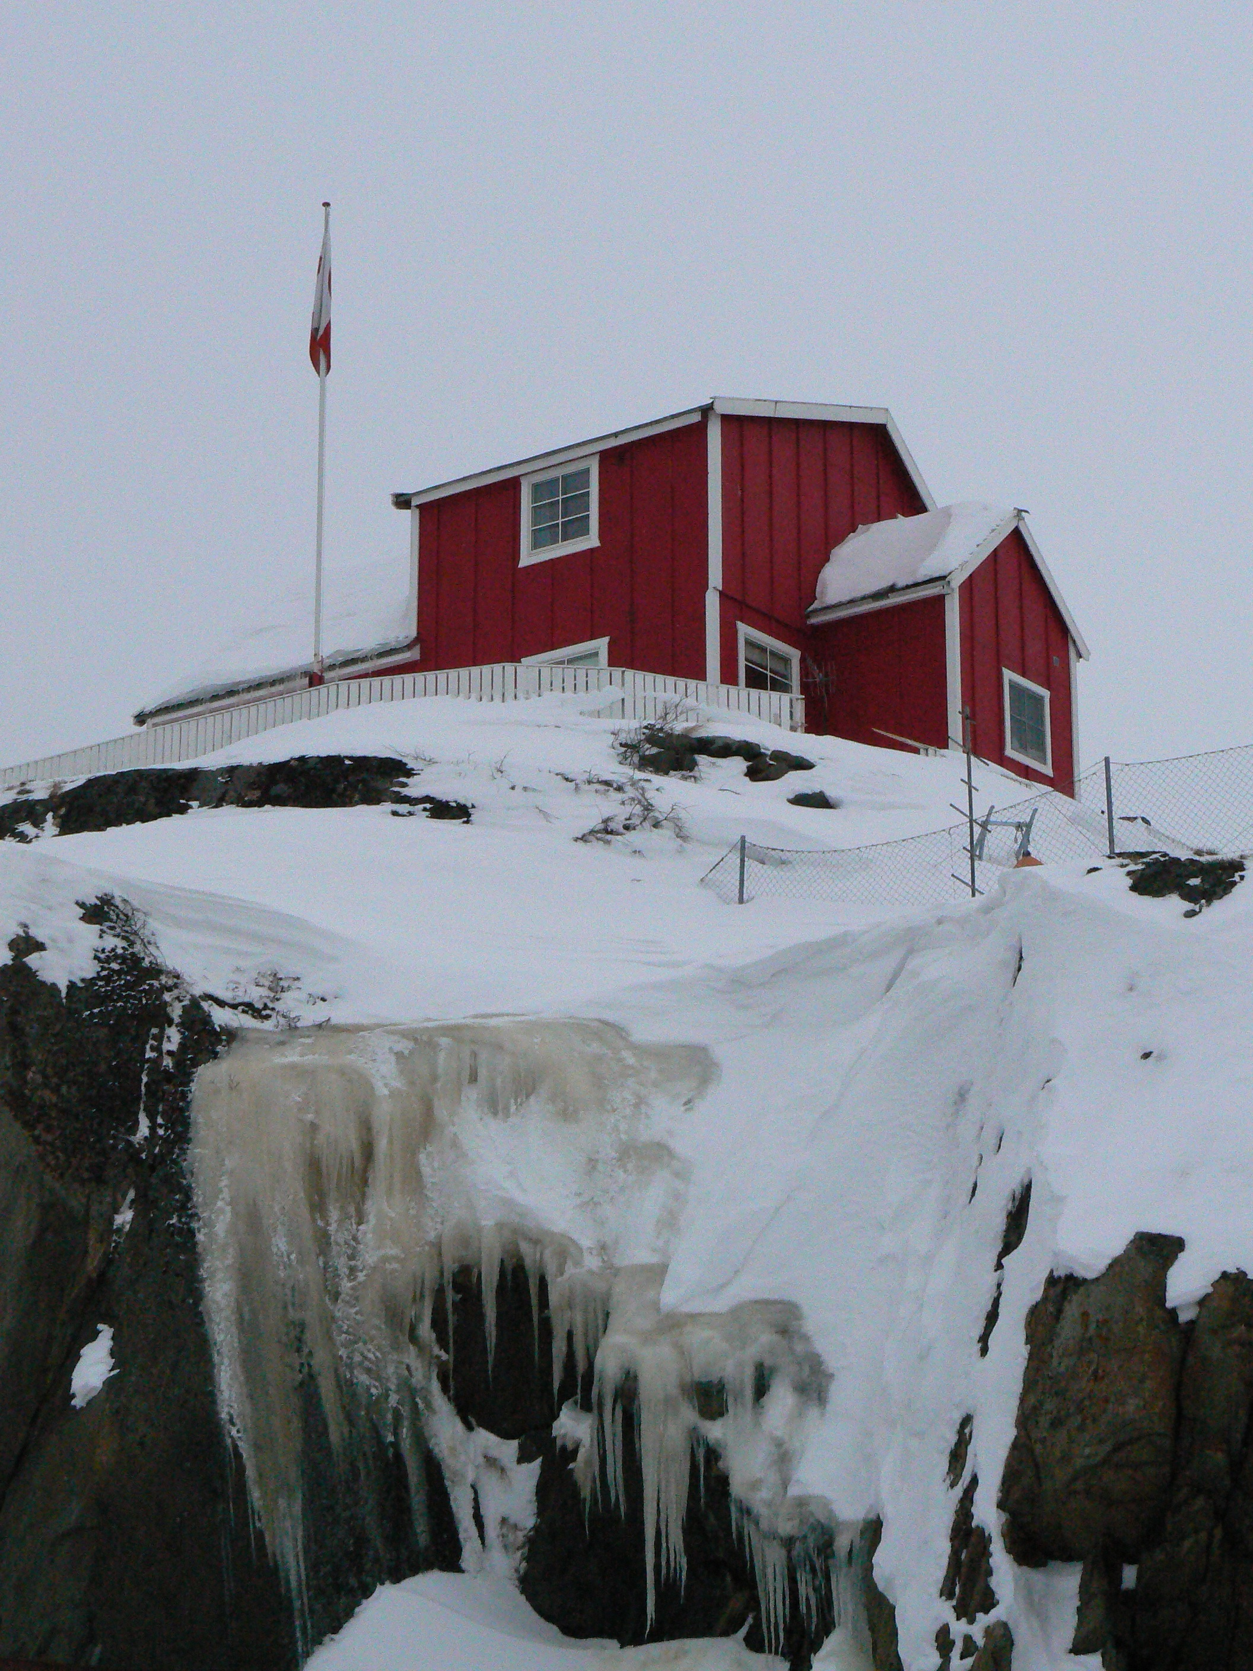
Department of Plant and Environmental Sciences
14
January 11, 11

Slide 18
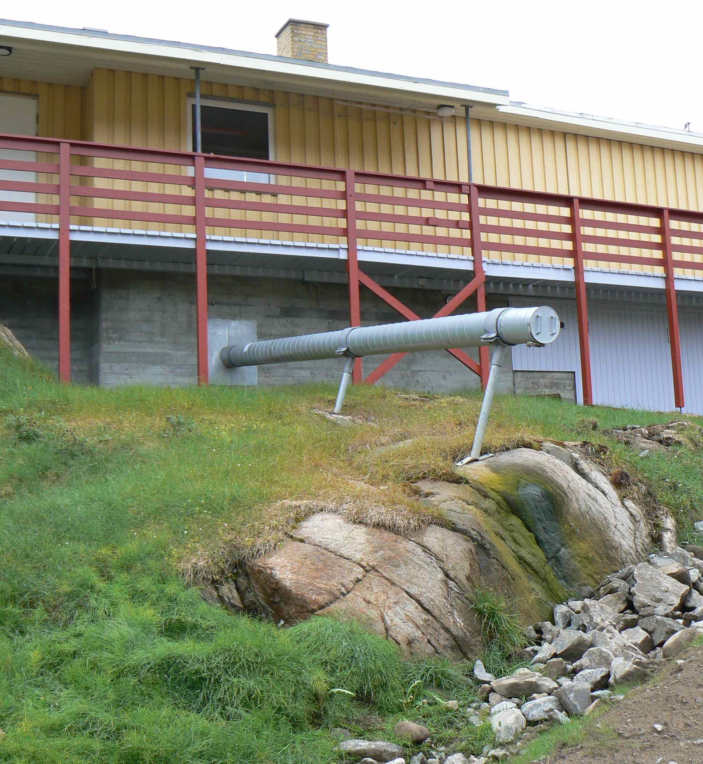
Greywater discharge pipe
15
January 11, 11

Slide 19


Handling of wastewater in the Arctic
Wastewater is led untreated to the recipients everywhere in Greenland
WHY IS WASTEWATER HANDLING POORLY DEVELOPED
WHAT ARE THE CONSEQUENCES FOR THE WATER ENVIRONMENT?
Department of Plant and Environmental Sciences
NORWEGIAN UNIVERSITY OF LIFE SCIENCES
Sewage outlet
19
www.umb.no

Slide 20
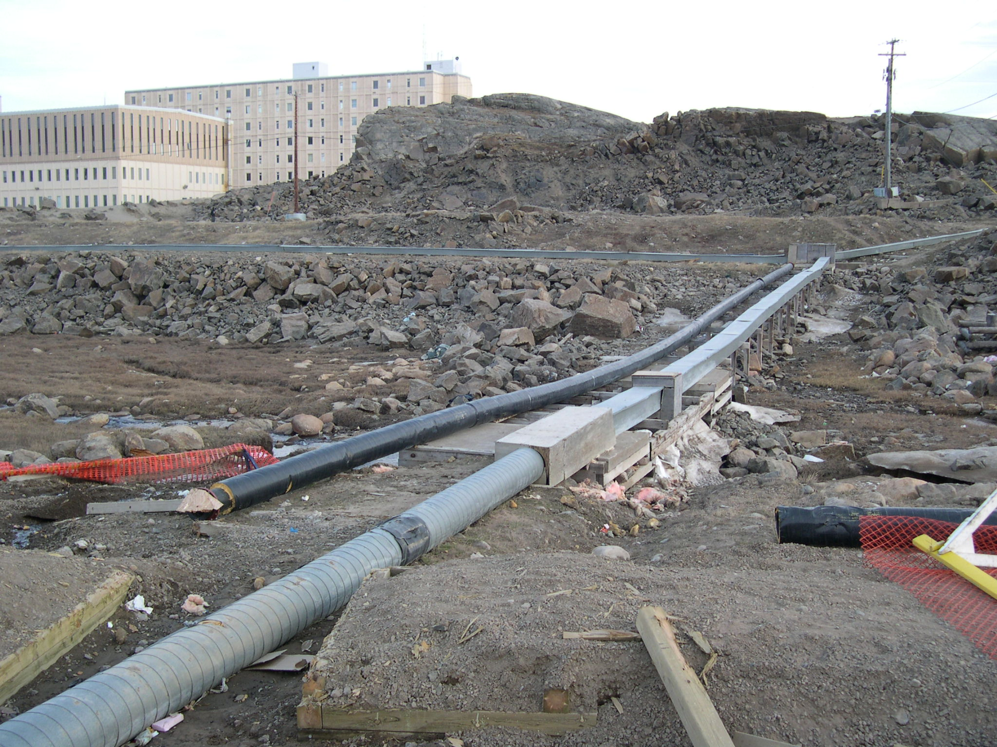
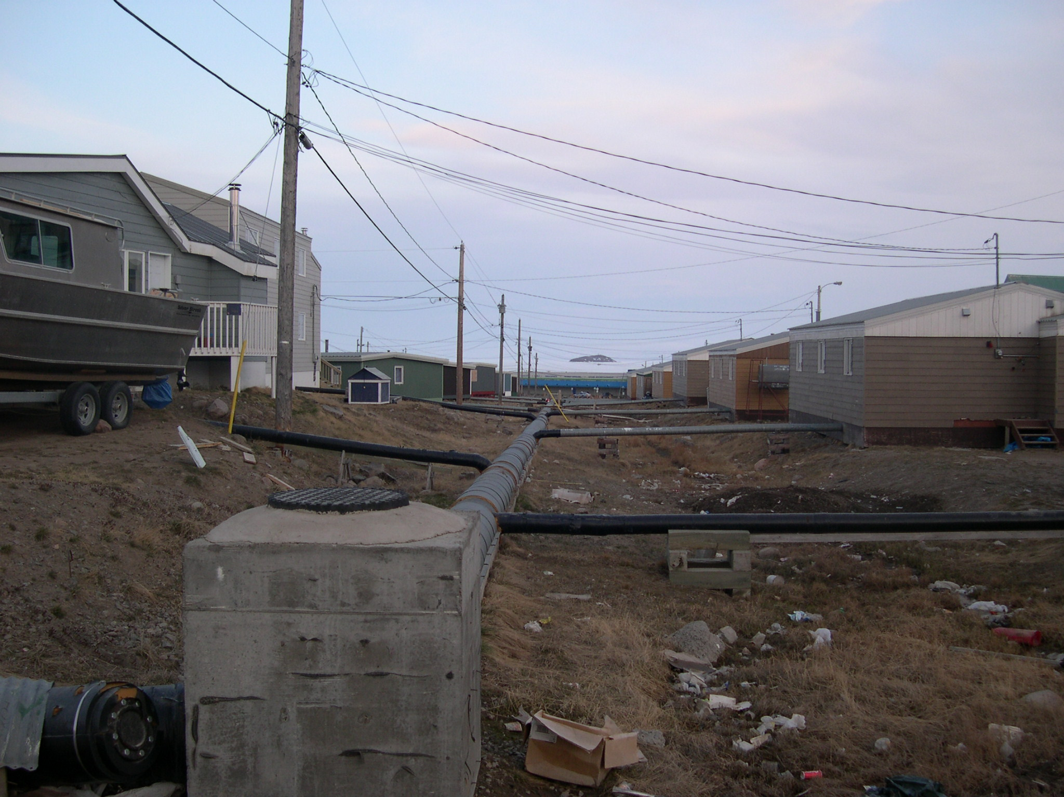
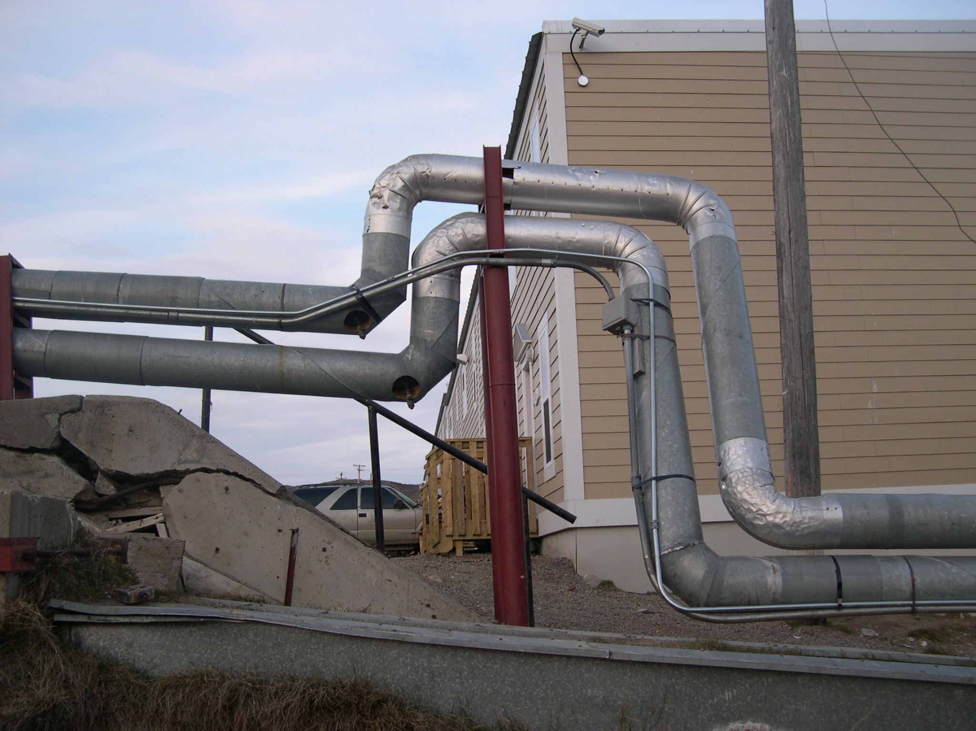
Wastewater transport in the arctic is challenging
Piping systems
Department of Plant and Environmental Sciences
NORWEGIAN UNIVERSITY OF LIFE SCIENCES
20
20
Photos: Frøydis M. Reinhart
www.umb.no

Slide 21
Wastewater handling in Greenland
Wastewater handling in Greenland
Wastewater is led untreated to the recipients everywhere in Greenland
  This goes for both black wastewater (toilet waste) and gray wastewater (wastewater from kitchen, bathroom and washing facilities)
30% of the Greenlandic residences were not connected to sewerage in 2001
Wastewater pipes
January 11, 11

Slide 22
Wastewater handling in the Arctic
Piping systems are extremely expensive
January 11, 11

Slide 23
Wastewater handling in the Arctic
Piping systems are extremely expensive
Treatment processes are challenging/expensive to operate
January 11, 11

Slide 24
Handling of wastewater in the Arctic
Wastewater is led untreated to the recipients everywhere in Greenland
WHY IS WASTEWATER HANDLING POORLY DEVELOPED?
WHAT ARE THE CONSEQUENCES FOR THE WATER ENVIRONMENT AND HEALTH?
Department of Plant and Environmental Sciences
NORWEGIAN UNIVERSITY OF LIFE SCIENCES
Sewage outlet
24
www.umb.no

Slide 25
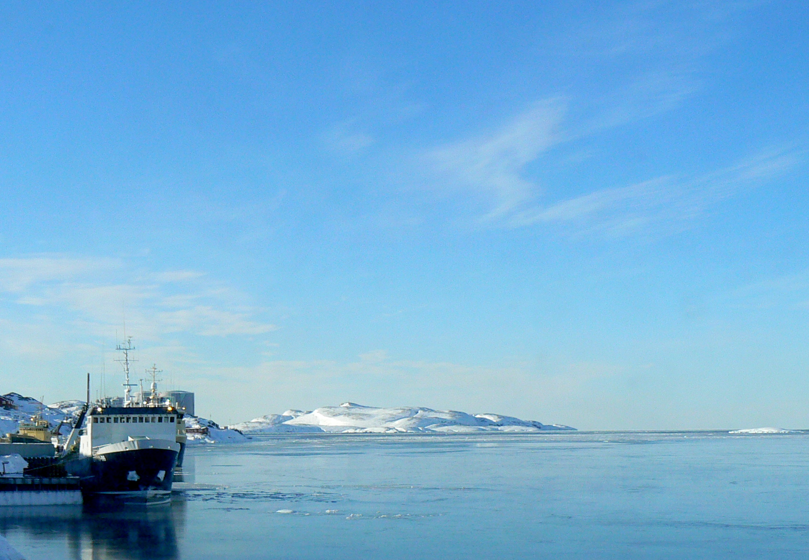
Wastewater discharge to arctic waters – problems?
Nutrients (nitrogen and phosphorus) ?
Organic matter ?
Pathogens, microorganisms ?

Slide 26
Wastewater discharge to arctic waters – problems?
Nutrients (nitrogen and phosphorus) ?
Organic matter ?
Pathogens, microorganisms ?
50 000
inhabitants

Slide 27
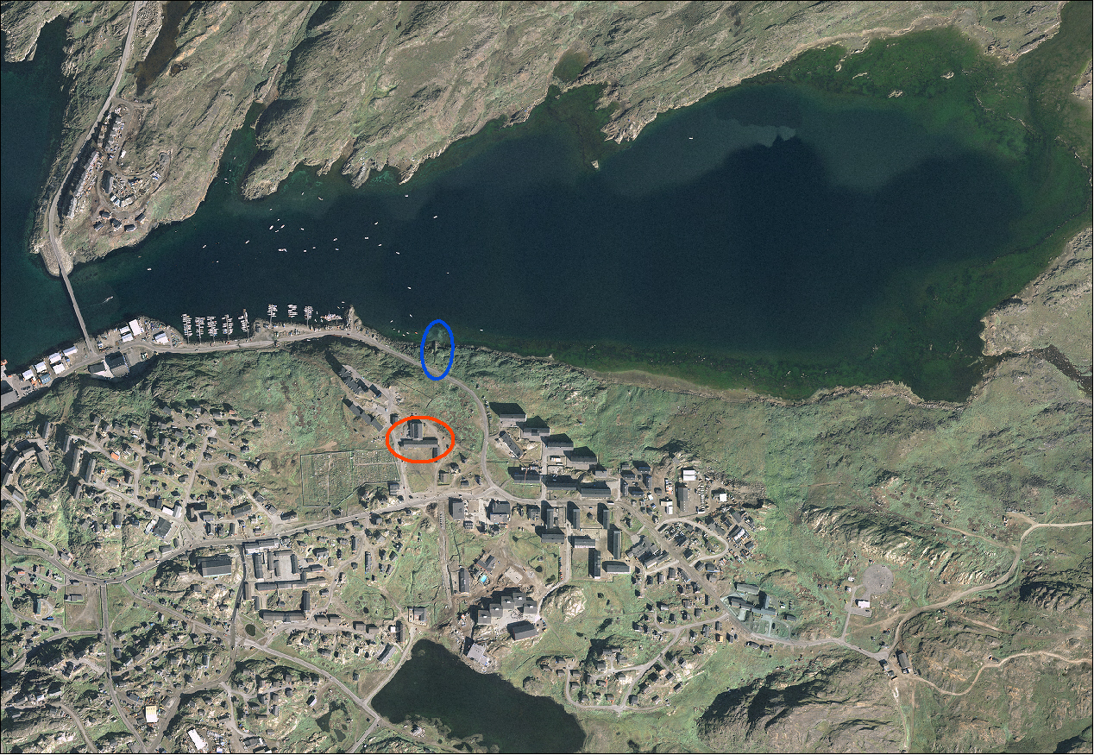
Wastewater discharge to arctic waters – problems?
Nutrients (nitrogen and phosphorus) ?
Organic matter ?
Pathogens, microorganisms?
Ulkebugten

Slide 28
Wastewater discharge to arctic waters – problems?
Nutrients (nitrogen and phosphorus) ?
Organic matter a local problem
Pathogens, microorganisms?
Ulkebugten

Slide 29
Wastewater discharge to arctic waters – problems?
Nutrients ?
Organic matter ?
Pathogens ?
Organic micropollutants ?
* Medicine residues
* POP´s
Sisimiut Greenland
Sewage outlet
Hospital

Slide 30
Wastewater discharge to arctic waters – problems?
Nutrients ?
Organic matter ?
Pathogens ?
Organic micropollutants ?
* Medicine residues
* POP´s
Sisimiut Greenland
Antibiotic resistant bacteria
Higher concentration of antibiotic resistant bacteria close to the outlet from the hospital (Project Maribact)

Slide 31
Wastewater discharge to arctic waters – problems?
Nutrients ?
Organic matter ?
Pathogens ?
Organic micropollutants ?
* Medicine residues
* POP´s
Sisimiut Greenland
Antibiotic resistant bacteria
Higher concentration of antibiotic resistant bacteria close to the outlet from the hospital (Project Maribact)
Pharmaceutical residues
It has been shown that hormones for instance affect fish at remarkably low concentration (1,0 ng/L) (Routledge et al., 1998, Purdom et al., 1994)

Slide 32
Accumulation of unwanted substances in the food chain

Slide 33
Wastewater discharge to arctic waters – problems?
Nutrients - no problem
Organic matter a local problem
Antibiotic resistant bacteria
Organic micropollutants
* Medicine residues
* POP´s

Slide 34
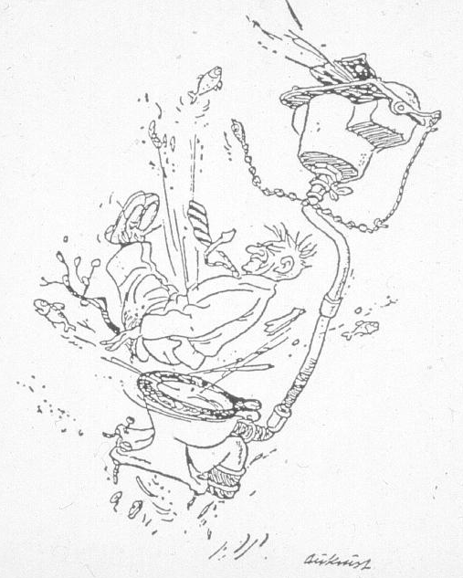
Solutions to the sanitary challenges
Department of Plant and Environmental Sciences
NORWEGIAN UNIVERSITY OF LIFE SCIENCES
Centralized systems
Onsite systems (decentralized)
Systems with source separation (decentralized)
  Low flush, dry or incineration toilets
  Urine divertion
  Greywater treatment
34
www.umb.no

Slide 35
Solutions to the sanitary challenges
Department of Plant and Environmental Sciences
NORWEGIAN UNIVERSITY OF LIFE SCIENCES
Centralized systems
Onsite systems (decentralized)
Systems with source separation (decentralized)
  Low flush, dry or incineration toilets
  Urine divertion
  Greywater treatment
35
www.umb.no

Slide 36
Wastewater handling in the Arctic
Piping systems are extremely expensive
Treatment processes are challenging/expensive to operate
January 11, 11

Slide 37
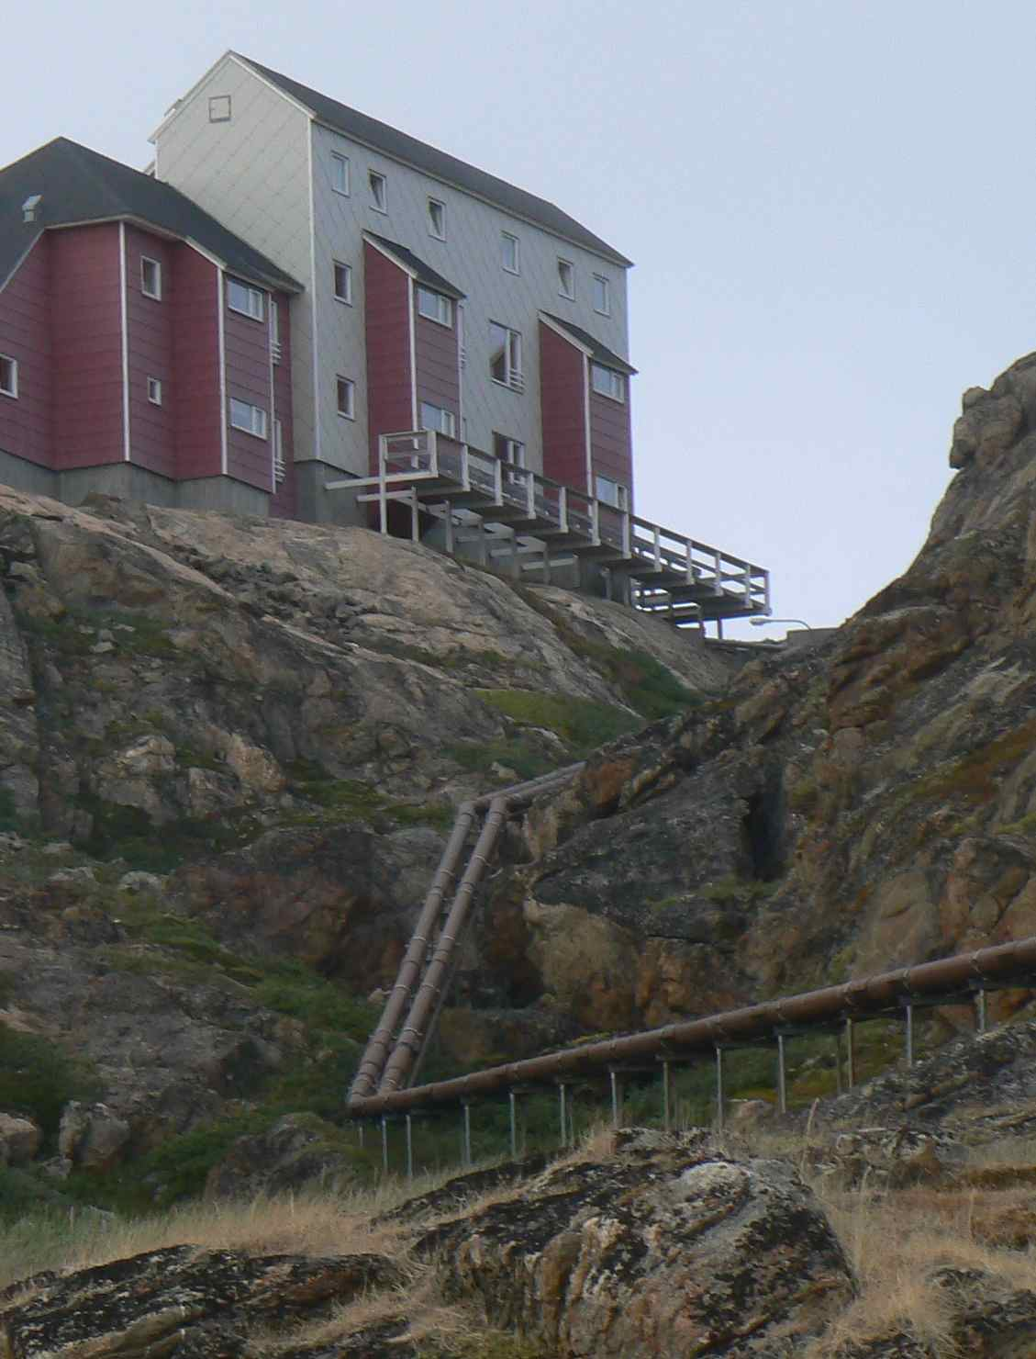
Cost aspects of
of centralized sewer systems
Department of Plant and Environmental Sciences
Collection system 70 - 90 %
Treatment 10 - 30 %
(Otis 1996, Mork et al. 2000)
NORWEGIAN UNIVERSITY OF LIFE SCIENCES
37
www.umb.no

Slide 38
Cost aspects of
of centralized sewer systems
Department of Plant and Environmental Sciences
Collection system 70 - 90 %
Treatment 10 - 30 %
(Otis 1996, Mork et al. 2000)
ENERGY:
The water sector is the forth most energy intensive sector in the UK
(The Parliamentary Office of Science and Technology, 2007)
NORWEGIAN UNIVERSITY OF LIFE SCIENCES
38
www.umb.no

Slide 39
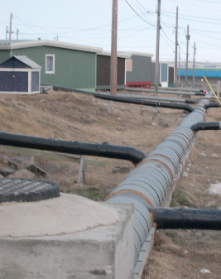
Centralized vs. decentralized
Centralized systems are expensive both to construct and to operate. If adequate decentralized systems (from a technical, economical and social aspect) are available these should be preferred
Department of Plant and Environmental Sciences
NORWEGIAN UNIVERSITY OF LIFE SCIENCES
39
Photo: F. Reinhardt
www.umb.no

Slide 40
Solutions to the sanitary challenges
Department of Plant and Environmental Sciences
NORWEGIAN UNIVERSITY OF LIFE SCIENCES
Centralized systems
Onsite systems (decentralized)
Systems with source separation (decentralized)
  Low flush, dry or incineration toilets
  Urine divertion
  Greywater treatment
40
www.umb.no

Slide 41
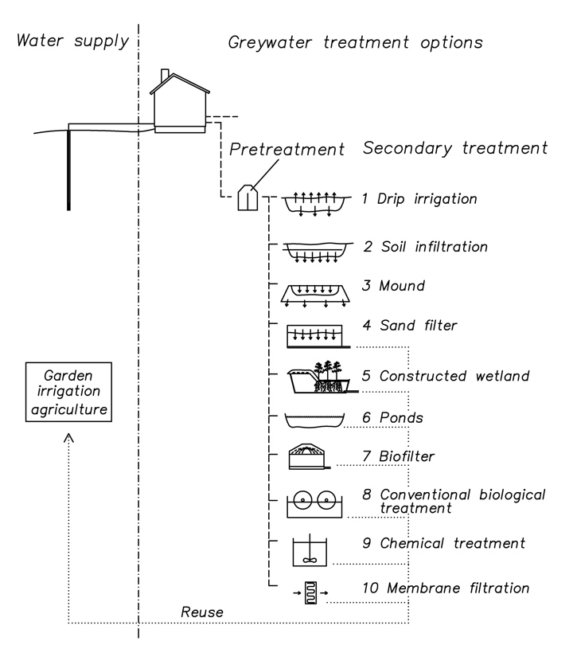
Onsite systems - technology options
Department of Plant and Environmental Sciences
NORWEGIAN UNIVERSITY OF LIFE SCIENCES
41
www.umb.no

Slide 42
Onsite systems
Department of Plant and Environmental Sciences
NORWEGIAN UNIVERSITY OF LIFE SCIENCES
42
www.umb.no

Slide 43
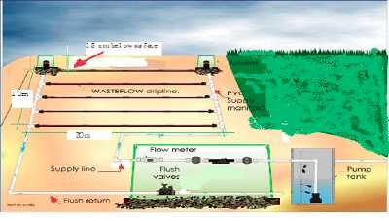
Drip irrigation
Department of Plant and Environmental Sciences
NORWEGIAN UNIVERSITY OF LIFE SCIENCES
43
www.umb.no

Slide 44
Drip irrigation
Treatment performance Overall | High
Treatment performance Hygiene | High
Investment cost | Medium/high
O&M | Medium
Technical complexity | Low/medium
Suitability arctic conditions | Low/medium
Department of Plant and Environmental Sciences
NORWEGIAN UNIVERSITY OF LIFE SCIENCES
44
www.umb.no

Slide 45
Onsite systems
Department of Plant and Environmental Sciences
NORWEGIAN UNIVERSITY OF LIFE SCIENCES
45
www.umb.no

Slide 46
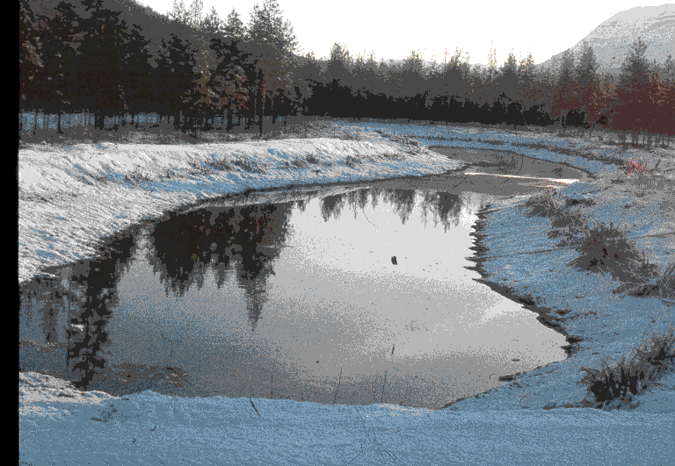
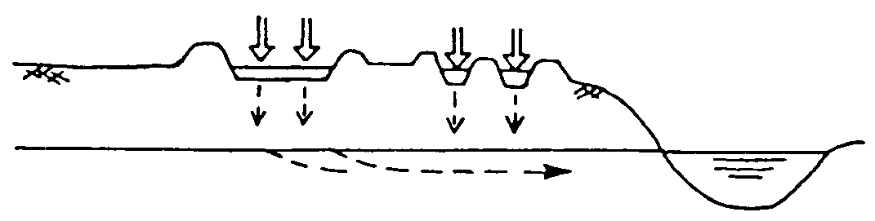
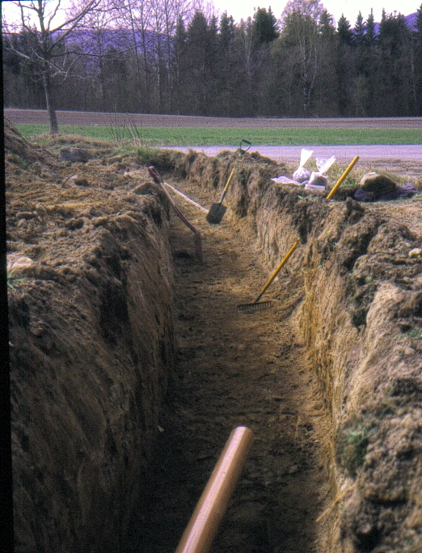
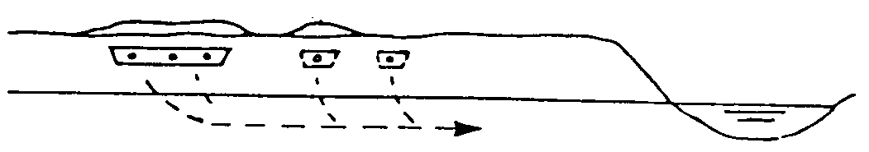
Soil infiltration systems
- system types
Open systems - infiltration in ponds
NORWEGIAN UNIVERSITY OF LIFE SCIENCES
Subsurface (buried) systems - infiltration trenches
46
www.umb.no

Slide 47
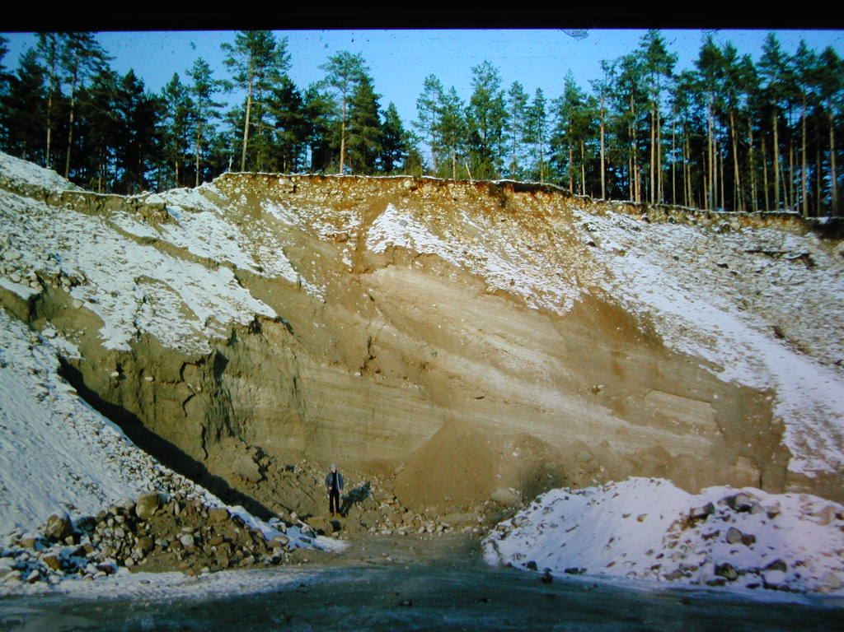
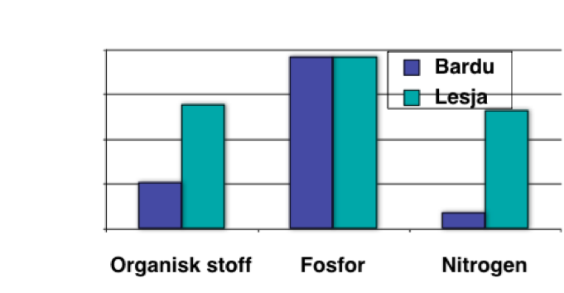
Department of Plant and Environmental Sciences
NORWEGIAN UNIVERSITY OF LIFE SCIENCES
Treatment results rapid infiltration Norway
Groundwater level
Fecal coli.
<100/100ml
47
COD Phosphorus Nitrogen (Kraft 1998)
www.umb.no

Slide 48
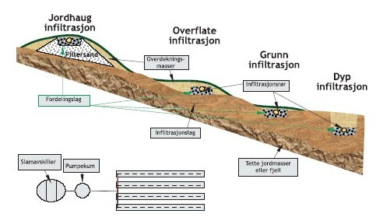
Buried soil infiltration systems - design types
Mound
DEPARTMENT OF PLANT AND ENVIRONMENTAL SCIENCES
Surface infiltration
NORWEGIAN UNIVERSITY OF LIFE SCIENCES
Shallow infiltration
Deep
infiltration
Soil
Septic tank
Pump/dosing
device
Bedrock
48
Source: www.avlop.no
www.umb.no

Slide 49
Soil infiltration systems
Treatment performance Overall | High
Treatment performance Hygiene | High
Investment cost | Low
O&M | Low
Technical complexity | Low/medium
Suitability arctic conditions | Low/medium
Open systems - infiltration in ponds
Department of Plant and Environmental Sciences
NORWEGIAN UNIVERSITY OF LIFE SCIENCES
Subsurface (buried) systems - infiltration trenches
49
www.umb.no

Slide 50
Onsite systems
Department of Plant and Environmental Sciences
NORWEGIAN UNIVERSITY OF LIFE SCIENCES
50
www.umb.no

Slide 51
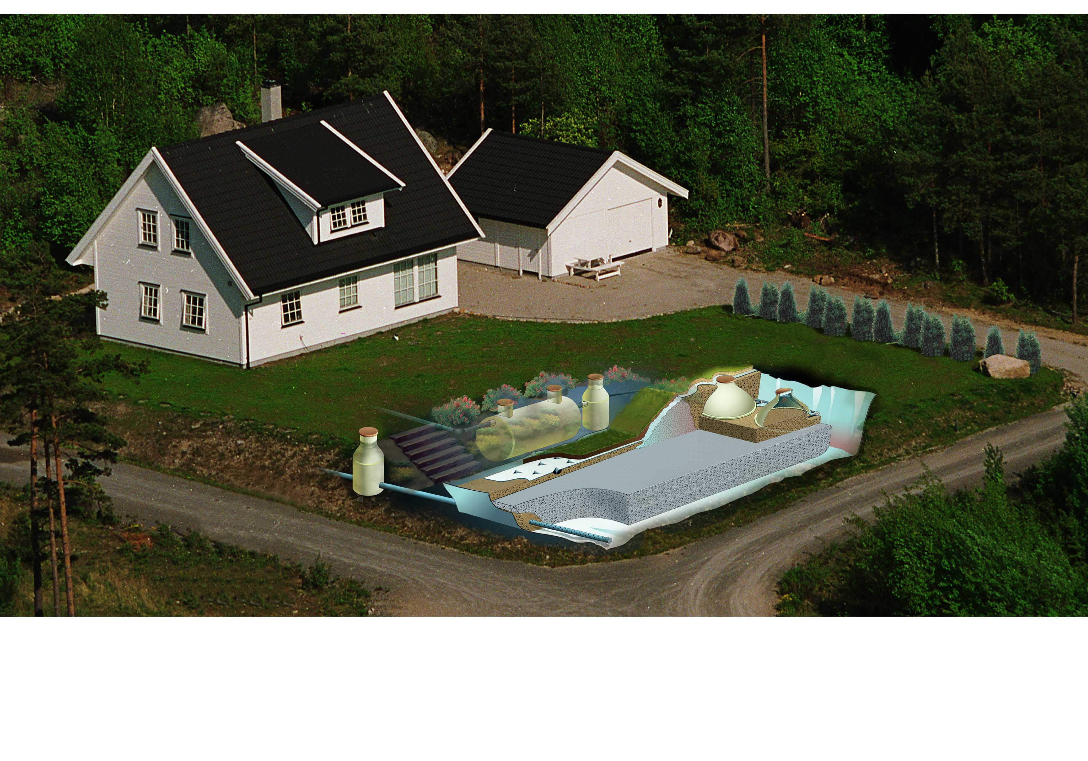
Constructed wetlands / filterbeds
Domestic WW: 7 - 9 m3/person
Greywater: 2- 3 m3/person
DEPARTMENT OF PLANT AND ENVIRONMENTAL SCIENCES
NORWEGIAN UNIVERSITY OF LIFE SCIENCES
7
40 m²/family
51
www.umb.no

Slide 52
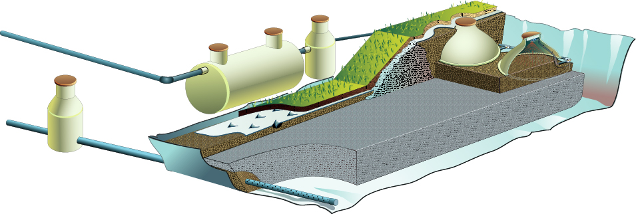
Constructed wetland/Filterbed
Department of Plant and Environmental Sciences
Septic
tank
Pump
Biofilter
NORWEGIAN UNIVERSITY OF LIFE SCIENCES
Subsurface flow
filterbed
52
www.umb.no

Slide 53
Compact filterbed
Biofilter
Department of Plant and Environmental Sciences
Septic tank
Upflow filter
NORWEGIAN UNIVERSITY OF LIFE SCIENCES
53
www.umb.no
Notes:
Anleggskomponentene. Etter dette kommer en animasjon

Slide 54
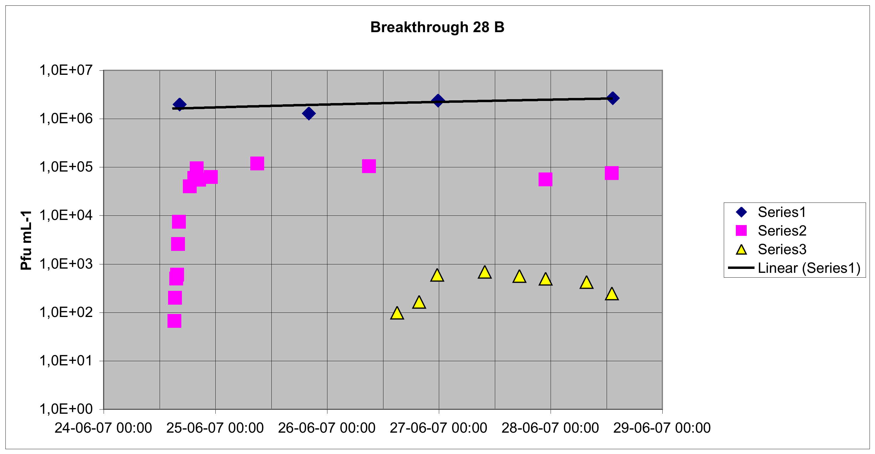
COMPACT FILTER
Spiking with virus
3 - 4 log₁₀ virus and E.coli reduction
Department of Plant and Environmental Sciences
NORWEGIAN UNIVERSITY OF LIFE SCIENCES
Inlet concentration
Biofilter effluent conc.
Final effluent conc.
54
www.umb.no
Notes:
Anleggskomponentene. Etter dette kommer en animasjon

Slide 55
Constructed wetland/Filterbed - verdict
Treatment performance Overall | High
Treatment performance Hygiene | High
Investment cost | High /medium
O&M | Medium
Technical complexity | Medium
Suitability arctic conditions | Medium/high
Department of Plant and Environmental Sciences
NORWEGIAN UNIVERSITY OF LIFE SCIENCES
55
www.umb.no

Slide 56
Onsite systems
Department of Plant and Environmental Sciences
NORWEGIAN UNIVERSITY OF LIFE SCIENCES
56
www.umb.no

Slide 57
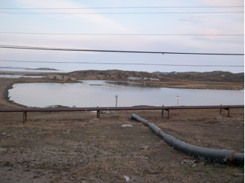
Sewage lagoons/ponds
Iqaluit’s Sewage Lagoon
Baffin Island
Department of Plant and Environmental Sciences
NORWEGIAN UNIVERSITY OF LIFE SCIENCES
57
www.umb.no

Slide 58
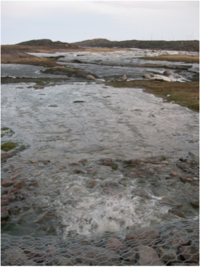
Sewage lagoons - pond systems
Treatment performance Overall | Low/medium
Treatment performance Hygiene | Low/medium
Investment cost | Low/medium
O&M | Low/medium
Technical complexity | Low/medium
Suitability arctic conditions | Low/medium
Baffin Island
Department of Plant and Environmental Sciences
NORWEGIAN UNIVERSITY OF LIFE SCIENCES
58
Photo: F. Reinhardt
www.umb.no

Slide 59
Onsite systems
Department of Plant and Environmental Sciences
NORWEGIAN UNIVERSITY OF LIFE SCIENCES
59
www.umb.no

Slide 60
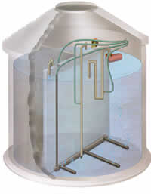
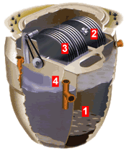
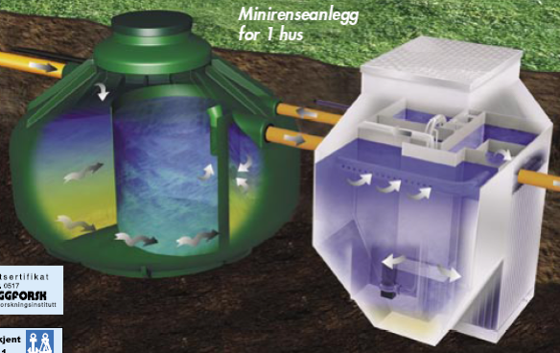
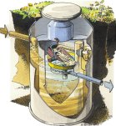
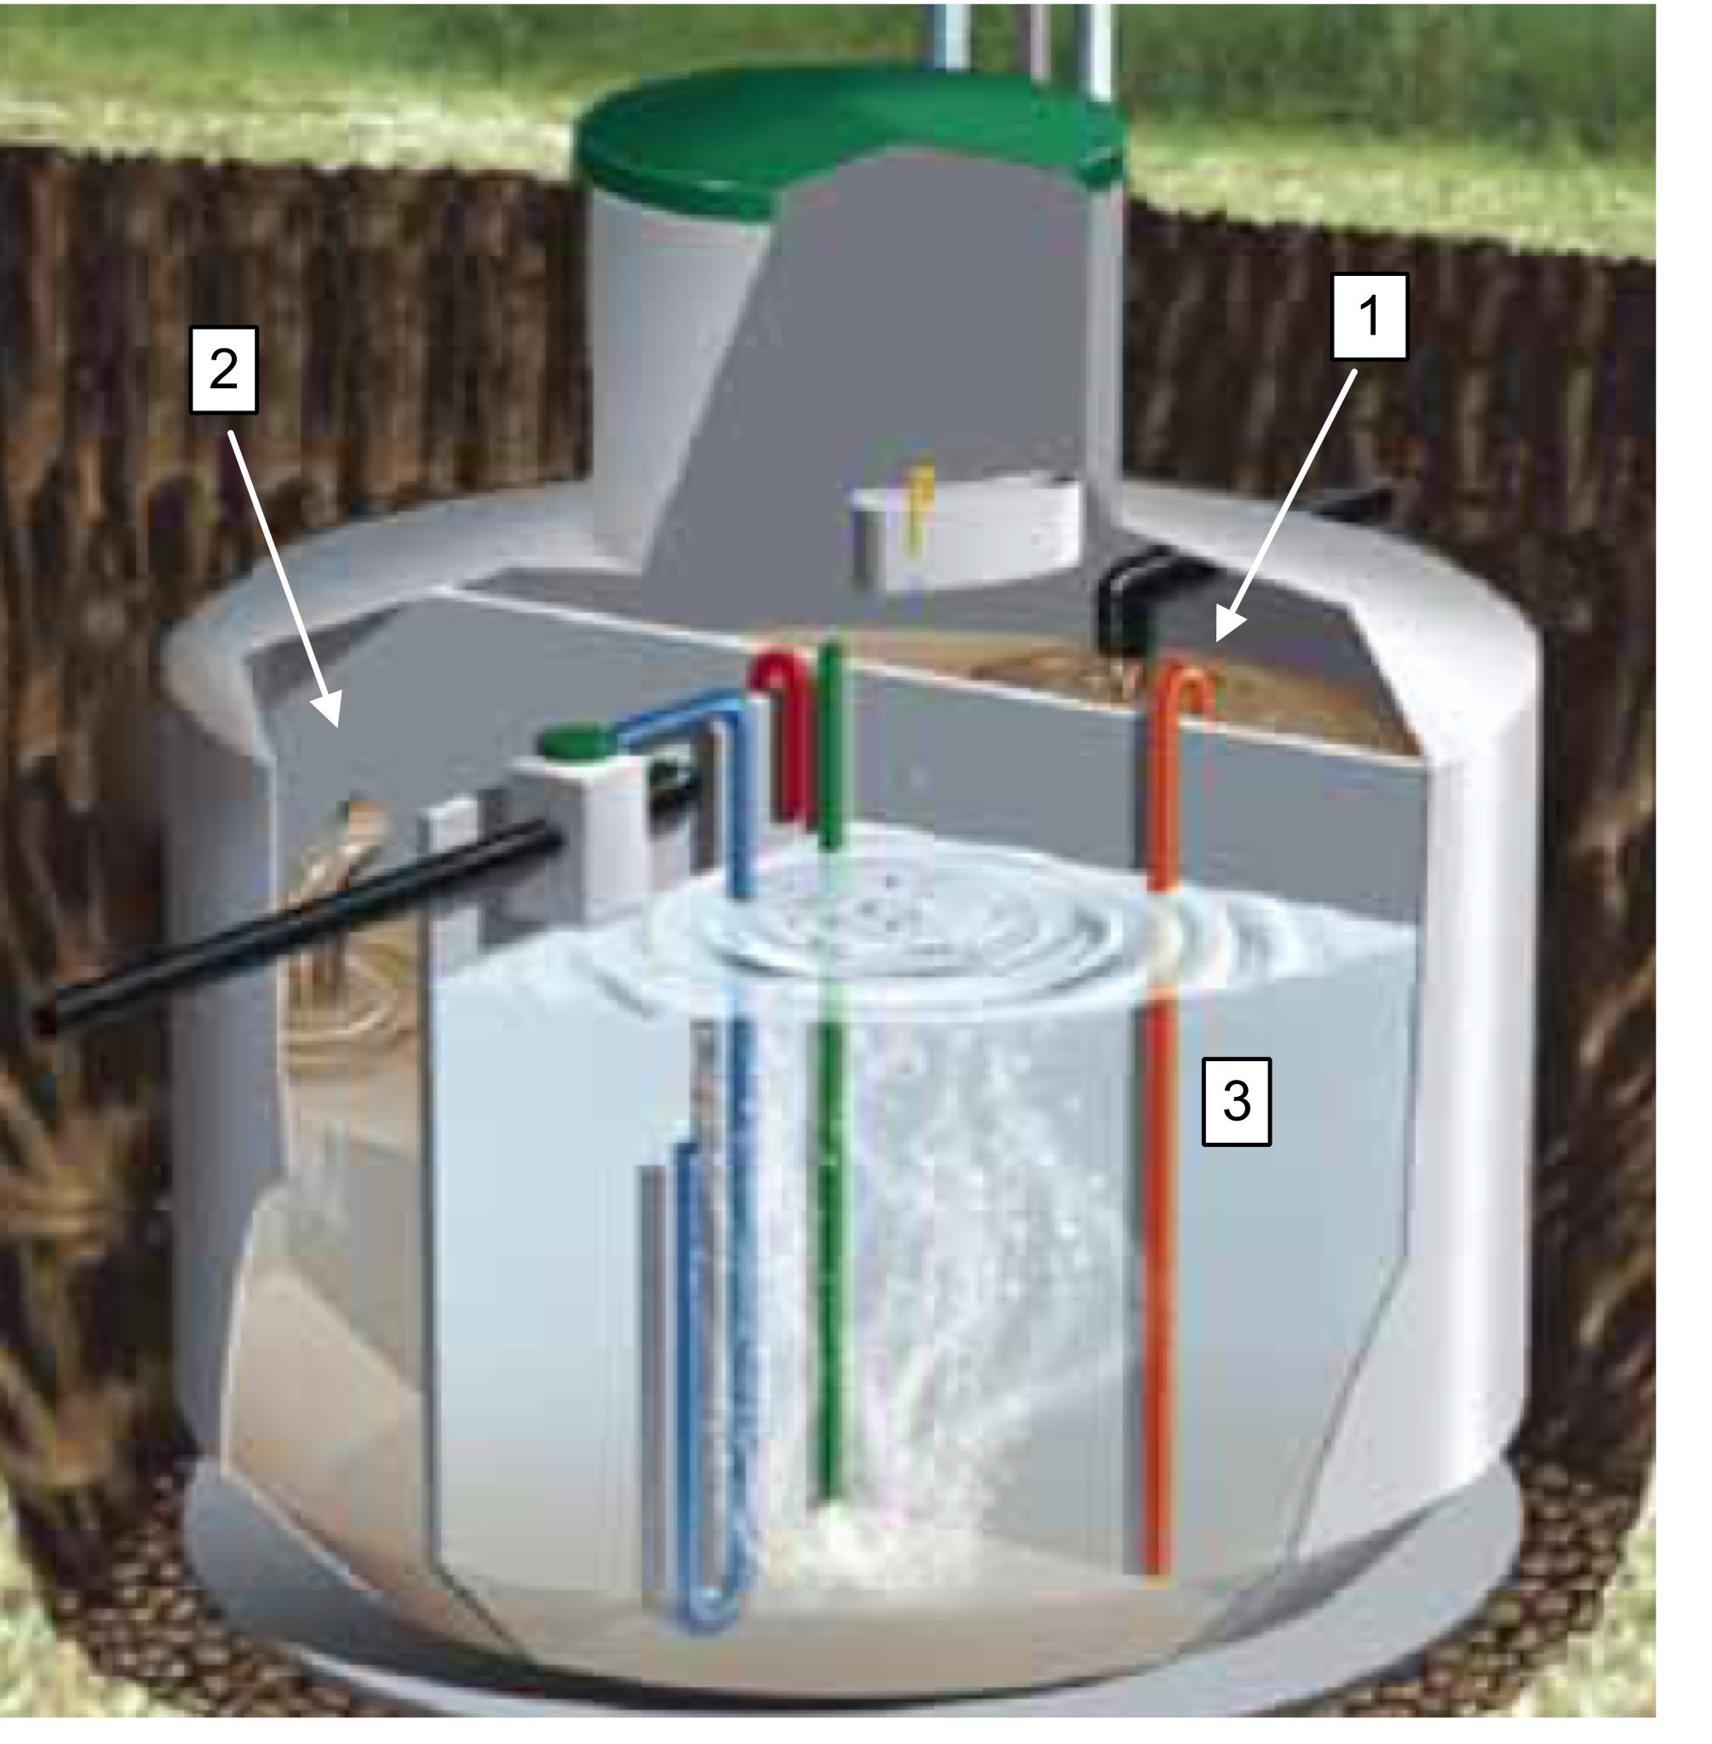
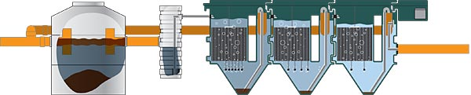
Package treatment plants - downsized conventional systems
Different designs
Department of Plant and Environmental Sciences
NORWEGIAN UNIVERSITY OF LIFE SCIENCES
60
www.umb.no

Slide 61
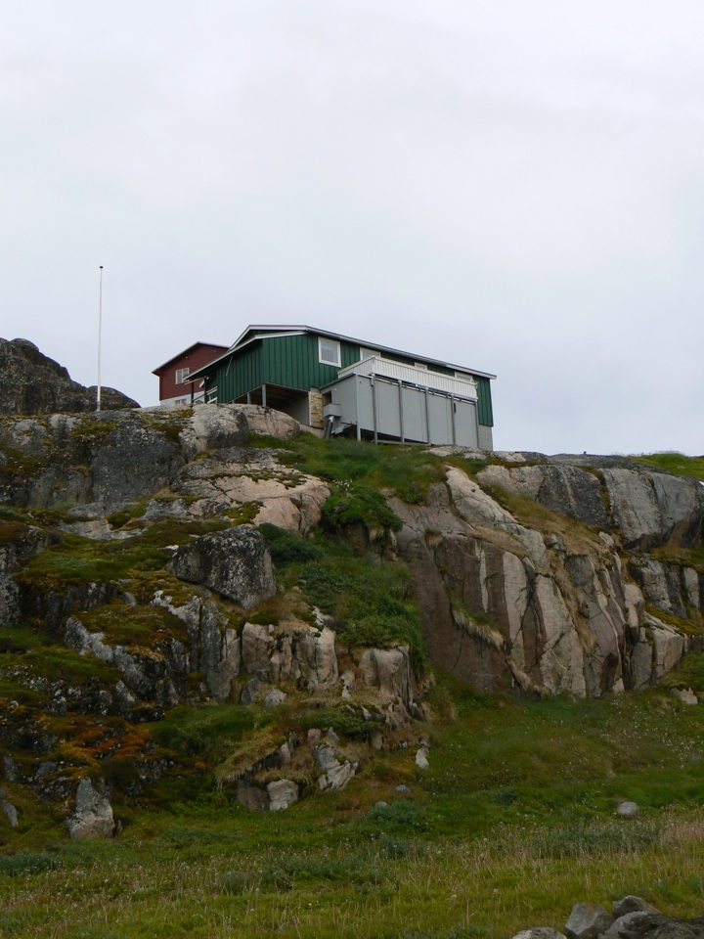
Package treatment plant - Sisimiut
Department of Plant and Environmental Sciences
NORWEGIAN UNIVERSITY OF LIFE SCIENCES
61
www.umb.no

Slide 62
Package treatment plant - Sisimiut
Department of Plant and Environmental Sciences
NORWEGIAN UNIVERSITY OF LIFE SCIENCES
62
www.umb.no

Slide 63
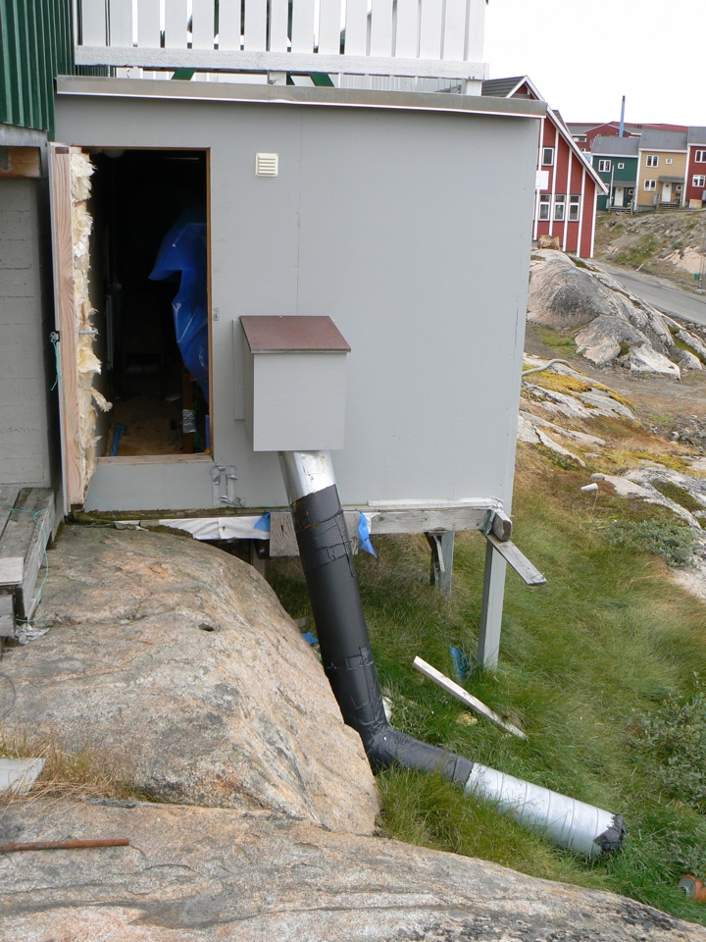
Department of Plant and Environmental Sciences
NORWEGIAN UNIVERSITY OF LIFE SCIENCES
63
www.umb.no

Slide 64
Package treatment plant - Sisimiut
Department of Plant and Environmental Sciences
NORWEGIAN UNIVERSITY OF LIFE SCIENCES
64
www.umb.no

Slide 65
Package treatment systems
Treatment performance Overall | Medium
Treatment performance Hygiene | Low/medium
Investment cost | High /medium
O&M | High
Technical complexity | High
Suitability arctic conditions | Low
Department of Plant and Environmental Sciences
NORWEGIAN UNIVERSITY OF LIFE SCIENCES
65
www.umb.no

Slide 66
Solutions to the sanitary challenges
Department of Plant and Environmental Sciences
NORWEGIAN UNIVERSITY OF LIFE SCIENCES
Centralized systems
Onsite systems (decentralized)
Systems with source separation (decentralized)
  Low flush, dry or incineration toilets
  Urine divertion
  Greywater treatment
66
www.umb.no

Slide 67
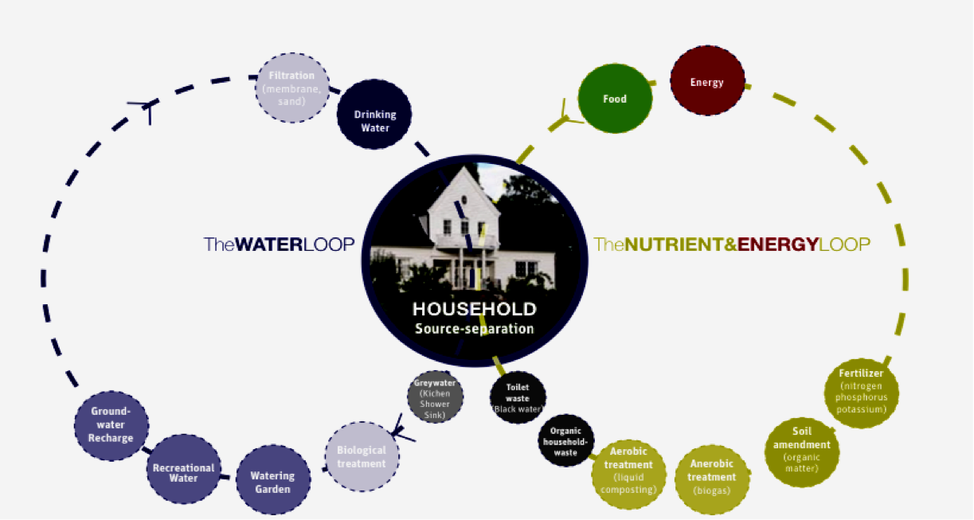
Source separation of wastewater
Department of Plant and Environmental Sciences
NORWEGIAN UNIVERSITY OF LIFE SCIENCES
67
(Alsen and Jenssen2005)
www.umb.no

Slide 68
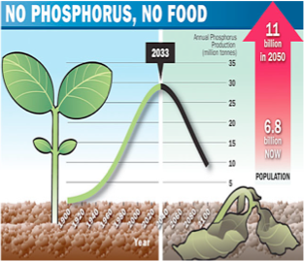
Department of Plant and Environmental Sciences
NORWEGIAN UNIVERSITY OF LIFE SCIENCES
68
www.umb.no
Data from: Cordell et al. 2009

Slide 69

Source separation - toilet options
0 Incinerating toilets
Department of Plant and Environmental Sciences
NORWEGIAN UNIVERSITY OF LIFE SCIENCES
69
www.umb.no

Slide 70
Source separation - toilet options
0 Incinerating toilets
Department of Plant and Environmental Sciences
NORWEGIAN UNIVERSITY OF LIFE SCIENCES
70
www.umb.no

Slide 71

Contribution from the toilet
* 90 % of N
* 80 % of P
* 80 % of K
* 40-75 % of org. matter
* Majority of the pathogens
Department of Plant and Environmental Sciences
NORWEGIAN UNIVERSITY OF LIFE SCIENCES
71
www.umb.no
Notes:
The majority of the nutrients in wastewater originates from our excreta, urine and feces and ends up in the toilet waste termed blackwater;

Slide 72
Contribution from the toilet
6 - 20 liters per flush !
20 - 40% of the total water use !
Department of Plant and Environmental Sciences
NORWEGIAN UNIVERSITY OF LIFE SCIENCES
72
www.umb.no
Notes:
The majority of the nutrients in wastewater originates from our excreta, urine and feces and ends up in the toilet waste termed blackwater;

Slide 73
Future toilet types
(commercially available today)
Department of Plant and Environmental Sciences
NORWEGIAN UNIVERSITY OF LIFE SCIENCES
Water use
    Composting /dry sanitation 0 - 0.1 liter/visit
    Urine diverting 0.1 - 4.0 liter/visit
    Water saving (vacuum&gravity) 0.5 - 1.0 liter/visit
    Incinerating 0 liter/visit
73
www.umb.no

Slide 74
Future toilet types
(commercially available today)
Department of Plant and Environmental Sciences
NORWEGIAN UNIVERSITY OF LIFE SCIENCES
Water use
    Composting /dry sanitation 0 - 0.1 liter/visit
    Urine diverting 0.1 - 4.0 liter/visit
    Water saving (vacuum&gravity) 0.5 - 1.0 liter/visit
    Incinerating 0 liter/visit
74
www.umb.no

Slide 75

Incinerating toilets
NORWEGIAN UNIVERSITY OF LIFE SCIENCES
75
www.umb.no

Slide 76



Incinerating toilets
Department of Plant and Environmental Sciences
NORWEGIAN UNIVERSITY OF LIFE SCIENCES
76
1
2
3
www.umb.no

Slide 77

Troll - the Norwegian research station in Antartica
NORWEGIAN UNIVERSITY OF LIFE SCIENCES
77
www.umb.no

Slide 78
Incinerating toilets
User friendliness | Medium/low
Hygiene | High
Investment cost | High
O&M | High
Technical complexity | High
Suitability arctic conditions | Low/medium
Department of Plant and Environmental Sciences
NORWEGIAN UNIVERSITY OF LIFE SCIENCES
78
www.umb.no

Slide 79
Future toilet types
(commercially available today)
Department of Plant and Environmental Sciences
NORWEGIAN UNIVERSITY OF LIFE SCIENCES
Water use
    Composting /dry sanitation 0 - 0.1 liter/visit
    Urine diverting 0.1 - 4.0 liter/visit
    Water saving (vacuum&gravity) 0.5 - 1.0 liter/visit
    Incinerating 0 liter/visit
79
www.umb.no

Slide 80


Composting toilet at roadside facility - Sweden
Elected the best
roadside facility
in Sweden 2003 - 2008
Department of Plant and Environmental Sciences
NORWEGIAN UNIVERSITY OF LIFE SCIENCES
80
www.umb.no

Slide 81

Composting toilet system - removable compartments
Department of Plant and Environmental Sciences
NORWEGIAN UNIVERSITY OF LIFE SCIENCES
81
www.umb.no

Slide 82

Composting toilet at roadside facility - Sweden
Department of Plant and Environmental Sciences
NORWEGIAN UNIVERSITY OF LIFE SCIENCES
Clean odourless
toilets
82
www.umb.no

Slide 83

Composting toilet - bathroom design
Department of Plant and Environmental Sciences
High standard and comfort possible
NORWEGIAN UNIVERSITY OF LIFE SCIENCES
83
www.umb.no

Slide 84

Composting toilets - design
Department of Plant and Environmental Sciences
NORWEGIAN UNIVERSITY OF LIFE SCIENCES
Single
compartment
Dual
compartments
Removable
compartments
84
www.umb.no

Slide 85

Composting toilets - advantages
Department of Plant and Environmental Sciences
NORWEGIAN UNIVERSITY OF LIFE SCIENCES
Volume reduction:
70 - 90%
550 down to 55 liters
Uses no water
Simple and robust
85
(Del Porto and Steinfeld 1999)
www.umb.no

Slide 86
Composting toilet - challenges
Department of Plant and Environmental Sciences
NORWEGIAN UNIVERSITY OF LIFE SCIENCES
Public acceptance
Maintenance
Excess liquid
Insulation
Hygiene
- no system
above 43ºC
- risk of handling
86
www.umb.no

Slide 87



Secondary composting
Final product
Temperature:
Outside -54C
Inside +12C

Slide 88

Composting toilets – an option for the Arctic ?
International research show that dry sanitation may give an equal or higher reduction of pathogens and a high reduction in risk of exposure.
(Stenström 2001)
Department of Plant and Environmental Sciences
NORWEGIAN UNIVERSITY OF LIFE SCIENCES
88
www.umb.no

Slide 89

Conclusions
Composting toilet - handling
Department of Plant and Environmental Sciences
Secondary composting opens for professional collection and treatment of material from composting toilets- thus reducing health risk
NORWEGIAN UNIVERSITY OF LIFE SCIENCES
89
www.umb.no

Slide 90
Conclusions
Composting toilet - handling
User friendliness | Medium/high
Hygiene | High
Investment cost | High/low
O&M | Medium/low
Technical complexity | Low
Suitability arctic conditions | High*
Department of Plant and Environmental Sciences
NORWEGIAN UNIVERSITY OF LIFE SCIENCES
90
www.umb.no

Slide 91
Future toilet types
(commercially available today)
Department of Plant and Environmental Sciences
NORWEGIAN UNIVERSITY OF LIFE SCIENCES
Water use
    Composting /dry sanitation 0 - 0.1 liter/visit
    Urine diverting 0.1 - 4.0 liter/visit
    Water saving (vacuum&gravity) 0.5 - 1.0 liter/visit
    Incinerating 0 liter/visit
91
www.umb.no

Slide 92


Low flush toilets – an option for the Arctic ?
Vacuum
0.5 - 1.5 liters/flush
Gravity
1 liter/flush
Department of Plant and Environmental Sciences
NORWEGIAN UNIVERSITY OF LIFE SCIENCES
92
www.umb.no

Slide 93


Low flush toilets – an option for the Arctic ?
Contemporary Scandinavian bathroom design
using vacuum toilets
Department of Plant and Environmental Sciences
NORWEGIAN UNIVERSITY OF LIFE SCIENCES
93
Photos: P.D. Jenssen
www.umb.no

Slide 94

Low flush toilets – adaption to the Arctic
Department of Plant and Environmental Sciences
NORWEGIAN UNIVERSITY OF LIFE SCIENCES
Insulated holding tank
Liquid level warning light
94
www.umb.no

Slide 95



Low flush toilets – adaption to the Arctic
Department of Plant and Environmental Sciences
NORWEGIAN UNIVERSITY OF LIFE SCIENCES
Insulated holding tank
Low flush
gravity toilet
Insulated
underground
holding tank
with heating
cable
Quick coupling
for easy
pumping
Liquid level warning light
95
www.umb.no

Slide 96

Low flush toilets – adaption to the Arctic
Department of Plant and Environmental Sciences
NORWEGIAN UNIVERSITY OF LIFE SCIENCES
Insulated holding tank
Low flush
gravity toilet
Quick coupling
for easy
pumping
Liquid level warning light
96
?
www.umb.no

Slide 97
Low flush toilets – adaption to the Arctic
Department of Plant and Environmental Sciences
NORWEGIAN UNIVERSITY OF LIFE SCIENCES
Insulated holding tank
Low flush
gravity toilet
Quick coupling
for easy
pumping
Liquid level warning light
97
www.umb.no

Slide 98

Low flush toilets – adaption to the Arctic
Department of Plant and Environmental Sciences
NORWEGIAN UNIVERSITY OF LIFE SCIENCES
Insulated holding tank
Quick coupling
for easy
pumping
Liquid level warning light
98
Blackwater
dewatering
unit
www.umb.no

Slide 99
Low flush toilets – adaption to the Arctic?
Blackwater dewatering unit
Department of Plant and Environmental Sciences
NORWEGIAN UNIVERSITY OF LIFE SCIENCES
99
www.umb.no

Slide 100
Low flush toilets – adaption to the Arctic?
Blackwater dewatering unit
Department of Plant and Environmental Sciences
NORWEGIAN UNIVERSITY OF LIFE SCIENCES
Final products:
* Organic soil/compost
* Clear odorless liquid
100
www.umb.no

Slide 101
Sisimiut Greenland
Modern
low flush
toilet
”Honey
buckets”
January 11, 11

Slide 102

Sisimiut Greenland
NORWEGIAN UNIVERSITY OF LIFE SCIENCES
102
www.umb.no

Slide 103
Low flush toilets – adaption to the Arctic
Department of Plant and Environmental Sciences
NORWEGIAN UNIVERSITY OF LIFE SCIENCES
Insulated holding tank
Biogas digester
Quick coupling
for easy
pumping
Liquid level warning light
103
Blackwater
dewatering
unit
www.umb.no

Slide 104

Low flush toilets – adaption to the Arctic
Department of Plant and Environmental Sciences
NORWEGIAN UNIVERSITY OF LIFE SCIENCES
Insulated holding tank
Biogas digester
Quick coupling
for easy
pumping
Liquid level warning light
104
Blackwater
dewatering
unit
www.umb.no

Slide 105
Sisimiut Greenland
NORWEGIAN UNIVERSITY OF LIFE SCIENCES
105
www.umb.no

Slide 106


Kildesep prinsipp
Sisimiut – New possibilities
Thermophilic anaerobic
treatment - BIOGAS
Waste incinerator
Energy
Nutrients
Growth medium
January 11, 11

Slide 107
Source separation - greywater
0 Incinerating toilets
Department of Plant and Environmental Sciences
NORWEGIAN UNIVERSITY OF LIFE SCIENCES
107
www.umb.no

Slide 108
Onsite systems suitable for GREYWATER treatment
Department of Plant and Environmental Sciences
NORWEGIAN UNIVERSITY OF LIFE SCIENCES
108
www.umb.no

Slide 109

Compact greywater treatment system
Department of Plant and Environmental Sciences
NORWEGIAN UNIVERSITY OF LIFE SCIENCES
Producing efluent that
meets European bathing
water standards
(Ecomotive Inc.)
109
www.umb.no

Slide 110
Greywater discharge pipe
15
January 11, 11

Slide 111
Department of Plant and Environmental Sciences
14
January 11, 11

Slide 112

SANBOX – a solar powered treatment system for
remote locations such as mountain lodges
Department of Plant and Environmental Sciences
NORWEGIAN UNIVERSITY OF LIFE SCIENCES
112
www.umb.no

Slide 113







The vision SANBOX
Vacuum
toilet system
Washing
facilities
Recycling
nutrients
into products
such as
compost or
firewood
dizzy
toilet
Dewater
and decompose
blackwater
solid fraction
high systems
reliability
with redundant
core
components
treat
greywater
to swimming
water quality
Evaporate blackwater liquid fraction
Use greenhouse technology to provide processes energy from solar heat

Slide 114


Main conclusions
Organic micropollutants, including medicine recidues, and hygiene components may pose the highest environmental and health risk of wastewater discharge to arctic waters
Conventional centralized sewer systems are expensive to construct an operate and probably not sustainable.
There are options that can be used immediately or after some R&D
Decentralized/onsite systems and source separating systems especially have potential to solve the sanitation problems in a sustainable way
Department of Plant and Environmental Sciences
NORWEGIAN UNIVERSITY OF LIFE SCIENCES
114
www.umb.no

Slide 115

NORWEGIAN UNIVERSITY OF LIFE SCIENCES
115
Thank you !
www.umb.no

Slide 116


Slide 117

Nutrients and volume of domestic wastewater fractions
Department of Plant and Environmental Sciences
NORWEGIAN UNIVERSITY OF LIFE SCIENCES
117
(Jönsson et al., 2000).
www.umb.no

Slide 118

NORWEGIAN UNIVERSITY OF LIFE SCIENCES
118
www.umb.no

