Slide 1
Water and Human Health in Alaska
Tom Hennessy, MD, MPH
Arctic Investigations Program
National Center for Emerging and Zoonotic Infectious Diseases
Centers for Disease Control and Prevention (CDC)
Anchorage, Alaska
tbh0@cdc.gov
Notes:
Good afternoon and thank you for that kind introduction. I’d like to thank Dean Easley for making this session possible, and to acknowledge the contributions of Dr David Driscoll from the Institute of Circumpolar Health Studies, also at the University of Alaska, Anchorage
Troy Ritter has just described some of the physical challenges of in home water provision in rural Alaska. I’d like to extend the discussion to describe what we’ve learned about the role of water in infectious diseases and how that’s helpfed to change our understanding of this important topic.

Slide 2
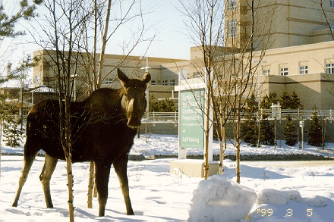

Slide 3
Proportion of US homes with complete plumbing, 1940 - 2000
Notes:
This slide shows US Census data on the proportion of homes with complete plumbing, meaning a working sink, a toilet and a shower or bathtub. The overal US is shown in yellow, Washington DC in green, Mississippi in blue and Alaska in red. Alaska ranks last among US states in this regard and our ranking is driven by nearly 1/3 of rural Alaskans who lack running water.

Slide 4
Proportion of US homes with complete plumbing, 1940 - 2000
Notes:
This slide shows US Census data on the proportion of homes with complete plumbing, meaning a working sink, a toilet and a shower or bathtub. The overal US is shown in yellow, Washington DC in green, Mississippi in blue and Alaska in red. Alaska ranks last among US states in this regard and our ranking is driven by nearly 1/3 of rural Alaskans who lack running water.

Slide 5
Proportion of US homes with complete plumbing, 1940 - 2000
Notes:
This slide shows US Census data on the proportion of homes with complete plumbing, meaning a working sink, a toilet and a shower or bathtub. The overal US is shown in yellow, Washington DC in green, Mississippi in blue and Alaska in red. Alaska ranks last among US states in this regard and our ranking is driven by nearly 1/3 of rural Alaskans who lack running water.

Slide 6
Proportion of US homes with complete plumbing, 1940 - 2000
Notes:
This slide shows US Census data on the proportion of homes with complete plumbing, meaning a working sink, a toilet and a shower or bathtub. The overal US is shown in yellow, Washington DC in green, Mississippi in blue and Alaska in red. Alaska ranks last among US states in this regard and our ranking is driven by nearly 1/3 of rural Alaskans who lack running water.

Slide 7
Proportion of US homes with complete plumbing, 1940 - 2000
Notes:
This slide shows US Census data on the proportion of homes with complete plumbing, meaning a working sink, a toilet and a shower or bathtub. The overal US is shown in yellow, Washington DC in green, Mississippi in blue and Alaska in red. Alaska ranks last among US states in this regard and our ranking is driven by nearly 1/3 of rural Alaskans who lack running water.

Slide 8
What we know
Alaska ranks last among U.S. States for in-home water services
Increasing evidence that
  Access to water service linked to improved health
Notes:
So, what we know is that Alaska ranks last among US states for in-home water services and that there is increasing evidence that in-home water service is linked to better health.
However, it’s also true that a lack of data linking water service to health in Alaska has hurt funding efforts for water infrastructure programs. This is because the scoring system applied to such programs has included an element where the programs are ranked lower if they don’t provide specific evidence that there is a health benefit for water and sanitation projects.
I know many of you are thinking thatt we have already established the value of in-home water as a fact. Right? You know, the Romans, the London Cholera Epidemic of 1854, municipal water systems, etc.
Asking rural Alaskans to prove that having running water is good for you is a bit like asking for more data on the value of parachutes in preventing death after falling out of an airplane. We all believe it, but there’s never been a randomised controlled trial.

Slide 9
Water-related infections:
The Bradley Classification*
Water-borne
  Pathogen ingested with water
    Cholera, other enteric infections
Water-washed
  Person-to-person, lack of water for hygiene
    Skin infections, trachoma
Water-based
  Aquatic intermediate host
    Schistosomiasis, guinea worm
Water-related insect vector
  Insects breed or bite near water
    Malaria, dengue
* “Drawers of Water”; White, Bradley, White; U of Chicago Press, 1972
Notes:
When thinking about water and infectious diseases, we can divide the problem into several categories, as Bradley and White did in their 1972 publication. Most of use think first of water-borne infectious, where the pathogen is ingested in contaminated water. Cholera and many enteric bacterial infectious are acquired this way, although these diseases can be acquired also by ingesting the pathogen via hand contamination.
Water-washed diseases are those spread person to person, where lack of water leads to inadequate hand or body hygiene. In the original classification, Bradley listed skin infections and trachoma as water washed.
Water-based infections arise where water is the home for an intermediate parasitic host such as for schistosomiasis and guinea worm.
Bradley called water-related infections those where the insect vector breed or bite near water as is the case for mosquitos transmitting malaria or dengue.

Slide 10
Examples of “Water-washed” Diseases
Handwashing education in Navy recruits
  45% less clinic visits for respiratory illness
    Ryan, Am J. Prev Med, 2001
Community trial of handwashing promotion
    Karachi, Pakistan
    Soap, antibacterial soap, education only
      Luby, Lancet, 2005
  Soap and education:
    50% less diarrhea, pneumonia
    33% less skin infection (impetigo)
Notes:
Much attention in public health is focused on water-borne infections and appropriately so, because they are both common and deadly. However, in recent years there has been an emerging awareness of the role of the water-washed infectious diseases, and in particular respiratory infections. I cite 2 examples here, Ryan in the Am J Prev Med reported results from a handwashing education campaign in Navy recruits where they evaluate rates of respiratory illness before and after the campaign. They showed a 45% reduction in outpatient respiratory infection visits.
More recently, Luby reported results froma controlled handwashing promotion in Karachi, Pakistan where they randomised neighborhoods to receive either plain soap, antibacterial soap or handwashing education only. The neighborhoods receiving either of the soap showed approximately a 50% reduction in diarrheal disesase and pneumonia and a XXXX% drop in skin infections. Clear evidence for the value of handwashing in preventing water washed disease.

Slide 11
What we know
Alaska ranks last among U.S. States for in-home water services
Increasing evidence that
  in-home water service linked to better health
Prior to 2008, data linking water service to health in Alaska were limited
  Has hurt funding for water infrastructure programs
Notes:
So, what we know is that Alaska ranks last among US states for in-home water services and that there is increasing evidence that in-home water service is linked to better health.
However, it’s also true that a lack of data linking water service to health in Alaska has hurt funding efforts for water infrastructure programs. This is because the scoring system applied to such programs has included an element where the programs are ranked lower if they don’t provide specific evidence that there is a health benefit for water and sanitation projects.
I know many of you are thinking thatt we have already established the value of in-home water as a fact. Right? You know, the Romans, the London Cholera Epidemic of 1854, municipal water systems, etc.
Asking rural Alaskans to prove that having running water is good for you is a bit like asking for more data on the value of parachutes in preventing death after falling out of an airplane. We all believe it, but there’s never been a randomised controlled trial.

Slide 12
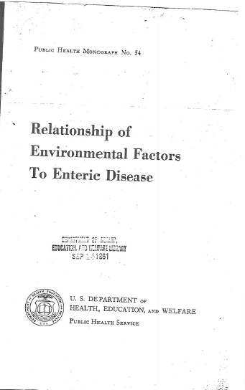

Slide 13
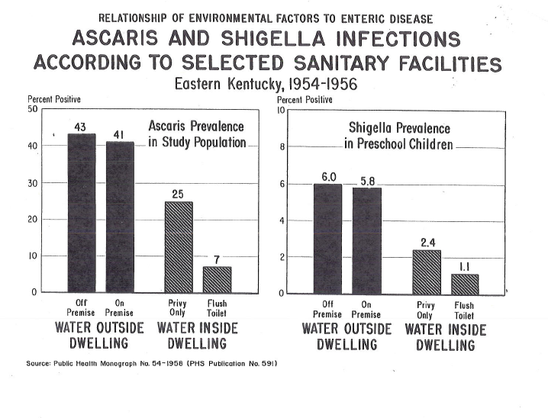

Slide 14

Does providing in-home water and sanitation service result in improved health for Alaska Native people?
Notes:
So, in an effort to support sanitation programs in rural Alaska, we’ve been busy trying to provide data to answer this question.
Is in-home water and sanitation service liked to the health of Alaska Native people?

Slide 15
Rural Alaska Housing Sanitation Inventory, 2001
Statewide survey
“Served” homes have internal plumbing
  Municipal piped water, pressure tanks, private wells
“Unserved” without internal plumbing
  Self-hauled water
Notes:
We used data from the rural Alaska Housing Sanitation Inventory, a statewide survey that classified homes as being served or unserved. Served homes have internal plumbing supplied by either municipal piped water, a pressure tank or a private well. Unserved homes lack internal plumbing and residents must self haul water and waste.

Slide 16
In-Home Water and Sewer Service, Rural Alaska Regions, 2001
Region | Communities surveyed | Homes surveyed | Homes with piped water | Homes with Flush Toilets
A | 4 | 368 | 100% | 100%
B | 25 | 1555 | 89% | 87%
C | 26 | 2834 | 88% | 85%
D | 10 | 834 | 75% | 75%
E | 49 | 5513 | 61% | 60%
F | 14 | 1376 | 57% | 55%
Total | 128 | 12,480 | 73% | 71%
Notes:
This slide shows in home water and sewer service for 6 rural regions of Alaska. The proportion of homes served ranged from 57 to 100%. We grouped the regions into high and low service as indicated by the yellow line.

Slide 17
Hospitalization Rates for “High” and “Low” Water Service Regions, Alaska, 2000-2004
*
*
Rate per 10,000
*
*
* P < 0.05
Notes:
When we matched hospitalization rate to water service this is what we found. Higher rates of hospitalzation for pneumonia and influenza, RSV in children, skin infections and MRSA. Interestingly, diarrhea hospitalizations were uncommon in all regions and did not differ according to water service.

Slide 18
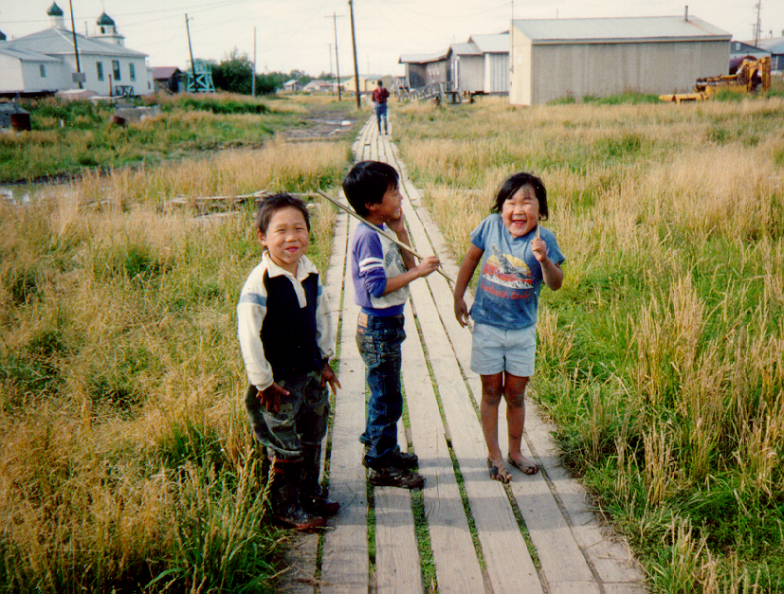
Notes:
Most villages have no running water and most residents are supported by a subsistence lifestyle.

Slide 19
Hospitalization rates for Alaska Native infants, according to percent of homes with water service
1999 - 2004*
Rate per 1,000 births
* Hennessy, AJPH, 2008
Notes:
So, this slide shows hospitalization rates for Alaska Native infants according to the % of homes with water service in their village. The height of the bars shows rates of hospitalization, per thousand infants, for three diagonoses: Lower respiratory tract infection (the first set of bars), xray confirmed pneumonia and lab confirmed Respiratory Syncytial Virus (RSV). The light blue bars represent rates for infants living in villages where less than 10% of homes have running water, the dark blue show rates for villages with 10 -79%, the purple for those villages> 80% served, the red shows rates for the region’s main town, where 100% of homes have running water. The brown and yellow bars show rates for all Alaska Native infants and for the overall US infant rate.
For each of these respiratory illnesses, rates of hospitalizations are highest in children coming from villages with the lowest level of water service and rates decrease with increasinng levels of water service.

Slide 20
Hospitalization rates for infants in villages with < 10% of homes with water service, compared with U.S. infants
Rate per 1,000 births
5 x
11 x
5 x
Notes:
Here I’ve isolate the rates for chiildren living in villages with <10% of homes with running water to highlight the health disparity vs the general US infant rate. For example, the rate of pneumonia is 250 per 1000 per year, or 25% percent of infants. This is 11 times higher than the overall US rate, and places Alaska Native children among the highest reported in the world for respiratory infection hospitalization rates.

Slide 21
Skin infection rates, all ages, by village water service,
Southwest Alaska, 1999 - 2000
Water Service
Rate per 1,000 persons
Notes:
This slide is set up the same way and shows data for skin infections due to lab confirmed Staph aureus, Methicillin Resistant Staph aureus and hospitalization for skin infections among persons of all ages from southwest Alaska. As we saw with respiratory infections, rates are highest in villagers lacking running water and decrease with increasing levels of water availability.

Slide 22
Serious infections with Streptococcus pneumoniae in children < 5 years old,
Southwest Alaska, 2001-2007
Water Service
Rate per 100,000
20X
* J Wenger, 2010, Pediatric Infectious Diseases
Notes:
We conduct laboratory based surveillance for invasive Streptococcus pneumoniae infections throughout Alaska. The pneumococcus is a respiratory pathogen spread by coughing or sneezing and via contaminated hands. This slide, set up the same way as the previous ones, shows the greatly increased rates of invasive infections, such as blood stream and meningitis, among childre from villages that lack inhome running water.
Each of these health outcomes, lower respiratory infections, skin infections and invasive pneumooccal disease share a person to person mode of transmission that can be broken by having adequate amounts of water available for hand washing and body hygiene. We think lack of water availability explains these health disparities.

Slide 23
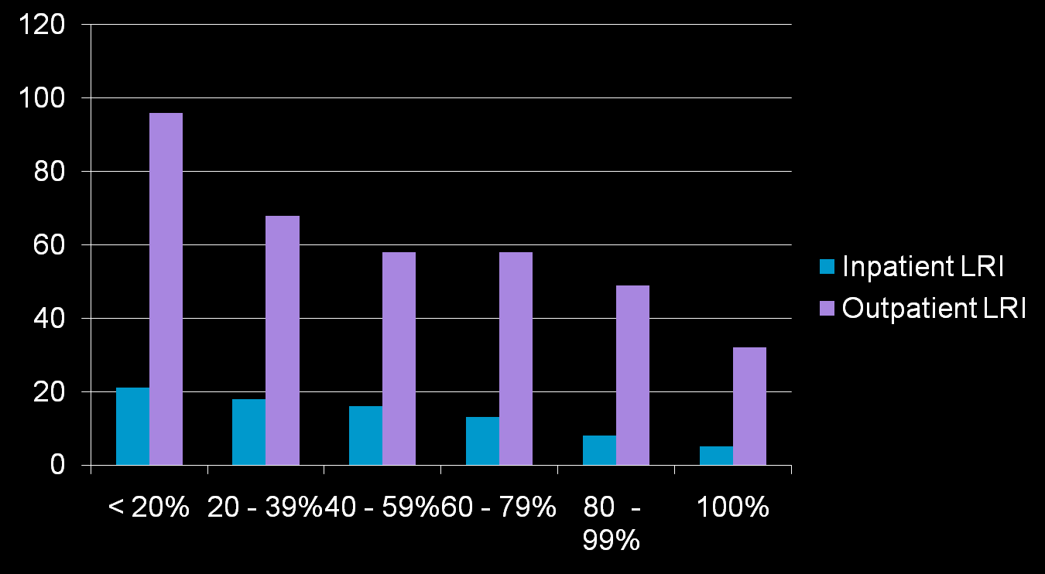
LRI Incidence Among Alaska Children < 2 years, Enrolled in Medicaid 1998- 2003
Incidence per 100 child-years
Community in-home water service
Gessner, J Pediatrics, 2008

Slide 24
Dental Caries, a Water-washed Disease?
Dental caries a growing health problem
Water fluoridation in rural Alaska is less available in last 15 years
  Fluoride poisoning death in 1992
    Fluoridation only offered in municipal piped systems
  Southwest Alaska villages
    1990s: appx. 25 of 52 fluoridated water
    2009: 4 of 52 villages
Notes:
Last fall, while responding to a Tribal request to evaluate oral health among children from this same region, we asked: Are dental caries a water-washed disease among Alaska Native children?
Dental caries is a growing problem in this population compounded by a lack of dental providers, high rates of soda consumption leading to extremely high caries rates and in many children a need for extensive full mouth restoration under general anesthesia.
Compared to 15 years ago, Water fluoridation in rural Alaska has decreased due in part to fear surrounding a case of fatal fluoride poisoining in the region. Fluoridation is only offered via municipal piped water systems making it unavailble to communities with pressure tank small haul systems. In the early 1990’s approximately ½ of the regions 52 villages offered fluoridated water, now only 4 do.

Slide 25
Dental Caries in Primary Teeth by
Village Fluoridation Status,
Southwest Alaska, 2008
3x
*
*
1.5x
1.6
1.8
* p < 0.01
Notes:
Not surprisingly, we found that dental caries in the region varies by water fluoridation, as shown here. Dental caries in primary teeth were 3 times higher for children 4 – 6 years old living without fluoridated water than for chilfdren from villages with fluoridated water> This pattern is repeated for older children and for permanent teeth.

Slide 26
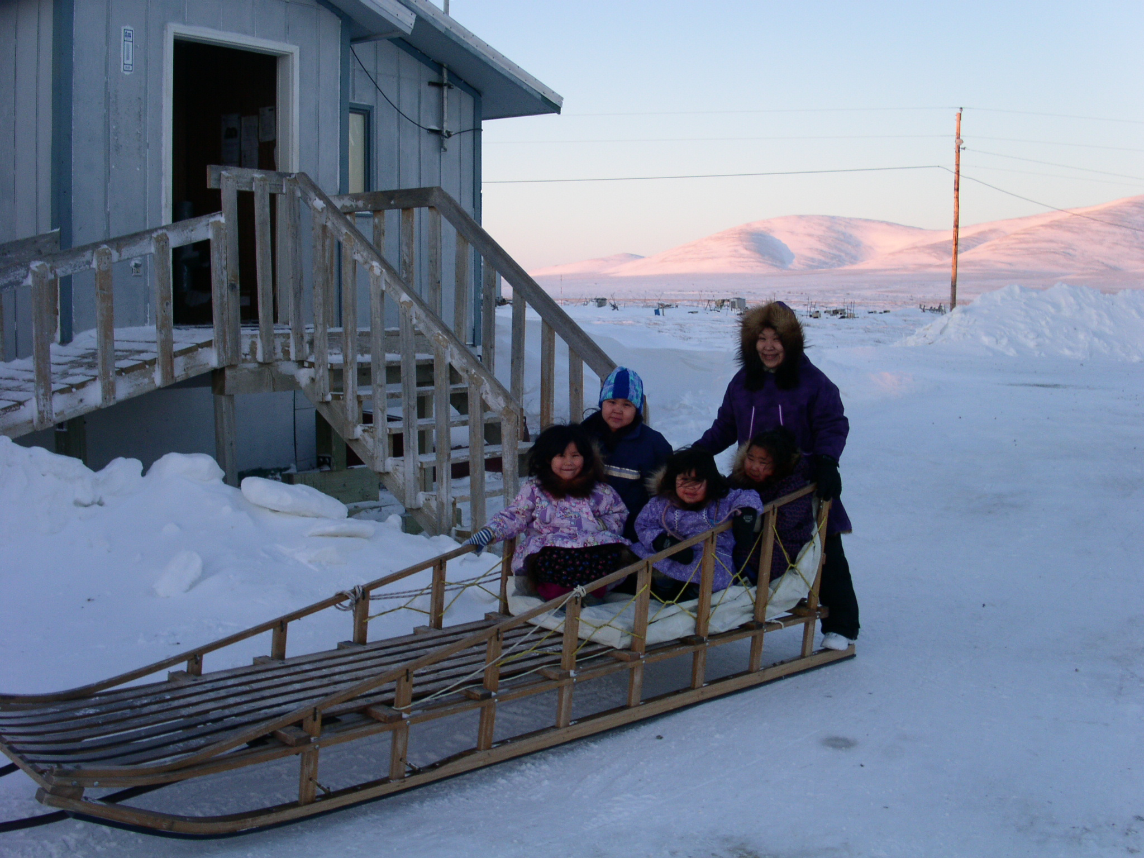

Slide 27
Summary of Alaska Data
  - Low water service regions have higher hospitalization rates of
  - Pneumonia & influenza
  - RSV
  - Skin infections
  - NOT infectious diarrhea
  In Southwest region, low water service is linked to higher rates of
    Respiratory hospitalizations in infants
    Skin infections, all ages
    Serious pneumococcal infections in children
    Dental caries in children
Notes:
Allow me to summarize these Alaska data.

Slide 28
Other Studies in Progress
Evaluate infectious disease rates in villages with new water systems
  “4 village study”
    ANTHC – CDC project (Troy Ritter, P.I.)
    Water use promotion and health evaluation
    Data analysis ongoing
  Opportunities to repeat in other villages
Economic analyses
  Cost of RSV hospitalizations
  Cost effectiveness of water fluoridation and other preventive dentistry approaches
In-home water service and infectious diseases in other I.H.S. Areas
Notes:
From these data we recommend:

Slide 29
Remaining questions
How much water is needed to maximize healthy behaviors?
  High cost, limited water supply lead to rationing in some “served” homes
What other indicators are linked to in-home water service?
  Diarrhea
  Injuries
  Lost economic opportunities

Slide 30
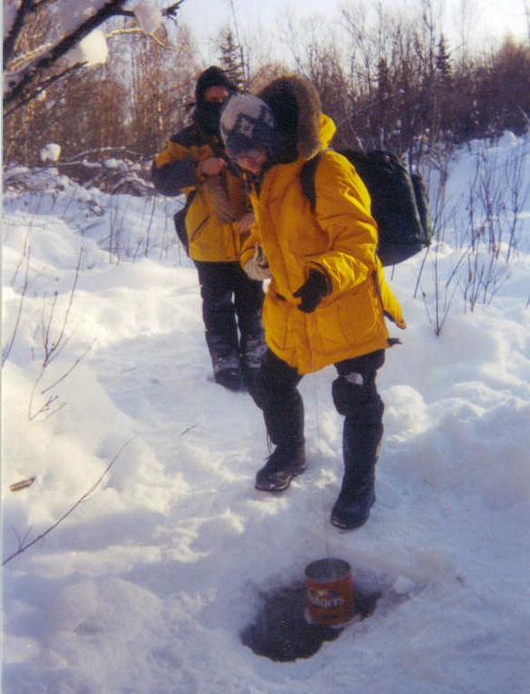
Collecting Water:
Red Devil, AK

Slide 31
Limitations of Health Data
Water availability is not the only determinant of infectious disease risk
    Household crowding, indoor air quality, nutrition, individual immunity, pathogen factors
    Provision of in-home water will not eliminate disease completely
Economic gains from improved health will not equal costs of water systems

Slide 32
Uses of Health Data
Provides added justification for new construction
  Water services delivery is a tool to address ongoing health disparities
  A way to measure progress
May provide information about optimal water quantity needed
Water use promotion activities can accelerate benefits of new water systems

Slide 33
Summary
Provision of in-home water service is associated with improved health in rural Alaska
Alaska ranks last among US States for in-home water service
  Providing adequate water to more homes can be expected to result in improved health for rural Alaska Native persons

Slide 34


Slide 35
Thanks to…
Alaska Native Tribal Health Consortium
  Troy Ritter
  Jeff Smith
  Ros Singleton
Yukon Kuskokwim Health Corporation
  Joe Klejka
State of Alaska
  Joe McLaughlin
  Brad Whistler
CDC Alaska
  Dana Bruden
  Lisa Bulkow
  Jay Wenger
  Michael Bruce
  Tim Thomas
CDC Atlanta
  Bob Holman
  Kathy Byrd
Indian Health Service
  Jim Cheek
Notes:
I’d like to thank you for your attention and acknowledge my many collaborators in Alaska and at CDC in Atlanta.

Slide 36
Infectious Disease Hospitalizations by Region, 2000-2004
Region | Homes with Plumbing | Rate per 10,000 persons per year
 |  | Diarrhea | Pneumonia and Influenza | Resp. Syncytial Virus | Skin Infection | MRSA
Anchorage (urban) | 100% | 7 | 63 | 79 | 51 | 5
Barrow | 100% | 6 | 98 | 214 | 41 | 1
Bristol Bay | 89% | 6 | 86 | 148 | 47 | 3
Southeast | 88% | 10 | 42 | 30 | 26 | 1
“High” Service | 91% | 8 | 63 | 75 | 43 | 4
“Low” Service | 61% | 7 | 158 | 249 | 93 | 16
Kotzebue | 75% | 6 | 101 | 136 | 34 | <1
Yukon Kuskokwim | 61% | 8 | 199 | 314 | 113 | 27
Norton Sound | 57% | 4 | 91 | 129 | 39 | 1

Slide 37
Villages Grouped by Water Service,
YK Region
 | Homes with Plumbing |  |  | Bethel, 100%
 | < 10% | 10 – 79% | ≥ 80%
Villages | 20 | 13 | 14 | 1
Population | 6956 | 4743 | 6415 | 5459
Village Size, (median) | 312 | 370 | 493 | 5459

Slide 38
Type of Water Service, YK Region

Slide 39
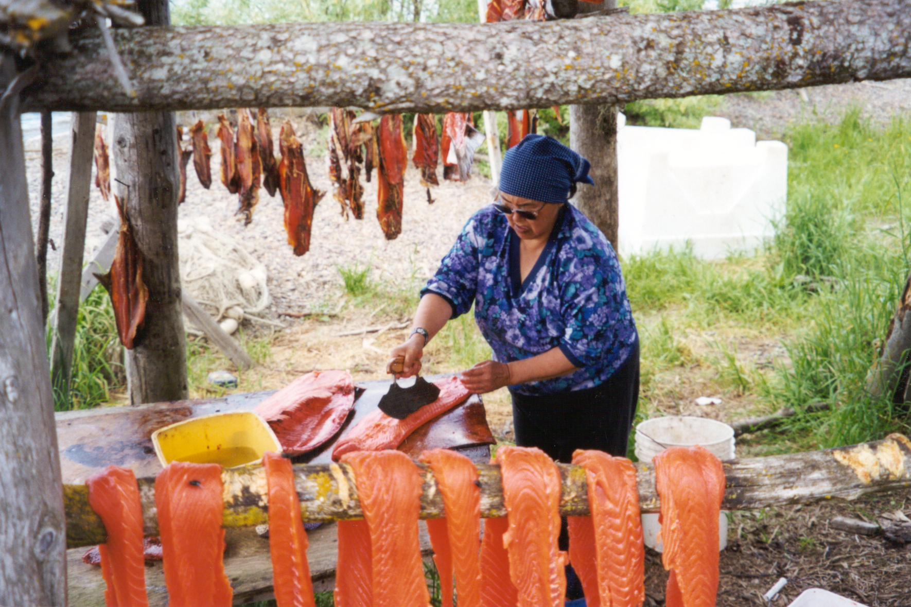

Slide 40
http://www.arcticlivingconditions.org/

Slide 42
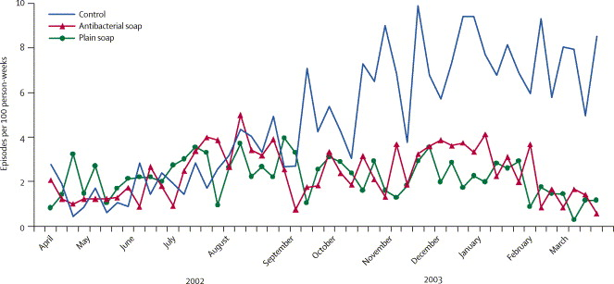
Incidence of pneumonia in children younger than 5 years, Pakistan
Effect of handwashing on child health: a randomised controlled trial. S. Luby, M. Agboatwalla, D. Feikin
The Lancet. 2005; (366) 9481

Slide 43
Risk Factors for Dental Caries, Multivariate Analysis
 | Primary teeth |  | Permanent teeth
 | Dental caries |  | Dental caries
Variable | aOR | P - value | aOR | P - value
Lack of water fluoridation | 3.1 | <0.01 | 1.8 | <0.01
Soda-pop consumption
0 soda / day 1 soda / day 2 soda / day ≥3 sodas / day | ref |  | ref
 | 1.1 |  | 1.3
 | 1.3 |  | 1.6
 | 1.5 | 0.02 | 2.0 | <0.01
Notes:
Increased soda-pop consumption was also found to be significantly associated with dental caries.
ORs ranged from 1.1 and 1.3 in children drinking 1 soda per day in primary and permanent teeth respectively and up to 1.5 and 2.0 in children drinking 3 or more sodas a day for primary and permanent teeth.
No other variables were found to be statistically significant

Slide 44
“The findings and conclusions in this presentation are those of the author and do not necessarily represent the views of the Centers for Disease Control and Prevention.”
Notes:
I have no financial relationships to disclose, although the Centers for Disease Control and Prevention does want to assert plausible deniability by having me remind you that although I work for CDC, my comments may not reflect the position of the Agency.
I guess it’s not hard to understand why they want me to say this. After all, the government needs to protect itself against the actions of the occassional rogue researcher who might wander off message. And I am from Alaska, after all, where going “Rogue” is sometimes celebrated. I’ll try not to get all mavericky on you.

Slide 45
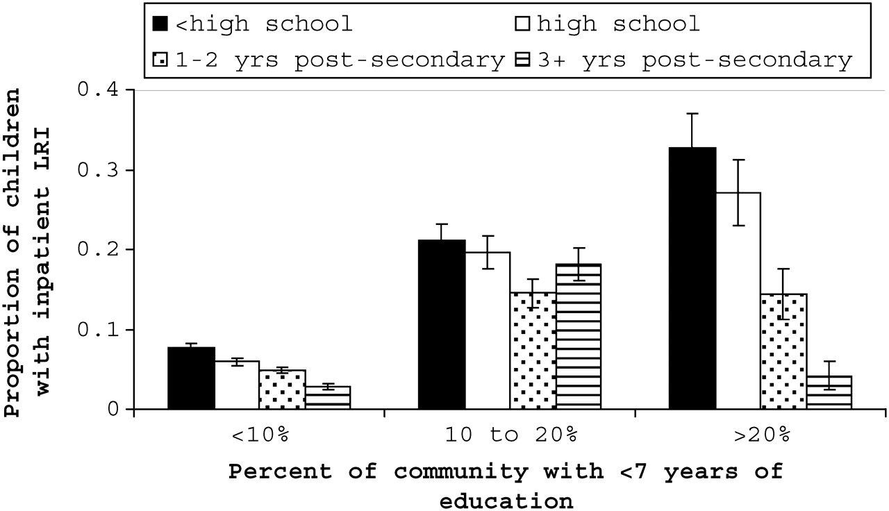

Cumulative proportion of Medicaid-enrolled children age <2 years with at least one inpatient lower respiratory infection (LRI) by maternal education and stratified by the proportion of the child's community with less than 7 years of education; Alaska, 1999-2003.
Gessner B D et al. J Epidemiol Community Health 2010;64:130-135
©2010 by BMJ Publishing Group Ltd
Notes:
Cumulative proportion of Medicaid-enrolled children age <2 years with at least one inpatient lower respiratory infection (LRI) by maternal education and stratified by the proportion of the child's community with less than 7 years of education; Alaska, 1999-2003. Adjusted for the number of days of Medicaid enrolment, Alaska Native race, and the proportion of the child's community with modern water service. N=12 322.

