Slide 1
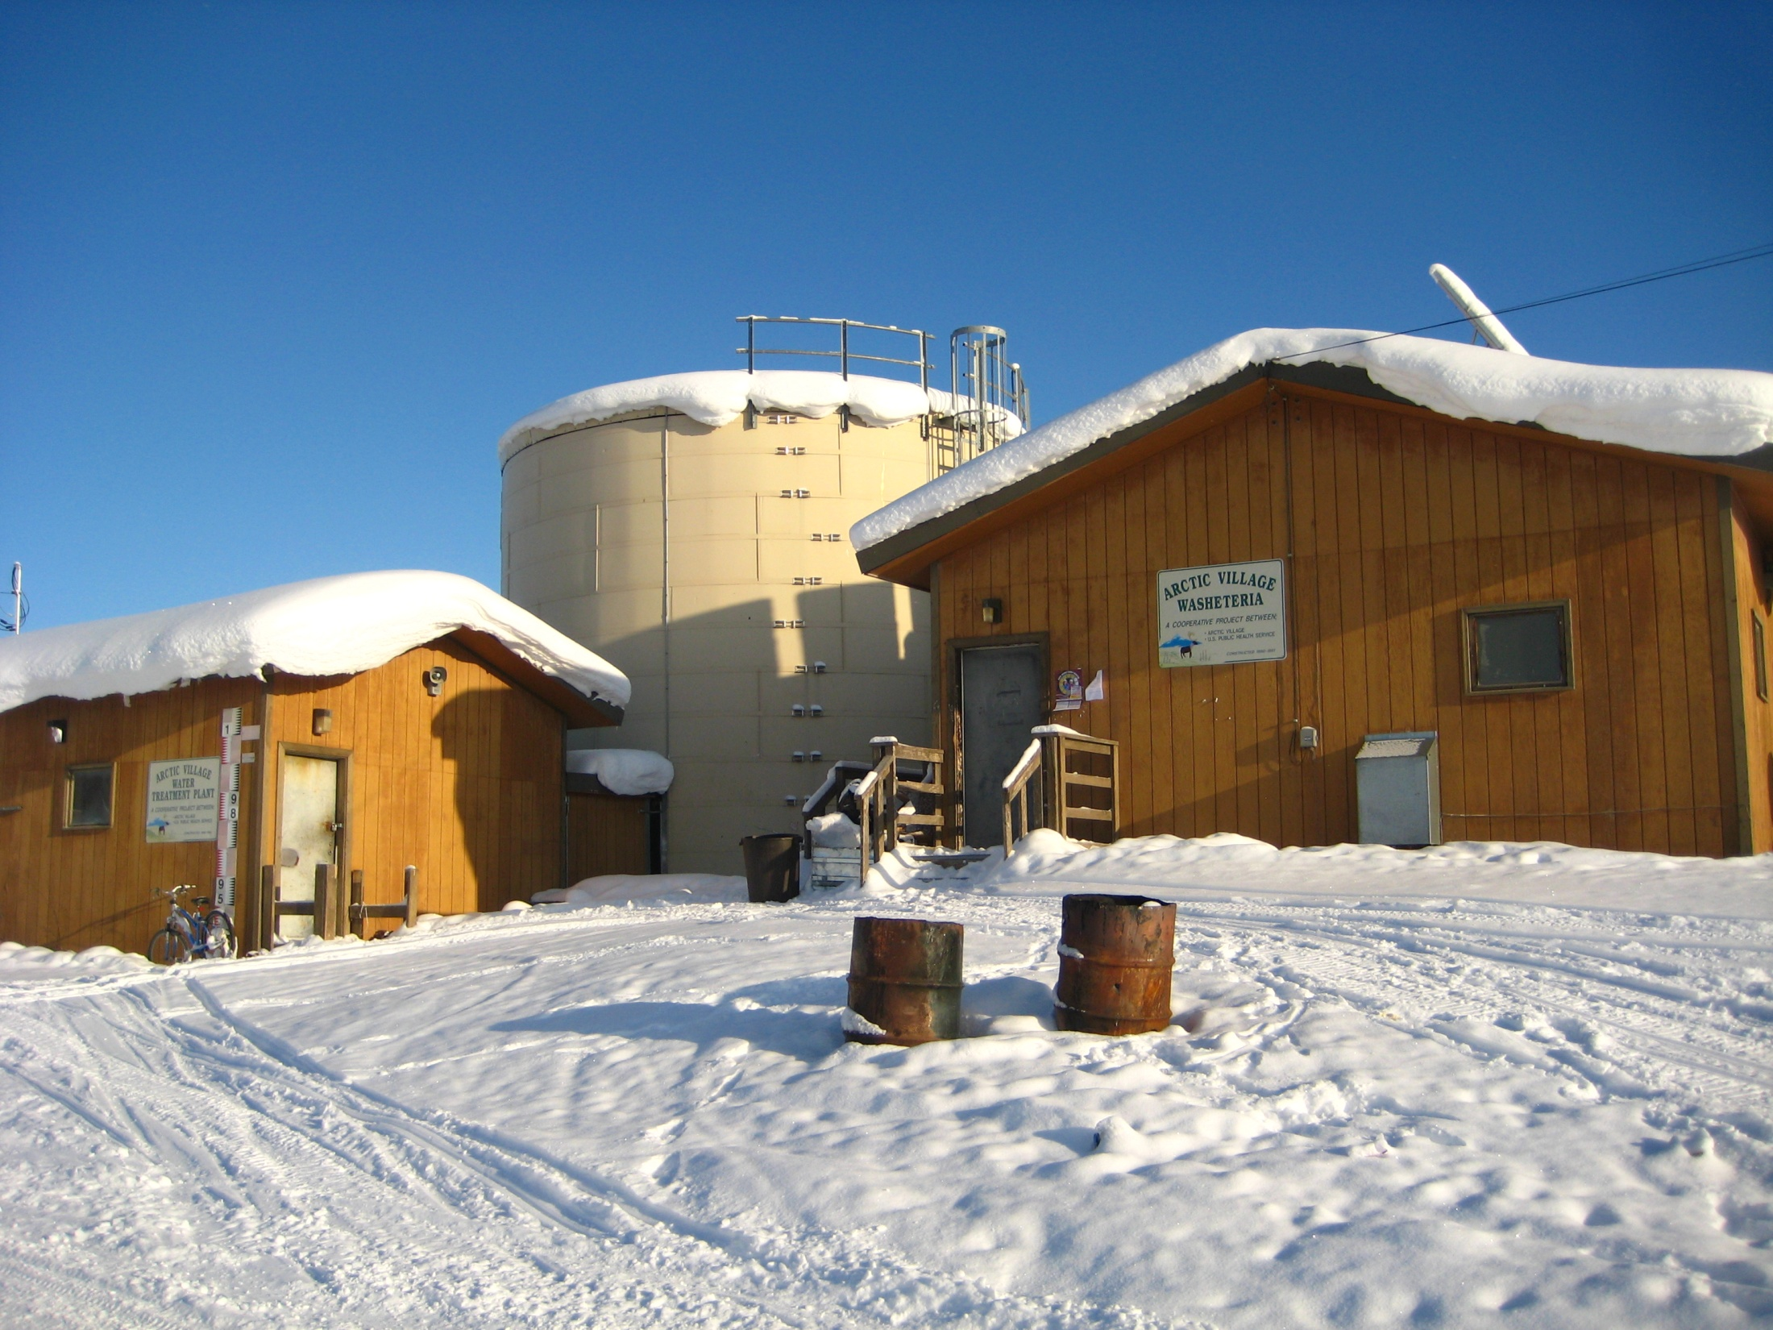
Alaska Village Sanitation:
Current Status and the
Need for New Technology
Bill Griffith
Alaska Department of Environmental Conservation

Slide 2
Progress in Alaska Village Sanitation
For half a century, we’ve focused on
“putting the honey bucket in the museum”
Much progress has been made:
  30 years ago, fewer than 25% of rural Alaska households had running water and flush toilets.
  In 1996, 55% of rural homes had piped or covered haul service.
  Today, approximately 75% of rural homes have indoor plumbing

Slide 3
Boilerplate Approach Since 1970:
100% water treatment to full regulatory compliance (regardless of ultimate use)
Storage of large quantities of water, usually requiring heat addition
Distribution of treated water to individual homes via pipes or haul vehicle, usually requiring heat addition
Collection of all household sewage for lagoon disposal, usually requiring heat addition

Slide 4
Historical Pace of Rural Alaska Sanitation Funding
1960 - 2010
1981-1990
1960-1980

Slide 6
Rural Alaska Water and Sewer Needs: Much Work Remains

Slide 9
Cost to Complete New, Ongoing
Piped Water & Sewer Systems
There are 11 ongoing construction projects in Alaska villages to provide first-time piped water and sewer services.
Most of these projects have been ongoing for several years, some for more than a decade.
Estimated cost to complete these projects is $150 million.
Once these projects are done, there will still be 35 villages with no water and sewer services to individual homes.

Slide 11
EPA Recommended Sustainability Threshold
- - - - - - - - Lower 48 Average

Slide 12
Bottom Line:
Boilerplate system used for the past 50 years is increasingly unaffordable to build and maintain.
Available funding will not be adequate to serve remaining homes and make needed improvements.
New technologies are needed now in order to address health problems associated with water and sewer system deficiencies.

Slide 13
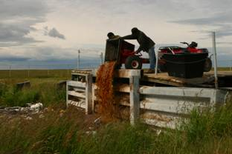
The need for technological improvements exists at every service level:
Thousands of people will continue to handle honey buckets for years to come

Slide 14
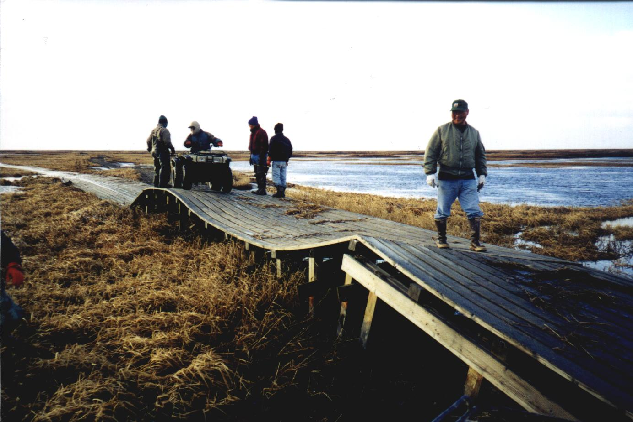
Water and sewer haul systems will continue to rely on transportation infrastructure

Slide 15
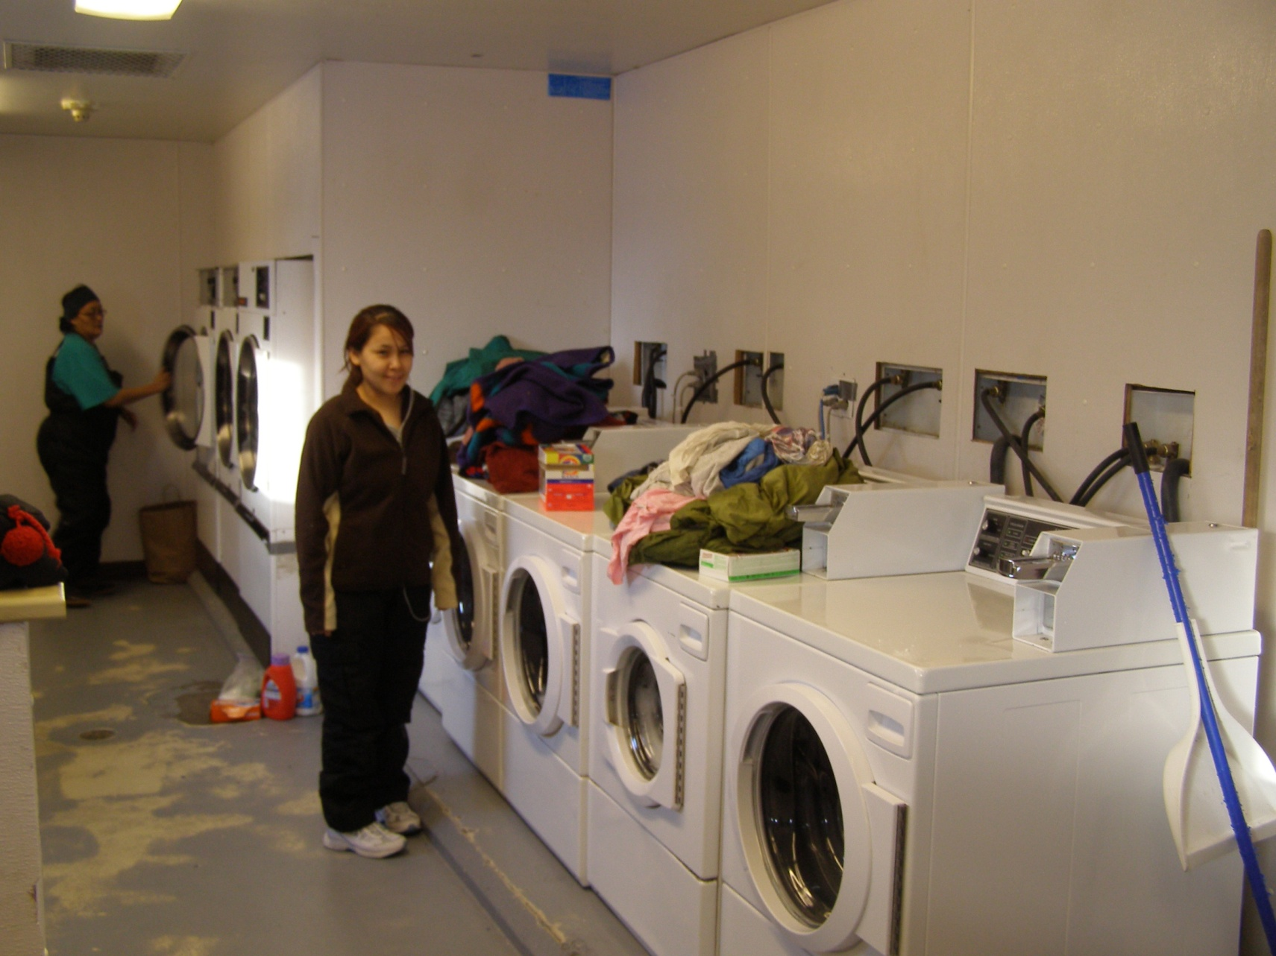
Washeterias will remain the most sustainable level of service for many villages

Slide 16
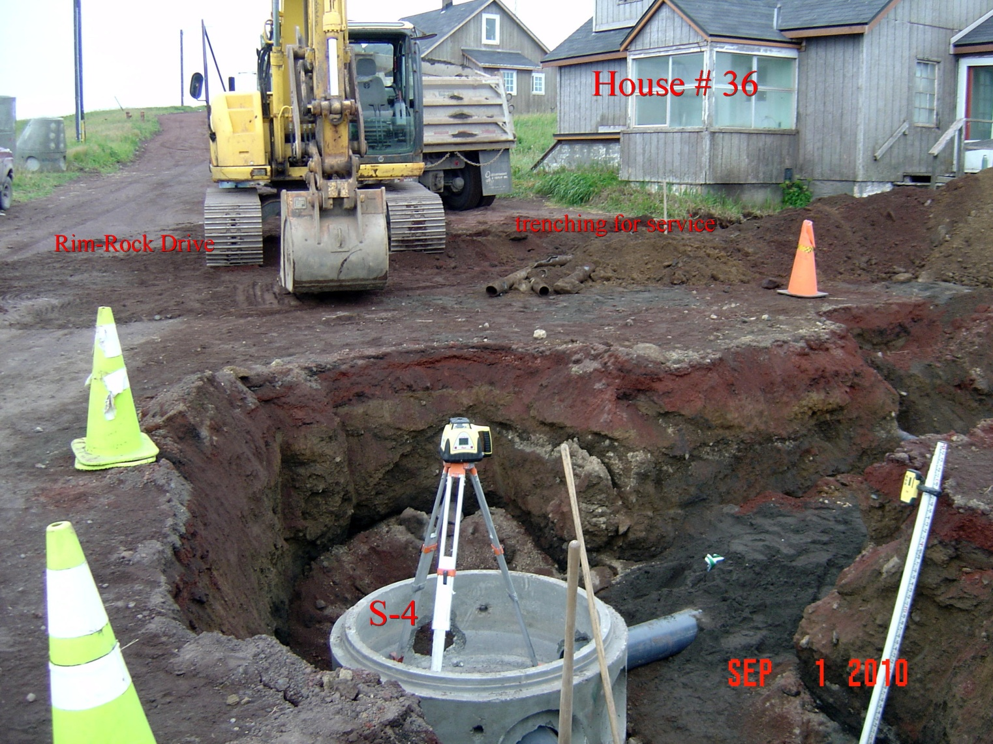
Many existing piped systems are at the end of their useful life or require major upgrades

Slide 17
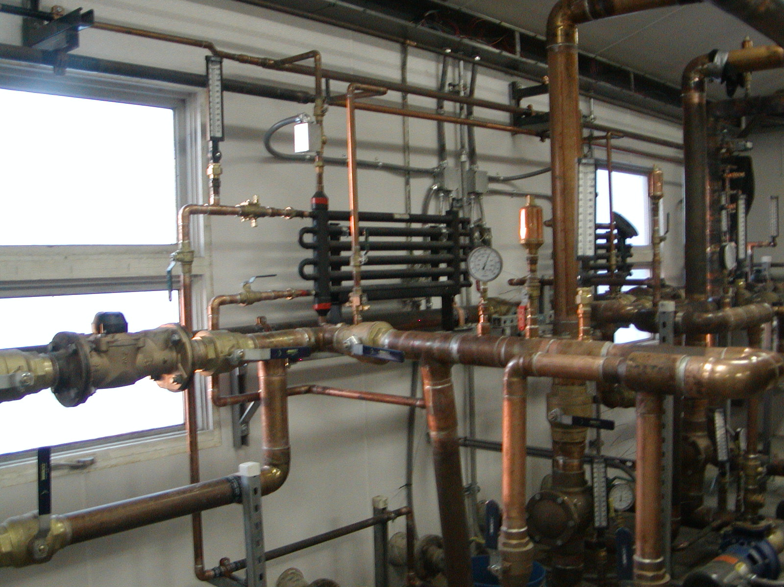
Upgrades to water plants and other buildings will improve energy efficiency and monitoring capability

Slide 18

“Our way of life has been influenced by the way technology has developed. In the future, it seems to me, we ought to try to reverse this and so develop our technology that it meets the needs of the sort of life we wish to lead.”
HRH the Duke of Edinburgh, Men, Machines and Sacred Cows, 1984

