Slide 1
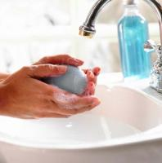
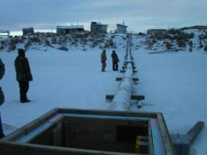
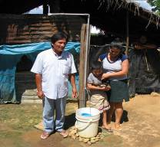
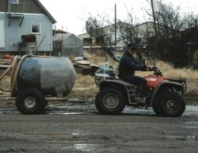
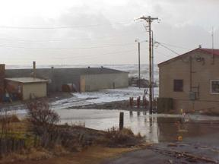
Connecting the Dots: Reducing Water, Sanitation, and Hygiene-related Diarrheal Illness
Michael J. Beach, PhD
Centers for Disease Control and Prevention
Water and Sanitation Innovations for the Arctic Workshop
Anchorage, AK
January 13, 2011
National Center for Emerging and Zoonotic Infectious Diseases
Division of Foodborne, Waterborne, and Environmental Diseases

Slide 2
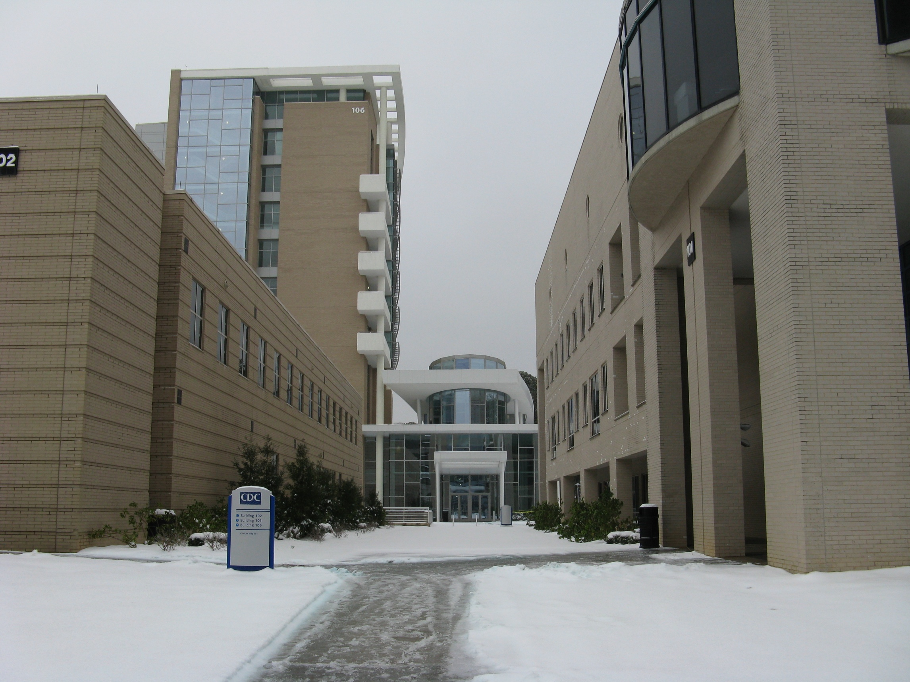
Connecting the Dots: Reducing Water, Sanitation, and Hygiene-related Diarrheal Illness
Michael J. Beach, PhD
Centers for Disease Control and Prevention
Water and Sanitation Innovations for the Arctic Workshop
Anchorage, AK
January 13, 2011
National Center for Emerging and Zoonotic Infectious Diseases
Division of Foodborne, Waterborne, and Environmental Diseases

Slide 3
Background
Leading Causes of Death Globally, 2001
  Ischemic heart disease (7.2 million)
  Cancer (7.1 million)
  Cerebrovascular disease (5.5 million)
  Lower respiratory infection (3.9 million)
  Unintentional injuries (3.5 million)
  HIV/AIDS (2.9 million)
  COPD (2.7 million)
  Diarrheal Diseases: Unsafe water, sanitation, hygiene (1.7 million)
  TB (1.6 million)
  Intentional injuries (suicide, homicide, war) (1.6 million)
  Malaria (1.1 million)
  WHO, 2002

Slide 4
Drinking Water and Disease Transmission
Mills-Reincke Phenomenon (1893-94)
  Filtration of the polluted public water-supplies of Lawrence , MA and of Hamburg, Germany produced a notable decline in the general death-rate of each of these cities above that of typhoid fever
Hazen's Theorem (1904)
  “Where one death from typhoid fever has been avoided by the use of better water, a certain number of deaths, probably two or three, from other causes have been avoided.”

Slide 5
Drinking Water and Disease Transmission
1900: Approximately 100 cases typhoid for every 100,000 Americans
1908: First disinfection of U.S. public water supply in NJ
1910-1920:
  Thousands of U.S. cities begin disinfecting water
  Dramatic decrease in cases of waterborne illness /death
2006
  Approximately 0.1 cases of typhoid for every 100,000 Americans (most due to international travel)
One of the greatest public health achievements of the 20th Century
EPA. The History of Drinking Water Treatment: 2000.; CDC. Achievements in Public Health, 1900-1999: Safer and Healthier Foods. MMWR 1999; 48(40): 905.; CDC. Summary of Notifiable Diseases—United States, 2006. MMWR 2008; 55(53): 17

Slide 6
Baltimore, MD
Typhoid Fever Trend (Mortality per 100,000) and Sanitary Interventions, 1900–1936
Chlorination
Filtration
Cutler D, Miller G. Demography. 2005;42(1):1-22.

Slide 7
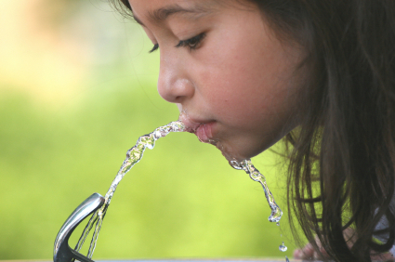
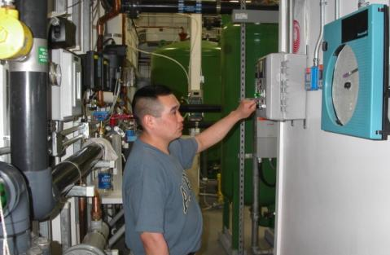
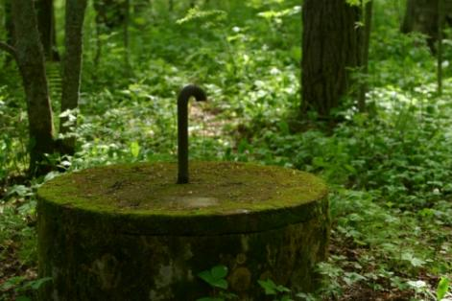
Providing Safe and Healthy Water

Slide 8
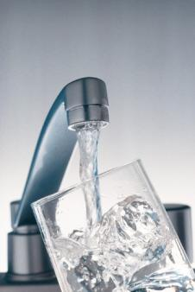
Does Safe Water Reduce the Risk of Diarrhea Globally?
1991¹
  15-17% reduction for improved water quality in 16 studies
  20-27% reduction for water quantity in 15 studies
2009²
  55% reduction for all ages in 7 studies
  46% reduction in children <5 y.o. in 5 trials
Why the difference?
1. Esrey et al., 1991. Bull WHO 69:609-621.
2. Clasen et al., 2009. Cochrane Library 2009(1);1-115.
Notes:
Drinking Water Systems
Aging infrastructure:
-Plants, distribution systems, source water protection, water development
-> 1 trillion estimate cost
- CSO’s, SSO’s
Private wells:
-Serve over 42 million people
-Prone to poor construction, operation, maintenance, water quality
-WA 2003: most small systems had > 1 system deficiencies that posed a potential public health hazard
-AL 2005: 40% of private wells failed bacteriologic testing
-MI: more private wells than any other state (1.12 million)
-Aging water distribution systems
-Most systems in U.S. long overdue for replacement
-1000’s of annual “water” advisories
-Leaks, breaks, low pressure events open systems to contamination and health effects
Building systems
-Aging water distribution systems
-Most systems in U.S. long overdue for replacement
-1000’s of annual “water” advisories
-Leaks, breaks, low pressure events open systems to contamination and health effects
Cooling=Aerosolization of Legionella
GWASH
Enteric disease: household water treatment (point of use treatment, safe storage vessels); small piped systems, boreholes; larger systems (crumbling infrastructure, degradation of source water with industrialization);
NTDs: integration of water, sanitation, hygiene
Climate change
-Floods=Sewer overflows, groundwater contamination, infrastructure failures
-Droughts=groundwater contamination, saltwater intrusion, re-use of wastewater, groundwater recharge
-Increasing water temps=enhanced growth of Naegleria, Vibrio, Pseudomonas, harmful algal blooms, indicators

Slide 9

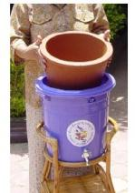
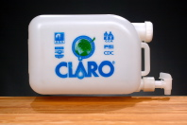
Does Site or Type of Water Treatment Reduce Diarrheal Illness?
Treat at Source or at Home
27% Reduction
Treat at Source
13% Reduction
Treat in Home
44% Reduction
Chlorination
39% Reduction
Filtration
63% Reduction
Storage
39% Reduction
  Clasen et al., 2010. Cochrane
  Library 2009(1);1-115.

Slide 10
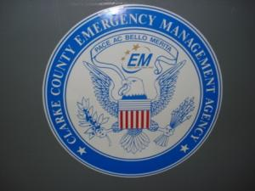
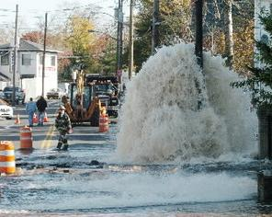
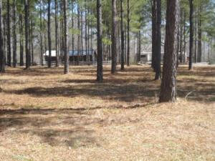
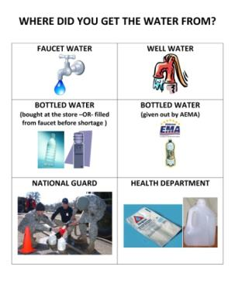
The Converse: What Happens When We Lose Water Service?
Alabama, Winter 2010
  Extended freeze left ~18,000 residents without water service for up to 12 days
Comparing diarrhea in residents w/o water service to those with service
  Lost water for > 7 days
    odds 2.4x more
  Lost water pressure for > 7 days
    odds 3.5x more
    Dose dependence correlated to length
    of time with water or pressure loss
  Drank non-recommended water:
    odds 3.7x more
Gargano J, Freeland A, Miller M, Brunkard J. et al., CDC Epi-Aid Report 2010-039.
Notes:
Drinking Water Systems
Aging infrastructure:
-Plants, distribution systems, source water protection, water development
-> 1 trillion estimate cost
- CSO’s, SSO’s
Private wells:
-Serve over 42 million people
-Prone to poor construction, operation, maintenance, water quality
-WA 2003: most small systems had > 1 system deficiencies that posed a potential public health hazard
-AL 2005: 40% of private wells failed bacteriologic testing
-MI: more private wells than any other state (1.12 million)
-Aging water distribution systems
-Most systems in U.S. long overdue for replacement
-1000’s of annual “water” advisories
-Leaks, breaks, low pressure events open systems to contamination and health effects
Building systems
-Aging water distribution systems
-Most systems in U.S. long overdue for replacement
-1000’s of annual “water” advisories
-Leaks, breaks, low pressure events open systems to contamination and health effects
Cooling=Aerosolization of Legionella
GWASH
Enteric disease: household water treatment (point of use treatment, safe storage vessels); small piped systems, boreholes; larger systems (crumbling infrastructure, degradation of source water with industrialization);
NTDs: integration of water, sanitation, hygiene
Climate change
-Floods=Sewer overflows, groundwater contamination, infrastructure failures
-Droughts=groundwater contamination, saltwater intrusion, re-use of wastewater, groundwater recharge
-Increasing water temps=enhanced growth of Naegleria, Vibrio, Pseudomonas, harmful algal blooms, indicators

Slide 11
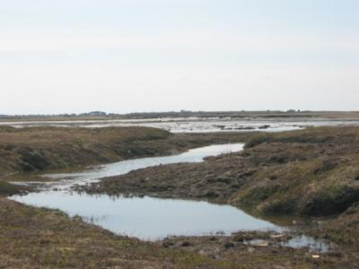
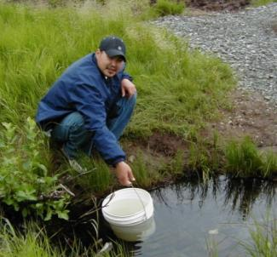
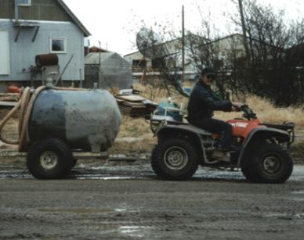
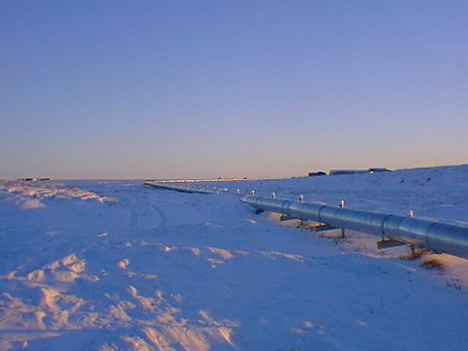
Providing Improved and Accessible sanitation

Slide 12
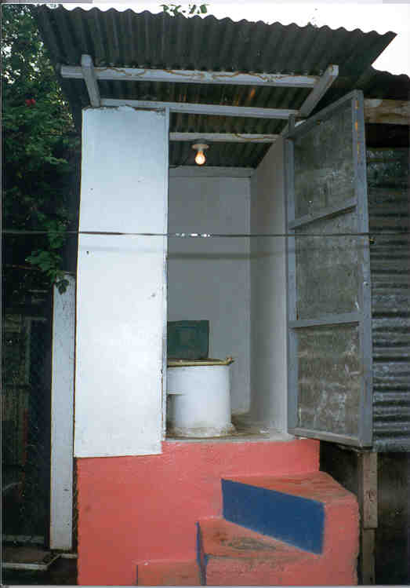
Does Improved Sanitation Reduce Diarrheal Illness?
22% reduction in 10 studies¹
36% reduction in 11 studies²
32% reduction in 2 studies³
37% reduction using 6 studies⁴
Difficult to assess due to multiple differences between studies using 13 studies⁵
  1. Esrey et al., 1985. Bull WHO 63;757-72.
  2. Esrey et al., 1991. Bull WHO 69;609-21.
  3. Fewtrell et all., 2005. Lancet Infect Dis 5;42-52.
  4. Waddington et al., 2009. J Develop Effect 1;295-335.
  5. Clasen et al., 2010. Cochrane Reviews 2010(6): 1-30..
Notes:
Drinking Water Systems
Aging infrastructure:
-Plants, distribution systems, source water protection, water development
-> 1 trillion estimate cost
- CSO’s, SSO’s
Private wells:
-Serve over 42 million people
-Prone to poor construction, operation, maintenance, water quality
-WA 2003: most small systems had > 1 system deficiencies that posed a potential public health hazard
-AL 2005: 40% of private wells failed bacteriologic testing
-MI: more private wells than any other state (1.12 million)
-Aging water distribution systems
-Most systems in U.S. long overdue for replacement
-1000’s of annual “water” advisories
-Leaks, breaks, low pressure events open systems to contamination and health effects
Building systems
-Aging water distribution systems
-Most systems in U.S. long overdue for replacement
-1000’s of annual “water” advisories
-Leaks, breaks, low pressure events open systems to contamination and health effects
Cooling=Aerosolization of Legionella
GWASH
Enteric disease: household water treatment (point of use treatment, safe storage vessels); small piped systems, boreholes; larger systems (crumbling infrastructure, degradation of source water with industrialization);
NTDs: integration of water, sanitation, hygiene
Climate change
-Floods=Sewer overflows, groundwater contamination, infrastructure failures
-Droughts=groundwater contamination, saltwater intrusion, re-use of wastewater, groundwater recharge
-Increasing water temps=enhanced growth of Naegleria, Vibrio, Pseudomonas, harmful algal blooms, indicators

Slide 13
What is the Economic Impact of Inadequate Sanitation?
New report from World Bank documents losses to the Indian economy related to inadequate sanitation¹
US $53 billion or 6.4% of GNP (2006)
  US $38.5 billion from premature deaths, health effects
  US $10.7 from time lost seeking access to sanitation
  US $4.2 billion for drinking water-related impacts
1. Water and Sanitation Program, World Bank 2010. Available at http://www.wsp.org/wsp/sites/wsp.org/files/publications/wsp-esi-india.pdf
Notes:
Drinking Water Systems
Aging infrastructure:
-Plants, distribution systems, source water protection, water development
-> 1 trillion estimate cost
- CSO’s, SSO’s
Private wells:
-Serve over 42 million people
-Prone to poor construction, operation, maintenance, water quality
-WA 2003: most small systems had > 1 system deficiencies that posed a potential public health hazard
-AL 2005: 40% of private wells failed bacteriologic testing
-MI: more private wells than any other state (1.12 million)
-Aging water distribution systems
-Most systems in U.S. long overdue for replacement
-1000’s of annual “water” advisories
-Leaks, breaks, low pressure events open systems to contamination and health effects
Building systems
-Aging water distribution systems
-Most systems in U.S. long overdue for replacement
-1000’s of annual “water” advisories
-Leaks, breaks, low pressure events open systems to contamination and health effects
Cooling=Aerosolization of Legionella
GWASH
Enteric disease: household water treatment (point of use treatment, safe storage vessels); small piped systems, boreholes; larger systems (crumbling infrastructure, degradation of source water with industrialization);
NTDs: integration of water, sanitation, hygiene
Climate change
-Floods=Sewer overflows, groundwater contamination, infrastructure failures
-Droughts=groundwater contamination, saltwater intrusion, re-use of wastewater, groundwater recharge
-Increasing water temps=enhanced growth of Naegleria, Vibrio, Pseudomonas, harmful algal blooms, indicators

Slide 14
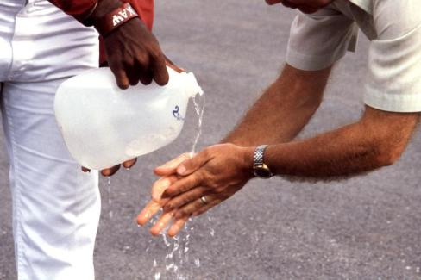
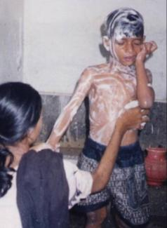
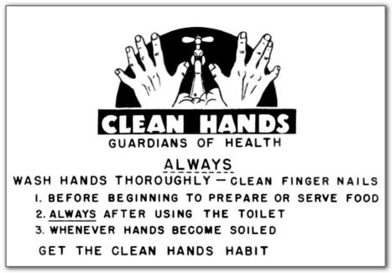
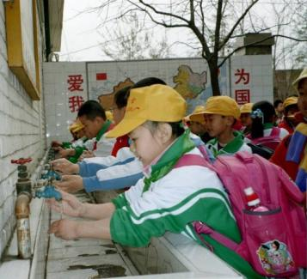
Enhanced Handwashing and Hygiene

Slide 15
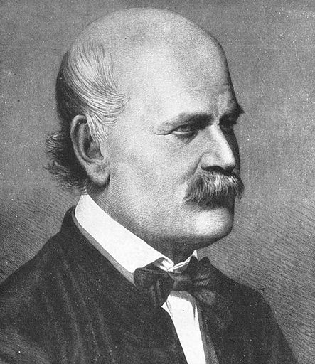
Ignaz Semmelweis
1818- 1865
Puerperal fever at Vienna
Lying-In Hospital
  Midwife ward mortality 2%
  Medical student ward
  mortality 13%
Intervention 1847
  Medical students required to wash hands thoroughly with chlorinated lime after autopsies
  Proportion of puerperal fever in student ward dropped to 2.4%
Conclusion
  Handwashing saves lives
Notes:
Drinking Water Systems
Aging infrastructure:
-Plants, distribution systems, source water protection, water development
-> 1 trillion estimate cost
- CSO’s, SSO’s
Private wells:
-Serve over 42 million people
-Prone to poor construction, operation, maintenance, water quality
-WA 2003: most small systems had > 1 system deficiencies that posed a potential public health hazard
-AL 2005: 40% of private wells failed bacteriologic testing
-MI: more private wells than any other state (1.12 million)
-Aging water distribution systems
-Most systems in U.S. long overdue for replacement
-1000’s of annual “water” advisories
-Leaks, breaks, low pressure events open systems to contamination and health effects
Building systems
-Aging water distribution systems
-Most systems in U.S. long overdue for replacement
-1000’s of annual “water” advisories
-Leaks, breaks, low pressure events open systems to contamination and health effects
Cooling=Aerosolization of Legionella
GWASH
Enteric disease: household water treatment (point of use treatment, safe storage vessels); small piped systems, boreholes; larger systems (crumbling infrastructure, degradation of source water with industrialization);
NTDs: integration of water, sanitation, hygiene
Climate change
-Floods=Sewer overflows, groundwater contamination, infrastructure failures
-Droughts=groundwater contamination, saltwater intrusion, re-use of wastewater, groundwater recharge
-Increasing water temps=enhanced growth of Naegleria, Vibrio, Pseudomonas, harmful algal blooms, indicators

Slide 16
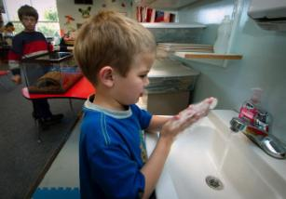
Comparing Handwashing Studies from Around the Globe
Institution-based (schools, child care centers)
  39% reduction in diarrheal episodes
Community-based (still all children)
  32% reduction in diarrheal episodes
Immunosuppressed
  58% reduction in diarrheal episodes (2.9-1.2 episodes)
High income
  39% reduction in diarrheal episodes in children in institutions
Middle to low income
  32% reduction in diarrheal episodes in children living in communities
  Ejemot et. al. 2008. Cochrane Library 2009(3) (14 studies)
Notes:
Drinking Water Systems
Aging infrastructure:
-Plants, distribution systems, source water protection, water development
-> 1 trillion estimate cost
- CSO’s, SSO’s
Private wells:
-Serve over 42 million people
-Prone to poor construction, operation, maintenance, water quality
-WA 2003: most small systems had > 1 system deficiencies that posed a potential public health hazard
-AL 2005: 40% of private wells failed bacteriologic testing
-MI: more private wells than any other state (1.12 million)
-Aging water distribution systems
-Most systems in U.S. long overdue for replacement
-1000’s of annual “water” advisories
-Leaks, breaks, low pressure events open systems to contamination and health effects
Building systems
-Aging water distribution systems
-Most systems in U.S. long overdue for replacement
-1000’s of annual “water” advisories
-Leaks, breaks, low pressure events open systems to contamination and health effects
Cooling=Aerosolization of Legionella
GWASH
Enteric disease: household water treatment (point of use treatment, safe storage vessels); small piped systems, boreholes; larger systems (crumbling infrastructure, degradation of source water with industrialization);
NTDs: integration of water, sanitation, hygiene
Climate change
-Floods=Sewer overflows, groundwater contamination, infrastructure failures
-Droughts=groundwater contamination, saltwater intrusion, re-use of wastewater, groundwater recharge
-Increasing water temps=enhanced growth of Naegleria, Vibrio, Pseudomonas, harmful algal blooms, indicators

Slide 17
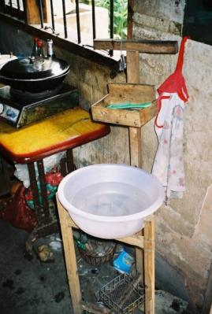
Impact of a School-Based Handwashing Promotion Program on Students and Their Households
Randomized 154 elementary schools in
Pakistan
  Control: standard practices
  Standard: an existing school handwashing promotion program ( one 90-min lesson plus student hand-outs)
  Expanded: standard school handwashing program, on-going supply of soap for school, and a student hygiene champion assigned in each class
Followed absenteeism among 1st graders and illnesses among students’ household members for 5 months
Bowen et al., 2010. Unpublished data.

Slide 18
Absence Rates by Etiology and Study Group
p=0.03
p<0.0001
p=0.01
p<0.0001
Bowen et al., 2010. Unpublished data.

Slide 19
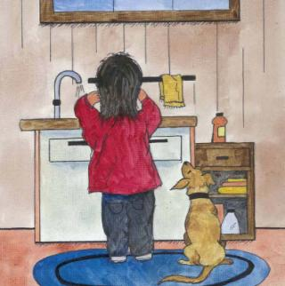
Do the Handwashing Interventions Make a Difference?
Substantial health impact
Health impact extended to student household contacts
  Novel finding
Among households, the Expanded Intervention group had a significant economic impact
  Lower rates of health care visits for illness
  Lower rates of work absenteeism among parents due to illness
Worldwide access to hand soap and peer hygiene education in schools could have broad public health and economic implications
Bowen et al., 2010. Unpublished data.

Slide 20
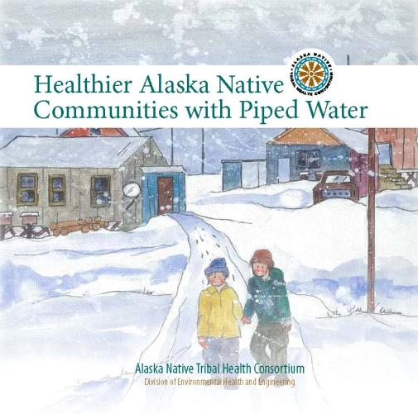
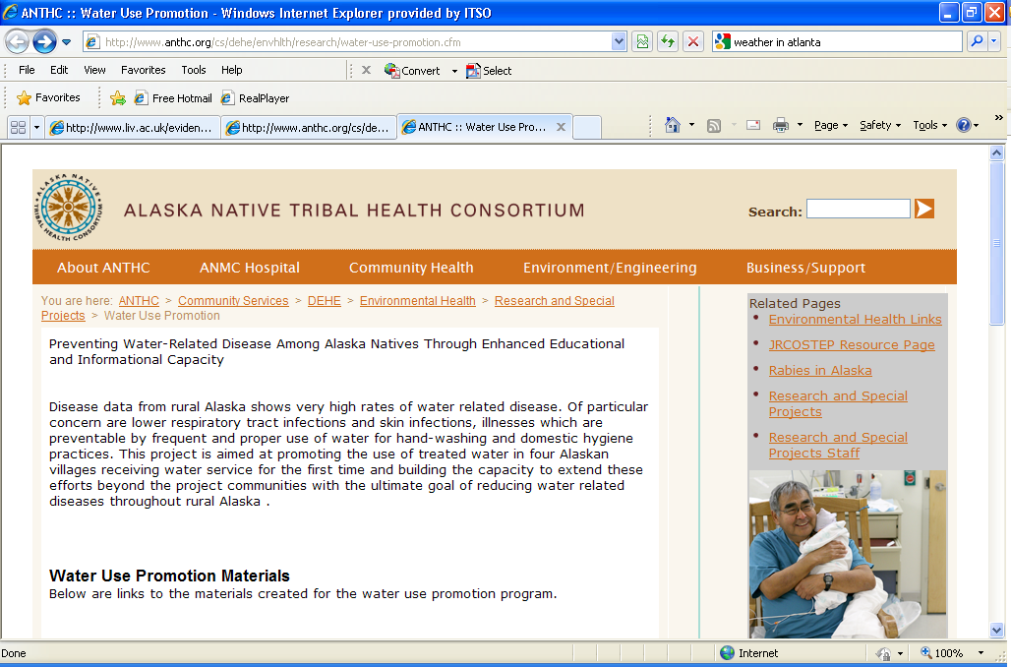
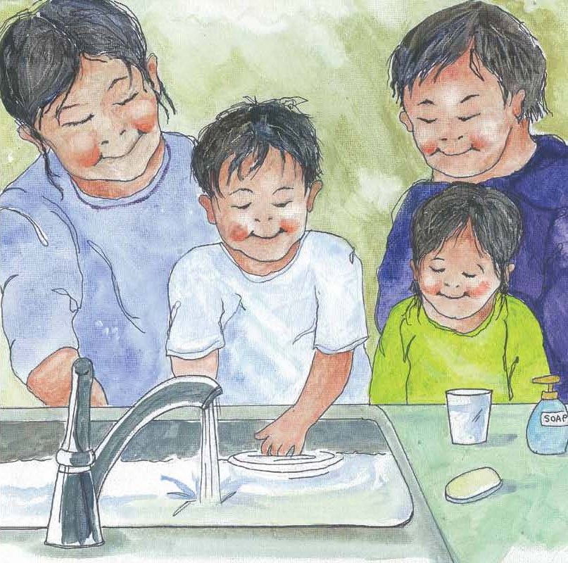
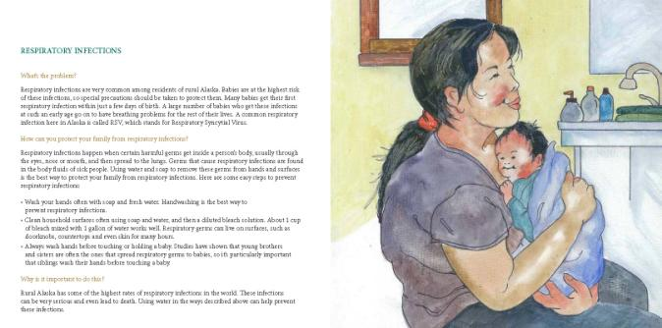
Promoting and Monitoring Behavior Change to Reduce Diarrheal Illness
http://www.anthc.org/cs/dehe/envhlth/research/water-use-promotion.cfm

Slide 21
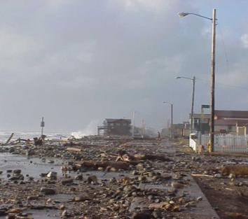
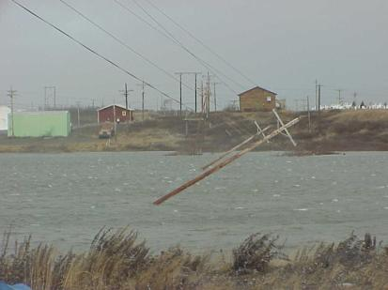
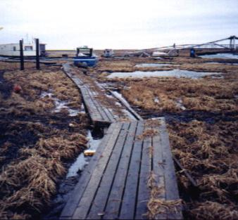
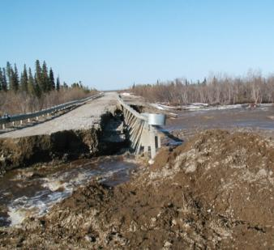
Effects of Climate Variability on Water Quality and Quantity: Future Challenges

Slide 22
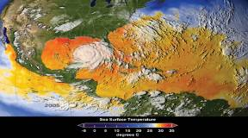
Climate Change and Water Impacts: General
Air and water temperature increases
Sea level changes
Portion of precipitation falling as snow declines
Increased or decreased water availability by region
Extreme weather events increase
  Droughts, floods, increased temperatures
Water quantity as well as water quality becomes issue
Sources: IPCC, 2007; USGCRP, 2009
Notes:
Drinking Water Systems
Aging infrastructure:
-Plants, distribution systems, source water protection, water development
-> 1 trillion estimate cost
- CSO’s, SSO’s
Private wells:
-Serve over 42 million people
-Prone to poor construction, operation, maintenance, water quality
-WA 2003: most small systems had > 1 system deficiencies that posed a potential public health hazard
-AL 2005: 40% of private wells failed bacteriologic testing
-MI: more private wells than any other state (1.12 million)
-Aging water distribution systems
-Most systems in U.S. long overdue for replacement
-1000’s of annual “water” advisories
-Leaks, breaks, low pressure events open systems to contamination and health effects
Building systems
-Aging water distribution systems
-Most systems in U.S. long overdue for replacement
-1000’s of annual “water” advisories
-Leaks, breaks, low pressure events open systems to contamination and health effects
Cooling=Aerosolization of Legionella
GWASH
Enteric disease: household water treatment (point of use treatment, safe storage vessels); small piped systems, boreholes; larger systems (crumbling infrastructure, degradation of source water with industrialization);
NTDs: integration of water, sanitation, hygiene
Climate change
-Floods=Sewer overflows, groundwater contamination, infrastructure failures
-Droughts=groundwater contamination, saltwater intrusion, re-use of wastewater, groundwater recharge
-Increasing water temps=enhanced growth of Naegleria, Vibrio, Pseudomonas, harmful algal blooms, indicators

Slide 23
Climate Change and Water Impacts: Arctic
Melting permafrost
  Stress to water and wastewater infrastructure
Storm surge
  Saline intrusion of water sources
  Flooding damage to water/wastewater systems
  Coastal erosion
Increased particulate and nutrient loads
  Surface and groundwater sources affected
  Operational issues with high turbidity and organic load; decreased efficacy of disinfection
Changes in climate sensitive pathogens such as Giardia
Notes:
Drinking Water Systems
Aging infrastructure:
-Plants, distribution systems, source water protection, water development
-> 1 trillion estimate cost
- CSO’s, SSO’s
Private wells:
-Serve over 42 million people
-Prone to poor construction, operation, maintenance, water quality
-WA 2003: most small systems had > 1 system deficiencies that posed a potential public health hazard
-AL 2005: 40% of private wells failed bacteriologic testing
-MI: more private wells than any other state (1.12 million)
-Aging water distribution systems
-Most systems in U.S. long overdue for replacement
-1000’s of annual “water” advisories
-Leaks, breaks, low pressure events open systems to contamination and health effects
Building systems
-Aging water distribution systems
-Most systems in U.S. long overdue for replacement
-1000’s of annual “water” advisories
-Leaks, breaks, low pressure events open systems to contamination and health effects
Cooling=Aerosolization of Legionella
GWASH
Enteric disease: household water treatment (point of use treatment, safe storage vessels); small piped systems, boreholes; larger systems (crumbling infrastructure, degradation of source water with industrialization);
NTDs: integration of water, sanitation, hygiene
Climate change
-Floods=Sewer overflows, groundwater contamination, infrastructure failures
-Droughts=groundwater contamination, saltwater intrusion, re-use of wastewater, groundwater recharge
-Increasing water temps=enhanced growth of Naegleria, Vibrio, Pseudomonas, harmful algal blooms, indicators

Slide 24
Climate Change, Water, and Public Health:
Building Adaptive Management Models
CDC collaboration with AWWA
Identify current and future water and public health impacts of climate change on water utilities
Collect lessons learned from water utilities dealing with the effects of climate change
16 participating utilities including three in Alaska
  Sitka, Anchorage, Barrow
Analysis of ongoing issues and anticipated issues completed for 13 utilities (Alaska not included yet)
Notes:
Drinking Water Systems
Aging infrastructure:
-Plants, distribution systems, source water protection, water development
-> 1 trillion estimate cost
- CSO’s, SSO’s
Private wells:
-Serve over 42 million people
-Prone to poor construction, operation, maintenance, water quality
-WA 2003: most small systems had > 1 system deficiencies that posed a potential public health hazard
-AL 2005: 40% of private wells failed bacteriologic testing
-MI: more private wells than any other state (1.12 million)
-Aging water distribution systems
-Most systems in U.S. long overdue for replacement
-1000’s of annual “water” advisories
-Leaks, breaks, low pressure events open systems to contamination and health effects
Building systems
-Aging water distribution systems
-Most systems in U.S. long overdue for replacement
-1000’s of annual “water” advisories
-Leaks, breaks, low pressure events open systems to contamination and health effects
Cooling=Aerosolization of Legionella
GWASH
Enteric disease: household water treatment (point of use treatment, safe storage vessels); small piped systems, boreholes; larger systems (crumbling infrastructure, degradation of source water with industrialization);
NTDs: integration of water, sanitation, hygiene
Climate change
-Floods=Sewer overflows, groundwater contamination, infrastructure failures
-Droughts=groundwater contamination, saltwater intrusion, re-use of wastewater, groundwater recharge
-Increasing water temps=enhanced growth of Naegleria, Vibrio, Pseudomonas, harmful algal blooms, indicators

Slide 25
Climate-related Impacts on Water Utilities
Water Quantity | Current (N) | Future (N)
More intense precipitation events | 7 | 7
Increased drought | 6 | 7
Climate variability | 5 | 5
Increased flooding | 3 | 6
Changes in precipitation patterns/runoff | 2 | 7
Decreased snowpack, earlier snowmelt | 2 | 3
Sea level rise | 2 | 6
N= 13 utilities; Brunkard, 2011. Unpublished data .

Slide 26
Climate-related Impacts on Water Utilities
Water Quality | Current (N) | Future (N)
Algal blooms | 3 | 8
Ecological changes | 2 | 10
Water quality changes | 2 | 10
Turbidity and treatment challenges | 2 | 5
Water age/economic downturn | 2 | 5
Increase in more extreme weather events | 1 | 6
Infrastructure challenges | 0 | 5
N= 13 utilities; Brunkard, 2011. Unpublished data .

Slide 27
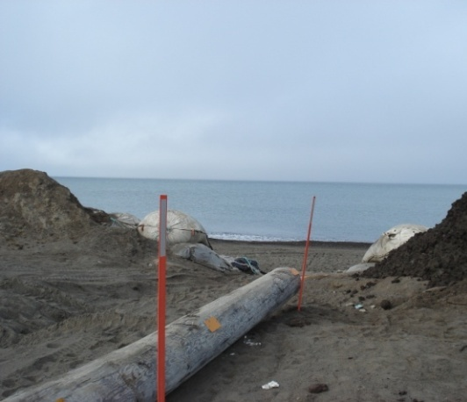
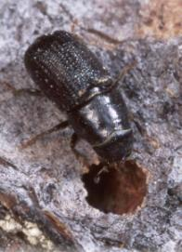
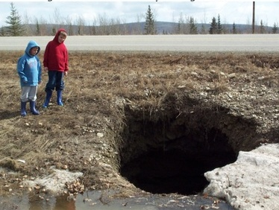
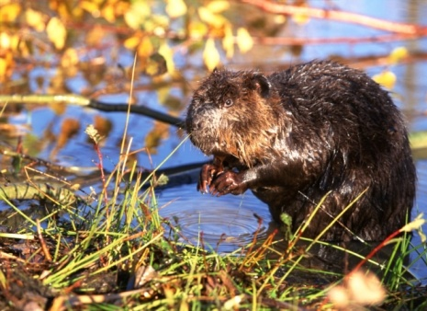
Ecologic Changes: unintended consequences

Slide 28
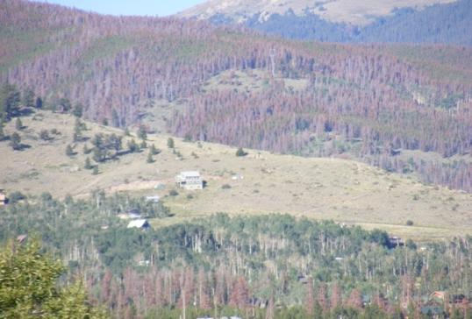
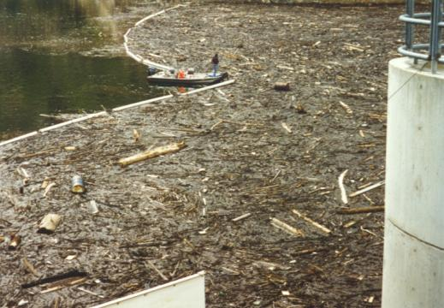
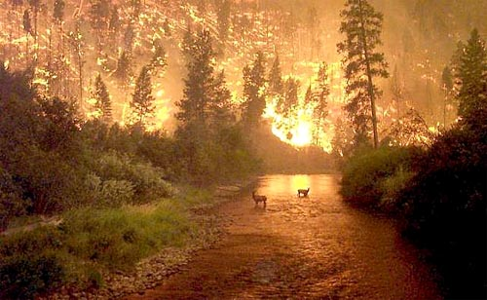
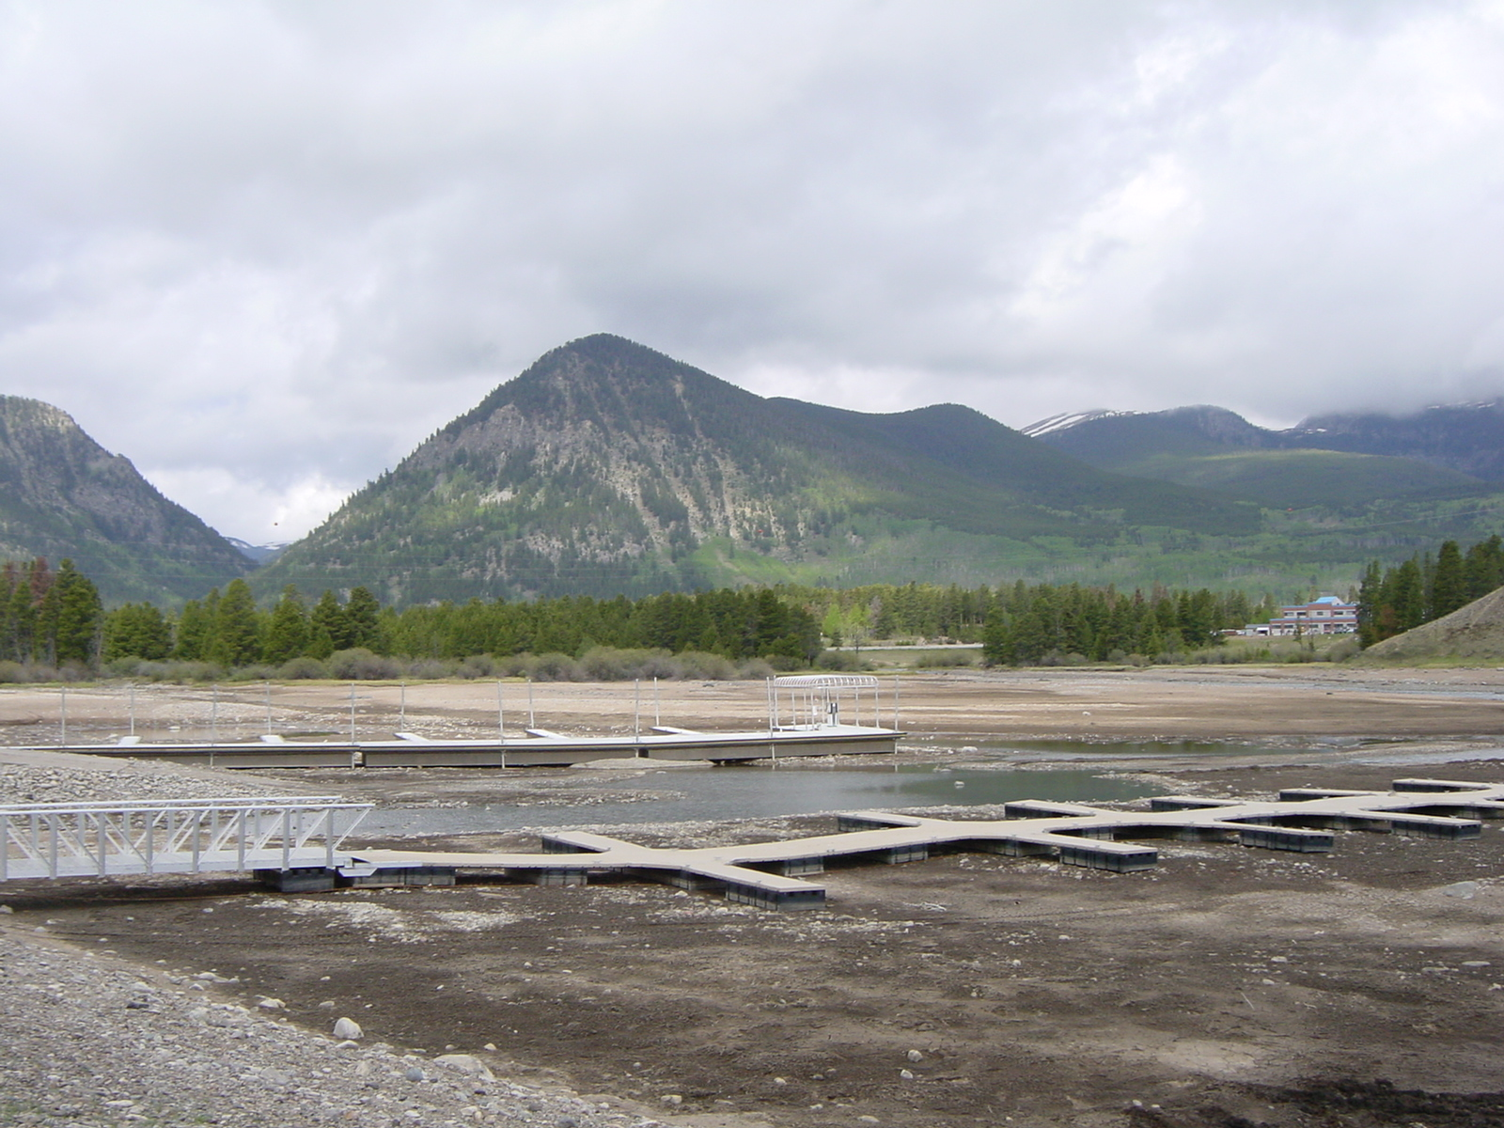
The Ecological Cascade Effect:
↑ Minimum Temp, Pine Beetle Exceeds Carrying Capacity, ↑ Forest Fires, ↑ Sediment Load in Water
Source: Marc Wagge, Denver Water

Slide 29
The Ecological Cascade Effect:
↑ Minimum Temp, Pine Beetle Exceeds Carrying Capacity, ↑ Forest Fires, ↑ Sediment Load in Water
$25,000,000
Source: Marc Wagge, Denver Water

Slide 30

Summary and Future Outlook
Strong body of data demonstrating reductions in diarrheal illness with improved WASH
  Both water quality and quantity important
  Role for point-of-use treatment and improved storage?
Data also demonstrates collateral benefits with reduced respiratory illness and skin infections
Water provision & infrastructure issues require complementary hygiene-related behavioral changes
Climate change is wild card due to increasing stress on source water quality and infrastructure
Need improved monitoring and evaluation of changes
  What does water testing in Alaska show now?
Notes:
Drinking Water Systems
Aging infrastructure:
-Plants, distribution systems, source water protection, water development
-> 1 trillion estimate cost
- CSO’s, SSO’s
Private wells:
-Serve over 42 million people
-Prone to poor construction, operation, maintenance, water quality
-WA 2003: most small systems had > 1 system deficiencies that posed a potential public health hazard
-AL 2005: 40% of private wells failed bacteriologic testing
-MI: more private wells than any other state (1.12 million)
-Aging water distribution systems
-Most systems in U.S. long overdue for replacement
-1000’s of annual “water” advisories
-Leaks, breaks, low pressure events open systems to contamination and health effects
Building systems
-Aging water distribution systems
-Most systems in U.S. long overdue for replacement
-1000’s of annual “water” advisories
-Leaks, breaks, low pressure events open systems to contamination and health effects
Cooling=Aerosolization of Legionella
GWASH
Enteric disease: household water treatment (point of use treatment, safe storage vessels); small piped systems, boreholes; larger systems (crumbling infrastructure, degradation of source water with industrialization);
NTDs: integration of water, sanitation, hygiene
Climate change
-Floods=Sewer overflows, groundwater contamination, infrastructure failures
-Droughts=groundwater contamination, saltwater intrusion, re-use of wastewater, groundwater recharge
-Increasing water temps=enhanced growth of Naegleria, Vibrio, Pseudomonas, harmful algal blooms, indicators

Slide 31
Acknowledgements
Waterborne Disease Prevention Branch
  Anna Bowen
  Joan Brunkard
  Julia Gargano
  Amy Freeland
NCEH/EHSB
  Mark Miller
  Charles Otto
"The findings and conclusions in this presentation have not been formally disseminated by CDC and should not be construed to represent any agency determination or policy“

Slide 32
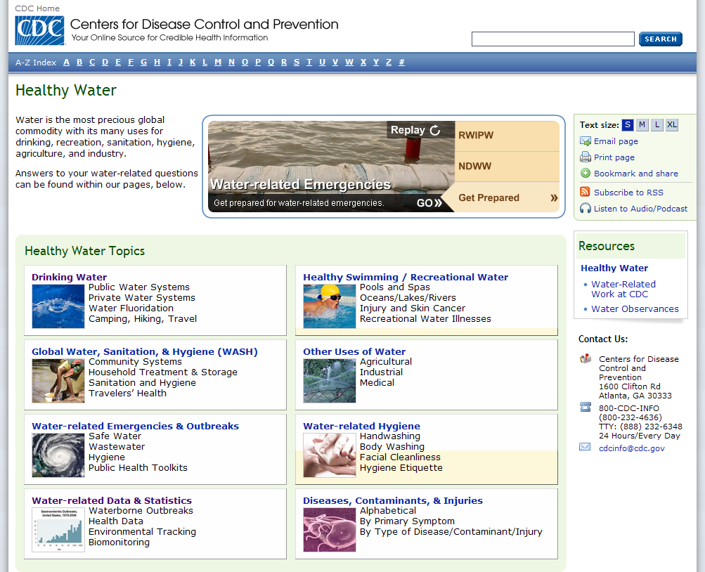
Questions?
More Information: Healthy Water Website www.cdc.gov/healthywater
National Center for Emerging and Zoonotic Infectious Diseases
Division of Foodborne, Waterborne, and Environmental Diseases

Slide 33
Does Safe Water Reduce the Risk of Diarrhea Globally?
1991¹
  15-17% reduction for improved water quality in 16 studies
  20-27% reduction for water quantity in 15 studies
2009²
  55% reduction for all ages
    RR 0.45, 95% CI 0.33 to 0.62 in 7 studies
  46% reduction in children <5 y.o.
    RR 0.54, 95% CI 0.43-0.69 in 5 trials
Why the difference?
1. Esrey et al., 1991. Bull WHO 69:609-621.
2. Clasen et al., 2009. Cochrane Library 2009(1);1-115.
Notes:
Drinking Water Systems
Aging infrastructure:
-Plants, distribution systems, source water protection, water development
-> 1 trillion estimate cost
- CSO’s, SSO’s
Private wells:
-Serve over 42 million people
-Prone to poor construction, operation, maintenance, water quality
-WA 2003: most small systems had > 1 system deficiencies that posed a potential public health hazard
-AL 2005: 40% of private wells failed bacteriologic testing
-MI: more private wells than any other state (1.12 million)
-Aging water distribution systems
-Most systems in U.S. long overdue for replacement
-1000’s of annual “water” advisories
-Leaks, breaks, low pressure events open systems to contamination and health effects
Building systems
-Aging water distribution systems
-Most systems in U.S. long overdue for replacement
-1000’s of annual “water” advisories
-Leaks, breaks, low pressure events open systems to contamination and health effects
Cooling=Aerosolization of Legionella
GWASH
Enteric disease: household water treatment (point of use treatment, safe storage vessels); small piped systems, boreholes; larger systems (crumbling infrastructure, degradation of source water with industrialization);
NTDs: integration of water, sanitation, hygiene
Climate change
-Floods=Sewer overflows, groundwater contamination, infrastructure failures
-Droughts=groundwater contamination, saltwater intrusion, re-use of wastewater, groundwater recharge
-Increasing water temps=enhanced growth of Naegleria, Vibrio, Pseudomonas, harmful algal blooms, indicators

Slide 34
Does Site or Type of Water Treatment Reduce Diarrheal Illness?
27% reduction: source or household treatment:
  RR 0.73 [ 0.63, 0.85]
13% reduction: source treatment
  RR 0.87 [ 0.74, 1.02]
44% reduction: household treatment
  RR 0.56 [ 0.42, 0.74]
39% reduction: household chlorination
  RR 0.61 [ 0.46, 0.81]
63% reduction: household filtration
  RR 0.37 [ 0.15, 0.92]
39% reduction: household storage
  RR 0.79 [ 0.61, 1.03]
  Clasen et al., 2010. Cochrane database of systematic reviews 2009(1);1-115.
Notes:
Drinking Water Systems
Aging infrastructure:
-Plants, distribution systems, source water protection, water development
-> 1 trillion estimate cost
- CSO’s, SSO’s
Private wells:
-Serve over 42 million people
-Prone to poor construction, operation, maintenance, water quality
-WA 2003: most small systems had > 1 system deficiencies that posed a potential public health hazard
-AL 2005: 40% of private wells failed bacteriologic testing
-MI: more private wells than any other state (1.12 million)
-Aging water distribution systems
-Most systems in U.S. long overdue for replacement
-1000’s of annual “water” advisories
-Leaks, breaks, low pressure events open systems to contamination and health effects
Building systems
-Aging water distribution systems
-Most systems in U.S. long overdue for replacement
-1000’s of annual “water” advisories
-Leaks, breaks, low pressure events open systems to contamination and health effects
Cooling=Aerosolization of Legionella
GWASH
Enteric disease: household water treatment (point of use treatment, safe storage vessels); small piped systems, boreholes; larger systems (crumbling infrastructure, degradation of source water with industrialization);
NTDs: integration of water, sanitation, hygiene
Climate change
-Floods=Sewer overflows, groundwater contamination, infrastructure failures
-Droughts=groundwater contamination, saltwater intrusion, re-use of wastewater, groundwater recharge
-Increasing water temps=enhanced growth of Naegleria, Vibrio, Pseudomonas, harmful algal blooms, indicators

Slide 35
The Converse: What Happens When We Lose Water Service?
Alabama, Winter 2010
  Extended freeze left ~18,000 residents without water service for up to 12 days
Comparing diarrhea in residents w/o water service to those with service
  Lost water for > 7 days; odds 2.4X more (95% CI 1/.1-5.2)
  Lost water pressure for > 7 days; odds 3.5X more (95% CI 1.4-8.9)
    Dose dependence correlated to length
    of time with water or pressure loss
  Drank non-recommended water: odds 3.7X more (95% CI 1.8-7.5)
Gargano J, Freeland A, Miller M, Brunkard J. et al., CDC Epi-Aid Report 2010-039.
Notes:
Drinking Water Systems
Aging infrastructure:
-Plants, distribution systems, source water protection, water development
-> 1 trillion estimate cost
- CSO’s, SSO’s
Private wells:
-Serve over 42 million people
-Prone to poor construction, operation, maintenance, water quality
-WA 2003: most small systems had > 1 system deficiencies that posed a potential public health hazard
-AL 2005: 40% of private wells failed bacteriologic testing
-MI: more private wells than any other state (1.12 million)
-Aging water distribution systems
-Most systems in U.S. long overdue for replacement
-1000’s of annual “water” advisories
-Leaks, breaks, low pressure events open systems to contamination and health effects
Building systems
-Aging water distribution systems
-Most systems in U.S. long overdue for replacement
-1000’s of annual “water” advisories
-Leaks, breaks, low pressure events open systems to contamination and health effects
Cooling=Aerosolization of Legionella
GWASH
Enteric disease: household water treatment (point of use treatment, safe storage vessels); small piped systems, boreholes; larger systems (crumbling infrastructure, degradation of source water with industrialization);
NTDs: integration of water, sanitation, hygiene
Climate change
-Floods=Sewer overflows, groundwater contamination, infrastructure failures
-Droughts=groundwater contamination, saltwater intrusion, re-use of wastewater, groundwater recharge
-Increasing water temps=enhanced growth of Naegleria, Vibrio, Pseudomonas, harmful algal blooms, indicators

Slide 36
Does Improved Sanitation Reduce Diarrheal Illness?
22% reduction in 10 studies¹
36% reduction in 11 studies²
32% reduction in 2 studies³
  (95% CI 0.53-0.87)
37% reduction using 6 studies⁴
  (95% CI 0.43-0.93)
Difficult to assess due to multiple differences between studies using 13 studies⁵
  1. Esrey et al., 1985. Bull WHO 63;757-72.
  2. Esrey et al., 1991. Bull WHO 69;609-21.
  3. Fewtrell et all., 2005. Lancet Infect Dis 5;42-52.
  4. Waddington et al., 2009. J Develop Effect 1;295-335.
  5. Clasen et al., 2010. Cochrane Reviews 2010(6): 1-30..
Notes:
Drinking Water Systems
Aging infrastructure:
-Plants, distribution systems, source water protection, water development
-> 1 trillion estimate cost
- CSO’s, SSO’s
Private wells:
-Serve over 42 million people
-Prone to poor construction, operation, maintenance, water quality
-WA 2003: most small systems had > 1 system deficiencies that posed a potential public health hazard
-AL 2005: 40% of private wells failed bacteriologic testing
-MI: more private wells than any other state (1.12 million)
-Aging water distribution systems
-Most systems in U.S. long overdue for replacement
-1000’s of annual “water” advisories
-Leaks, breaks, low pressure events open systems to contamination and health effects
Building systems
-Aging water distribution systems
-Most systems in U.S. long overdue for replacement
-1000’s of annual “water” advisories
-Leaks, breaks, low pressure events open systems to contamination and health effects
Cooling=Aerosolization of Legionella
GWASH
Enteric disease: household water treatment (point of use treatment, safe storage vessels); small piped systems, boreholes; larger systems (crumbling infrastructure, degradation of source water with industrialization);
NTDs: integration of water, sanitation, hygiene
Climate change
-Floods=Sewer overflows, groundwater contamination, infrastructure failures
-Droughts=groundwater contamination, saltwater intrusion, re-use of wastewater, groundwater recharge
-Increasing water temps=enhanced growth of Naegleria, Vibrio, Pseudomonas, harmful algal blooms, indicators

Slide 37
Comparing Handwashing Studies from Around the Globe
Institution-based (schools, child care centers)
  39% reduction in diarrheal episodes (IRR 0.61, 95% CI 0.40-0.92)
Community-based (still all children)
  32% reduction in diarrheal episodes (IRR 0.68, 95% CI 0.52-0.90)
Immunosuppressed
  58% reduction in diarrheal episodes (2.92 to 1.24 episodes; 95% CI 1.93-1.43)
High income
  39% reduction in diarrheal episodes in children in institutions (IRR 0.61, 95% CI 0.40 to 0.92)
Middle to low income
  32% reduction in diarrheal episodes in children living in communities (IRR 0.68, 95% CI 0.52 to 0.90; 4 trials)
  Ejemot et. al. 2008. Cochrane Library 2009(3) (14 studies)
Notes:
Drinking Water Systems
Aging infrastructure:
-Plants, distribution systems, source water protection, water development
-> 1 trillion estimate cost
- CSO’s, SSO’s
Private wells:
-Serve over 42 million people
-Prone to poor construction, operation, maintenance, water quality
-WA 2003: most small systems had > 1 system deficiencies that posed a potential public health hazard
-AL 2005: 40% of private wells failed bacteriologic testing
-MI: more private wells than any other state (1.12 million)
-Aging water distribution systems
-Most systems in U.S. long overdue for replacement
-1000’s of annual “water” advisories
-Leaks, breaks, low pressure events open systems to contamination and health effects
Building systems
-Aging water distribution systems
-Most systems in U.S. long overdue for replacement
-1000’s of annual “water” advisories
-Leaks, breaks, low pressure events open systems to contamination and health effects
Cooling=Aerosolization of Legionella
GWASH
Enteric disease: household water treatment (point of use treatment, safe storage vessels); small piped systems, boreholes; larger systems (crumbling infrastructure, degradation of source water with industrialization);
NTDs: integration of water, sanitation, hygiene
Climate change
-Floods=Sewer overflows, groundwater contamination, infrastructure failures
-Droughts=groundwater contamination, saltwater intrusion, re-use of wastewater, groundwater recharge
-Increasing water temps=enhanced growth of Naegleria, Vibrio, Pseudomonas, harmful algal blooms, indicators

Slide 38
Parental Missed Work due to Illness
median = 1.5
median = 1.7
median = 0.8
p = 0.01
Control
Standard intervention
Expanded intervention

Slide 39
Health Care Visits due to Illness
median = 8.9
median = 7.8
median = 6.8
p = 0.0008
Control
Standard intervention
Expanded intervention

Slide 40
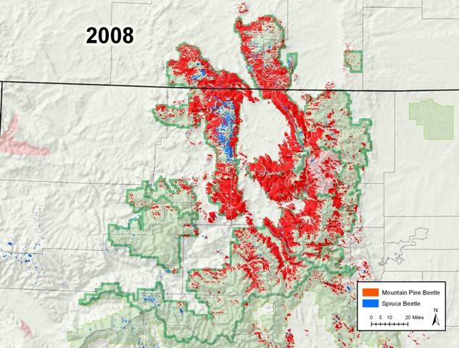
Trees Killed By Pine Beetles
Denver’s Watershed
Source: Marc Wagge, Denver Water
40

