Slide 1
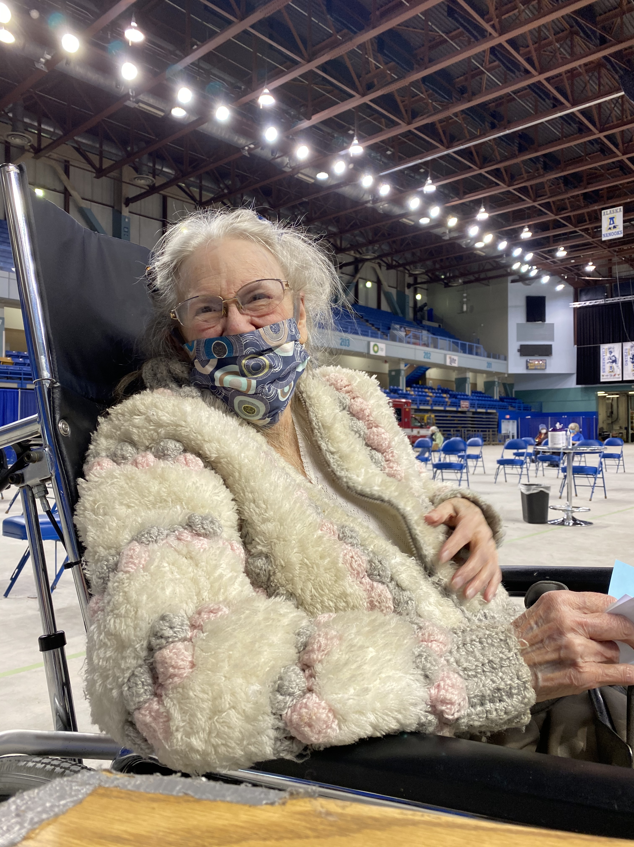

COVID-19 Update
Dr. Anne Zink, Chief Medical Officer
February 2, 2021

Slide 2
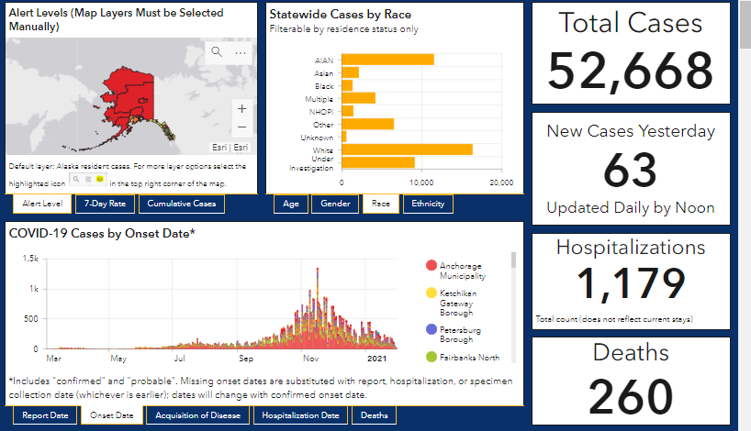
COVID-19 Data Hub
Pandemic to Date: Updated February 1, 2021
Onset Date
Notes:
Tessa

Slide 3
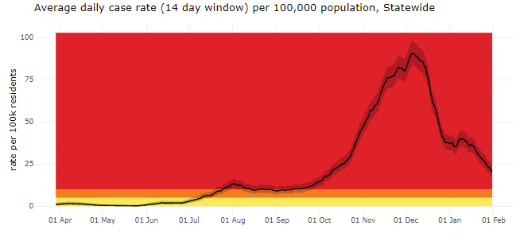
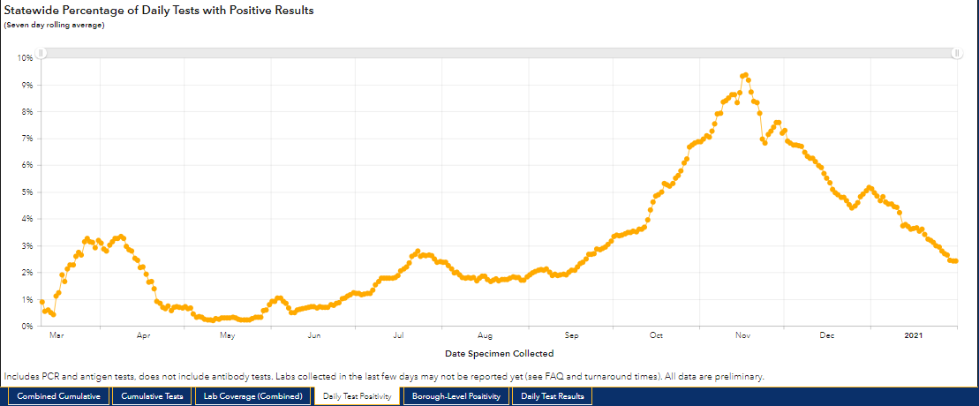
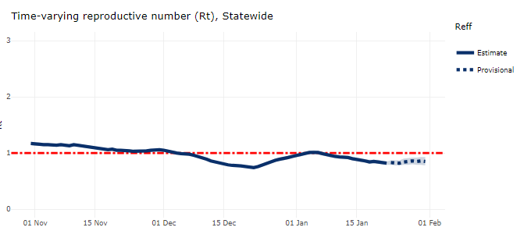
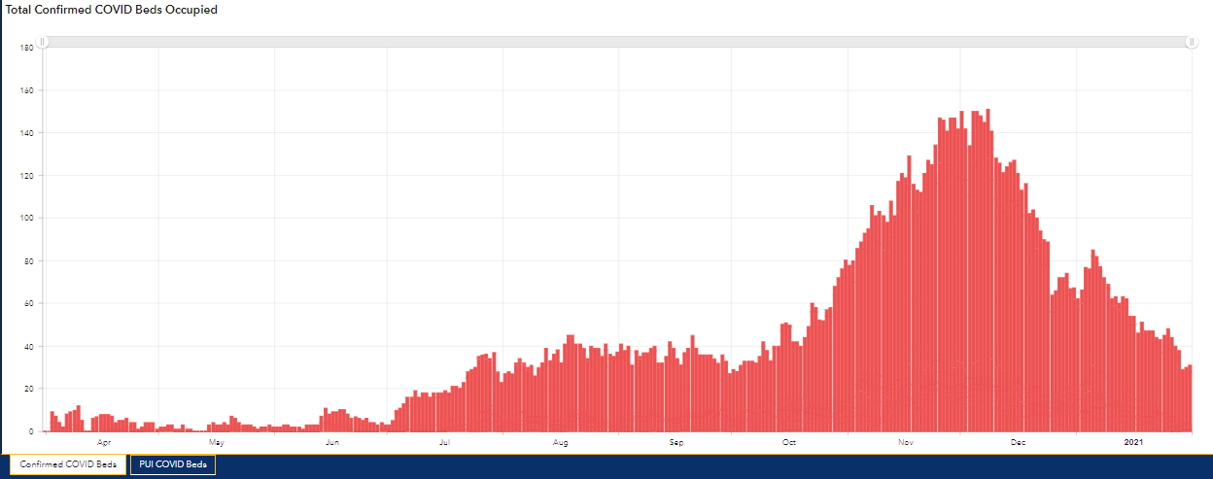
COVID-19 Data Hub
Pandemic to Date: Updated February 1, 2021
COVID-19 Data Summary
Updated 1.28.2021
High Alert Level
20.7 per 100,000 population
% Positivity: 2.42%
-Total COVID Beds Occupied
-4.9% inpatient beds occupied with COVID positive patients
Current Rt = 0.85

Slide 4
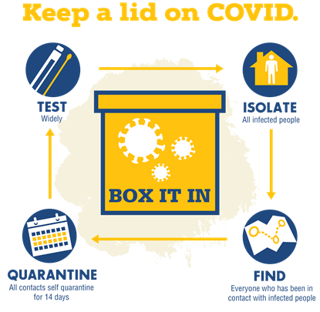
Testing and Contact Tracing
Workforce expanded to about 500 contact tracers.
Cases called the day they are entered into the database.
Average statewide of three days between testing and a call from a contact tracer.
Only about 2% decline to participate after picking up a contact tracer’s call.

Slide 5
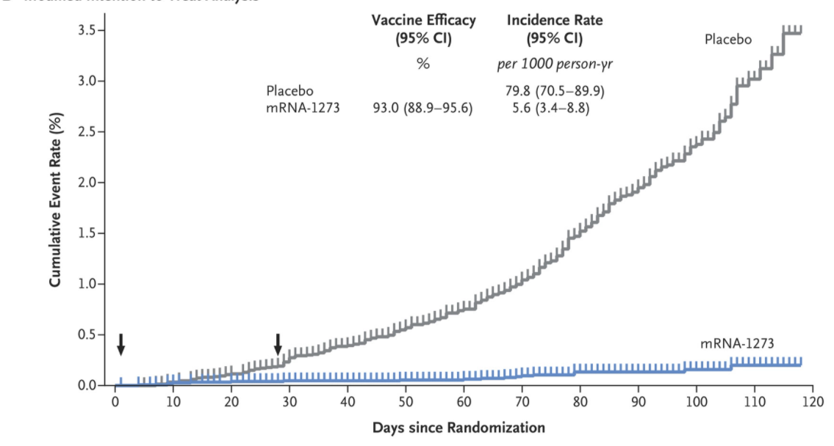
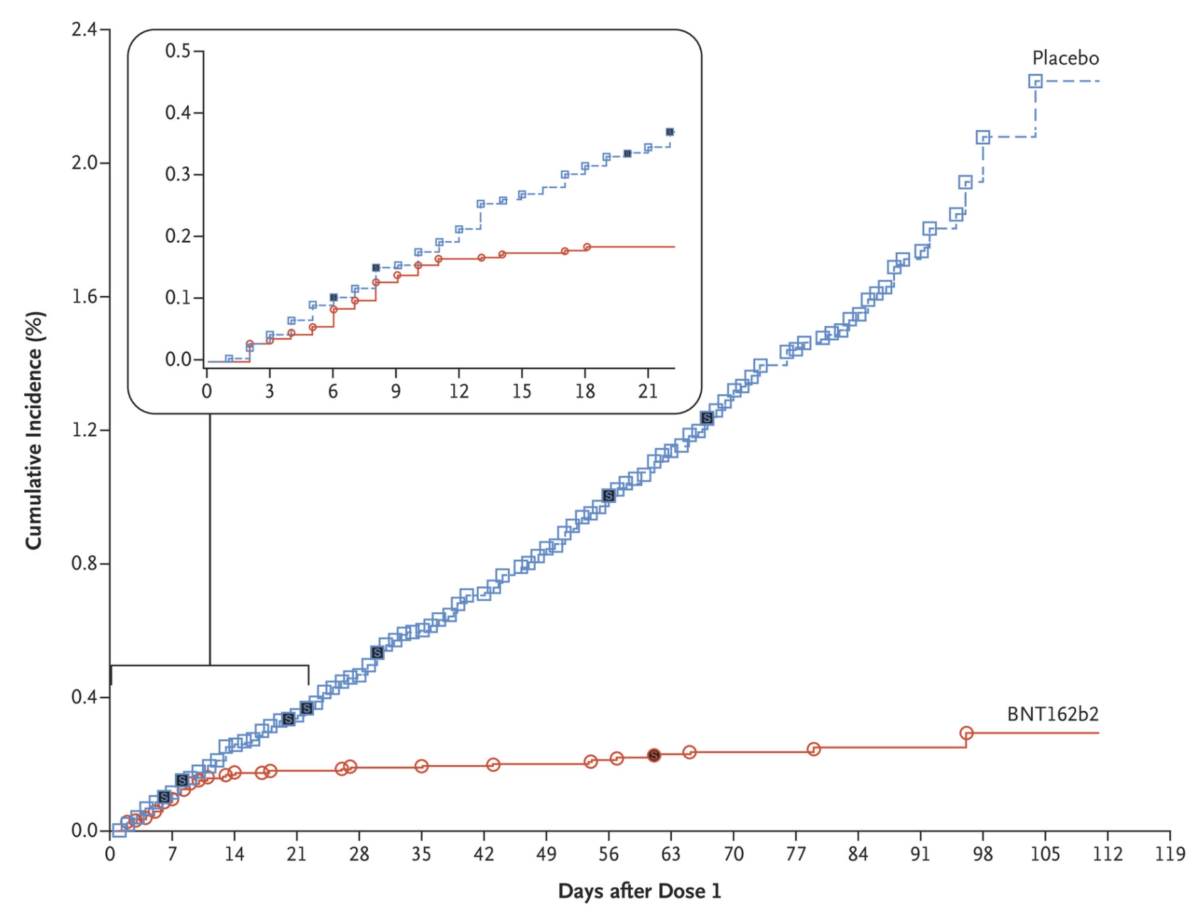
Safe and Highly Effective Vaccines
Moderna vaccine =
94.1% effective at
preventing COVID-19
Pfizer vaccine =
95% effective at
preventing COVID-19
Vaccines also protect you against severe disease. Protection against spread of transmission is still not known.
Notes:
Protection against severe COVID

Slide 6
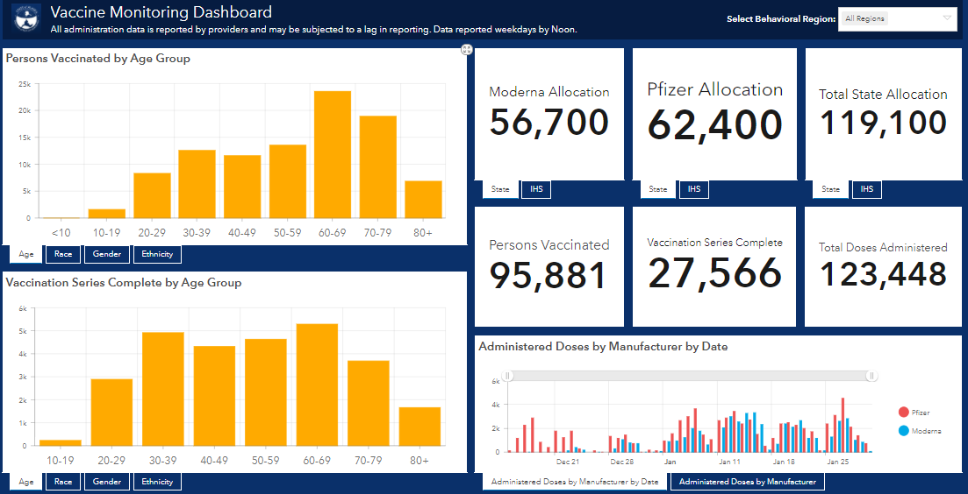

COVID-19 Vaccine Dashboard
Updated February 1, 2021
Notes:
Tessa

Slide 7
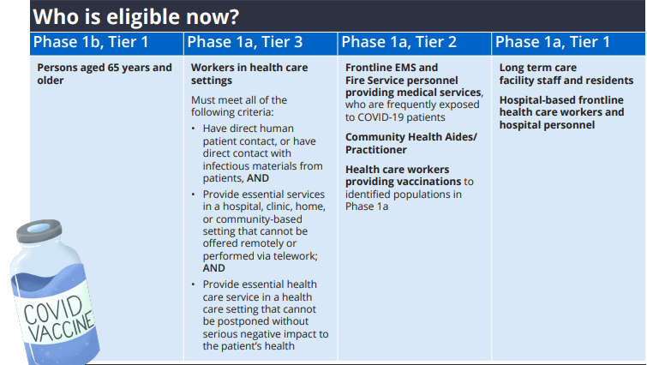
Vaccine Eligibility
Notes:
Tessa

Slide 8
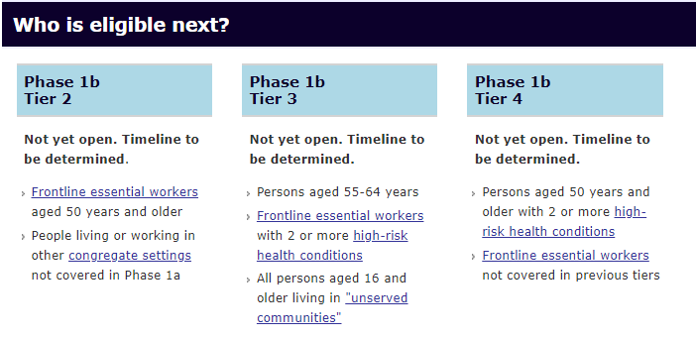
Vaccine Eligibility
Notes:
Tessa

Slide 9
Frontline Essential Workers
1. Frontline essential workers are defined as people who are working in sectors essential to the functioning of society and are at substantially higher risk of exposure to SARS-CoV-2 because their work-related duties must be performed on-site and involve being in close proximity (<6 feet) to the public or to coworkers.
Education (PreK–12 educators and school staff, childcare workers and support staff, including Indigenous language and culture educators);
First responders and public safety personnel, including state troopers, public safety officers, police, firefighters, and Office of Children’s Services staff and public health workers in direct contact with individuals and families not vaccinated in Phase 1a;
Food and agriculture (e.g., seafood, food distributors);
Grocery store workers;
Public transit workers, including rural aviation workers serving communities defined as essential air services, and rural cab service workers;
U.S. Postal Service workers and contract rural postal workers including mail planes;
Utility and power workers – rural communities; and
Water and wastewater – rural communities
Note: Rural is defined as communities with a population less than 10,000 and off the road system. The “road system” is defined as any community connected by a road to the Steese, Elliot, Dalton, Seward, Parks, Klondike, Richardson, Sterling, Glenn, Haines, or Top of the World Highways.
Notes:
Tessa

Slide 10

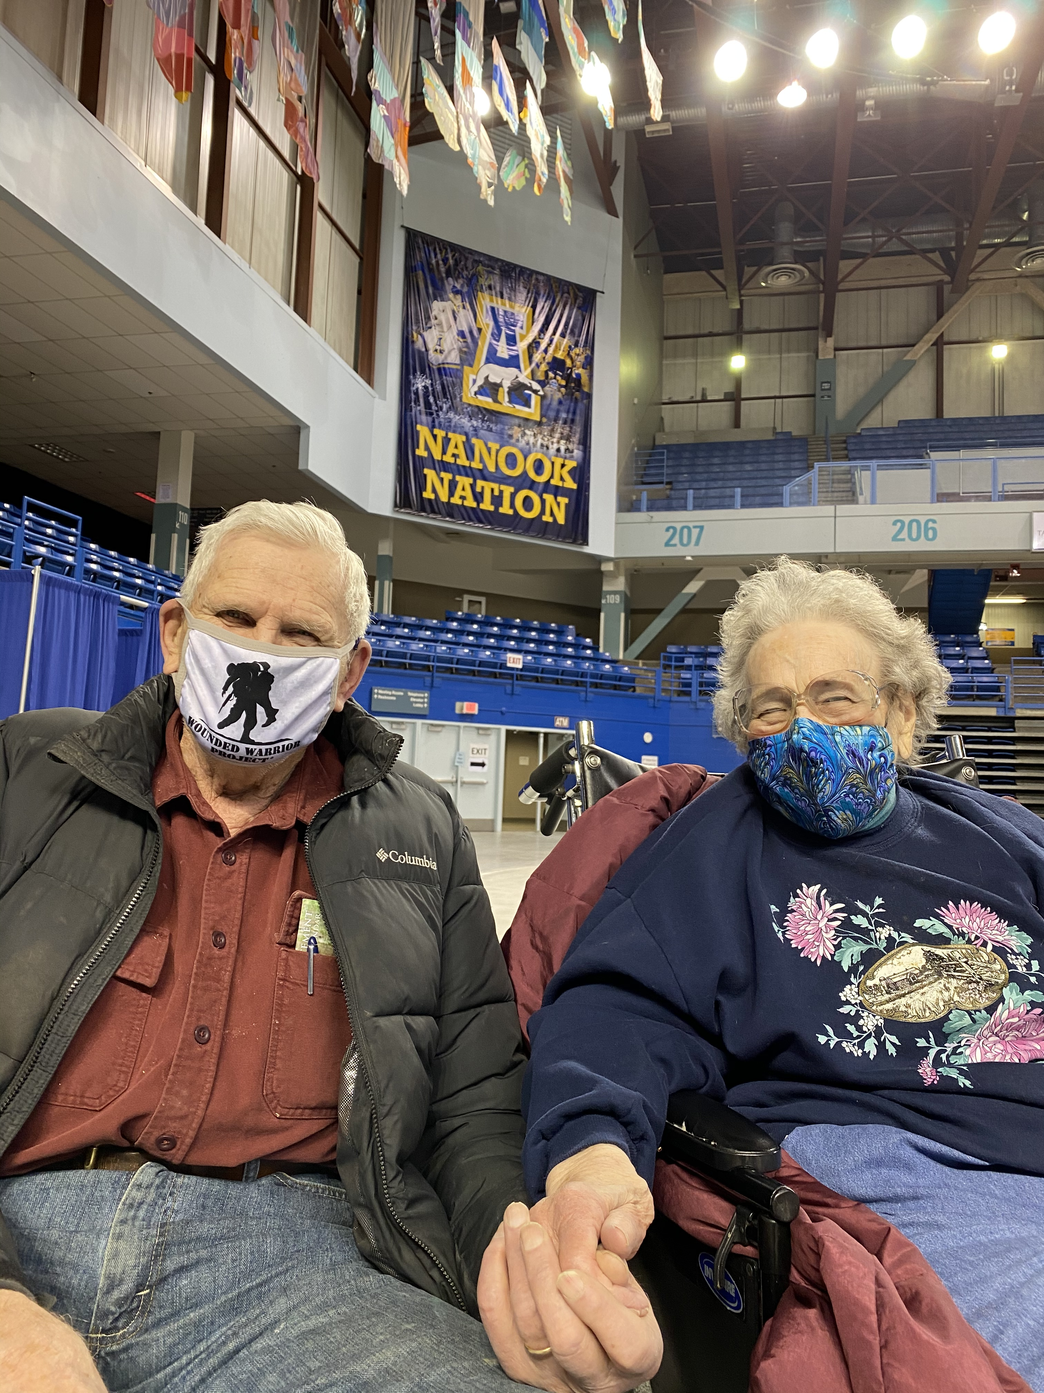
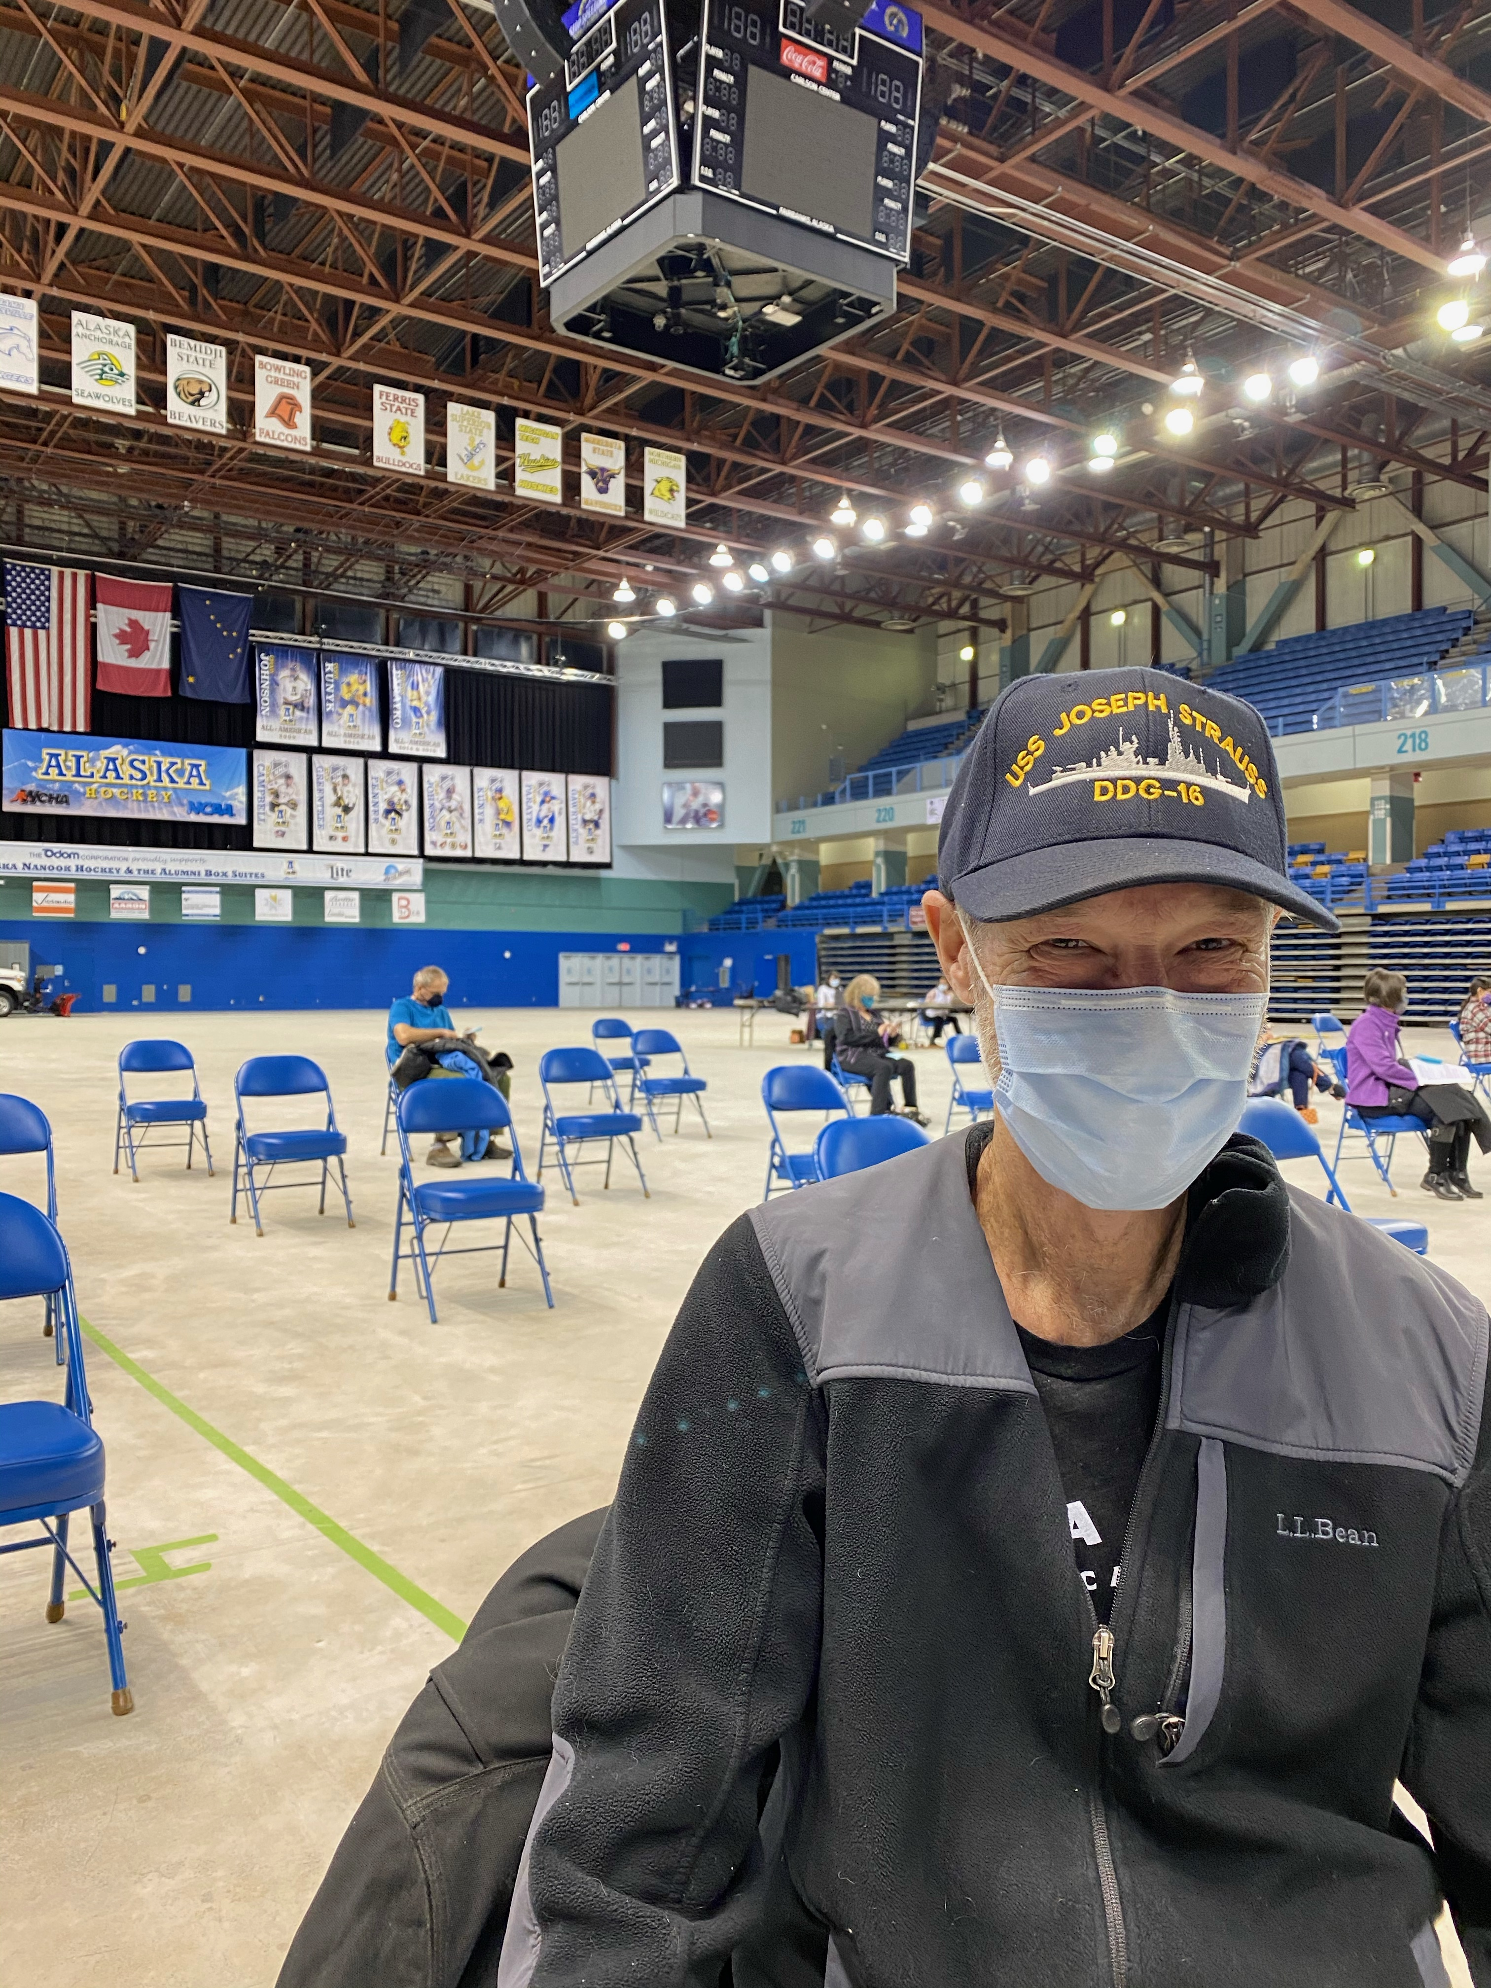
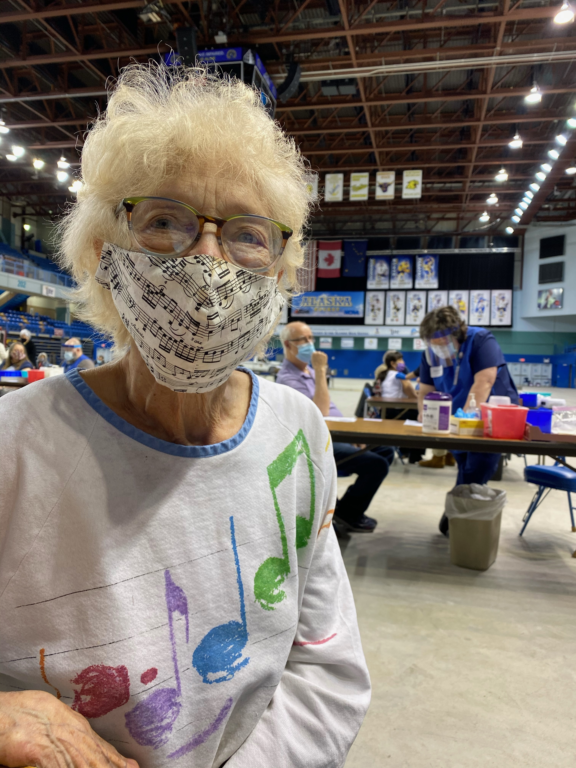
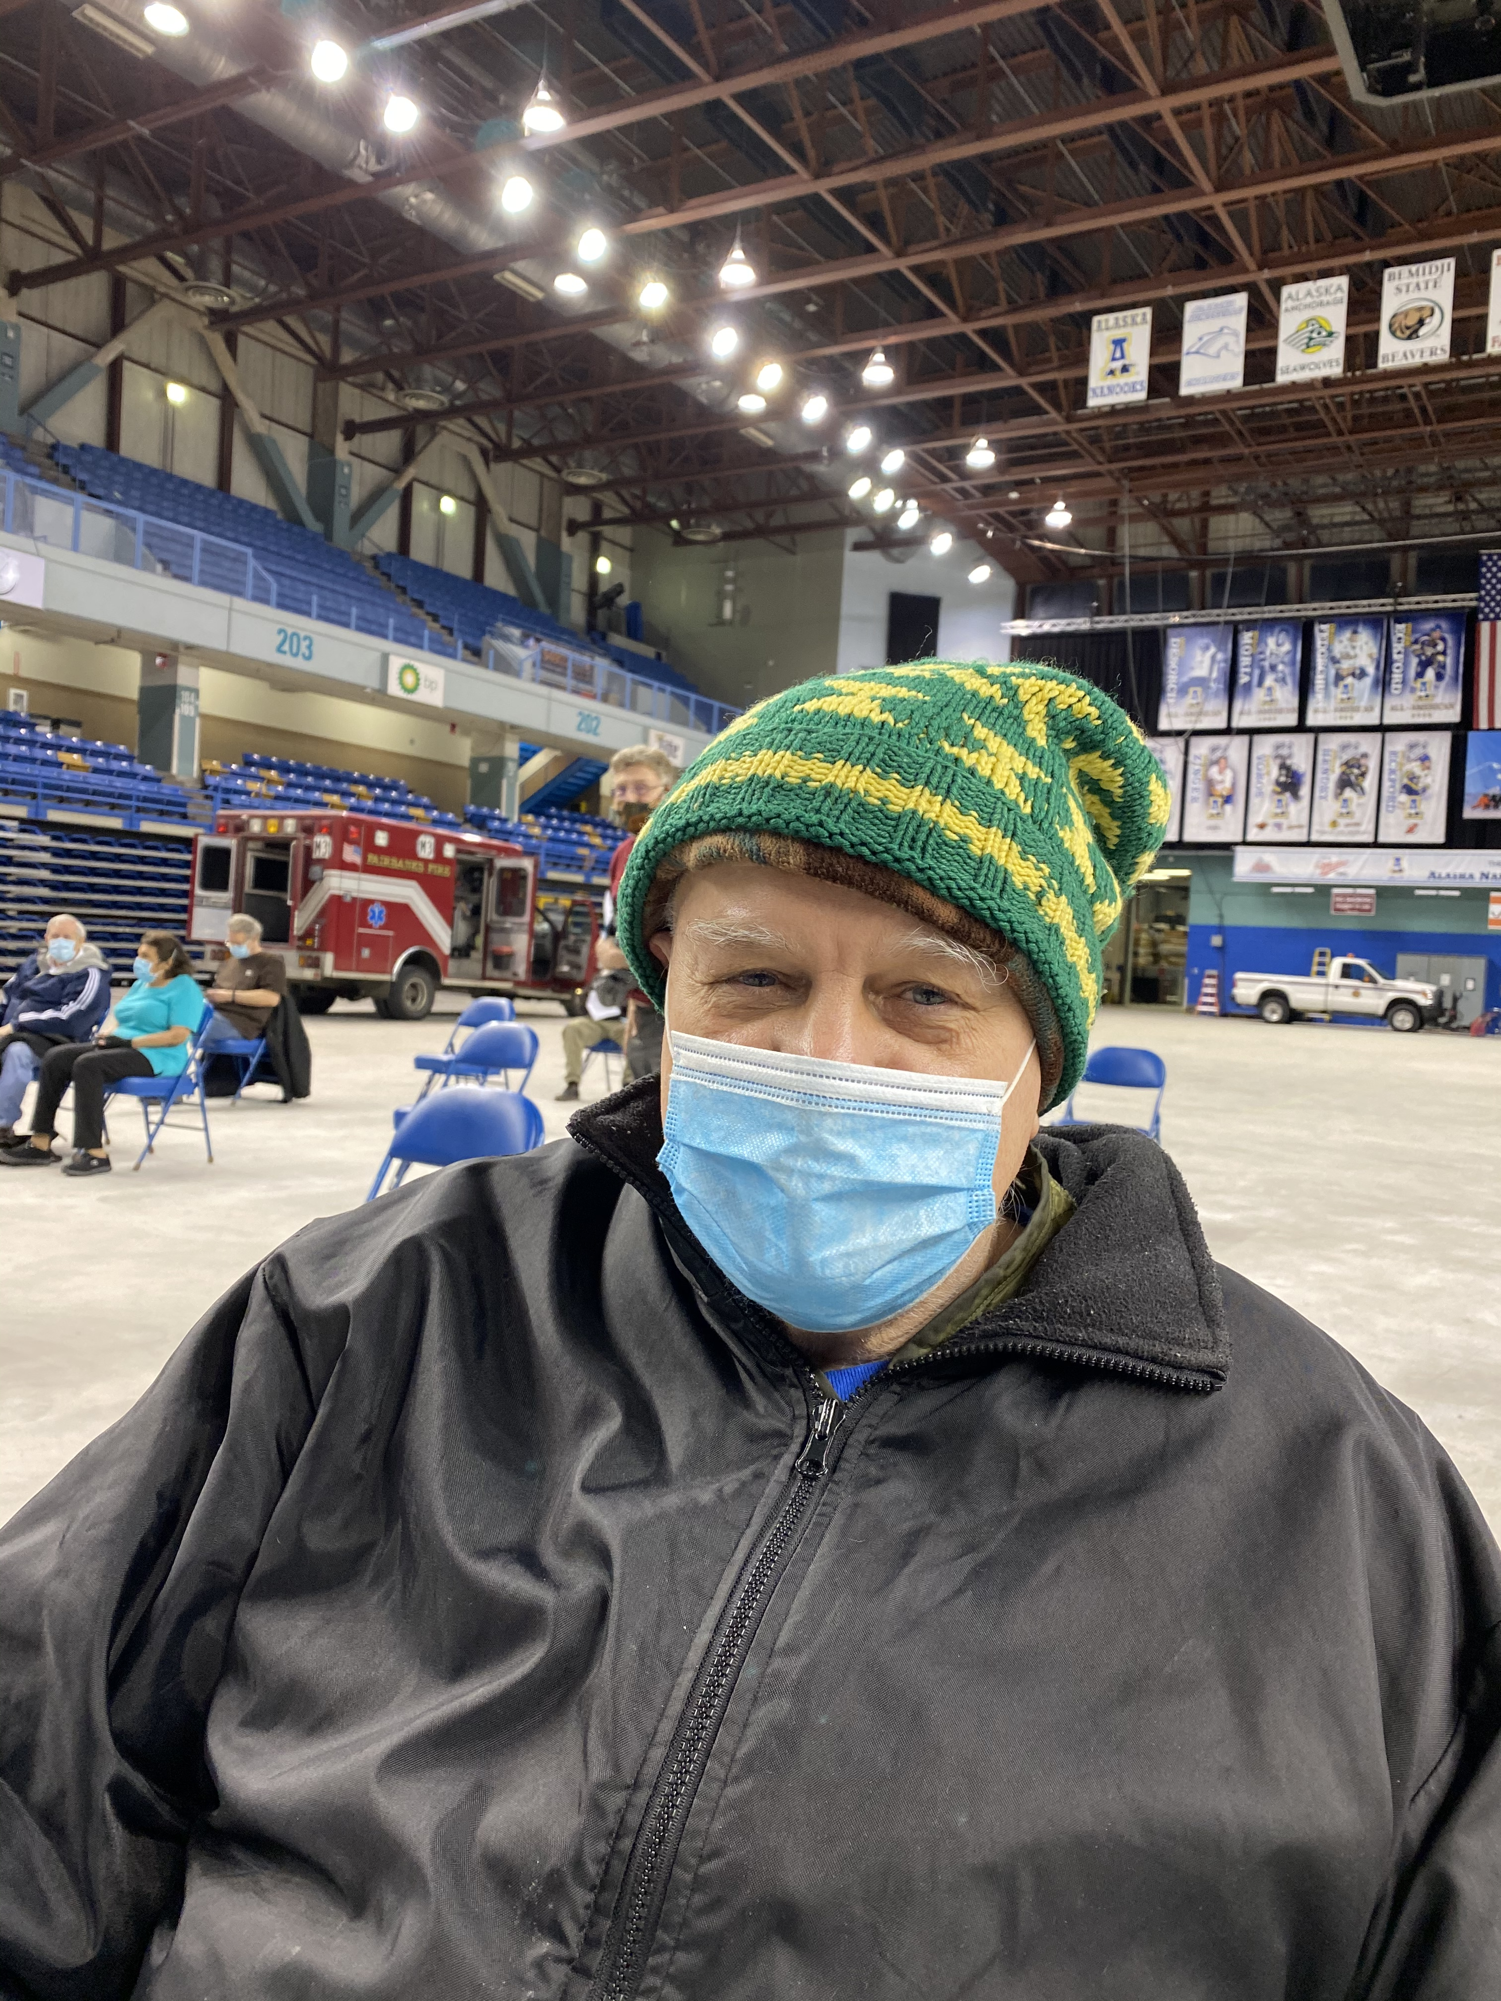
Thank you, Alaskans!
Alaskans have come together: providers and volunteers, families and friends, municipal and tribal leader. Alaskans have risen to the challenge in the most amazing ways.

Slide 11
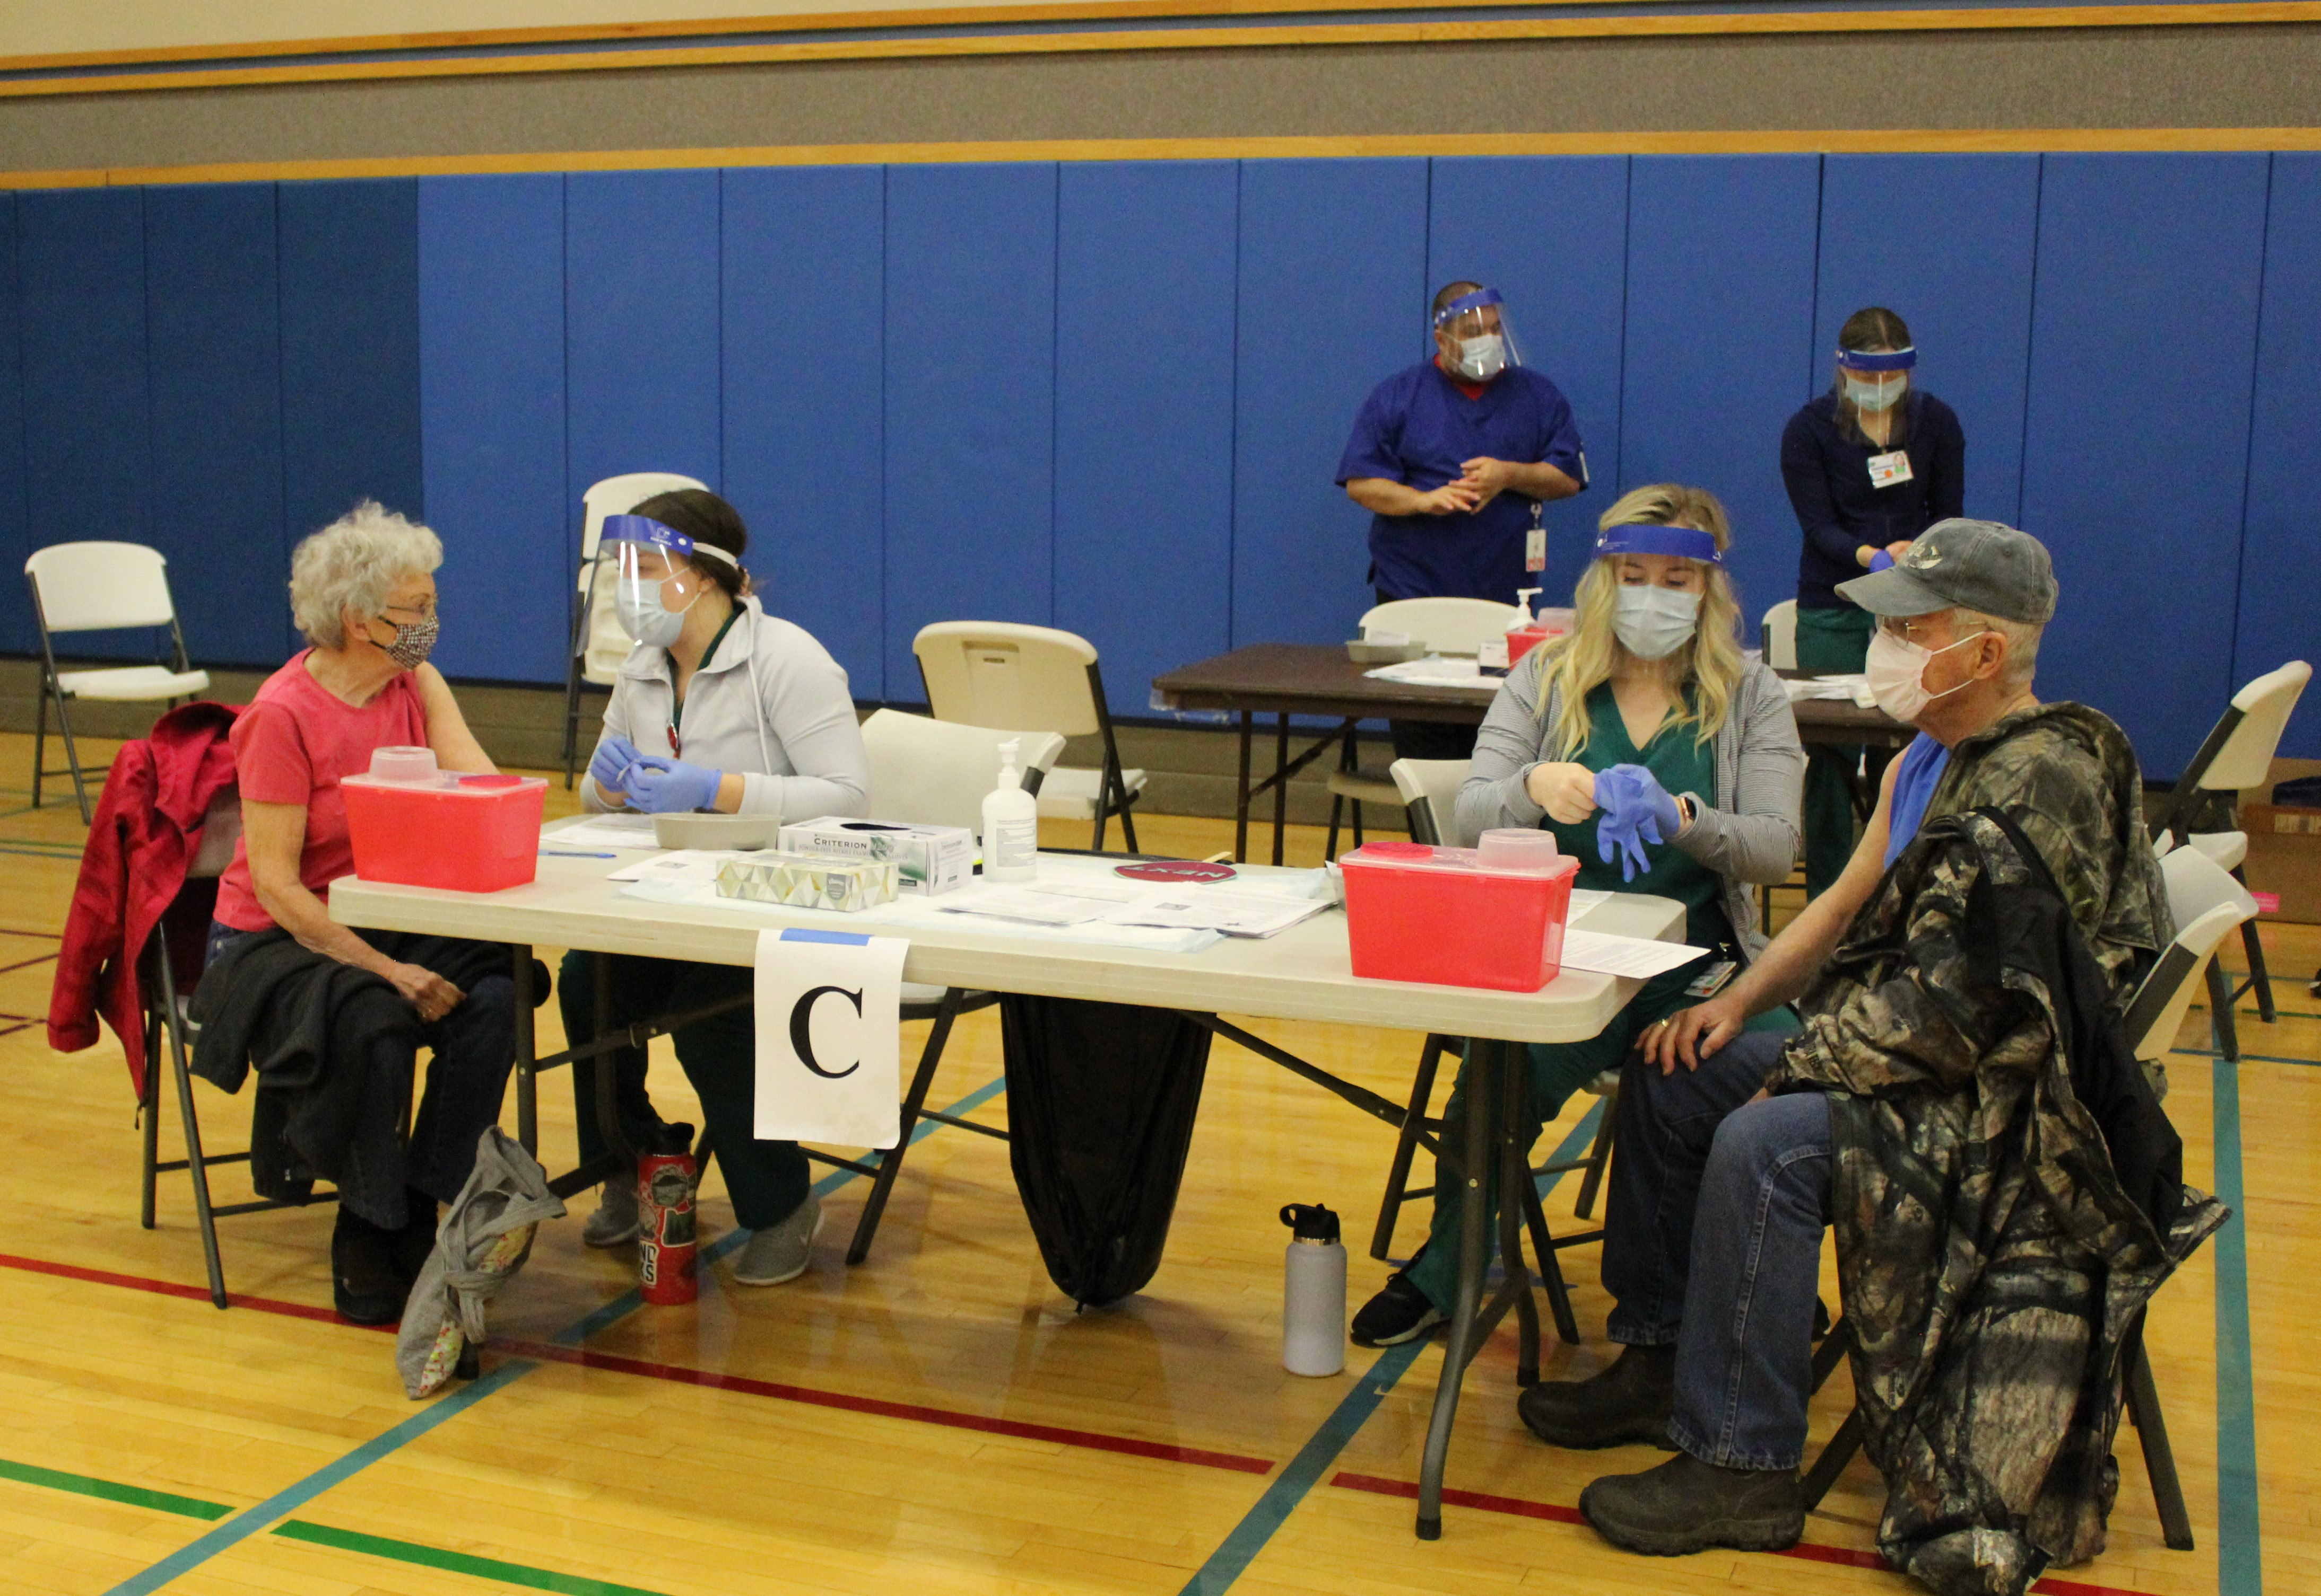
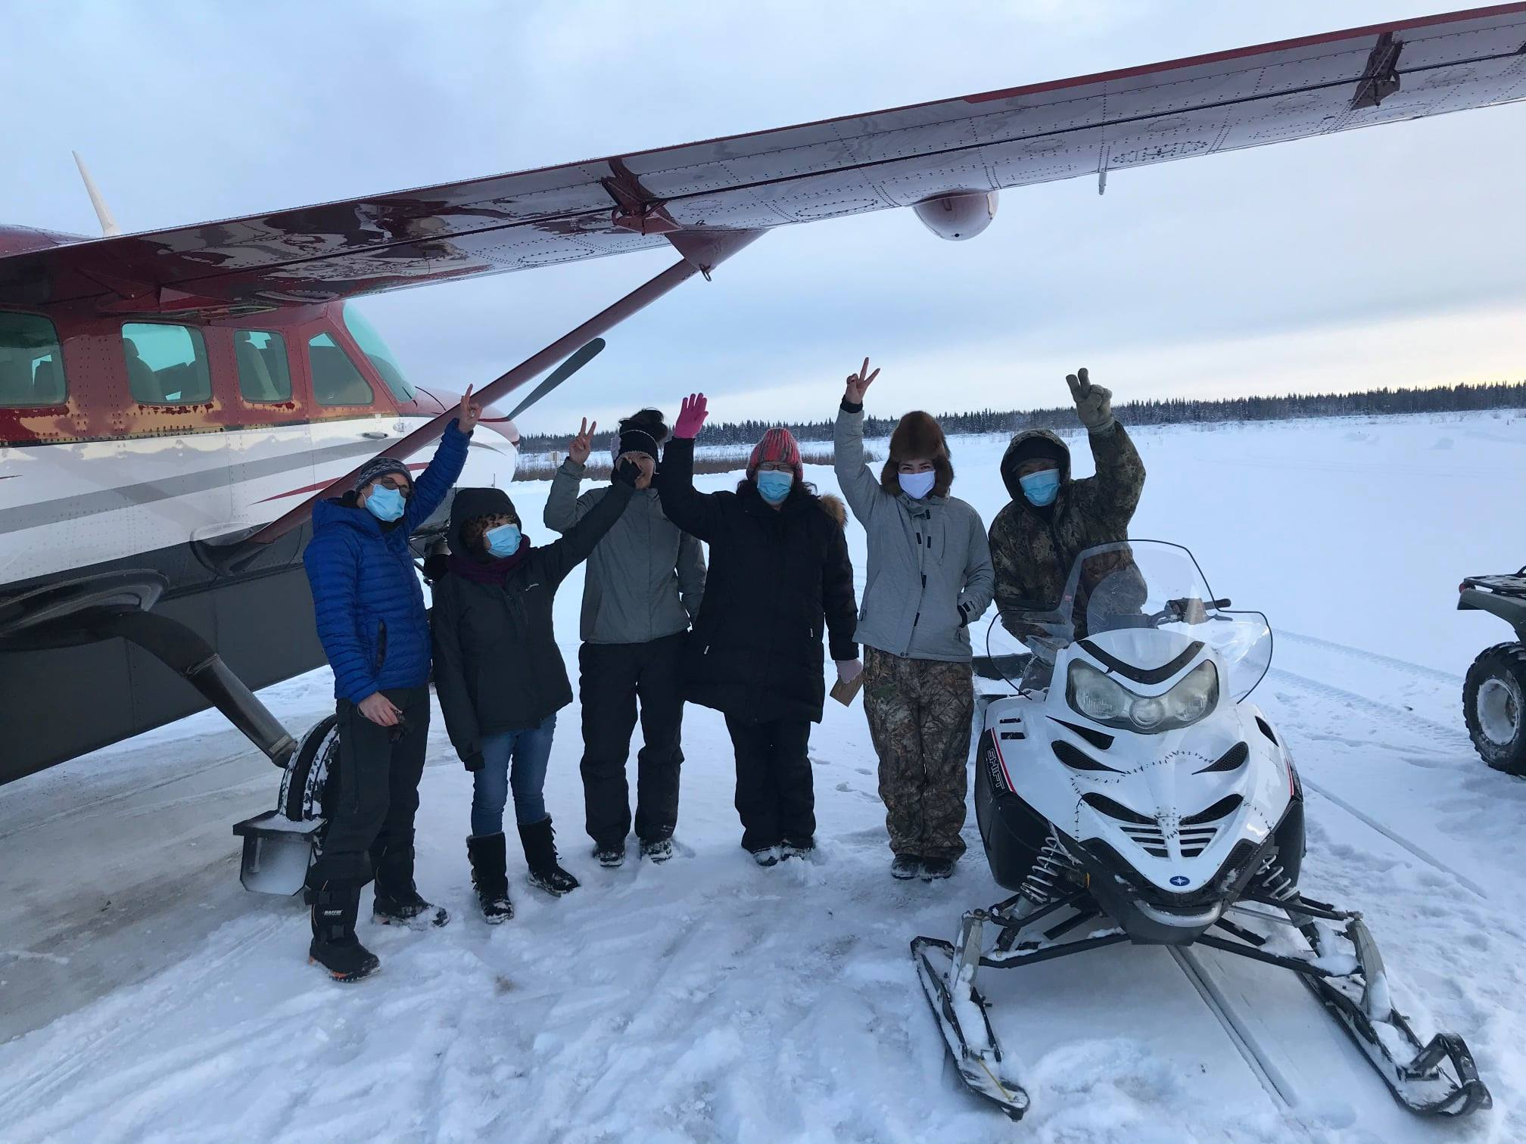
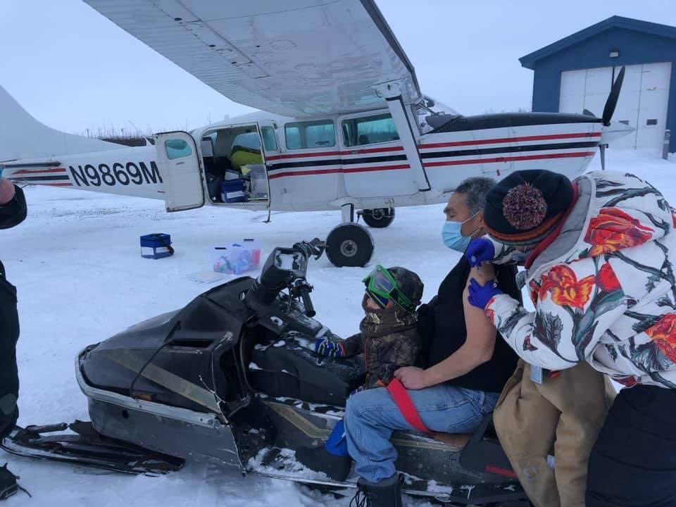
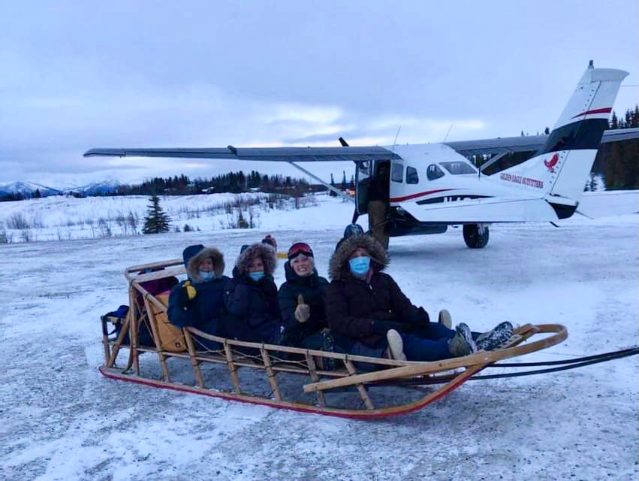
Partnerships
Alaska Tribal Health System, Department of Veterans Affairs, Department of Defense

Slide 12
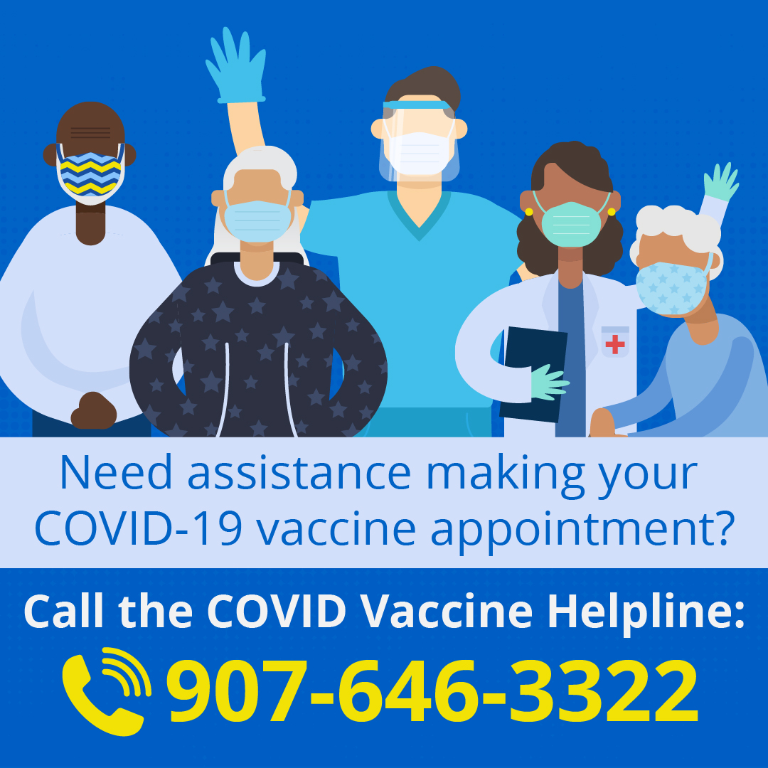
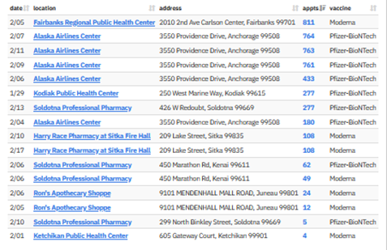
Vaccine Appointments Available
Help our Seniors and Elders
http://covidvax.alaska.gov

Slide 13
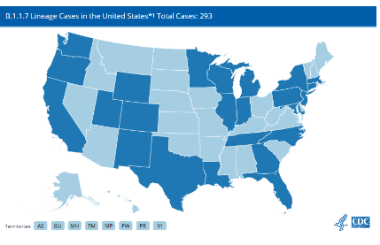
COVID-19 Variant Strains
Alaska will be added to CDC map. Updates Monday, Wednesday and Friday.
Alaska detected strain from recently completed sequencing. Sequencing takes time.
Test specimen collected Dec. 20, individual isolated after testing positive. One close contact also isolated.
Alaska has been sequencing SARS-CoV-2 viral genome from positive cases since spring 2020 to monitor circulating strains in Alaska. To date, 4-5% of positive cases have been sequenced.
https://www.cdc.gov/coronavirus/2019-ncov/transmission/variant-cases.html
http://dhss.alaska.gov/dph/Epi/id/Pages/COVID-19/variants.aspx
http://dhss.alaska.gov/News/Documents/press/2021/DHSS_PressRelease_Variant_20210126.pdf
Notes:
Tessa

Slide 14


Slide 15
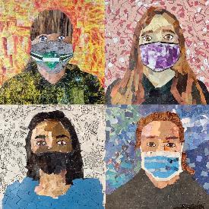
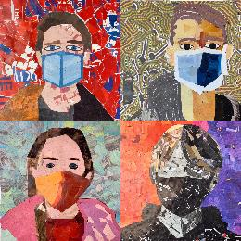
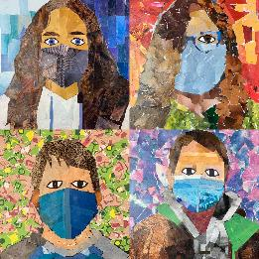
Stay Safe and Strong, Alaska

