Slide 1

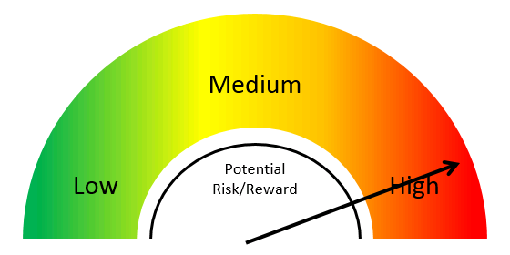
Temporal Detection and Phylogenetic Assessment of SARS-CoV-2 in Municipal Wastewater
Blake Wiedenheft
Montana State University
Dept. of Microbiology and Immunology
bwiedenheft@gmail.com
Nemudryi A, and Nemudraia A, et al Cell Reports Medicine
http://doi.org/10.1016/j.xcrm.2020.100098

Slide 2

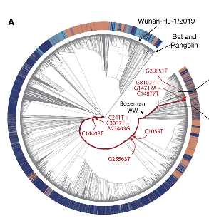
The punchline
Wastewater provides real-time information on SARS-CoV-2 prevalence in the community
Sequencing wastewater can be used to identify SARS-CoV-2 strains that are circulating in a community

Slide 3

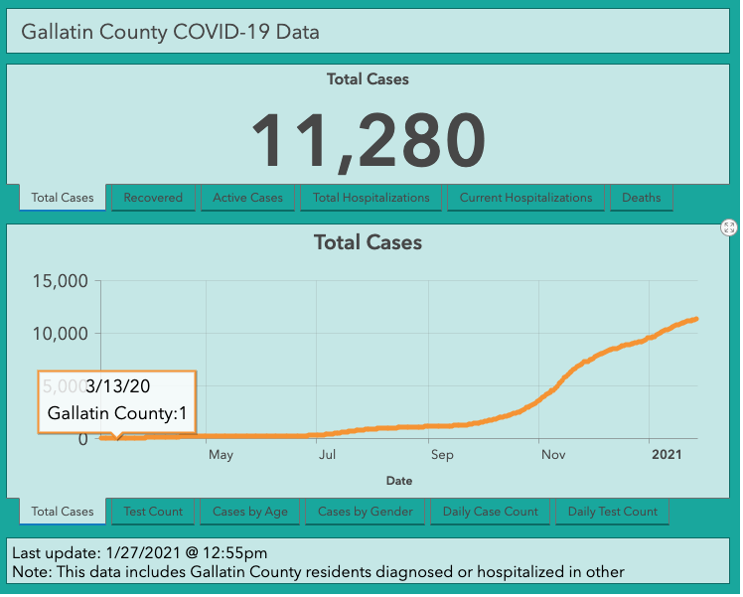
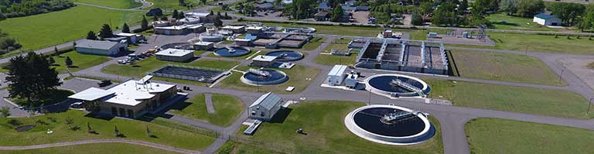
Can we detect SARS-CoV-2 in municipal wastewater?
Bozeman Water Reclamation Facility
Population served: 49,831
Daily flow: ~ 6 million gallons per day
Sample is positive!

Slide 4
Wastewater captures a snapshot of community spread
We hypothesized that wastewater can be used to monitor viral prevalence in the community

Slide 5
B
We hypothesized that wastewater levels of SARS-CoV-2 RNA correlate with COVID-19 incidence rates and that this data could be used as an epidemiological indicator to track the outbreak in real-time.

Slide 6
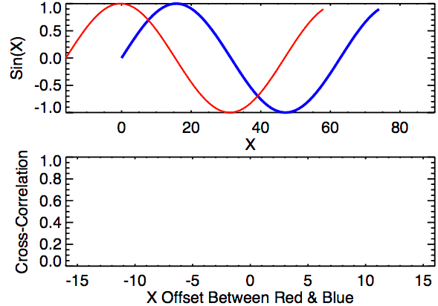
Cross-correlation analysis

Slide 7
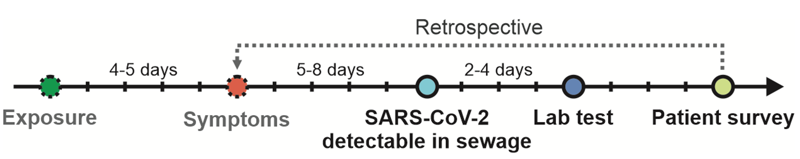
Wastewater surveillance is the earliest real-time measure of SARS-CoV-2 prevalence

Slide 8
Wastewater surveillance is a real-time measure of SARS-CoV-2 prevalence in the community
WW surveillance provides advanced warning of SARS-CoV-2 surge
WW surveillance is independent of healthcare-seeking behaviors and access to clinical testing
WW surveillance offers quick and cost-effective method for tracking the outbreak

Slide 9



Phylogenetic analysis of SARS-CoV-2 sequence isolated from wastewater
Tanner Wiegand
Kevin Surya
Murat Buyukyoruk
Nemudryi et al., 2020

Slide 10
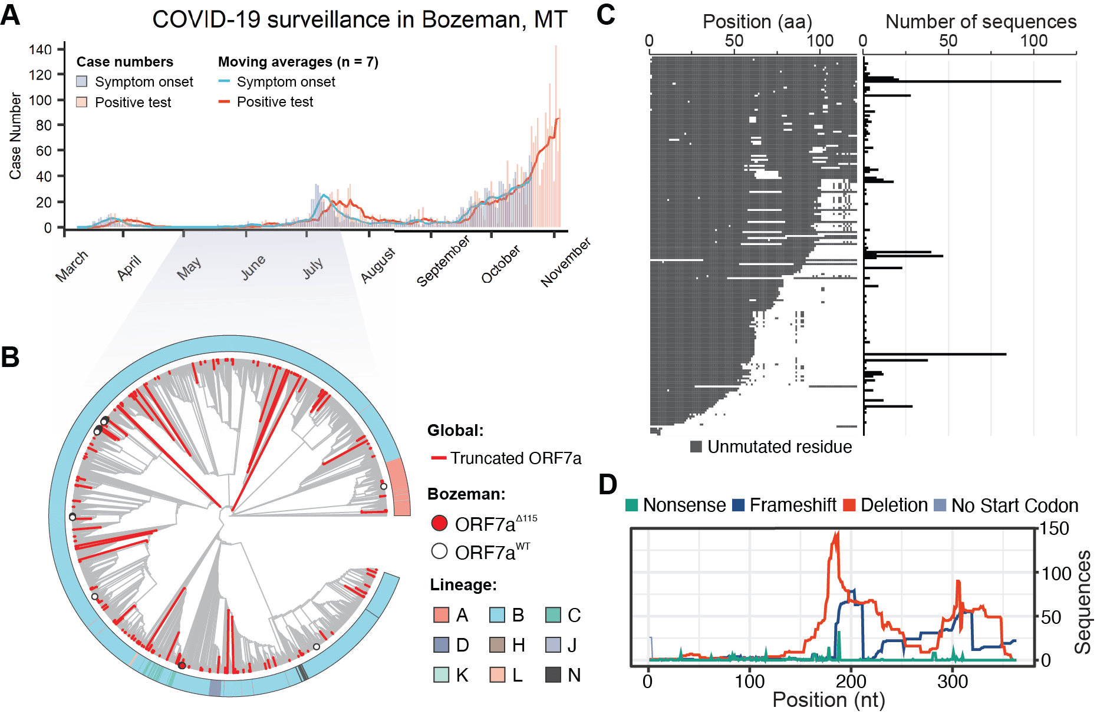
Local SARS-CoV-2 surveillance identifies variant that reoccurs around the globe.
Nemudryi et al., 2021
Unpublished data

Slide 11

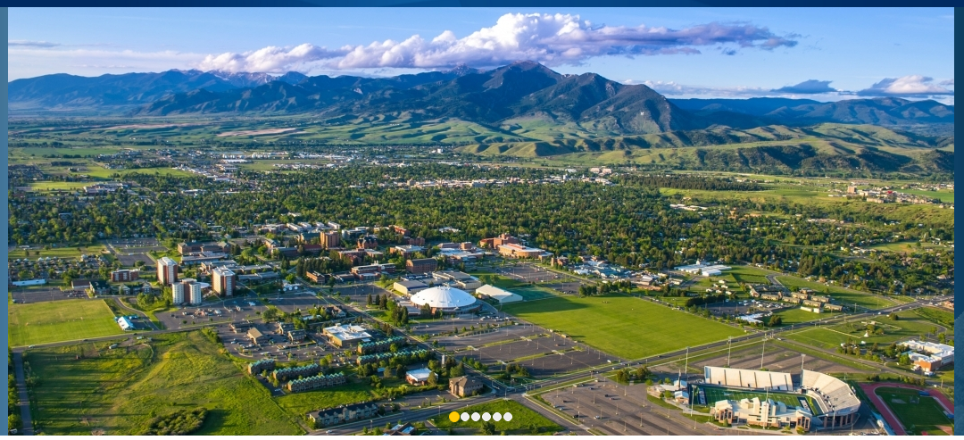

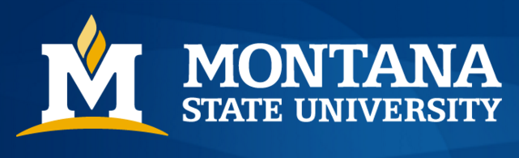

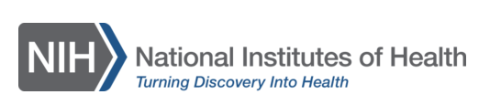


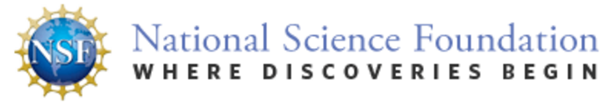
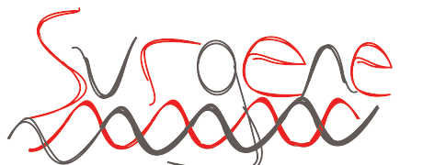
Acknowledgements
WIEDENHEFT LAB
Artem Nemudryi
Anna Nemudraia
Tanner Wiegand
Kevin Surya,
Murat Büyükyörük
Calvin Cicha
Royce Wilkinson
Andrew Santiago-Frangos
Clay Hunt
Joey Nichols
Laina Hall
Pushya Krishna
Reece Erickson
Will Henriques
FUNDING
Karl K. Vanderwood
Mitch Reister
Josh French
Justin Roberts

Slide 12
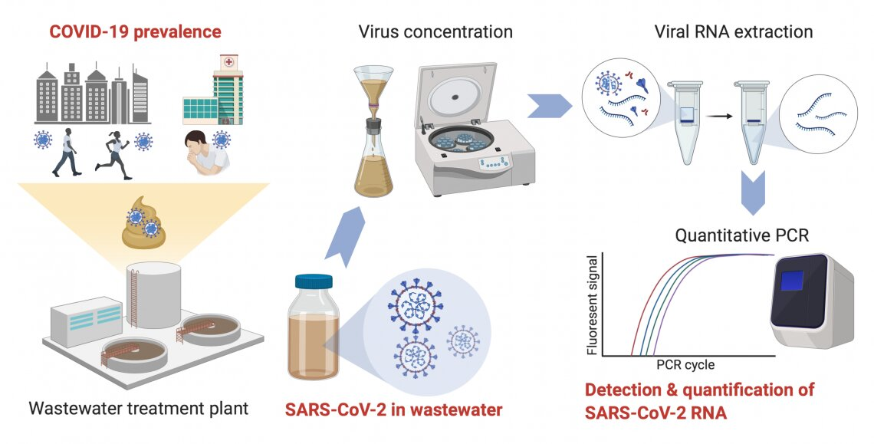
There is no standard method for concentrating SARS-CoV-2 from the wastewater!
https://medicalxpress.com/news/2020-08-sars-cov-rna-untreated-wastewater-louisiana.html

Slide 13
Methods to concentrate SARS-CoV-2 from wastewater
Membrane filtration is used to retain viral particles while solvent passes through.
Virus adsorbs to flocs of Al(OH)₃ precipitate that are pelleted with centrifugation.
Virus adsorbs to the filter membrane at low pH and elutes at neutral pH.
Centrifugation at >100k x g pellets viral particles
Virus particles precipitate in high salt in the presence of polyethylene glycol (PEG) polymers.
Adapted from Rusinol et al., 2020 and Ahmed et al., 2020

Slide 14
PEG precipitation and ultrafiltration performed better
Nemudryi et al., in prep

Slide 15
Pasteurization does not significantly reduce detected viral titers.
Nemudryi et al., in prep

Slide 16
PEG precipitation and ultrafiltration show moderate to high correlation
We compared two methods over the course of 20 days
Nemudryi et al., in prep

