Slide 1


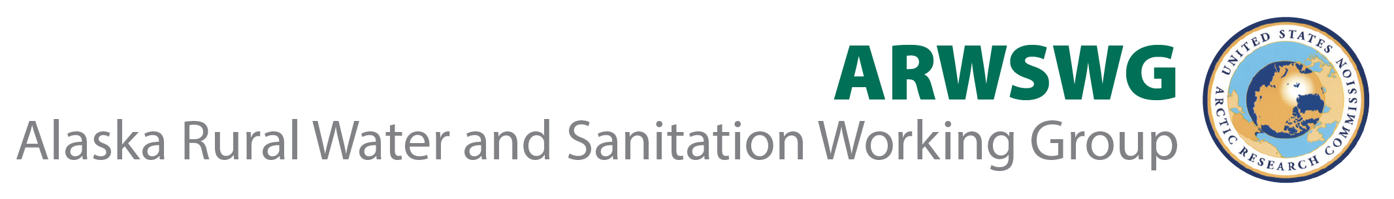



Tracing the Pandemic Through Wastewater:
Using Sewage Monitoring to Investigate Infectious Disease
Day 1 RECAP: Dr. Cheryl Rosa, USARC

Slide 2
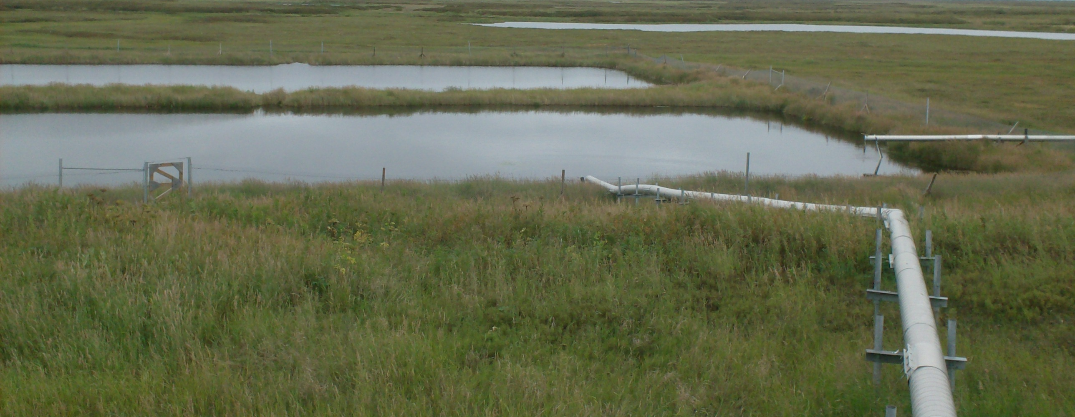
Welcome!
z

Slide 3
Housekeeping
The conference is being recorded and will be accessible via the workshop website ~1-2 days after we adjourn on today.
This workshop consists of two days of content, each from 8:30am-noon AK time. The first day will focus broadly, with the second more Alaska/Arctic-specific.
  Today’s speakers have been asked to leave time for 1-2 questions at the end of their presentations.
Please use the Q&A box whenever you like. We will be moderating questions so they can be asked during the Q&A.
When you log off of the webinar, a short survey will automatically open in your browser. Please answer these questions, as they assist us with future planning! ☺
Any issues? Please contact rescoord@arctic.gov and we will get them taken care of!

Slide 4
Day One, Session One
We heard an overview of rural wastewater systems and treatment modalities, as well as the challenges that may be encountered when trying to run a sampling program.
We learned about the historical toll of epidemics on AN communities and discussed the importance of this context to public health endeavors conducted in rural Alaska.
An update on Alaska’s COVID status was provided, with an emphasis on rural community information.

Slide 5
Day One, Session Two
We learned about the usefulness of wastewater monitoring and about specific examples at the University of Arizona and Tucson.
We heard about how wastewater epidemiology had been used historically and internationally for uses beyond pathogen detection
Dr. Daniel Gerrity presented on his work in Southern Nevada: specifically, potential applications of SARS-CoV-2 wastewater surveillance.
Dr. Blake Wiedenheft presented on his work in Montana on how wastewater analysis and sequencing can be used to identify the prevalence and types SARS-CoV-2 strains that are circulating in a community, as well as methods for concentrating SARS-CoV-2 from wastewater

Slide 6
Workshop Objectives
Provide an overview of the current state of the science of Wastewater Epidemiology, both globally and nationally
Determine the need for and current/potential uses of Wastewater Epidemiology in Alaska, with special focus on rural, cold climate communities
Discuss testing goals and potential sampling approaches for Alaska’s unique and varied remote communities
Examine the ethics and public engagement sensitivities related to these activities

