Slide 1


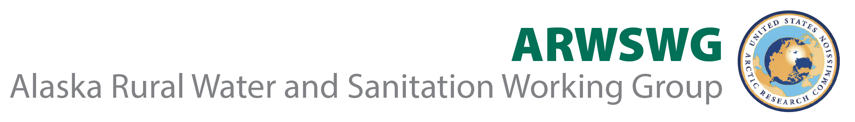



Tracing the Pandemic Through Wastewater:
Using Sewage Monitoring to Investigate Infectious Disease
Introductory Remarks: Dr. Cheryl Rosa, USARC

Slide 2
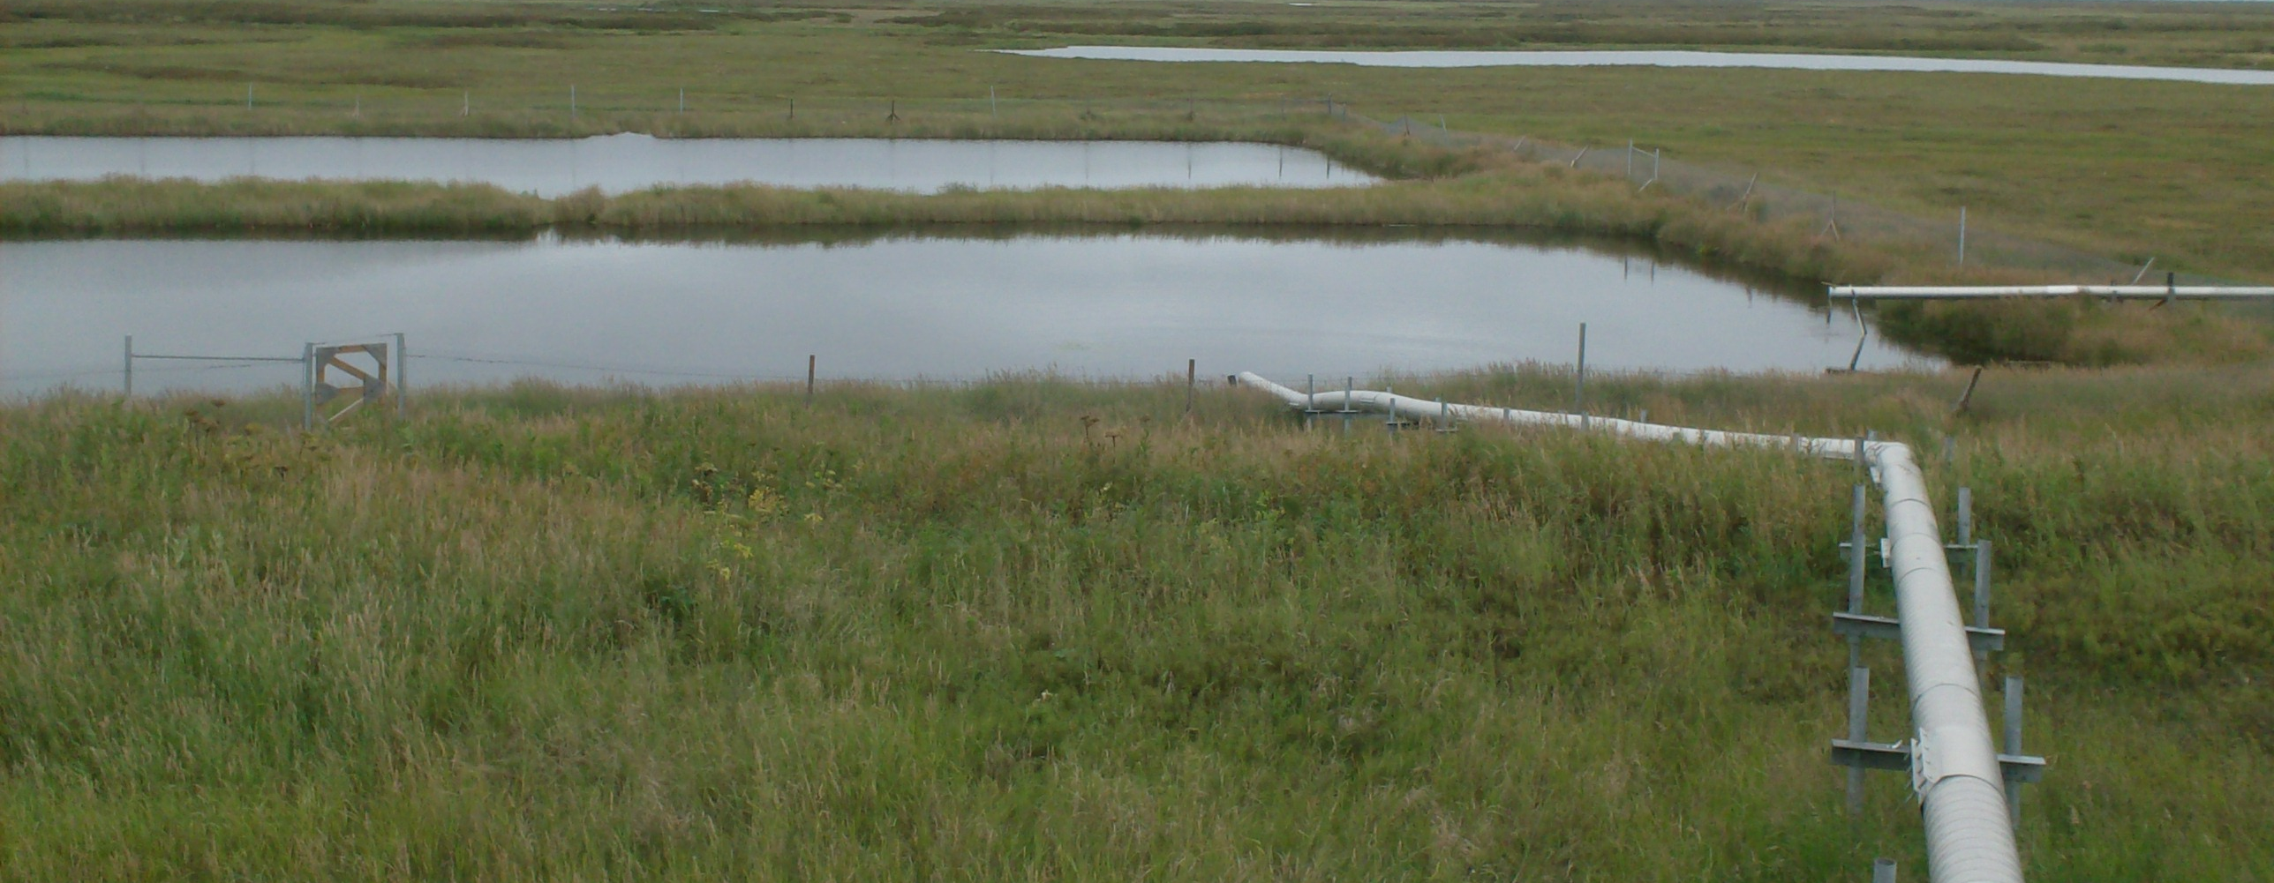
Welcome!
z

Slide 3
Housekeeping
The conference is being recorded and will be accessible via the workshop website ~1-2 days after we adjourn on Wednesday.
This workshop consists of two days of content, each from 8:30am-noon AK time. The first day will focus broadly, with the second more Alaska/Arctic-specific.
  Today’s speaker sessions will have 30-minute discussions after the presentations. Questions will be held until the end of the session.
Chat/raised hands. If you have a question, please ask it in the Q&A box whenever you like. We will be moderating questions so they can be asked during the Q&A.
There will be a survey that will ask you for input on water and sanitation research at the end of tomorrow’s sessions. Please answer it! It helps us ☺
Any issues? Please contact rescoord@arctic.gov and we will get them taken care of!

Slide 4
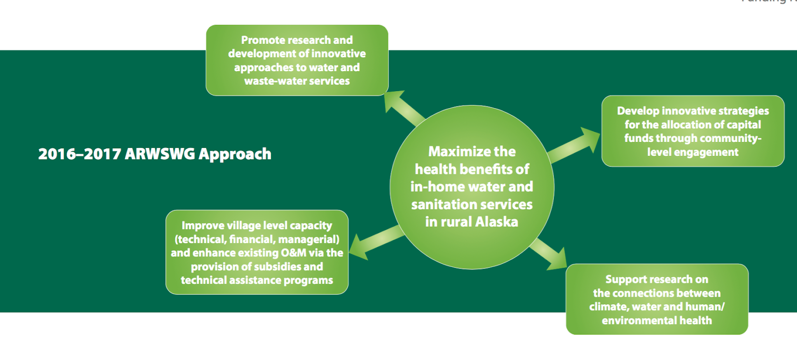
Notes:
The US Arctic Research Commission coordinates the Alaska Rural Water and Sanitation Working Group, comprised of representatives from State, Federal, Local and Tribal entities. The working group is focused on water and sanitation in rural Alaska, its connection with health, and also the impact that climate change is having on water/sanitation infrastructure presently and in the future. The Working Group’s mission is to maximize the health benefits of in-home water and sanitation services in rural Alaska.

Slide 5
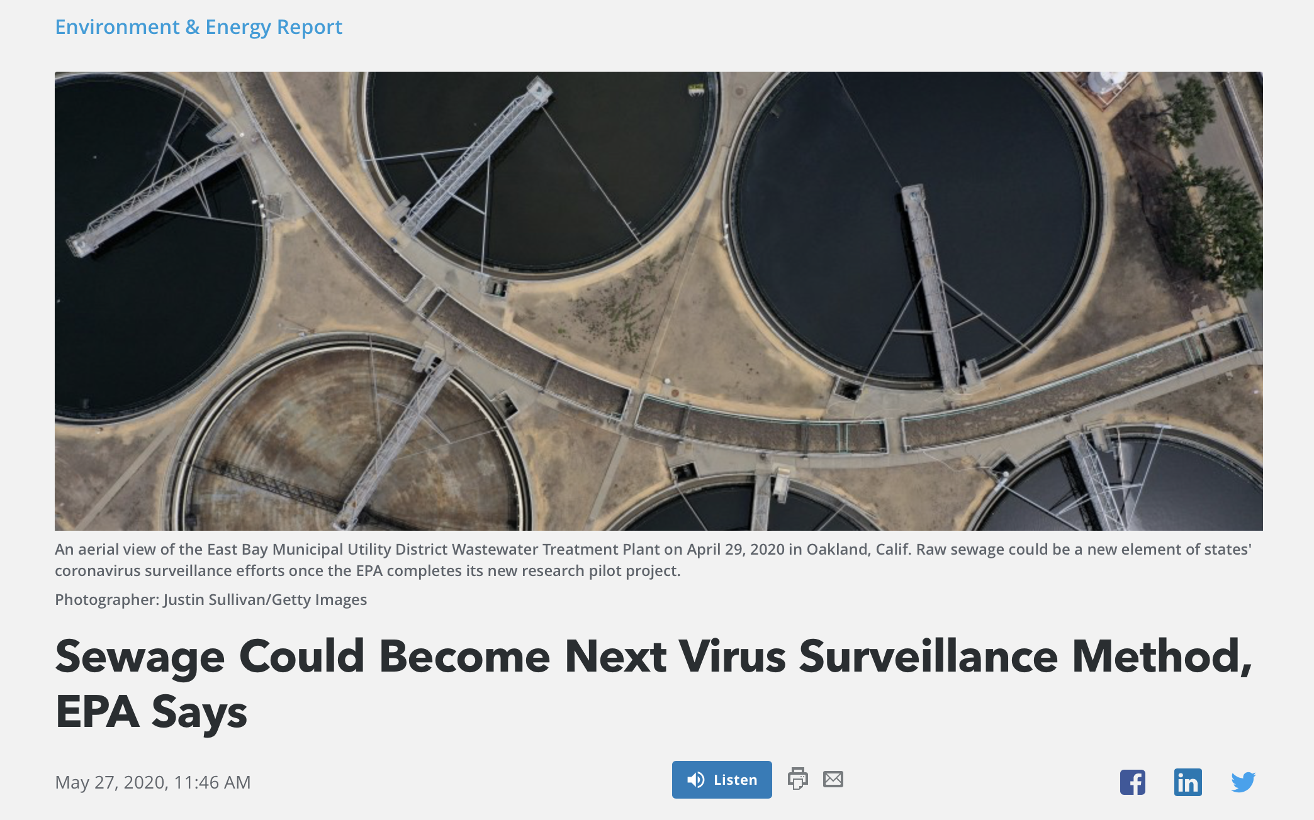
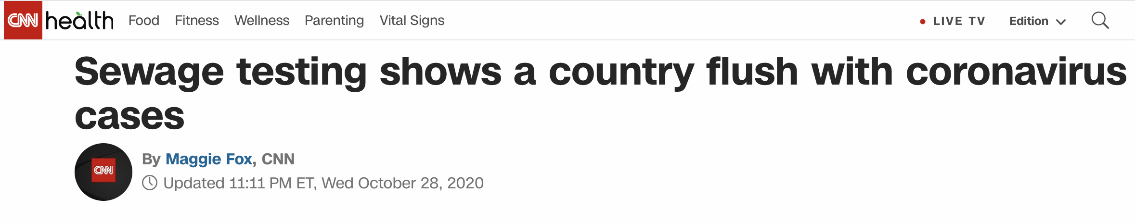
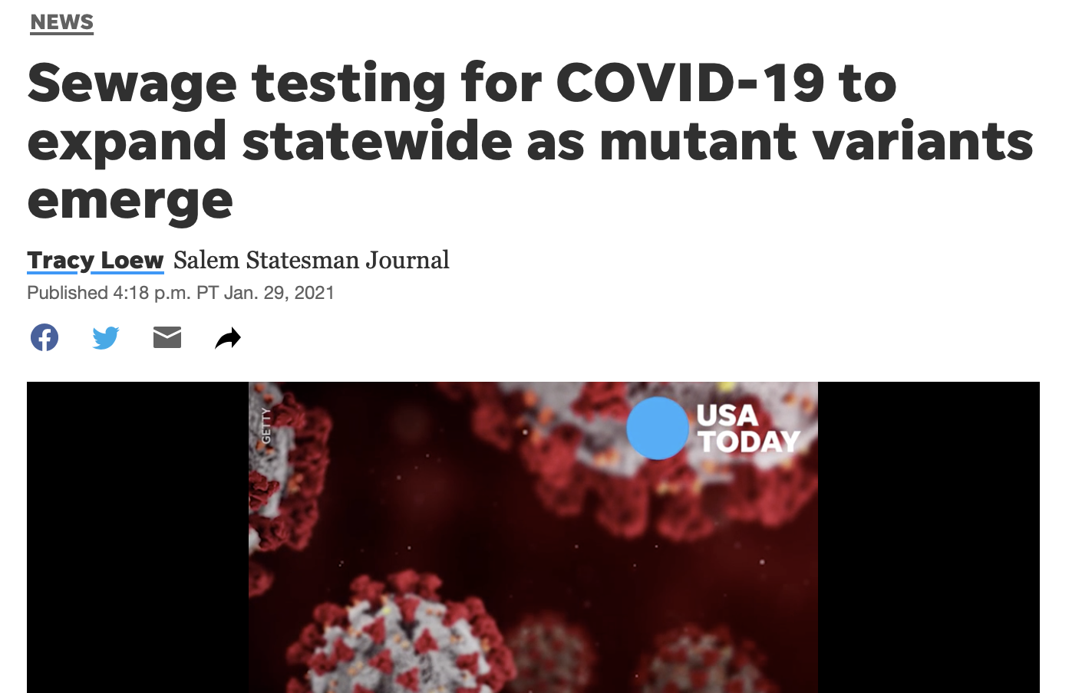

Slide 6
Definitions
Wastewater, also referred to as sewage, includes water from household/building use (such as toilets, showers, and sinks) that can contain human fecal waste, as well as water from non-household sources (including rainwater runoff and industrial use).
Wastewater surveillance is the strategic sampling and testing of wastewater and analysis and interpretation of the collected data (such as presence or concentration of pathogens, physical-chemical measures) to better understand disease within a community.
Centralized (or sewered) wastewater systems transport wastewater through a piped network to a central waste treatment facility and often serve urban communities.
Decentralized wastewater systems, like pit latrines or septic tanks, collect, treat, and/or dispose of wastewater close to the point of generation and often serve smaller communities or individual households.
https://www.cdc.gov/coronavirus/2019-ncov/cases-updates/wastewater-surveillance/low-resource-waste-systems.html

Slide 7
z
Low-resource waste systems are ineffective centralized systems (e.g., systems with substantially decaying infrastructure) or wastewater-impacted environmental waters. These systems have unknown fecal inputs and losses and are open to environmental processes that unpredictably impact the persistence of SARS-CoV-2 RNA throughout the system, including sunlight, predation from other microorganisms, and variable pH and temperature.

Slide 8
Why do wastewater surveillance?
Wastewater surveillance for SARS-CoV-2 is a useful supplement to case surveillance because it provides data on COVID-19 presence within a community that is independent of healthcare-seeking behavior or access and potentially in advance of clinically reported cases. For these reasons, wastewater surveillance for SARS-CoV-2 in low-resource waste systems could provide a critical supplementary data source, particularly in communities without clinical surveillance resources.

Slide 9

Alaskan disparity: disproportionate impact in AI/AN communities
COVID-19 incidence is higher among American Indians/Alaska Natives (AI/ANs) than among non-Hispanic Whites. In 2009, AI/ANs experienced disproportionately high pandemic influenza A(H1N1)–associated mortality.
COVID-19–associated mortality among AI/ANs was 1.8 times that among non-Hispanic Whites. Among AI/ANs, mortality was higher among men than among women, and the disparity in mortality compared with non-Hispanic Whites was highest among persons aged 20–49 years.
Arrazola J, Masiello MM, Joshi S, et al. COVID-19 Mortality Among American Indian and Alaska Native Persons — 14 States, January–June 2020. MMWR Morb Mortal Wkly Rep 2020;69:1853–1856.
Notes:
On its website, the CDC cites “long-standing systemic health and social inequities” as a major contributing factor to why people from racial and ethnic minority groups are overall at an increased risk of getting sick and dying from COVID-19. Discrimination, lack of health care access, and poverty are all “inequities in social determinants of health that put racial and ethnic minority groups at increased risk,”

Slide 10

A multi-stage effort
Characterize and sample a given place/community (Alaska has many dissimilar options!)
Develop and apply an analytical approach
Connect the dots: determine what data is possible to interpret for each given community/wastewater system
Translate this information into public health information and decisions that help people live healthier lives

Slide 11
Public health possibilities?
Alaska and other Arctic regions present unique challenges with respect to wastewater epidemiology, many of which will be discussed over the next two days.
It is unlikely that the array of uses expected in a high-resource waste system will be possible for rural villages, but there is still utility.
There are also many sociocultural aspects to testing and public health messaging that must be considered.
Ultimately, we plan to discuss the range of possibilities over the next two days in hopes of encouraging progress in this area of research.
Notes:
The focus is on trends or significant changes in the number of viral gene copies detected.
• To serve as an early warning of infection in communities and possibly more targeted areas within communities.
Mobilize additional testing or PPE and alert hospitals, physicians, other health care providers
Closely monitor & evaluate data, (hot spots, contact tracing)
Develop methodologies/predictive models to translate viral loads detected for comparison to health surveillance data or percentage of infection in communities.
Predict or compare results to the prevalence data study for specific communities to better understand factors affecting disease spread.
Determine impacts on disproportionately affected communities (blue-collar, ethnic, race) where risk of infection is greater.

Slide 12
Workshop Objectives
Provide an overview of the current state of the science of Wastewater Epidemiology, both globally and nationally
Determine the need for and current/potential uses of Wastewater Epidemiology in Alaska, with special focus on rural, cold climate communities
Discuss testing goals and potential sampling approaches for Alaska’s unique and varied remote communities
Examine the ethics and public engagement sensitivities related to these activities

