Slide 1
National Wastewater Surveillance System
Implementation Update
Amy E. Kirby, PhD MPH
NWSS@cdc.gov
February 3, 2021
Water and Sanitation Innovations for the Arctic

Slide 2

Wastewater Surveillance | Public Health Toolbox
Wastewater serves as an efficient pooled sample of community (or sub-community) infection prevalence
Captures sub-clinical infections
Independent of healthcare-seeking behavior and testing access
Data available within days of viral shedding onset versus up to 2-week lag for other surveillance data

Slide 3
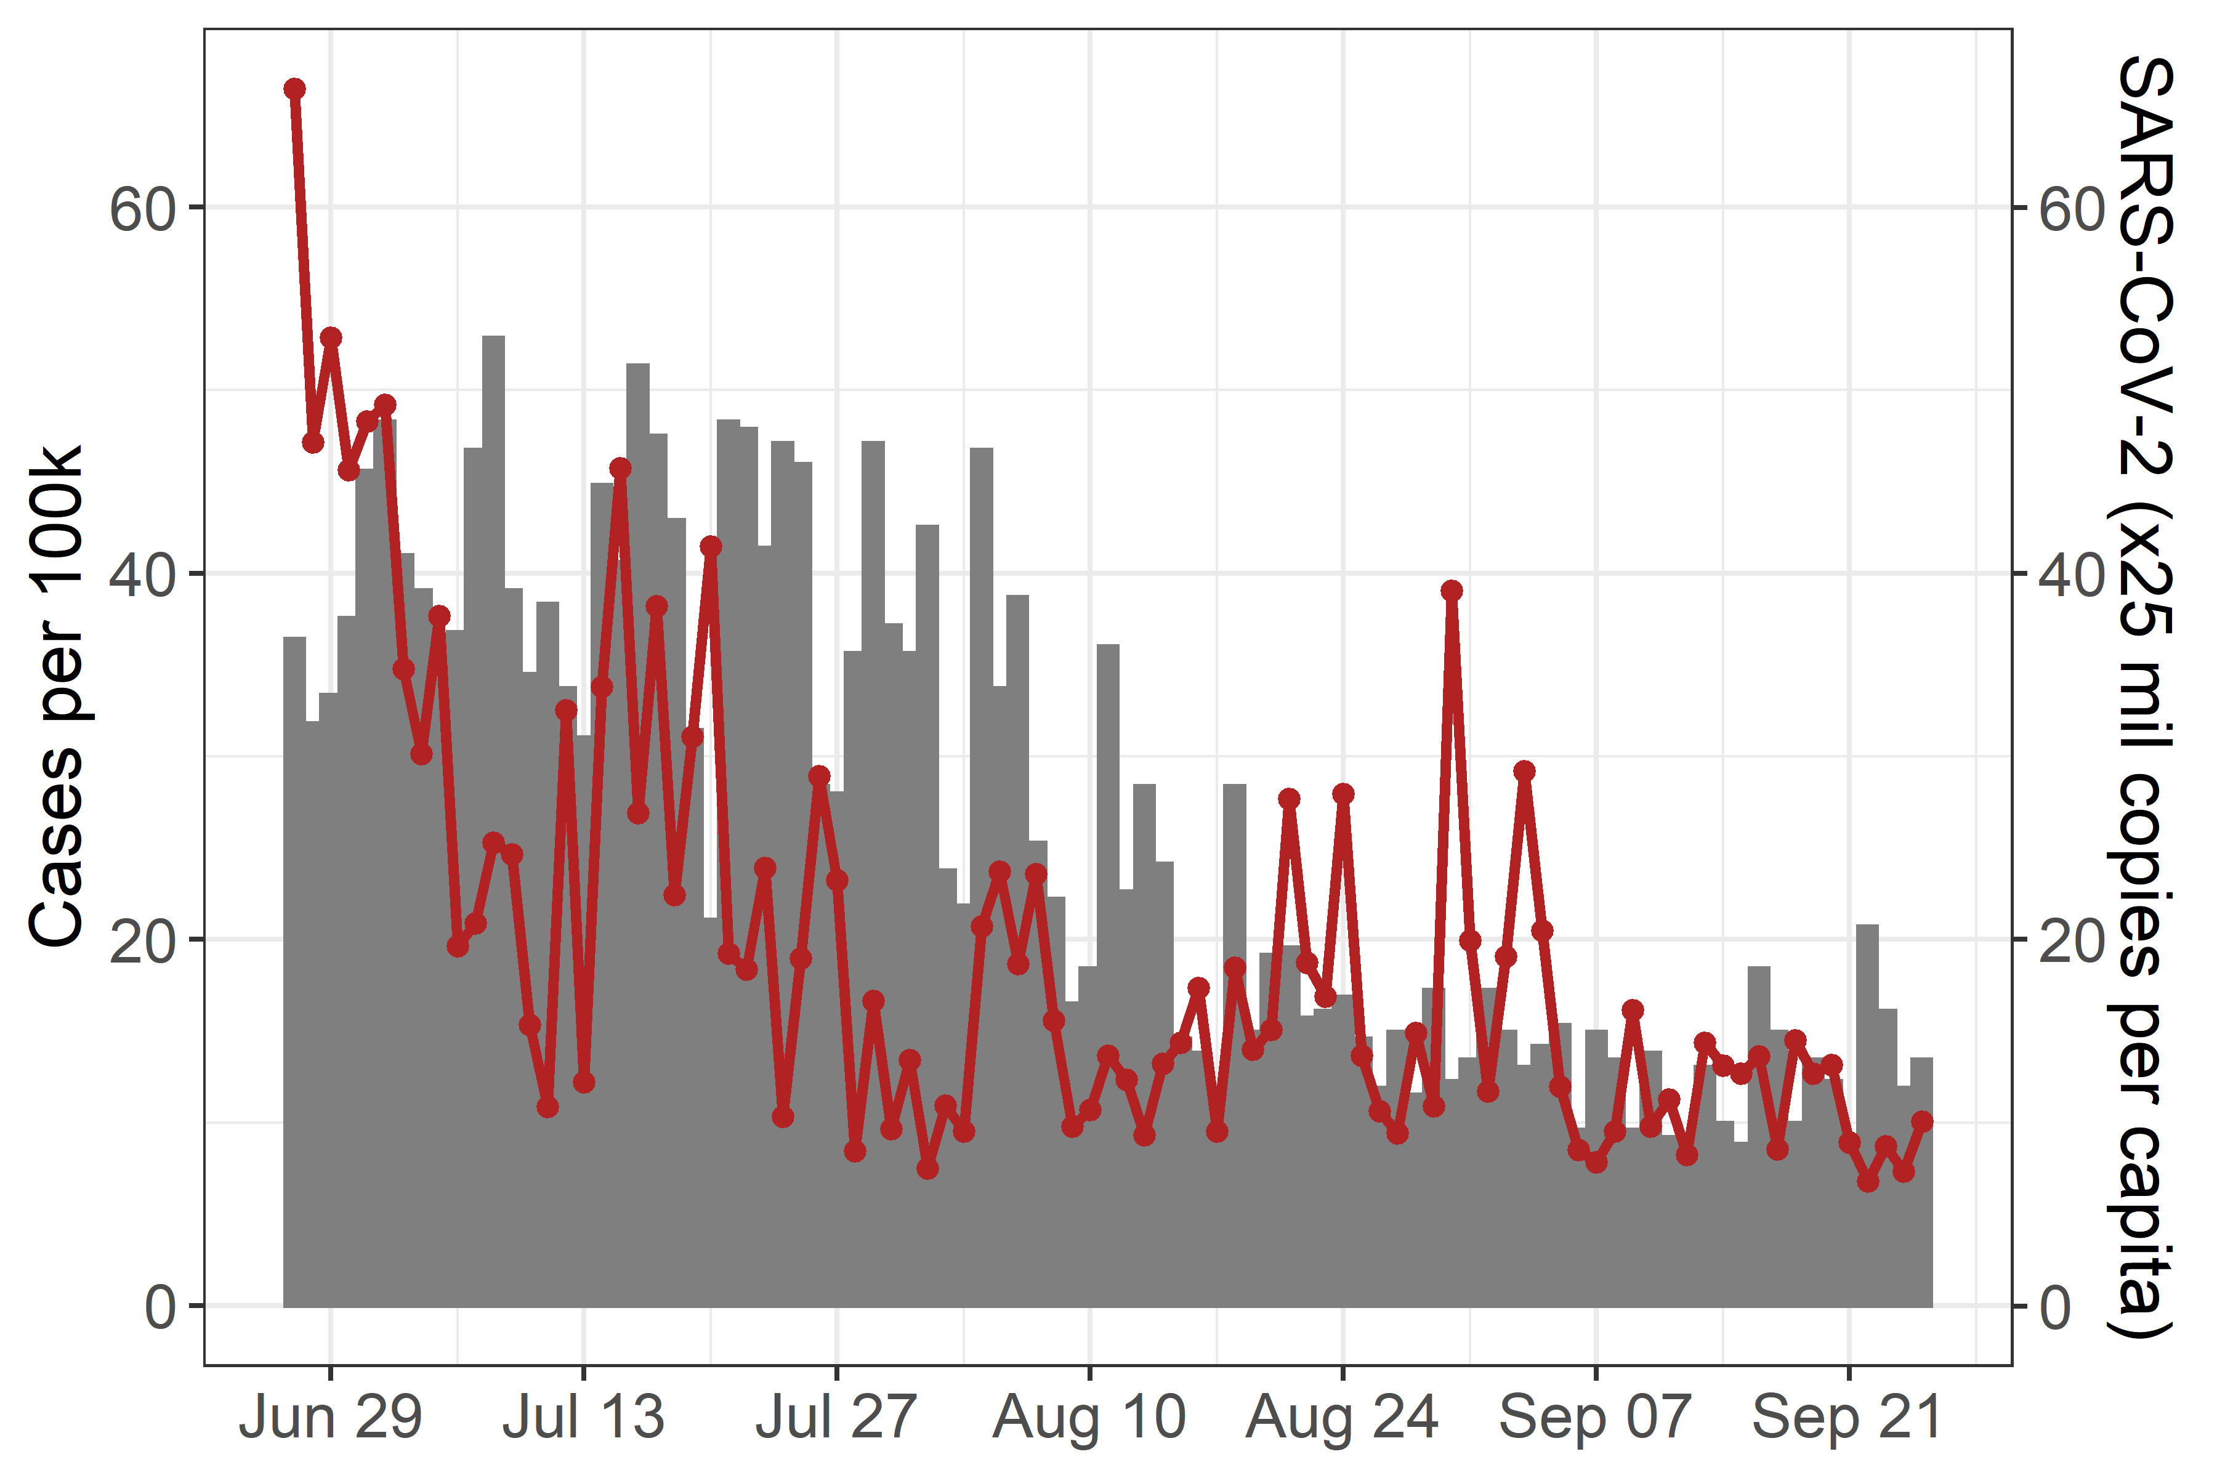
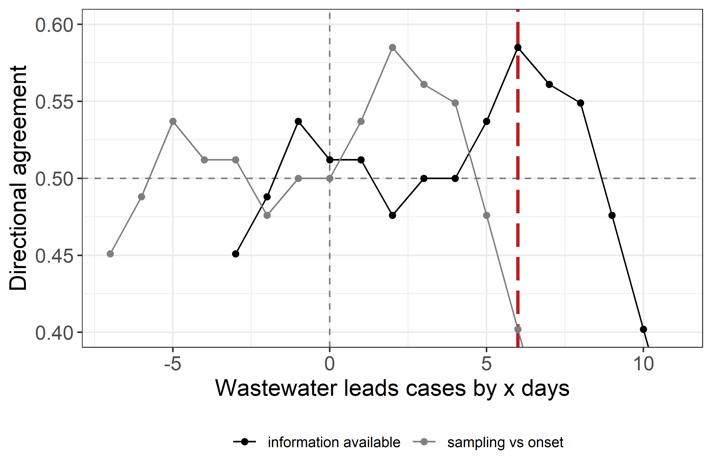
SARS-CoV-2 Wastewater Surveillance Evaluation
Reported wastewater data associated with reported cases ~6 days in the future.
Confirmed Cases
SARS-CoV-2 in Wastewater
Timeseries
Leading Indicator Analyses
Notes:
The data shown here are rom daily measurements take from wastewater utility serving a city in the Idaho from late June through September.
The left-hand side graph is a timeseries where the bars represent the case counts based on illness onset, shown on the left-hand vertical axis, and the red line represents the SARS-CoV-2 sewage concentration data shown on the right-hand vertical-axis.
The right-hand side graph is the leading indicator analyses between the wastewater SARS-CoV-2 wastewater concentrations and case counts – with a 1 on the vertical axis being the direction of the two datasets agree all the time (i.e., when one goes up, the other always goes up), 0 being the direction of the two datasets never agree, and 0.5 showing equal agreement and disagreement (i.e., no association). The gray line represents the relationship between wastewater concentrations on the date it was sampled and illness onset date of cases. The black line represents the relationship between wastewater concentrations and cases on the date the information is reported to the health department.
The horizontal axis represents the wastewater concentration relationship with cases on x number of days later.
For example, the 0 on the x-axis represents the expected relationship between wastewater concentrations collected or reported today and the average number of cases with illness onset or reported today, respectively. Similarly, the 6 on the x-axis represents wastewater concentrations data related to the case data from 6 days later.
The peak on the correlation graph shows that (at this location) available wastewater concentration data are most strongly associated with new cases reported approximately 6 days in the future (red dashed line), demonstrating wastewater data as a leading indicator of reported cases similar to what has been reported by other researchers around the world.

Slide 4
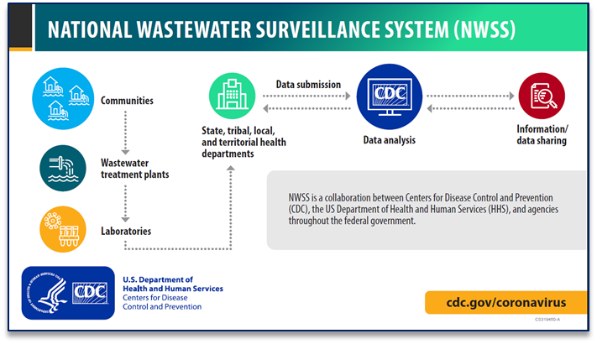

Slide 5
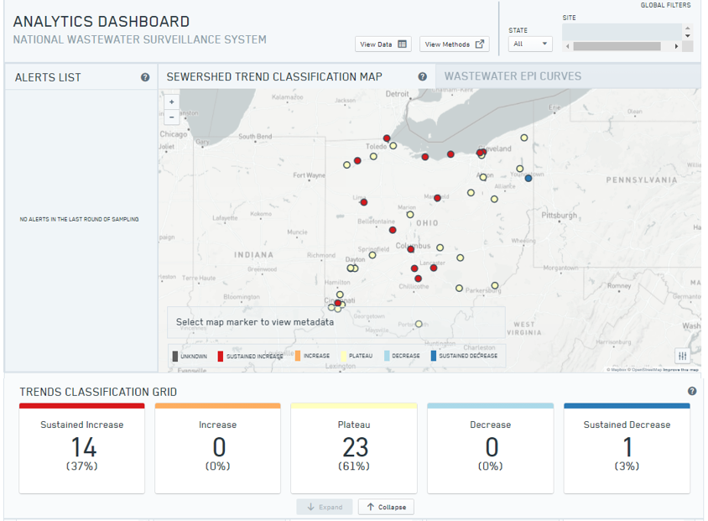
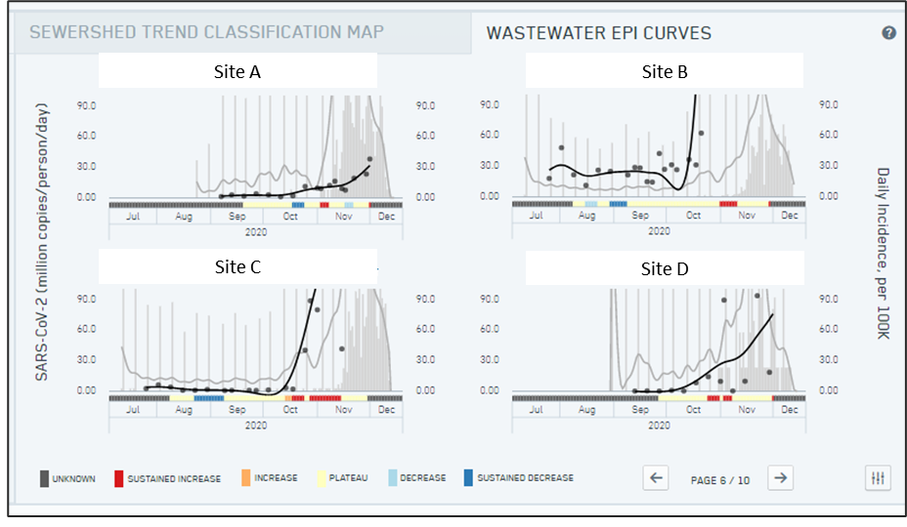
NWSS DCIPHER Results Dashboard
4
1
2
3

Slide 6


COVID-19 Sewage Assessment | Limitations
Decentralized wastewater treatment facilities will not be captured
~25% of US residences are not connected to sewer
Low incidence may be below the limit of detection
Cannot be used to “clear” a community or facility
May be impacted by pre-treatment of sewage for odor or worker safety

Slide 7
NWSS Communities of Practice
Health Departments
Host: CDC
Sampling strategy
Data coordination
Data submission
Data interpretation
Public health action
Laboratories
Host: APHL
Testing methods
Data comparability
QA/QC
Biosafety
Industry sharing
Defining PHL role
Utilities
Host: Water Environment Federation
Sampling methods
Operational factors
Worker safety
Data sharing
Beth Conway
econway@wef.org

Slide 8
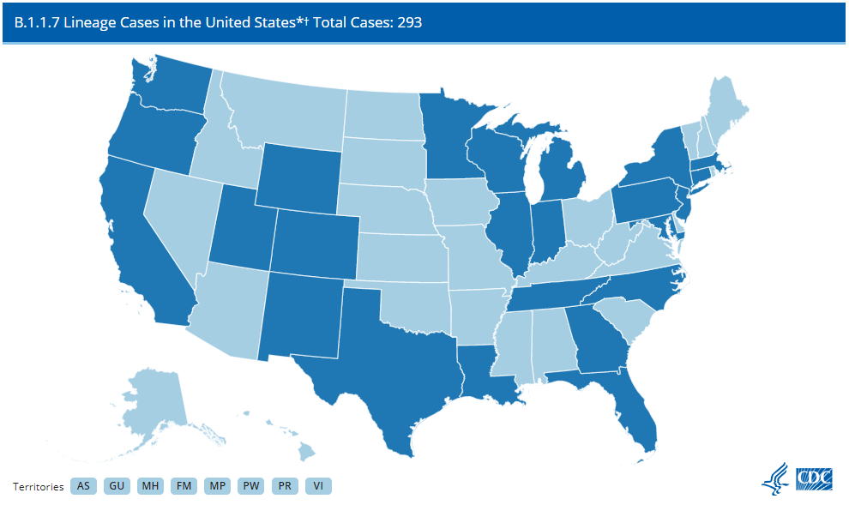

SARS-CoV-2 Variant Tracking in Wastewater
Wastewater sequencing may be useful for variant detection and tracking
CDC is pursuing multiple avenues to generate wastewater sequence data for analysis
Working with NCBI to establish database for wastewater SARS-CoV-2 sequence data
Updated January 25, 2021
First U.S. case of P.1 variant reported Jan. 25

Slide 9
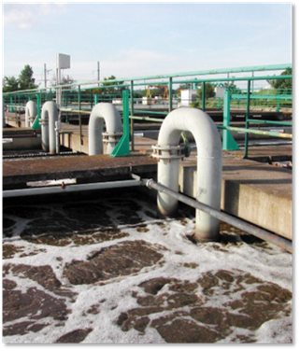
NWSS | A New Tool for Disease Surveillance
Built to be flexible to incorporate additional health targets and nimble enough to respond to changing public health needs
Can incorporate genetic data to track pathogen origin and evolution
Potential additional targets
  Antibiotic resistance genes
  Enteric bacteria and viruses
  Influenza
  Hospital-associated pathogens

Slide 10
NWSS Email: NWSS@cdc.gov
https://www.cdc.gov/coronavirus/2019-ncov/cases-updates/wastewater-surveillance.html

