Slide 1

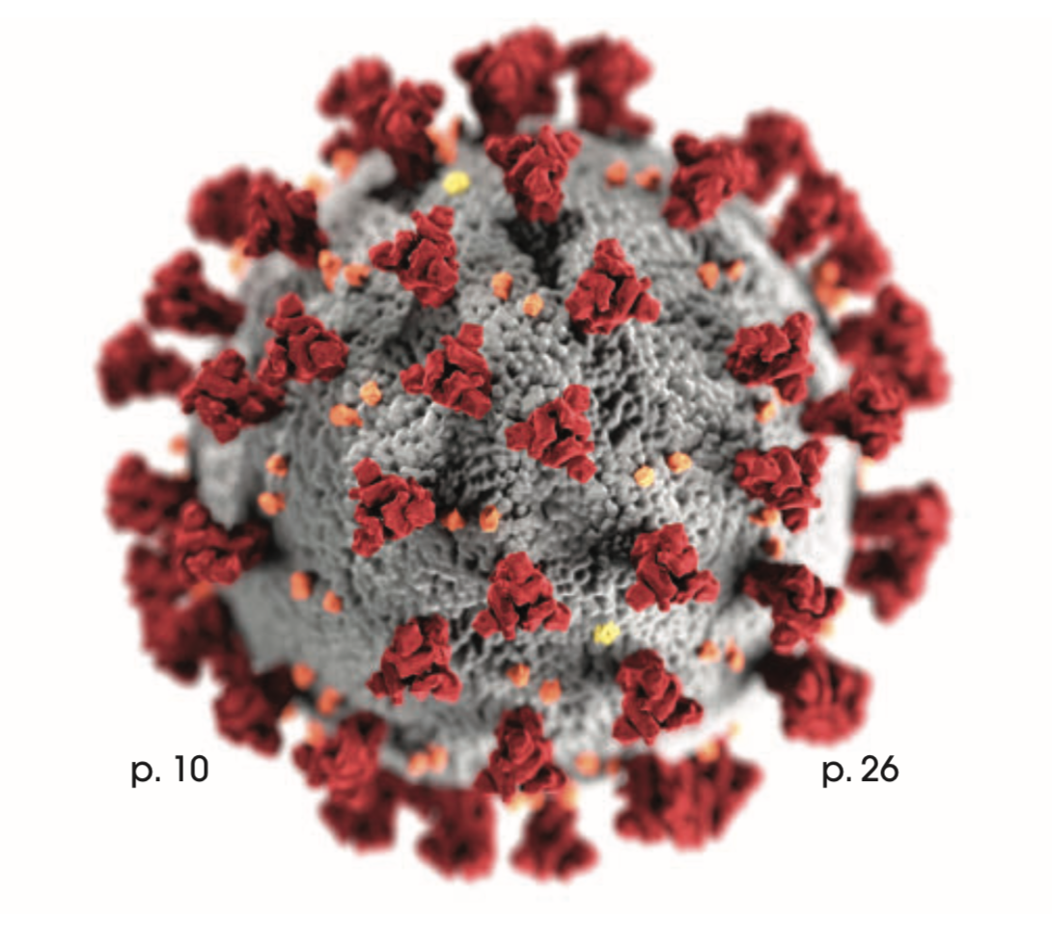
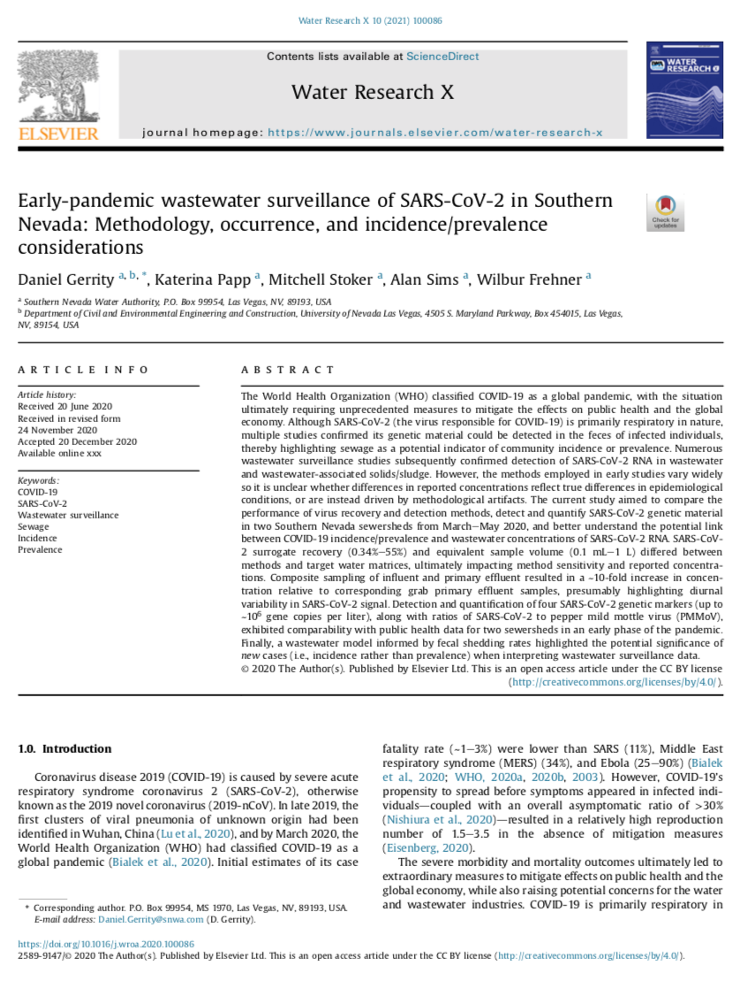
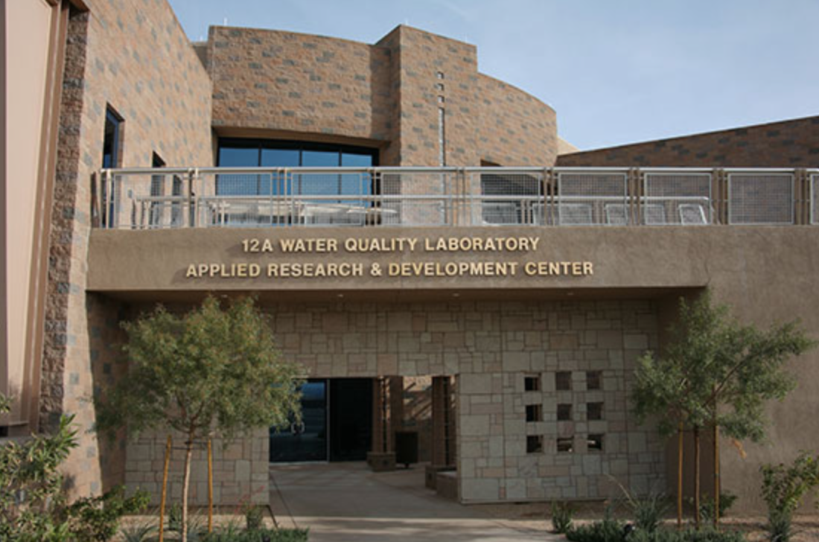
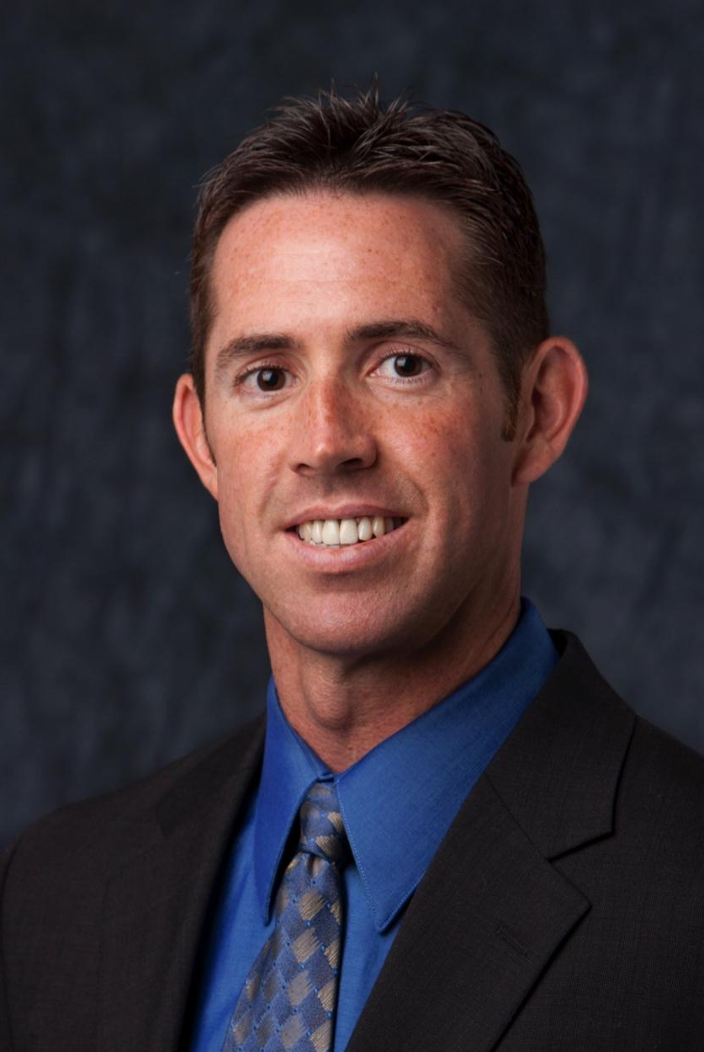
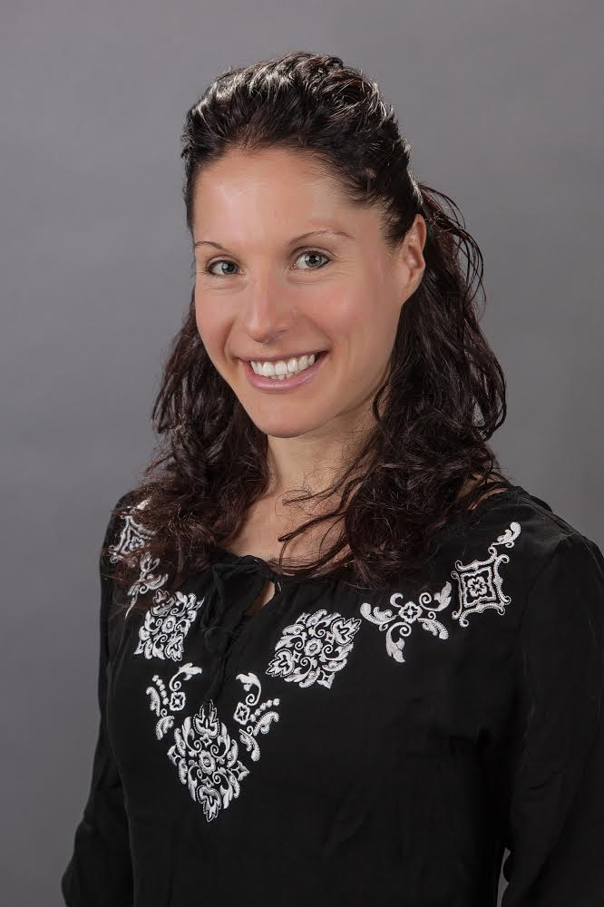
Wastewater Epidemiology for SARS-CoV-2 in Southern Nevada: Lessons Learned for Collaboration and Long-Term Implementation
Daniel Gerrity, Ph.D. and Katerina Papp, Ph.D.
Water Quality R&D, Southern Nevada Water Authority
Email: daniel.gerrity@snwa.com

Slide 2
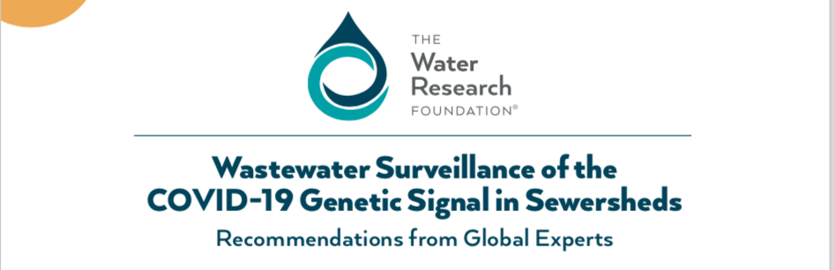
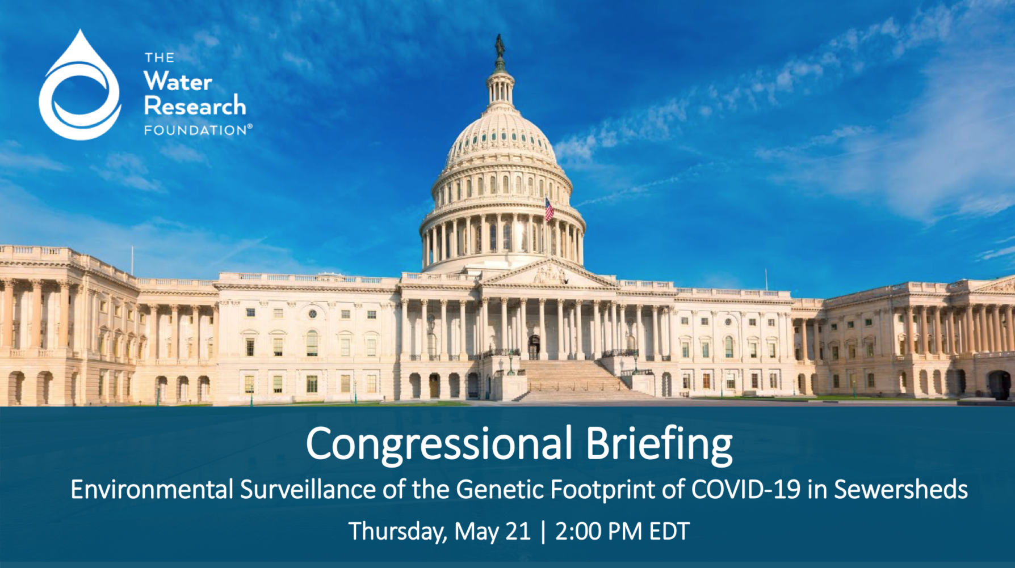
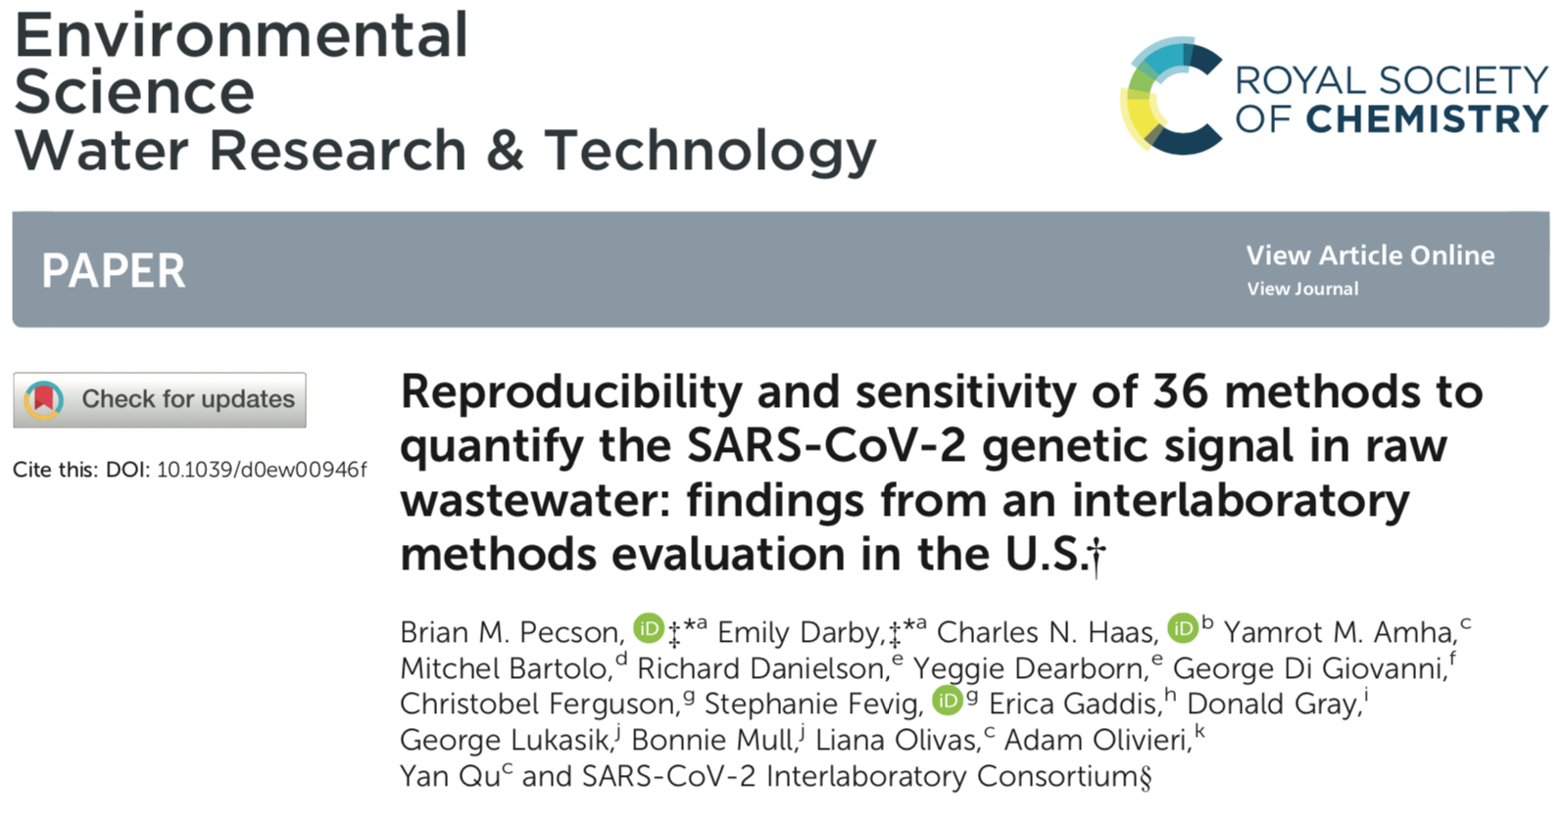
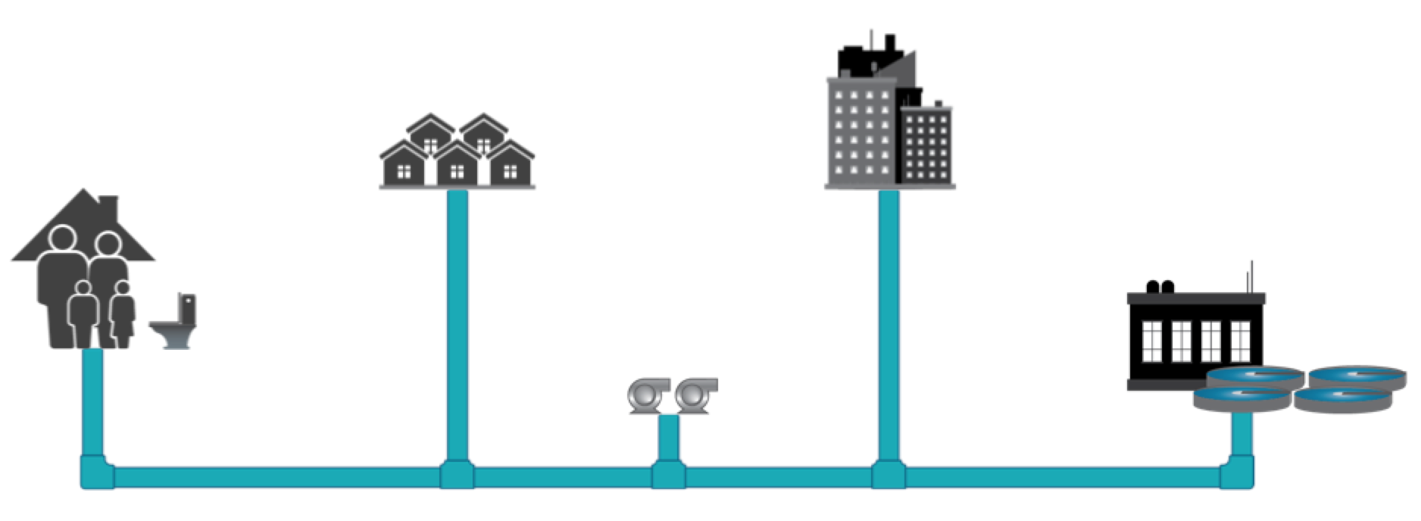
GLOBAL COLLBORATION
  Virtual International Research Summit in April
  Congressional Briefing in May
  Round Robin Method Comparison
  WW Surveillance Concepts:
    Trend Analysis
    Community vs. (Sub)sewershed vs. Facility
    Virus Evolution

Slide 3
Potential Applications of SARS-CoV-2 Wastewater Surveillance
SCALE and TIMING

Slide 4
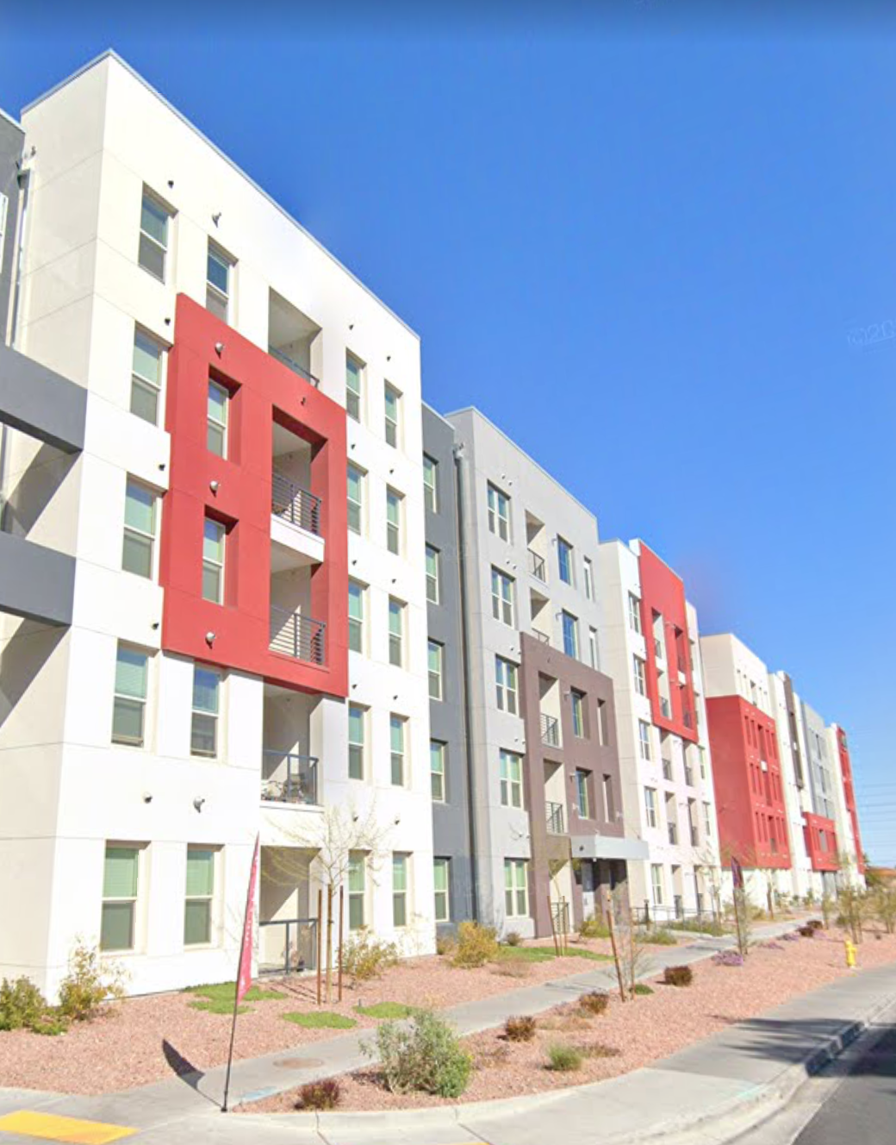
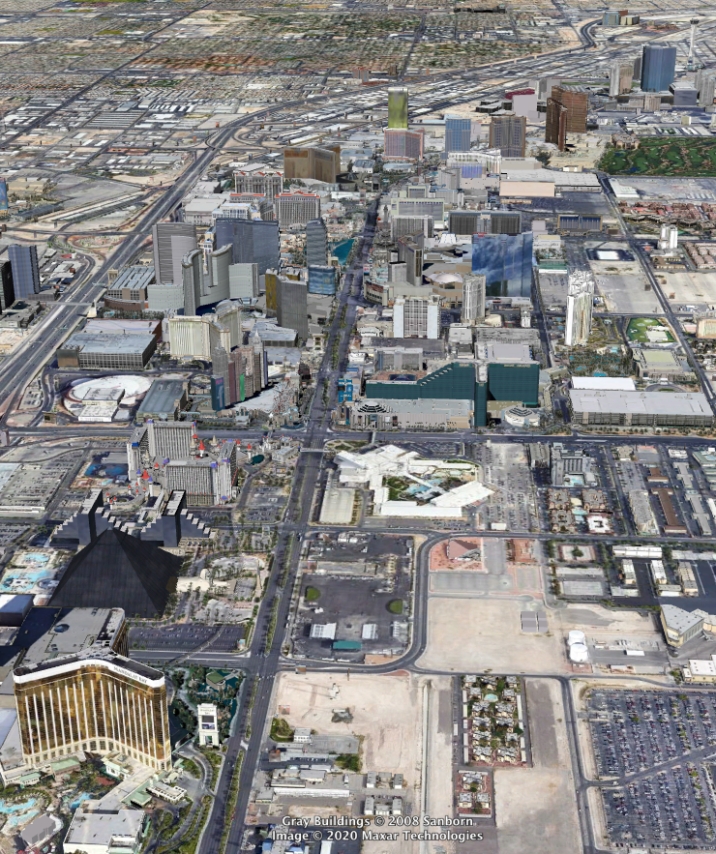
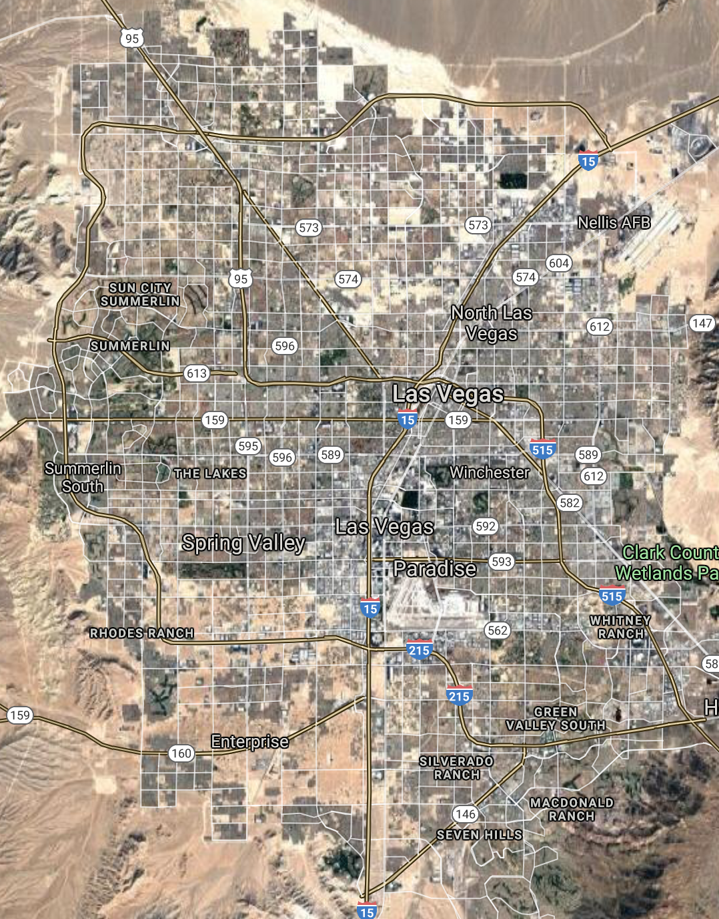
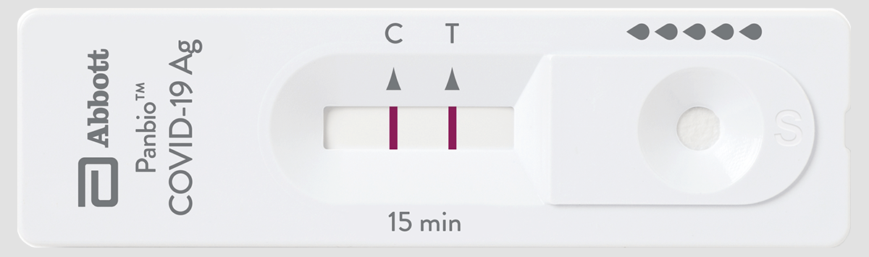
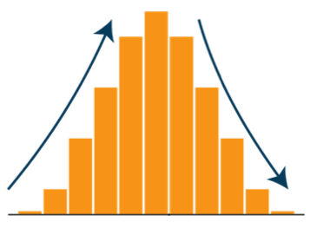
Facility
Sub-Sewershed
Region
SCALE
ACTIONABILITY
High
Moderate
Low
Confirmation of Trends in
Clinical Data

Slide 5
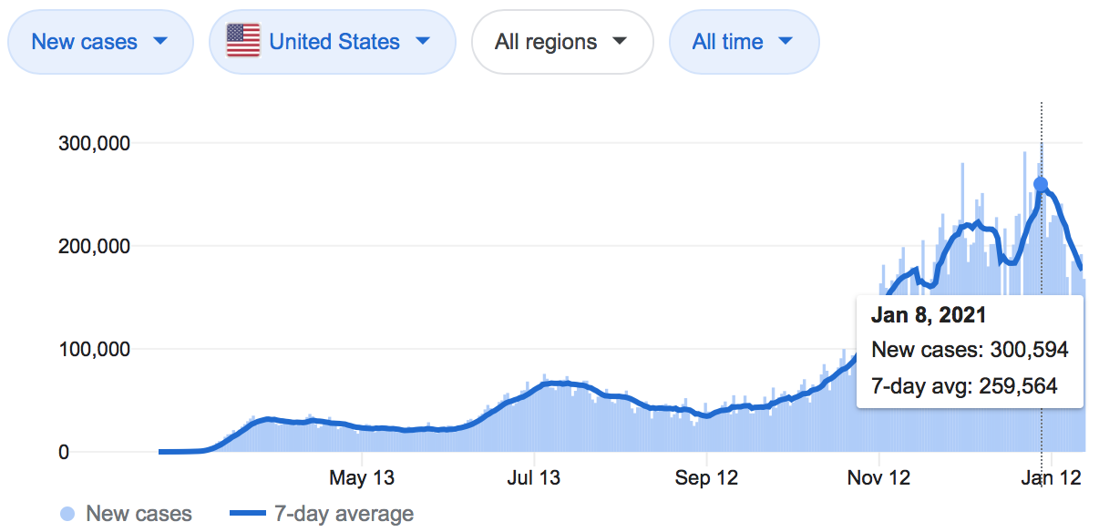
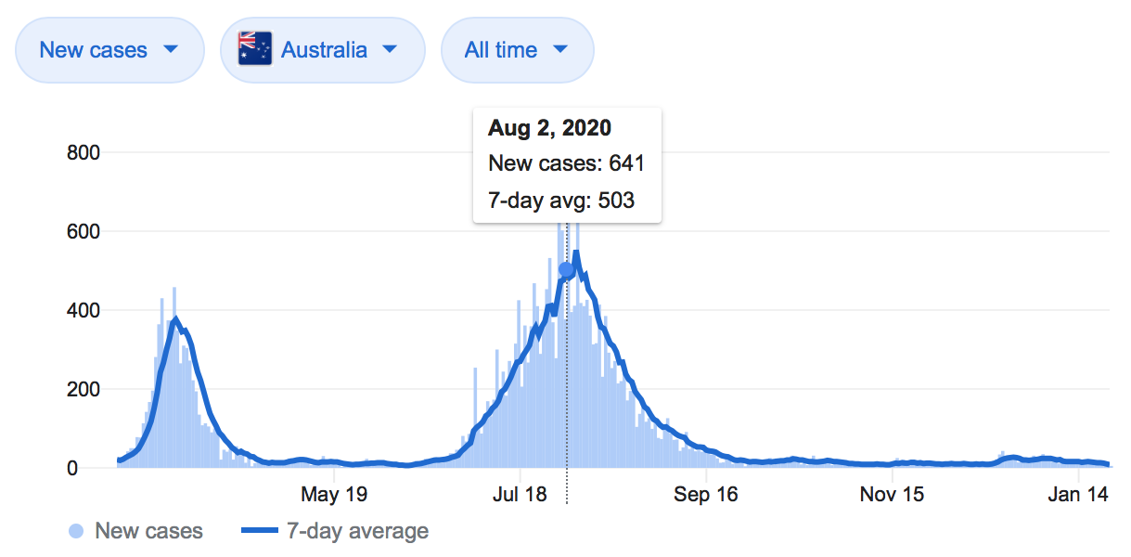
A TALE OF TWO COUNTRIES
United States
Population = 330 million
Max Daily Cases = ~300,000
Max Daily Cases = 91 per 100,000
Note Different Scales
Australia
Population = 25 million
Max Daily Cases = ~700
Max Daily Cases = 3 per 100,000

Slide 6
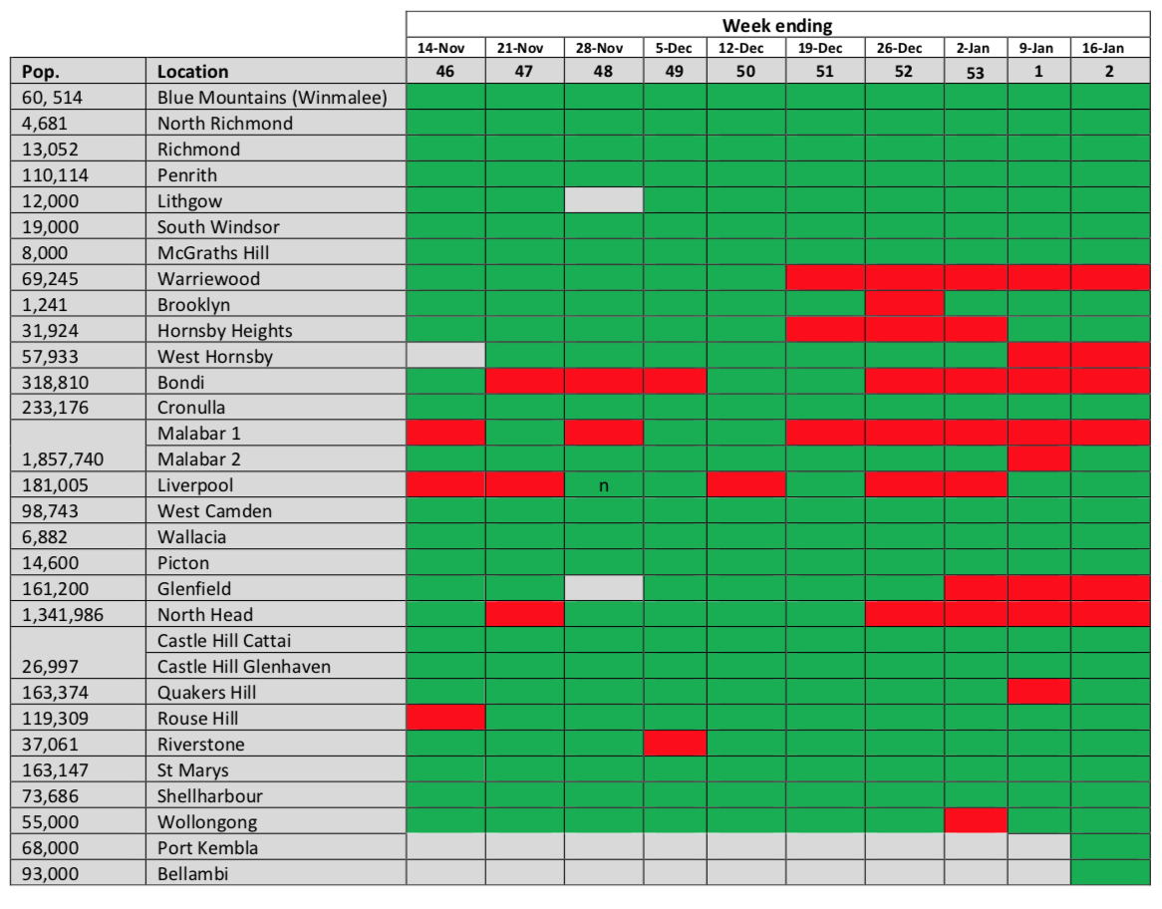
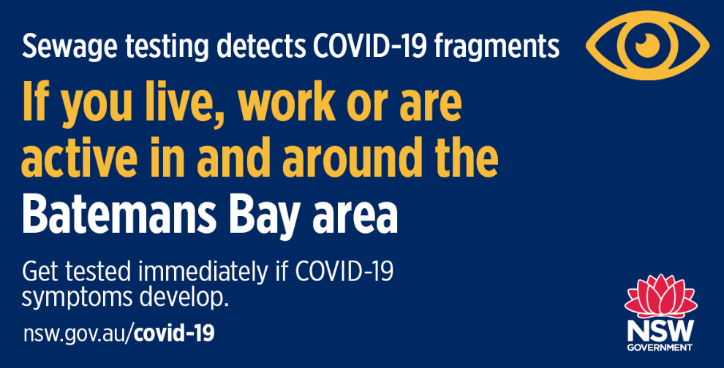
EARLY WARNING FOR RE-EMERGENCE
NOT DETECTED
DETECTED
  Source: health.nsw.gov.au

Slide 7
SARS-CoV-2 Wastewater Surveillance Methodology

Slide 8
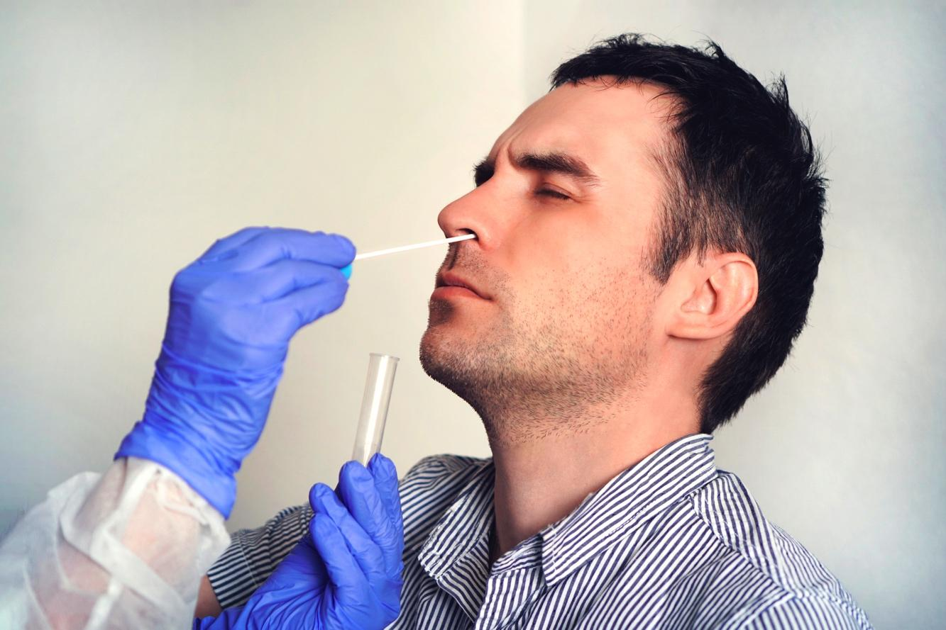
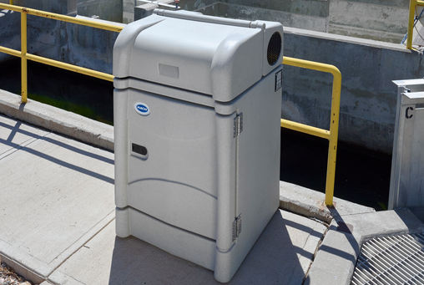


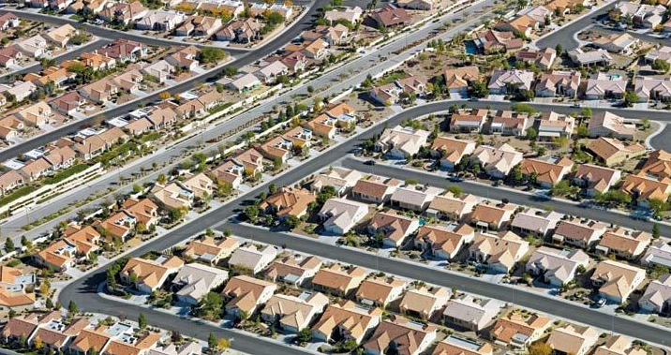
SARS-COV-2 IN WASTEWATER
Sample Collection (Every Monday Morning)
Pooled Testing

Slide 9
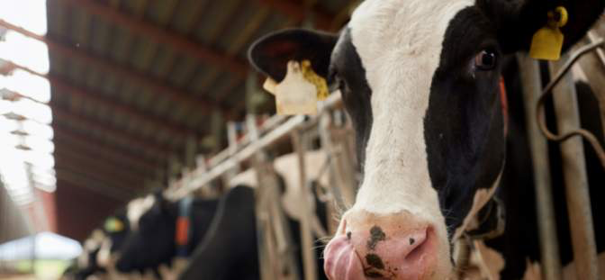
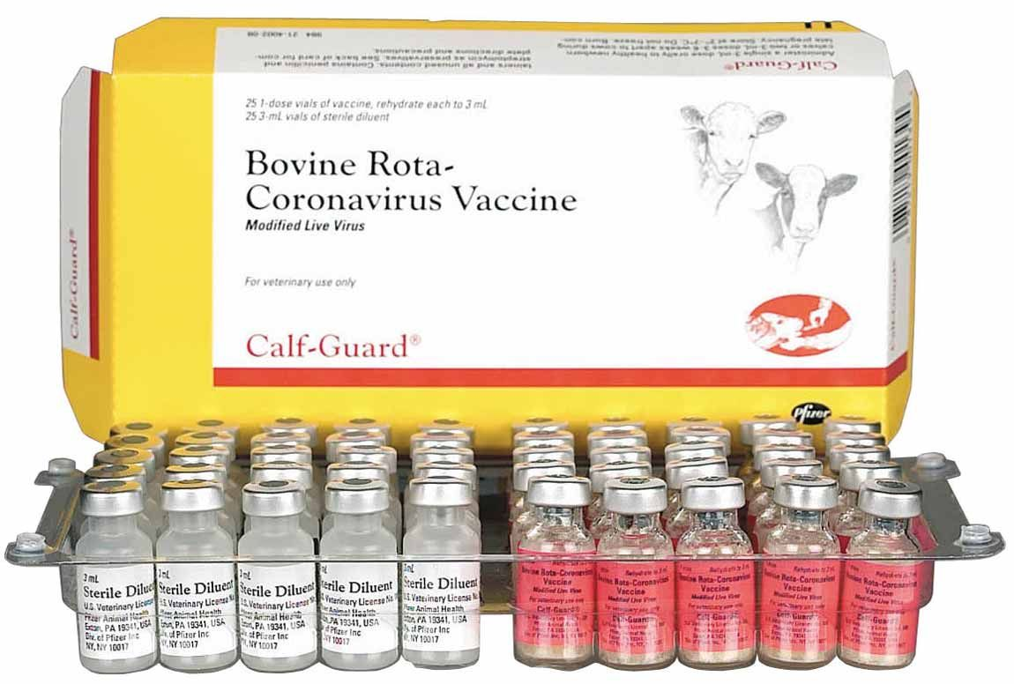
SARS-COV-2 IN WASTEWATER
Sample Collection (Every Monday Morning)
Surrogate Spike for Recovery (Bovine Coronavirus)

Slide 10
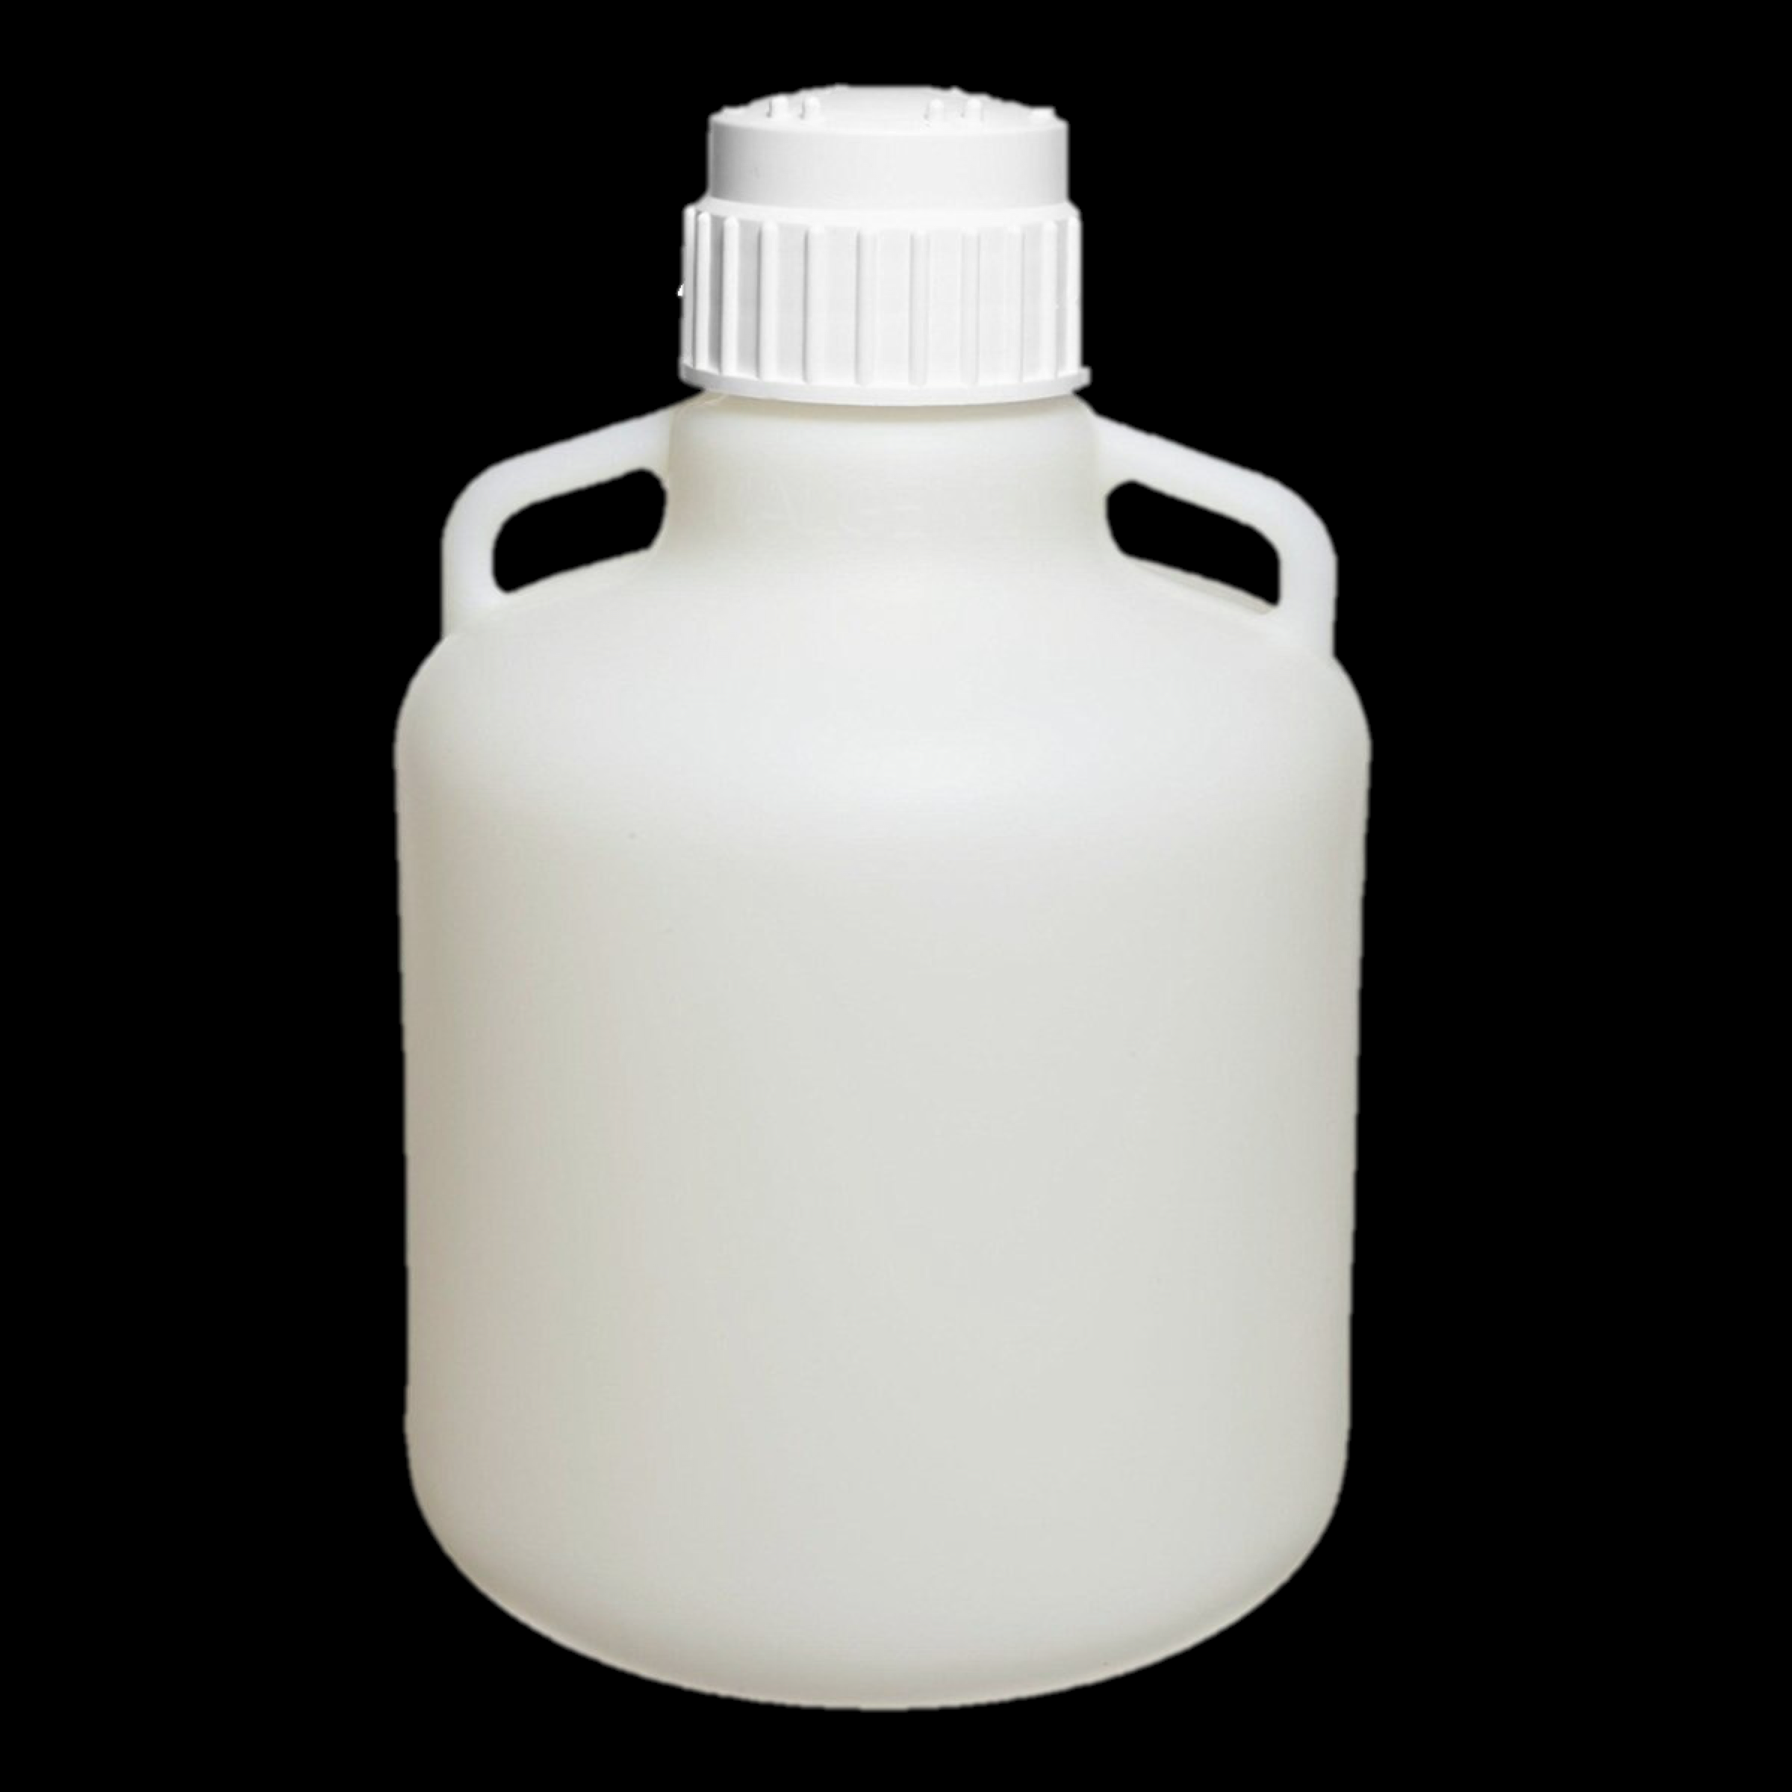
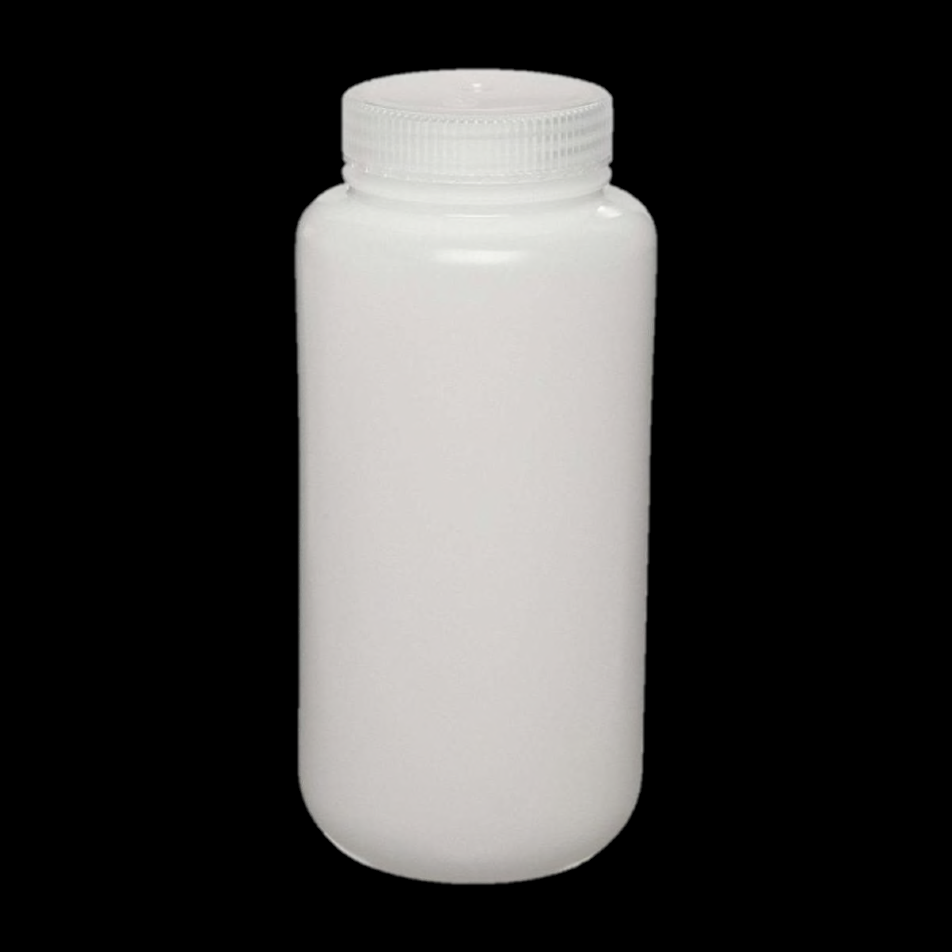
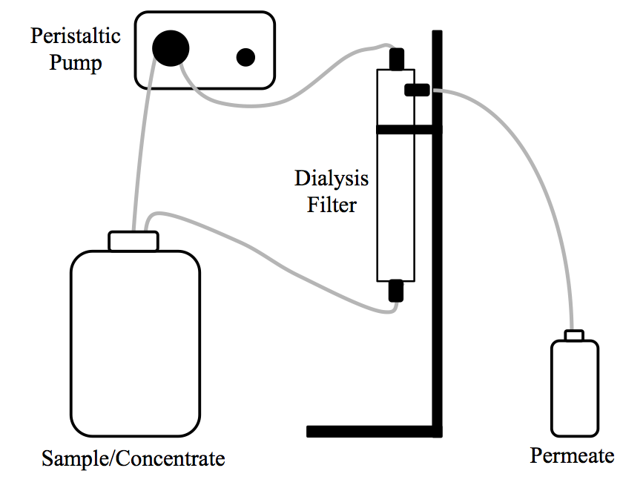
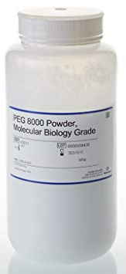
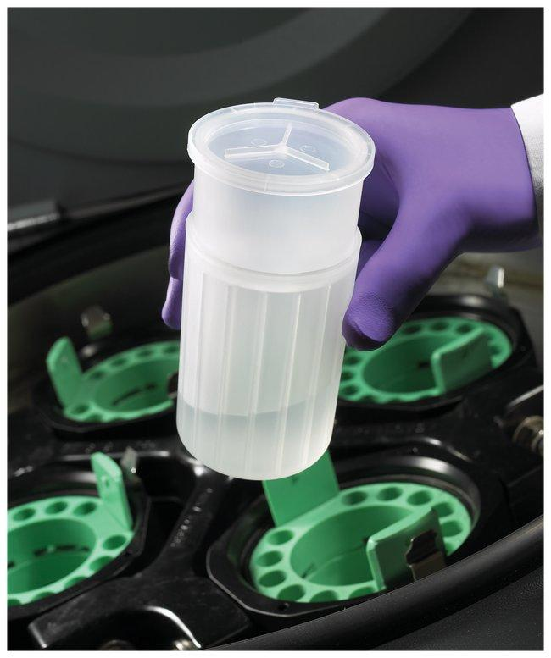
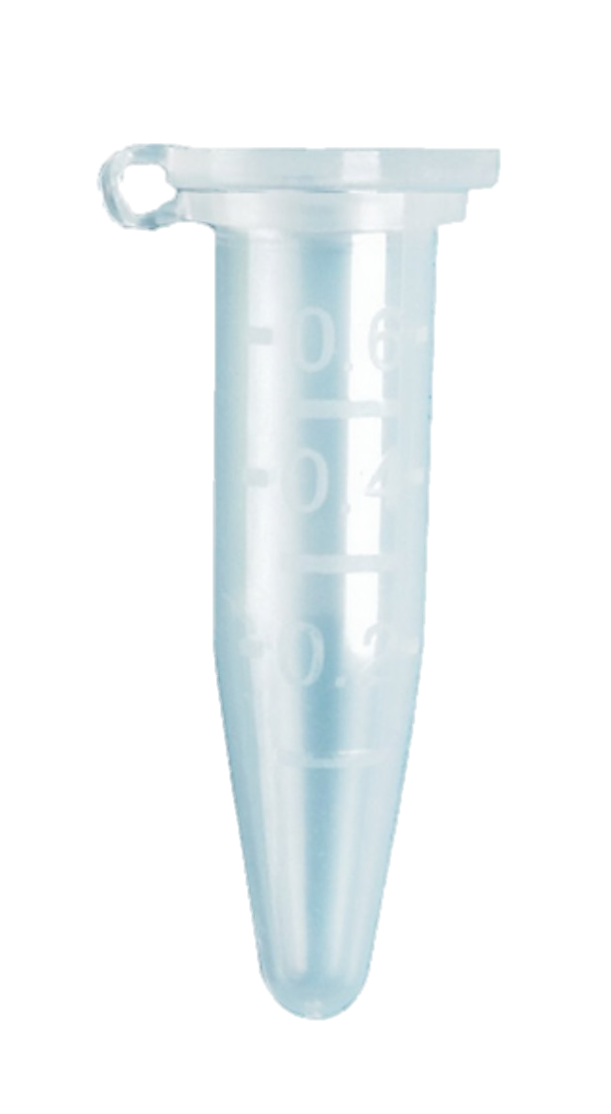
SARS-COV-2 IN WASTEWATER
Sample Collection (Every Monday Morning)
Surrogate Spike for Recovery (Bovine Coronavirus)
Sample Concentration
10 L
1 L
<0.001 L

Slide 11
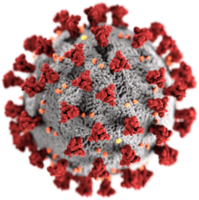
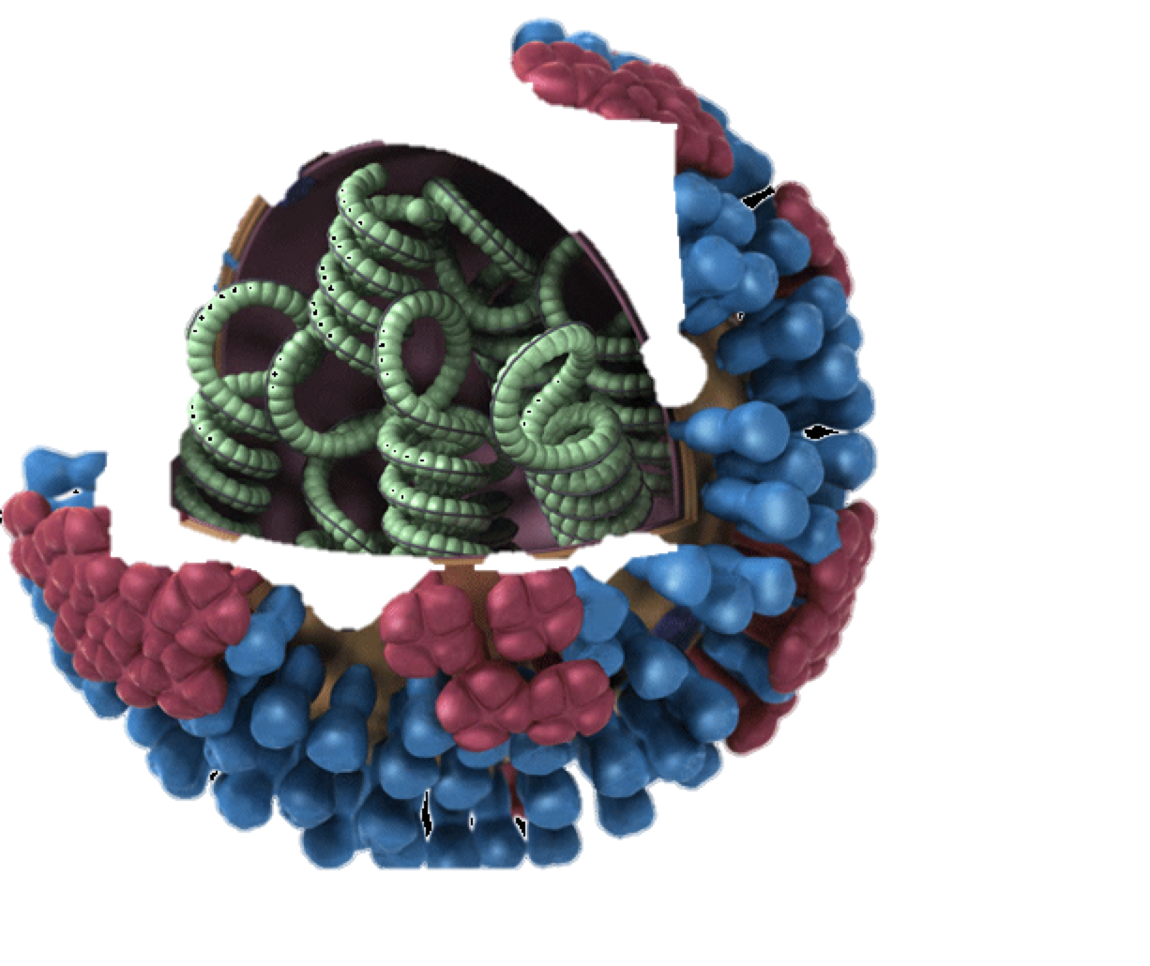
SARS-COV-2 IN WASTEWATER
Sample Collection (Every Monday Morning)
Surrogate Spike for Recovery (Bovine Coronavirus)
Sample Concentration
Nucleic Acid Extraction and Complementary DNA (cDNA) Synthesis
RNA 🡪 cDNA

Slide 12
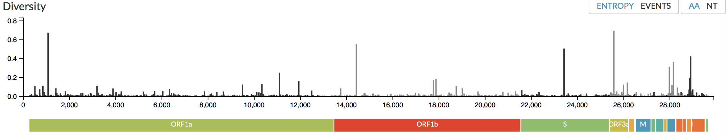
SARS-COV-2 IN WASTEWATER
Sample Collection (Every Monday Morning)
Surrogate Spike for Recovery (Bovine Coronavirus)
Sample Concentration
Nucleic Acid Extraction and Complementary DNA (cDNA) Synthesis
Analysis by qPCR with Gene-Specific Primers/Probes (4 Different Assays)
SARS-CoV-2 Genome

Slide 13
SARS-COV-2 IN WASTEWATER
Sample Collection (Every Monday Morning)
Surrogate Spike for Recovery (Bovine Coronavirus)
Sample Concentration
Nucleic Acid Extraction and Complementary DNA (cDNA) Synthesis
Analysis by qPCR with Gene-Specific Primers/Probes (4 Different Assays)
Convert SARS-CoV-2 Concentration to COVID-19 Incidence

Slide 14
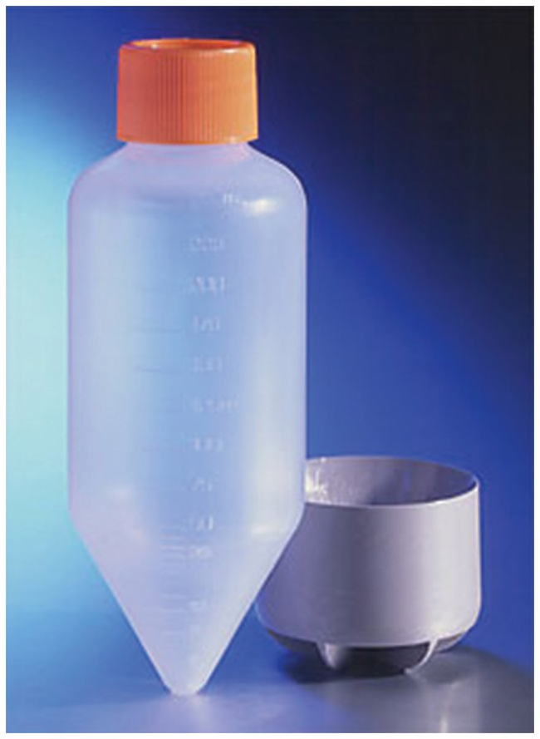
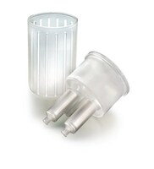
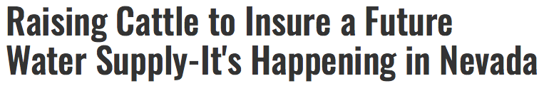
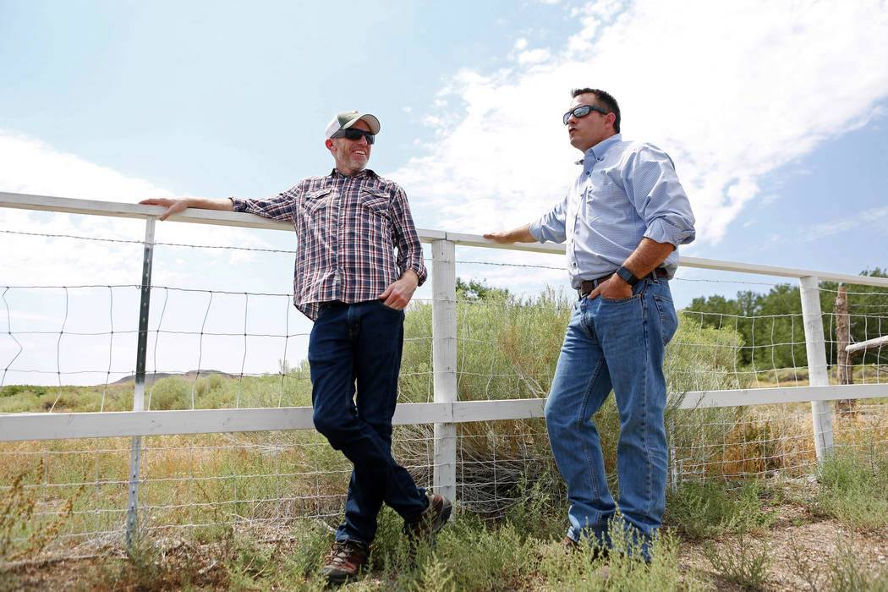
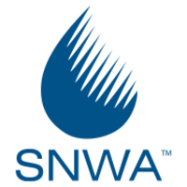
SUPPLY CHAIN CONSIDERATIONS
Backordered!
Centricon Plus-70
Centrifugal Filters (100 kDa)
Consider required consumables (cost and availability) when selecting a method
Have a method backup plan and understand implications of method changes
Refrigerated storage may be fine (avoid freezing)

Slide 15
Southern Nevada Wastewater Surveillance Data

Slide 16
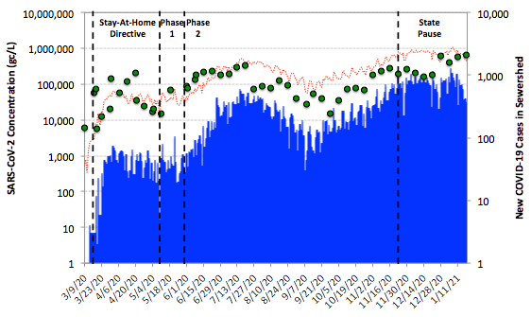
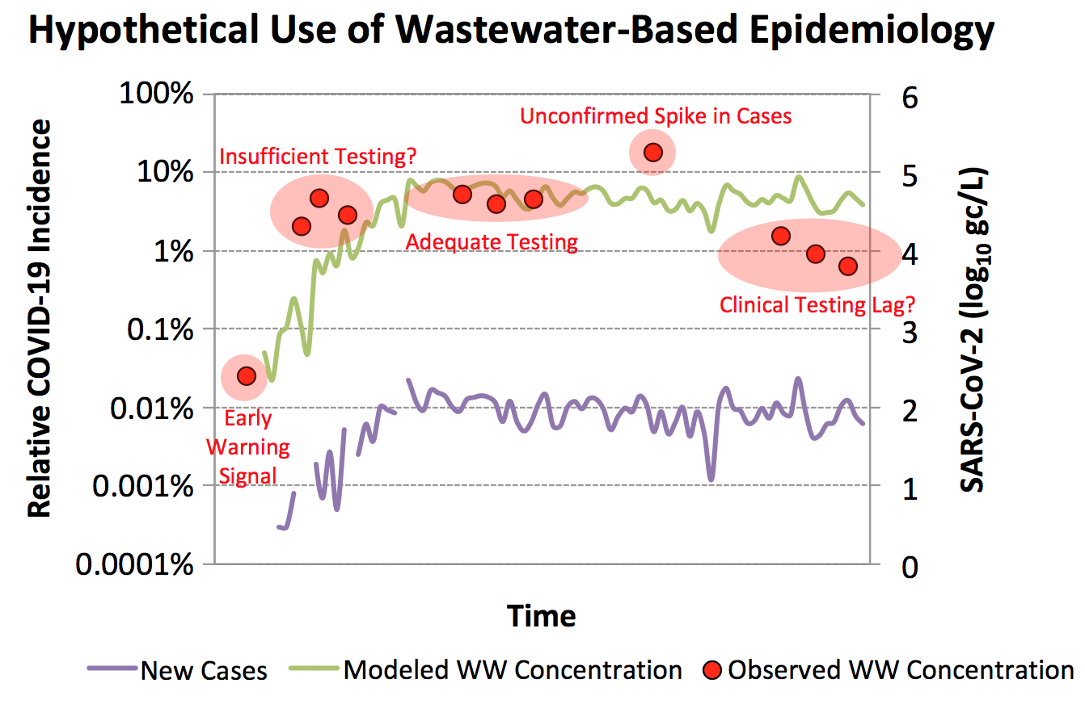
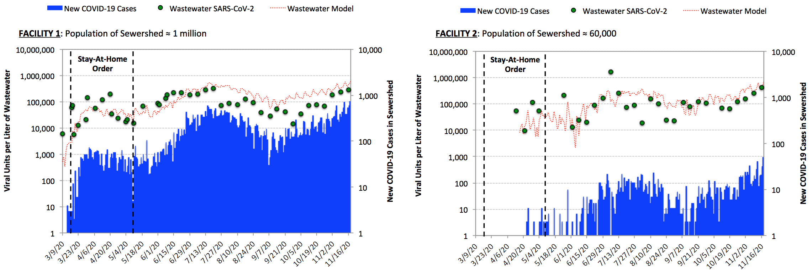
COMMUNITY TREND ANALYSIS
  Facility 1: 100 mgd and 1 million people
  Potential Interpretation of WW Surveillance
  (mgd = million gallons per day)

Slide 17
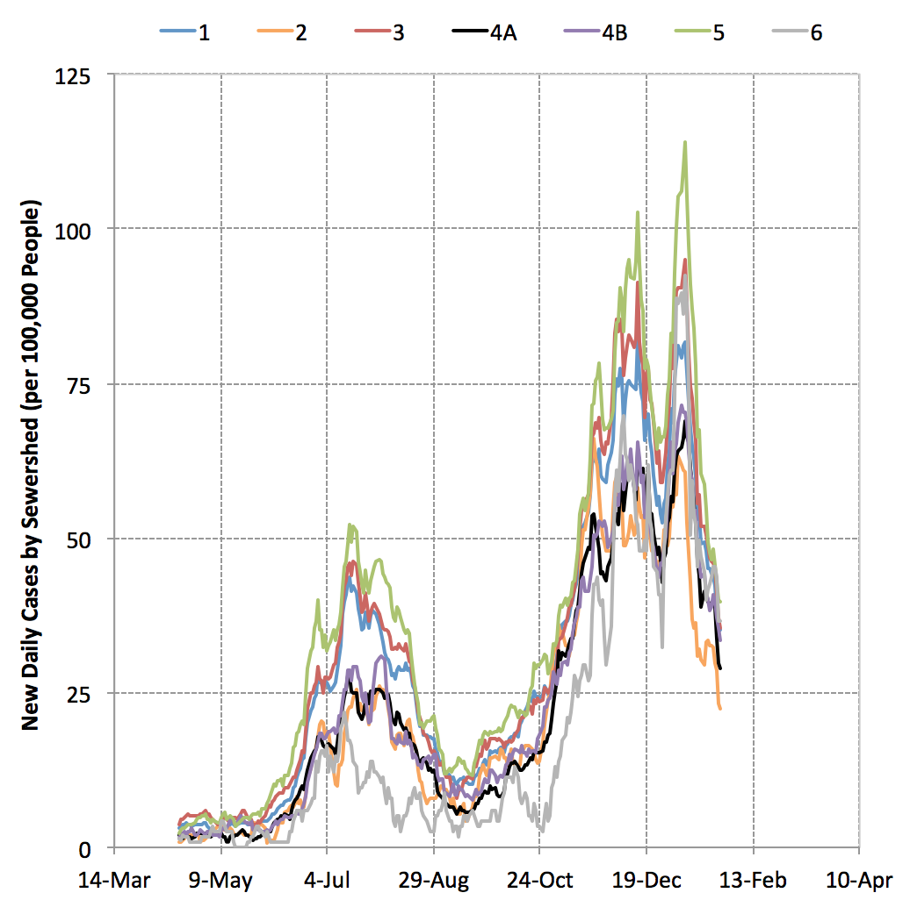
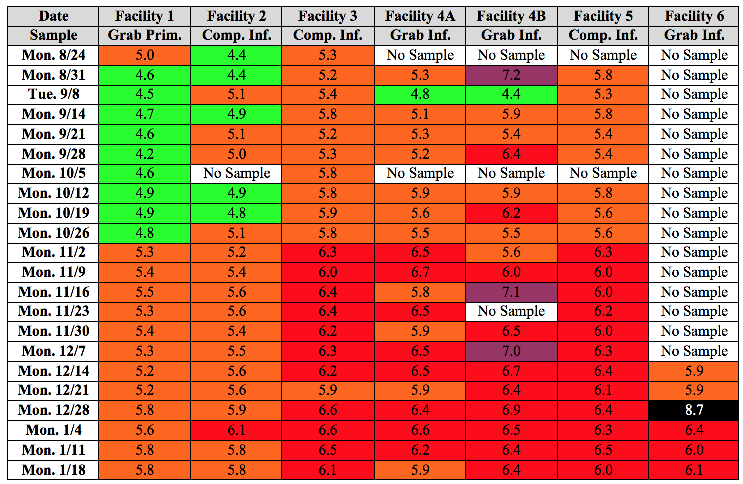
(SUB)SEWERSHED TREND ANALYSIS
  Sewershed COVID-19 Cases
  (per 100,000 people)
  Sewershed SARS-CoV-2 Concentrations
  (log₁₀ gc/L)
Facility
Critical

Slide 18
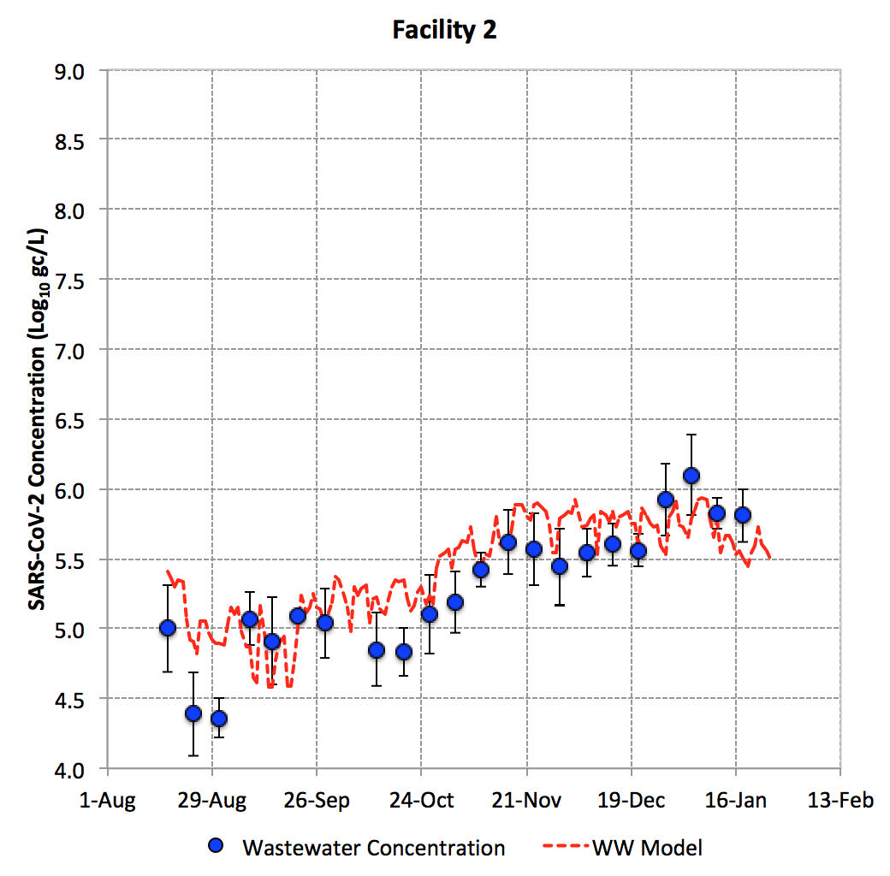
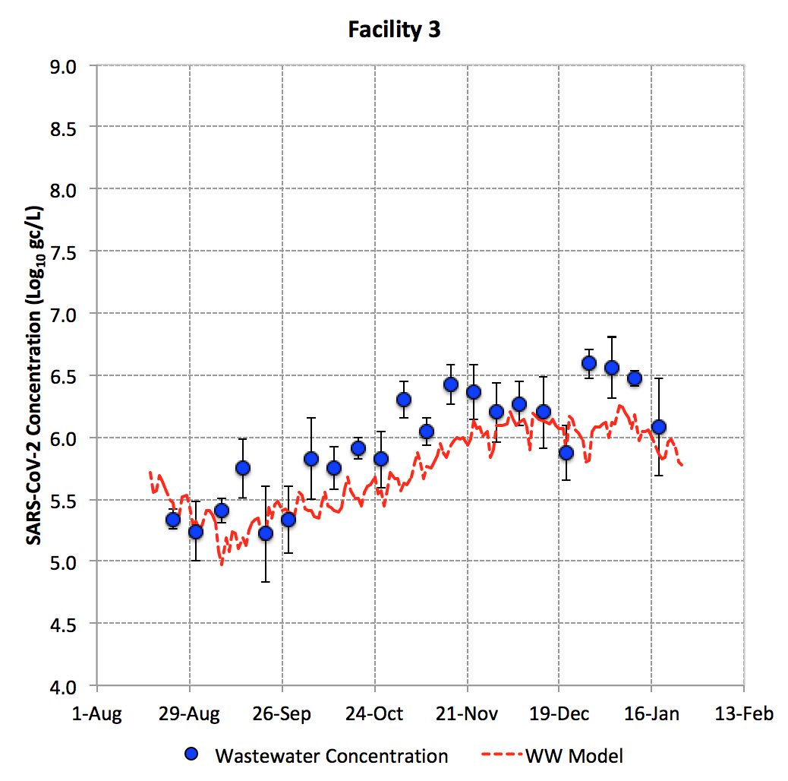
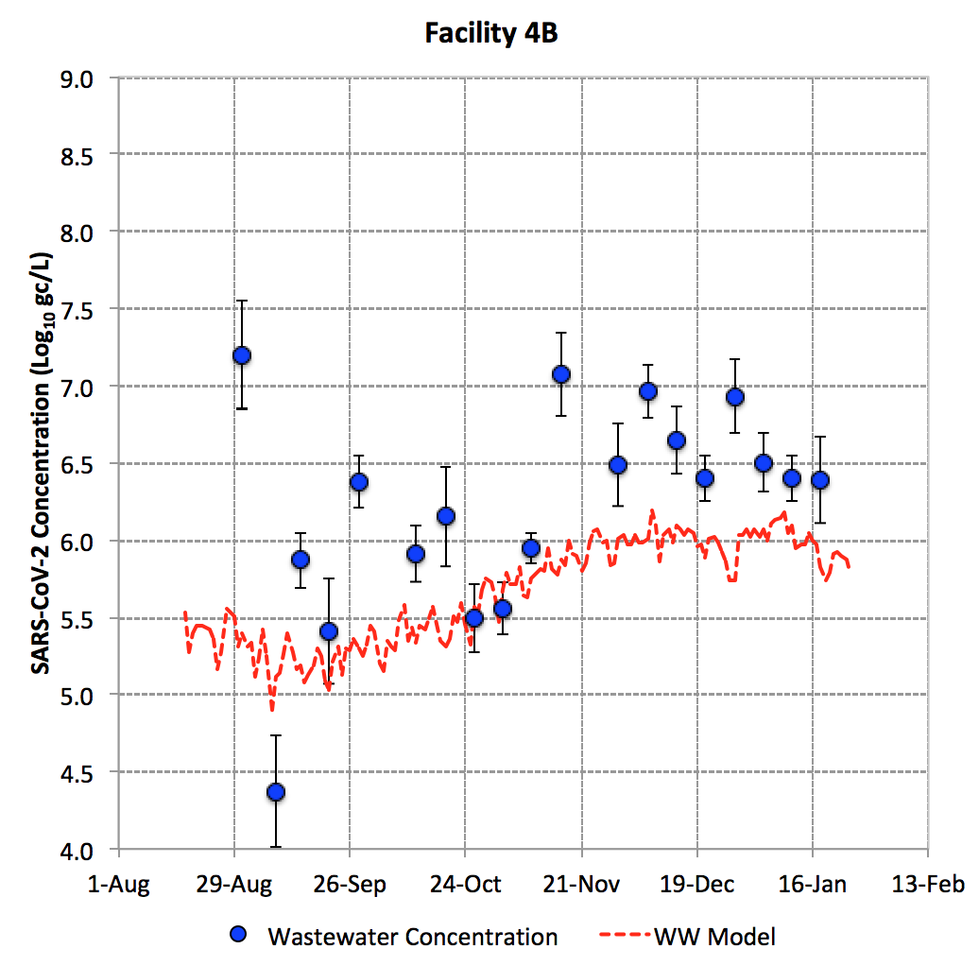
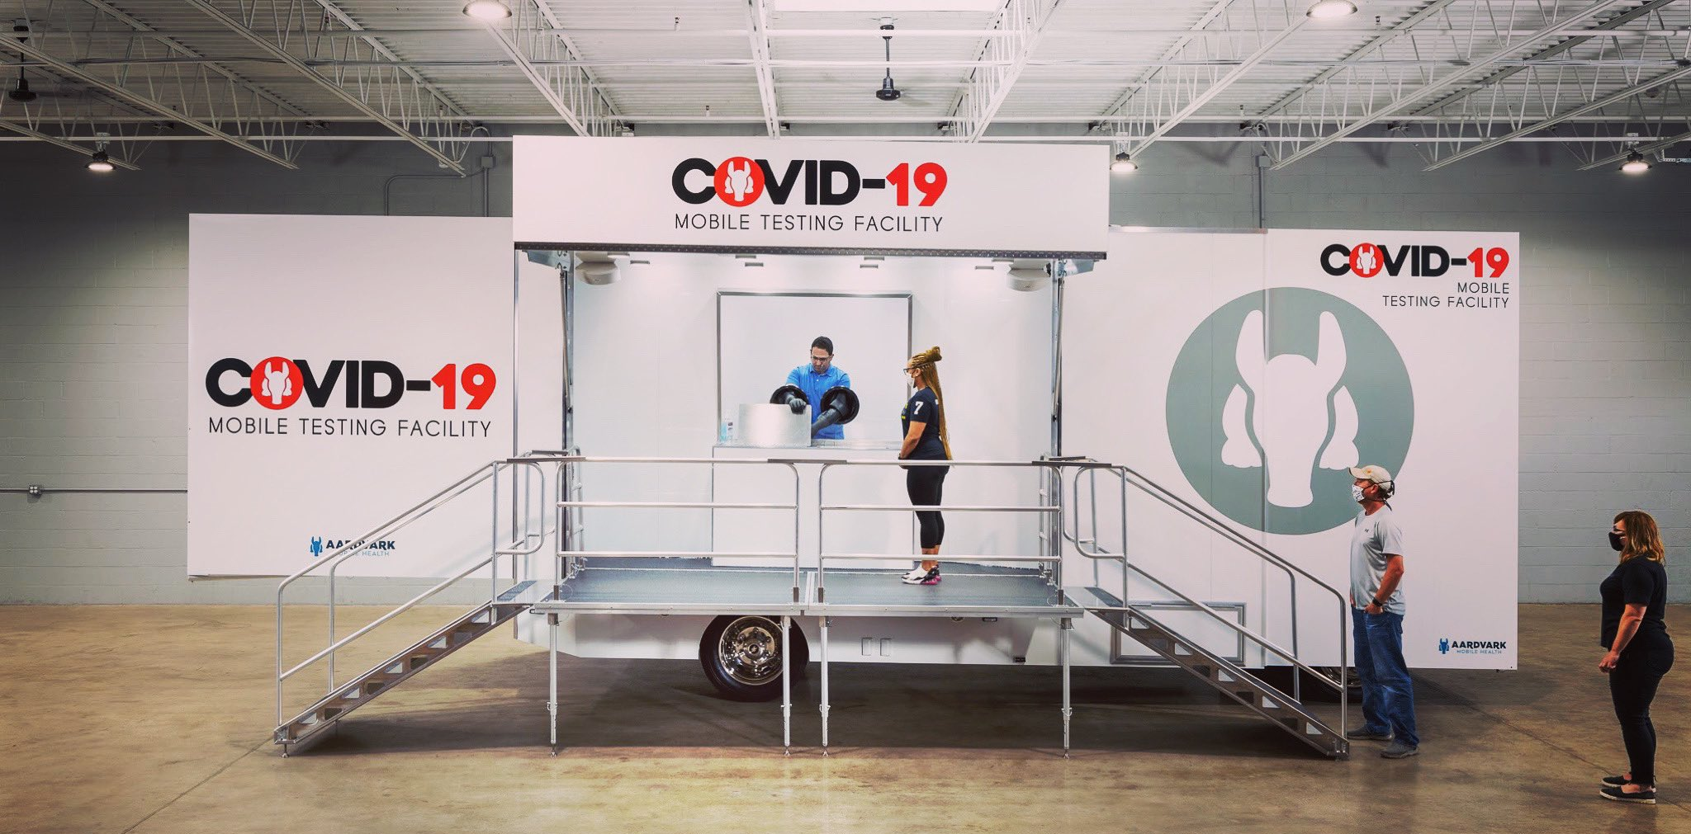
(SUB)SEWERSHED SCALE
Facility 4B: Greater discrepancy between wastewater concentrations and clinical case data (i.e., model)

Slide 19
ACKNOWLEDGMENTS
This work was partially supported by the National Science Foundation under Grant No. 1832713.
Staff at the collaborating wastewater agencies for their assistance with sample logistics and data access
Staff at the Southern Nevada Water Authority for ensuring a safe work environment during the pandemic
Casey Hall and the UNLV Genomics Core Facility
Mark Borchardt and Susan Spencer at the U.S. Department of Agriculture for generously providing the bovine coronavirus vaccine stock.
Countless research colleagues for their guidance
Questions: daniel.gerrity@snwa.com

