Slide 1
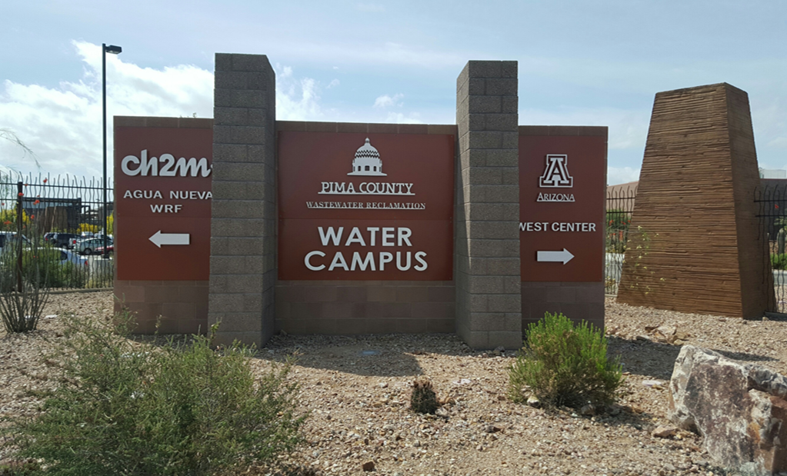

Introduction to Sewage Epidemiology
Walter Betancourt
Charles P. Gerba
Ian Pepper
Department of Environmental
Science

Slide 2
Sewage Surveillance
The virus concentration in sewage is related to the number of cases in a community
Goes back more than 40 years for detecting poliovirus cases in communities – in use by poliovirus eradication program
Advantages:
  Can detect one case of infection in 100,000 persons
  Can determine success or failures of interventions
  Can predict the number of cases 7 to 10 days before clinical cases are recognized
  Can be use to identify facilities with infected individuals
  Less closely than large numbers of clinical tests

Slide 3
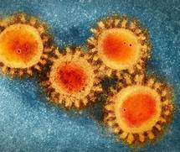
SARS- CoV-2 Studies Underway
Sewage surveillance of
  Communities
  Dormitories
Determination of infectivity of SARS-CoV-2 in wastewater
Survival of SARS-CoV-2 in wastewater
Disinfectant assessment
  UV light
  Chloramines
Persistent anti-viral coatings and fabrics
  Anti-viral clothing (Masks and protective equipment)

Slide 4
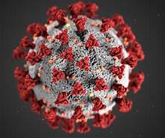
Coronaviruses
An enveloped virus
ssRNA
Survives several days in wastewater/ water
Excreted in both the urine and feces

Slide 5
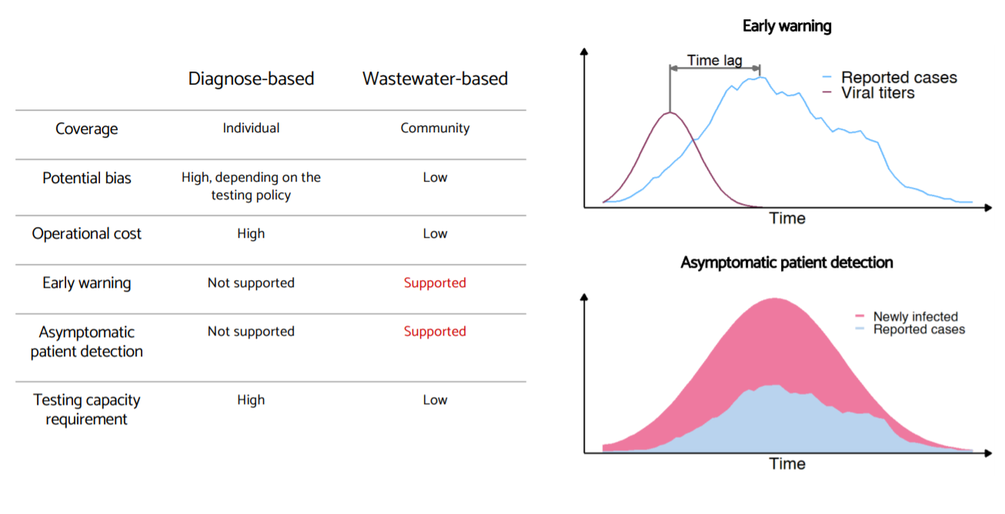
Advantages of Wastewater Epidemiology

Slide 6
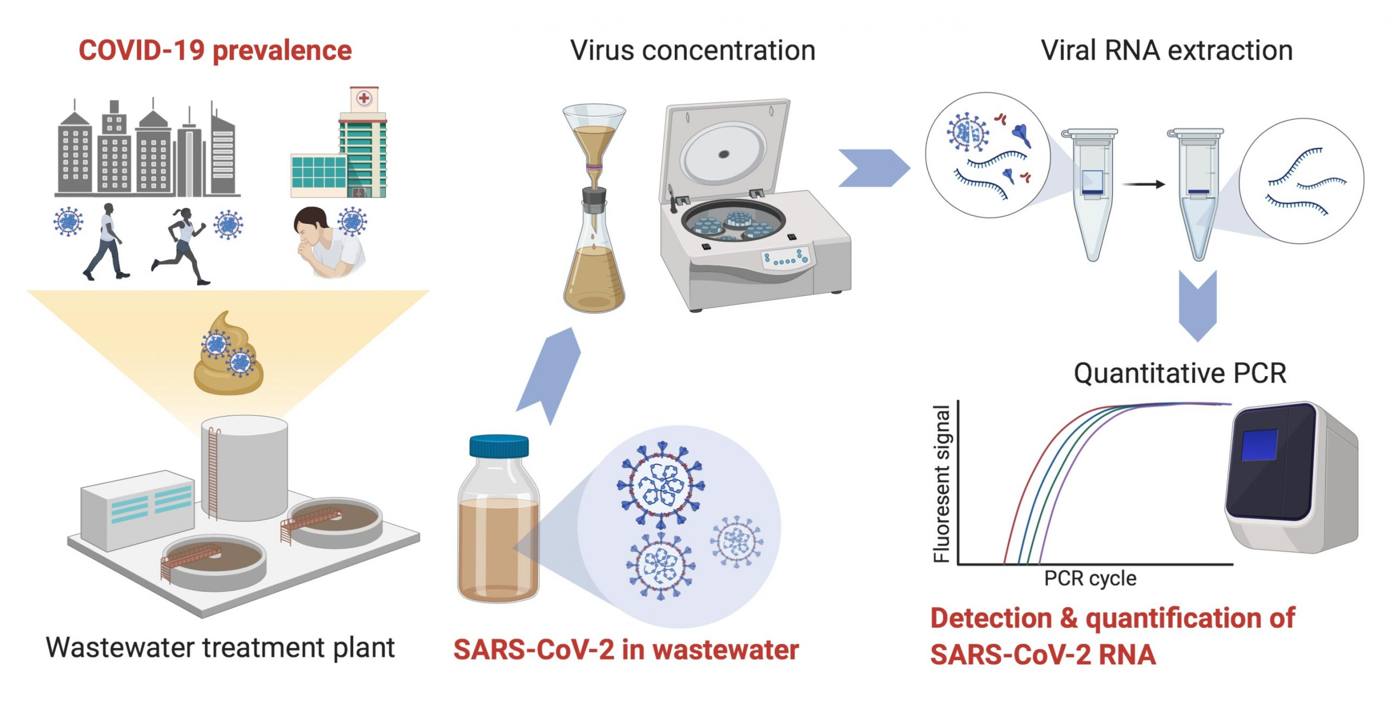

Slide 7








How University of Arizona aimed to control spread among 7,600 students
Population
Collection
Lab processing
Structured decision tree based on results
7,600 on-campus students
23 dorm buildings
Weekly collection for each building
Anomalous results trigger additional sampling
Anonymous nature of sampling alleviates CLIA requirements
Existing BSL 2 lab
Filters and centrifuges for simple sample prep
CDC panel assay
Roche and Biorad RT-PCR analyzers
10¹ to 10² viral copies: increased wastewater screening of target building
10³ to 10⁴ viral copies: increased wastewater screening and initial individual screening
10⁵ to 10⁹ viral copies: intensive response with antigen testing of all individuals and follow-on molecular tests

Slide 8
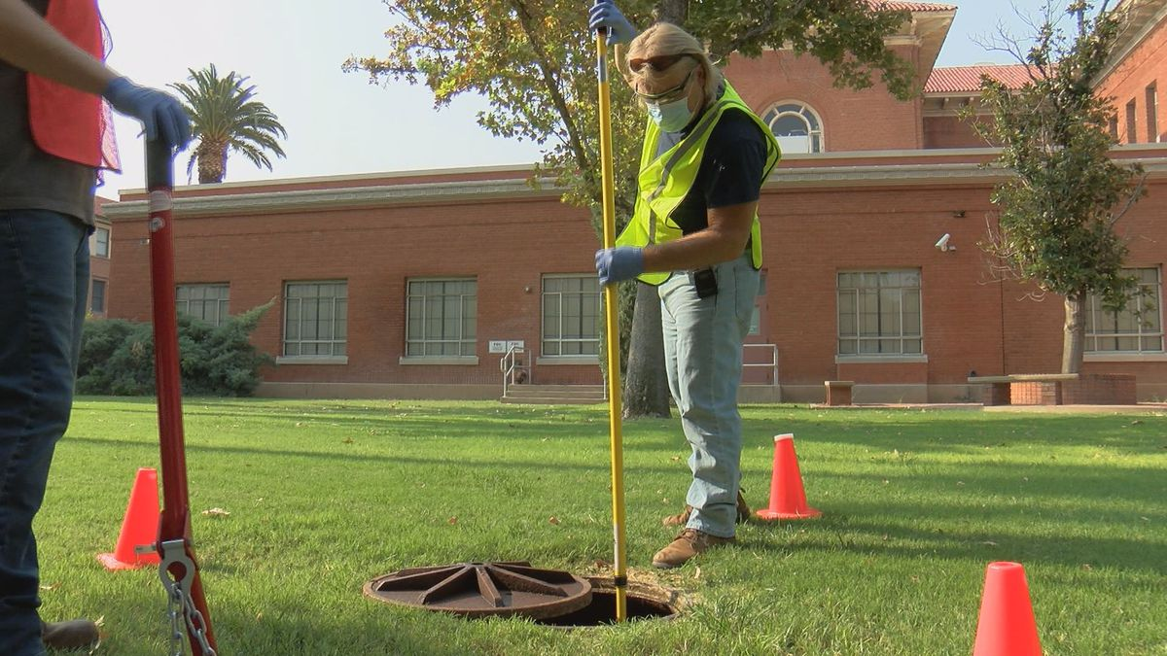
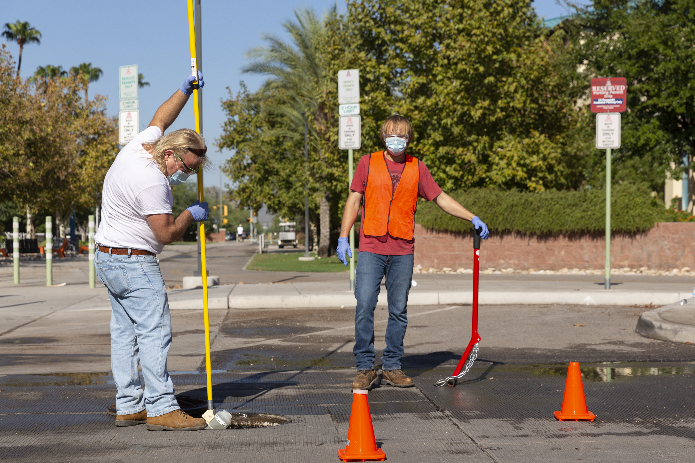
Collecting Wastewater from Dorms

Slide 9
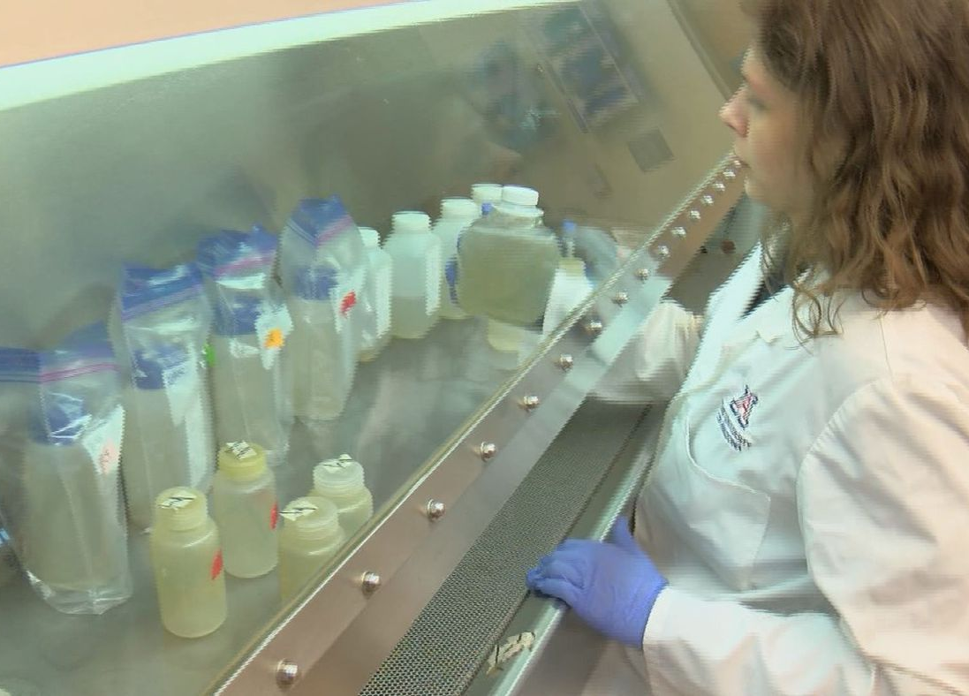
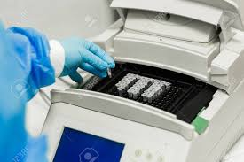
From 100 samples/year to 100 samples/Week

Slide 10
Wastewater-Based Epidemiology at the University of Arizona WEST Center
The Likins Dorm Case Study - Timeline
Date | Time | Event
August 25 | 8:30am | Likins Dorm wastewater sampled
 | 8:30am – 5:00pm | Sample analyzed
 | 6:00pm | positive for SARS-CV-2 and announced to UA Task Force
 | 11:00pm | Emergency meeting, Dr. Pepper with Task Force including President Robbins
August 26 | 8:00am | Emergency meeting – decision made to test students in Likins Hall
 | 8:30am | 5 samples, one every 5 minutes, collected from Likins Dorm sewage
 | 11:00am | Antigen and PCR tests of students in Likins Dorm
 | 5:30pm | All 5 samples positive for SARS-CoV-2. Concentrations virtually identical in all 5 samples. Two students positive for antigen test and removed from Likins Dorm
August 27 | 8:30am | Wastewater sample collected from Likins Dorm
 | 12:30pm | Additional sample collected from Likins Dorm
 | 5:00pm | All samples found to be negative
August 28 | 8:30am | Likins Hall sample collected
 | 5:00pm | Sample found to be negative
August 30 |  | Plans made to double WBE testing capacity - Originally 10 locations twice weekly - New projection 24 locations 3x a week

Slide 11
Effectiveness of the COVID-19 Containment Strategy at the University of Arizona
No new cases from 10/17
To 11/30

Slide 12
SARS-CoV-2 Virus - Update
No infectious virus detected yet detected in wastewater
By RT-qPCR as high as 10,000,000/liter detected in wastewater
By RT-qPCR high a 100,000,000/liter detected in primary sludge

Slide 13
What have we learned – sewage monitoring for SARS-CoV-2 at the University of Arizona and Tucson
Grab samples collected in the morning works in identifying cases
Can identify as few as 2 infected students in a in dorms of ~327
No viruses detected in sewage after infected students removed
Four-day lead on identifying cases before positive clinical test by student health center
Concentration of virus increases in community sewage after Memorial day, 4th of July, Labor, Thanksgiving and New Year day before increase seen in clinical cases
Social distancing, use of masks, and stay in place decreased concentration of virus in sewage
Virus concentrations in dorm sewage with infected individuals range from 1e3 to 1e9 per liter

Slide 14
What is needed
Development of standard methods
  Several companies are producing SARS-CoV-2 test kits for wastewater testing
Tools for data analyses
Education and training
  Most health departments do not know how to use the data
  Many potentional applications
    – quantifying successes of interventions
    -targeting interventions to greatest number of cases with a region
National network data collection
  100 treatment systems will be in a nationwide network in the U.S. (NIH/CDC)

