Slide 1

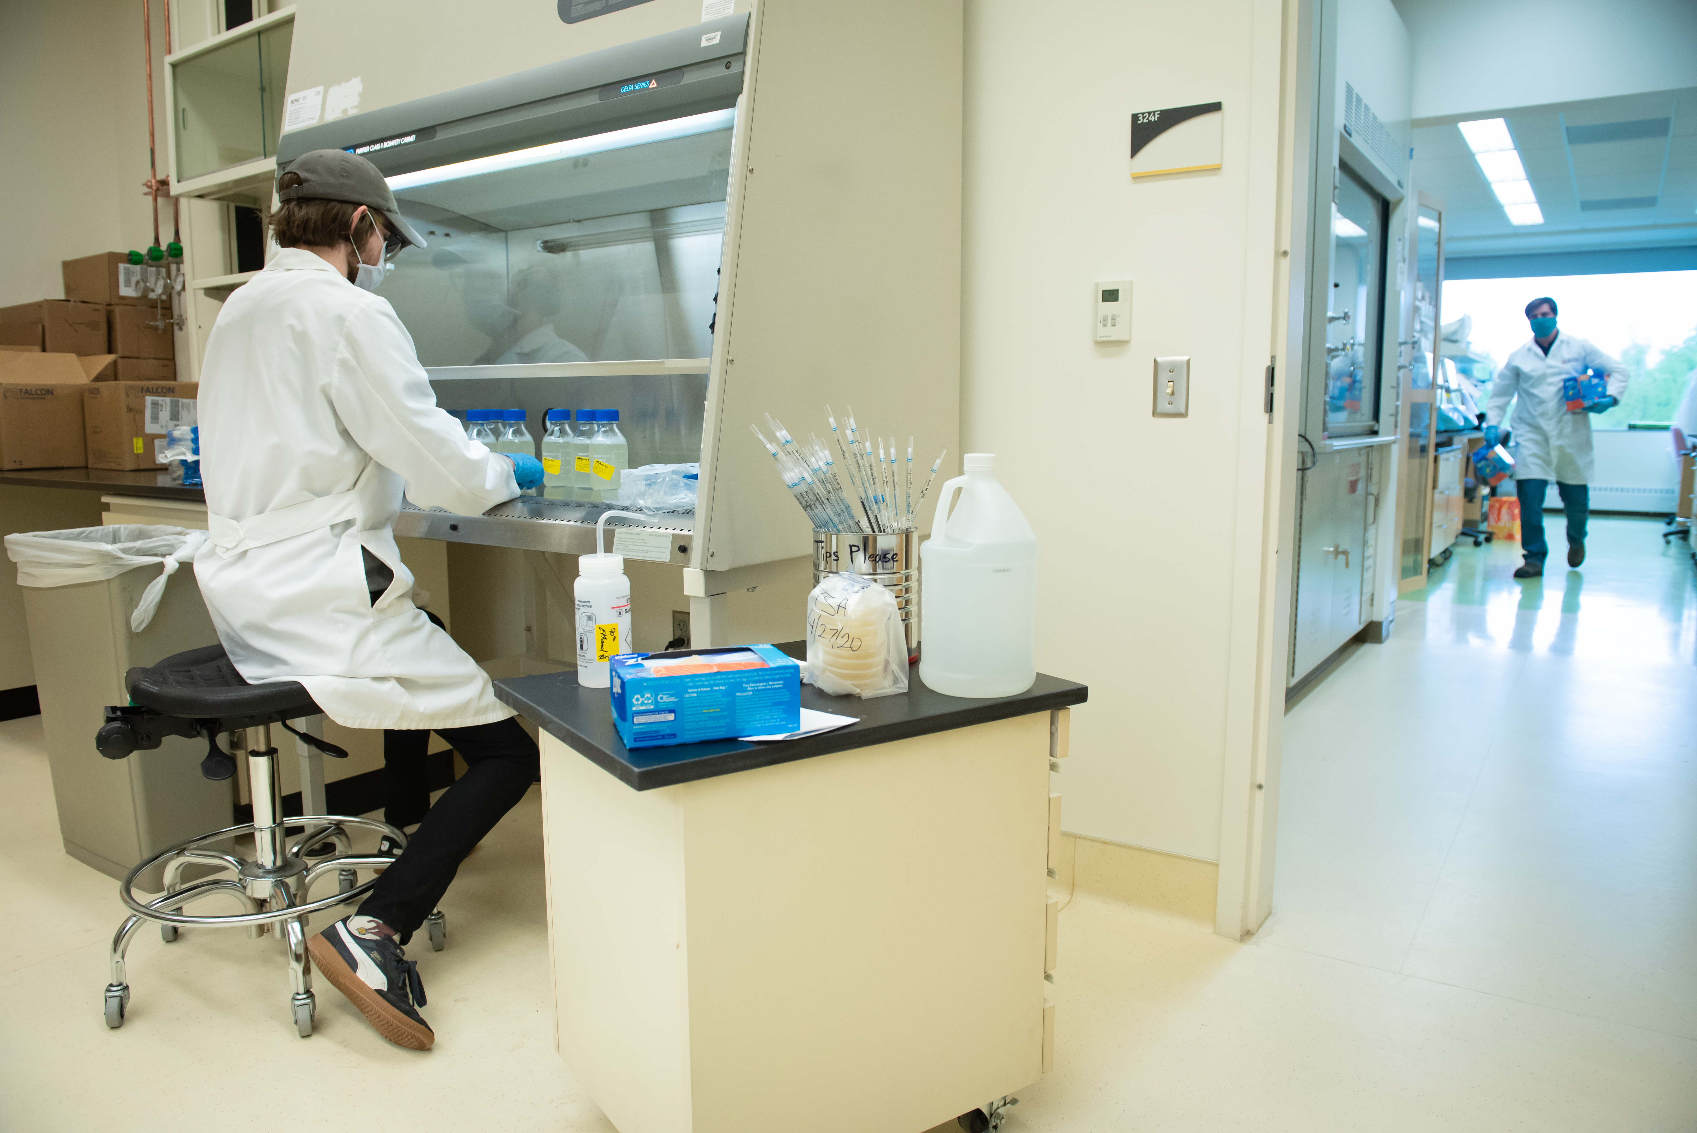


SARS-CoV-2: Wastewater Surveillance in Alaska
uaa.alaska.edu/Biological-sciences
Brandon R. Briggs¹,
Kodi Haughn¹, Ralf Dagdag¹,Thomas Kosten¹, Eric Bortz¹, Eric Henderson¹, Devin Drown², Cameron Wilson¹, Aaron Dotson¹
¹University of Alaska Anchorage & ²University of Alaska Fairbanks
UA is an AA/EO employer and educational institution and prohibits illegal discrimination against any individual: www.alaska.edu/nondiscrimination

Slide 2
Timeline
May, 2020
Contacted by DEC
Began initial trials:
Anchorage, Fairbanks, Sitka
June, 2020
July, 2020
Initial protocols were established
August, 2020
Key components became limiting
September, 2020
Modified protocols and began helping communities
Refining protocols to increase turn around time.
Wastewater surveillance of 4 Alaskan communities
Today

Slide 3
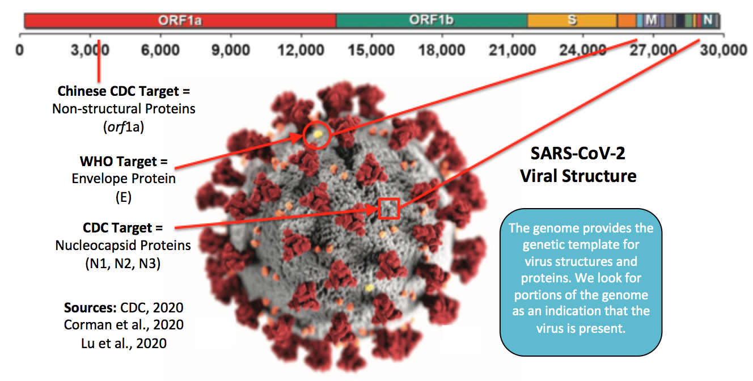
Molecular Targets for Surveillance
Genome
Current Target
Source: Nemudryi et al. (2020)

Slide 4
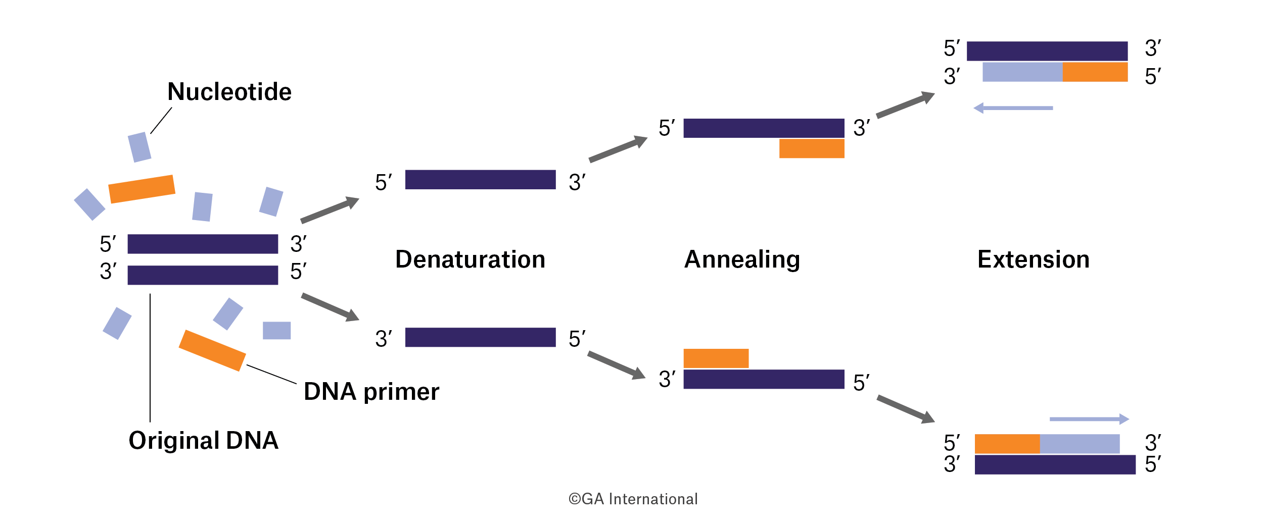
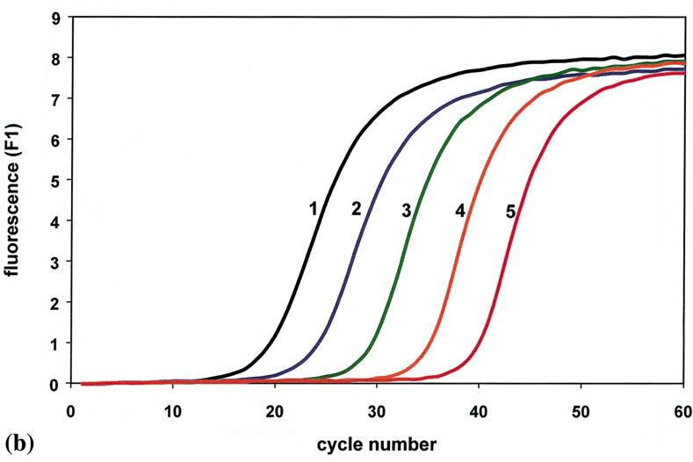
qRT-PCR

Slide 5
Fairbanks, Alaska
Negative Sample Dates
7/6,7,8
7/1
6/29

Slide 6
Sitka, Alaska
At the time of sampling total of 13 cases with 2 active cases.
Detection limits is dependent on facility.

Slide 7
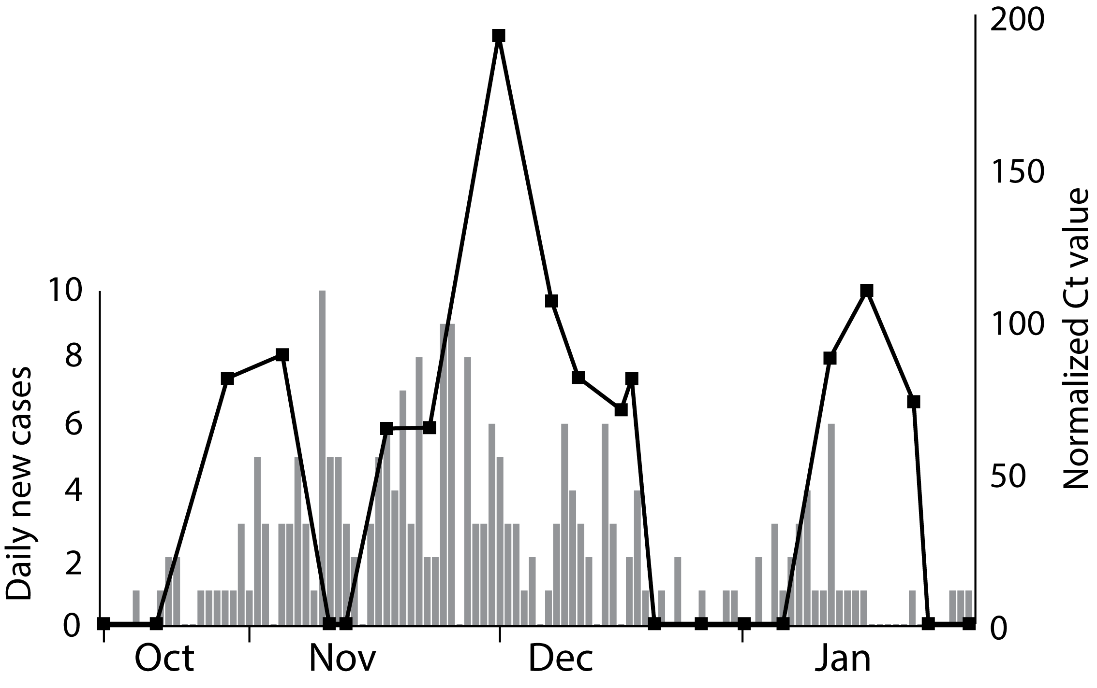
Sitka, Alaska

Slide 8

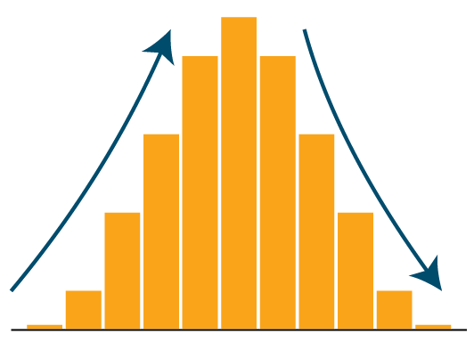
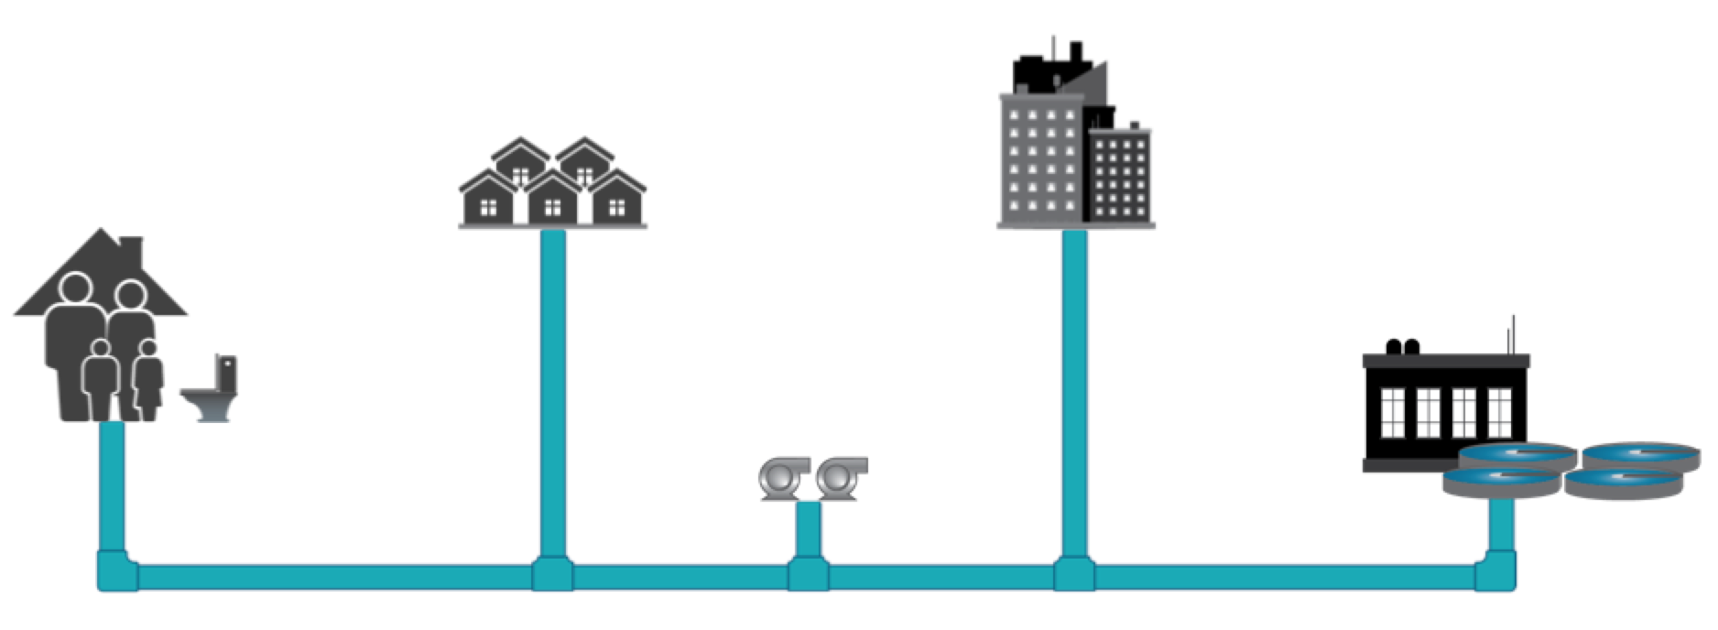

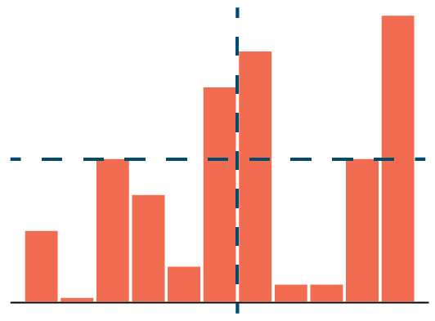
Challenges
Qualitative?
Initial Onset
or
Second Wave
Time to Relax Mitigation Measures?
Semi-Quantitative?
Quantitative?
Hot Spots?
Trigger
Thresholds
Policy making?
EARLY WARNING SIGN
Source: WRF International Water Research Summit on COVID-19

Slide 9
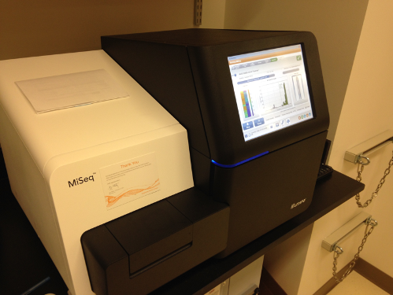
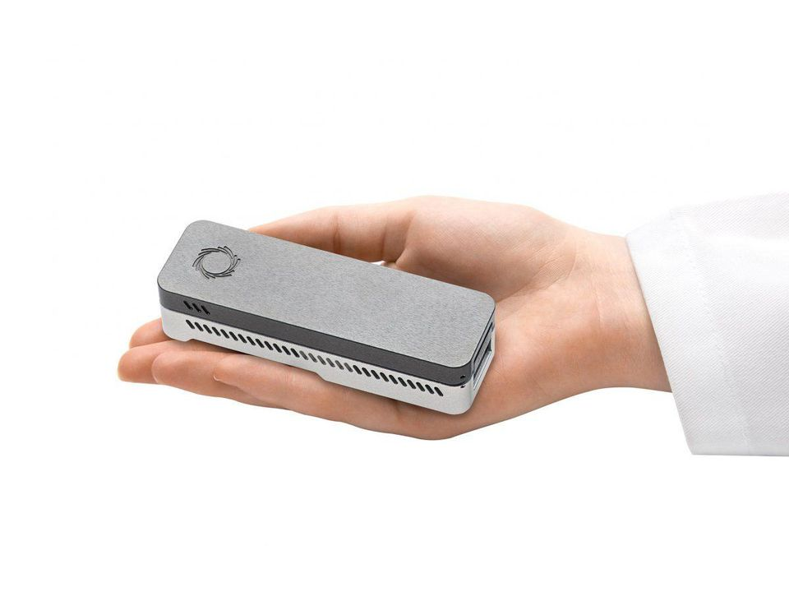
Moving Forward
Advanced Instrumentation in Microbiome Studies (AIMS) Core Facility
Turn around time
  24hrs
Sequencing
  SARS-CoV-2
  Other pathogens

Slide 10
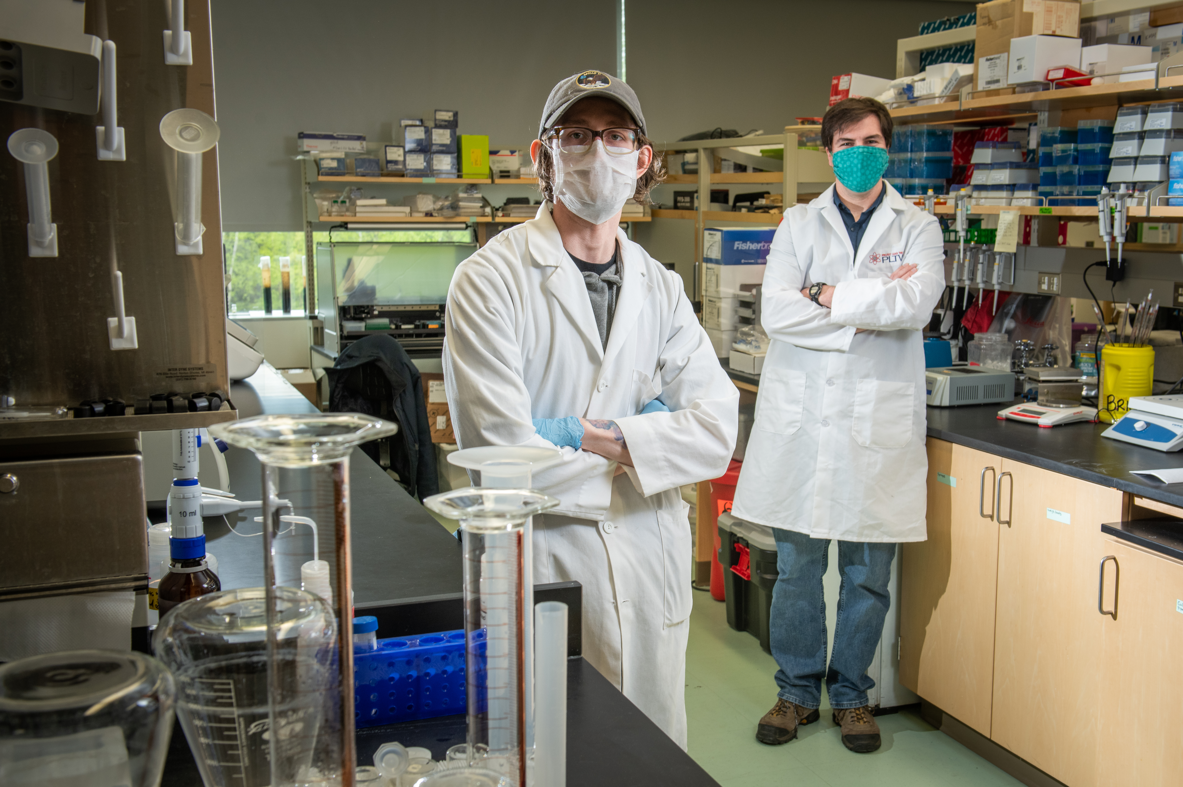

uaa.alaska.edu/Biological-sciences

