Slide 1
11th Annual Water and Sanitation Innovations for the Arctic Workshop
International focus: how this technology has been used in the past
Frederic Béen
KWR Water Research Institute

Slide 2
Sewage surveillance or wastewater-based epidemiology

Slide 3
Applications
Environmental surveillance of pathogens
(Illicit) drug use
Population dynamics
Environmental contaminants
Antibiotic resistance
Health biomarkers

Slide 4
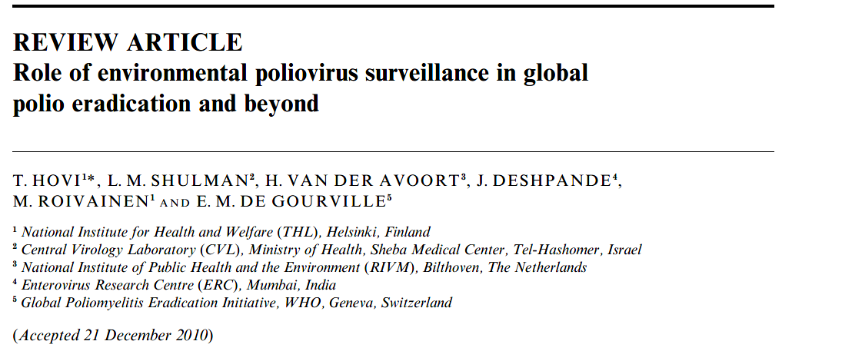
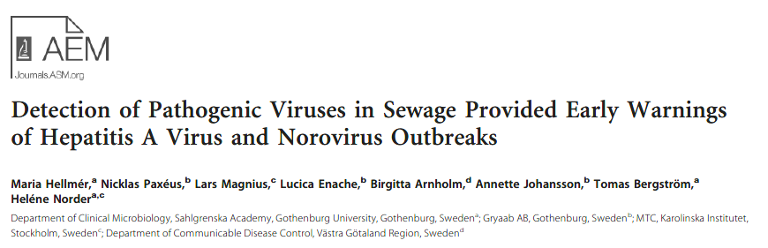
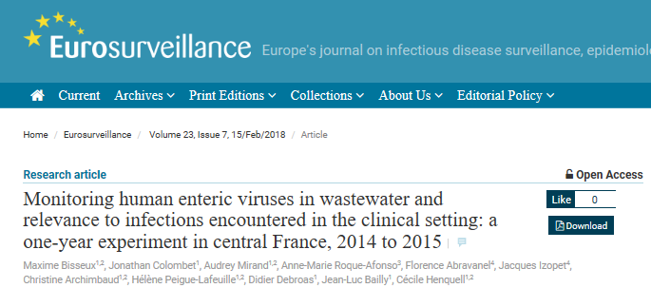
1. Environmental surveillance
Poliovirus
    absence of virus circulation in (unvaccinated) population
    early warning outbreaks
    ‘herd monitoring’: only 0.1-1% paralysis
Adenovirus, norovirus, rotavirus, parechovirus,
enterovirus, astroviruses, hepatitis A and E viruses
    early warning outbreaks
    virus circulation in population
    virus genotypes circulating in population

Slide 5
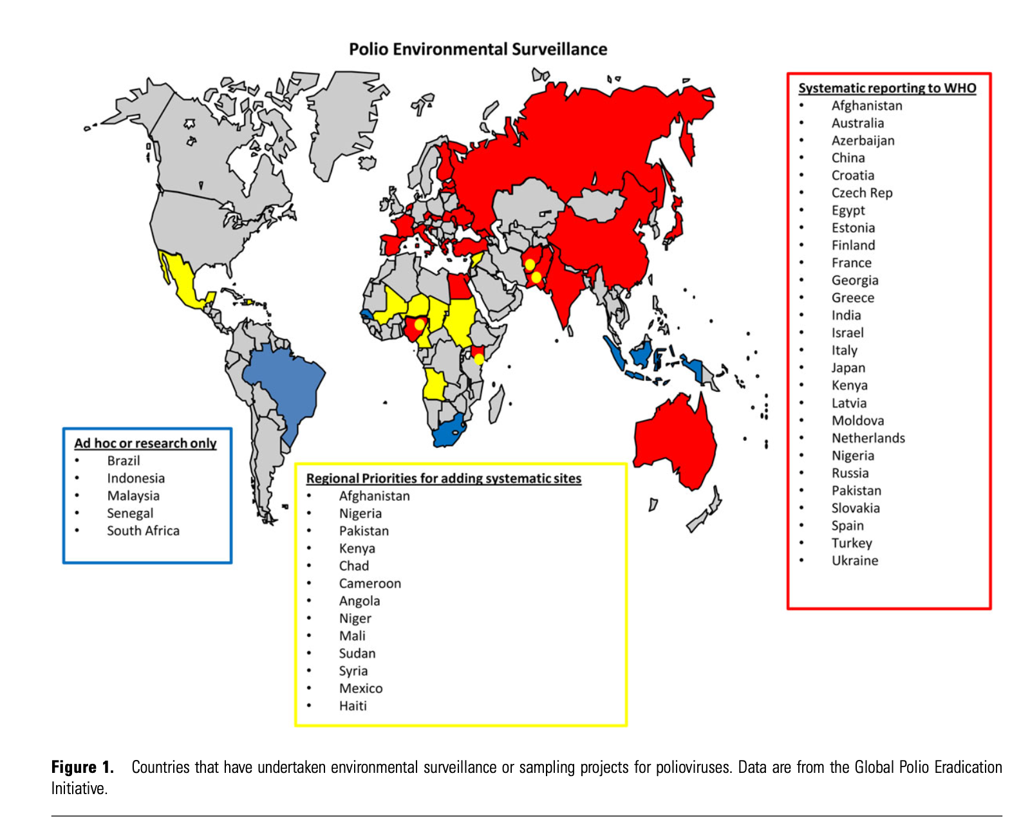
1. Environmental surveillance
Polio virus
Asghar et al. 2014

Slide 6
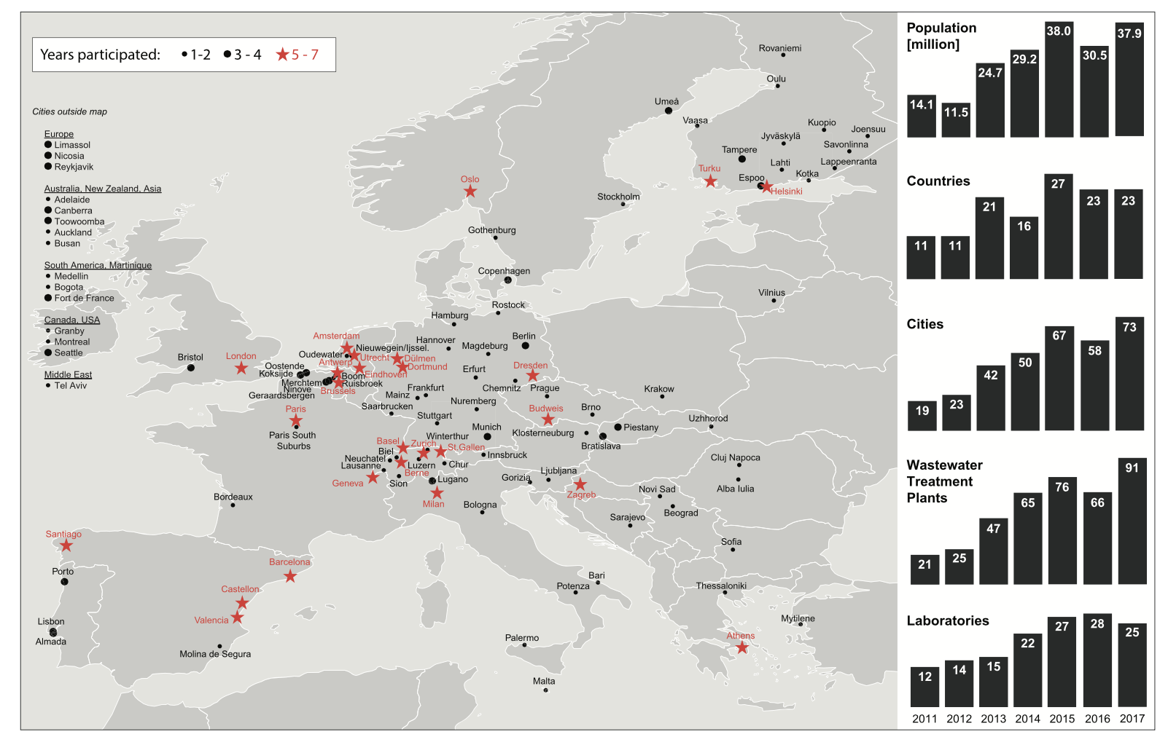

2. (Illicit) drug use
First implementation in 2005, monitoring cocaine use in Milan, Italy
Number of studies increased substantially ever since
EU and Australia main drivers
Cocaine, amphetamine, MDMA, methamphetamine, cannabis and “novel psychoactive substances” (NPS)
Extensions to (counterfeit) pharmaceuticals

Slide 7
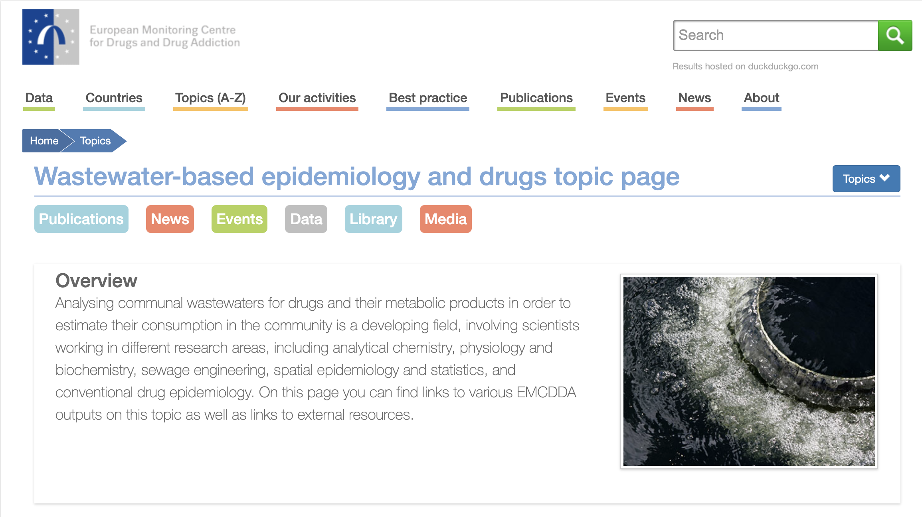
2. (Illicit) drug use
Creation of the Sewage Analysis CORe group Europe (SCORE) network
    Yearly monitoring campaign and interlaboratory exercises
Endorsement by the European Monitoring Centre for Drugs and Drug Addiction (EMCDDA)
    WBE as indicator for drug use surveillance

Slide 8
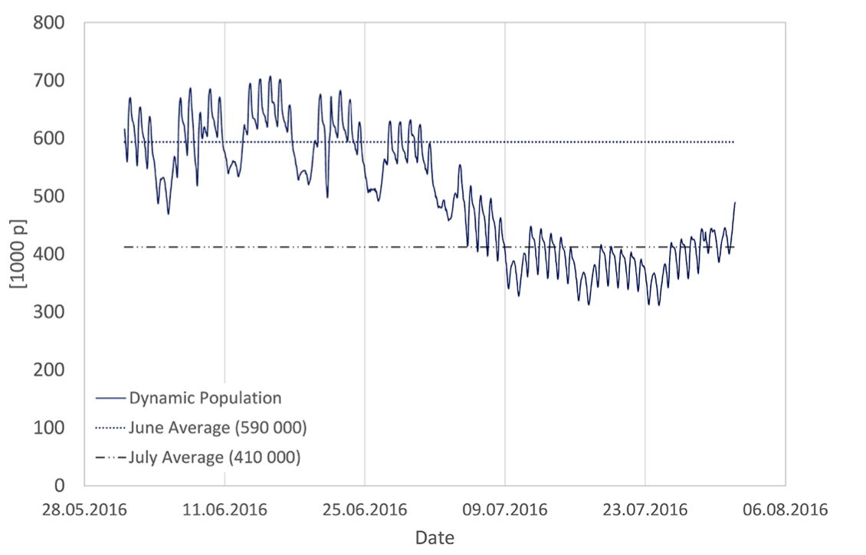
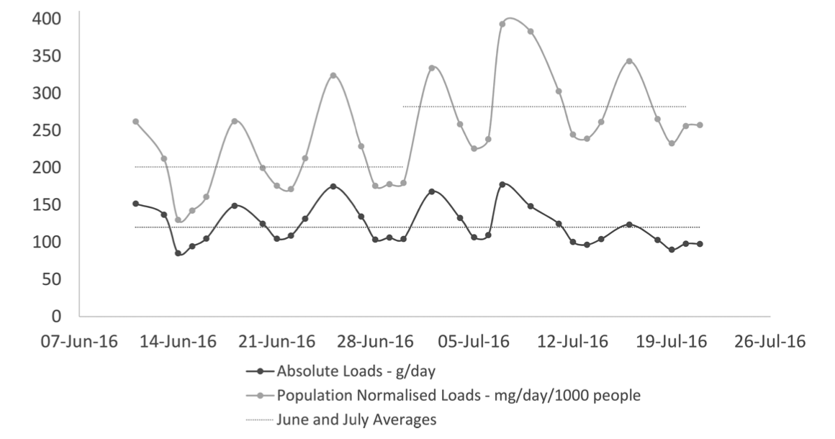
3. Population dynamics
Size of the population contributing to (highly) variable
    Commuters
    Holidays
    Public events
Interpretation of observed trends?
    Increased consumption (drugs) or prevalence (pathogen/disease) or
    Increase in absolute number of inhabitants
Thomas et al. 2017

Slide 9
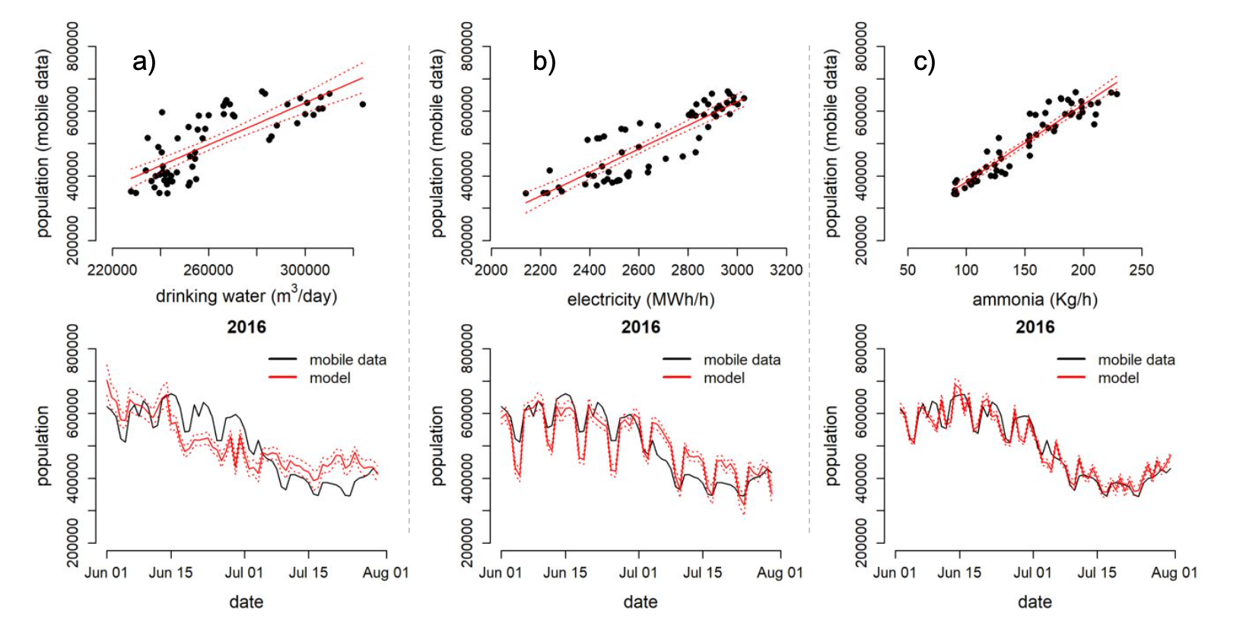
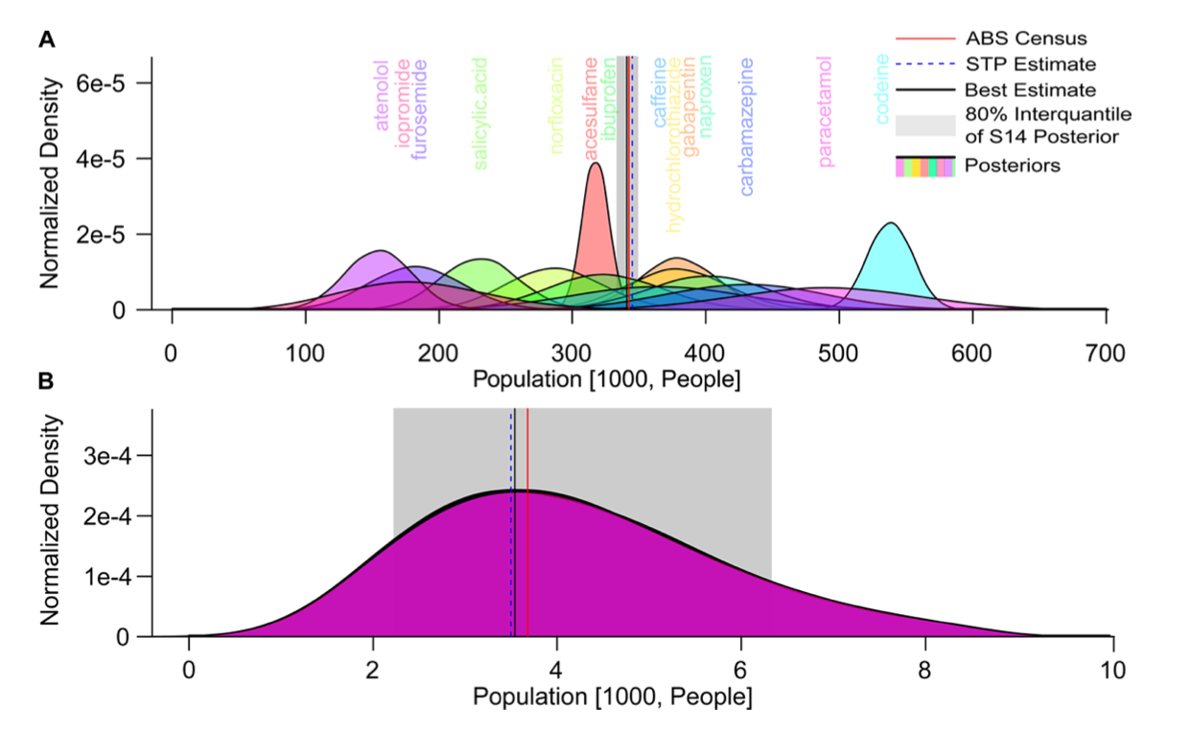
3. Population dynamics
Anthropogenic markers
Mobile phone data ($)
O’Brien et al. 2014
Baz-Lomba et al. 2019

Slide 10
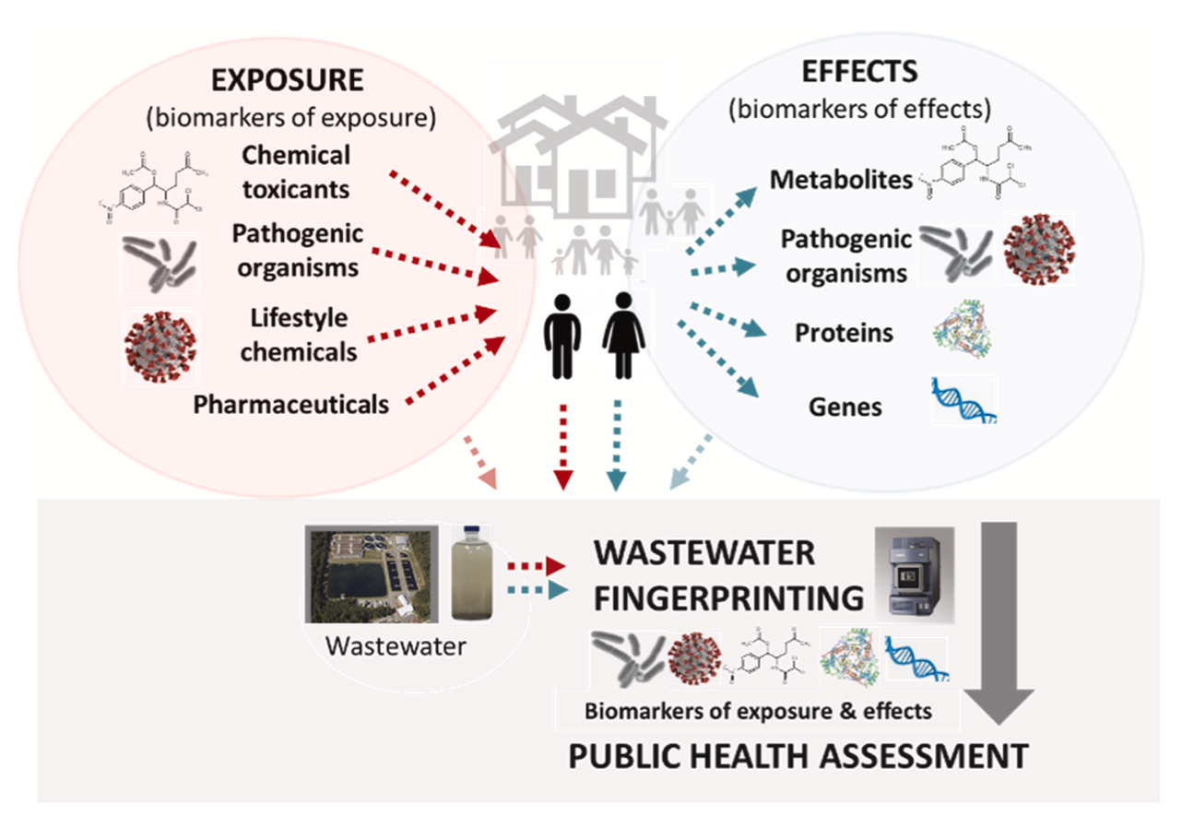
4. Environmental contaminants
Link with the concept of Exposome
Clinical/cohort studies monitor human exposure to environmental contaminants
    Exposure biomarkers (e.g. urinary metabolites)
    Used to establish causality:
    exposure ← → health endpoint
    Limited in size, space and time
Kasprzyk-Hordern et al. 2021

Slide 11
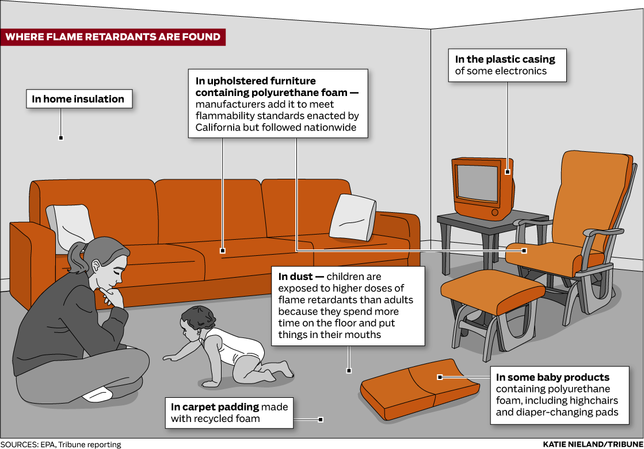
4. Environmental contaminants
Pesticides
Mycotoxins
Phthalates
Flame retardants
Been et al. 2019

Slide 12
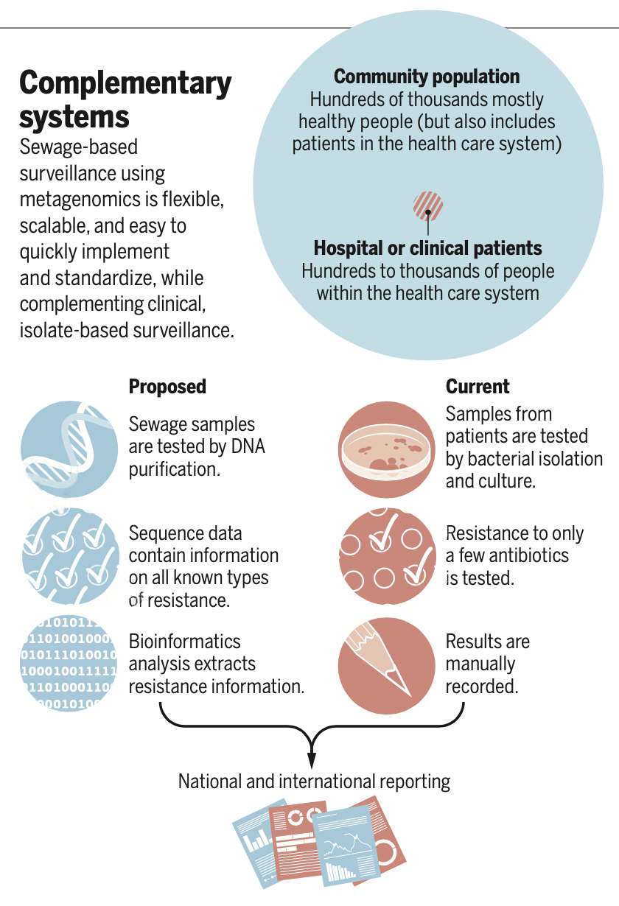
5. Antibiotic resistance
Monitoring antibiotics and AMR emissions and HGT in WWTP
Focus on emissions to the environment and further selective pressure
Inversed perspective: use WWTP to monitor community-wide AMR burden
Monitor ARGs and/or sequencing
Measure antibiotics/antimicrobials (e.g. (over)prescription)
Aarestrup et al. 2020

Slide 13

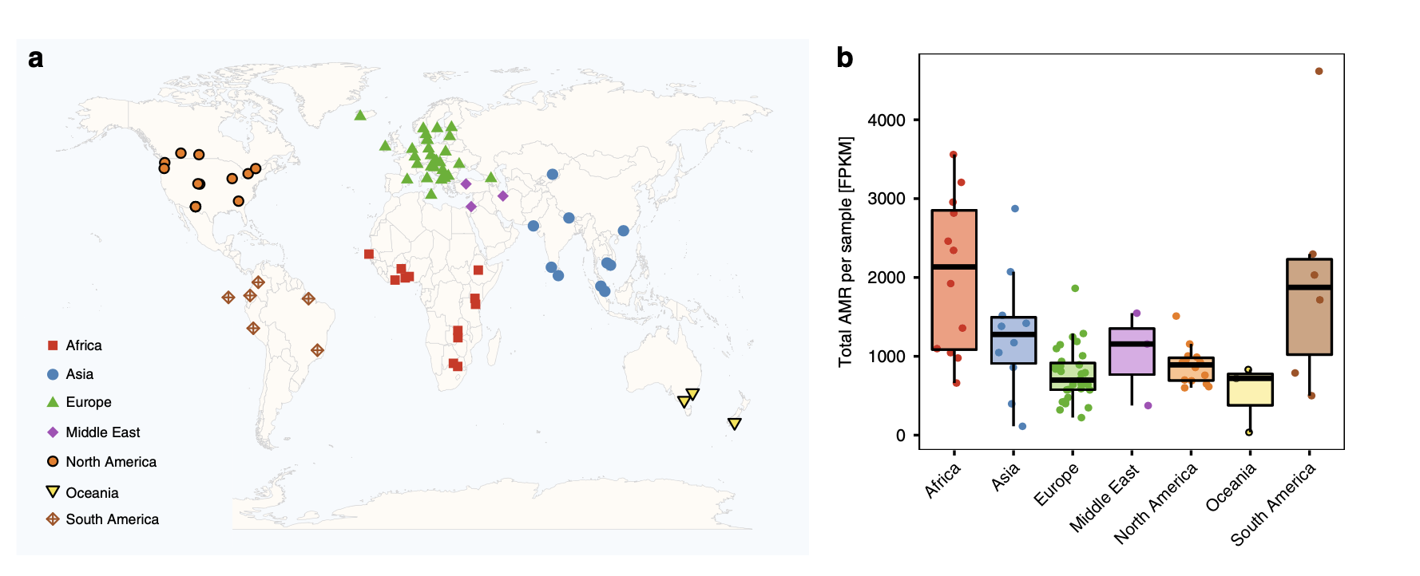
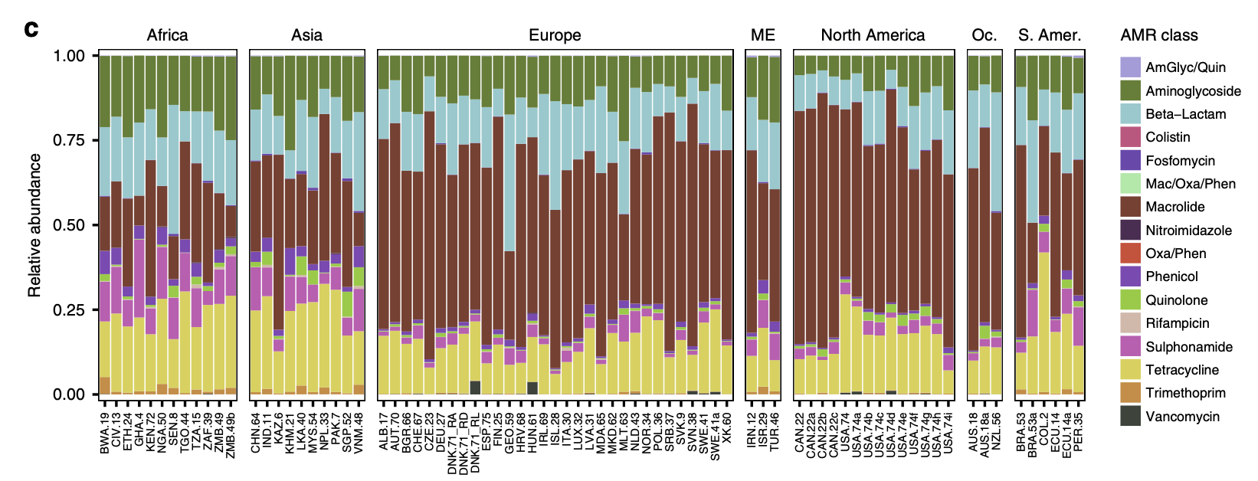
5. Antibiotic resistance
Metagenomic analysis
AMR genes
Link with other socio-economical covariates
    Antibiotic use
    Sanitation
    Health
    …
Hendriksen et al. 2019

Slide 14
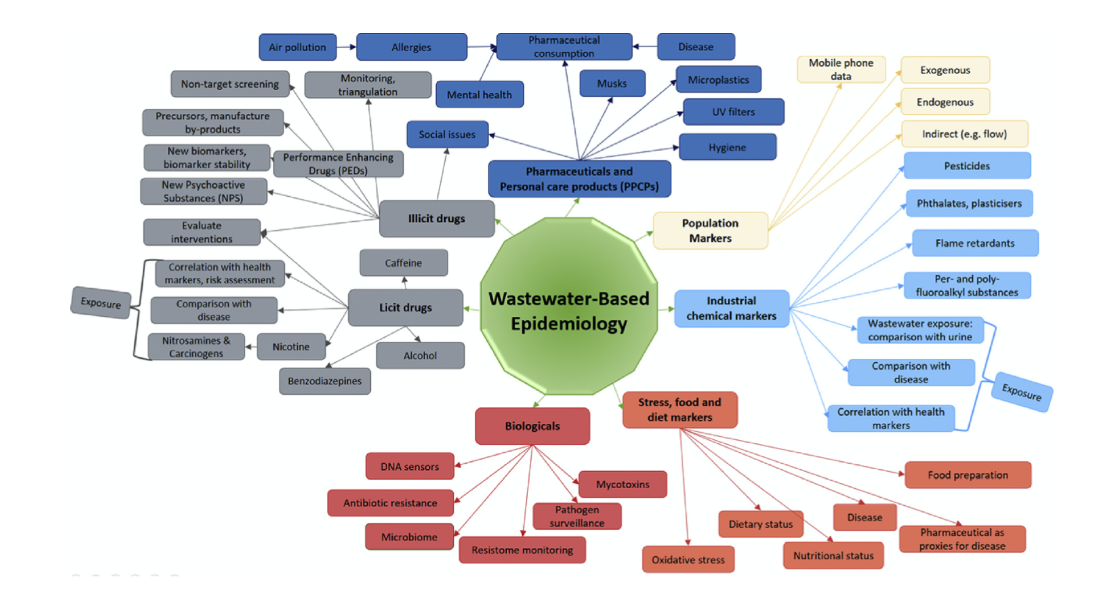
6. Health biomarkers
The holy grail of WBE
Measure biomarkers diagnostic about community-wide disease prevalence/incidence
Endogenous biomarkers
Metabolites
Proteins

Slide 15
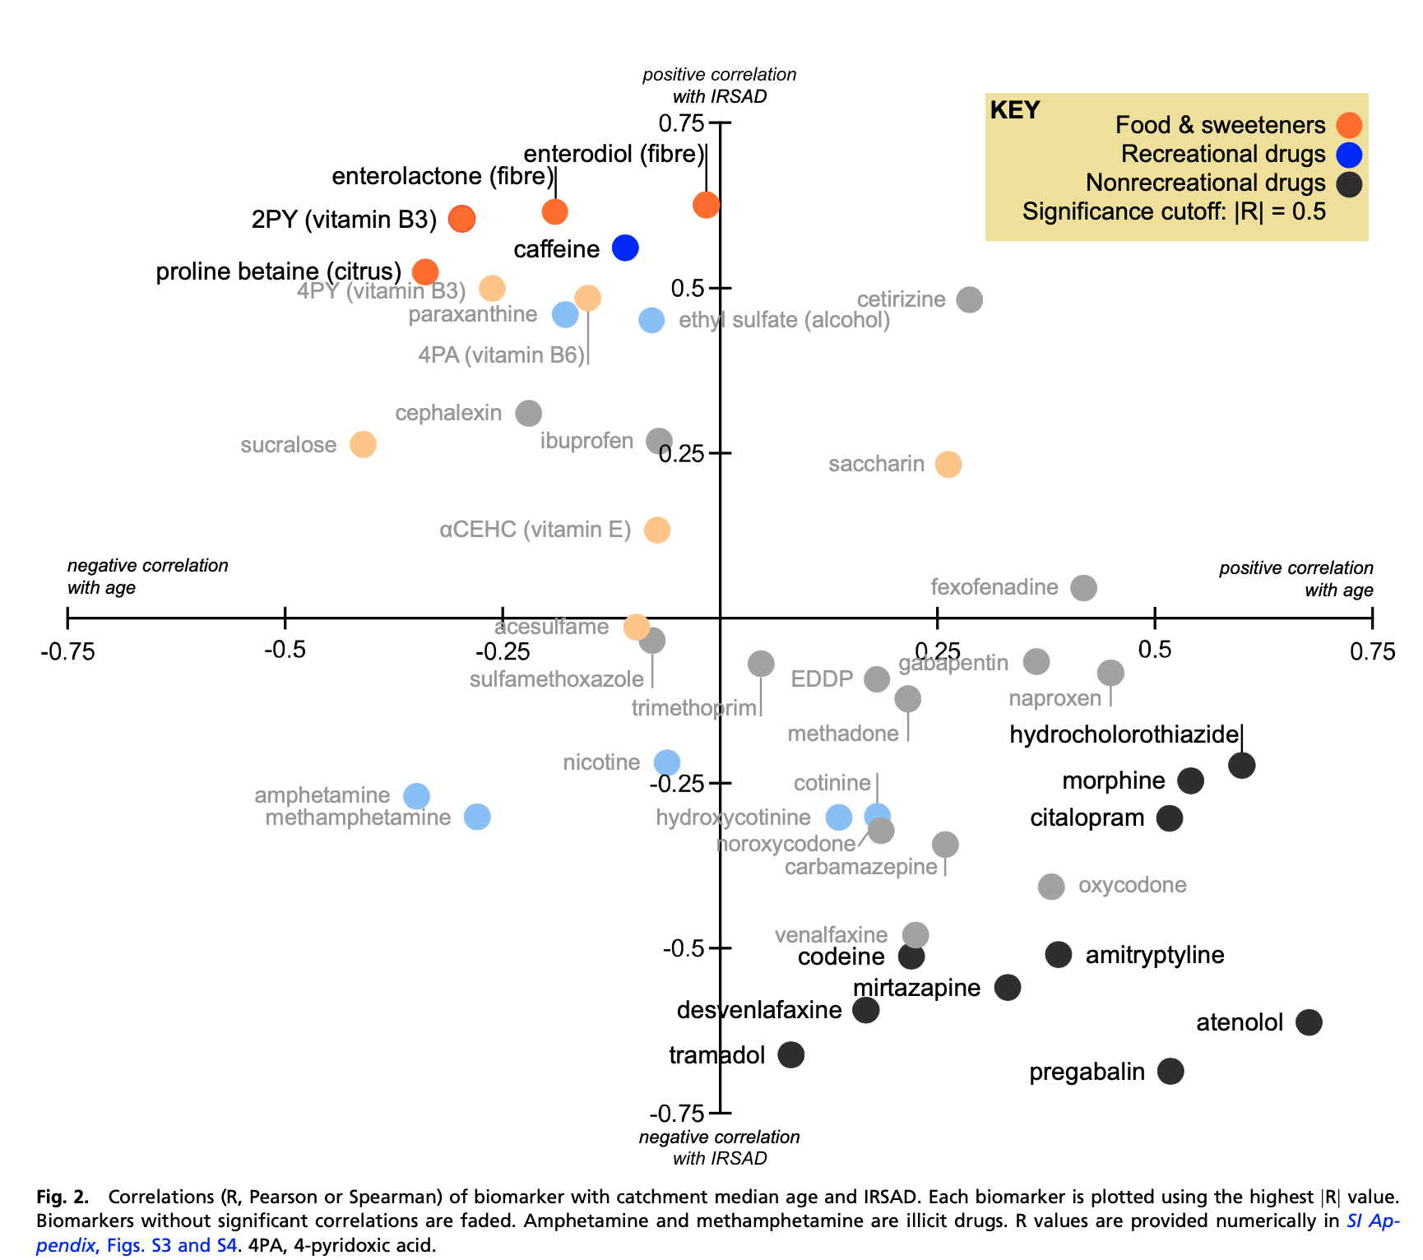
6. Health biomarkers
Monitoring a broad range of (endogenous) biomarkers and correlate to socio-economical covariates
Choi et al. 2019

Slide 16
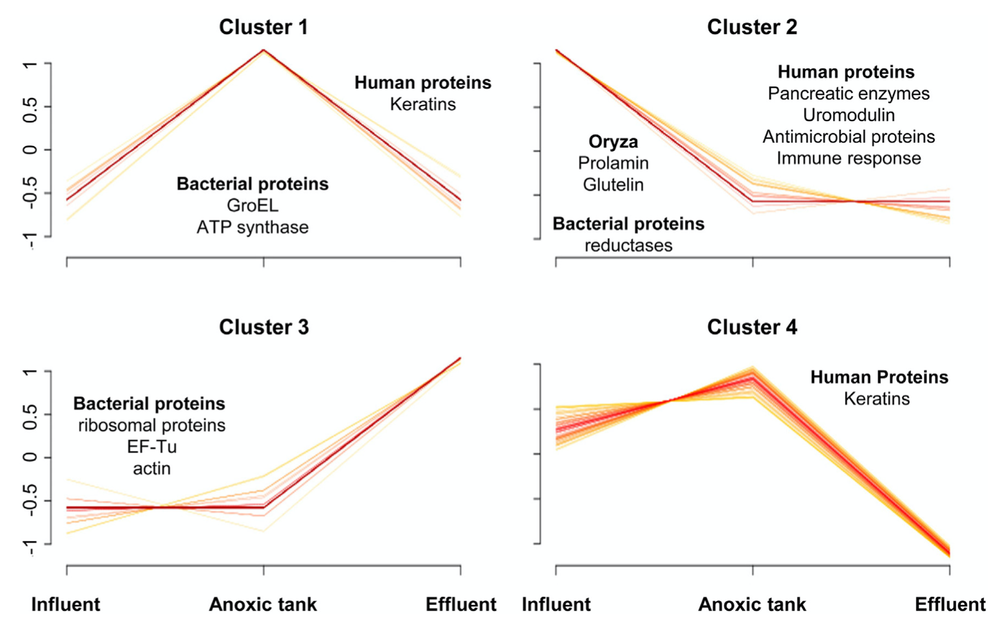
6. Health biomarkers
First steps in the field of “wasteomics”
Use of polymeric probes to analyse 690 bacterial, plant and animal proteins
    Identified 57 human proteins
      S100A8
      Uromodulin
      defensins
      …
Carrascal et al. 2020

Slide 17
7. Future
Additional (fundamental) research needed in many areas
Need for collaboration and harmonization
Stronger links with clinical studies
How do we translate/interpret wastewater data
Involvement of health authorities and stakeholders
But the future is bright

Slide 18
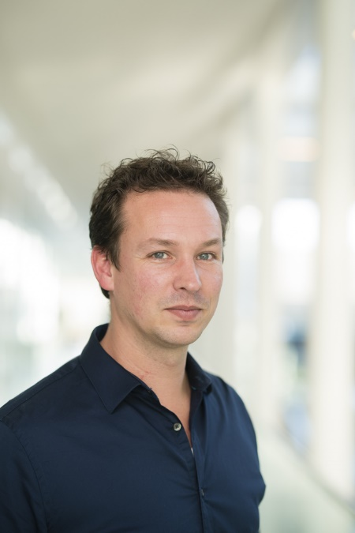

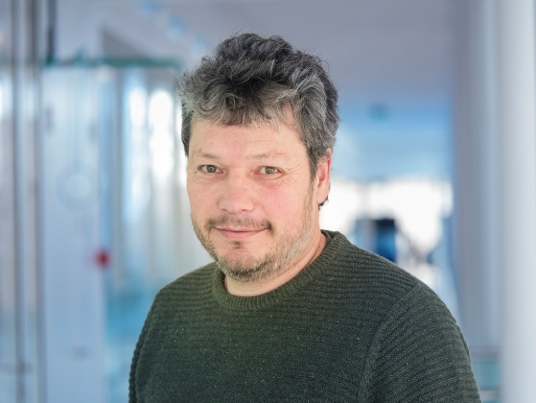




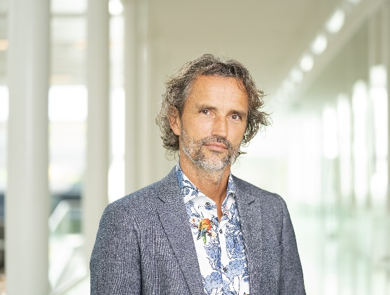






Slide 19

Frederic Béen
  Frederic.been@kwrwater.nl

