Slide 1
Kake Heat Pump Rate Analysis
Arctic Sustainable Energy Research Conference
April 21, 2021

Slide 2
Outline
Context: Heat Pumps (HP) as potential beneficial load growth
Current Kake situation:
Load
Generation
Costs and complexities
This study
Caveats / future research

Slide 3
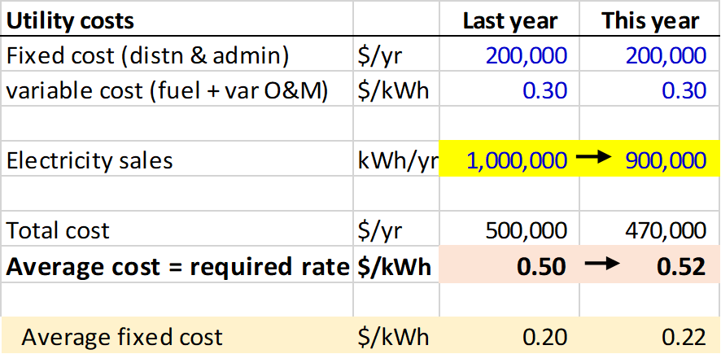
Declining load = higher rates
Notes:
When load declines total cost goes down, but fixed costs do not. Average cost goes up, so required rates must rise.

Slide 4
Declining load = higher rates
Notes:
The same fixed costs must be spread over fewer kWh.

Slide 5
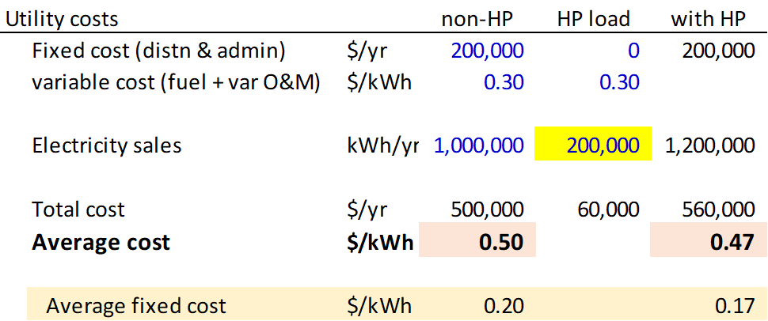
Opportunity: Increasing load = lower average cost...
….then what?
Notes:
The good news version of this story is that increasing load, perhaps by installing heat pumps, spreads the fixed cost over more kWh.

Slide 6
Lower uniform rates…..?
….might be too high for potential heat pump users
Notes:
How can the utility translate lower average cost into lower rates? It could reduce the uniform rate from 50 cents to 47 cents. But that might be too high to make heat pumps economical.

Slide 7
Special rate for HP use…?
Utility breaks even, and non-HP customers not worse off.
Lowest possible HP rate = marginal cost of serving HP load.
Notes:
An alternative is a special rate for the new HP load. If the non-HP rate stays at 50 cents, the lowest possible HP rate is 30 cents, which covers the variable cost of additional power to serve HP load.

Slide 8
Win-win rates
Non-HP customers pay lower rates;
HP rate must be low enough to reduce HP owners’ heating bills.
Notes:
Win-win rates are lower than they were for non-HP customers and even lower for HP customers to attract them onto the system. Many combinations of new win-win rates are possible that allow the utility to break even (revenues cover costs).

Slide 9
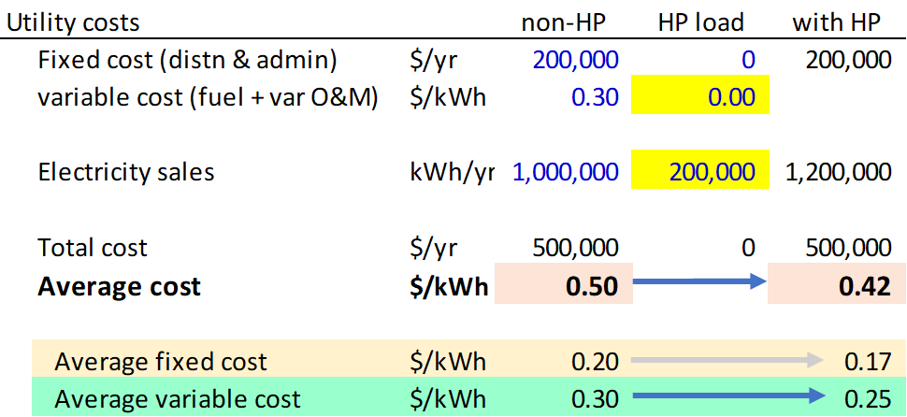
Serving new load with excess* zero-fuel hydro helps even more
*hydro available after serving existing non-HP load
Notes:
New load is even more beneficial when it can tap low-cost supply, such as excess hydro. Here the average total cost of utility service drops even more. In addition to spreading fixed costs over more kWh, the utility is adding some zero-fuel resources into the mix and reducing the average variable cost as well as the average fixed cost.

Slide 10
Many win-win rate combinations with excess* hydro
*hydro used for HP only after serving existing non-HP load
Notes:
With an eight cents per kWh drop in average total cost, the range of possible win-win rates becomes much wider.

Slide 11
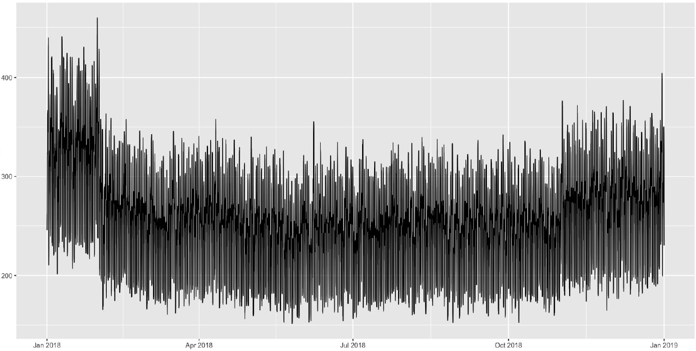
Modeled Kake electric load
Total consumption = 2.2 million kWh per year
Based on 2019-2020 data - Peak load 465 kW in Jan 2020

Slide 12
Kake generation
4 x 450 kW diesel generators
Effective operational capacity of 720 kW
Plus:
500 kW Hydro (Gunnuk Creek) - new!

Slide 13
Kake cost situation
Marginal cost of diesel =
17.7 cents per kWh (fuel)
+ 10.6 cents per kWh (nonfuel O&M)
= 28.3 cents per kWh total
This is the minimum rate for any new load,
-- absent further complexities

Slide 14
Further complexities:
Some HP load can be served by excess hydro
Some HP load will pay full/regular non-HP rate
Hence, an HP incentive rate for use greater than 500 kWh per month can be less than full marginal cost of diesel
Also - IPEC has postage stamp rates for hydro and non-hydro communities!
Notes:
Some HP load can be served at a marginal cost of zero from excess hydro. Some HP load will occur under the 500 kWh per month cap on PCE usage and will therefore pay the full rate if the incentive rate applies to usage exceeding 500 kWh per month. These two considerations provide a sort of “cushion” allowing the HP incentive rate to be somewhat below the full marginal cost of diesel which is about 28 cents per kWh. But, opposing the availability of hydro in Kake is that some other IPEC communities do not have hydro, and the single HP incentive rate would need to be uniform across all IPEC communities.

Slide 15
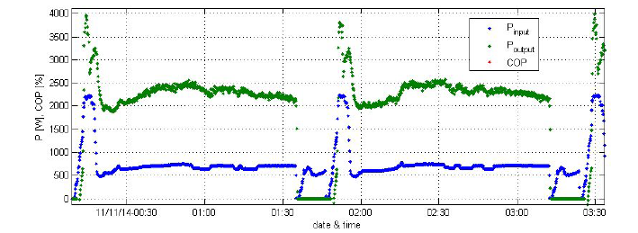
Additional Considerations
Housing authority installing HP already…
-better indoor air quality, less maintenance
~doubles winter household electricity load
~max coincident load?? (vs. existing
generation limits)

Slide 16
Study
-Break even rate for utility: ~8 to 10 cents/kWh + COPA
= (approx) 23 - 25 cents/ kWh
-varied hydroelectric potential, fuel price and marginal non-fuel cost of power from diesel generation in sensitivity analysis
-Monte Carlo simulations on above parameters
https://acep.uaf.edu/projects-(collection)/bee.aspx

Slide 17
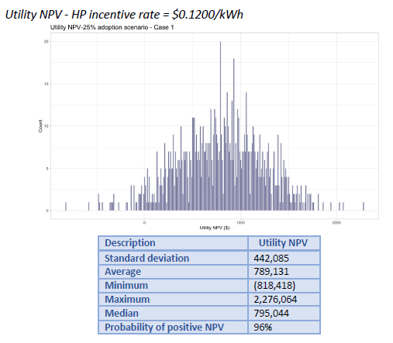
Monte Carlo Simulations

Slide 18
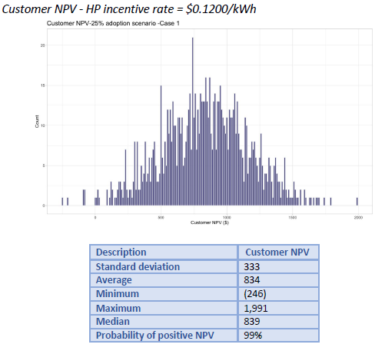
Monte Carlo Simulations

Slide 19
Caveats and Future work
Split costs between HA and resident not accounted for (install/electricity)
More experience will nail down some parameters
true costs of HP installation/maintenance
energy usage of HPs (back up heating?)
coincident peak load of HPs?
hydro availability and variability
What about other communities?
climate/costs/generation sources

Slide 20
The End Thank You

Slide 21
beyond here is junk DNA
Stuff I am not sure what to do with, yet, but not worth discarding, either

