Slide 1
Hydrogen and Renewables: Technical and Economic Potential
Mark F. Ruth
Arctic Sustainable Energy Research Conference
April 22, 2021
Report available at: https://www.nrel.gov/docs/fy21osti/77610.pdf
Detailed demand report available at: https://greet.es.anl.gov/publication-us_future_h2
Notes:
Discuss peer review process

Slide 2
Hydrogen in Today’s Energy System: 10 MMT / yr

Slide 3
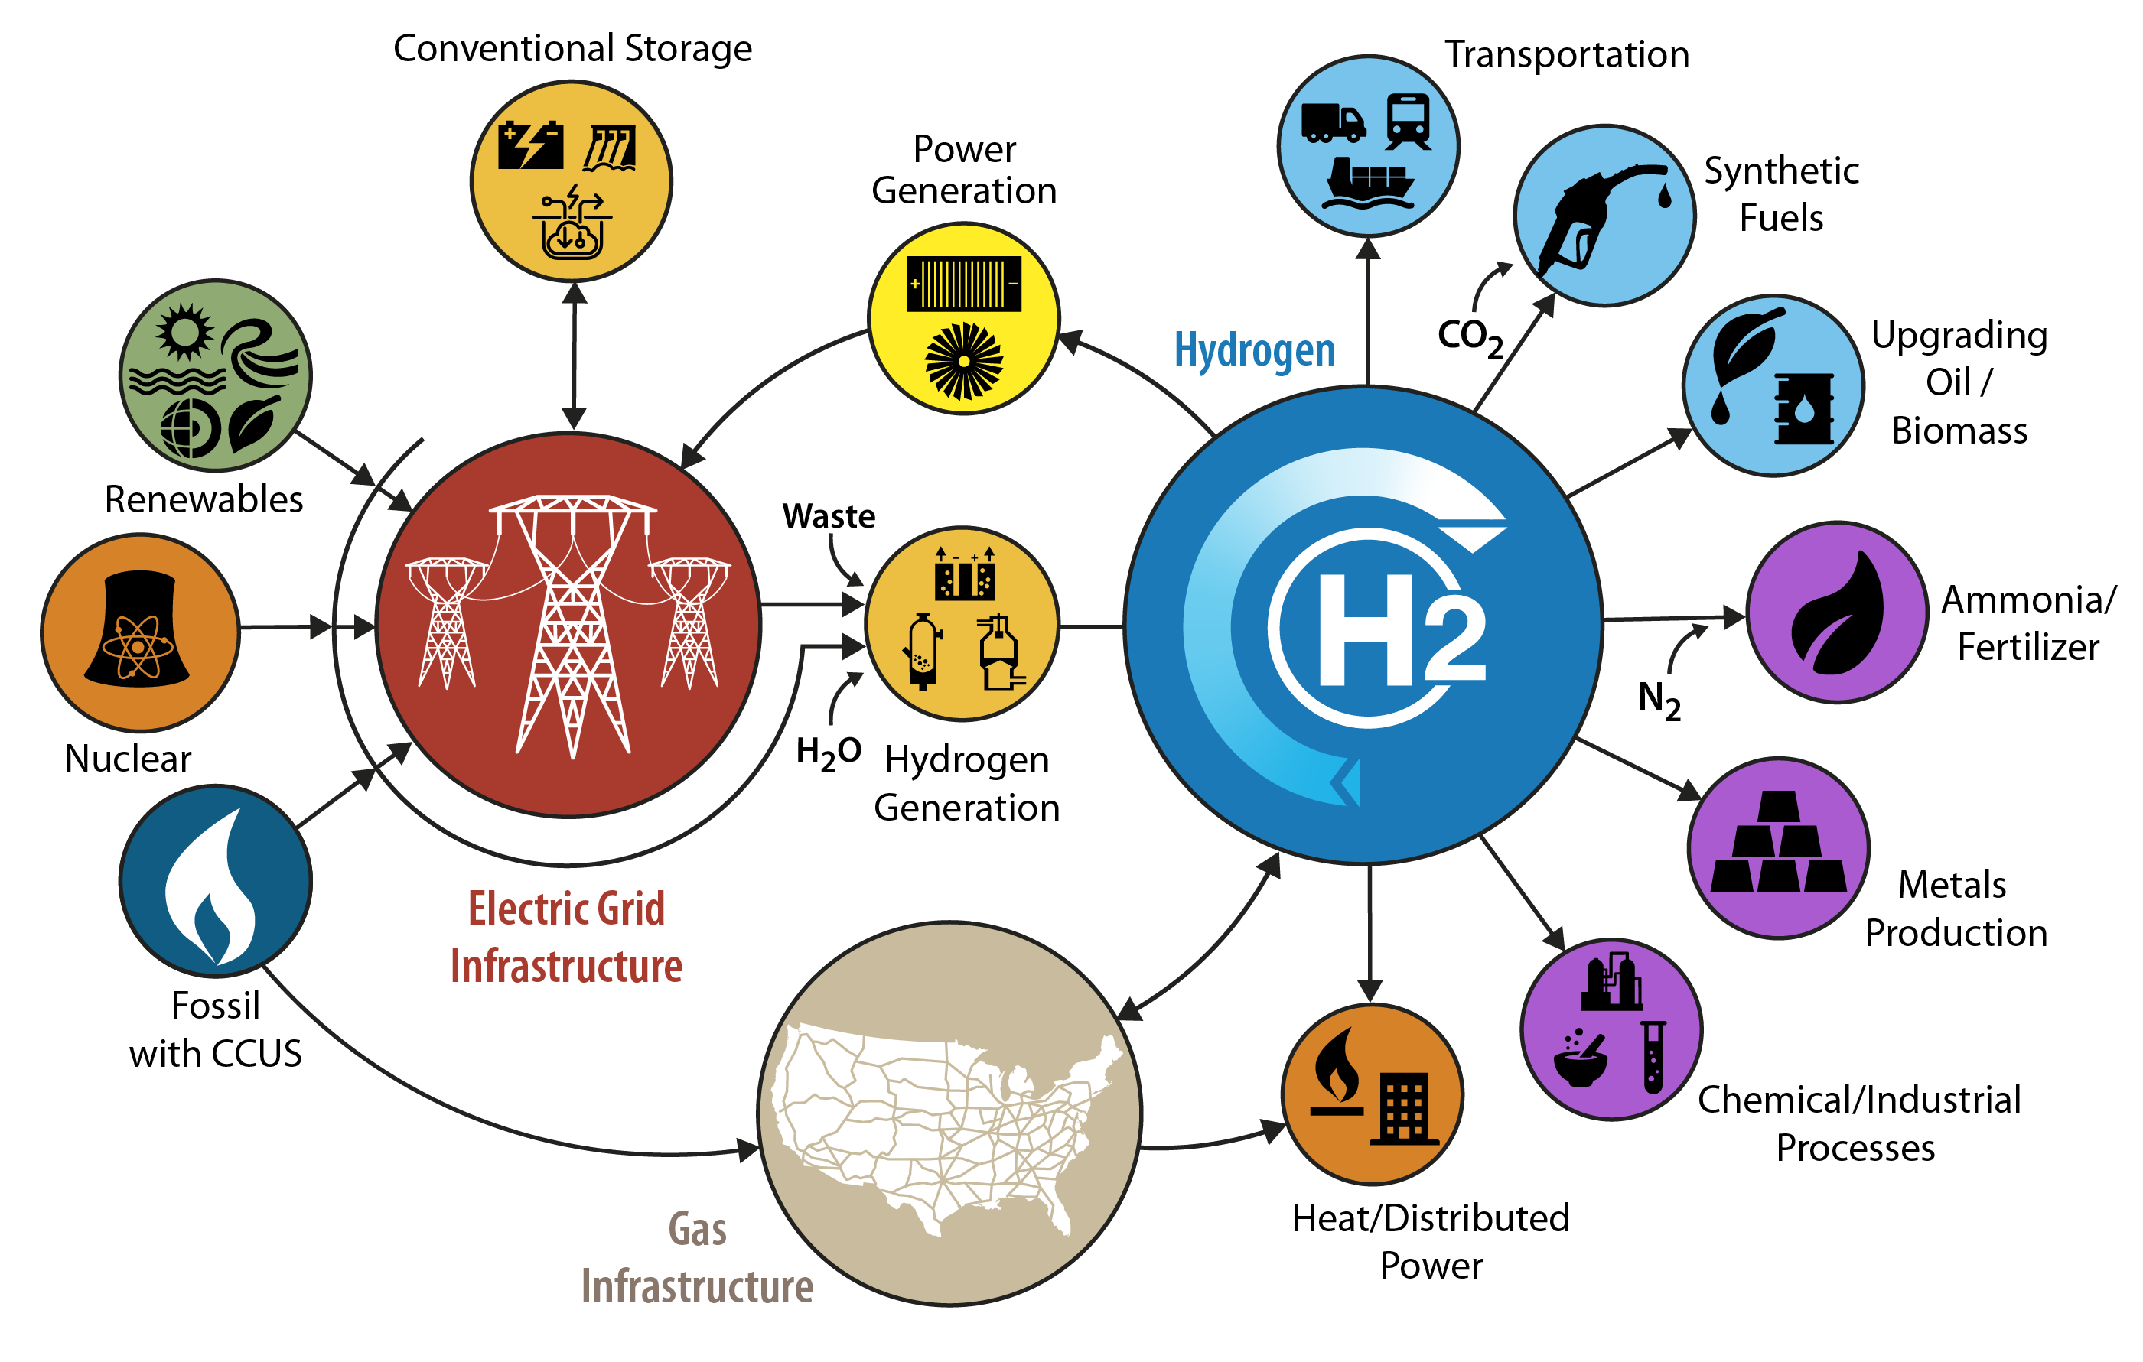
H2@Scale
DOE initiative focusing on hydrogen as an energy intermediate.
https://www.energy.gov/eere/fuelcells/h2scale

Slide 4
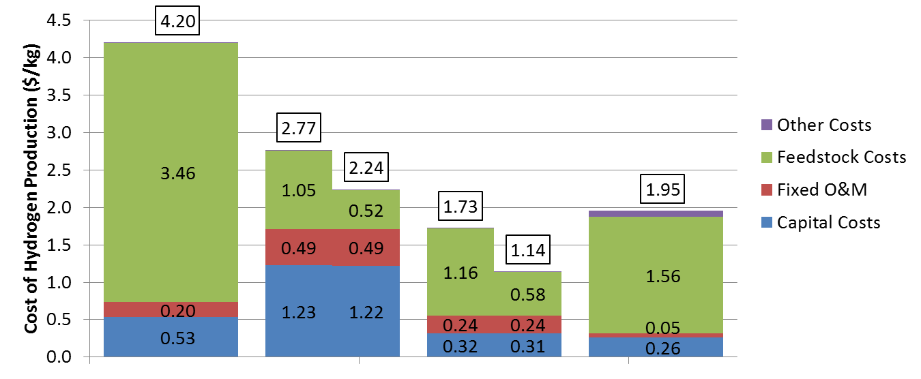
Low-Cost, Variable Electricity Could Be Source for Low-Cost Hydrogen
VRE integration
R&D Advances
0.0
Capacity Factor
Cost of Electricity
Capital Cost
Efficiency (LHV)
Steam Methane
Reforming
Low-temperature electrolysis could produce hydrogen using low-cost, dispatch-constrained electricity.

Slide 5
Economic Potential: Limitations and Caveats
Market equilibrium methodology and market size estimates in 2050
Transition issues such as stock turnover are not considered
New policy drivers, such as emission policies, are not included either for hydrogen or the grid
Technology and market performance involve many assumptions about adjacent technologies
In all but the non-reference scenario, the assumption is that R&D targets are met
Demand analysis is limited to sectors that could be forecast for the foreseeable future
Hydrogen use to convert biomass based market size equal to 50% of aviation demand
Hydrogen for industrial heat is not included
Single hydrogen threshold price for fuel cell vehicle market estimates
Estimates of delivery costs were standardized and without location specificity
Potential long-term production technologies (e.g., photo-electrochemical) not included
Economic feedback impacts are not considered
Competing technologies (both for markets that use hydrogen and for resources to generate hydrogen) are addressed in a simplified manner only

Slide 6
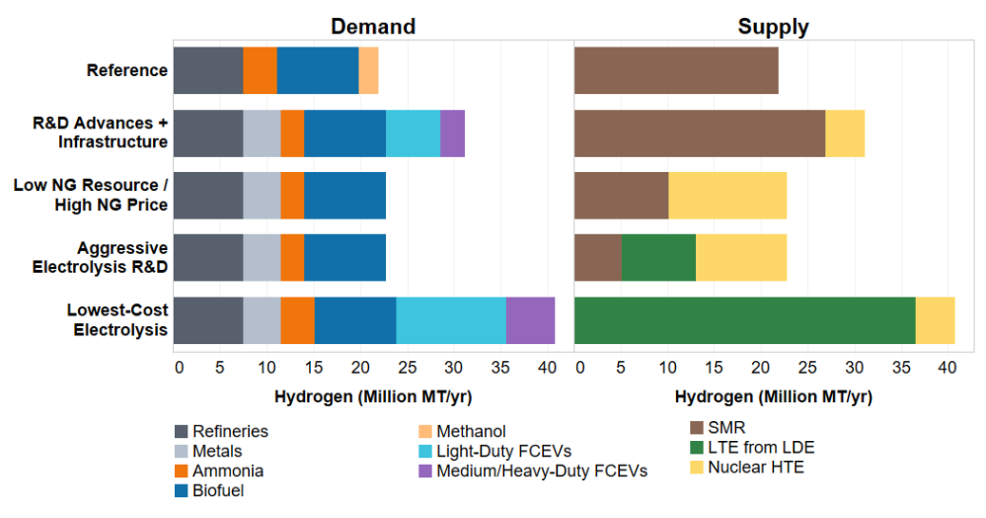
Five Economic Potential Scenarios
The economic potential of hydrogen demand in the U.S. is 2-4X current annual consumption based on our market-equilibrium analysis
Scenario | Insights
Reference | Growing markets for refining, ammonia, and biofuels met with low-cost NG
R&D Advances + Infrastructure | Higher penetrations of FCEV + drivers for metals, SMR dominates production due to low cost NG but have some nuclear HTE
Low NG Resource / High NG Price | High NG price increases cost of hydrogen for same quantity and limits FCEV penetration but more nuclear HTE
Aggressive Electrolysis R&D | Some LTE penetration at $200/kW capital cost with grid value.
Lowest-Cost Electrolysis | Low-cost electrolyzers with high grid value reduce hydrogen cost and can enable additional H₂ applications
Incentives are needed for hydrogen to compete for long-duration storage / dispatchable electricity generation and for use to generate heat (in place of or supplementing natural gas)
FCEV: Fuel-cell electric vehicles
SMR: Steam methane reforming
NG: Natural gas
LTE: Low-temperature electrolysis
LDE: Low-cost, dispatch-constrained electricity
HTE: High-temperature electrolysis

Slide 7
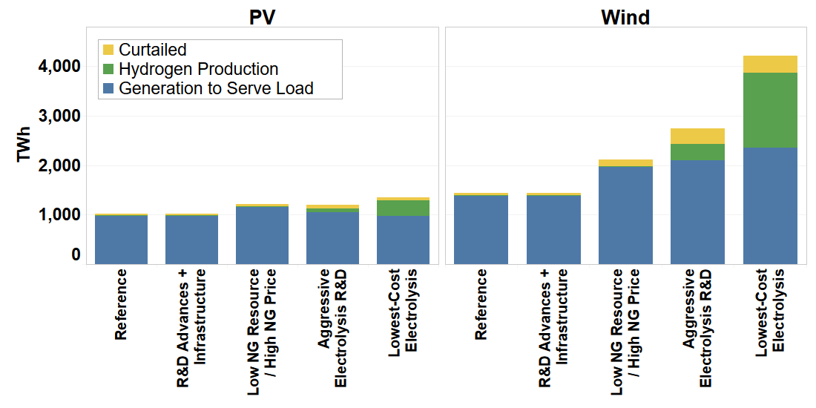
Increase Market Size of and Available Electricity from Variable Generation
H2@Scale has the potential to increase the total market size of wind and solar photovoltaic (PV) generation
Source: https://www.nrel.gov/docs/fy21osti/77610.pdf
Estimates are based on national scenarios with minimal resolution into regional constraints. Increased resolution will likely impact the most competitive source of energy supply
Notes:
Figure 28 in report

Slide 8
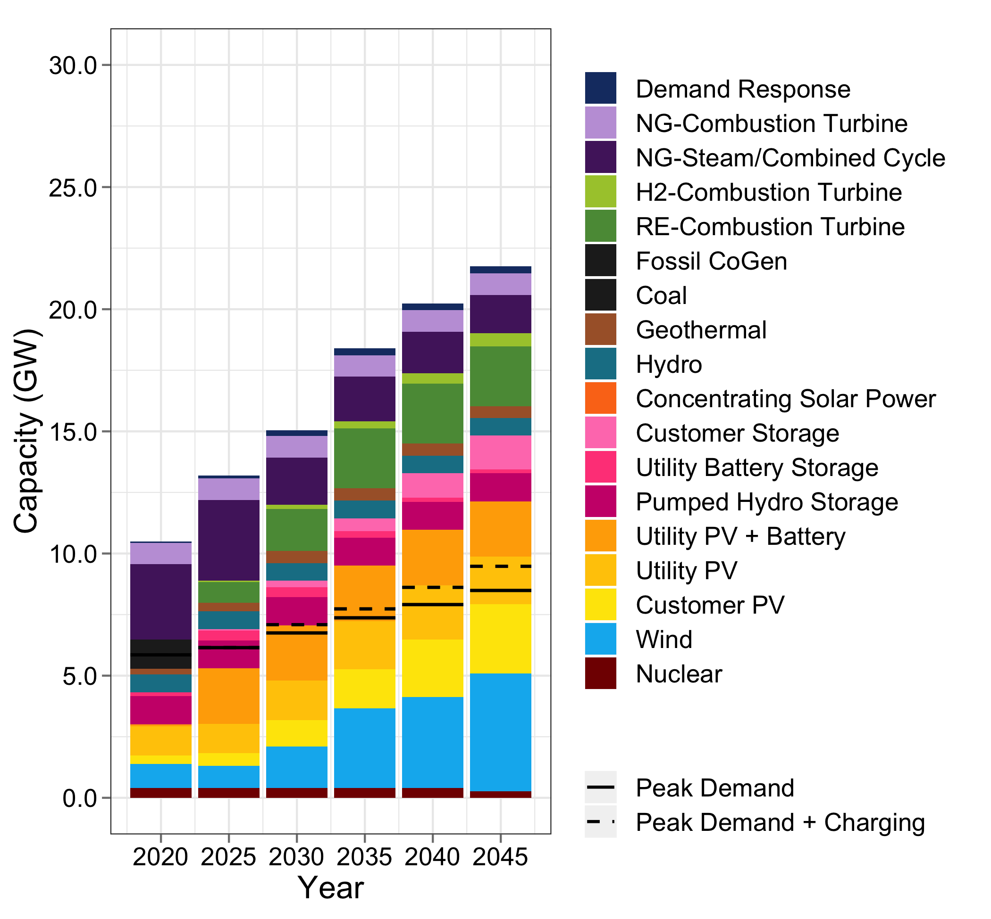
100% Renewable Electricity Standards for Dispatchable Generation Requires Chemical Energy Storage
The LA100 project analyzed opportunities and challenges for decarbonizing electricity generation.
Optimally, 10% or more of generating capacity will be non-carbon emitting dispatchable generators.
More available at: https://maps-dev.nrel.gov/la100/#
Source: https://maps-dev.nrel.gov/la100/key-findings/scenarios/sb100/moderate#annual-generation-twh-2020-2045

Slide 9
Summary
The economic potential of hydrogen demand in the U.S. is 2.2-4.1X current annual consumption even without carbon policies.
At those market sizes, hydrogen production is 4-17% of primary energy use.
An increased hydrogen market size can be realized even if low-cost LTE is not available as long as other hydrogen production options are available
Grid-integrated electrolysis can increase renewable energy generation by more than 60% by monetizing additional low-cost, dispatch-constrained electricity
Long-duration storage is critical for >90% decarbonization of the electric grid. In many locations, hydrogen is the best option to provide that storage.
Notes:
R&D conclusions:
Metals: metals is a consistent growth market but additional research is needed to achieve cost parity, subsequently targets for metals production need to be set
Clarify the story, figure out what we mean by cost parity (might have to adjust 2.50 threshold price)
Biofuels is a consistent growth market and further analysis is needed to better quantify that opportunity
Seasonal energy storage as we consider it is not cost-competitive, but other research looking at regional/local opportunities
Injection into NG is not cost competitive, but we did not look at regional congestion or policy
External non-technical/market drivers would impact production and demand

