Slide 1
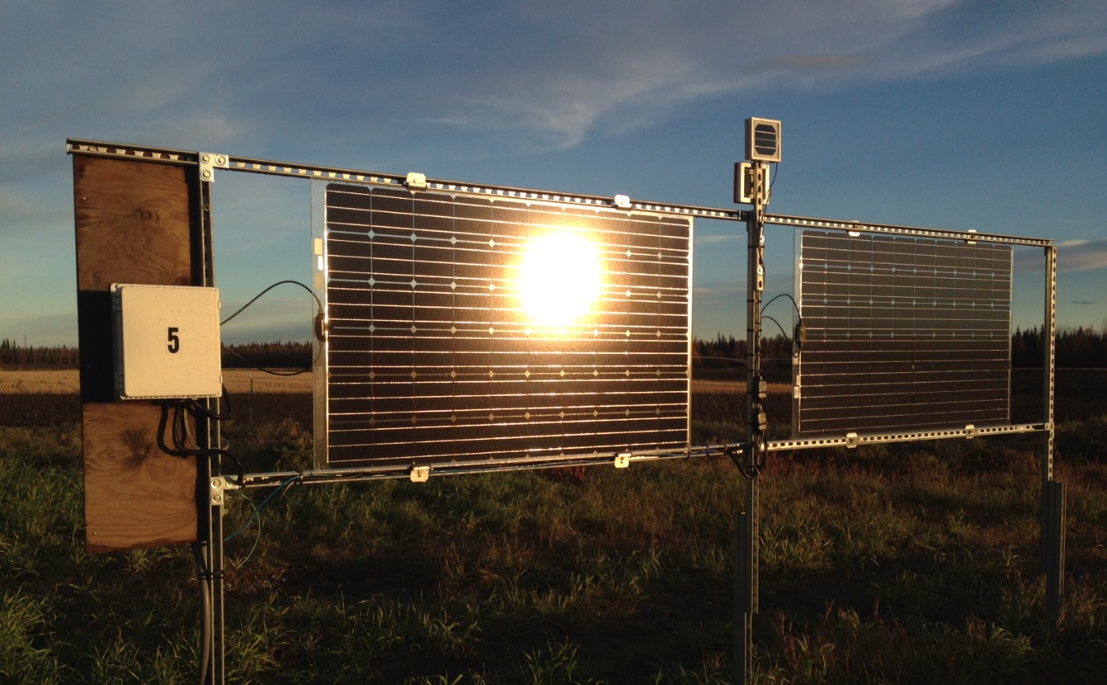
Bifacial Solar PV in the North
Chris Pike
Alaska Center for Energy and Power
22 April 2021

Slide 2
ACEP Solar Program Research Goals
The ACEP Solar Technologies Program works to support responsible and equitable development of solar photovoltaic (PV) technology in Alaska and other cold regions and high latitude areas where it is technically and economically warranted.
Give stakeholders tools to make decisions related to solar in Alaska and beyond
Maximize production
Minimize levelized cost
Improve integration strategies
Notes:
Change out Pictures for all Anchorage ones!!

Slide 3
Pike, C., Whitney, E., Wilber, M., Stein, J.S. Field Performance of South-Facing and East-West Facing Bifacial Modules in the Arctic. MDPI Energies, 14, 1210 (2021).
https://www.mdpi.com/1996-1073/14/4/1210
Notes:
Change out Pictures for all Anchorage ones!!

Slide 4
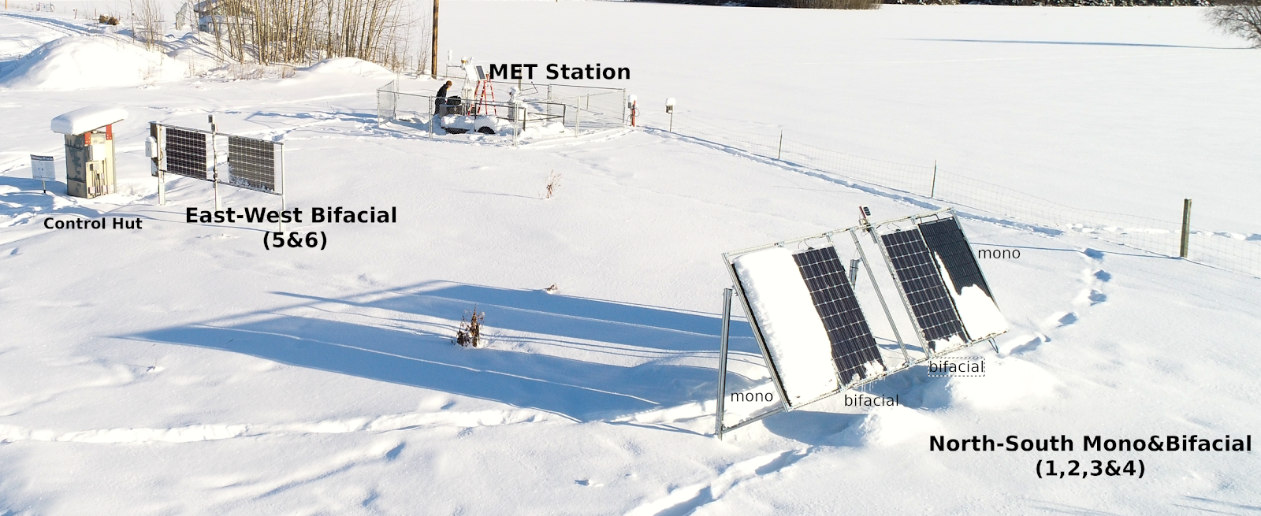
UAF Bifacial Test Site
Bifacial Costs are near or at monofacial cost
Currently account for about 20% of world market and that could rise to 70% by 2030^{i}
Bifacial modules have special potential in high latitudes
i. International Technology Roadmap for Photovoltaic (ITRPV)—Results 2019. Available online: http://itrpv.vdma.org/
Notes:
Change out Pictures for all Anchorage ones!!

Slide 5
South Facing Monofacial Versus Bifacial
Annual bifacial gain of 21% observed
Notes:
Change out Pictures for all Anchorage ones!!

Slide 6
South Facing Bifacial Versus East-West Vertical Bifacial
Annual energy production was nearly the same between the two orientations
Notes:
Change out Pictures for all Anchorage ones!!

Slide 7
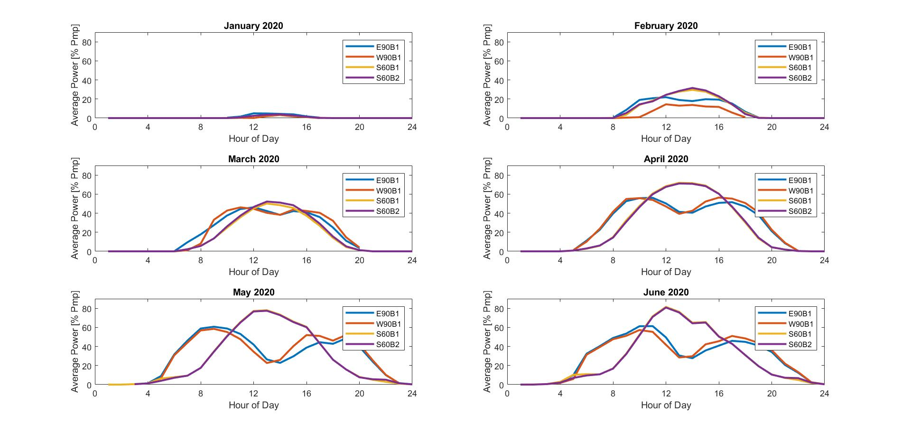
South Facing and East-West Facing Production Curves
Notes:
Change out Pictures for all Anchorage ones!!

Slide 8
Future Research
Bifacial model validation in northern environments with larger systems
Ground coverage ratio and effect on south facing and vertical bifacial
Racking options for bifacial
Notes:
Change out Pictures for all Anchorage ones!!

Slide 9
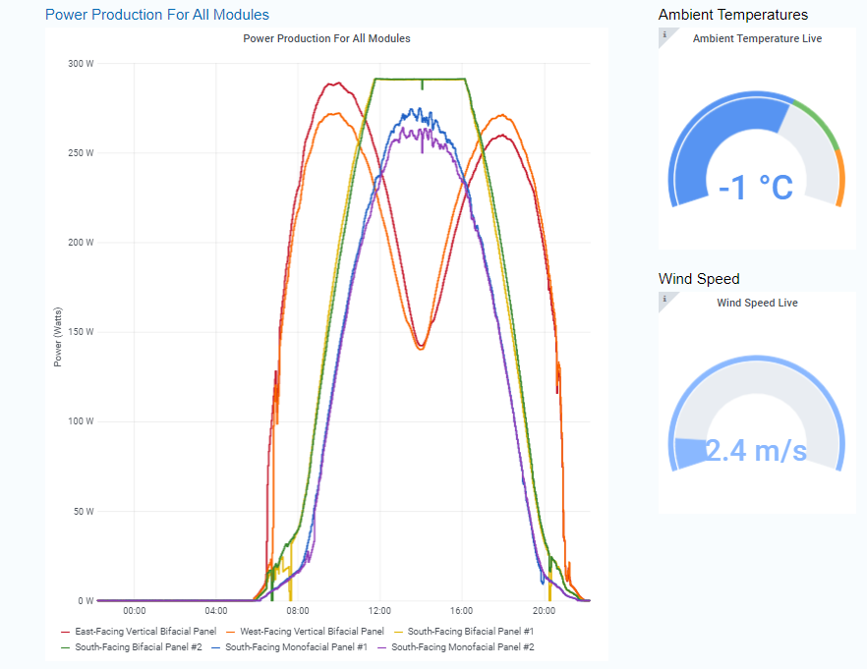
Thank You!
Chris Pike, Research Engineer Alaska Center for Energy and Power
University of Alaska Fairbanks cpike6@alaska.edu
acep.uaf.edu/solar
This project is part of the ARCTIC Program, an initiative supported by the Office of Naval Research (ONR)
Notes:
Change out Pictures for all Anchorage ones!!

