Slide 1
How Behavioral Science Can Inform Energy Program Design
Elizabeth Palchak, PhD | Arctic Sustainable Energy Research Conference
April 21, 2021

Slide 2
Driven by purpose, committed to impact
VEIC is on a mission to generate the energy solutions the world needs.
VEIC works with organizations across the energy landscape to create immediate and lasting change
We serve as an objective partner for our clients as they navigate complex energy challenges
Every challenge is different, but our commitment is the same: make an impact
Notes:
Speaker name, title, and organization: Lauren Wentz, Program Manager, Efficiency Vermont
Speaker contact information: email address and phone #: lwentz@veic.org, (802) 658-7617
Title of the presentation: Targeting Energy Burden: A Vermont Case Study
Presentation length: 1 hour
Presentation abstract:
A Vermont case study focused on how an energy efficiency program created a new way for targeting income-qualified residential customers with a simple energy burden calculation tool, and the resulting surge in participation. This case study illustrates how program design decisions to target affordability instead of energy usage, and to emphasize excellent customer experience, have helped Efficiency Vermont dramatically increase the number of people served. The redesigned program resulted in enrollment of the same number of customers in 10 days as was achieved the entire previous year. It has reached customers that have never participated in Efficiency Vermont’s programs and is receiving overwhelmingly positive feedback. This presentation will include an overview of the program design, eligibility requirements, and screening methods, as well a comparison of the program results to those of the Efficiency Vermont’s other residential programs.
Let’s use the equity metrics framework and ACEEE paper to pull in some details and highlight equity metrics
Let’s reorganize the slides to follow the flow of the paper
Maybe pull in graphs from paper
Cut the “tools for assessing impact”
Close with a nod to other efforts, ongoing work to address equity in the clean energy industry

Slide 3
Where we work

Slide 4
Our Services
Sustainable & Scalable Solutions
LMI & Community Focus
Supply Chain & Emerging Tech
Technical & Human Approach
Innovation & Pilots

Slide 5
The Human Perspective

Slide 6
Federal Policy
Shalanda Baker, the first deputy director for energy justice at the US Energy Department recently highlighted structural racism and structural inequality that is “baked into the energy system” and she calls on those in the industry to examine it.
NBC News, March 9th, 2021

Slide 7
Federal Policy
Significant commitment to reducing energy burden from the Biden Administration in the American Jobs Plan:
Strong focus on workforce development for BIPOC communities and women in the workforce
Particular focus on driving investments in disadvantaged communities that have “not yet benefited from clean energy investments”
$27B Clean Energy and Sustainability Accelerator to mobilize private investment into distributed energy resources; retrofits of residential, commercial and municipal buildings; and clean transportation
Notes:
$27B Clean Energy and Sustainability Accelerator to mobilize private investment into distributed energy resources; retrofits of residential, commercial and municipal buildings; and clean transportation

Slide 8
“We are customer-obsessed”
Mary Powell, Former CEO, GMP
Notes:
Harvard T.H. Chan “Leadership Studio”, What CEOs Say
At the helm for 12 years
2019 Executive of the Year by Utility Dive
Led an acquisition of Central Vermont Public Service – GMP grew from 88,000 customers to 260,000 when she left – revenues of $640 million with $2 billion in assets
Groundbreaking work on home batteries and the Tesla- first utility anywhere to offer customers the Tesla Powerwall battery Powerwall
Engaged in climate change and how it’s changing utilities
GMP on Fast Company’s list of most innovative companies 3 years in a row
First utility to become a B Corporation – social, environmental, governance transparency
J.D. Powers put GMP among top utilities in 2018 and 2019 for customer satisfaction
“One of Vermonts Best Places to Work”

Slide 9
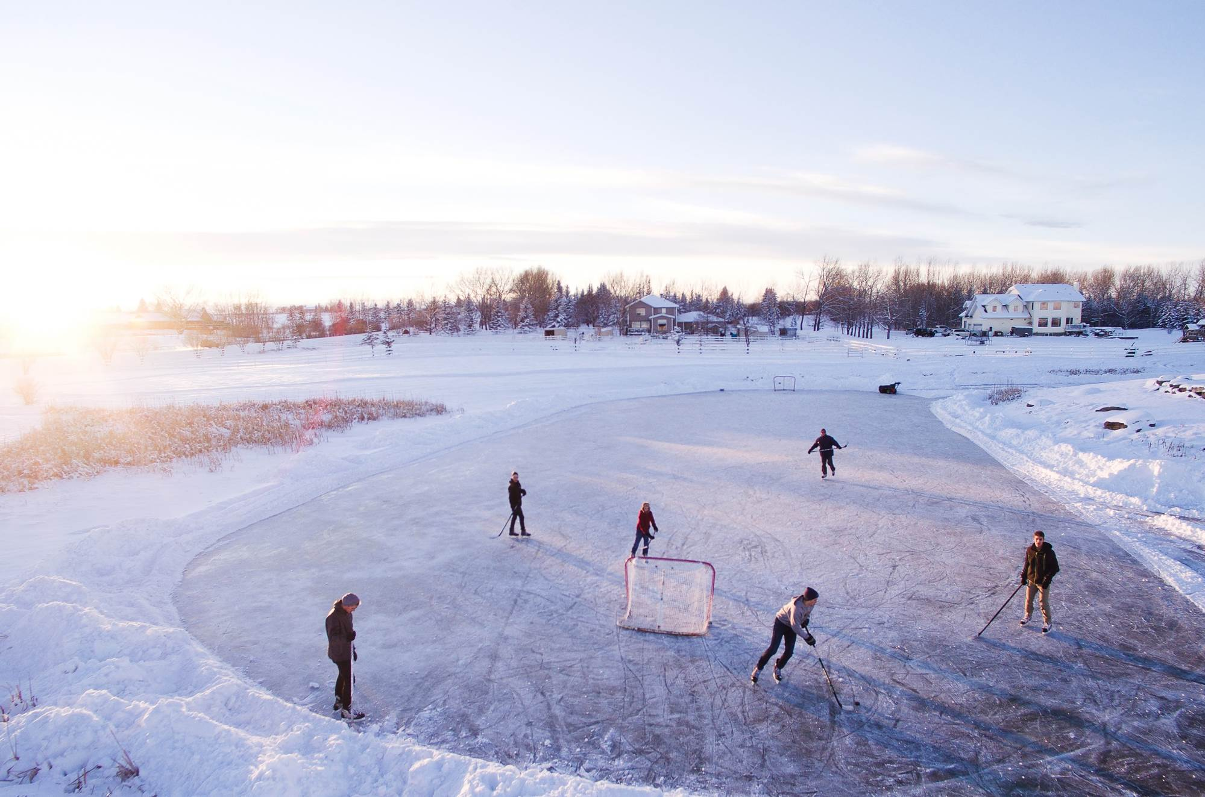
Understanding Your Customers
Who are you trying to reach?
What do they care about?
What are their challenges?
Notes:
Understanding our customers is key to delivering effective programs to your markets.

Slide 10
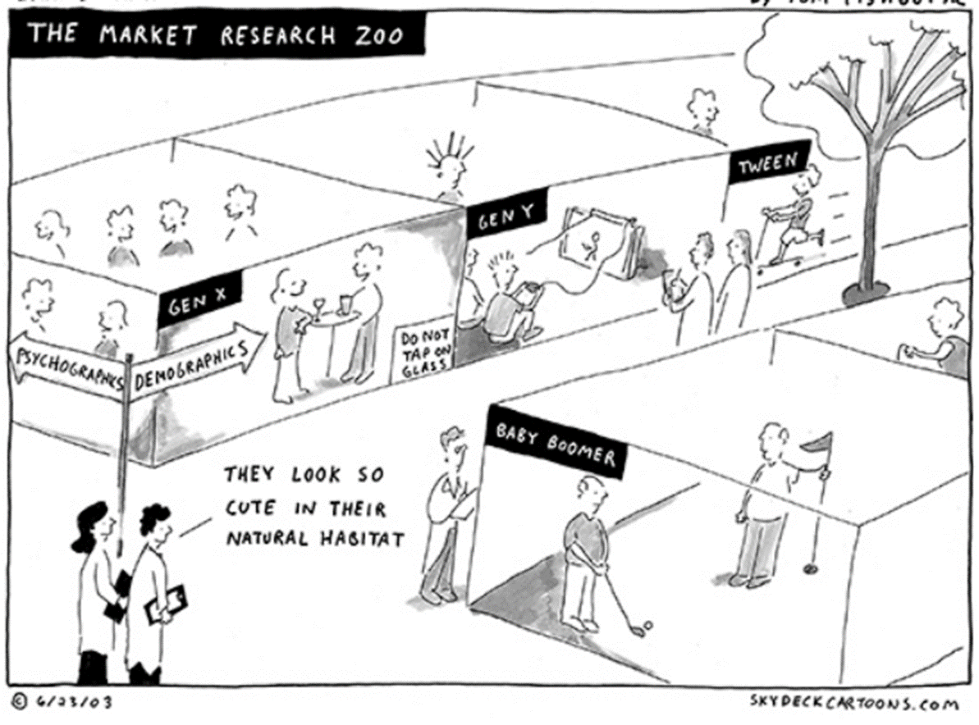
Understanding Your Customers
How can you get a little bit more intel on your customers?
YOU DON’T KNOW EXACTLY HOW THEY THINK
Notes:
Persona: A fictional character that communicates the primary characteristics of a group of users
80/20 Rule: Targets the universe that makes up 80% of the customer base.
Customer Centric: Enables us to design the best user experience for our target audience(s)
Litmus test for program design

Slide 11
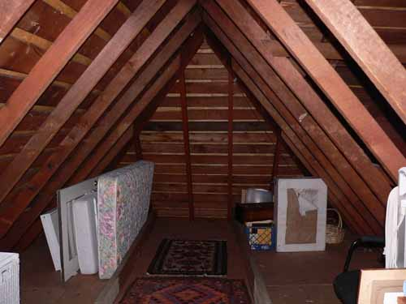
What will it take to increase attic insulation in homes?
Offer group discounts to groups of neighbors who agree to insulate their attics
Offer generous subsidies (essentially pay people) to put insulation in their homes
Explain the environmental benefits
Notes:
CREATE POLL #1
Sometimes the barriers to energy efficiency are misunderstood. This is an example of a policy-making process in Britain that targeted reduced rate home weatherization projects. But, the utilities had a very difficult time recruiting customers. Which of these options was the most effective solution to recruiting customers?

Slide 12
What will it take to increase attic insulation in homes?
Offer group discounts to groups of neighbors who agree to insulate their attics
Offer generous subsidies (essentially pay people) to put insulation in their homes
Explain the environmental benefits
Notes:
CREATE POLL #1
Sometimes the barriers to energy efficiency are misunderstood. This is an example of a policy-making process in Britain that targeted reduced rate home weatherization projects. But, the utilities had a very difficult time recruiting customers. Which of these options was the most effective solution to recruiting customers?

Slide 13
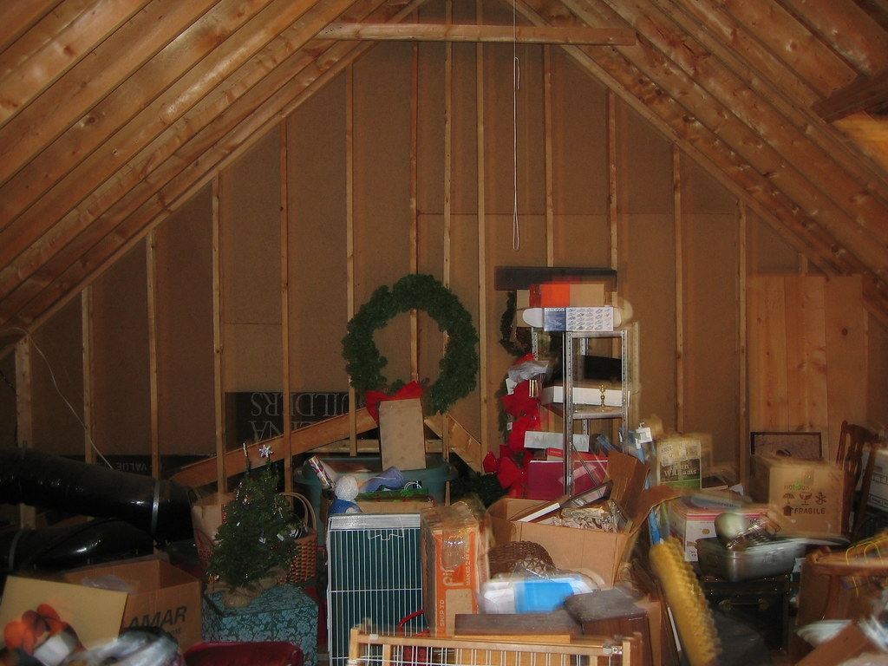
Notes:
There are often hidden motivators for behavior.
Most people’s attics are messy.
When Britain’s Behavioral Insights Team added a loft clearing service with the insulation process, uptake in the insulation program rose dramatically. People didn’t want to clear their attics!

Slide 14
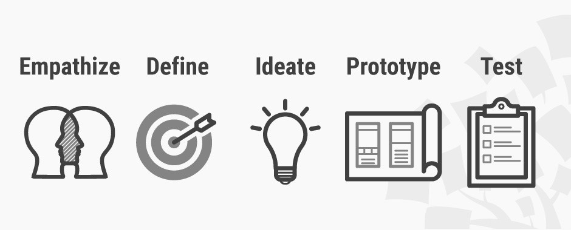
Human-Centered Design
https://www.interaction-design.org

Slide 15
“
If you think good design is expensive, you should look at the cost of bad design.
“
Ralf Speth – CEO of Jaguar Land Rover
Notes:
Put the time in. If you have it, put the financial resources in – or, we’ll talk about some low-cost ways to bring the human perspective to your work

Slide 16
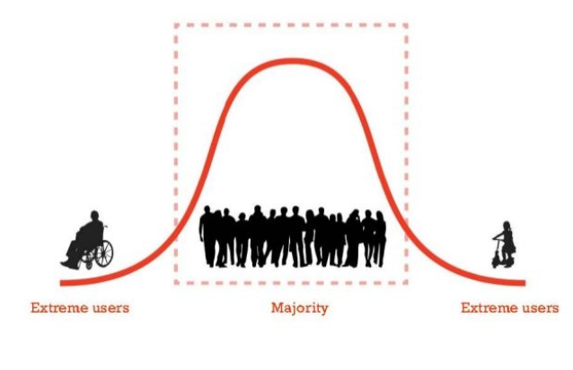
Gain Insights from Extreme Users
Notes:
If we were designing a walkable/bikeable community – these might be examples of extreme users

Slide 17
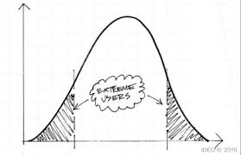
Who Are Your Extreme Users?
Notes:
A human-centered design approach can gain significant insights from users who are atypical. In the energy efficiency industry, this might mean interview moderate, average energy users – but also interviewing high energy users and very low energy users. During market research, gain information from the majority, but also glean insights from customers at the tails of the bell curve, “extreme users”.

Slide 18
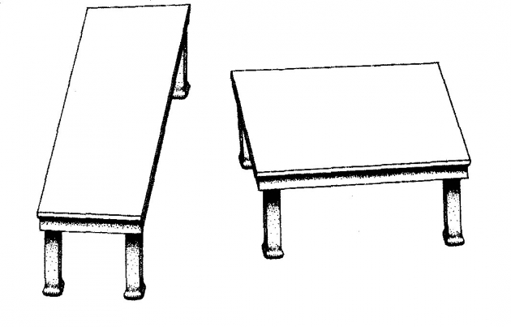
Shephard tables, 1990

Slide 19
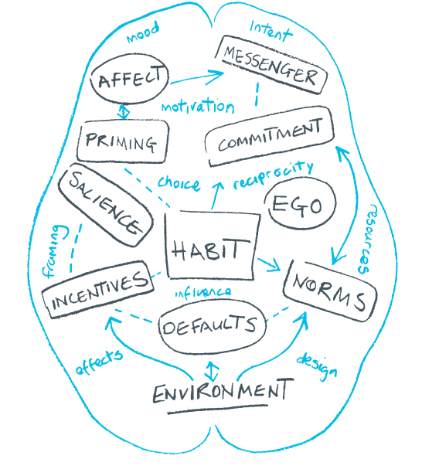
Nudging with Behavioral Science
Psychology + Marketing + Energy
Notes:
Behavioral science in our industry integrates insights from these fields
Source: http://www.behaviouralinsights.co.uk/publications/mindspace/

Slide 20
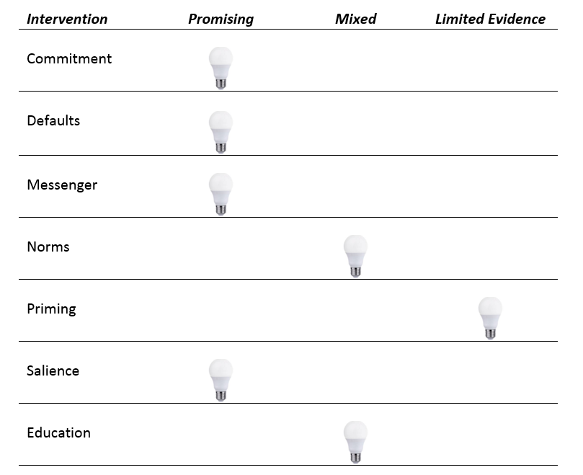
Behavior Change Evidence
Byerly et al., 2018 Frontiers in Ecology and Environment
Notes:
This is from a forthcoming paper I co-authored in Frontiers in Ecology and Environment. This is what we understand about energy use and behavioral science. When teased apart by researchers from these other contextual interventions, social norms were often identified as not statistically significant. Norms are often combined with other interventions. When combined with salience and financial incentives on average in one study we examined = 19.4% reduction in electricity, 17.5% reduction in gas. Back to idea of social influence….face-to-face seems to work best…
Financial incentives also showed inconsistent evidence. Cost of energy is very low, “boomerang effects”, and measuring energy use by costs did not appear to motivate customers…we did find evidence that financial incentives could be used as part of a peak-pricing mechanism
Education – education when combined with other treatments showed a limited effect. Almost no evidence that workshops are effective

Slide 21
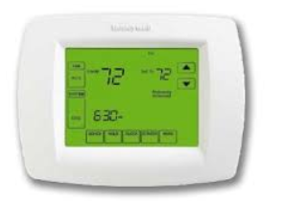
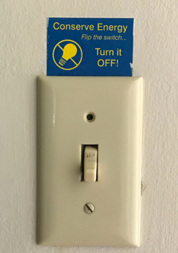
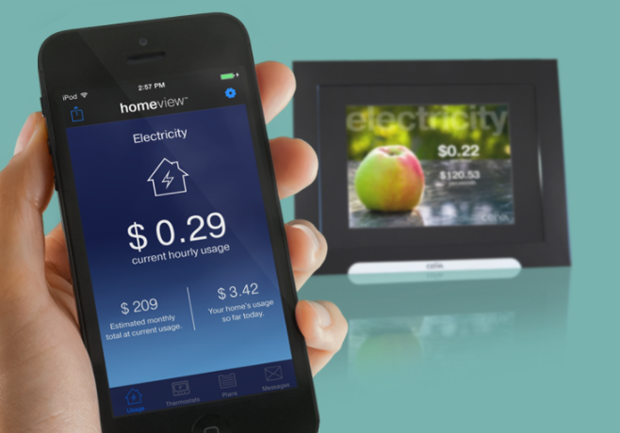
Salience
Notes:
Salience: the quality of being particularly noticeable or important; particularly important in energy use because it’s invisible; increasing frequency of information, changing the medium (on a computer vs. on a bill), reduce the difficulty of temporal discounting – find better, easier ways to express information
Defaults: show promise to leverage further, often combined with financial incentives which showed a stronger effect; where we saw the highest effect size “make it easy”

Slide 22
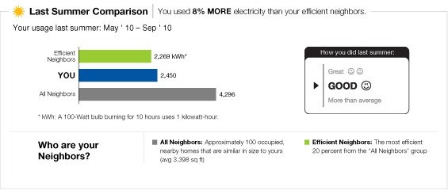
Social Norms
Notes:
SMUD = Sacramento Municipal Utility District. SMUD provides electric service to more than 600,000 in and around Sacramento, CA and is a leader in energy efficiency
Neighbor comparisons are a social norming approach to drive behavior change
Home Energy Reports include:
Information on energy usage by category and appliance
Specific tips, tailored to individual homes and businesses, on how to cut energy consumption and reduce electric bills
Referrals to specific programs

Slide 23
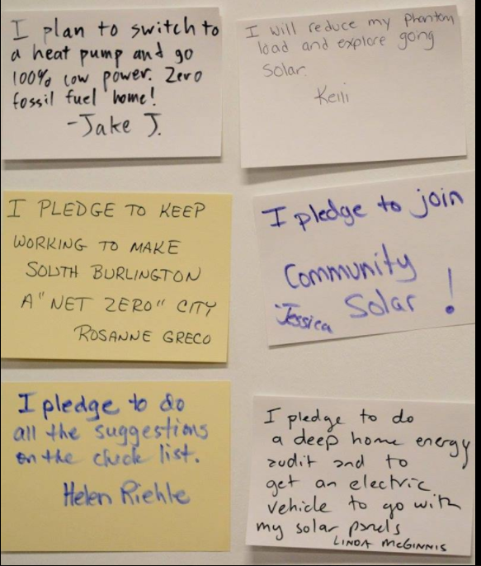
Commitment
Notes:
Commitments showed promise when combined with other treatments. When teased apart, this intervention showed an effects size in experiments of .3-.5
We used commitments in a recent pilot we conducted with low-income customers in Vermont…we are now exploring the question of how do get commitments to scale…which is admittedly, a challenge
Source: Shared by the South Burlington Energy Prize Committee

Slide 24
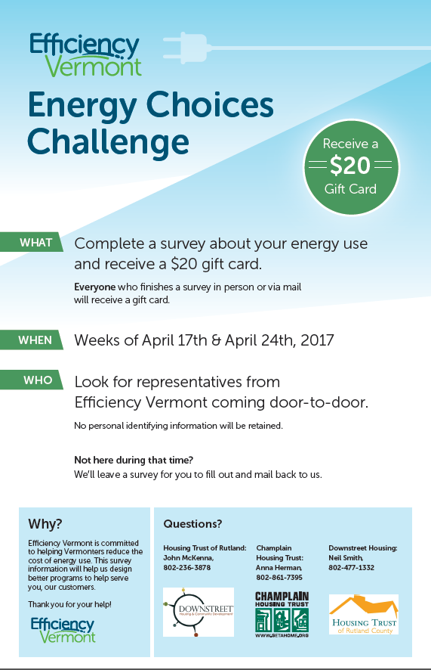
Low-Income Multifamily Behavior Program
Empathy: Focus groups with residents
Prototype: 2 poster designs for final report
Test: Lobby of MF apartments, plate of doughnuts
Savings of 7-20% in participating homes
Messenger, Salience, Financial Incentives
New American communities
Renters
Raffle for free rent
Regular feedback on usage and change in use
Notes:
Behavioral Change Tool
Applied in VT Home Energy Challenge
Commitment
Send in your pledge card to commit to improving efficiency in your home. Earn points for your community.
Public commitment of participants in media and public spaces
Social norming
Lawns signs for homes with completed projects
Public commitment (as above)
Visual ID associated with Challenge and/or home efficiency improvements
Key influencers
Social diffusion
Local partners implement programs emphasizing interpersonal contact; e.g. home energy visits, door-to-door, home energy parties
Incentives/awards
Towns receive grant for efficiency improvements in municipal building/community efficiency project
Homeowners receive incentives under HPwES
Help your town win!
Effective messaging
Message to local partner: -- neighbors-helping-neighbors save money through energy savings
Visual, captivating, draws you in
Reciprocity
Energy saving kits offered via survey/order form
Home energy visits
Feedback
Town-level dashboard measuring progress toward goal/target
Goal setting
Town level targets of 3%
Sign up 5 of your neighbors
Reduce energy use by xx% through efficiency improvements
Prompts
Posters reminding people to get an audit/retrofit
Source: Document created by Efficiency Vermont

Slide 25
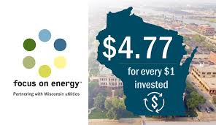
Save to Give: Focus on Energy Wisconsin
Messenger, Salience, Financial Incentives
Rural communities
Simple energy-saving actions
Self-reported and energy bills
Points awarded to local charities
Leveraging altruistic tendencies

Slide 26
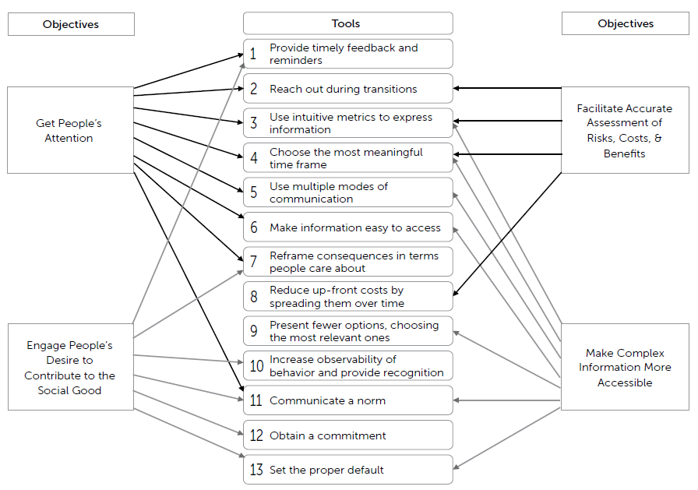
Key Resource for Integrating Behavioral Science
“Behavioral Science Tools to Strengthen Energy and Environmental Policy”
Yoeli et al., 2017

Slide 27
Key Themes
Behavioral science and user-centered design should be integrated as often as possible
Use a strategic approach to program selection and development
Define your customer markets and listen to them

Slide 28
Elizabeth Palchak, PhD | VEIC
epalchak@veic.org

