Slide 1
Air Source Heat Pumps in Cold Climates
Tom Marsik, PhD, CCHRC-NREL/UAF BBC-ACEP Vanessa Stevens, PMP, CCHRC-NREL Robbin Garber-Slaght, PE, CCHRC-NREL
Notes:
MARTIN

Slide 2
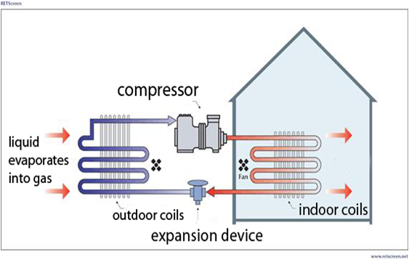
How does an air source heat pump work?
Image courtesy of RETSCREEN.

Slide 3
Advantages of Heat Pumps
Low maintenance
No combustion
Partially renewable
Potential for lower energy costs
"Efficiencies" over 100%

Slide 4
Coefficient of Performance (COP)
$$COP= \frac{heat delivered by the heat pump}{electrical energy supplied to the heat pump}$$

Slide 5
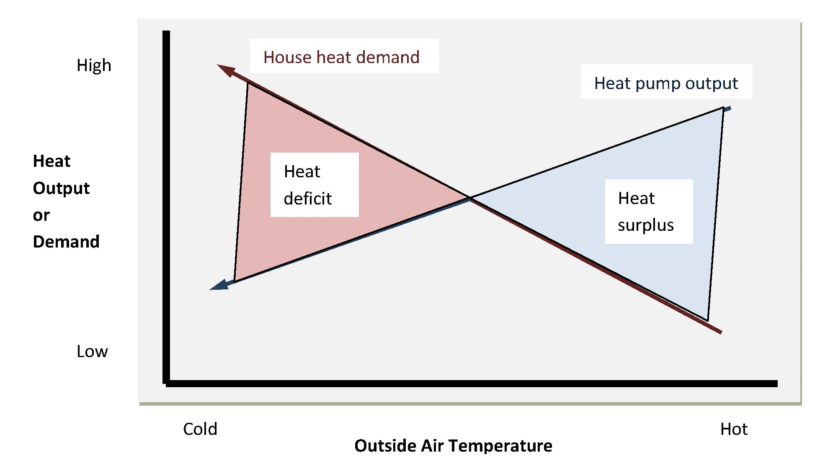
Air-Source Heat Pumps: Fundamental Challenge

Slide 6
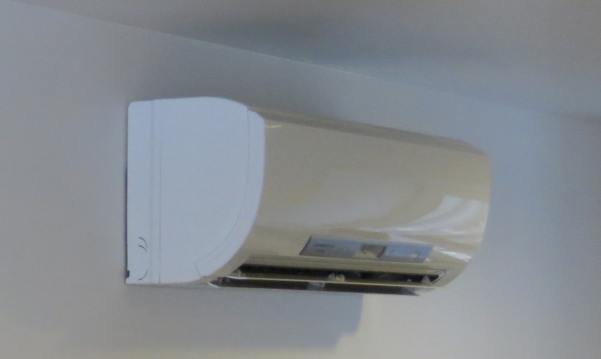
ASHPs – Special Considerations
Need for a backup heat source in cold climates
What is the source of electricity and its efficiency?
Air-to-air versus air-to-water
For air-to-air: ducted versus ductless
Outside air cutoff temperature

Slide 7
Emerging Energy Technology Fund Grant
Air Source Heat Pump Potential in Alaska: CCHRC, UAF Bristol Bay Campus, Wrangell Municipal Light & Power
Main Objectives
Study the field performance of ASHPs in Alaskan conditions
Study the behavior of ASHPs around cut-off temperatures
Study the potential of using ASHPs as an electrical demand management tool by replacing resistive heating systems (primarily in Southeast Alaska)
Wrangell City Hall in Southeast Alaska is heated by a heat pump.

Slide 8
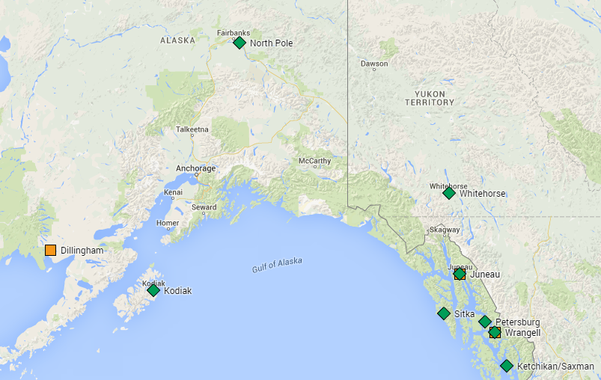
Locations of ASHPs in the 2014-2015 Study

Slide 9
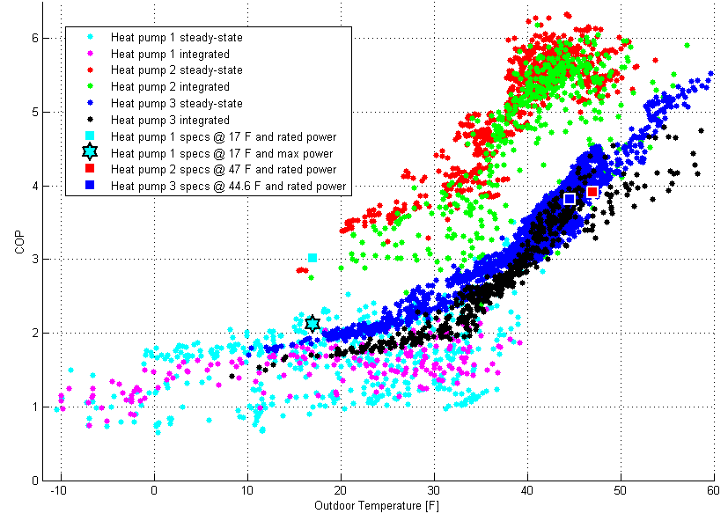
ASHP Detailed Monitoring Results

Slide 10
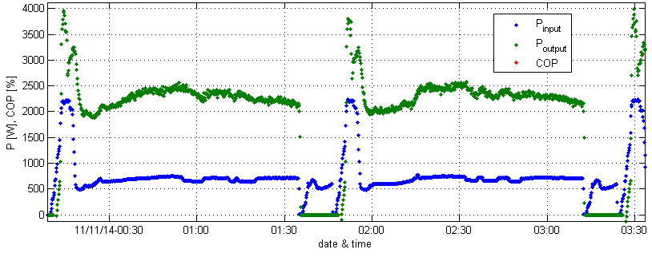
ASHP detailed monitoring – general conclusions
Manufacturer’s specifications do not always correctly reflect field performance
Most documentation focuses on steady-state performance, but integrated performance data is needed for more accurate representation of cold-climate operation (includes cycling due to defrost)
Large variations in efficiency among individual models

Slide 11
ASHP General Monitoring - Results
Selected Sites – direct and/or indirect monitoring of ASHP electricity
Main findings
Limited data does not confirm that ASHPs will always reduce electrical energy use, even when replacing electric resistance heat.
ASHPs have only a small effect on peak power demand.
Demand-side management programs should include measures other than ASHPs.

Slide 12
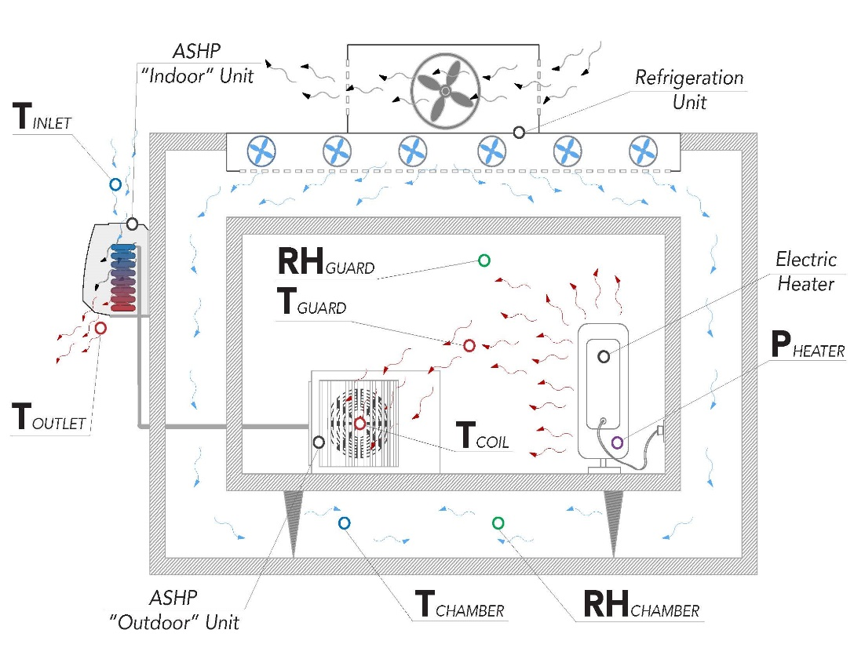
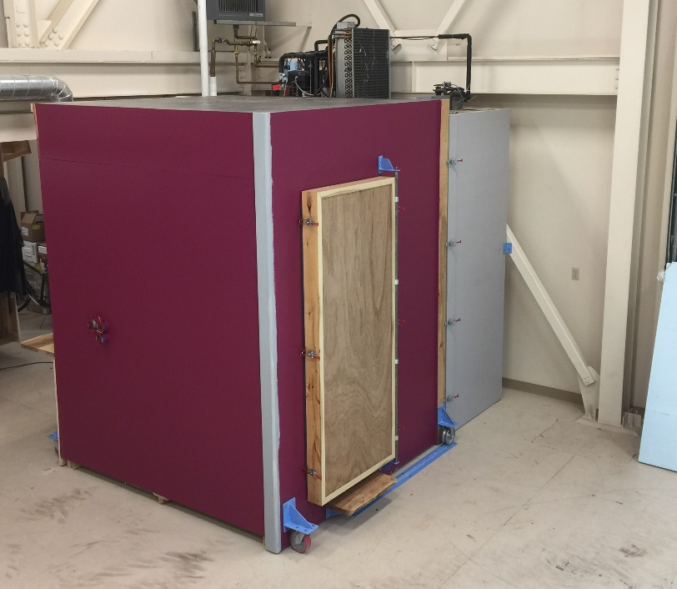
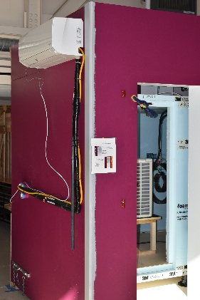
Current Research
Evaluating ASHP performance at different levels of thermal loading

Slide 13
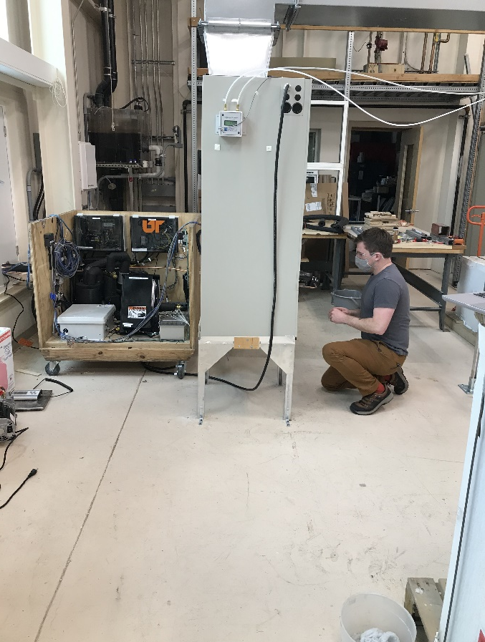
Current Research
Oak Ridge National Lab study
Evaluating an ORNL prototype for cold climates at CCHRC
CCHRC first studied an ORNL heat pump in 2017; it operated efficiently at -30°F
This new cold climate heat pump is designed to operate efficiently down to -10°F and lower
This prototype is close to market ready

Slide 14
Current Research
Helping Alaska Heat Smart implement Thermalize Juneau campaign
First thermalize campaign in Alaska
Economies of scale to implement heat pumps and other energy efficiency measures
Study energy savings and homeowner satisfaction

Slide 15
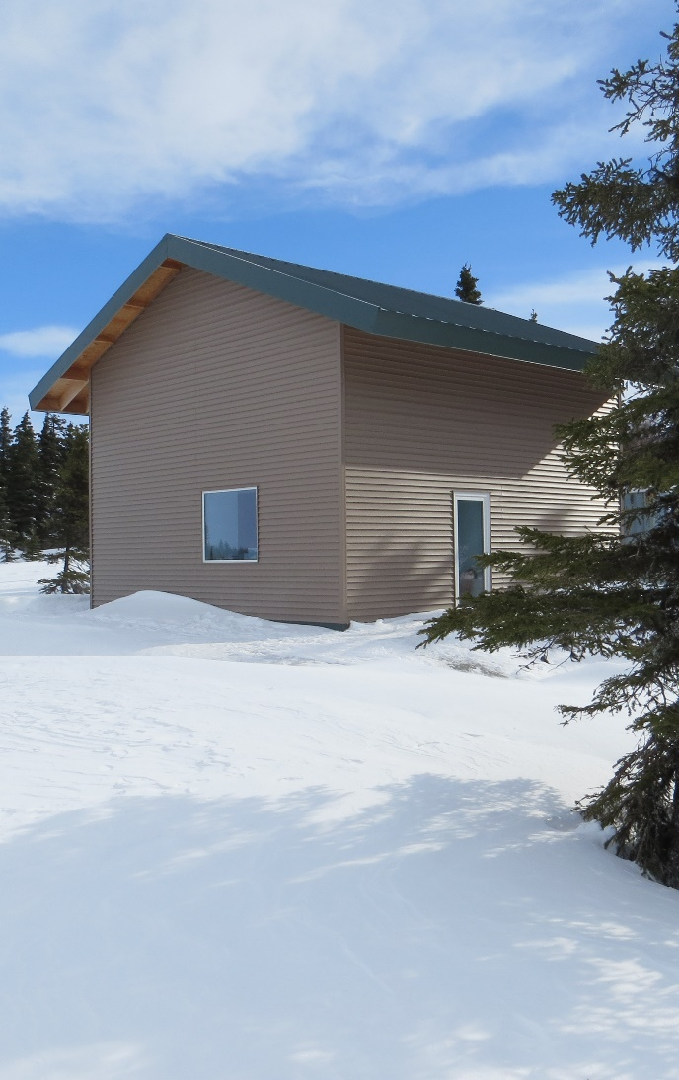
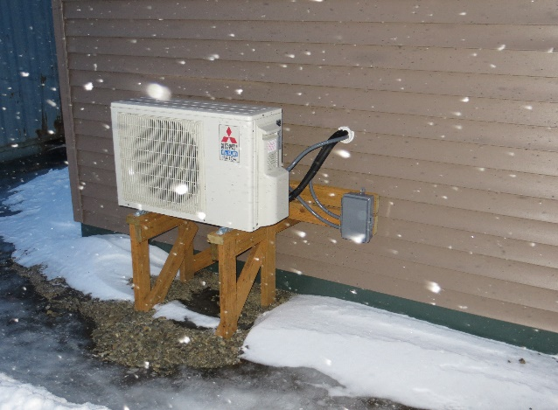
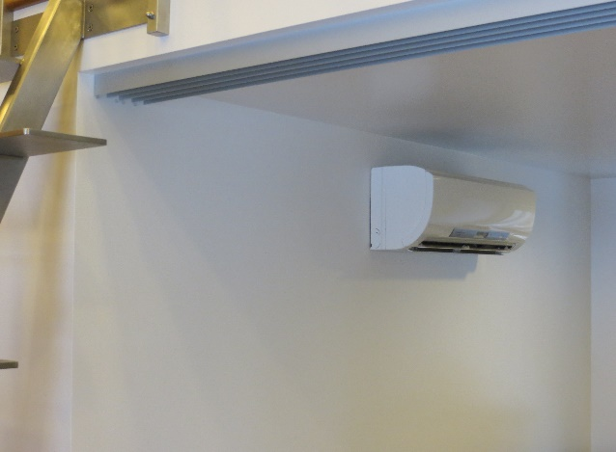
System Approach: Heat Pump + Efficient Envelope
Notes:
All of these technologies and manufacturers ALREADY exist. We just need to organize it, coordinate it, and build a market around it.

Slide 16
ASHPs – Main Conclusions
ASHPs can significantly reduce energy use and energy costs when used in appropriate situations and done right.
More research needed to gain better understanding of ASHP performance in cold climates to guide future deployment.
System approach yields biggest savings.
Notes:
All of these technologies and manufacturers ALREADY exist. We just need to organize it, coordinate it, and build a market around it.

Slide 17
Credits
ASHP General Monitoring - Results
Individuals:
Colin Craven
Bruno Grunau
Clay Hammer
Jim Rehfeldt
Chris Pike
Erin Whitney
Alan Mitchell
Dirk Baker
Others
Organizations:
Alaska Energy Authority
National Science Foundation
U.S. Dept. of Agriculture
Alaska Housing Finance Corporation
U.S. Dept. of Defense
U.S. Dept. of Energy
Others
THANK YOU!
17
17

Slide 18
Thank you!
Questions ?
Tom Marsik
tom.marsik@nrel.gov
Vanessa Stevens
vanessa.stevens@nrel.gov
Robbin Garber-Slaght
robbin.garberslaght@nrel.gov
www.cchrc.org
acep.uaf.edu
uaf.edu/bbc

