Slide 1
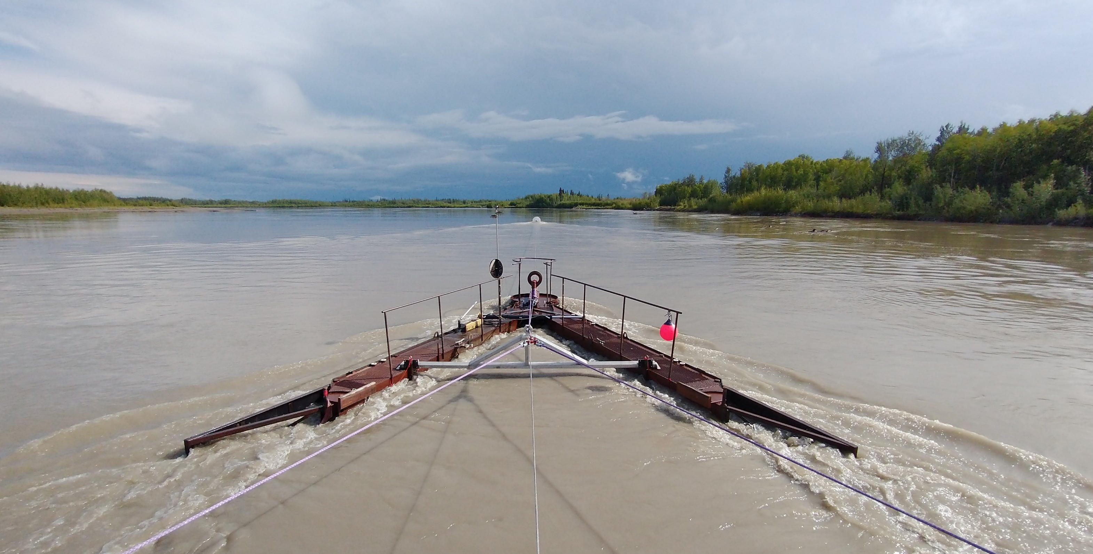
Hydrokinetic Energy Research
22 April 2021
Arctic Sustainable Energy Research Conference 2021
Ben Loeffler, Alaska Center for Energy and Power
at UAF
bhloeffler@alaska.edu

Slide 2
Outline
UAF - MHK Background
Definition of hydrokinetic
Types of hydrokinetic systems
Alaska MHK resource
Challenges to MHK
UAF work in hydrokinetics – current projects
Research gaps in Hydrokinetics

Slide 3
Marine HydroKinetics (MHK) at UAF
Established as Alaska Hydrokinetic Energy Research Center (AHERC) within ACEP in 2010
Research in Nenana, Ruby, Eagle, Igiugig, Yakutat
Collaborate with UAF College Fisheries and Ocean Science (CFOS)
Joined Pacific Marine Energy Center (PMEC) with University of Washington and Oregon State University in 2014

Slide 4
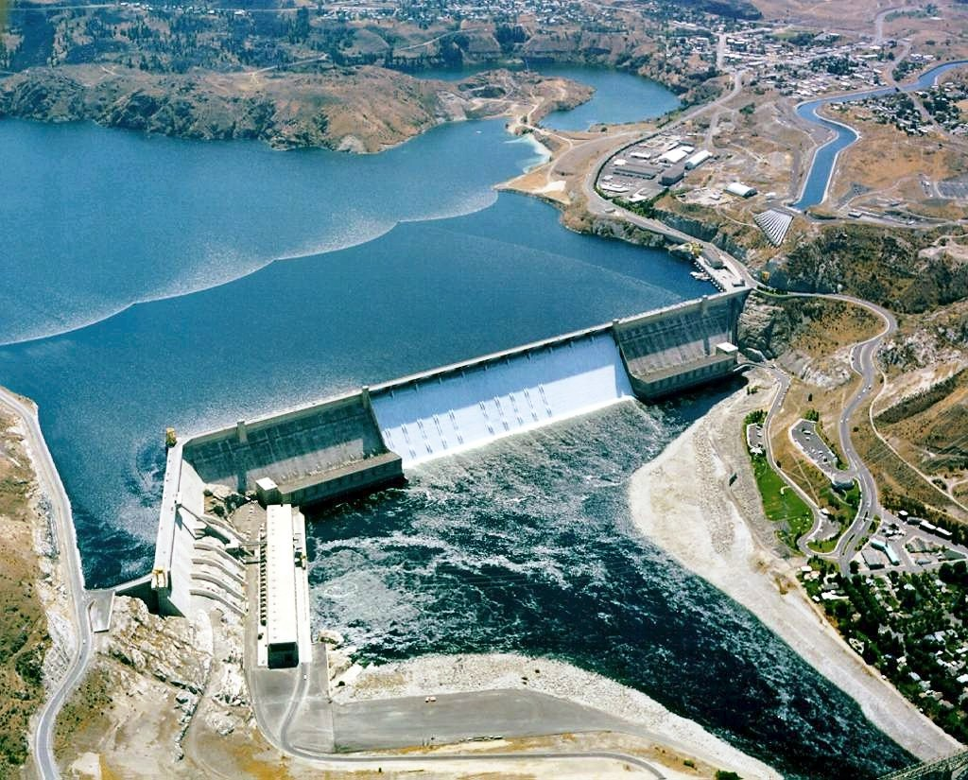
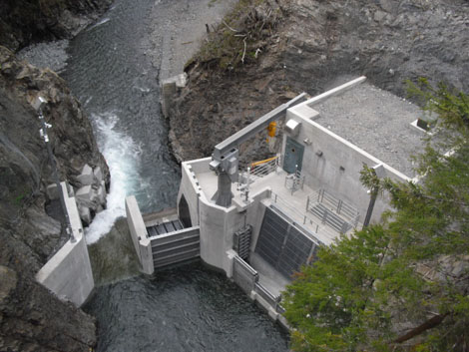
Hydrokinetic vs “traditional hydro”
Traditional Hydropower – Harnesses falling water
  Dams - store water in lake
    Grand Coulee Dam (6,800 MW)
    Bradley Lake Hydro (120MW)
  Diverters - “run-of-river” – no storage
    Cordova Electric (6MW)

Slide 5
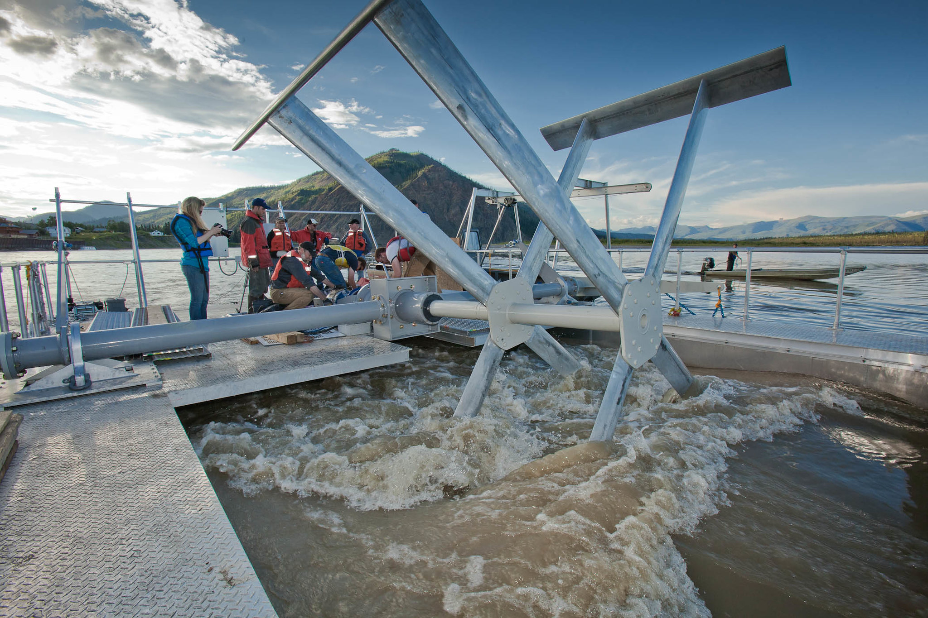
Hydrokinetic vs “traditional hydro”
Hydrokinetic - Harnesses natural movement of water
  Wave, Tidal, River
  Device installed directly into water with no/minimal civil infrastructure
  Floating, submerged, or bottom mounted
DOE video - https://youtu.be/LXsuU_ZC56E

Slide 6
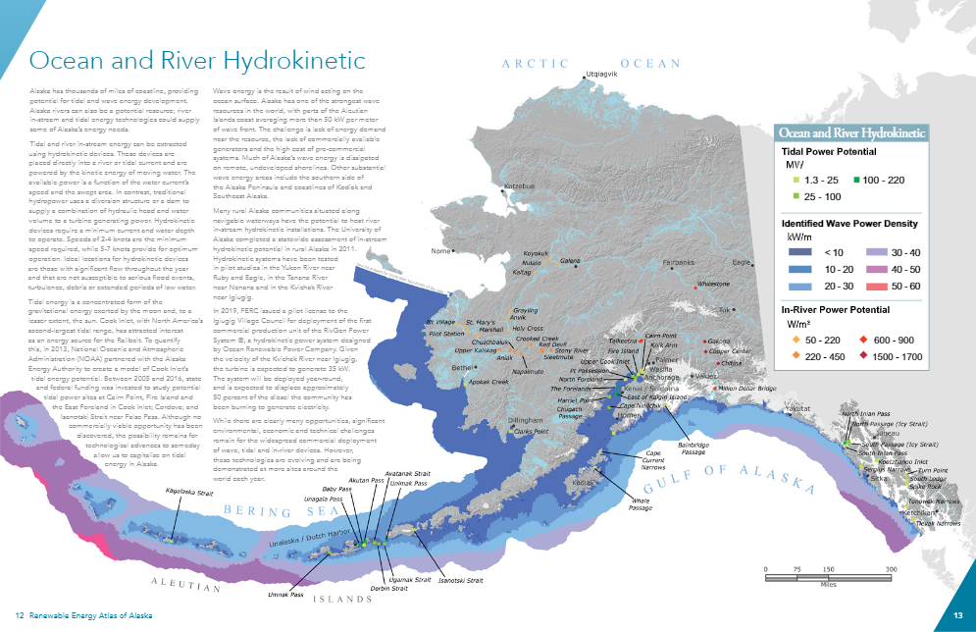
MHK Opportunities
Alaska has:
  40% of US River Energy
  90% of US Tidal Energy
  60% of US Wave Energy
Almost all communities are on rivers or coastline.
https://alaskarenewableenergy.org/library/renewable-energy-atlas/

Slide 7
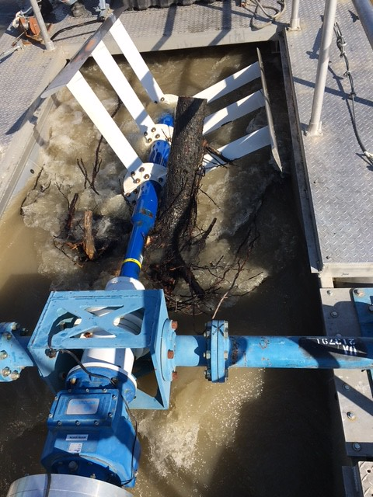
MHK Challenges
Cost
  Inherently small scale
  Competing low-cost energy sources
Efficiency
  low speed motions
Reliability
  debris, sediment, corrosion
  Seasonality
  extreme events – waves, floods
Environmental
  fish, marine mammals, sediment transport
Integration with microgrids
  seasonality, dispatchability, black-start

Slide 8
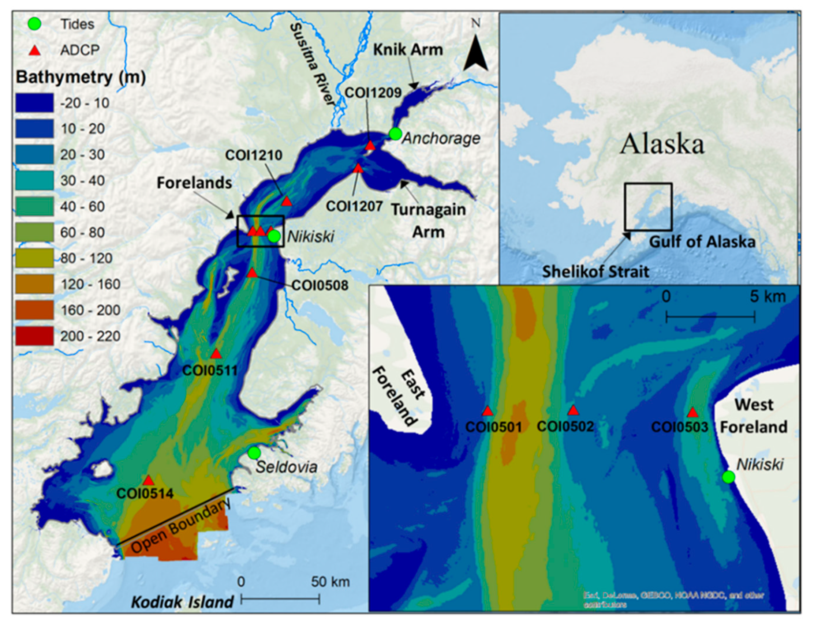
Tidal Energy
Alaska areas of interest
  Cook Inlet (Anchorage)
  Kootznahoo Inlet (Angoon)
  Aleutian Islands
Challenges
  Competing with low cost energy
  Requirement for storage to serve as baseload
Wang T, Yang Z. A Tidal Hydrodynamic Model for Cook Inlet, Alaska, to Support Tidal Energy Resource Characterization. Journal of Marine Science and Engineering. 2020; 8(4):254. https://doi.org/10.3390/jmse8040254

Slide 9
Wave Energy Converter (WEC) Challenges
Multiple types of motions which vary over time and space
  pitch, heave, surge
Challenging conditions
  corrosion, biofouling, maintenance
Power-Take-Off (PTO) – convert motion into electricity
  tradeoffs between efficiency and cost/complexity
( all images from https://www.aquaret.com/index.html)

Slide 10
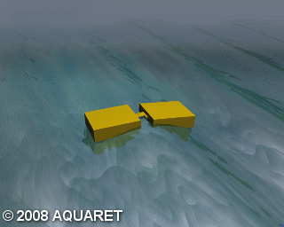
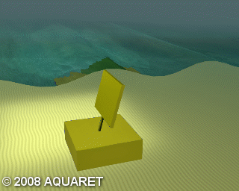
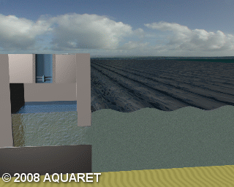
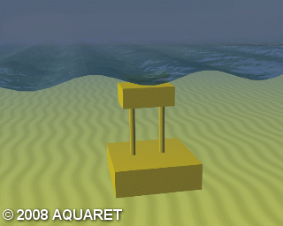
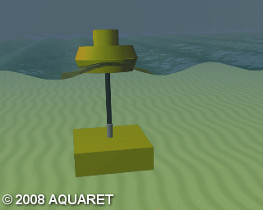
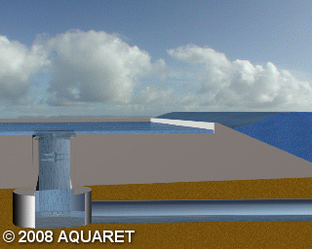
Wave Energy Converter (WEC) Types
( all images from https://www.aquaret.com/index.html)

Slide 11
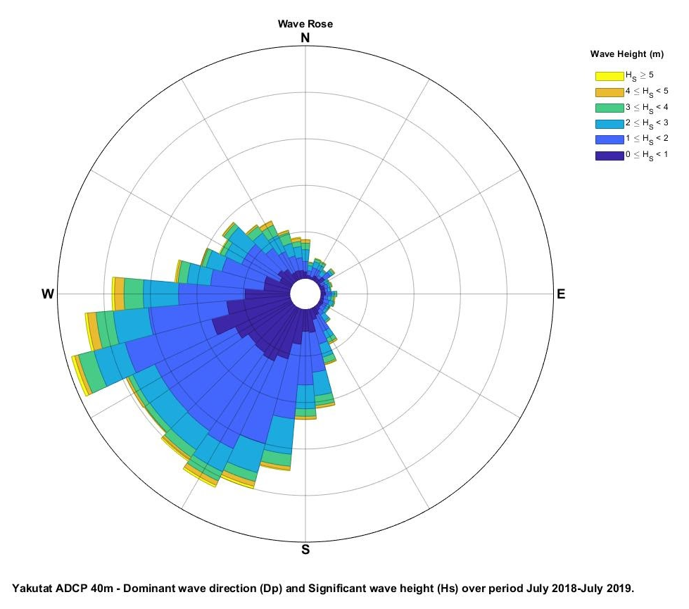
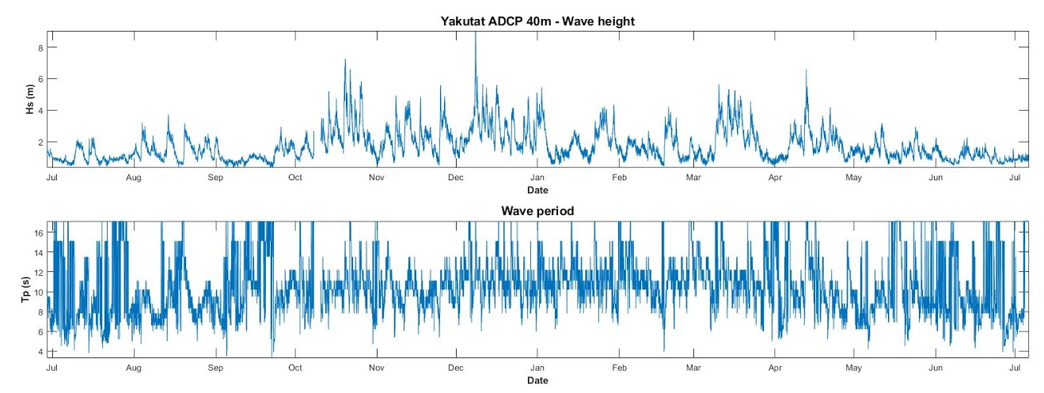
Wave energy for Yakutat, Alaska
ACEP study of solar and wave energy resources
Modeling of hybrid diesel-battery-solar-wave grid
Efforts funded by ONR, Sandia, BOEM

Slide 12
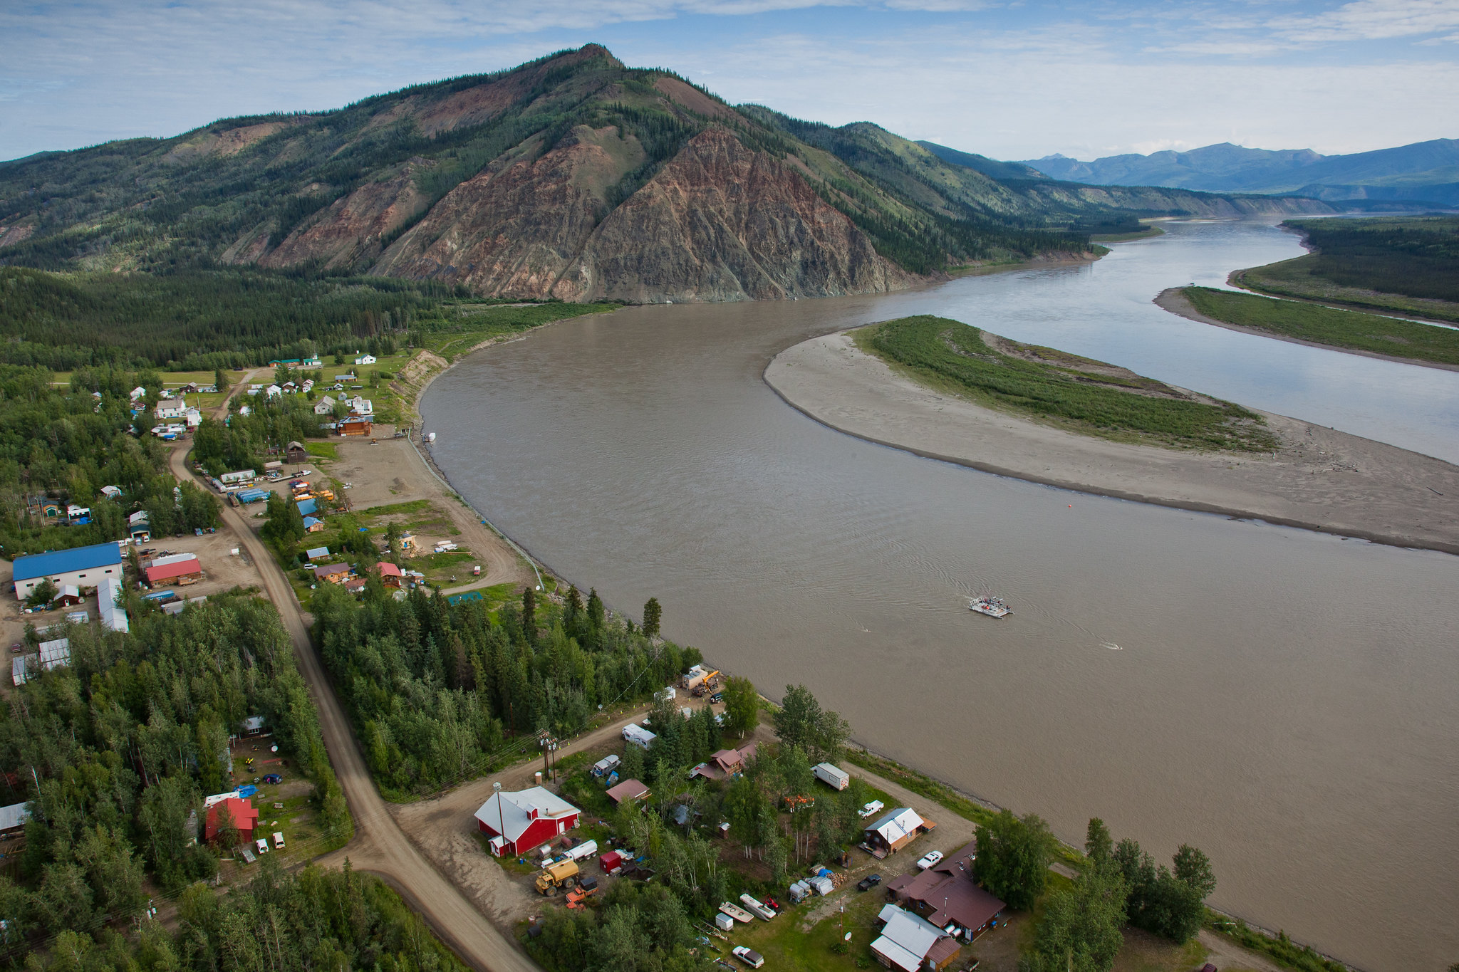
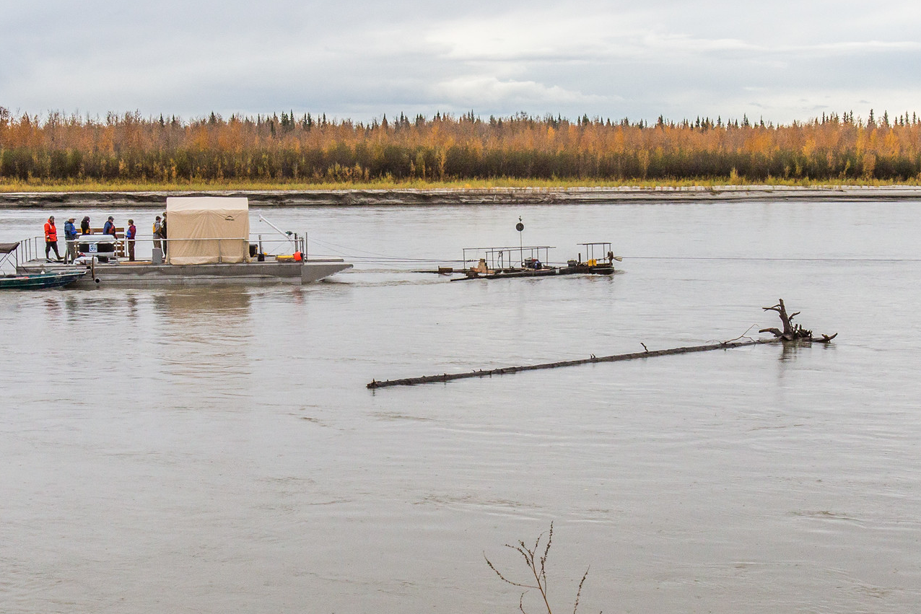
Current Energy Converter (Riverine)

Slide 13
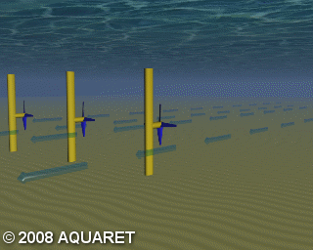
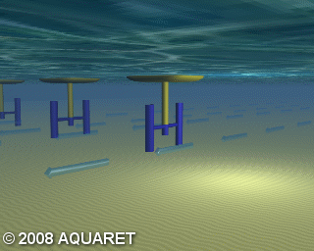
Current Energy Converter Types
ACEP video on ORPC in Igiugig at https://youtu.be/lANhN3xTwR0

Slide 14
Tanana River Test Site – Overview
Located in Nenana, AK (55 highway miles SW of Fairbanks)
Open water May thru October
Velocity 1.3 to 3.0 m/s
Depth ~ 6m (20 ft)
Fully Permitted
http://acep.uaf.edu/facilities/tanana-river-hydrokinetic-test-site.aspx

Slide 15
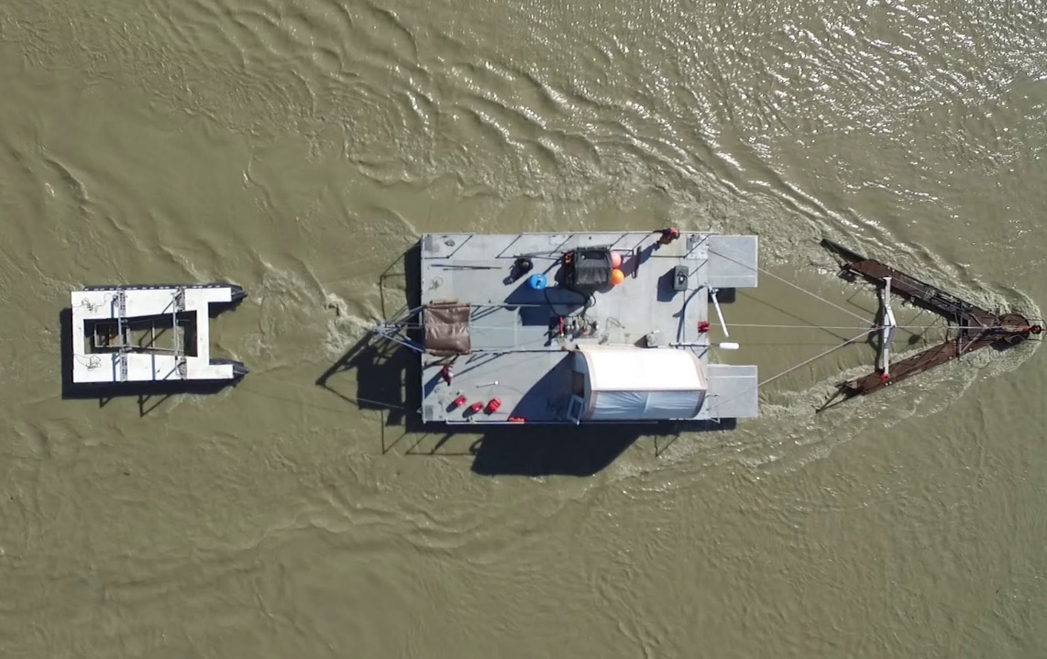
Tanana River Test Site - Equipment
Inclined Plane Fish Trap
River Debris Diversion Platform (RDDP)
Research Barge

Slide 16
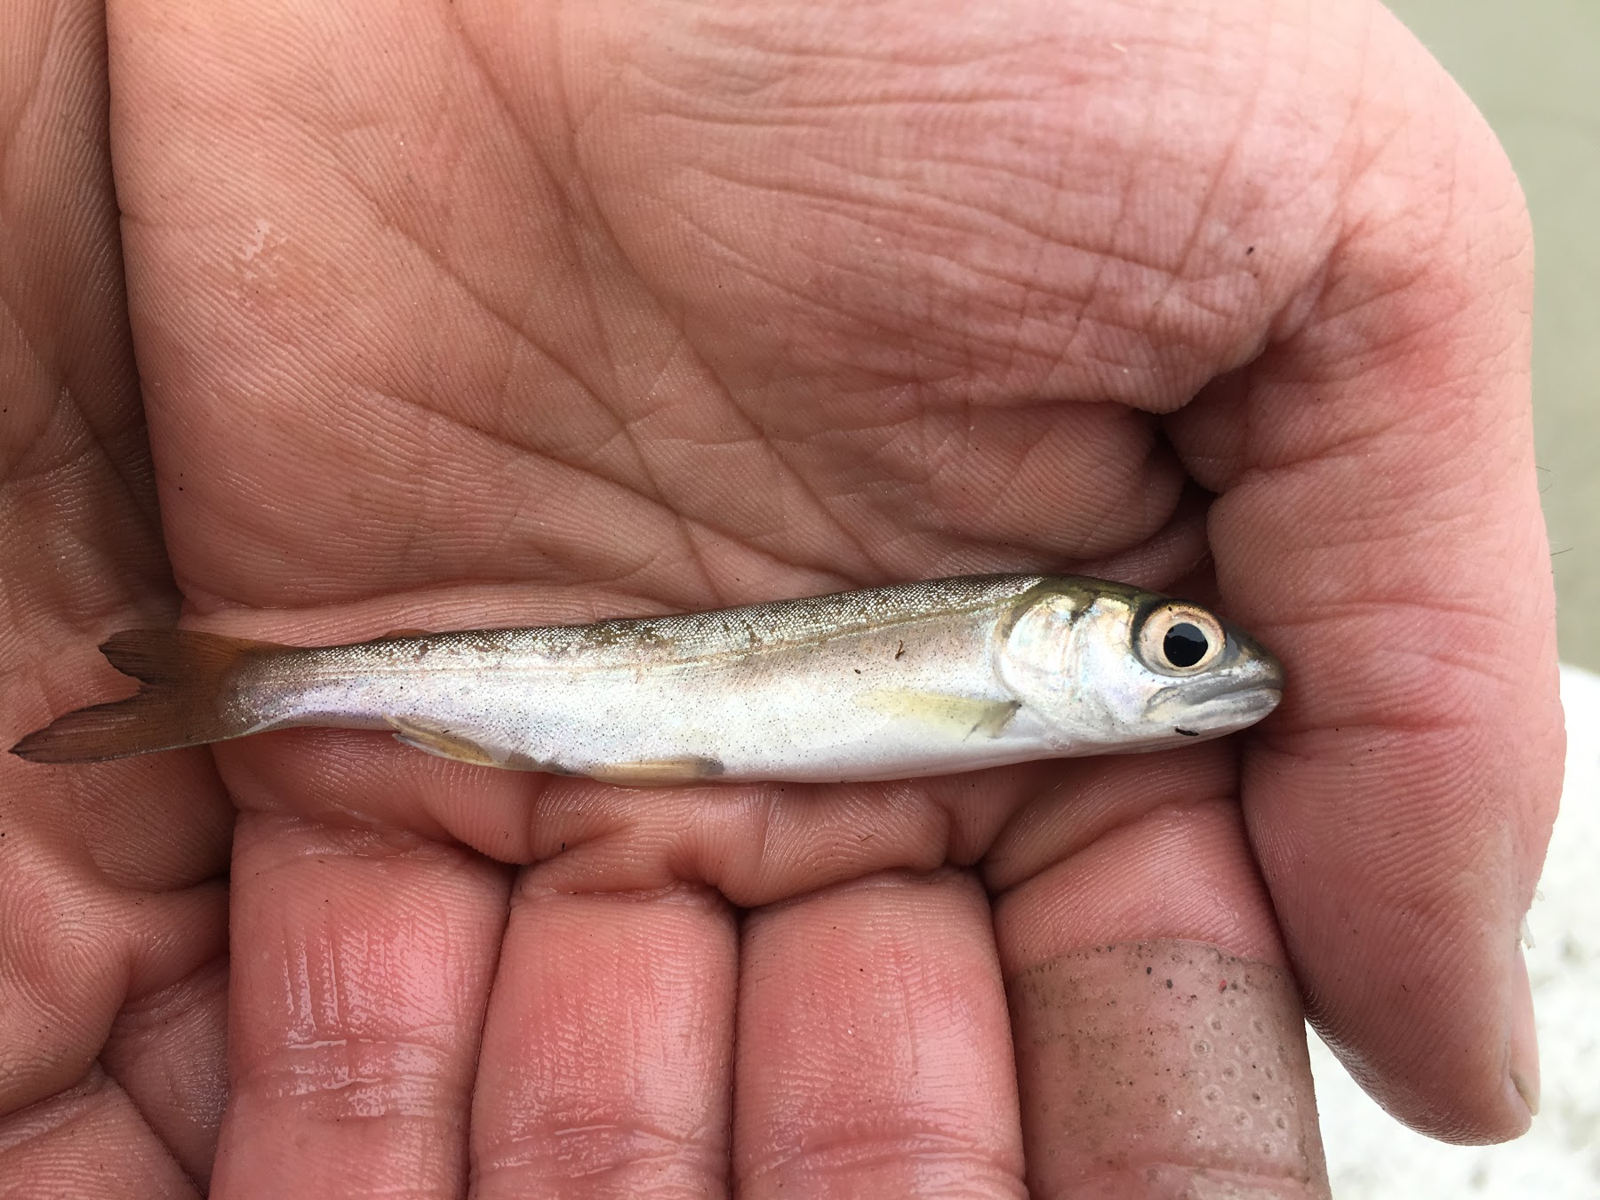
UAF Research
Publications available at:
  https://acep.uaf.edu/programs/alaska-hydrokinetic-energy-research-center/publications.aspx
Resource assessments
  wave, river
Fish Characterizations
  smolt interactions with turbines
Debris
  characterization, detection, diversion, forces
MHK System Testing & Development
  Ruby, Eagle, Igiugig, TRTS

Slide 17
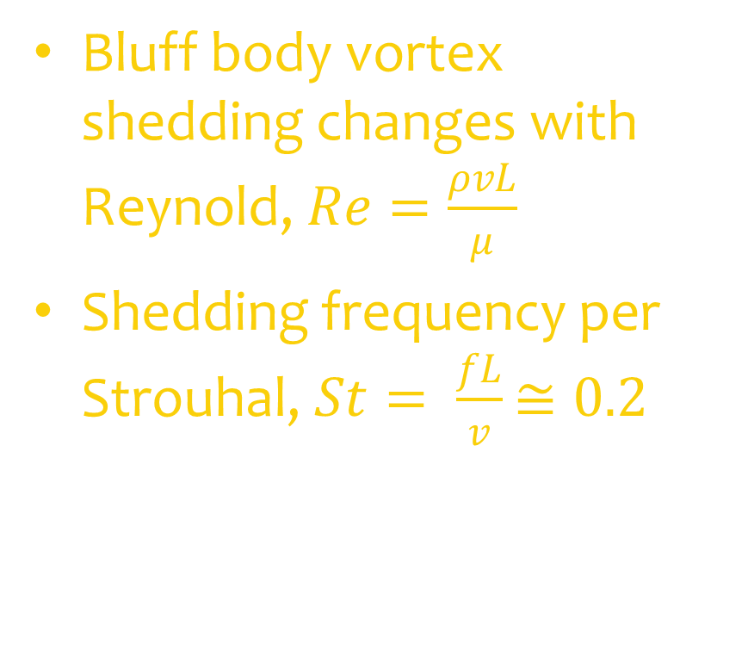
Water Horse - Galloping Current Energy System
Bluff body vortex shedding changes with Reynold, $Re=\frac{ρvL}{μ}$
Shedding frequency per Strouhal, $St= \frac{fL}{v}$ $≅0.2$
M. M. Bernitsas, “The VIVACE Converter,” 2011.

Slide 18
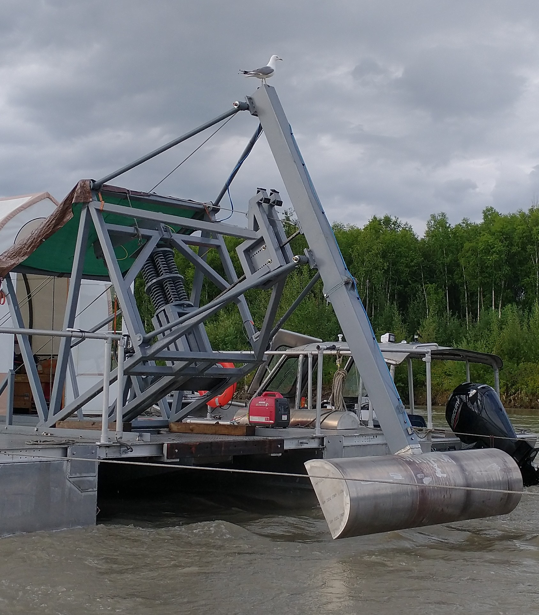
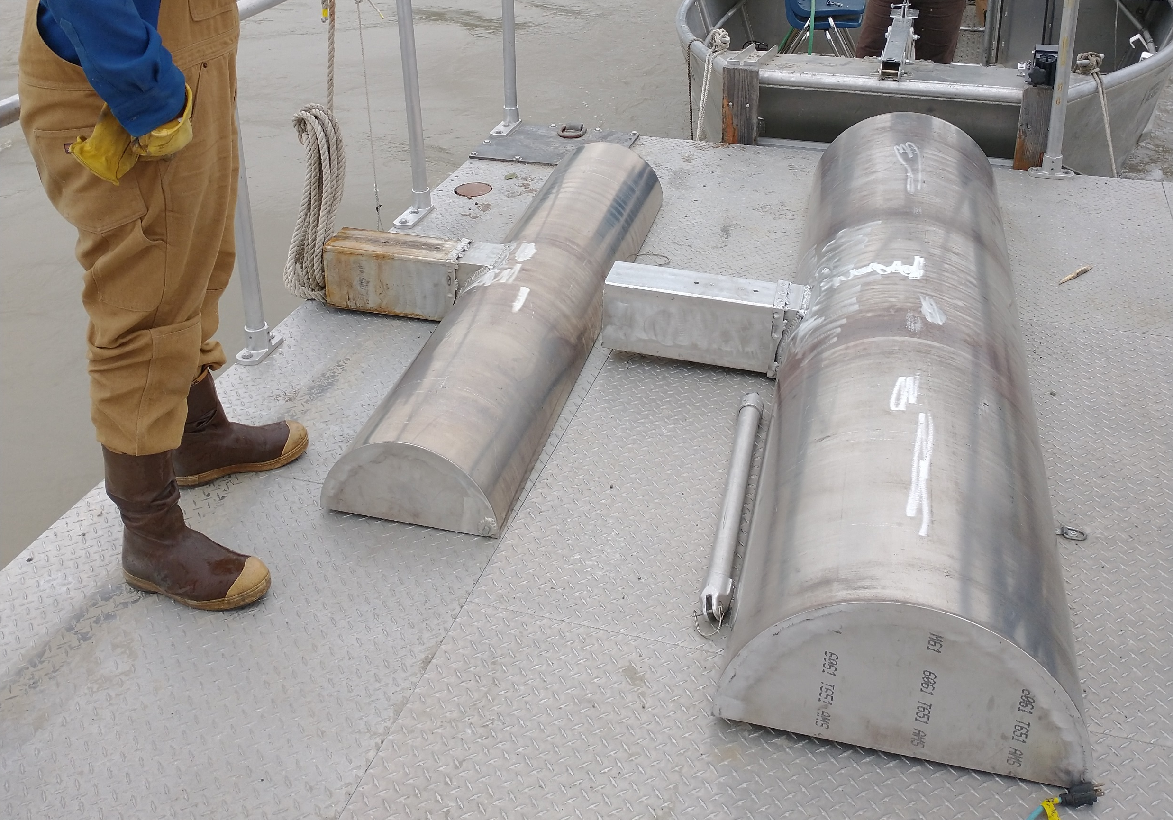
Water Horse Prototype
WPTO Funding
Renerge, Inc IP
Tested at TRTS July 2020

Slide 19
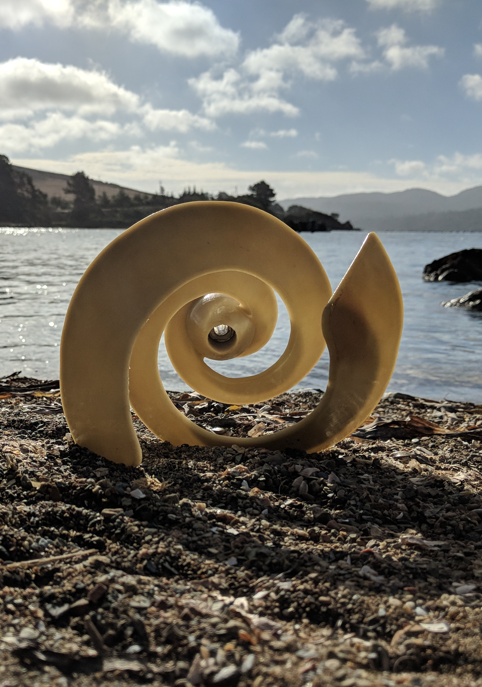
ARPA-E SHARKS
3-year award starting 2021
Programmatic focus on LCOE
  Material Efficiency
  Conversion Efficiency
  Operating Expenditures
Collaboration with private sector startups
  BladeRunner Energy, Inc.
  C-Motive Technologies, Inc.

Slide 20
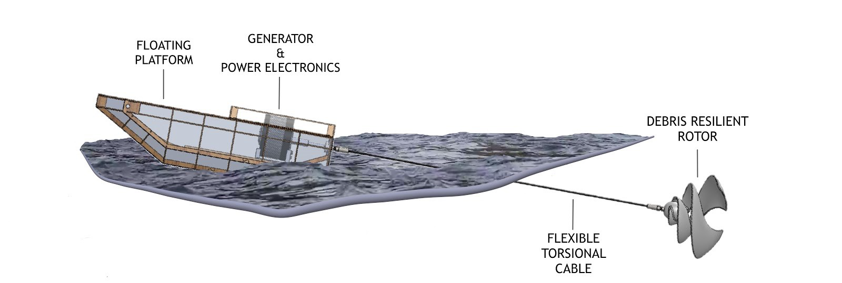
ARPA-E SHARKS
  Tethered turbine with single point mooring.
    All structural loads are in tension. Highly material efficient.
    Decouples generator and rotor sizing. Can scale rotor to match resource.
  Electrostatic generator.
    High efficiency at direct-drive speeds.
  Shore-based deployment/retrieval system
    Drastic reduction in OpEx.
    Improved capacity factor.

Slide 21
MHK Research Gaps
Compare to Wind/Solar
  Industry has not coalesced around a single architecture – everyone is still trying to solve multiple problems at the same time
  Range of unique challenges – submerged generators, debris, marine construction
  More predictable (tidal, river), improves grid integration and storage efficacy

Slide 22
MHK Research Gaps
Gaps are recognized and being addressed by:
  Private Sector Technology Developers
  Test Sites – TRTS in AK, PACWAVE off Oregon, WETS in Hawaii
  Public Funding
    Department of Energy
      Water Power Technology Office (WPTO) – National Labs
      Advanced Research Projects Agency – Energy (ARPA-E)
    Bureau of Ocean Energy Management (BOEM)
    Office of Indian Energy
    State of AK
      EETF and REF (previously)

Slide 23
Funding Acknowledgements
Water Horse material is based upon work supported by the U.S. Department of Energy’s Office of Energy Efficiency and Renewable Energy (EERE) under the Water Power Technologies Office Award Number DE-EE0008389.
Yakutat work funded by ONR (through University of Hawaii), Sandia National Lab, Bureau of Ocean Energy Management
Disclaimer: “This report was prepared as an account of work sponsored by an agency of the United States Government. Neither the United States Government nor any agency thereof, nor any of their employees, makes any warranty, express or implied, or assumes any legal liability or responsibility for the accuracy, completeness, or usefulness of any information, apparatus, product, or process disclosed, or represents that its use would not infringe privately owned rights. Reference herein to any specific commercial product, process, or service by trade name, trademark, manufacturer, or otherwise does not necessarily constitute or imply its endorsement, recommendation, or favoring by the United States Government or any agency thereof. The views and opinions of authors expressed herein do not necessarily state or reflect those of the United States Government or any agency thereof.”

Slide 24
Links to Post in Chat
DOE Video – MHK - https://youtu.be/LXsuU_ZC56E
ACEP Video – Igiugig ORPC - https://youtu.be/lANhN3xTwR0
ACEP Publications - https://acep.uaf.edu/programs/alaska-hydrokinetic-energy-research-center/publications.aspx
Ocean Energy Europe - https://www.oceanenergy-europe.eu/

