Slide 1
Modeling renewable energy integration in Canada’s remote communities
Ryan Kilpatrick, CanmetENERGY-Ottawa
April 22, 2021
Notes:
Overview on CanmetENERGY Ottawa energy research on northern & remote communities

Slide 2
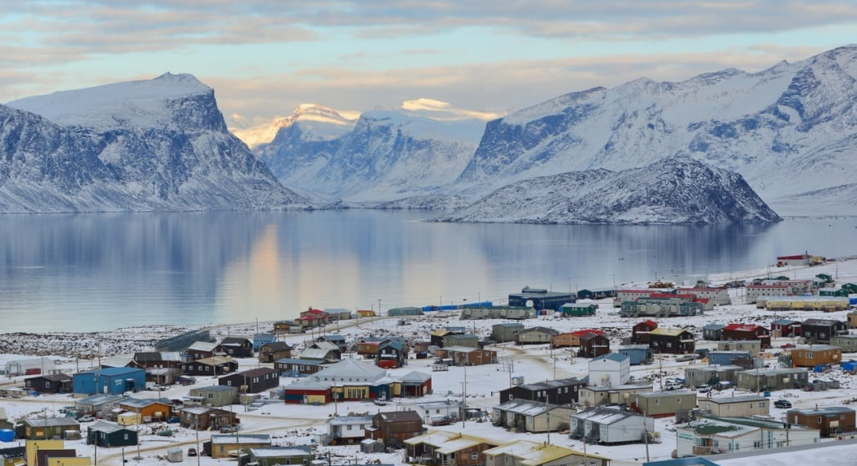
Canada’s Northern and Remote Communities
2
Northern and remote communities
Not connected to the North American electrical grid nor to the natural gas pipeline network
Long-term settlement (5 years or more) with at least 10 dwellings
220K people living in 280 remote, off-grid communities, roughly 190 use diesel as primary energy source
Extreme location & climate lead to high energy costs and deterioration of buildings & infrastructure
Logistical and financial challenges associated with reliable and affordable electricity & heat
Diesel electricity generation is dispatchable, reliable and established, and has relatively low capital investment cost; however, diesel generators are aging, in need of investments, and have concerns over oil spillages and air pollution
Heating consumes 2-3 times more diesel fuel than electricity
Notes:
280 communities: comes from remote community energy database
image: https://www.cbc.ca/news/canada/north/this-week-s-photo-recap-crisp-winters-crisp-photography-1.2825352
Remote communities share common characteristics such as extreme locations and climate lead to ….
- high energy costs
- deteriorating conditions in buildings and infrastructure
- logistical ….
As most of utilities who are supplying power/fuel in the north be familiar with, diesel gensets are well established as the most reliable and economical prime mover for electricity generation in remote northern communities as far back as 4 decades.
Aging diesel gensets in need of investments
However electricity is only part of the energy needs, according to 2018 NRCan data, remote communities use 2 to 3 times more fossil fuels for their heating needs (space heating and hot water) than for power generation. Predominant fuels used for heating include diesel, fuel oil and propane.
Oil spillages from storage tanks and air pollution from diesel gensets.

Slide 3
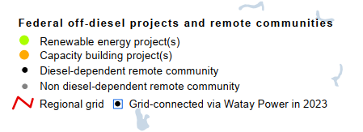
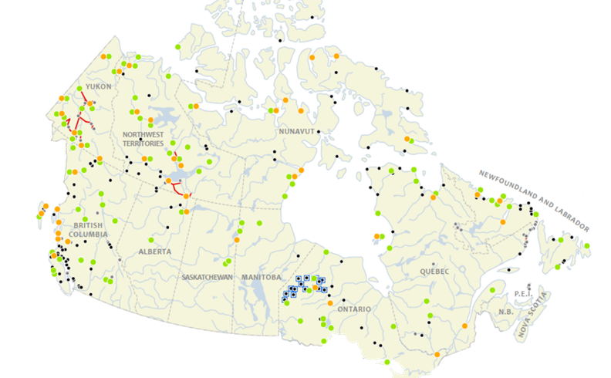



2030 Diesel Transition
3
Context
Success Factors
Success Factors
Success Factors
Community capacity,
engagement and ownership
Sustained source of easily
accessible funding
Project partnership between
PTs, utilities and communities
Notes:
Natural Resources Canada is one among several federal departments supporting the transition of remote and Indigenous communities from reliance on diesel-fueled power to clean, renewable and reliable energy by 2030
Many communities have installed or are in the process of installing RE projects, or are engaged in energy planning and capacity building
Many projects under Clean Energy for Rural and Remote Communities (CERRC) program

Slide 4
4
4
Context and Motivation
Research questions:
What are reasonable expectations for Renewable Energy in remote communities?
  What resources are locally available – solar, biomass, wind, hydro, etc.?
  What level of RE generation is possible before impacting existing diesel systems?
  What do high RE penetration systems look like? How do multiple generation types integrate?
  How to inform discussions with Utilities? Provinces? Territories? Communities?
Objective:
Develop a rapid, simplified analysis of potential RE options for Canadian remote communities based on public resource data and RE generation options
  Use hourly time series over representative year to understand community load and RE variability
  Identify opportunities for detailed analysis and support investment decisions

Slide 5
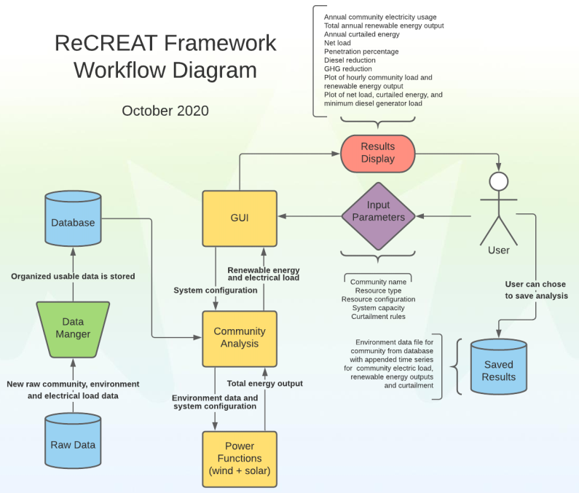
Remote Community Renewable Energy Analysis Tool (ReCREAT)
5
Rapid energy analysis tool dedicated to Canadian remote communities

Slide 6
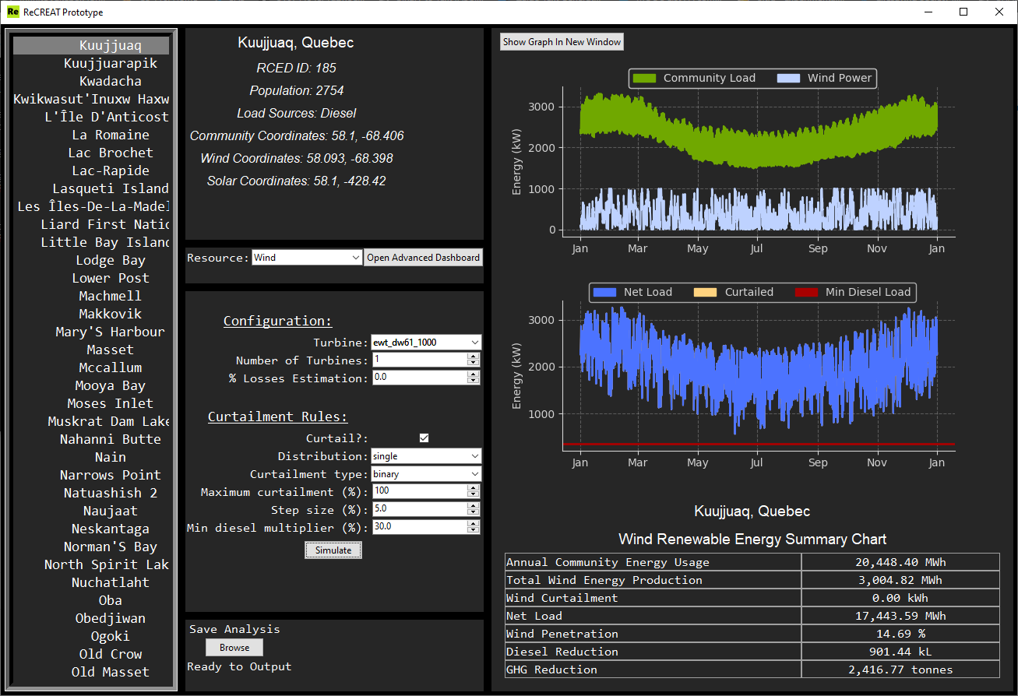
Remote Community Renewable Energy Analysis Tool (ReCREAT)
6
Rapid energy analysis tool dedicated to Canadian remote communities
Select community
Wind and solar resource data
for selected community
Community electric load
hourly time series
Analyzing potential range of RE technologies
- Starting with wind and solar
- Modelled annual hourly wind/solar data
- Real and modelled community load data
- Energy storage module in development
RE system configuration analysis
- Desktop application built in Python
- Supports initial considerations
- Not for detailed design
- Limited to internal use for now
Renewable electricity generation profile
Diesel electric generation net of renewables
Minimum diesel load (default 30% of rated capacity)
RE/Diesel hybrid configuration results
Notes:
Approximately 50 communities have loads of 1 MW or more; while 150 or more communities have loads in the 100s of kWs. Experience has been that most communities, especially smaller communities, have limited capacity to start thinking/analysis about possible RE projects. Intention to develop tool for engaging with communities and GoC programs to provide early stage analysis for project feasibility.
This project builds on the analytic methodology developed through previous work to:
- apply wind and solar analysis to all remote communities
- develop geospatial interface on the Remote Community Energy Database (existing)
- working with Federal Geospatial Programme
REED committed to support project $150/yr for 3 years, adding to CEO funding of $30k/yr.
Fully functional desktop application where the user can configure different
All weather data and diesel-electric loads for each community come pre-loaded in the app, differentiates tool from RETScreen, HOMER, SAM etc.
Only includes wind turbines that are commercially available and known to be dependable in northern applications

Slide 7
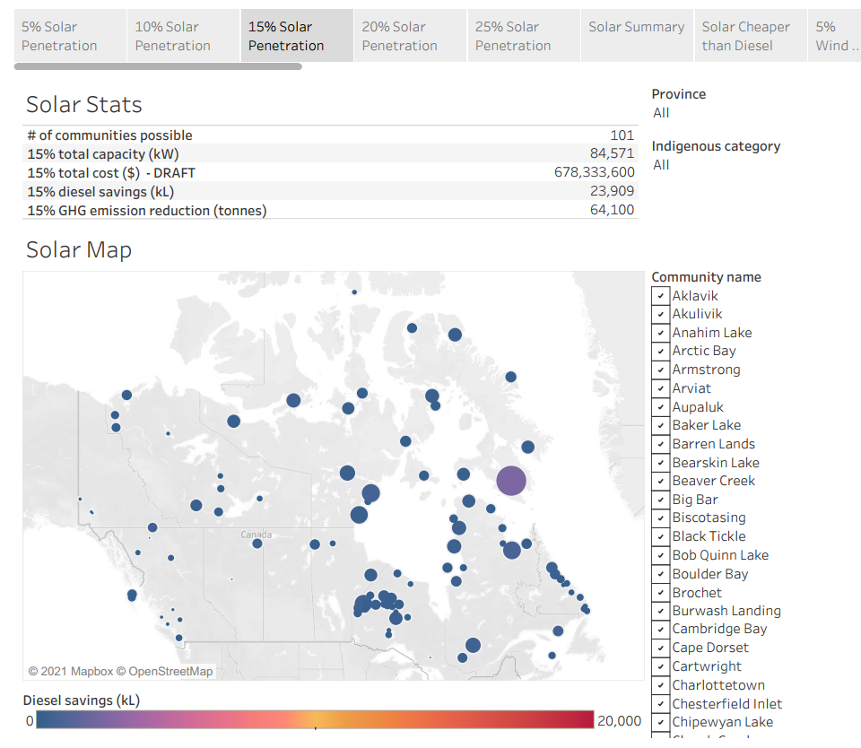
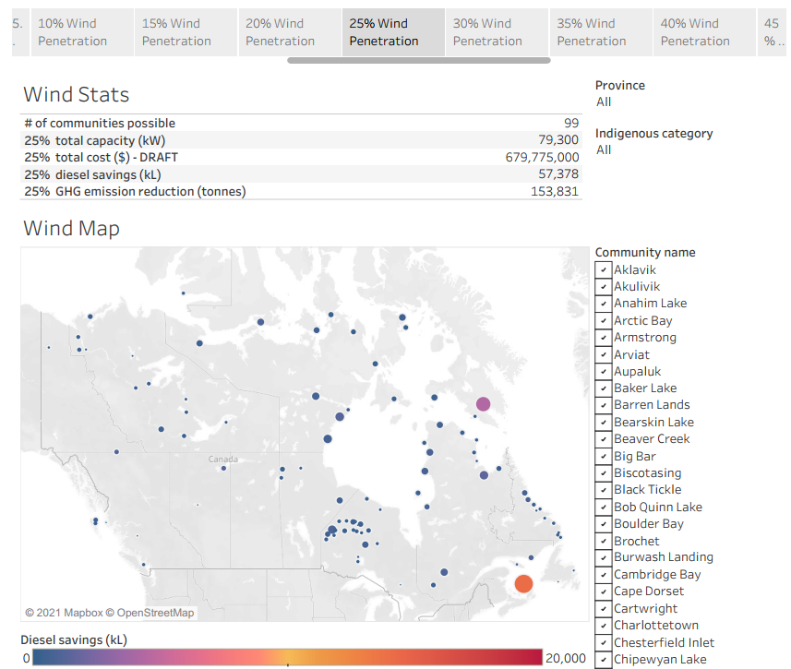
Community-level Results
7
Which communities can achieve different levels of renewable electricity penetration without storage based on
electricity demand and local wind/solar resource?

Slide 8
Aggregated Results
8
How many communities can achieve different levels of renewable electricity penetration without storage based on
electricity demand and local wind/solar resource?

Slide 9
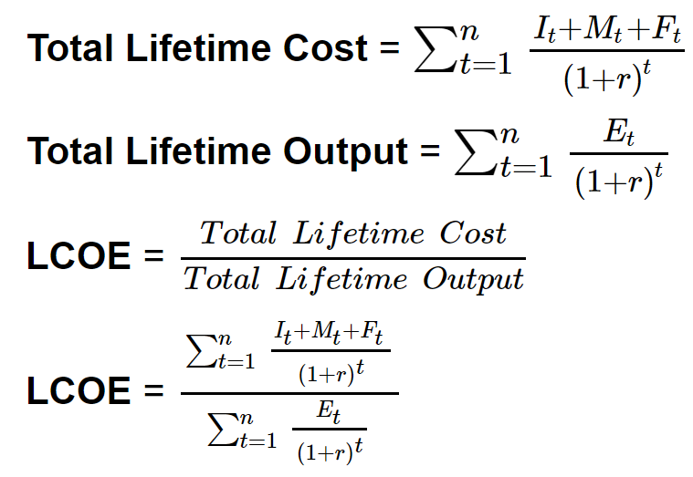
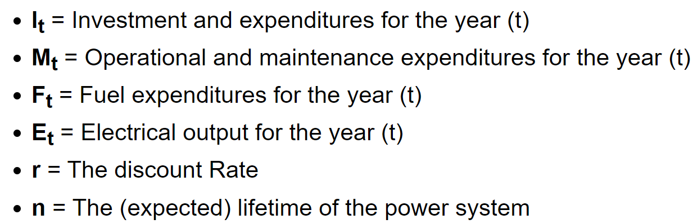
9
Economics
Levelized cost of energy (LCOE)
Baseline parameters used in this analysis:
  Consistent annual electricity generation
  Cost of debt = 5%
  Debt fraction = 80%
  Project lifetime = 30 years
  Discount rate = 3%
Installed costs
Project size | Project cost ($CAD/kW)
 | Wind | Solar
0 – 300 kW | 16,000 | 28,000
300 kW – 1 MW | 10,000 | 9,000
1 – 3 MW | 8,500 | 6,300
> 3 MW | 5,000 | 3,400
Source: University of Calgary Energy Education https://energyeducation.ca/encyclopedia/Levelized_cost_of_energy
Source: Accepted project proposals into NRCan's Clean Energy for Rural and Remote Community Program (CERRC): https://www.nrcan.gc.ca/reducingdiesel

Slide 10
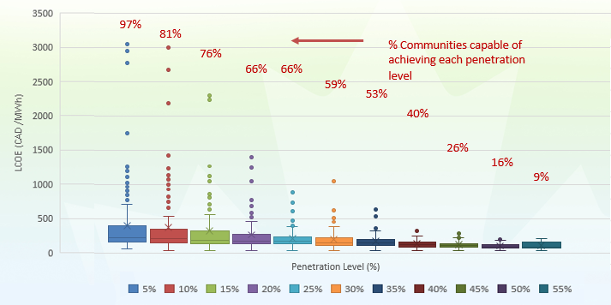
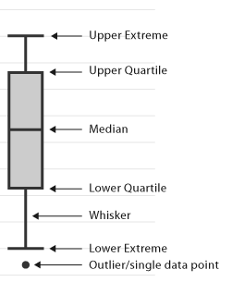
Economics
10
How does levelized cost of energy (LCOE) for renewables vary by penetration rate?
Estimate of LCOE by penetration rate for wind energy projects

Slide 11
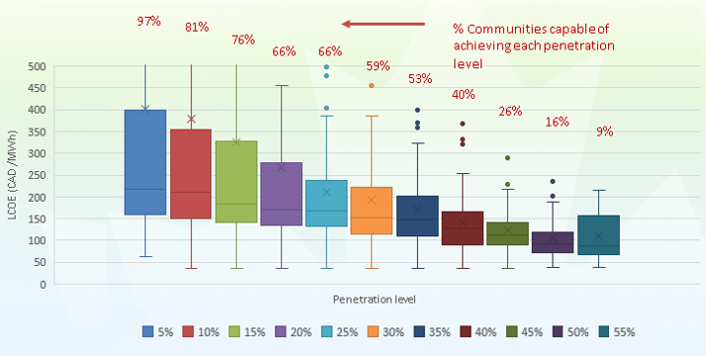
Economics
11
How does levelized cost of energy (LCOE) for renewables vary by penetration rate?
Estimate of LCOE by penetration rate for wind energy projects
 | Lazard* LCOE in the South (CAD/MWh) | ReCREAT LCOE (CAD/MWh)
Wind | $35 – $72 | $75 – 225
Solar | $85 – $125 | $500 – 1500
2-3x
6-10x
Source: https://www.lazard.com/perspective/levelized-cost-of-energy-and-levelized-cost-of-storage-2020/
**Using average 2020 USD to CAD conversion rate of 1.34

Slide 12
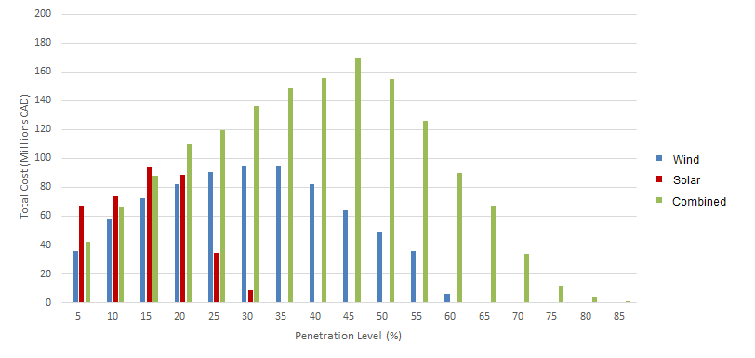
Economics
12
What is the cost of implementing the highest possible penetration level in each community?
Cost of achieving 20% penetration
 | Cost over capable communities (millions CAD) | Extrapolated cost over all 189 Communities (millions CAD)
Wind | 82 | 140
Solar | 89 | 178
Combined | 110 | 133

Slide 13
Conclusions
13
Many communities able to achieve over 20% diesel displacement through wind and solar without storage
Some communities technically capable of achieving >25% through solar and >50% through wind
Combinations of wind and solar can substantially improve possible penetration
Wind has generally lower capital cost and LCOE than solar but is more complex in both installation and maintenance and less modular

Slide 14
Future work
14
Fine-tune energy and cost results and run sensitivity analyses
Work towards filling data gaps with more measured data and more accurate estimates
Add battery electric storage and determine effect on RE penetration and LCOE
Assess potential of renewable heat technologies including bio-energy to displace heating fuel consumption

Slide 15
Thank you!
15
Ryan Kilpatrick, Research Engineer (ryan.kilpatrick@canada.ca)
Emily Huang, Co-op student (emily.huang@canada.ca)

Slide 16
© Her Majesty the Queen in Right of Canada, as represented by the Minister of Natural Resources, 2021

