Slide 1
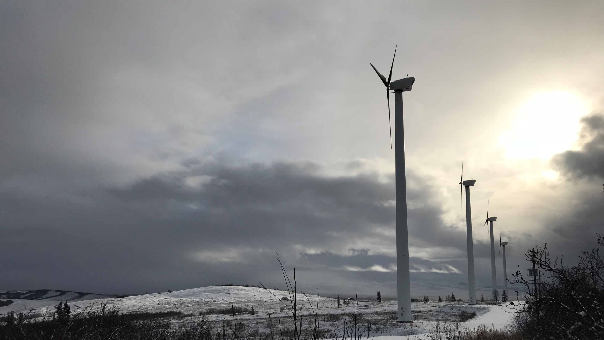
Energy Efficiency in Community Buildings
“Partnering with rural communities to make public health services more affordable by reducing energy costs”
Bailey Gamble, Mechanical Engineer II
bbgamble@anthc.org
Notes:
Good morning! My name is Bailey Gamble and I’m a Mechanical Engineer with the Energy Program at ANTHC, so working on the same team as Jim. Our program is part of ANTHC’s larger Engineering Division which focuses on construction and support of rural water and sanitation systems as an important part of preventative healthcare. Our Energy Program supports those systems by helping communities keep them going – making them more affordable to operate by lowering energy costs. In this presentation I’ll talk about how we do this.

Slide 2
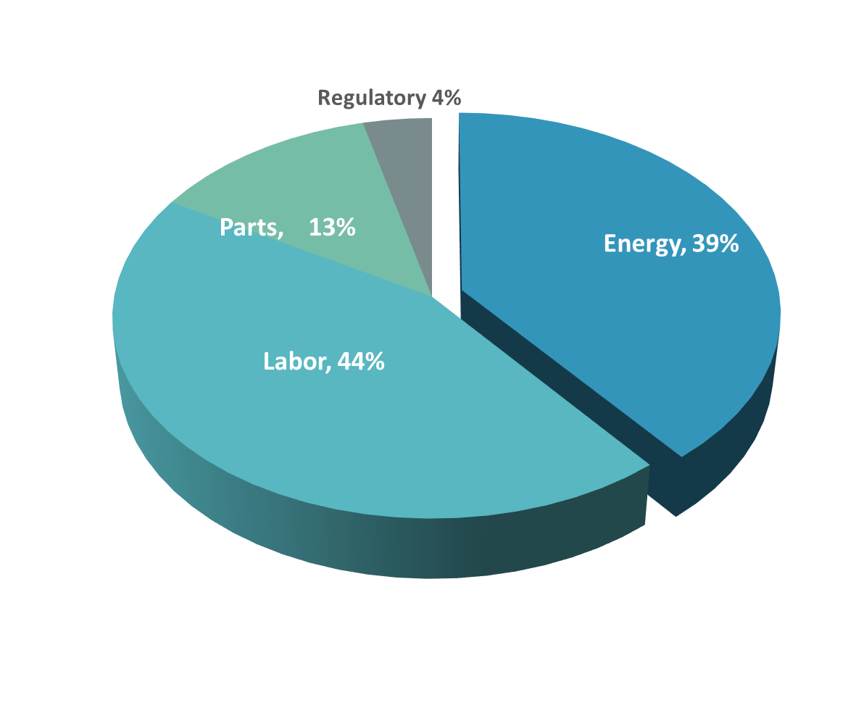
The Importance of Energy in Wat/San System Affordability
Notes:
Before optimization of energy systems and efficiency, energy costs make up on average nearly 40% of system operational costs. The energy costs before optimization alone equate to an average of 4-7% of median rural Alaska income. Without going in to detail, regulatory costs, parts and labor costs have already been squeezed to the maximum. Energy is the area in which opportunity lies for saving money/reducing costs.

Slide 3
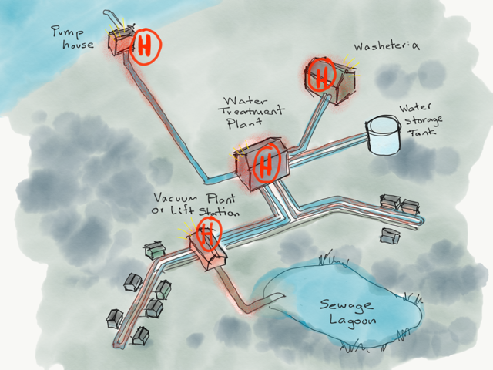
Water/Sanitation Facilities - Ideal Candidates for Energy Projects
High opportunity to save
High heating loads – freeze prevention, space heat, dry clothes
High electric loads - pumping, circulation, old lighting, heat tape
Aging components
Savings may be passed on to community members
Notes:
What makes water and sanitation systems ideal candidates for energy projects? They use a lot of energy! Along with schools and the further north the community, water treatment plants can be one of the top energy using facilities in the village, comprising up to a third of a community’s energy consumption.
Why do they require energy? To sum it up, a typical system pumps water from a source, sends that water to a treatment plant to be treated through filtration, chemical processes, then sends that water out to a storage to be stored until needed, then sends that water out individual buildings and homes, then transports the wastewater from the homes to a sewage lagoon. In order to prevent the system from freezing, heat is added at many points throughout the system, pumps are needed to keep water flowing throughout this journey

Slide 4
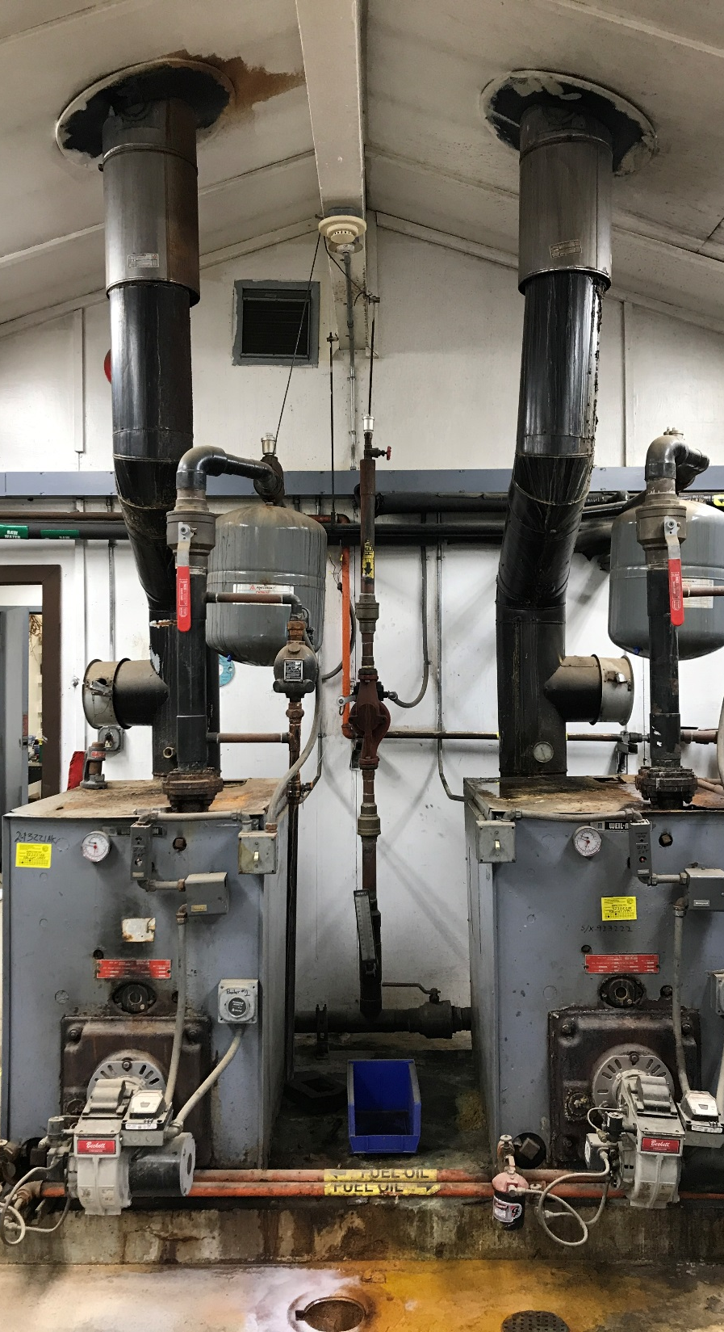
Reduce Heating and Electric Costs
Use less electricity
Replace old bulbs with LEDs
Optimize controls, operate only when needed
Replace old with new, energy efficient versions
Use less heat
Turn heat down when building is unoccupied
Weatherize to reduce heat loss
Add only as much heat to water as needed
Produce heat more efficiently
Clean/service boilers for best heat transfer
Incorporate sustainable sources of heat and electricity
Heat recovered from diesel gensets
Heat from biomass fuel
Electric heat from excess renewables
Electricity from solar panels
Notes:
Changes must balance efficiency and simplicity of design.

Slide 5
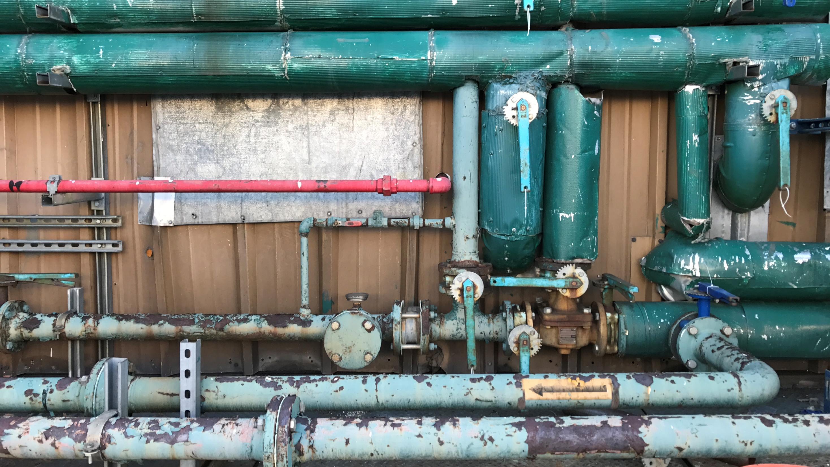
Example: Chevak, AK
Above ground pipeline, vacuum sewer system serving 1,074 people. WTP and Vacuum Plant were energy audited in 2012-2013.
Smaller retrofits Savings ($/yr)
Reduce circulation to 9 months/yr $ 5,460
Reduce raw water heating $ 4,550
Automate heat tape operation $ 455
Replace 38 bulbs with LEDs $ 230
Recommission controls, VP $ 7,500
Larger retrofits
2012: Install new vacuum pumps $17,000
2013: Replace oversized boilers $ 8,000
2015: Install Wind-to-heat boiler $ 4,000
2020: Install heat recovery system $48,000
Notes:
Ballpark cost for Smaller Retrofits - $30,000 simple payback 1-3 years
Ballpark cost for Larger Retrofits - $1.4M simple payback 17-18 years
Smaller – lower hanging fruit. Larger, still worth the investment. Combined offer a quicker payback. In this case the combined efforts allowed the utility to drop the water and sewer bills by 27%.

Slide 6
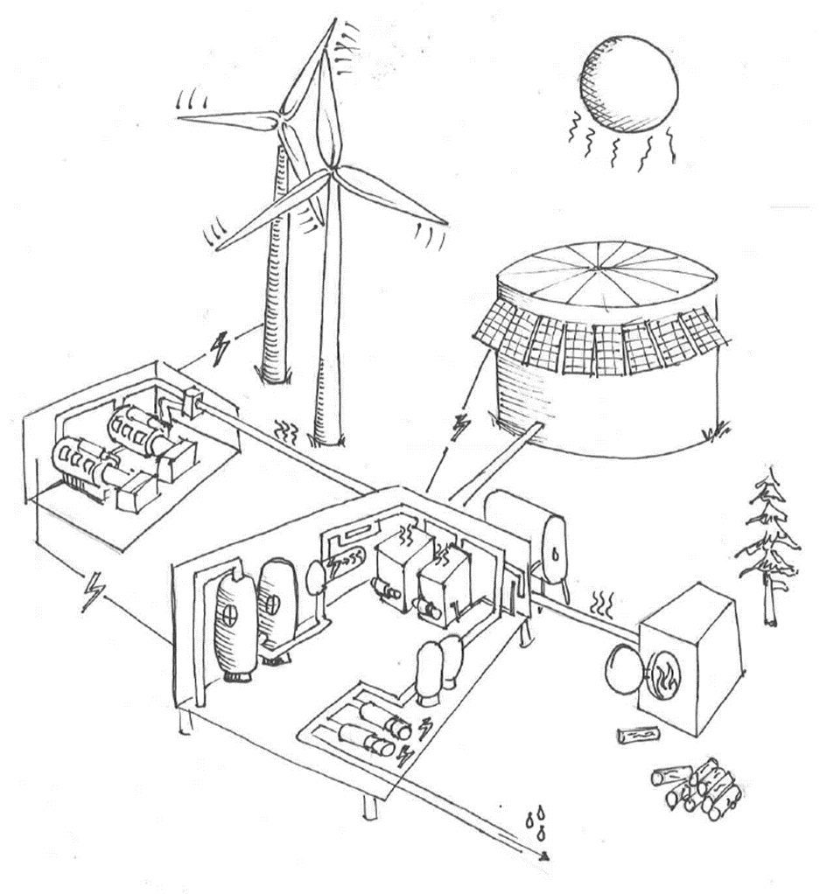
Heat recovery ratios for common gensets
Performance of existing systems
Facility to System view
Renewable/storage impact on recovered heat?
Sizing renewables for multiple objectives
Parallel operating renewables on small grids
Centering non-economic factors in project fundability
Putting $$ values to environmental and health benefits, resiliency
Renewable powered cooling of foundations
Notes:
Heat recovery ratios (DD S60 – AEA Study)
How does the integration of large renewable/storage systems impact availability of recoverable heat in existing heat recovery systems? (ANTHC/ACEP)
Rural power systems are typically sized to meet electric load. How would our approach be different if we considered power plants as more of cogeneration heat and power plants with other facility heating loads in mind? (Chaninik Wind Group, IES, Deerstone and the NANA region)
How does facility scale electric generation impact sustainability of the main power utility? (AVEC)
Center factors other than economics when determining what is fundable, how do we more impactfully communicate or put a dollar value to environmental and health benefits of renewables, resiliency of systems?

Slide 7
THANK YOU!
Bailey Gamble
Energy Management Engineer
bbgamble@anthc.org
729-4501

