Slide 1
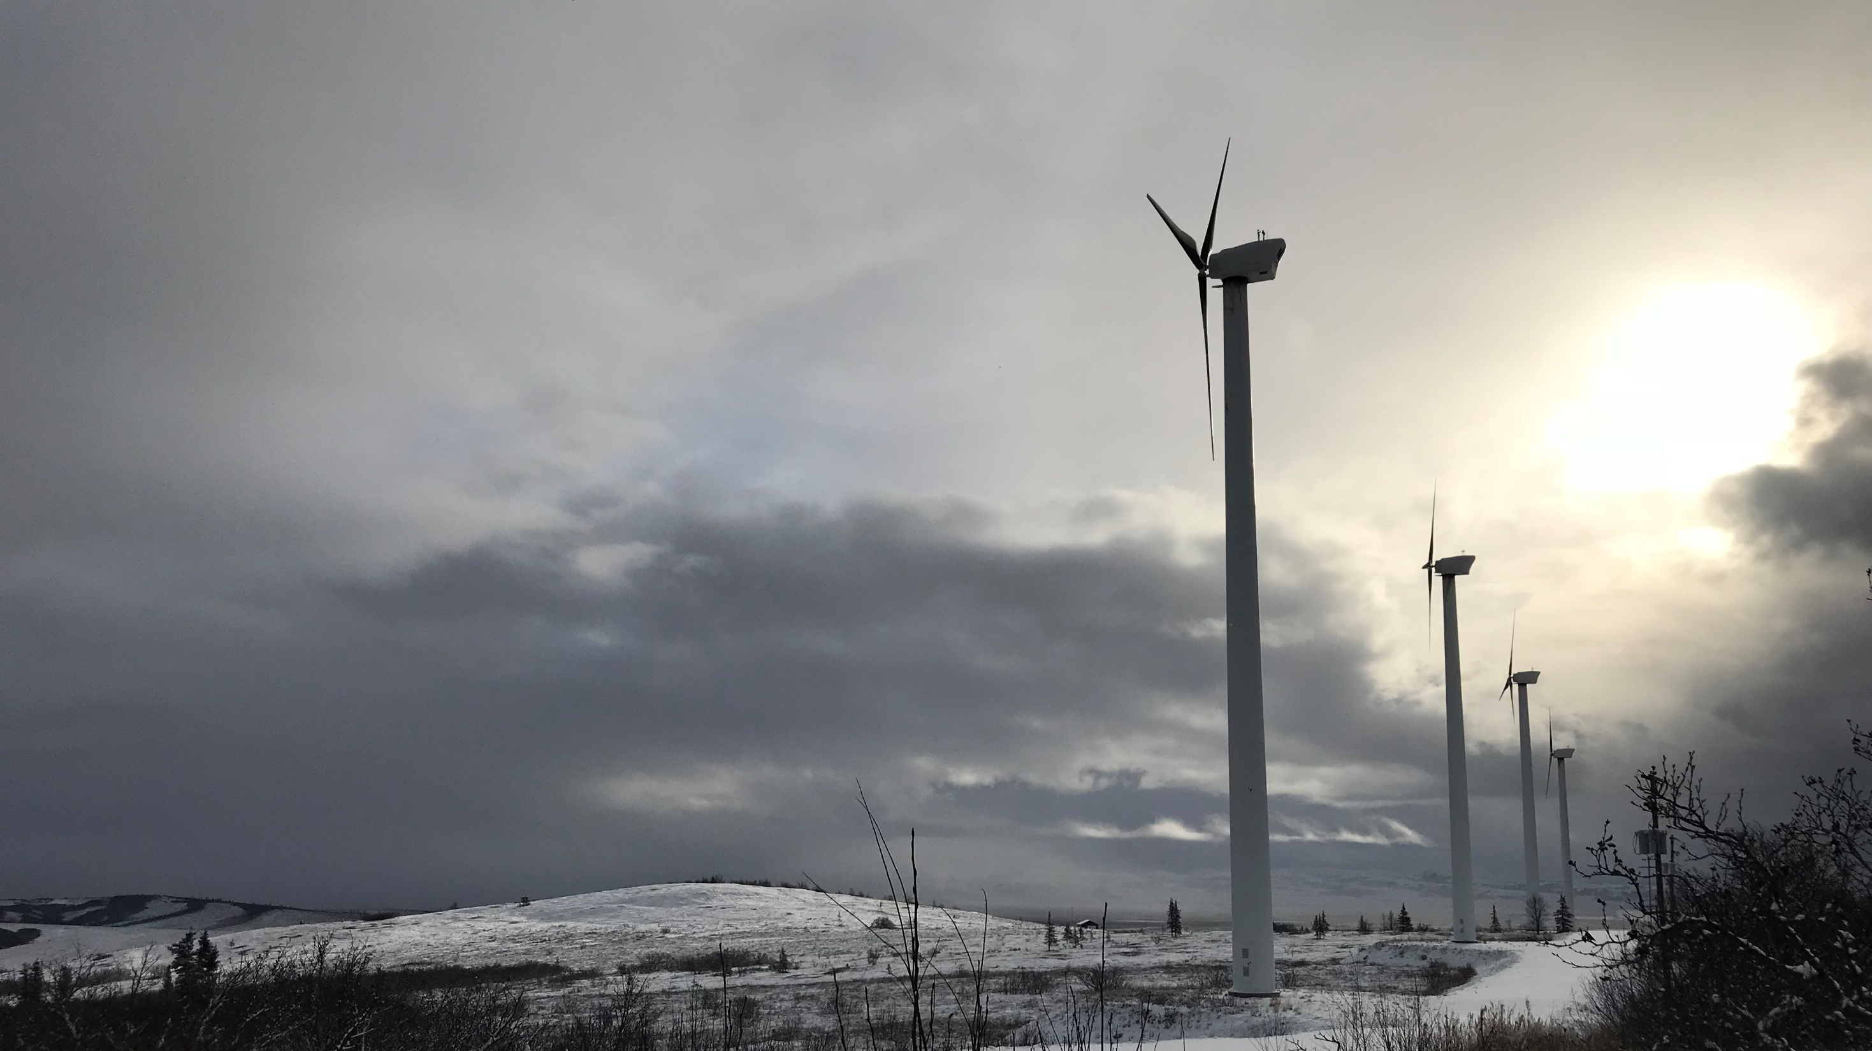
Energy Efficiency of Public Facilities in Rural Alaska
Jim Fowler, PE, CEM
Rural Energy Senior Project Manager
jffowler@anthc.org
“Partnering with rural communities to make public health services more affordable by reducing energy costs”

Slide 2
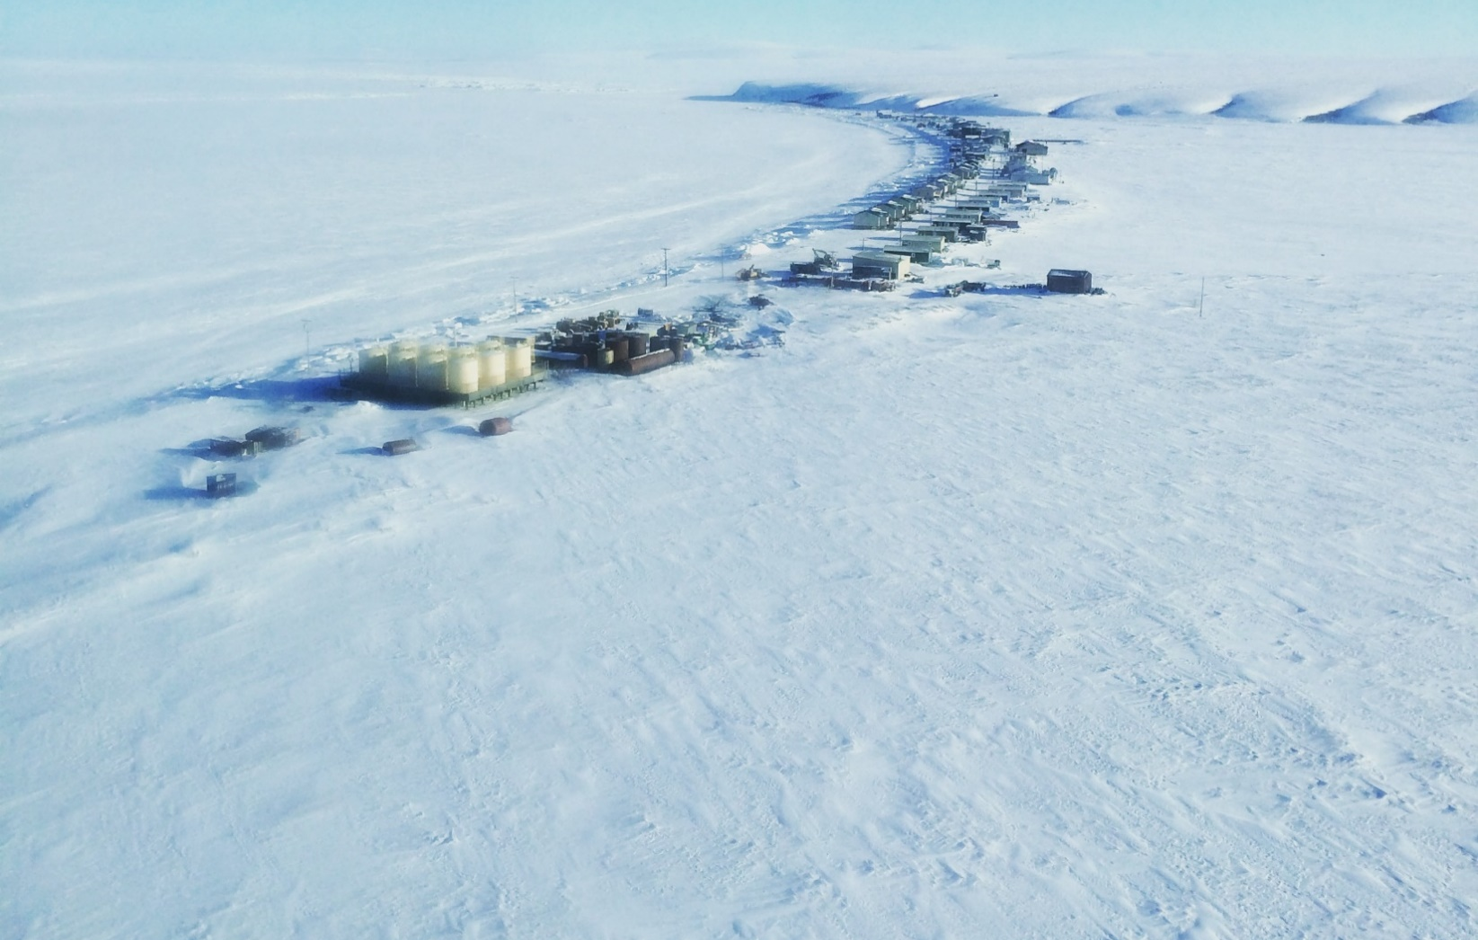
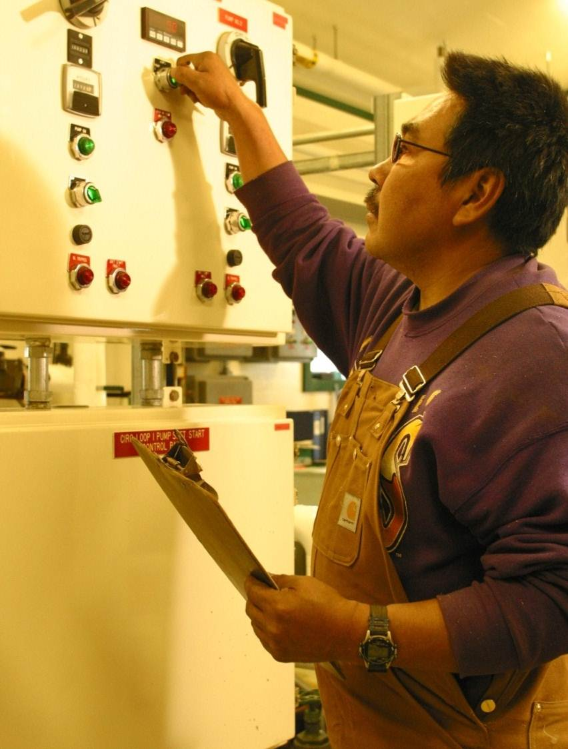
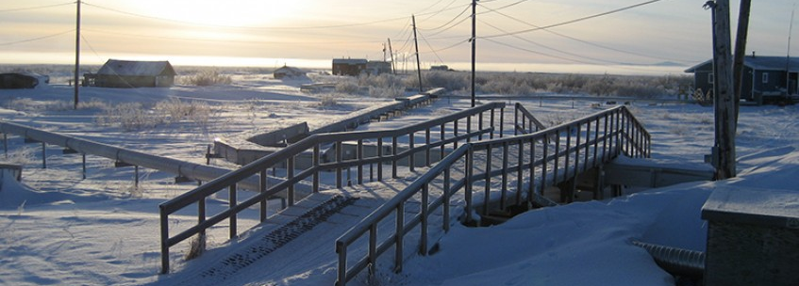
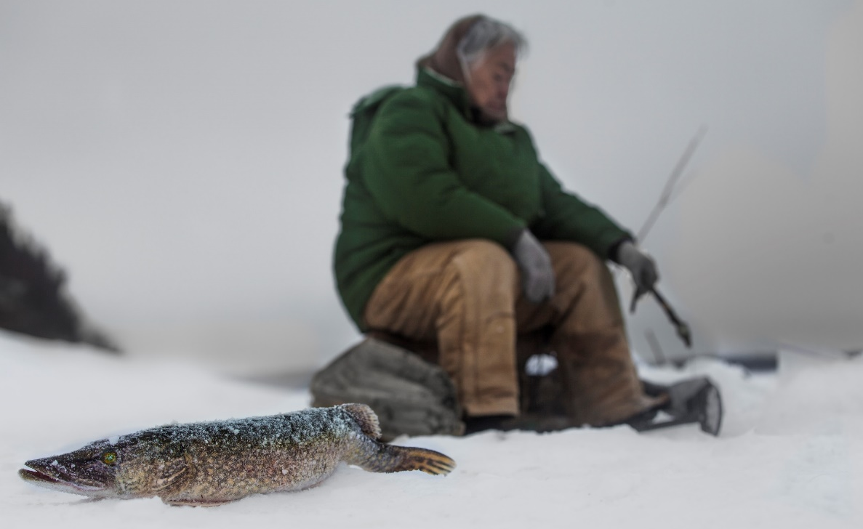
Arctic Communities
REMOTE
SCALE
Remote
Cold Climates
SUBSISTENCE
COLD CLIMATE
Small
Economies
Inter-connected
Notes:
Since this conference is focusing on arctic communities, I want to talk a little bit about some of the defining characteristics of the communities that we work with in terms of energy projects
- REMOTE… nearly 200 communities without road or rail access, you boat in or fly in, communities range in size from less than 20 people to more than 3000 in the hubs like Utgiagvik, Nome and Dillingham --> High cost of fuel, high cost of construction materials due to lack of availability and high cost of transport
- The next characteristic would be COLD --> the severity of cold weather is measured in heating degree days, Utgiagvik averages 18,000 – compare this to 5800 in Chicago and 2200 in San Francisco; it is warmer in the Southeast portion of the state, Ketchikan has 7000 HDDs
- this drives energy costs, I’ll get back to this in a minute
- this combination of remoteness and cold is also very Hard on infrastructure – roads, water systems, buildings – the freeze/thaw cycle requires very specialized and expensive building techniques, as Jack demonstrated in the residential sector. I was in a village school last year, beautiful school, huge high atrium…had a cracked window up near the peak. It could not be replaced, it was heavy enough to require a crane, not me mention the shipping cost since it had to come from the lower 48
- Errors like this are high consequence in remote settings – design errors, maintenance errors…
Then comes SCALE - Small communities lack economies of scale, and they typically lack sufficient population to provide the human resources required for specialization – this may be the most challenging of all the characteristics our communities face (cooperatives like ARUC and ANTHC…)
You have to be a generalist, most of us couldn't do the job of a village, city or tribal administrator – or the job of the village maintenance person:
Need to manage everything: water/sewer, building maintenance, public safety, power utilities
Have to repair boilers, furnaces, snow machines, cars trucks and boats
Are trying to meet Federal requirements developed for *much* larger communities/businesses/organizations
And finally, SUBSISTENCE: Subsistence lifestyles are the primary way of life in many communities. When the berries are ripe you need to be out there gathering, when the caribou are nearby, you have to be out there hunting. A fixed schedule doesn’t work in these communities.
As a result of these characteristics, many of these communities have extremely limited economies and almost no tax base

Slide 3
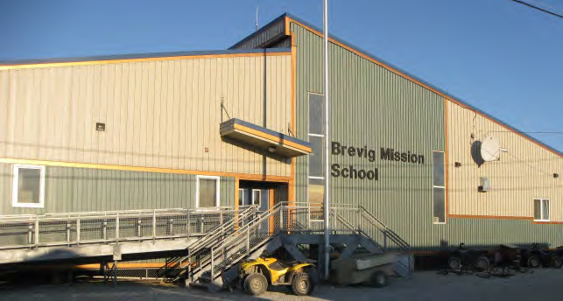
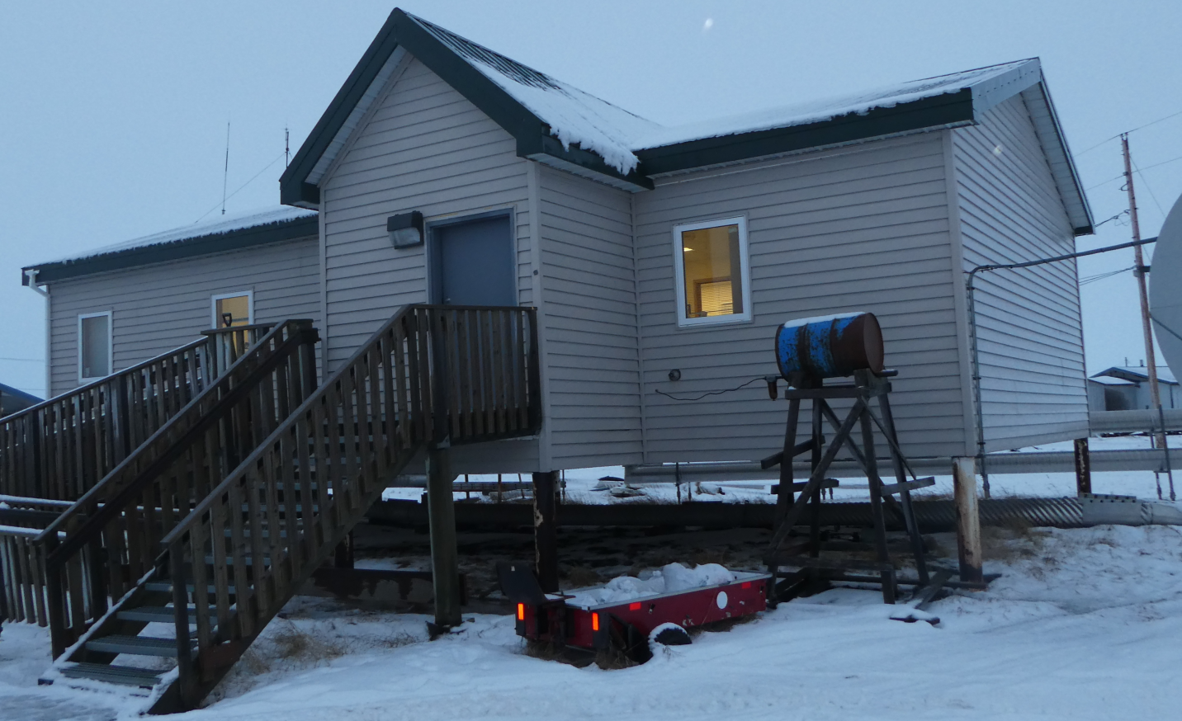
Public Facilities
SCHOOLS
CLINICS
Washateria / Water Treatment Plant
School
WATER TREATMENT
CITY/TRIBAL OFFICES
City / Tribal Offices
Clinic
Notes:
These are some examples of typical public facilities here. In the rural communities the largest building will always be the school and the three buildings with the highest energy costs will be the power plant, the school and the water treatment plant – the three most essential services.

Slide 4
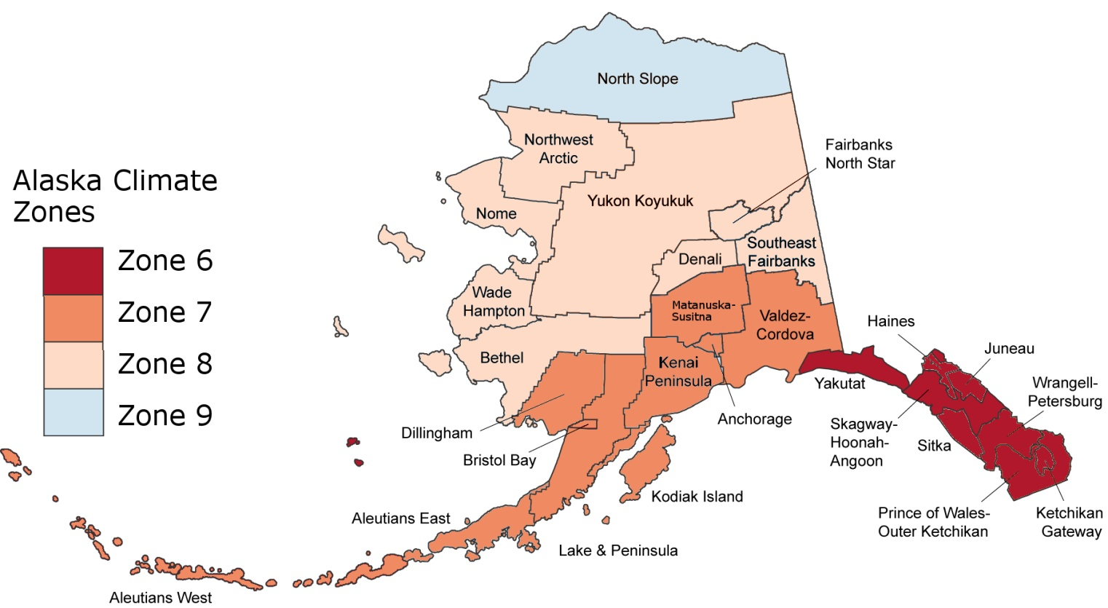
Public facility energy costs
$5.86 per square foot
$7.37 per square foot
$4.44 per square foot
$3.54 per square foot
Average energy cost per square foot based on energy audits of 348 public buildings
Notes:
Alaska is the only state in the US with 4 climate zones. You’d think that the North Slope would have the highest energy cost per square foot, but this graphic is skewed due to the energy subsidy the North Slope Borough provides for its residents. The Borough has the financial resources to subsides the cost of oil and electricity – otherwise it would have the highest energy cost on a per square foot basis.

Slide 5
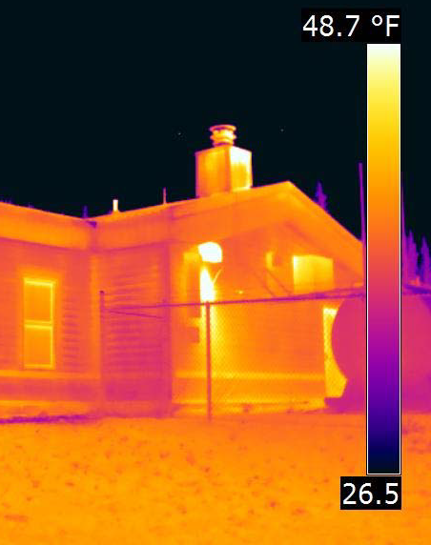
Public facility energy consumption
Space Heat Loss by Building Component
Notes:
In 2010-2012 348 public buildings were audited throughout Alaska – our moderator, Scott Waterman headed that project. The legend is bit small, the top pie chart shows that space heat is 72% of the energy consumed in these 348 buildings, lighting is next at 9%. The bottom chart shows that ventilation and air leakage is the largest source of heat loss at 51%, next comes walls and doors at 17% then the floor, ceiling and windows in that order.

Slide 6
Public facility energy consumption
Follow the BTU
Distribution of Energy Use
Notes:
If a rural community does not have solar PV or wind or hydro generation, and most of our communities don’t, then all of the energy that comes into a rural community is in the form of diesel fuel. This shows how the energy in 100 BTUs of diesel fuel is used throughout the village of Atqasuk which is in the North Slope Borough. The grey color is raw diesel, the green represents electric use and the red represents wasted energy. You can see that after the power plant which consumes 51% of all the energy, non-residential buildings are close second, consuming 44% of all the energy.

Slide 7
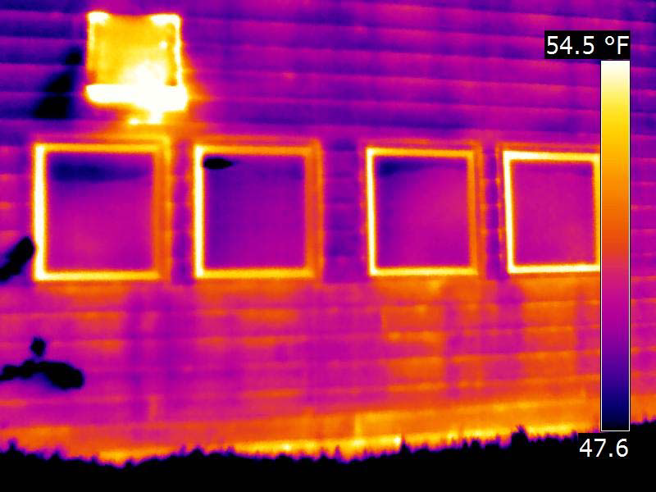
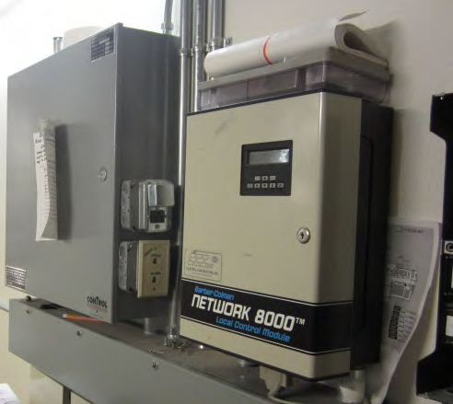
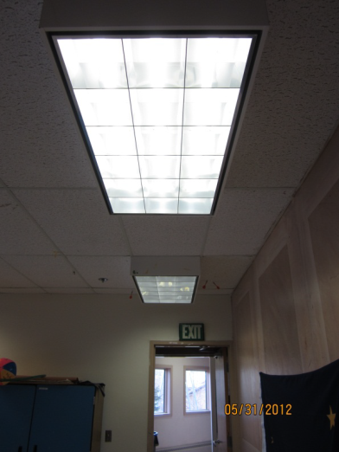
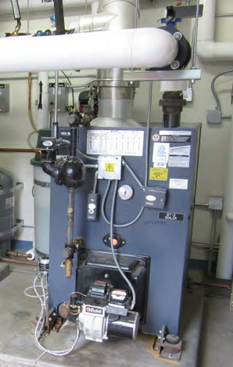
Efficiency is cost-effective
Estimated savings for 348 AK public buildings | Average
Cost effective annual energy savings ($) | $21,844
Installed cost of energy efficiency measures | $82,210
Simple payback (years) | ~4 years
% Energy savings | 22%
Notes:
An analysis performed by CCHRC, in fact by Dustin whom I’m standing in for, showed a 4 year payback and 22% reduction in energy costs for the measures that were cost effective.

Slide 8
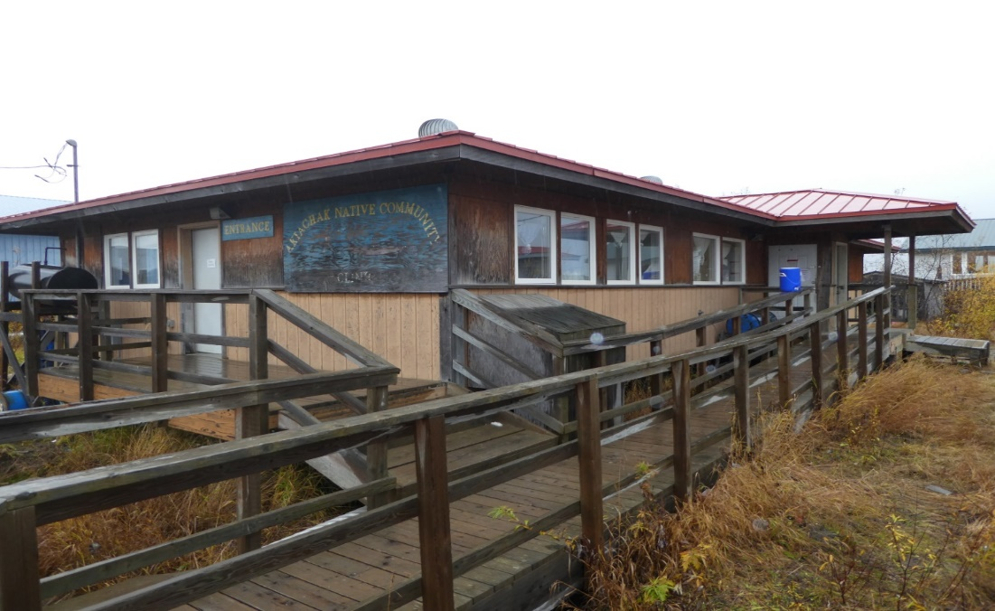
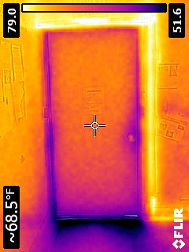
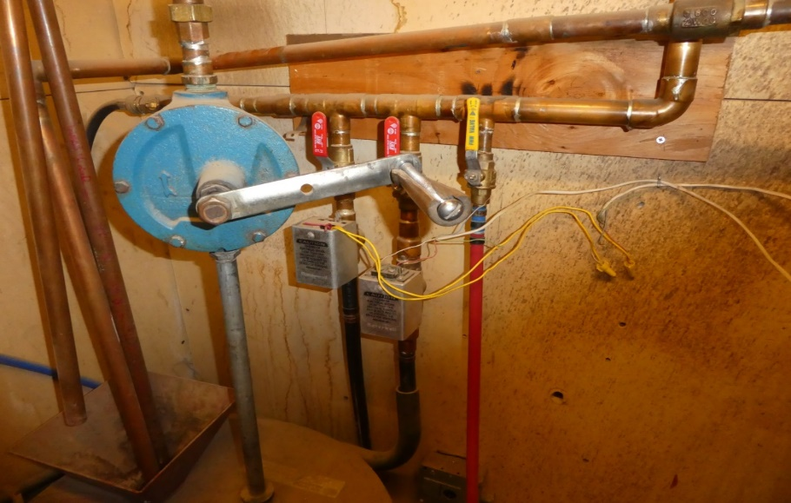
Efficiency is cost-effective: clinics
Estimated savings for 31 village clinics | Average
Cost effective annual energy savings ($) | $6,000
Installed cost of energy efficiency measures | $28,000
Simple payback (years) | 4.7 years
% Energy savings | 28%
Notes:
Another category of buildings in ANTHC’s wheelhouse are village clinics. This analysis looked at energy audits on 31 clinics, found 28% savings and a 4.7 year payback.
The types of heating efficiency measures that are most cost effective are Boiler tune-ups and retro-commissioning of the distribution systems, like failed zone valves and boiler controllers.
The building envelope efficiency measures that are most cost effective are reducing infiltration by air sealing and adding attic insulation

Slide 9
Barriers to efficiency projects
Incentives not aligned
Schools
Utility budgets vs. Facility budgets
Energy cost tracking
Remote monitoring
Scale
Bundling projects:
AEA’s Village Energy Efficiency Program
AK Public Facilities - ESCOs
Efficiency upgrades
Facilities can reinvest
Energy savings
Notes:
So what are the barriers getting in the way of non-residential efficiency projects in Alaska?
INCENTIVES, or the lack thereof. We have no rebates or any incentive programs at the State or utility provider level. Individual schools gain little benefit from efficiency programs, as the savings do not remain with the school to increase programming funds. At the community level, the person signing electricity check is not the person operating the building so there’s little feedback.
FUNDING: Alaska used to have quite a few grant programs. Many of them evaporated a few years ago with the drop in oil prices.
MONITORING, again, or the lack thereof. The old adage “if you don’t measure it you can’t manage it” definitely pertains to building energy management. Studies have shown that monitored buildings consume from 5% to 15% less energy than un-monitored buildings. Simple tracking systems or more complex building monitoring systems are available at relatively low cost here. The Alaska Housing Finance Corporation has developed a public domain web-based building monitoring system called BMON and is now creating a training program for building operators, but it is not yet widely used.
SCALE: Again as I mentioned earlier, the Lack of scale-ability in rural communities, the high expense of mobilization and the small talent pool – these are all barriers to energy efficiency.

Slide 10
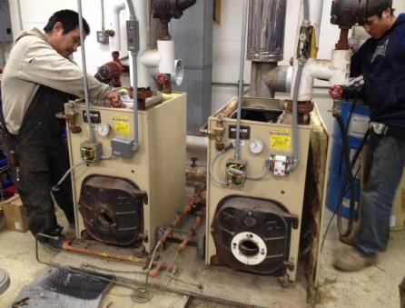
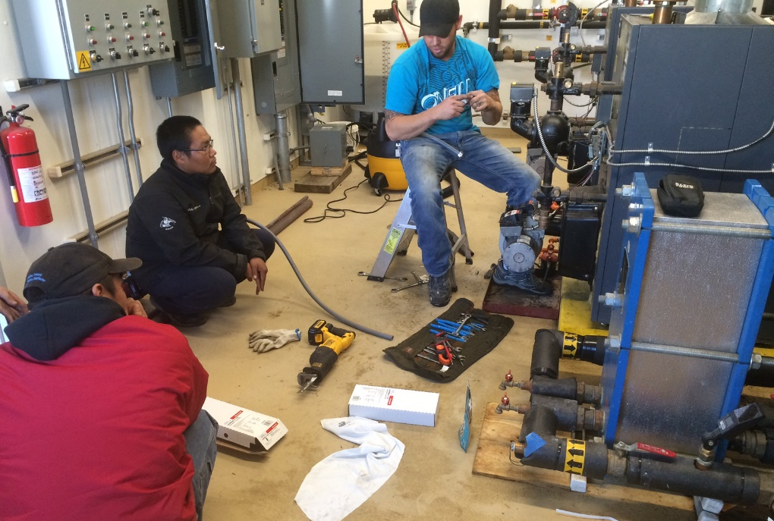
Maintaining savings
Design: simplify controls, include directions
Provide on-going training
Regional cooperatives / support systems:
Successful examples:
Remote maintenance workers
AVEC
ARUC
Empowering communities
Notes:
Efficiency solutions in our small communities have to be right for that community. Designs, controls and upgrades have to be simple and bullet proof – there are smart people running them but there are no hardware stores just down the street and the climate is hard on equipment.
Even large organization in cities have a difficult time finding enough people trained in programming / operating DDC controls. People will override things…
Training and support are critical: Need to train O&M staff after the upgrades are complete, then continue to provide support when called upon – turnover is common in our communities
There are several successful models in this area of training and support: ANTHC’s ARUC group, the States RMW’s and AVEC’s powerhouse operators are 3 good examples of training and support
This dual approach can be Empowering to the community: Operators are more likely to tackle problems if then can rely on backup like ARUC, the RMW and AVEC.

Slide 11
Research gaps
How long do energy efficiency and renewable energy projects last in remote, cold-climate communities?
What is the dollar value of operations and maintenance training?
Reduced energy costs
Longer equipment lives
What are the costs/benefits of regional support systems & cooperatives?
Notes:
And finally, where are the gaps in research? I’ll suggest the 3 areas listed above.
Boilers, zone valves, windows, foundations, water distribution systems…none of these systems or their components have the same life as in less harsh climates. And solar PV panels and wind turbines? How long do they last up here? We don’t really have these answers and the life of the product makes a huge difference in the payback calculations.
How much is operations and maintenance training worth? We know good O & M saves operating costs and extends the life of equipment – what is the monetary value of this? Is there an ROI on training?
What are the costs and benefits of regional cooperatives like ARUC, RMW’s and even ANTHC? How do these kinds of organizations affect the quality of life and health of the folks living in the community?

Slide 12
Questions? Comments? Thank You Jim Fowler Project Manager ANTHC Rural Energy Program jffowler@anthc.org http://anthc.org/what-we-do/rural-energy/
Partnering with rural communities to make public health services more affordable
by reducing energy costs
We believe basic sanitation should be efficient, sustainable and affordable
Notes:
Thank you! The link on this slide will direct you to more information on what ANTHC does if you’re interested.

Slide 13
The Big Picture: Total Cost of Ownership A buildings’ costs over 40 years
Why energy efficiency?
Construction
Operation
11%
50%
Financing
14%
Alterations
25%
Notes:
Spare slide…

